Slide 1
David Hume (Mott MacDonald) and Kevan Brian (Watercare Services)
PREDICTION OF WASTEWATER TREATMENT GREENHOUSE GAS EMISSIONS USING A REAL-TIME MODEL
Mott MacDonald, Watercare Services
Notes:
Tēnā koutou. My name is David Hume and I am a principal process engineer at Mott MacDonald. With me is Kevan Brian who is the Technology and Innovation Manager at Watercare and Nick Dempsey, treatment team leader at MM. This morning we will be talking about a project at Watercare’s Rosedale WWTP to baseline and predict N2O emissions from the activated sludge process.

Slide 2
1
Nitrous oxide – what is it?
Agenda
2
Watercare GHG targets
3
Rosedale WWTP GHG monitoring
4
Key findings
5
Next stages
Notes:
Todays agenda starts with N2O what is it?

Slide 3
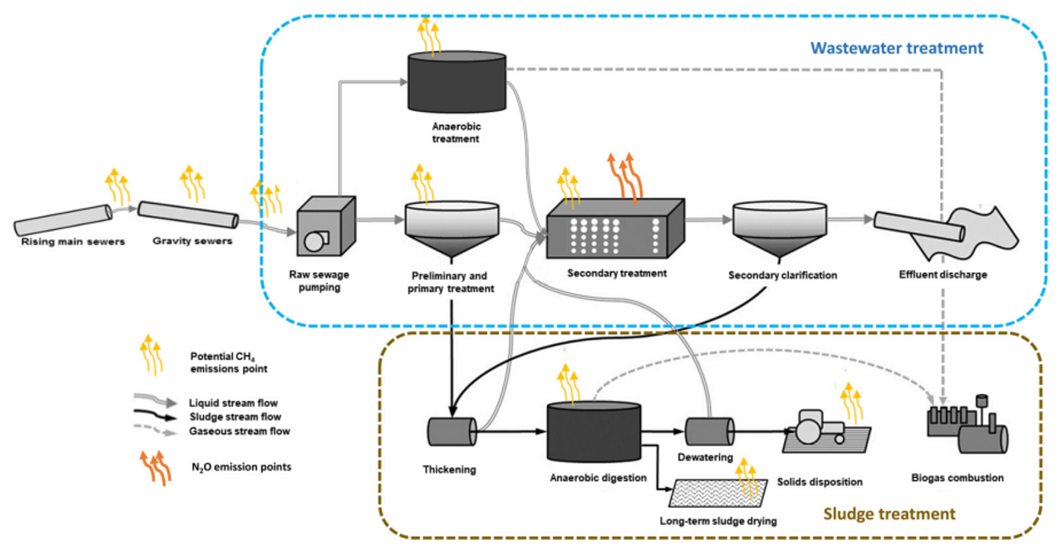
Nitrous Oxide, N₂O – what is it?
Notes:
Direct GHG emissions from WWTPs include N2O, methane and CO2.
CH4 emissions: sewers, preliminary, 1º and 2º treatment, AD and D/S solids handling
N2O is generated and released during biological nitrogen removal processes, forming as an intermediate step during nitrification and denitrification.
At present, most water companies report N2O emissions using rule of thumb static emission factors. However, there is a high uncertainty with these, due to the large number of influences, including wastewater characteristics, the type of treatment process, and how the process is operated and controlled.

Slide 4
Process Emissions:
3.2%
of global emissions
70%
of Watercare ops emissions
90%
of site emissions
50%
reduction by 2030
Process Emissions
Nitrous oxide
Methane
Methane (CH₄) has a GWP of 28 times that of CO₂
Nitrous Oxide (N₂O) has a GWP 273 times that of CO₂
Notes:
According to the 6th IPPC report (intergovernmental panel on climate change) N2O has Global Warming Potential 273 times that of CO2, and methane 28 times
It is estimated that global emissions from sewage treatment account for 3% of total anthropogenic N2O emissions
Watercare estimates that ~70% of its operational emissions is from WWTP process emissions.
Of these N2O contributes up to 90%
Watercare has a target to reduce operational GHG emissions by 50% by the year 2030

Slide 5
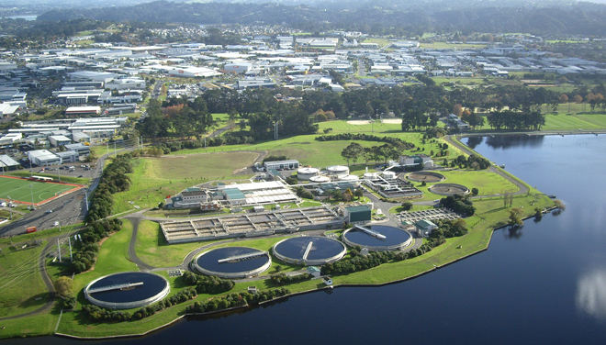
Rosedale WWTP
Notes:
The Watercare Rosedale WWTP located in Auckland, serves a population equivalent of about 240,000. The process consists of primary sedimentation, biological treatment through the Modified Ludzack-Ettinger (MLE) process, clarification, UV disinfection, and anaerobic digestion for solids stabilisation.
There are 4 MLE reactors each receiving 25% of the flow.
Watercare has recently purchased two Picarro gas analysers for measuring GHG concentrations. This provided the ideal opportunity to implement a measuring campaign at Rosedale WWTP.

Slide 6
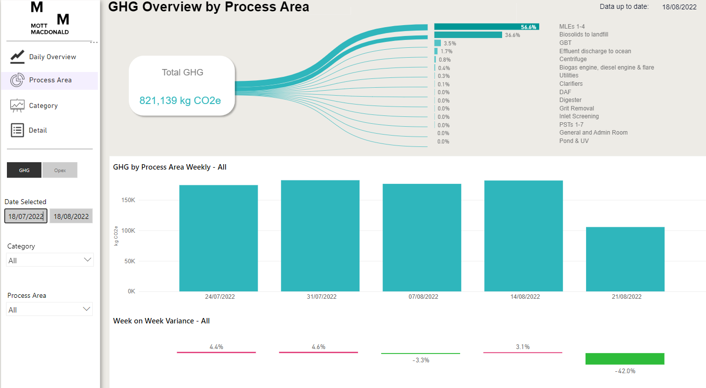
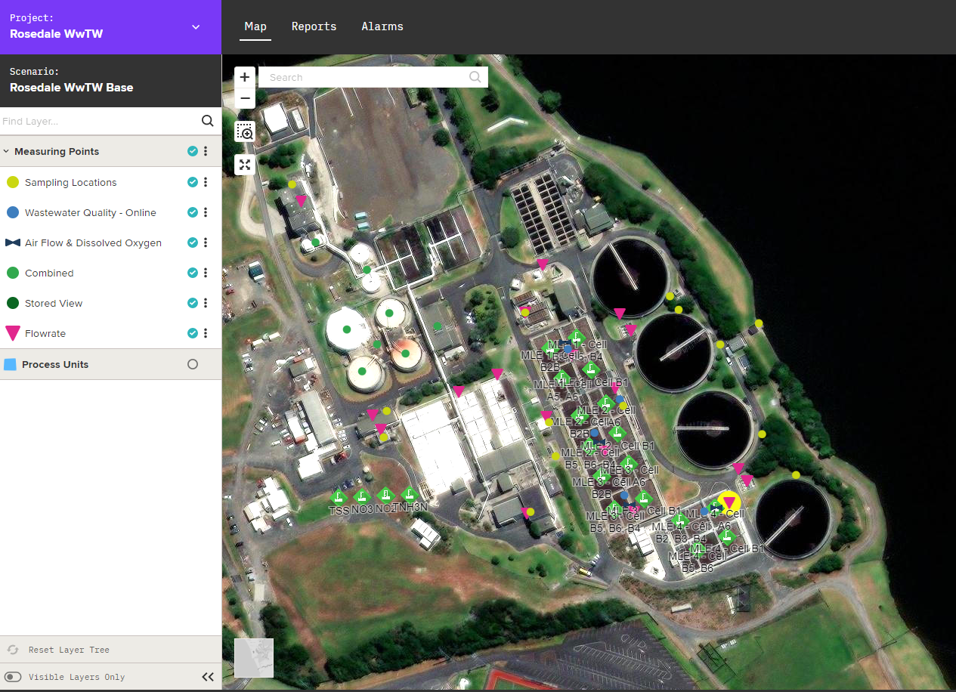
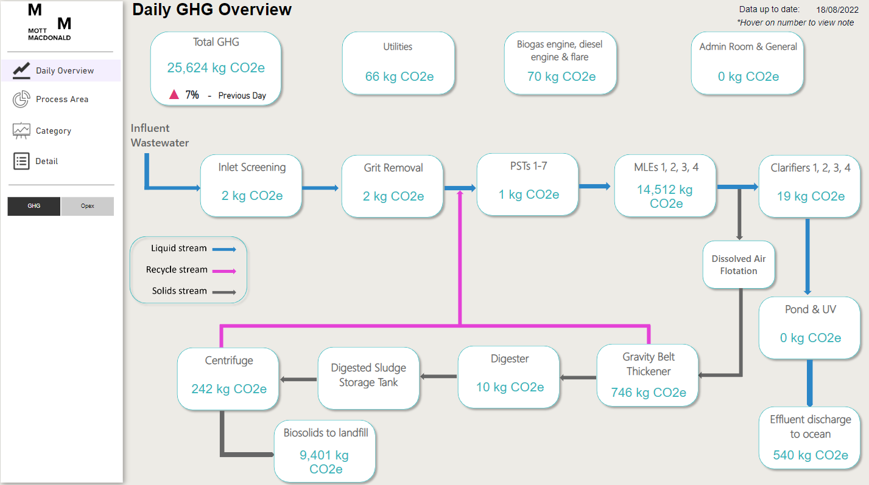
Rosedale WWTP
Notes:
In 2020 MM developed a digital twin for Rosedale to support commissioning of the fourth MLE reactor. The digital twin combines biological modelling and machine learning with real-time data and dashboards to generate new insights into plant performance.
A core component of the Digital Twin is a live BioWin Model. The real-time inputs into the model come from online instrumentation (flows, DO, WAS). The outputs from the model are compared with actual data from the plant historian through the dashboards and adjustments are made to improve the accuracy of the model.

Slide 7
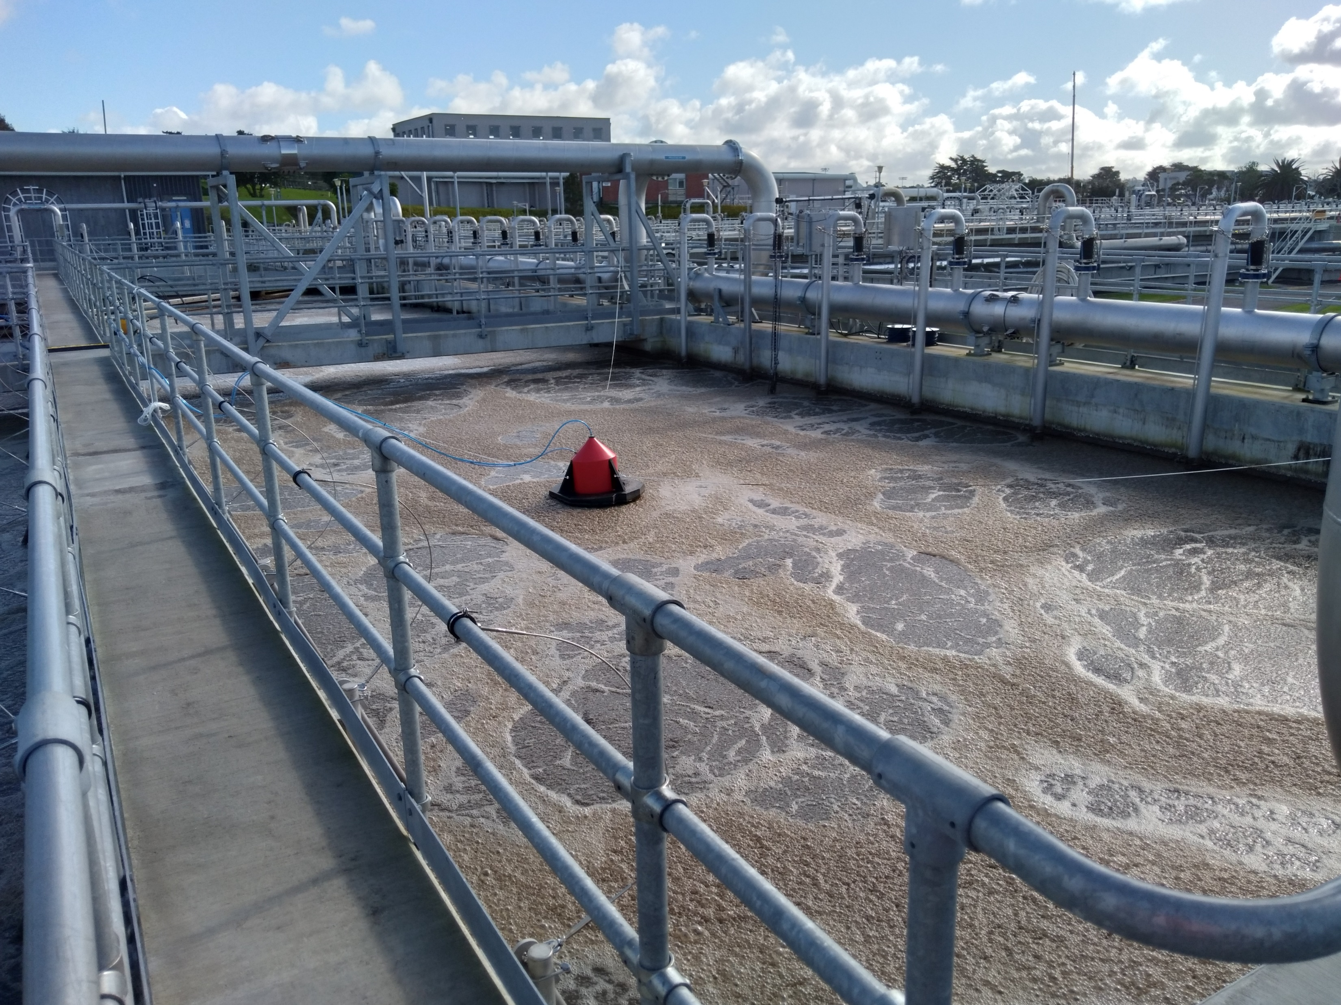
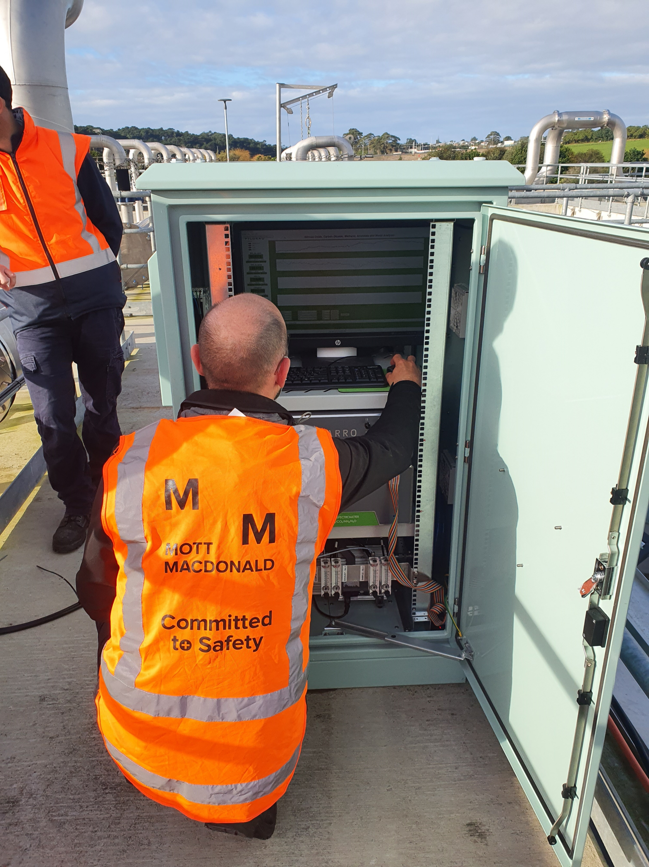
N₂O Monitoring at Rosedale WWTP
Objective: Understand N₂O emissions
Liquid-phase N₂O concentration
Gas-phase N₂O concentration
Notes:
We proposed to Watercare to further develop the digital twin to include live reporting of GHG emissions to assist with planning and benchmarking, and we sought Watercare innovation funding to progress this. This required comparing the biological model with site-measured emissions data.
To this end, a sampling campaign was devised to collect data to baseline the current emissions and support the model development. The fourth MLE was proposed to be used, as there is independent air flow measurement to a number of zones.
The primary objective was to understand the N2O emissions. This required us to know where in the process N2O is generated (by measuring the liquid-phase N2O) and where it is emitted (by measuring the gas-phase N2O concentration) and the off-gas flowrate.

Slide 8
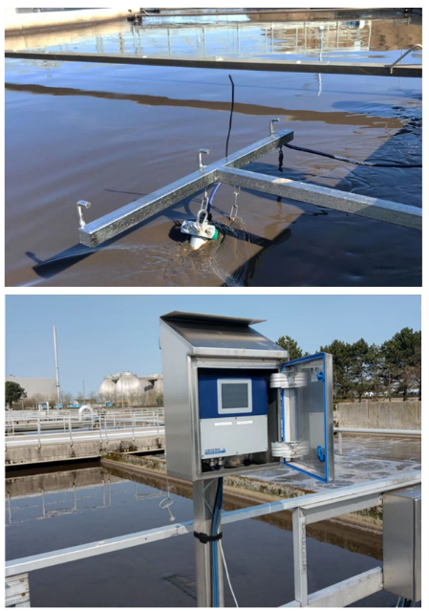
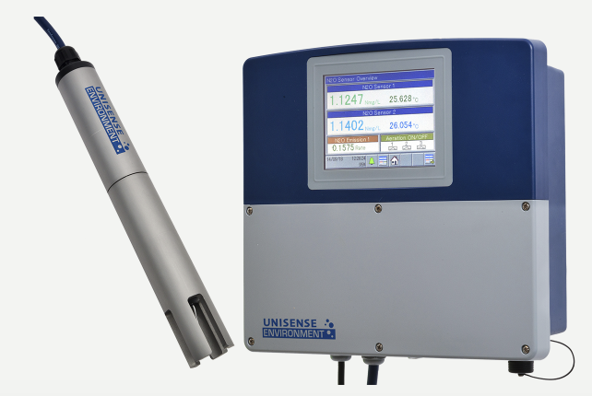
Dissolved N₂O Measurement via Unisense Probe
Notes:
Liquid-phase N2O concentration was measured using a Unisense Clarke-type microsensor. Two probes were installed, one was left in the same aerobic cell for the duration of the survey, whilst the other was moved from cell to cell. This provided a fixed reference point to see how the concentration varied spatially as well as in time.

Slide 9
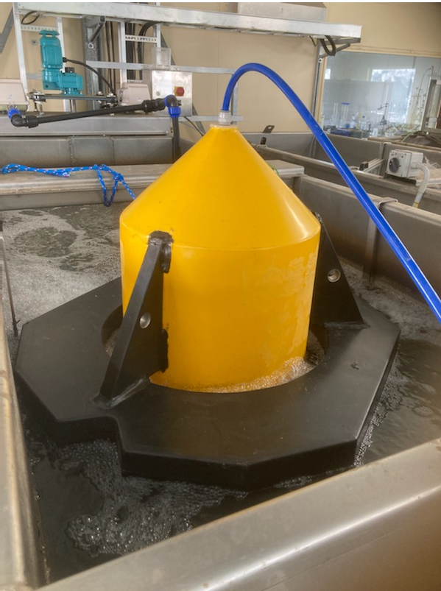
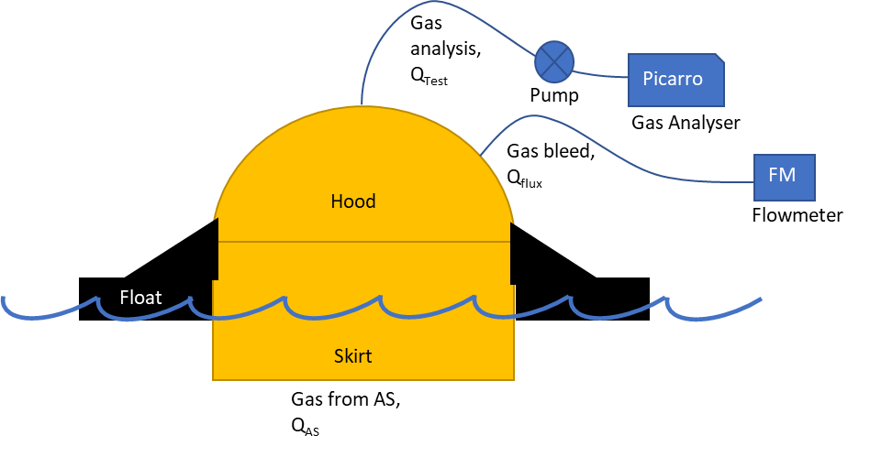
N₂O Gas Measurement via Picarro Unit and Hood
Prototype hood design
Notes:
At this time there is no off the shelf floating hood available for measuring off-gas. So a prototype hood had to be designed and fabricated.
The hood has 2 sets of tubing, a gas analysis line going to the analyser, and a gas bleed with a flow meter.
By measuring the gas flow through the hood and knowing the gas-phase concentration the N2O emission flux from the hood can be calculated. This can then be correlated with the known flowrate of gas from the hood and applied to the air flow rate in the
whole cell to obtain the surface emission from that cell.

Slide 10
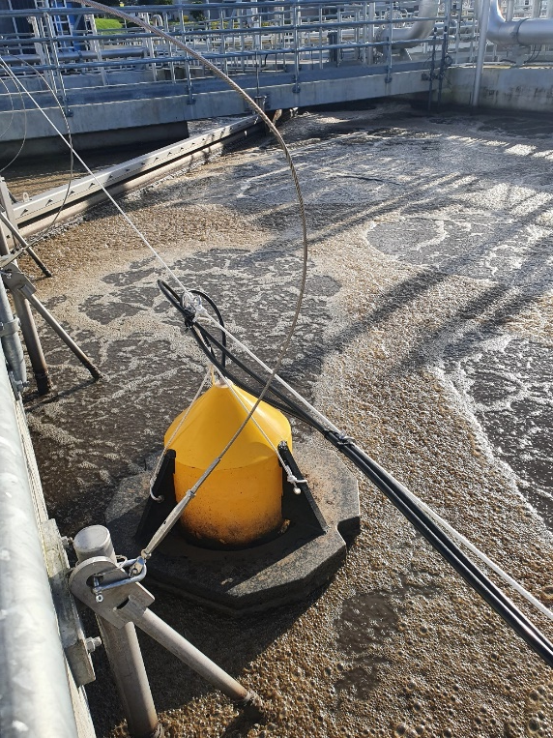
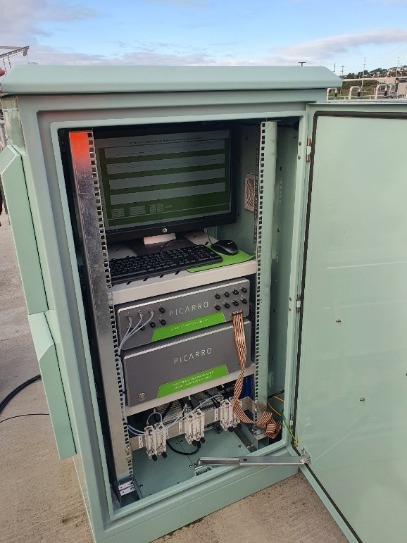
N₂O Gas Measurement via Picarro Unit and Hood
Notes:
Gas-phase N2O concentration was measured using a Picarro off-gas concentration analyser.
3 hoods were installed to allow the off-gas to be measured at different places in the process. These primarily covered the aerobic cells. The emissions from the anoxic cells were anticipated to be small and therefore were not measured. This was borne out by dissolved N2O analysis in these cells as we will discuss shortly.

Slide 11
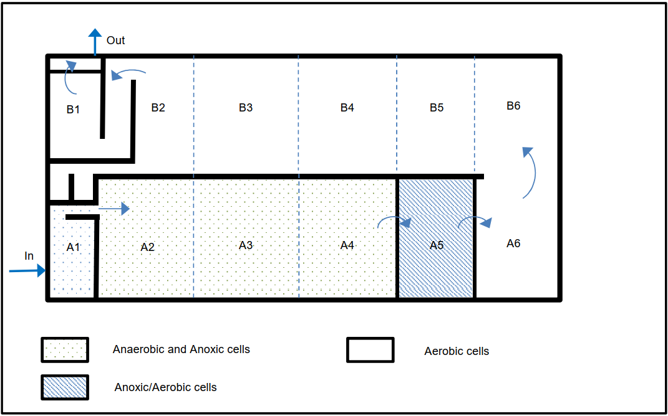
N₂O Monitoring at Rosedale WWTP
M
S
S
F
T
Unisense probe
Gas hood
T
F
S
S
M
T
W
Notes:
This figure shows the layout of MLE4 which is comprised of a number of cells. Cell A1 is anaerobic, A2 – A5 anoxic, A6 – B1 aerobic. There is 4 x internal recycle from B2 to A2.
The Unisense probe was moved progressively from cell to cell each day, starting with A1 and finishing with B1.
The Gas Hood and analyser were used from cell A5 onwards (predominantly aerobic cells). This provided coincident liquid and gas-phase concentrations, which when combined with the air flow rate, allowed a better understanding of the N2O mass transfer coefficient
Liquid grab samples were taken every 6 hours in the same cell as the probe for analysis of parameters such as (sCOD, NH3, NO3, NO2, DO, pH) to help us understand the conditions under which the N2O was being formed

Slide 12
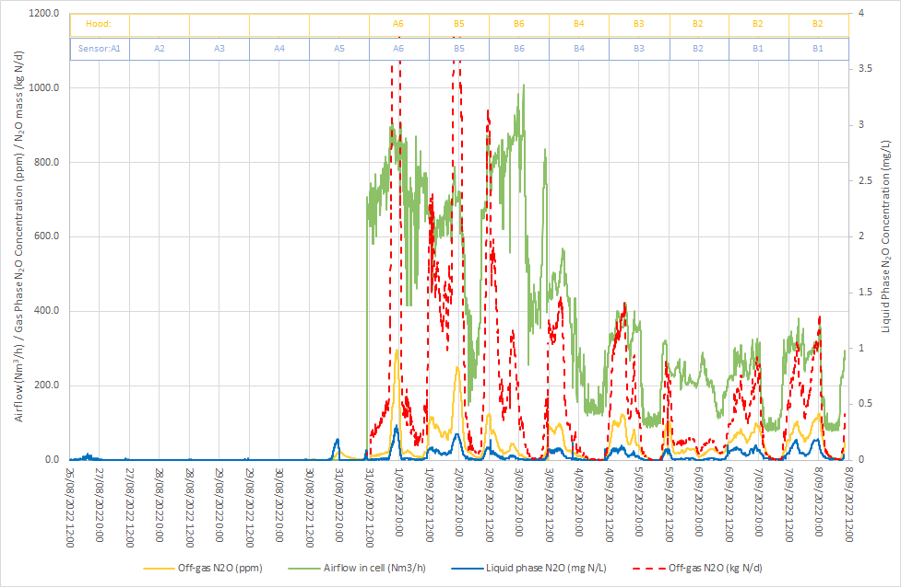
Findings
Air flow rate in cell (Nm³/h)
Liquid-phase N₂O (mg N/L)
Gas-phase N₂O (ppm)
N2O mass emission (kg N/d)
Notes:
This graph shows the results of the liquid and gas phase analysis as we advanced the sensor and hood along the reactor from inlet to outlet. The bars across the top indicate to which cell the data refers.
The airflow to each cell is shown in green, dissolved N2O in blue, gas-phase N2O in yellow, corresponding N2O mass emission rate in red.
As seen by the red arrow – there is very little dissolved N2O in the anoxic cells. This means that not only is it not accumulating but N2O in internal recycle is being removed in anoxic cells.
Nearly all the N2O is in the aerobic cells (which start at the blue arrow)
The dissolved N2O concentration follows the influent ammonia load profile, which suggests it is primarily influenced by nitrification.
The gas-phase N2O trend follows dissolved concentration.
N2O mass emission rate is strongly dependent on air flow rate.

Slide 13
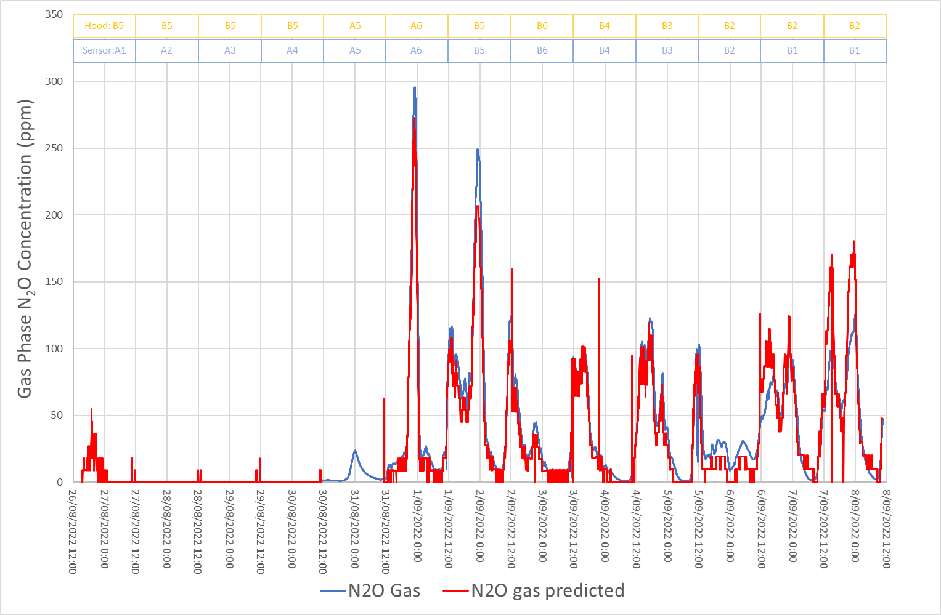
Findings
Dissolved N₂O concentration can be used to calculate off-gas concentration given air flow rate
Notes:
The Unisense manual provides a formula for estimating the off-gas N2O concentration in aerated zones based on the dissolved concentration and the superficial gas velocity. This showed good agreement with the measured off-gas concentration, indicating that the dissolved N2O concentration can be used to provide an estimate of N2O emission rates.
This is important because it means that once a correlation between liquid and gas-phase concentration has been established, the off-gas analyser can be deployed elsewhere. We note however, that this still relies on only one or two probes to represent the whole reactor. A real-time model offers the potential to overcome this limitation. However, it is necessary to have a high level of confidence in the model and in the data that goes into it.

Slide 14
Findings
Emission factor (EF) = 0.005 kg N₂O-N/kg N_{influent} (0.5% N₂O-N/TN_{influent})
Based on only 2 weeks
Recommend monitoring for at least 1 year (seasonal variations)
Source | EF (kg N₂O-N/kg N_{influent})
IPPC default (2019) | 0.016
Water NZ default (2021) | 0.010
Rosesdale WWTP | 0.005
Notes:
The EF was calculated to be 0.5% of the plant influent TN load. This is about half the default value quoted in the Water NZ carbon accounting guidelines for wastewater treatment.
We note however that this is based on a snap shot of the plant operation with only a single day of measurement in each cell. Several days of measurement in each cell would be preferable to ensure consistent readings.
For example a heavy rainfall event on one day likely affected the results in cell B2, causing a reduction in nitrification and N2O generation.
A year’s worth of data is required to capture seasonal variations.

Slide 15
BioWin model
1
Nitrification byproduct
DO >> 0 mg/L
DO 0 - 0.4 mg/L
DO 0.4 – 0.8 mg/L
pH < 7.5 or > 8
2
Nitrifier denitrification
3
Heterotrophic denitrification
Notes:
Biowin includes three major process mechanisms for nitrous oxide production:
With Nitrification byproduct: when AOBs are operating at maximum rate in the presence of excess ammonia and with no oxygen limitation, a small fraction of the oxidized ammonia is directed to N₂O.
With Nitrifier denitrification: Under oxygen-limited conditions where nitrite is present, free nitrous acid (FNA) can be used as a terminal electron acceptor and is converted to N₂O.
With Heterotrophic denitrification: At low DO and depending on nitrite concentration and pH, free nitrous acid (FNA) reaches a level where the final step of denitrification is inhibited, and N₂O accumulates.

Slide 16
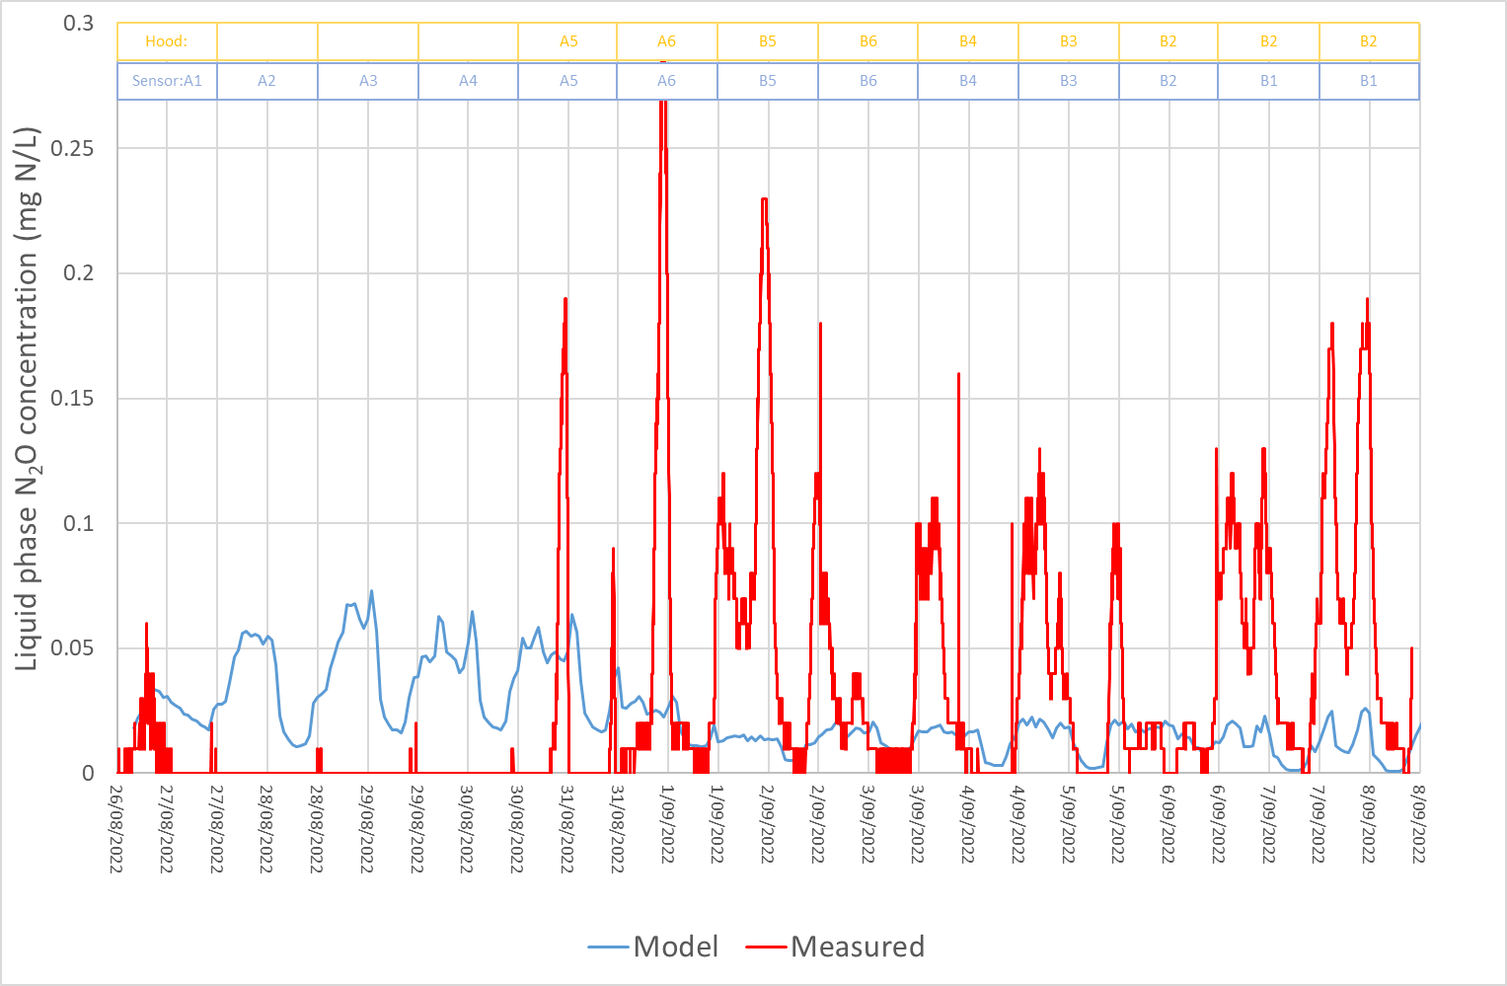
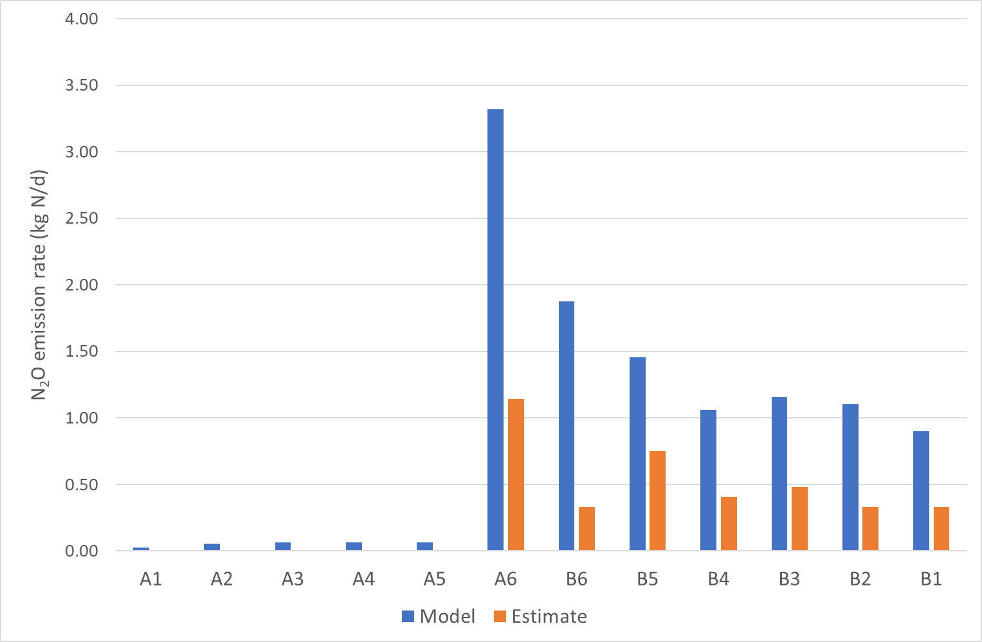
BioWin model
Notes:
The Biowin model was run with default parameters for N2O modelling to see how well it predicted.
The model appears to overpredict the concentration in the anoxic cells. The trend in the aerated cells is similar to the measured, but
the magnitude of the values is much lower in the model.
This leads to overprediction of mass emission rates as seen on the right.

Slide 17
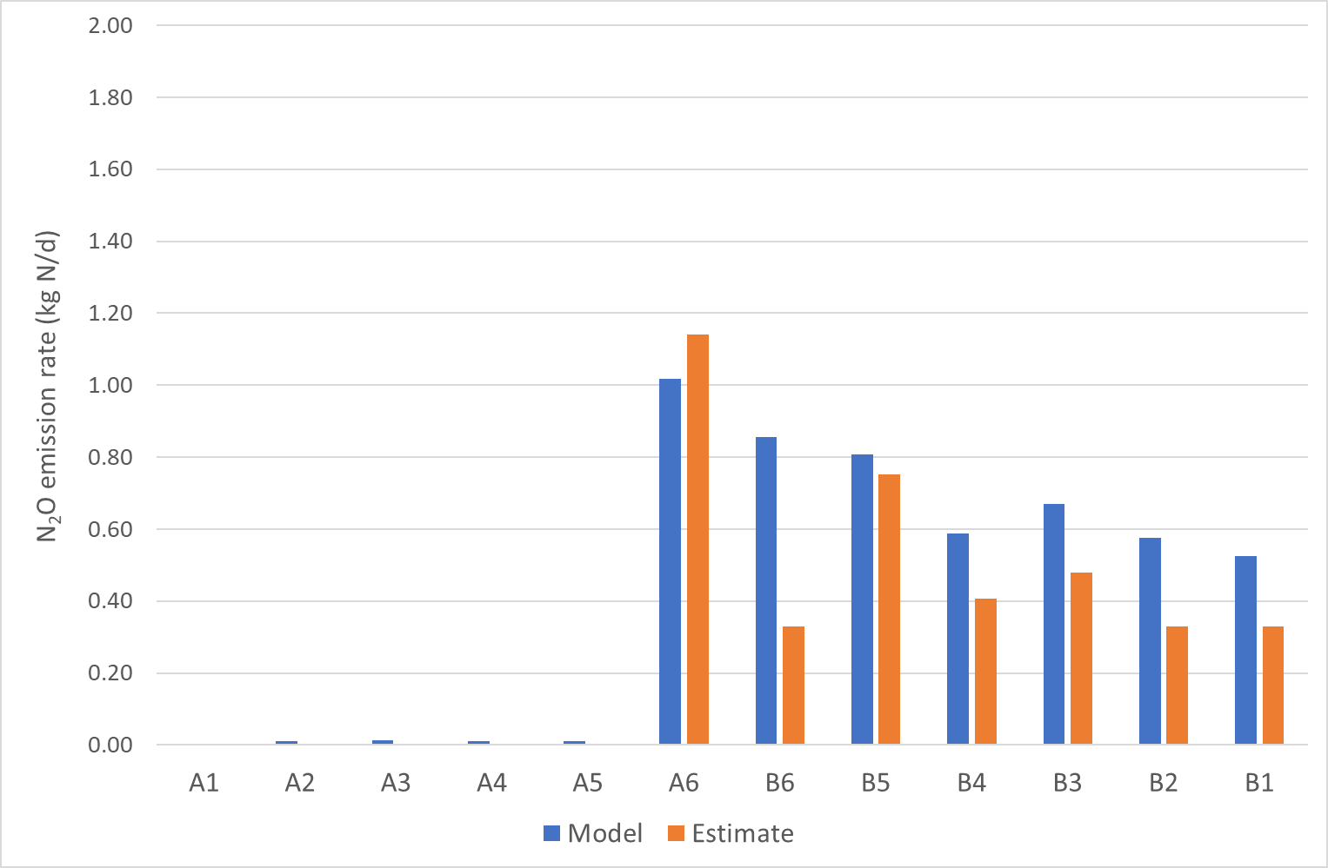
BioWin model
Switching off heterotrophic denitrification (Mechanism #3)
Notes:
Given that the observed data indicated no N2O accumulation in the anoxic cells, we found that by turning off het DN we were able to achieve a closer agreement between the predicted emission rates and those estimated based on measured data.
This would suggest focusing on the heterotrophic DN switching functions in the Biowin model at the next stage.

Slide 18
Practical Challenges
Procurement and installation time
Gas hoods not an off the shelf item
How to get data off instruments (USB, ethernet)
Instrument calibration
Data cleaning
Water in flexible tubing
Tracer gas may be required
Sampling schedule, preservation and LOD
Notes:
The following challenges were encountered.
Procurement and assembly of equipment (some of which ships from Europe or America), and installation of power and comms cabling can take several months.
Gas hoods cannot just be bought off the shelf and need to be manufactured.
Unisense can be networked to the SCADA, or data can be download onto USB but you need to purchase specialised software to read the data (also many companies block USB for security)
For the Picarro we downloaded data onto USB because the network protocol made it very difficult to connect it to the site SCADA.
It is important to ensure purchase of sufficient length of cabling for the Unisense and other probes to reach the various parts of the reactor (max cable length available is 100m)
Careful calibration of instruments is important. The Unisense requires the calibration standard to be made up at the same temperature as the treatment process. The Picarro will require a calibration gas to be made up at the required concentration range.
Unisense probes have a 6 month shelf life from manufacture whether used or not. Replacement sensor heads are required every 6 months.
A lot of time and effort is required to clean the data. Comparing trends of instrument data with ops data can highlight issues (eg the Unisense controller was set up in the wrong time zone which presented very puzzling results until the data was cross-checked with the operator data).
Water can accumulate in small bore tubing which interferes with flow measurement, so consider 1 inch tubing, keep it short, and consider adding water traps
Tracer gas may be required for measuring off-gas flow rate in anoxic cells due to the low off-gas production, which adds complexity to the process.
Create a sampling schedule for operators to fill in (including date and time)
Mixed liquor samples require filtration on site to preserve sCOD, ammonia, NOx if being sent to a lab for analysis – either settle first or pre-filter with a coffee filter as syringe filters will block
Advise the lab of expected analytical ranges, so that appropriate LOD are used (eg sCOD lower LOD was 30 mg/l which was not known until the results started to come in – so we switched to trace COD test towards the end)

Slide 19
Next stages
Review results of site-wide sampling campaign
Improve accuracy of BioWin model
Propose and test mitigation strategies
Continue to monitor N₂O to understand long-term variations
Expand to other sites and develop site specific EF
Notes:
The following are recommended for the next stage of the project:
There are ongoing efforts to improve calibration of the model. Once this is completed, it is expected that the Rosedale WWTP Digital Twin will provide an invaluable tool for identifying and mitigating process emissions.

Slide 20
Thank you
Kenny Williamson (Watercare)
Apra Boyle-Gotla (Watercare)
Andrew Kennedy (Watercare)
Glenys Rule (Watercare).
Notes:
We would like to thank a few people for their support with this project.
Kenny Williamson – production manager north – championed the project
Apra Boyle Gotla – head of innovation at Watercare
Andrew Kennedy – maintenance controller - helped with procuring and installing the equipment
Glenys Rule – operations controller at Rosedale
We are happy to take any questions now.

