Slide 1
The Value of Water
A national conversation on how we can build water literacy and a water conservation ethic amongst Kiwis

Slide 2
Karakia
E te wai e
E te wai nui, e te wai roa
E te wai nō tawhiti, e te wai nō tata
Kia tau te wai hei piringa
Kia tau te wai hei tauranga
Kia tau te wai hei ōranga mō te tangata
Haumi e, Hui e, Taiki e!
The water
The big bodies of water, the long bodies of water
The water from afar, the water from near
It is to remain as a haven
It is to remain as a resting-place
It is to remain as a life source for man
Come together!

Slide 3
Mihi
Tēnā koutou katoa
Ko Julian Fyfe tōku ingoa
Nō Dhawura Ngunnawal Ahitereiria ōku tīpuna
Kei te noho au ki Kāpiti
Kei Ngā Wai Hangarua (Wellington Water) ahau e mahi ana
Greetings to all
My name is Julian Fyfe
My ancestors are from Ngunnawal Country, Australia
I live in Kāpiti
I work at Ngā Wai Hangarua (Wellington Water)

Slide 5
Agenda
Item | Format | Timing
Introduction | Facilitators speaking | 5 mins
Watercare – Responding to an extreme drought | Presentation Q&A | 10 mins 5 mins
Smart Water – behaviour change, community outreach and collaboration | Presentation Q&A | 10 mins 5 mins
Audience participation | Live poll | 10 mins
The Water Conservancy – Droughts and flooding rains - the Australian experience and Water Night | Presentation Q&A | 10 mins 5 mins
Barriers and Enablers | Table discussions | 15 mins
Audience votes - Community of Practice | Audience voting | 10 mins
Wrap-up | Facilitators summarise outcomes | 5 mins

Slide 6
Watercare
Responding to an extreme drought

Slide 7
Smart Water
‘Smart Water starts with you!’ Behaviour change, community outreach & collaboration

Slide 8
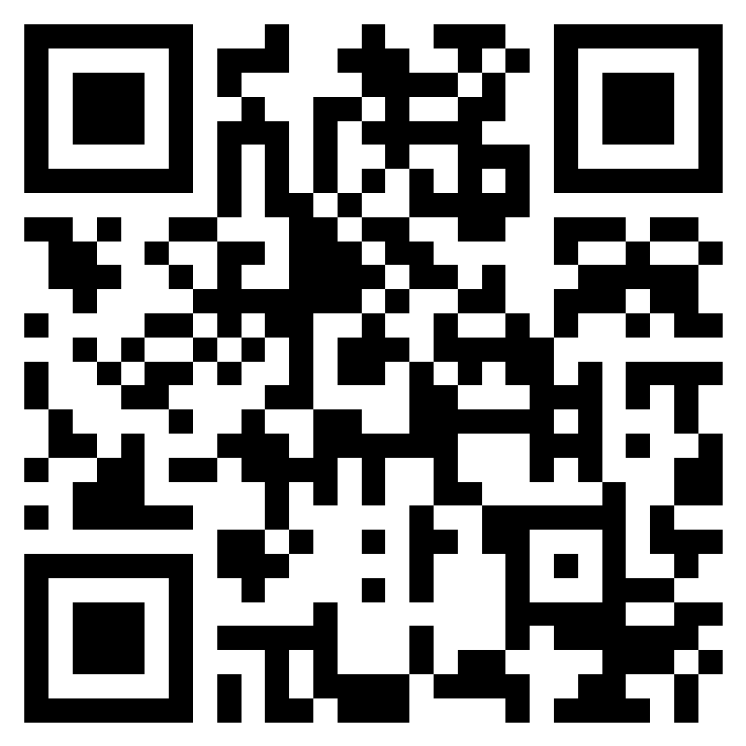
Live Poll
Scan the QR code or navigate to:
https://forms.office.com/r/dKH7gVQZcG

Slide 9
The Water Conservancy
Innovative tactics to increase water literacy and the value of tap water

Slide 10
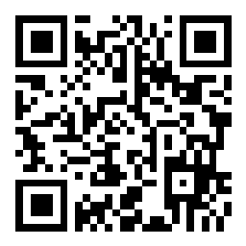
Table Discussions
Scan the QR code OR
Navigate to Slido.com
and enter code #3347023
OR navigate to:
https://app.sli.do/event/pTHaQ2oWkYBQTHL2cAQdAH

Slide 11
Question 1
Identify some barriers that prevent your organisation from building water literacy and a water conservation ethic amongst your customers

Slide 12
Question 2
Now identify some enablers that would help your organisation to build water literacy and a water conservation ethic amongst its customers

Slide 13
Audience Voting
Place a red post-it note with your full name written on it next to an issue that you have experience with
Place a yellow post-it note with your full name written on it next to an issue that you would assistance with

Slide 14
Wrap Up
We hope to hear from you or (even) see you again.
Look out for a post-workshop survey in your email soon!

