Slide 1
Development of a Pipe Lining Design Specification
Tony Gordon, WSP NZ & ASTT Pipelining SIG

Slide 2
Introduction
Australasian Society for Trenchless Technology
September 2020 the ASTT Pipe Lining SIG was re-established
Included key participants from the Australasian Pipe Lining Supply Chain
Consultant Designers
Material Suppliers
Installation Contractors
Asset Owners
Agreed the key value to the industry was the development of a Lining Design Specification – one didn’t exist
Agreed the basis would be AS/NZS 2566.1 Buried flexible pipelines Part 1: Structural design

Slide 3
Design Specification
For Circular, non-pressure pipelines, ≤ 1200 mm internal diameter, host pipe depth to invert up to 15 m
It is a design specification and is NOT a Specification for lining installation
Applicable for lining methods:
Cured in Place Pipe (CIPP)
Spiral Wound Lining (SWL)
Fold & Form Lining (F&F)
Slip Lining
Liners will have an expected ovality of less than or equal to 10% when installed
It is suitable for circular grouted liners in all types of host pipes, but loss of hydraulic capacity may need to be considered.

Slide 4
Structural Renovation
Pipe renovation methods that do not require the host pipe to sustain all loads acting on the pipe.
There are two types of structural renovations:
Partially Deteriorated – the host pipe is capable of supporting applied loads from soil, other dead loads and traffic loads. The liner is designed to withstand the external pressure from groundwater only.
Fully Deteriorated – the host pipe is considered to have no remaining strength, and is no longer capable of supporting loads. The design allows that all loads from soil, groundwater, any other dead loads and traffic loads are all supported by the liner, independent of the existing pipe.

Slide 5
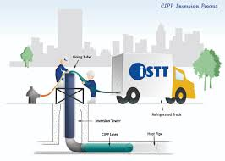
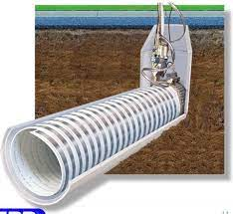
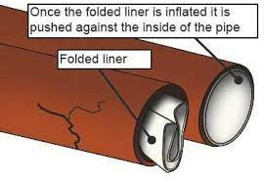
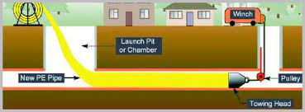
Lining Methodologies
CIPP
SWL
F&F
Slip Lining

Slide 6
Current Liner Design Specifications
Current international liner design specifications include:
ASTM (formally known as American Society for Testing and Materials) standards F1216 and F2019 (CIPP), F1741 (SWL), F1947 (F&F)
ISO 11296 Plastics piping systems for renovation of underground non-pressure drainage and sewerage networks

Slide 7
Key Specific Design Considerations from the New Specification
Based on AS/NZS 2566 but with five key areas of difference in the Specification to AS/NZS 2566.1:
Section 4 Partially Deteriorated Condition
Section 5.3 Soil Properties for Design
Section 5.4 Soil Loads & Silo Reduction Factor
Section 5.5.5 Buckling
Section 6.4 Liquefaction

Slide 8
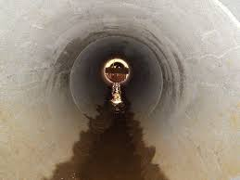
Design for the Partially Deteriorated Condition
Basic equations are based on equations in the ASTM standards
Basic equations
$P_{r} ≤ P_{rall}$ …(4)
Where:
P_{r} is the external fluid pressure acting on the liner
P_{rall} is the allowable external fluid pressure acting on the liner at the invert level
$P_{r}= γ_{L}.{(H}_{w}+D_{i}+t)$ …(5)
= density of the liquid x depth of fluid over the liner invert

Slide 9
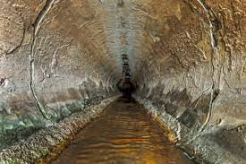
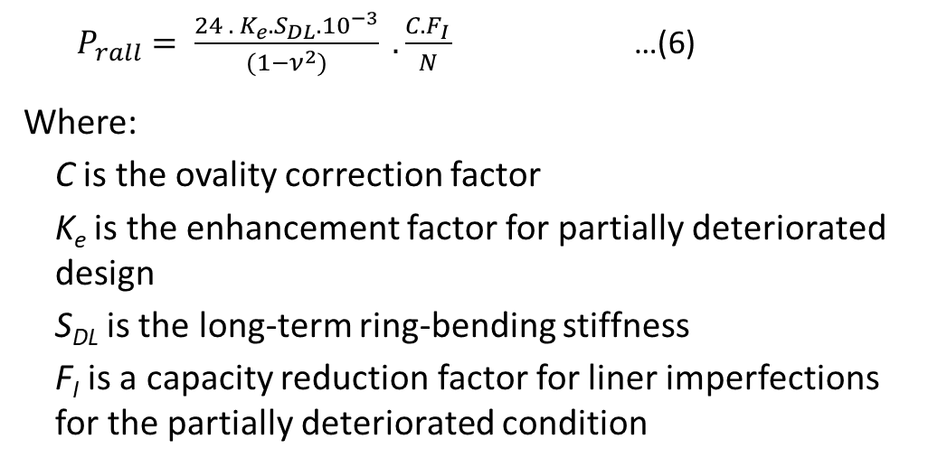
Design for the Partially Deteriorated Condition (continued)
$P_{rall}= \frac{24 .{ K}_{e}. S_{DL}. {10}^{−3}}{(1−ν^{2})} . \frac{C.F_{I}}{N}$ …(6)
Where:
C is the ovality correction factor
K_{e} is the enhancement factor for partially deteriorated design
S_{DL} is the long-term ring-bending stiffness
F_{I} is a capacity reduction factor for liner imperfections for the partially deteriorated condition
Equation 6 is based on Equation X1.1 of ASTM F1216, but parameter F_{I} is not in the ASTM Equation.
The ASTT SIG decided to include the factor F_{I} in Equation 6 but decided there was insufficient data to provide values of F_{I} that may be appropriate for these imperfections.

Slide 10
Design for the Partially Deteriorated Condition (continued)
For CIPP lining with an initial ovality, to account for bending stresses associated with bending of the non-circular ring when subject to external hydrostatic loading, the minimum wall thickness is calculated using the following equation:
$t_{min}= \frac{3\frac{∆}{100}D_{e}}{\left[0.5+{\left\{0.25+\left(6\frac{∆}{100}\left[\frac{σ_{L}}{P_{r}.N.(1+\frac{∆}{100})}\right]\right)\right\}}^{0.5}\right]}$ …(9)
Equation 9 is based on Equation X1.2 of ASTM F1216
Is based on ovality, diameter, external fluid pressure and long-term flexural strength ($σ_{L}$) of the lining.
Notes:
Equation 9 is based on the theory of elastic stability. When a circular tube with some imperfections (e.g. ovality) is subject to external uniform pressure there is some flattening of the tube and bending moments result. These bending moments = bending stress which needs to be compared to flexural strength.

Slide 11
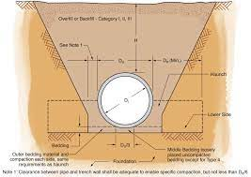
Fully Deteriorated Condition – Soil Properties for Design
This is all about what value of the combined soil modulus, E’, should be used in the various design equations of AS/NZS 2566.1
Soil Modulus is not the native soil strength from a geotechnical assessment
Soil Modulus is an indication of the amount of support the host pipe and surrounding ground provide to an installed liner
Default value in the Specification where no soil property information is available is E’ = 2.0 MPa

Slide 12
Fully Deteriorated Condition – Soil Properties for Design (continued)
Combined soil modulus, E’, may be increased to 4 MPa for any of the following conditions:
The annulus between liner and host pipe is grouted, and this grout will fill any voids outside the host pipe
Geotechnical investigations show that a higher value may be used
Host pipe has original circularity with no significant loss of cross section
Host pipe is located within engineered fill of road or rail embankment and no significant loss of circularity or holes or other major defects
Host pipe only contains minor defects (e.g. fine cracks) with no significant loss of circularity
Lining being done for pre-emptive replacement due to future loading but host pipe is in good condition
Host pipe is in good condition but being lined due to possible future deterioration
Please note that these are only a summary and please read the Specification for the full description of conditions

Slide 13
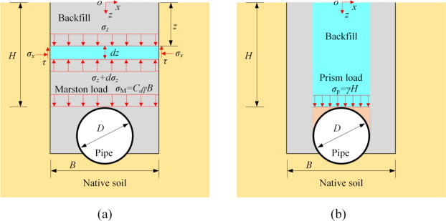
Soil Loads and the Silo Reduction Factor
Existing specifications tend to fall into two ‘camps’:
No silo reduction factor (sometimes incorrectly called trench effects) is allowed
It may be used when H/D > 10 – current case for AS/NZS 2566.1 There is no logic to this step – factor application should be a constant
Current design specifications / standards for ‘bored pipes’ such as AS/NZS 3725 (Concrete Pipes) or the German Association for Water, Wastewater and Waste’s DWA-A 161E (all pipes) use a silo reduction factor or equivalent (Marston formula) for full height of fill from cover depth H = 0 m.

Slide 14
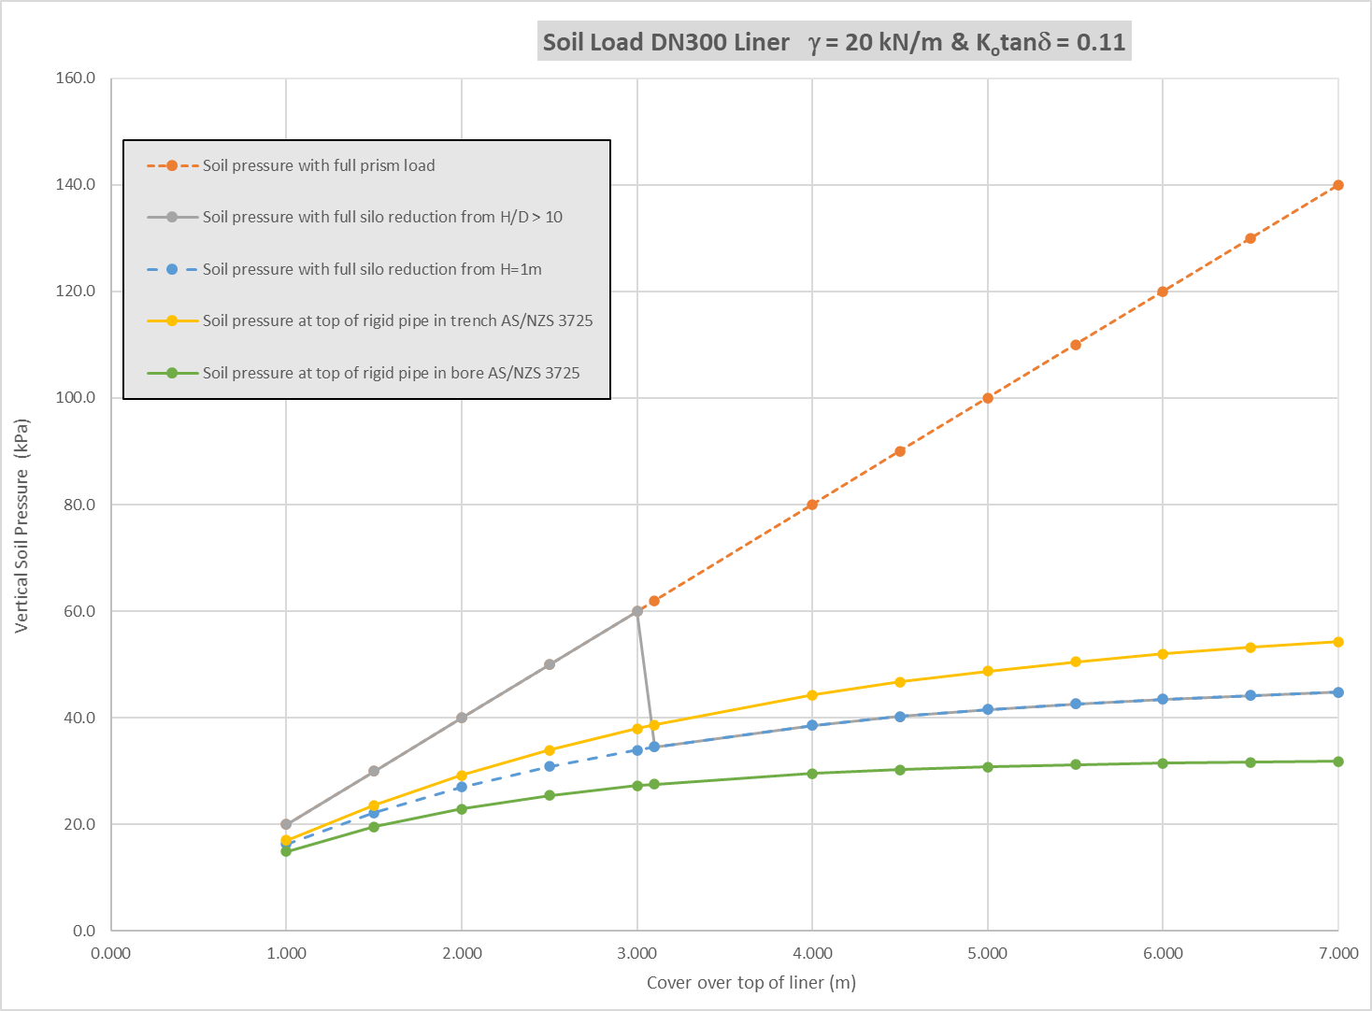
Soil Loads and the Silo Reduction Factor (continued)

Slide 15
Soil Loads and the Silo Reduction Factor (continued)
In the Specification conditions for allowing silo reduction factor are:
Host pipe originally installed in a trench or a bore (note referring to obtaining specialist advice for embankment installations)
Host pipe has been installed for at least 10 years
Height of fill ≥ 1 m
Equations are:
$w_{g}= κγ$H … (11)
$κ= \frac{1−e^{−2\frac{H}{B^{′}}K_{o}tanδ}}{2\frac{H}{B^{′}}K_{o}tanδ}$ … (12)
$B^{′}= \sqrt{3}D$ … (13)
Where:
$κ$ is the Silo Reduction Factor
$K_{o}tanδ$is taken from the Supplement to AS/NZS 3725 and given in a table
B’ is the width of slip plane above liner or slip lining pipe

Slide 16
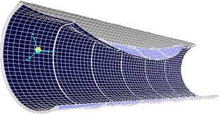
Buckling (Fully Deteriorated Condition)
Equations generally consistent with AS/NZS 2566.1 with two exceptions:
Existing buckling equations but with silo reduction factor included:
For $H ≥H_{w}$:
$κγ\left(H−H_{w}\right)+\left(γ_{L}+{κγ}_{sub}\right)\left(\frac{D_{e}}{2}+H_{w}\right)+ w_{gs}+w_{q}≤ q_{all}$ …(23)
For $H<H_{w}$:
$γ_{L}\left(\frac{D_{e}}{2}+H_{w}\right)+ {κγ}_{sub}\left(\frac{D_{e}}{2}+H\right)+w_{gs}+w_{q}≤ q_{all}$ …(24)
Where $q_{all}$ is the allowable buckling pressure
Design factor for buckling (safety factor) $F_{s}$ includes an increase for ovality:
$F_{s}= \frac{2}{C^{0.5}}$ , but not less than 2.5 ($C^{0.5}$ is consistent with ASTM F1216 for this condition)

Slide 17
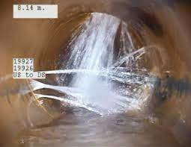
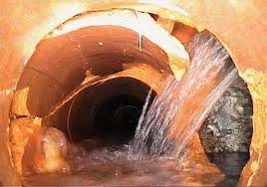
Design for Liquefaction (New Zealand only)
If the ground is subject to liquefaction in seismic events, there are two additional load cases to consider. These are:
The native soil will weaken but remain partially cohesive
The ground will fully liquefy
Details of what to allow for in each case are given in the Specification
The potential for liquefaction must be assessed by a suitably-qualified geo-professional considering the underlying geology, groundwater levels, and the likelihood of a liquefaction-inducing earthquake occurring at the site.
Designing for liquefaction events, when they are of low likelihood, will result in an excessively conservative design with little added value for the added cost.

Slide 18
Specification – Last Section – Design Examples
Australian Live Loads
New Zealand Live Loads
Liquefaction Load Cases (New Zealand Only)
Australian Railway Loading

Slide 19
Questions and Discussion?

