Slide 1
Water New Zealand Conference & Expo 2022
19 October 2022
Andrew WT Wong
3Waters Delivery on the Chatham Islands: Maximising Opportunities

Slide 2
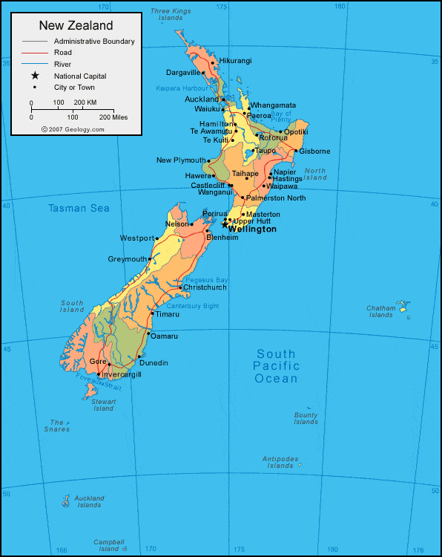
The Chatham Islands
Kaingaroa
800 km East of mainland NZ
Six main settlements
All goods from NZ
No cellular network until Nov. 2021
3Waters Servicing
Waitangi – water and wastewater
Kaingaroa – water
Funding
Targeted rates based on connection
Reliance on annual Crown allocation
Port
Hutt
Te One
Waitangi
Owenga
Pitt Island
NASA
2

Slide 3
Waitangi Wastewater System
1978 – Reticulation & Septic System
2005 – Inlet PS, Rising Main, WWTP
Critical Repairs / Issues
Inlet Pump Station – Pump and Valves
RBCs – Shafts and Bearings
Irrigation Area – Localised Ponding
Balance Tanks – Corrosion
3

Slide 4
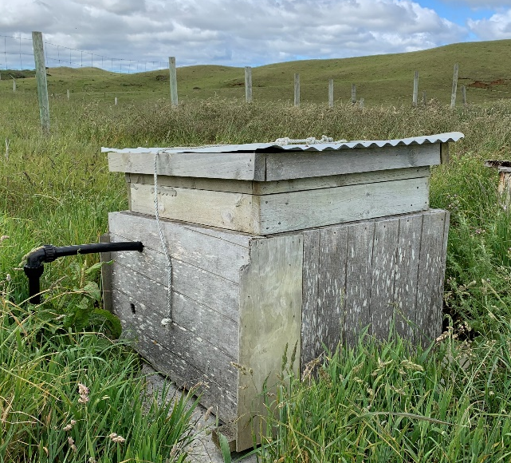
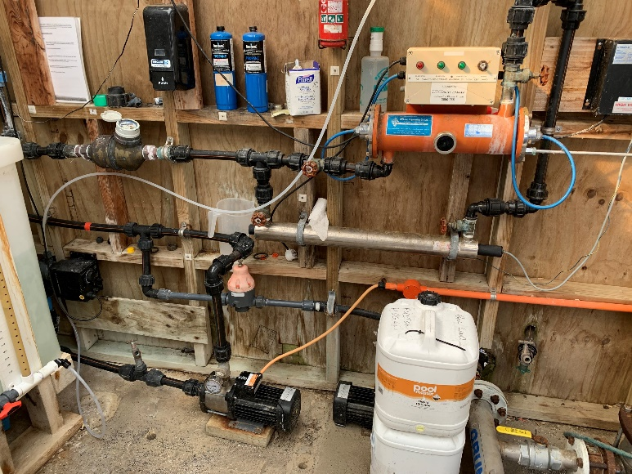
Waitangi Water Supply
2005 – Reticulation & WTP
Critical Repairs / Issues
UV Reactors – Past end of life
No online monitoring or telemetry
WTP Shed – Poor condition
4

Slide 5
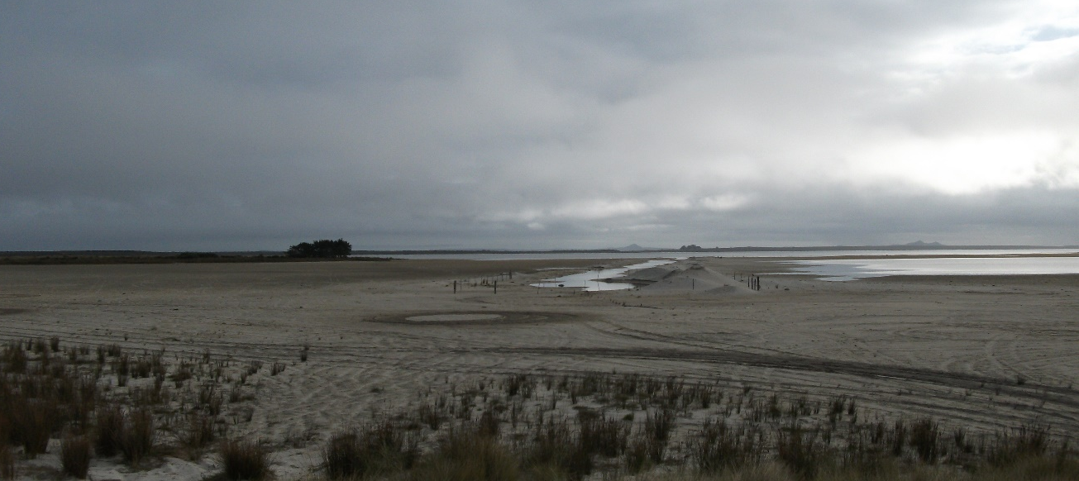
Kaingaroa Water Supply
1975 – Retic & WTP
2014 – WTP
Critical Repairs / Issues
Lake Rangitai Intake Channel
High organics – UVT & DBPs
No online monitoring or telemetry
5

Slide 6
Grant Funding
MoH - $340,000
3Ws - $640,000
Objectives
Improve public health outcomes
Improve system resilience
Maximise benefit to communities
Constructable / Operable
Complete on time
Buena Vista Interactive
6

Slide 7
Procurement
7 March 2022
Existing Contracts
Engineering Services – Stantec
O&M Contract – Fulton Hogan
Risks
Contractor / Subcontractor availability
Material / Equipment availability
Cost escalation
Shipping delays – weather / priority
National Alert Levels / Travel Restrictions
The Guardian
7

Slide 8
Fast Tracked Programme
Integrated programme of works
Minimise design time
Concept level, concise specifications, equipment lists, sketches
Informal RFQ process
Leverage O&M Contract
Materials, labour, subcontractors, MSQA
CIC direct supply contract
Collaborative teamwork
8

Slide 9
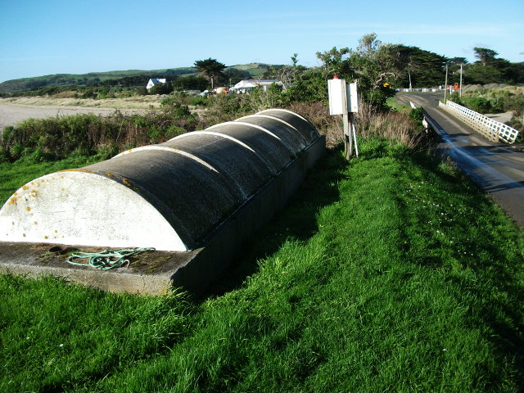
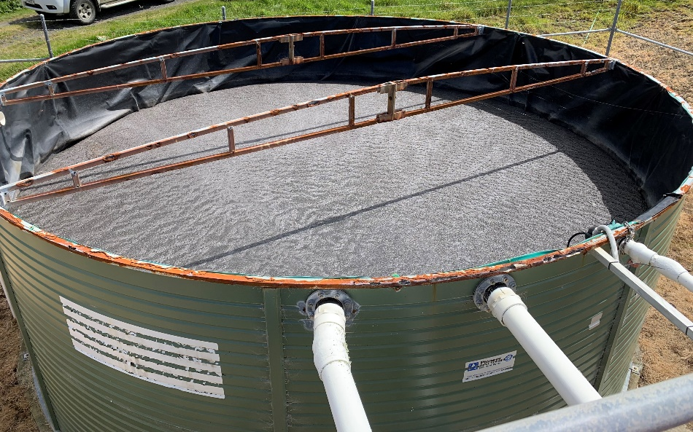
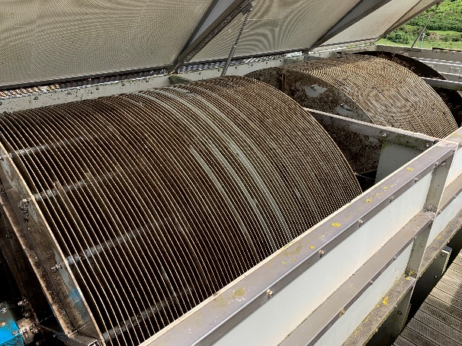
Wastewater Upgrades
Inlet Pump Station Critical Repairs
RBC Critical Repairs
Balance Tank Replacement
WWTP Upgrade Optioneering & Concept Design
Trickling Filter, Textile Filter, MBBR
CCTV Inspection of Retic Network
Land Application System Upgrade
New system and native plantings

Slide 10
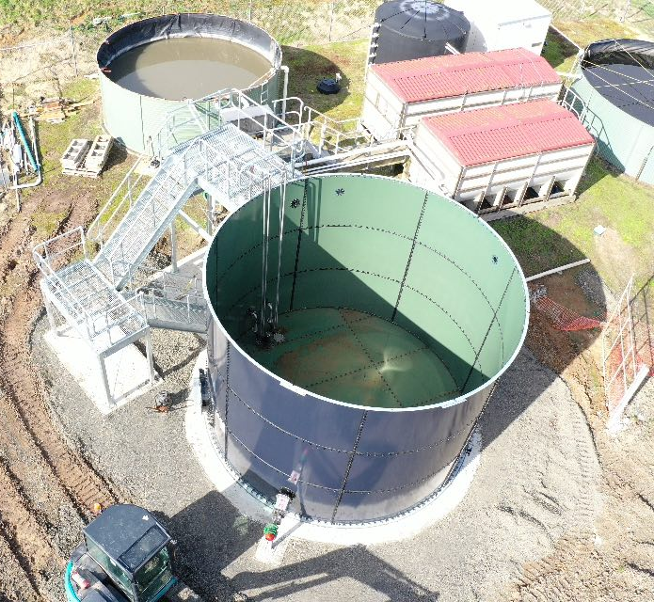
Wastewater Upgrades
Inlet Pump Station Critical Repairs
RBC Critical Repairs
Balance Tank Replacement
WWTP Upgrade Optioneering & Concept Design
Trickling Filter, Textile Filter, MBBR
CCTV Inspection of Retic Network
Land Application System Upgrade
New system and native plantings
Bonus Project: Drone survey

Slide 11
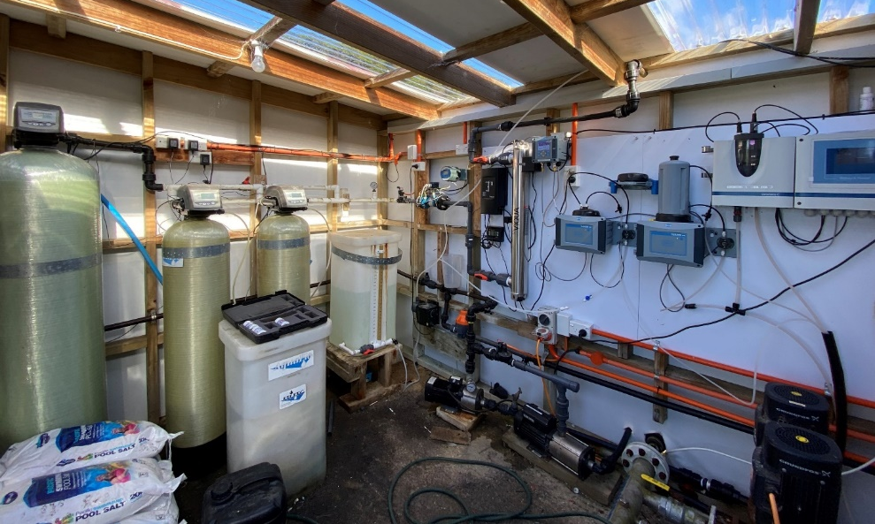
Waitangi WTP Upgrades
Before
After

Slide 12
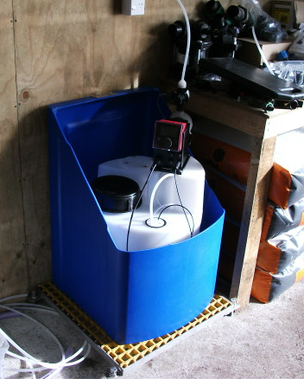
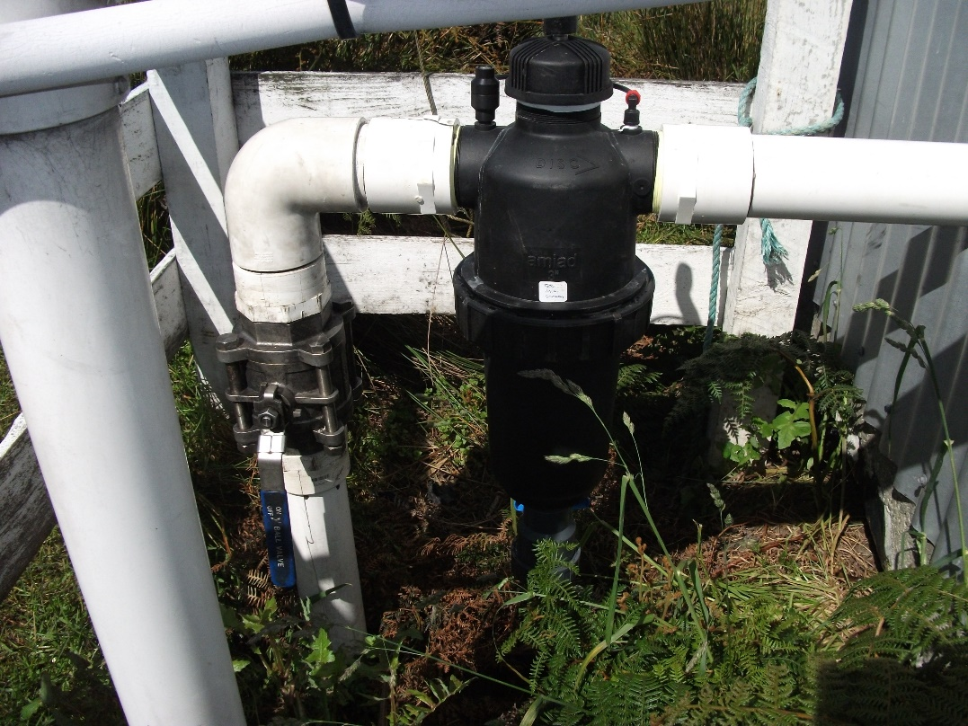
Kaingaroa WTP Upgrades

Slide 13
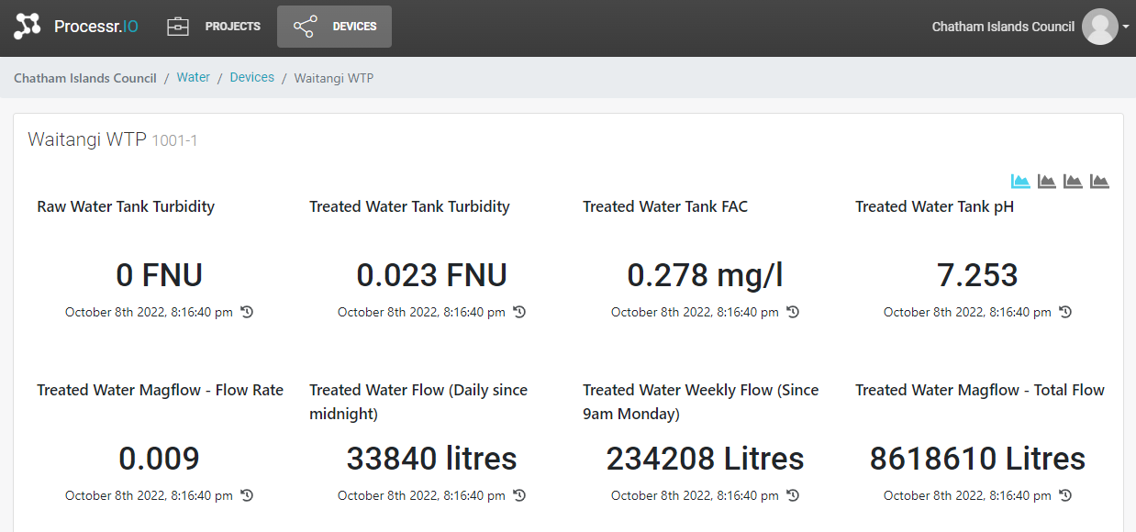
WTP Telemetry

Slide 14
WTP Telemetry

Slide 15
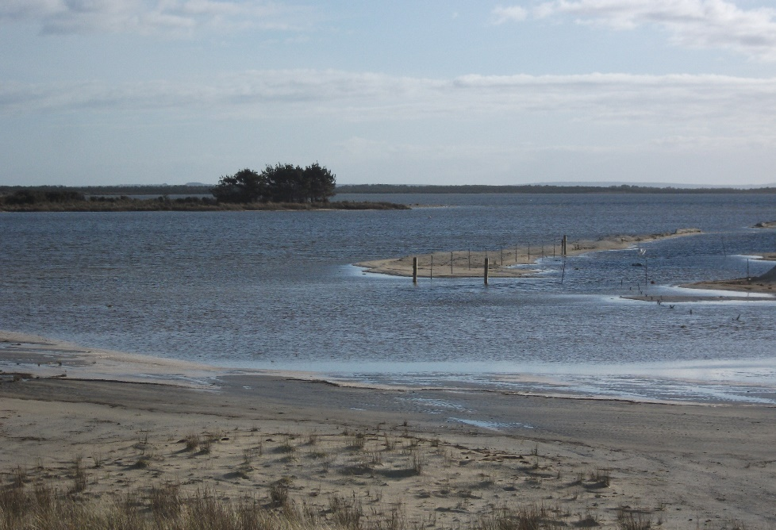
Water Resilience Projects
Waitangi toby boxes
Kaingaroa non-potable rainwater scheme
Kaingaroa Intake Extension

Slide 16
Conclusions
Collaborative project team (small + decision maker)
Set clear objectives
Allowance for flexibility and adaptability
Group similar projects together
Consider alternative procurement methods
Leverage local projects into opportunities
Budget fully spent by 30 June

Slide 17
Acknowledgements
Chatham Islands Council Staff
Fulton Hogan
FILTEC
ConnectM2M
Reliant Solutions
Stantec Transportation Team

Slide 18
Thank You
Andrew Wong
Andrew.Wong@Stantec.com

