Slide 1
Rūātoki Valley, Tūhoe - Eastern Bay of Plenty
My Papakāinga: My Homeland
Notes:
1. According to LAWA – Land & Water Aotearoa

Slide 2
TE urewera: a legal personhood

Slide 3
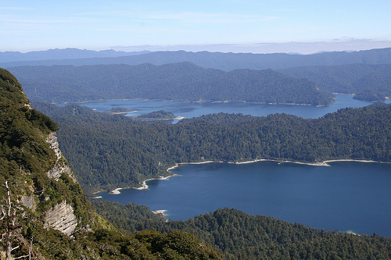
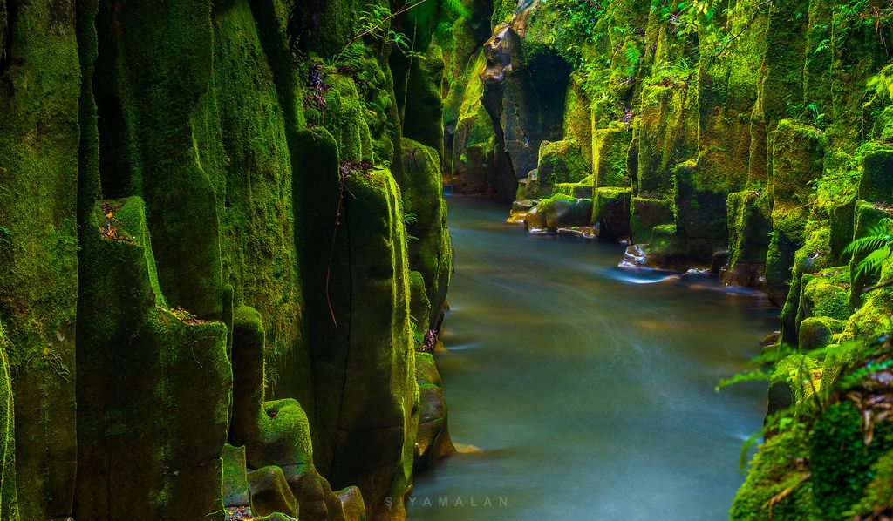
Waterways a riverways as ancestors

Slide 4
L. A. W. A E-Coli Sampling donut view
Whakatāne district council
Water supply And safety plan
July 2019
Statistics
About 21,020 people served by water supply
Water take consent 20198 expires on 10 October 2026
The consented maximum rate is 227 litres per second, 8,000m3
take per day in summer, 5,000m3 in winter
Five pumping stations
220km of pipes within system supply
Asset replacement value (2017): $87.98 million
90% Suitable for swimming
2% Caution advised
8%. Unsuitable for swimming

Slide 5
Environmental responsibility KAITIAKI – KAIMANAAKI (Carers not Owners)
Understanding Circular Economies in Simple Ways:
LINEAR
CIRCULAR
SQUARE

Slide 6
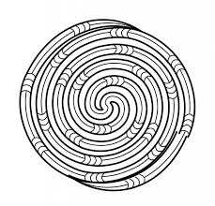
AN INDIGENOUS MĀORI SYSTEMS APPROACH
Mātauranga Māori is the indigenous system of knowing, thinking, experience and action couched in intergenerational wisdom.
It is anchored in a holistic philosophy.
Concepts such as recycling, resiliene, restoration and regeneration are embedded in Māori knowledge systems.
In turn, these have been drawn from more than 50,000 years of knowledge and experience emanating from Te Moana-nui-ā-Kiwa (the Pacific Ocean) and Te Ika-ā-Māui (the origins of Āotearoa land-whenua).
Who better then, to guide the regeneration of the Pacific Islands & Āotearoa than the people of those homelands joined with experts collaborators?

Slide 7
TAKARANGI

Slide 8
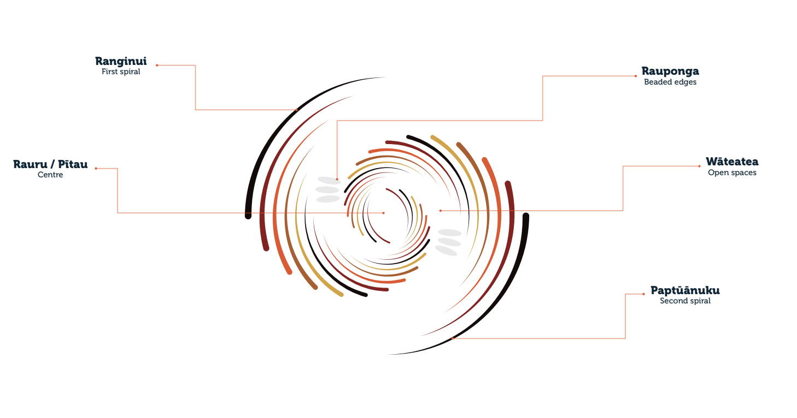

Slide 9
Tūhoe Living Community Challenge (People, Environment)
Tūhoe Living Building Challenge (Construction and Build)
Ivan Mercep & Jazmax Team (Design & Architects)
Arrow International (Builders)

Slide 10
wcw
Local materials, Ancestor narrative and wisdoms
Local knowledge of water
Local knowledge of solar energy
Local knowledge of behavior of the elements; water, sun, moon, stars, wind, land rhythm and pulse

Slide 12
1st LIVING BUILDING in New Zealand Aotearoa
Innovate: honesty, kindness, integrity, generosity, courage, confidence
Environmentally Responsible: by knowledge-sharing and recognizing the need for shift from a mechanistic, monocultural thought pattern to a re-humanizing one. This supports justice, interdependence, equity, community-based control of one’s destiny, unity and freedom to live as free men and women peacefully with our older siblings; the moon, the sun, mountains, rivers, stars, forests and animals. Returning gratefulness and honour to them for their shelter and sustenance.

Slide 14
3 key principles of a Circular Economy

Slide 15
Redesigning for Circularity
Design out waste & emissions; keep materials in use; regenerate natural systems
3Waters increases energy demand
BAU will mean 4ºC by 2060
650,000T organics to landfill
Source: MFE
Reliance on synthetic fertiliser
Canterbury’s nitrates 11x WHO limits
133M T primary sector organic
Waste
Source: Beca, First Gas Fonterra
Notes:
Wastewater treatment & sludge
disposal is a large cause of
council emissions, which will increase under 3Waters
We need to limit global warming to
1.5ºC. With BAU we’re trending toward 4ºC
650,000 tonnes of Council organic waste sent to landfill every year. Source: MFE
Aotearoa’s economy relies on synthetic fertilizer based on fossil fuels
Residual nitrates in Canterbury’s rivers are 11 times WHO -advised limits
133M tonnes of primary sector organic
waste

Slide 16
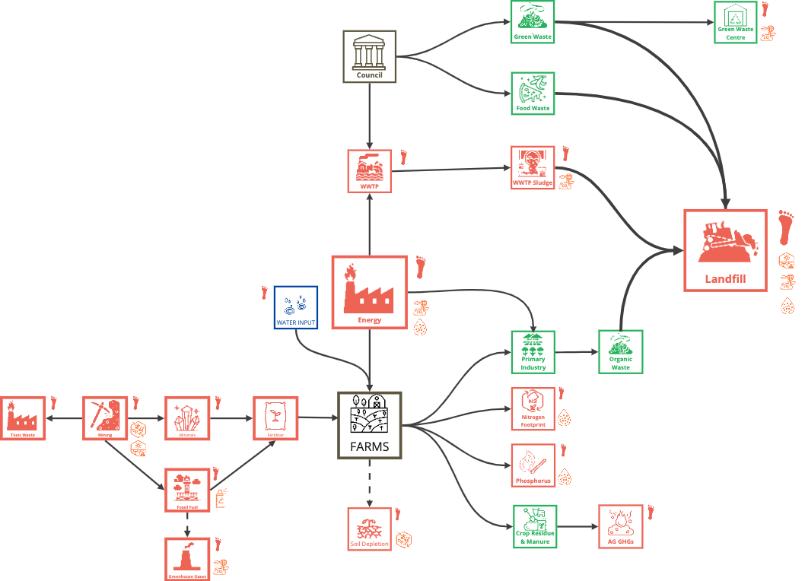
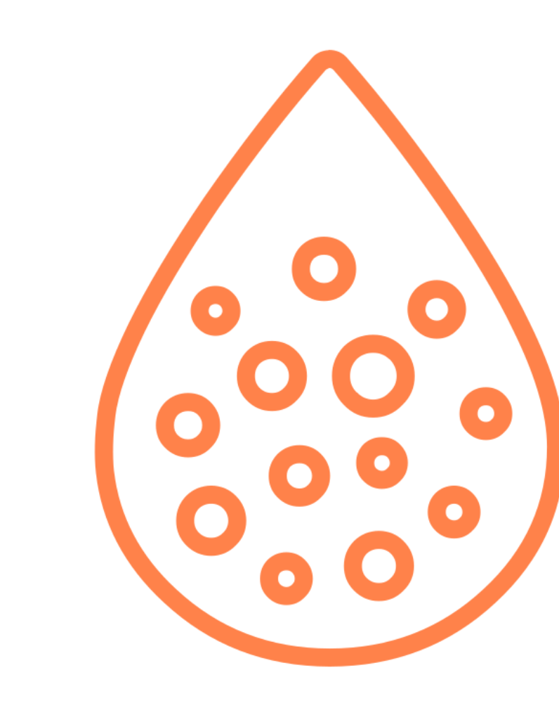
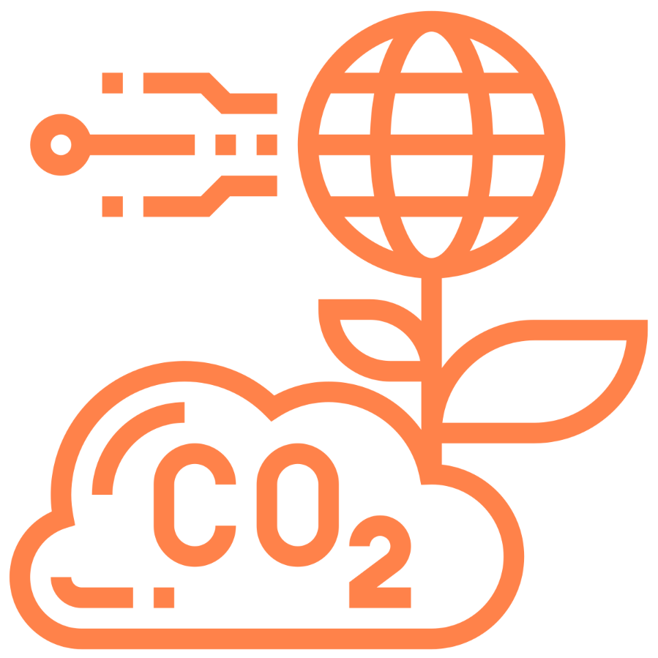
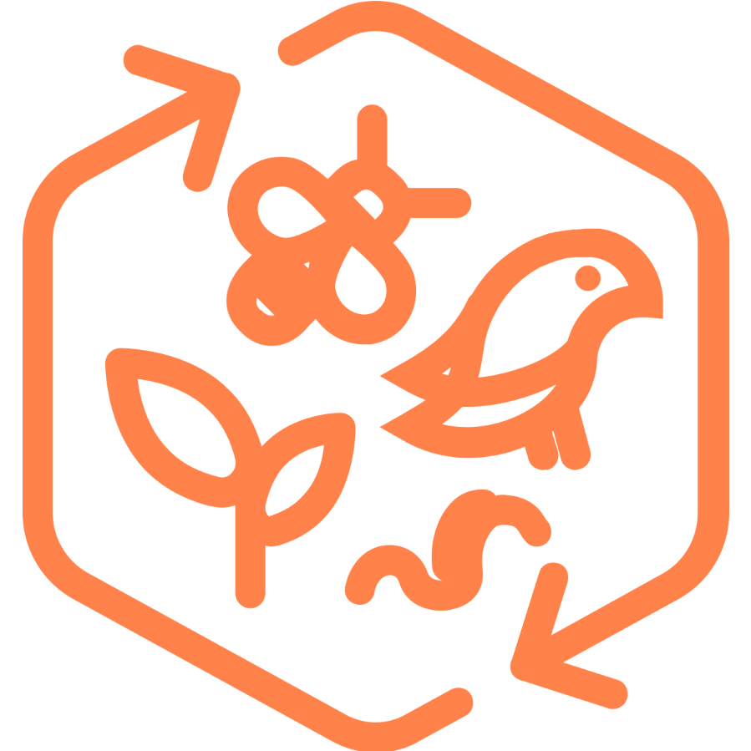
Planetary Accounting provides science targets beyond carbon
Linear
Fresh Water Use
Biogeochemical Flows
Climate Change
Land System Change
Ocean Acidification
Biodiversity
Notes:
Planetary Boundaryis a guideline. PAN is a tool is a system level tool regional liability is coming. Do you trust your existing waste paradigm or look for solutions inspired by nature to solve regional bioeconomy border economics
Emissions means very little
0.6% of global emissions
Impact for NZ on water quality
The main boundary getting exceeded is water quality
Debbie
Circular Precinct Modelling
WMF Funding can fund new thinking, 3Waters innovations in climate, supports transition for iwi ownership through Government funding in national NZ owned open source IP, Circular Economics
Transition Engineering
Cross Network Data and API’s
Create ERU, Don’t Buy ETS, Earn it.
Bioenergy Specialist
Create New Industry & Impact
Measure staying withing your regional Planetary Boundary Liability at a Regional Level with PAN.
Keep waste in place
#biomimicry# innovation & #community #iwiassetownership transfer #openinnovation

Slide 17
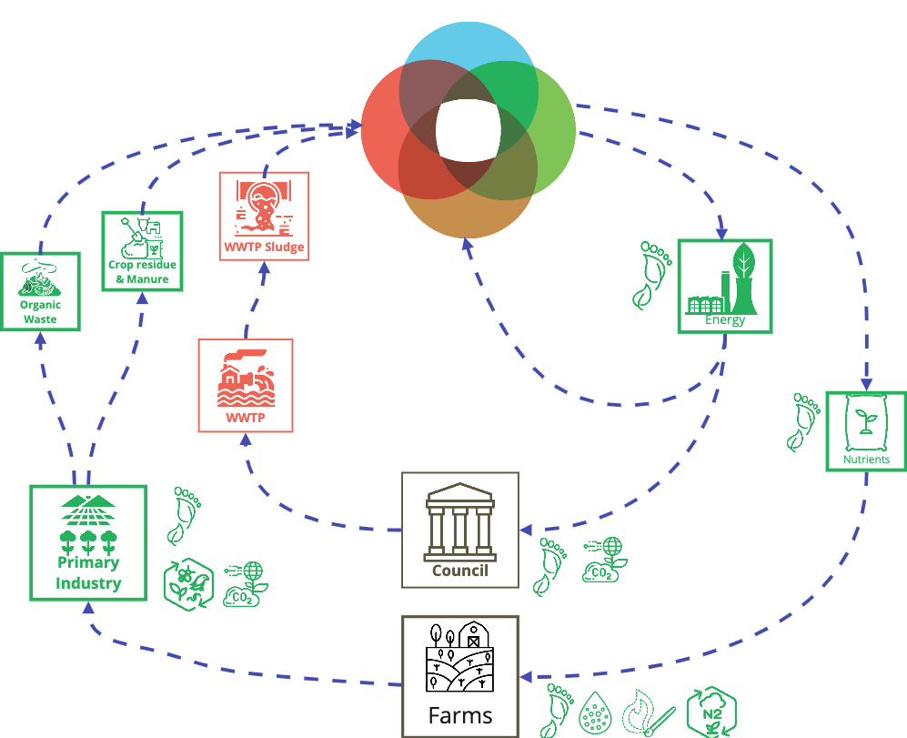
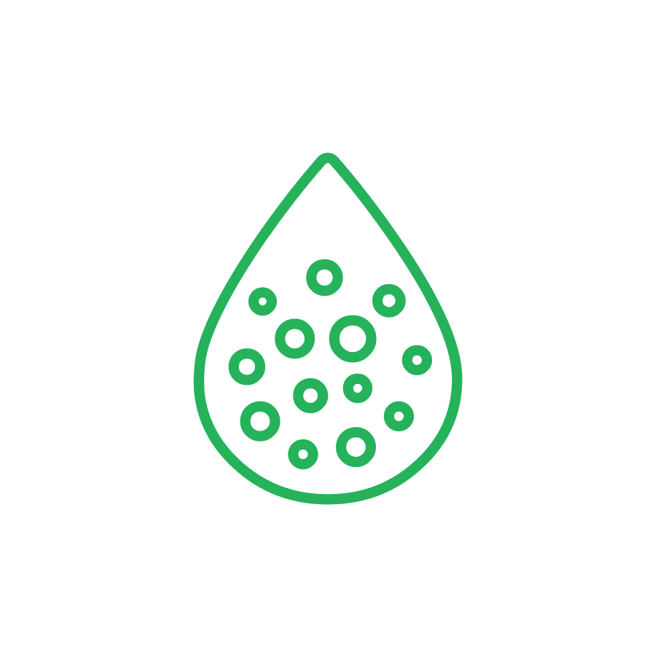
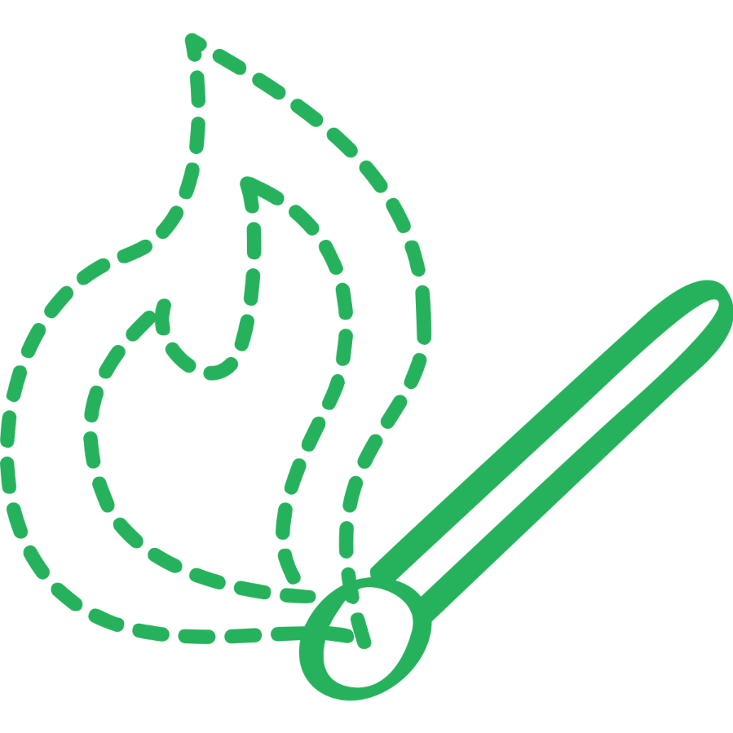
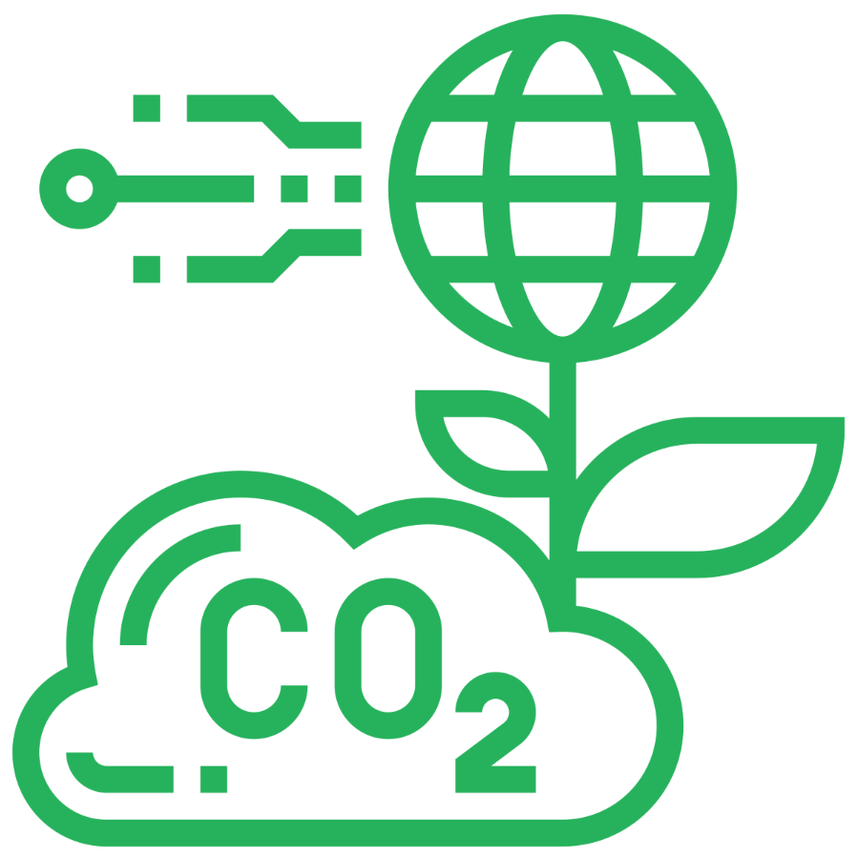
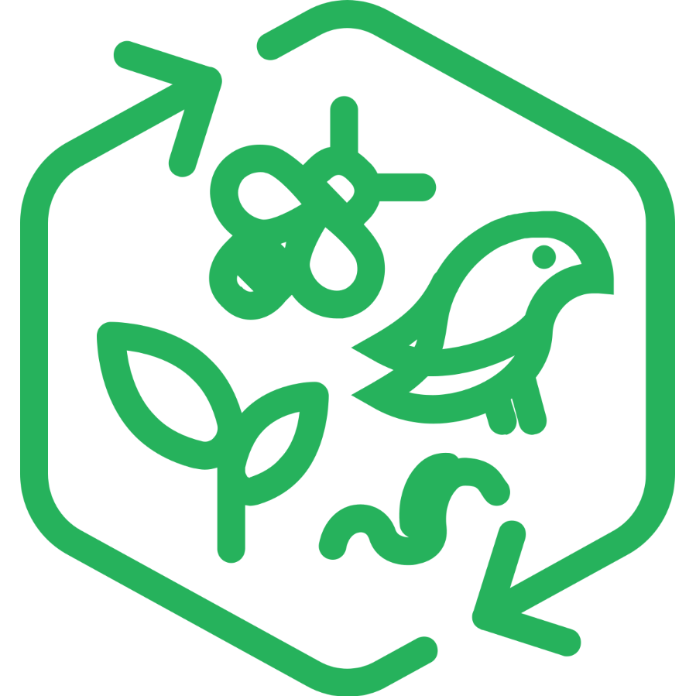
To stay within the Planetary Boundaries
Circular
Fresh Water Use
Biogeochemical Flows
Climate Change
Land System Change
Ocean Acidification
Biodiversity
Notes:
Planetary Boundaryis a guideline. PAN is a tool is a system level tool regional liability is coming. Do you trust your existing waste paradigm or look for solutions inspired by nature to solve regional bioeconomy border economics
Emissions means very little
0.6% of global emissions
Impact for NZ on water quality
The main boundary getting exceeded is water quality
Debbie
Circular Precinct Modelling
WMF Funding can fund new thinking, 3Waters innovations in climate, supports transition for iwi ownership through Government funding in national NZ owned open source IP, Circular Economics
Transition Engineering
Cross Network Data and API’s
Create ERU, Don’t Buy ETS, Earn it.
Bioenergy Specialist
Create New Industry & Impact
Measure staying withing your regional Planetary Boundary Liability at a Regional Level with PAN.
Keep waste in place
#biomimicry# innovation & #community #iwiassetownership transfer #openinnovation

Slide 18
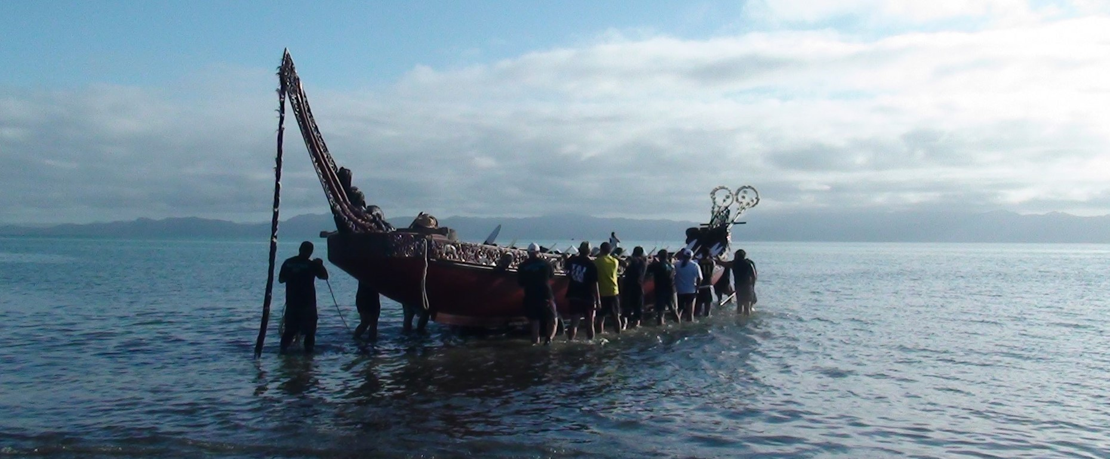
Ko Wai koe, ko Wai ahau
Ko Te Kotūiti Tuarua o Ngāti Paoa tōku waka taua
Notes:
You are water
I am water
Te wai āwhiowhio – the water cycle
Wairua - I precipitate from two spiritual waters
Birthed from the matrilineal waters of Ngāti Paoa and Ngāti Whanaunga
Tikapa is my ocean
And from my Dad, Waikato is my river – Ngāti Tahinga
I am water
This is my water story and sometimes slat-laden tears of Tikapa moana comes flowing out my eyes

Slide 19
NGĀ MANA WHENUA O TĀMAKI MAKAURAU
NGĀTI WHĀTUA
Te Runanga o Ngāti Whātua
Ngāti Whatua Ōrakei
Ngāti Whātua o Kaipara
Te Taou
MARUTUAHU
Ngāti Paoa
Ngāti Maru
Te Patukirikiri
Ngāti Tamaterā
Ngāti Whanaunga
TE WAIOHUA
Te Kawerau a Maki
Ngāti Tamaoho
Ngai Tai ki Tāmaki
Te Akitai Waiohua
Ngāti te Ata
Te Ahiwaru Waiohua
Waikato-Tainui
NGĀTI WAI
Ngāti Wai
Ngāti Manuhiri
Ngāti Rehua
Ngāti Whatua Ōrakei + Ngāti Paoa Kawenata Signing 2017
Notes:
Context before content
Tāmaki Makaurau – of a hundred lovers now 1.7million. That is a lot of wastewater..
I have heard it said many times that if you can crack the Iwi context in Tāmaki you can crack it anywhere in the country because of the complexies and shear numbers. My response is, ‘easier said than done’ so good luck.
Essentially these are the four Iwi groupings with a total of nineteen recognised by Auckland council and their CCO’S
In 2008 pre treaty negotiations there were fourteen Iwi represented on the TRMWF.

Slide 20
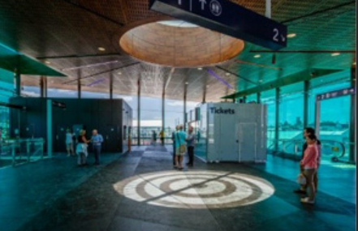
Regenerative Practice
Place sourced.
Culture led.
Community fed.
Notes:
Regenerative practice for me is one that is place sourced, culture led and community fed and I make no apologies about it needing to be in this order
.. is about coming into relationship first and foremost with place to realise its inherent potential; the wetland never wanted to be drained, its habitat and biodiversity wiped out. As Gabrielle stated yesterday, ‘what is it that Waimakariri needs, to flourish’
... is to create space for indigenous storytelling, for cultural expression to be felt, heard and seen; being led by indigenous knowledge and not just western science
... is providing for communities, tangata tiriti to express their sense of identity and their connection to place acknowledging the multicultural society that we live in and our values of manaakitanga as tangata whenua to support collective endevours
This is an image of the sun beaming through the skylight wayfinding and local navigation device on the floor of the newly built Panmure Railway station whose roofline depicts the kaitiaki bird who brought the sisters Reitu and Reipae to Maungarei, Mt Wellington.
“To hear our stories and to see our faces in our places”

Slide 21
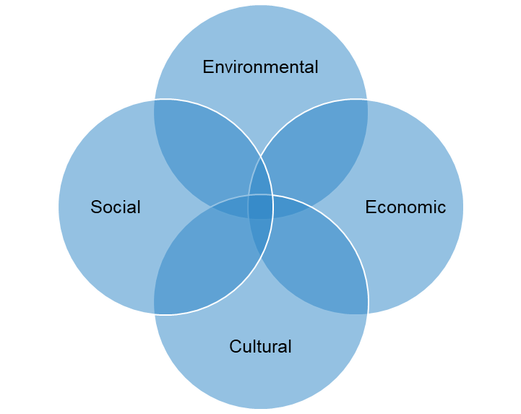
A Regenerative Development Approach
Place Sourced
Whole Systems Approach
Whakarito
Nested systems
MAURI
ORA
Whakaora
Community Fed
Whakatipu
Regenerative Potential
Whakapapa Centered
Culture Led
Notes:
This is my version of the circulatory system and embodiment of Broader Outcomes, (triple bottom lines, quadruple bottom lines and now broader outcomes) with mauri ora pulsating and influencing all spheres
A regenerative development approach:
Coalesces and uplifts mātauranga māori
Respecting and providing for indigenous knowledge
Whole systems approach not siloed
Inherent potential, not problems
It is not a one size fits all
It is re-evolutionary, evolving, deepening and growing
To quote my Alaskan sister Elizabeth Medicine Crow, ‘to be a good ancestor’
I’m just trying to be the cool aunty lol
Mauri ora is the sweet spot

Slide 22
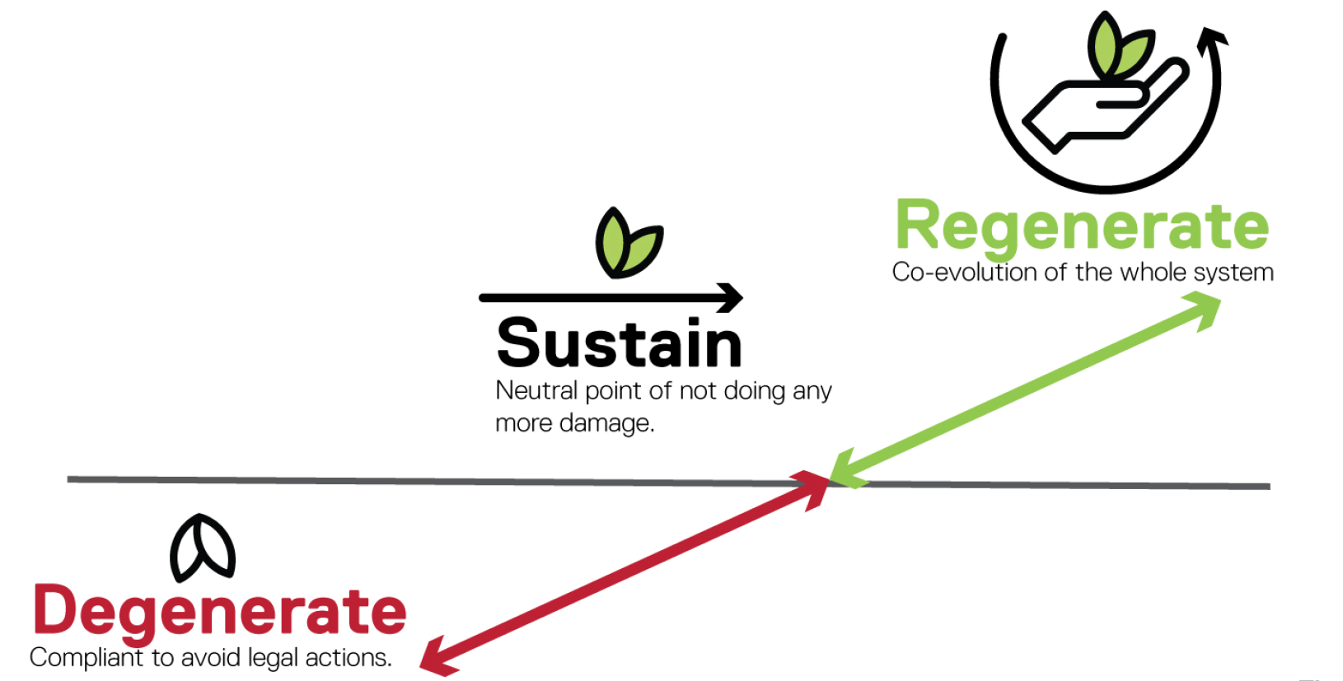
MAURI ORA
MAURI TU
MAURI HEKE
Notes:
We need to seek to find ways to co-evolve and bring health back living, thriving systems to all those places and spaces we love
True Regeneration moves beyond the idea of ‘sustainable development’ to strive for a future that is richer, healthier and more abundant through the evolution of natural, social, cultural and economic systems.
By viewing and treating these systems as nested and inextricably linked
Mana whenua state that we need to move beyond sustainability because the current is not pono.
I am pondering the potential to develop a relationship agreement with not only one another but with place
To treat as taonga and hold in higher regard than ourselves.

Slide 23
WHAKARITO
a regenerative practice
ME ANGA WHAKAMURI
ME ANGA WHAKAMUA
PŪRĀKAU
MAHITAHI
Place sourced
Community
Fed
PONO (WILL)
TIKA (FUNCTION)
MAURI ORA
HONONGA
© NativebyNature
TE WHAKARITO regenerative framework with Mauri Ora at
its core, uplifts the life essence and potential of deep connectedness across whole systems that calls forward the values of Pono (truth), Aroha (empathy) and Tika (right). Where a place sourced, culture led and community fed practice is possible, Pūrākau– the stories of place, Hononga – where indigenous values are embedded and cultures coalesce and Mahitahi – collaborative outcomes and where the magic happens
Culture Led
Notes:
I developed my own framework that I use as my whatu ariki (likened to those symbolic spiritual wayfinders on the front of the waka taua) brought about through my lived experiences and being circular and cyclic in nature allowing for all voices to be heard, sharing the mic and the pen.
Acknowledge Teina for sharing her interpretation of regeneration being whakarito, connected to Papatūānuku the centre shoot of the harakeke, flax bush reliant also on Ranginui to flourish and regenerate.
I’m (was) going to share a couple of those projects where my practice has been able to influence positive change – particularly as a Kaihautū Whakarito - regenerative practitioner

Slide 24
Placemaking is an approach where people work together to make places better, not only for themselves but for others and for the place itself.
Placemaking:
Is place sourced, culture-led, and community-fed.
Is inclusive and participatory.
Helps people express aroha, connection to their places, and in turn to each other.
Forges strong kaupapa/purpose.
Fosters learning by doing.
Values local knowledge and the lived experience of everyday people as well as their expertise.
Benefits everyone in a neighbourhood when places and people thrive together.
Involves people working together in place to make things better, for others and the place itself, now and into the future
It uplifts the mana/strength & mauri/spirit of communities, making them stronger and healthier: environmentally, culturally, socially and economically.
“INDIGENOUS PEOPLES DO NOT MAKE PLACE, PLACE MAKES US”
PLACE SOURCED
CULTURE LED
COMMUNITY FED
Notes:
In some instances, regenerative design and practice is simply about changing up the narrative.
What is our Aotearoatanga, our Aotearoa way of being? I like to call it the language of love. Aroha, tika and pono.
As a recognised placemaking thought leader and founding member for Placemaking Aotearoa, I expressed to the Placemaking founders based in the US that the term ‘placemaking’ is a bit hard on the ears because ‘indigenous peoples do not make place, place makes us’ and so working with organisations to best understand what that means has been an enlightening, growing and learning journey.
He Pia He Tauira – MW Rangatahi program leading PM activations and events across the region.

Slide 25
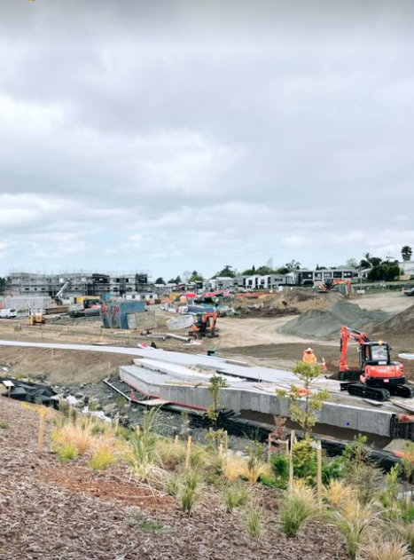
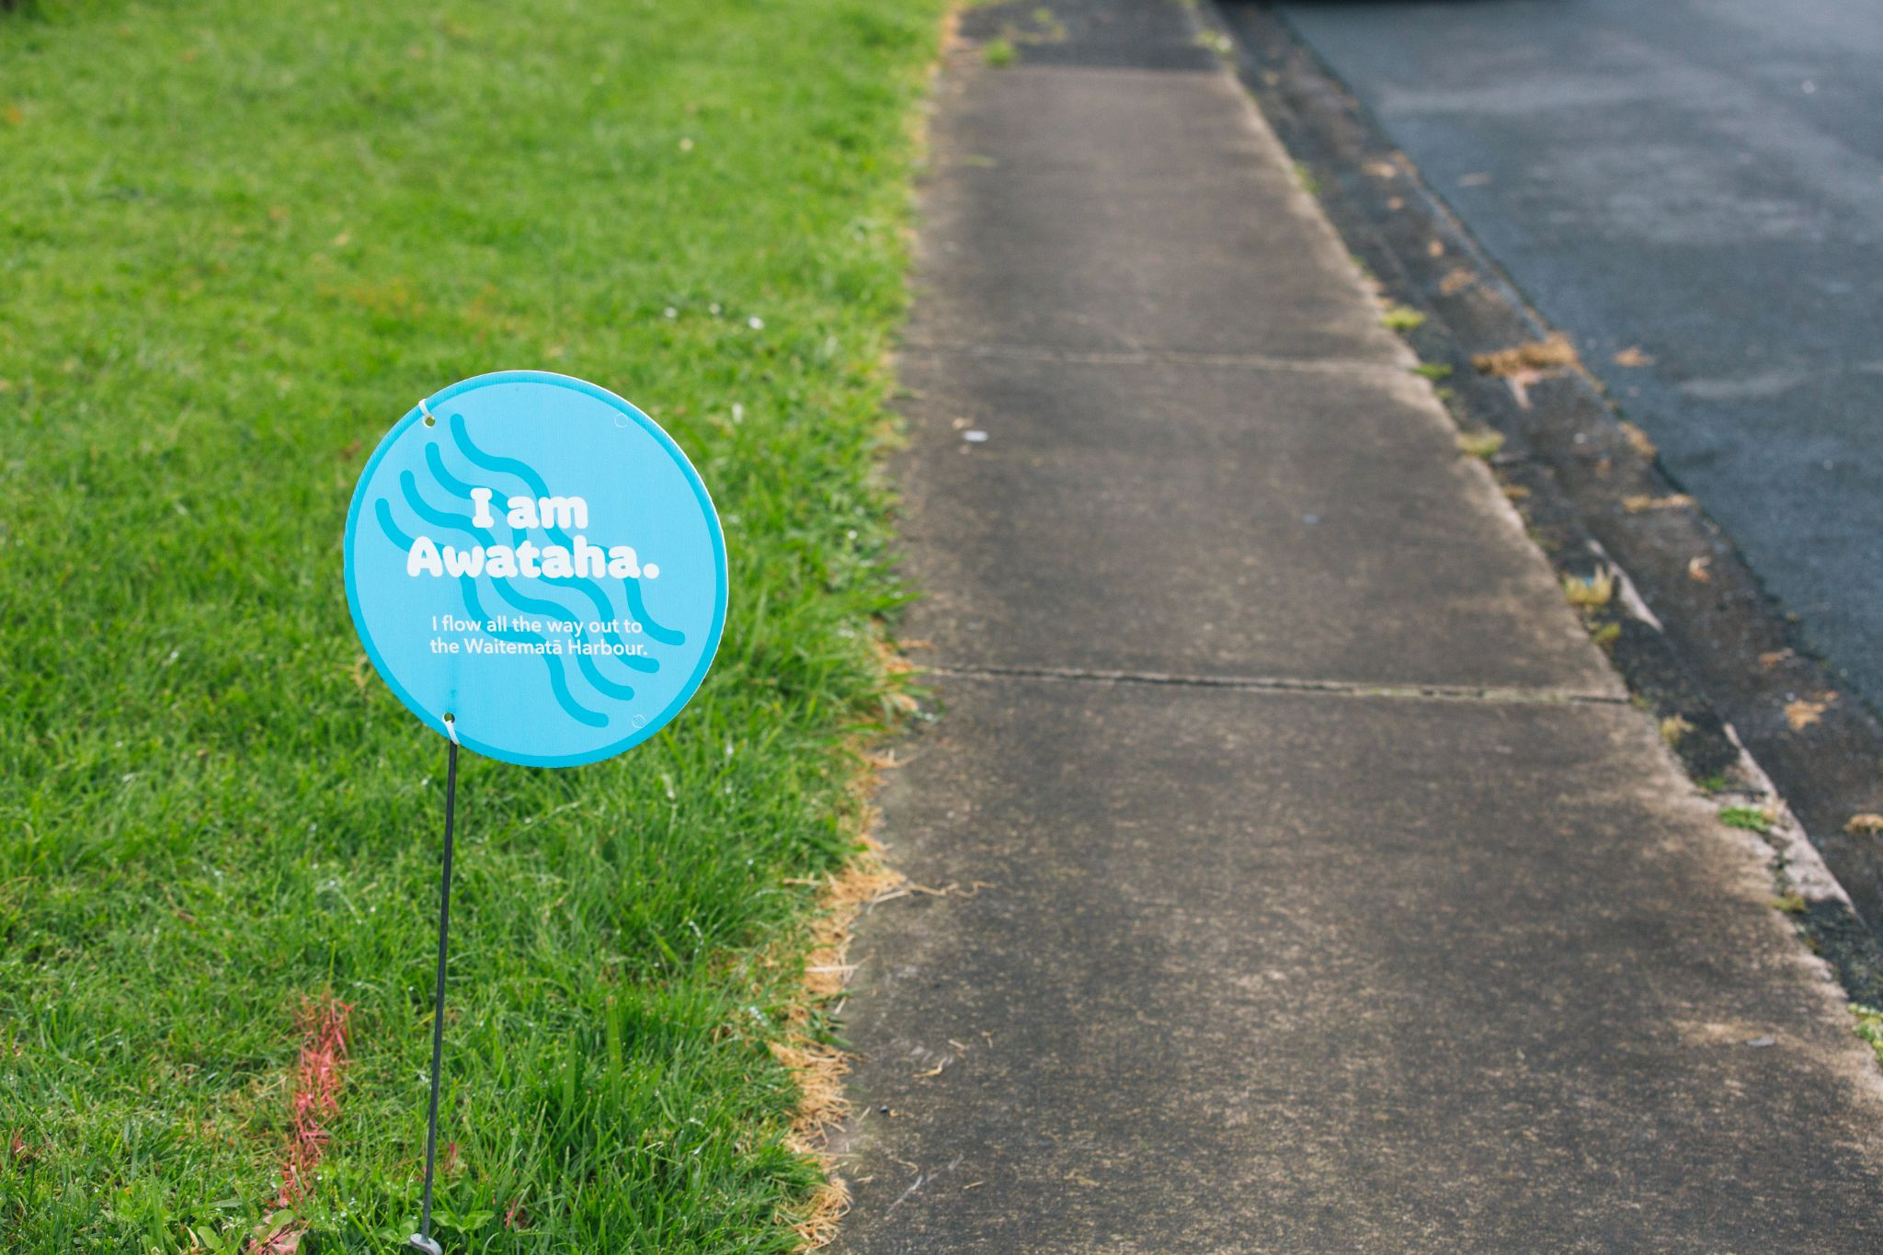
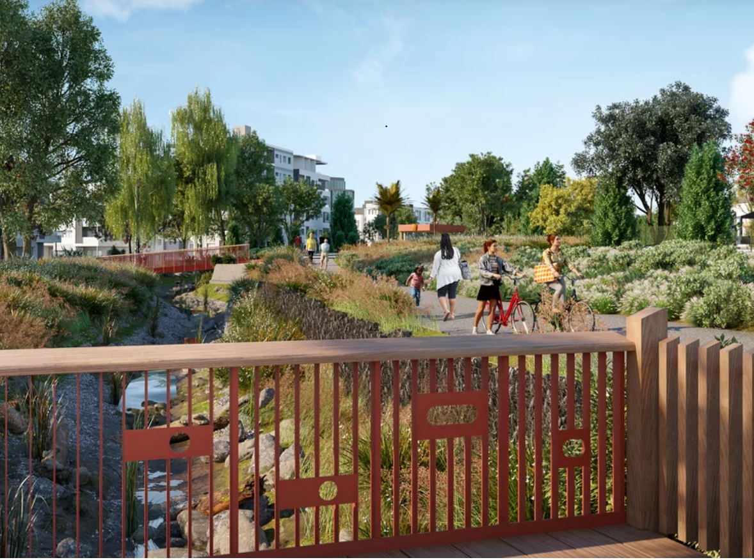
TE ARA AWATAHA, NORTHCOTE
“In order to daylight streams, we have to daylight minds”
Notes:
In 2015 I got the phone call…
Relationships are a beautiful thing. Mana whenua and Eke Panuku ensured that this Te Ara Awataha project captured the unique cultural narratives, kaitiakitanga values of this place. The design guide was based on the notion of weaving and a series of cultural health indicators, with a strong focus on healthy people and healthy environments called ‘Take Mauri Take Hono’ was developed by mana whenua specifically for this project.
At a community open day these placards were placed above the pipes that denied the Awataha to be a vibrant living waterbody. Many of the community didn’t know it existed. Circular ecology. Tu tonu te mana me te mauri o Te Awataha, she breathes..

Slide 26
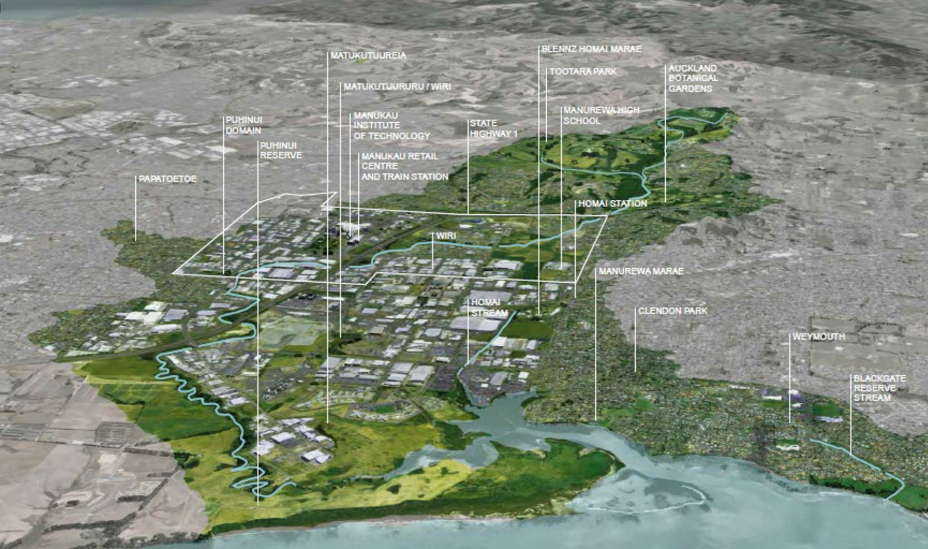
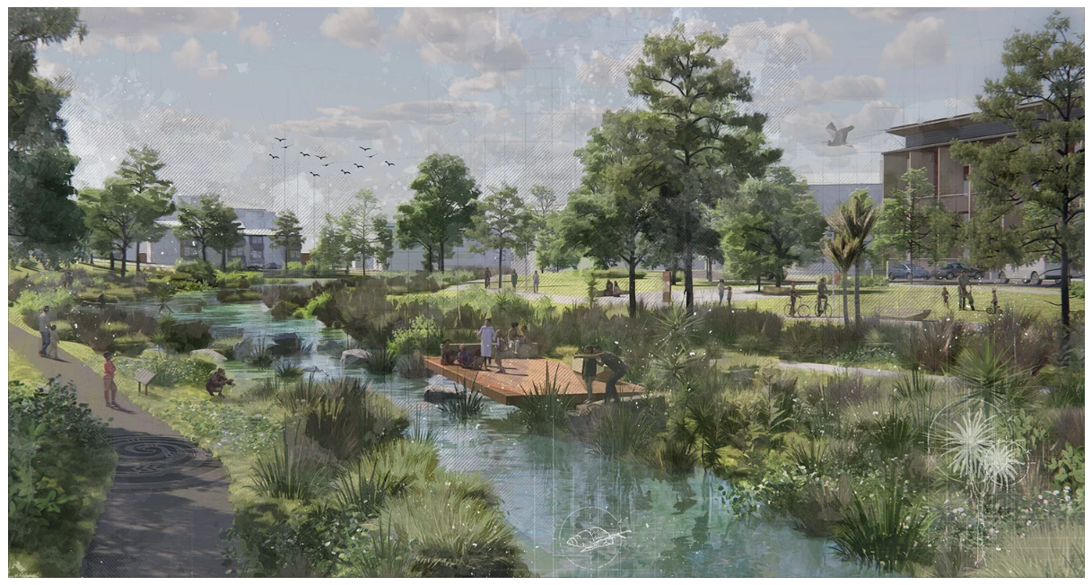
TE WHAKAORANGA O TE PUHINUI –
THE PUHINUI REGENERATION PROJECT
Mai i ngā maunga ki te moana
Notes:
In 2005 – with the Aunties around the Manukau city council mana whenua forum we advocated to do something about the dire state of this tupuna awa that ran from Totara Park, the botanic gardens, Huakaiwaka through residential, commercial, industrial and peri urban precincts out into the Manukau harbour captured in the Tomorrow’s Manukau Strategy.
Many years later the Puhinui Stream became the Eke Panuku’s Transform Manukau’s key move #1. The project scope being within this tshirt.
A 12km long stream in highly degraded catchment necessitating lots of hui and cuppa teas with local boards, govt ministries, community groups and individuals signing a Charter fully supporting this regeneration project.
Mana whenua’s initial response was, we can’t fix a stream in a box – and adopted a ‘mai i nga maunga ki te moana’ philosophy leading a ‘whole of systems’ approach to Te Whakaoranga o Te Puhinui.

Slide 27
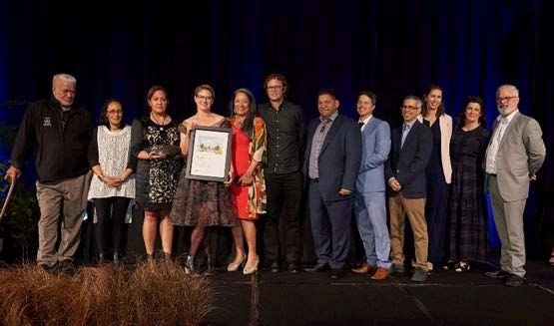
Te Whakaoranga o Te Puhinui – The Puhinui Regeneration Project
NZILA Charlie Challenger Supreme Award Oct 2022
Notes:
Last week the Puhinui Regeneration Project Strategy received the prestigious NZ Institute of Landscape Architecture’s Charlie Challeger Supreme Award.
I want to acknowledge those Ngāti Paoa and Waiohua kuia who just kept giving me all the jobs and in particular Kahurangi Nganeko Minhinnick instrumental in leading the Manukau Harbour claim Wai 08 that went on to influence the RMA. Te Huia who sits on the Taumata Arowai Māori Advisory – your Nan would be so proud of you.
I am absolutely humbled and priviledged to have traversed the places and spaces that I have and to have been and continue to be involved in phenomenal projects.. Projects have and will continue to take years but as a descendant of Tāmaki Makaurau, i’m not going anywhere but I am certainly taking my rangatahi on the ride.. To be ‘that aunty’ lol
What goes around comes around and for some of us it just keeps going... and giving. Some of us don’t have a choice.
What’s next for me? The exciting challenge and opportunity is how we bring a deeply regenerative practice to our business at Mott MacDonald that is intentional across our work to uplift these four wellbeings/broader outcomes and our relationships moving forward to be in service and to serve lots of cups of teas.
Regenerative practice starts with knowing self – Identity and core purpose,
the heart and love for place and for one another – We-dentity
Ko wai koe, ko wai au (waiata)

