Slide 1
Boosting Nitrogen Removal – Pilot trials with a Pure MABR
Presented by: Kevan Brian & Nadine Oschmann

Slide 2
Presentation Overview
Contributors/Acknowledgements
Background
What is an MABR?
Why we ran a pilot
Pilot overview and results
What next?

Slide 3
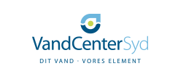
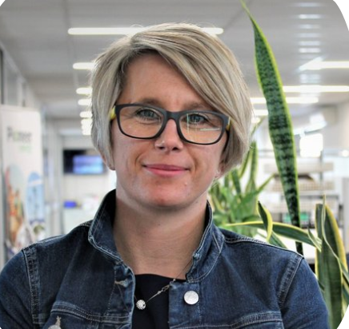
Contributors/Acknowledgements
Dr Jeff Peeters (Veolia WTS – Ontario Canada)
Matt Reeve (Veolia WTS - Ontario Canada)
Nadine Oschmann (Veolia WTS – NSW)
Dr Dwight Houweling (Dynamtia – Quebec Canada)
Dr Nerea Uni Carreno (Vand Center Syd – Copenhagen Demark)
Dr Alzbeta Bouskova (NZ)

Slide 4
Background
Notes:
Oxidation Ponds can struggle with removing nitrogen – particularly nitrogen
Typical upgrade pathway is activated sludge – lots of MBR – could plug that I did these first as well!
Watercare wanted to look at alternatives to upgrading ponds with activated sludge or if activated sludge was needed could it be smaller and more efficient
Mention wellsford as the plants where the challenge was initially focused – this developed into wider plants at Te Kauwhata and Hellensville

Slide 5
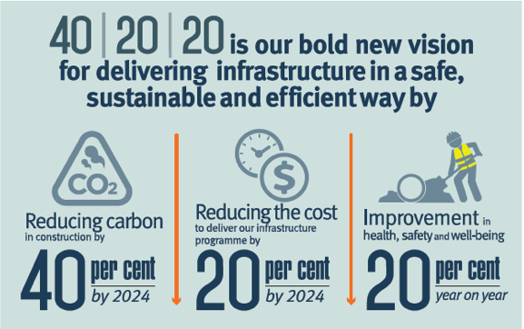
What we were looking for
We wanted a process that was consistent with 40/20/20 principles – and our journey to net zero emissions:
Something that uses less carbon to build
Could be built offsite (safer/faster)
Repeatable – can build many using the same design
Low energy consumption
Low N2O emissions
Needs less site preparation (faster/safer/cheaper)
Notes:
Shallower tanks for ground conditions at TK
N2O in general
Power consumption for road to net zero
40/20/20 principles and how to do more with less

Slide 6
What MABR Offers
Compact process
Can be built in shallow steel tanks
Uses 3-5 times less aeration energy than activated sludge
Reported as having lower N2O emissions than activated sludge
Notes:
A competitive process between two main suppliers was run for TK to select a technology partner.

Slide 7
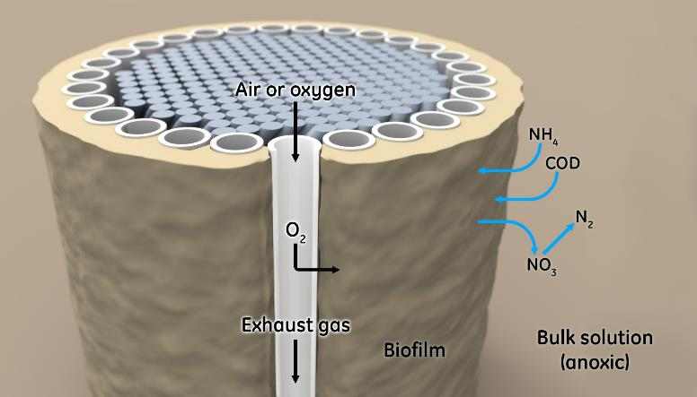
What is MABR?
highest efficiency of oxygen transfer by diffusion of O₂ into a biofilm
Notes:
Nadine to start here

Slide 8
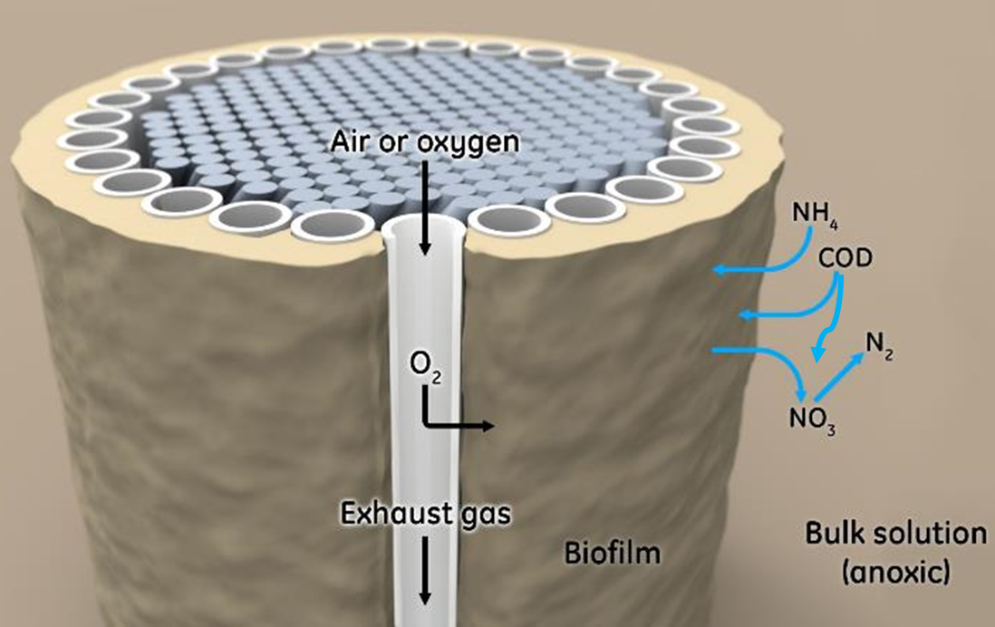
What is MABR?
Bugs grow on membrane fibre (looks like hollow spaghetti)
Oxygen diffuses through the membrane into the biofilm
Biofilm grows on the outside of the membrane
It’s NOT a filter
It’s NOT an aeration diffuser
No backwash
No CIP or chemical cleaning

Slide 9
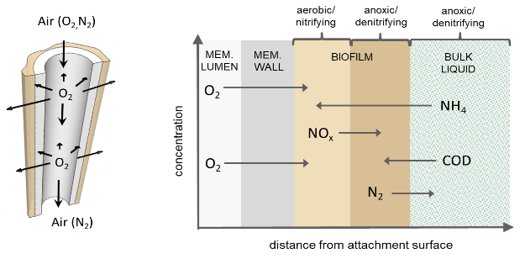
What is an MABR?
media-supported biofilm with its own built-in O₂ supply
counter-diffusional biofilm with “magical” properties
For more information on the unique properties of counter-diffusional biofilms see Downing and Nerenberg (2008) Applied Microbiology and Biotechnology, 81:153–162
Notes:
Inside of Biofilm can nitrify – close to oxygen
Outside of biofilm can denitrify – close to carbon and nitrate
Process can therefore nitrify and denitrify in the same place at same time without the need for separate anoxic or aerobic zones

Slide 10
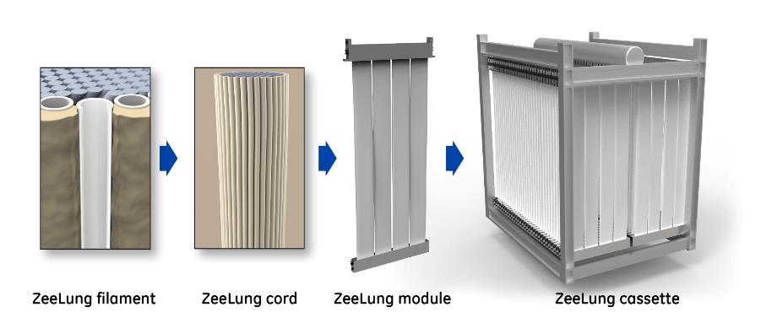
What is an MABR?

Slide 11
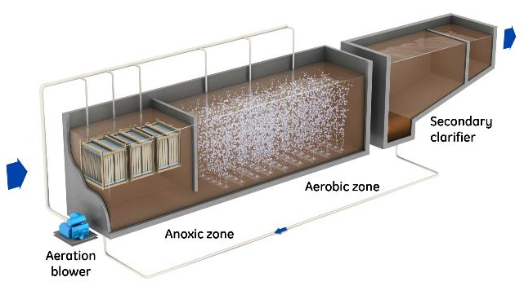
What is an MABR?
Typical application of MABR is to increase capacity of activated sludge.
Pure MABR has no mixed liquor, no recycle and only has a biofilm for treatment
This mode is very new (we are the first to try it at this scale)
Ideal as a one pass process for lagoons to remove nitrogen
Notes:
Biofilm operation:
Typical application of MABR is to increase capacity of activated sludge. Membranes go in the anoxic zone and have mixed liquor around them
Biofilm only mode has no mixed liquor, no recycle and only has a biofilm for treatment
This mode is very new (we are the first to try it at this scale)
Ideal as a one pass process for lagoons to remove nitrogen

Slide 12
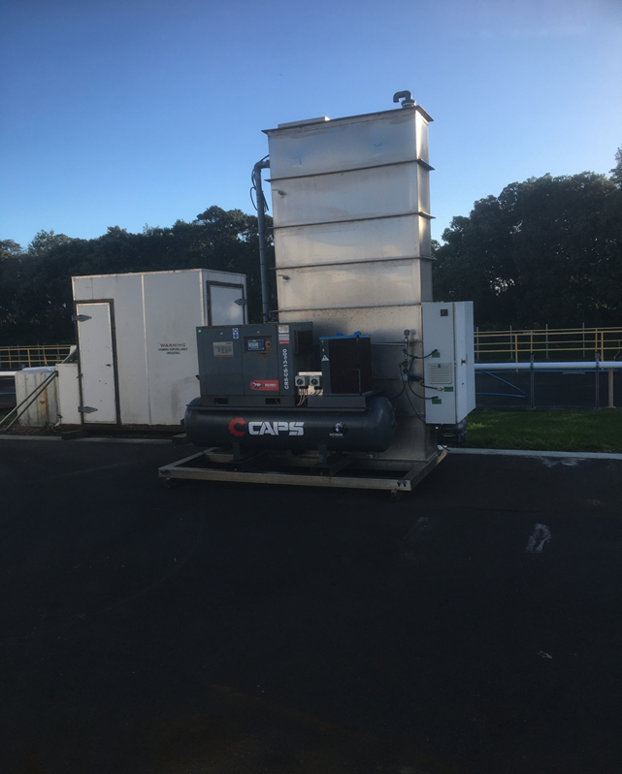
Why Pilot?
Test if we could get the process to work as Pure MABR
Measure aeration efficiency
Measure N20 Emissions
Determine how difficult (or easy) MABR is to operate

Slide 13
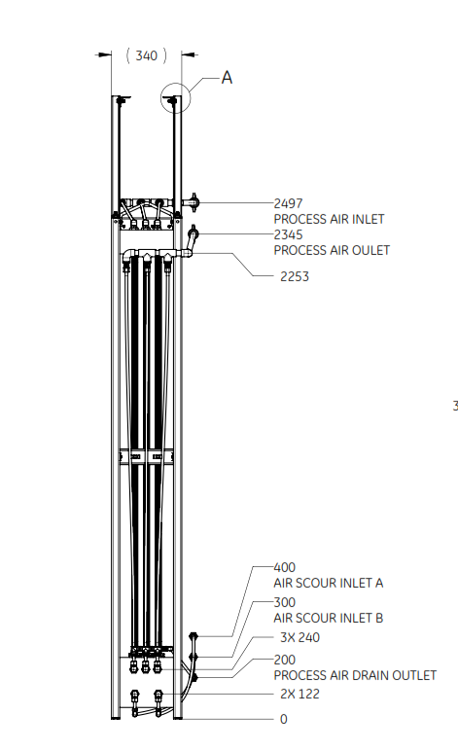
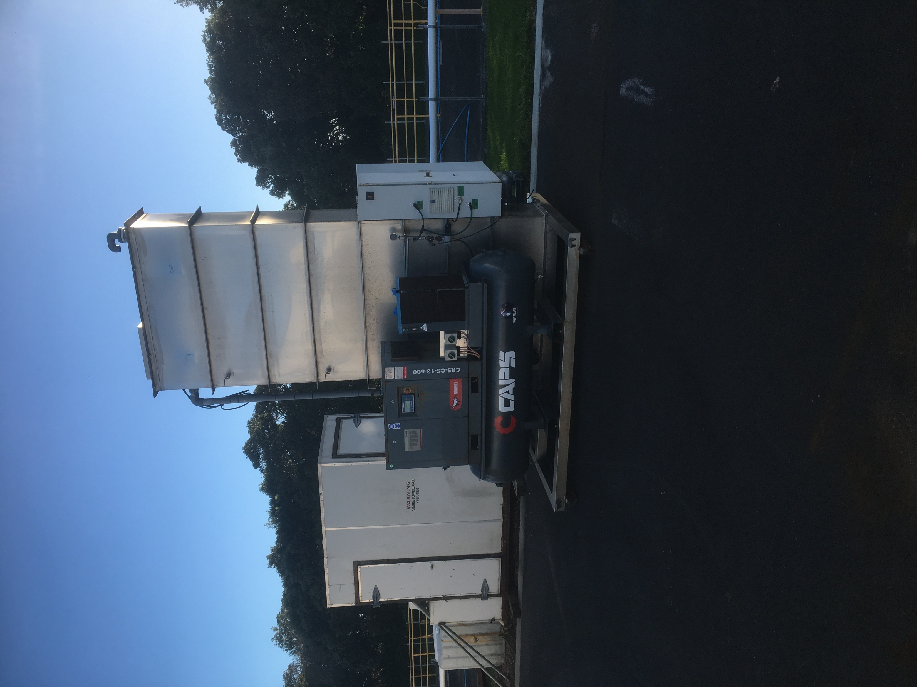
Pilot Plant Set up
3 ZeeLung Modules
120m2 ZeeLung area
Pilot influent flow 6-11m3/d
Process airflow 5L/min or 0.55Nm3/hr
Offgas Oxygen monitored continuously
Air supply via compressed air
Inlet Pressure ~ 0.7bar
Exhaust Pressure - 0.25-0.3bar

Slide 14
Monitoring
Daily Inflow
Inlet and Outlet Ammonia
Inlet and Outlet Nitrate/nitrite
Inlet and Outlet COD, CODf, CODff, TSS,VSS
Exhaust gas Oxygen for OTE%
Exhaust gas CO2 & N2O
Process air flow and pressure
Scour and mixing air rates and frequency

Slide 15
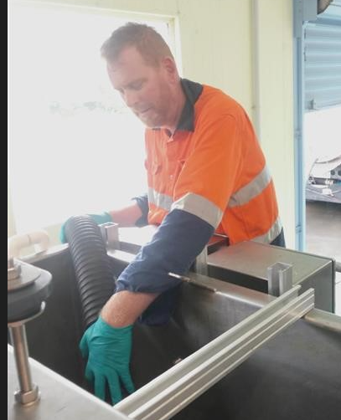
Results
Is MABR easy to Operate? – Yes it is! Even this guy can run it!
no DO probes
No recycles
No SRT control
No settling
YES!!

Slide 16
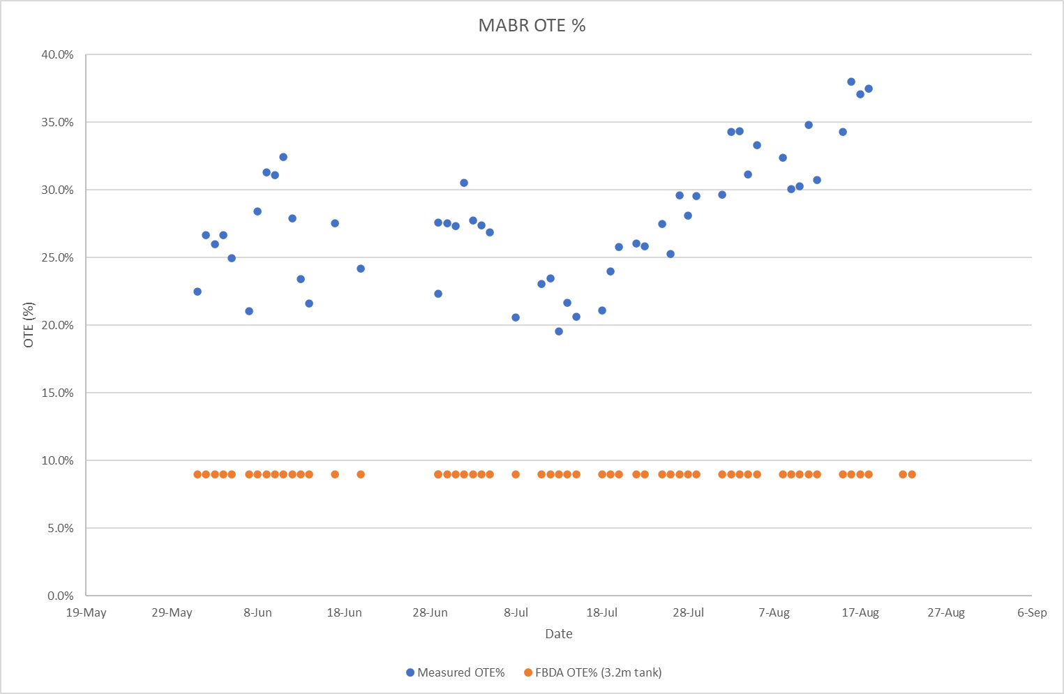
Results
Higher OTE% = Less Power for aeration

Slide 17
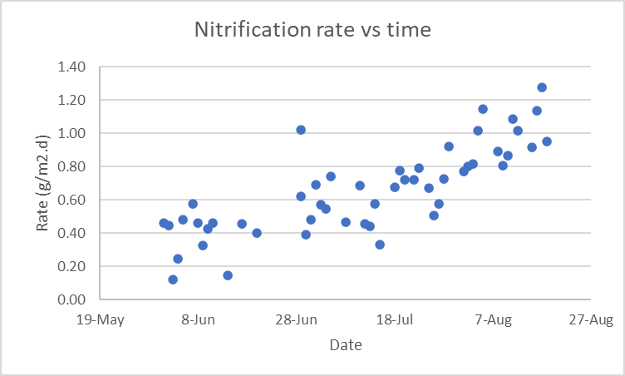
Results
Nitrification – It Works! Rates lower than expected but still OK

Slide 18
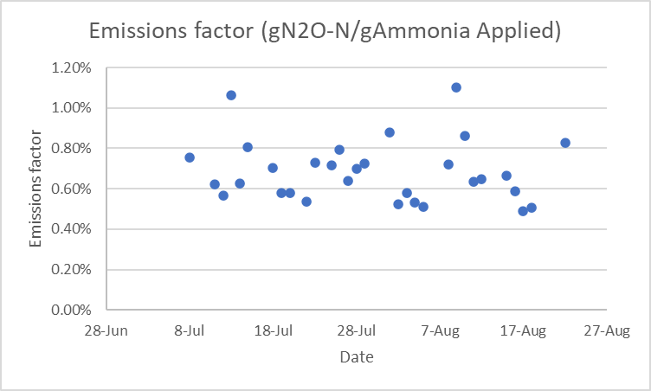
Results
Emission Rates lower than IPCC Factor for high rate systems

Slide 19
Future Work
Based on results of this trial the first Pure MABR in the world* of this scale is being built in Helensville – finished end of 2022
Te Kauwhata – Hybrid plant in design
Several others being considered
More results to publish on N2O, operating parameters, sulphur cycle

Slide 20
Boosting Nitrogen Removal – Pilot trials with a Pure MABR
Presented by: Kevan Brian & Nadine Oschmann

