Slide 1
Water New Zealand Conference
Bill Bayfield | Chief Executive 26 May 2022
Notes:
Tēnā koutou katoa
Nō Ingarangi ōku tipuna.
I whānau mai ahau i Ghana, Africa.
Heoi, i tipu ai ahau i raro i te maru o Taranaki Maunga,
Ki te taha o Waiongana iti awa, i raro i te mana o Te Atiawa.
Kei Te Whanganui-a-Tara au e noho ana ināianei me taku hoa Rangatira, Maggie.
Ko wai ahau? Ko Bill Bayfield, te Tumu Whakarae o Taumata Arowai.
Kia ora, I’m Bill Bayfield, the Chief Executive of Taumata Arowai, the new water services regulator for Aotearoa
It’s a pleasure to have this opportunity to speak to you today
This is a significant moment in time
I’ve spent the bulk of my career in local and central government working with the water services sector and in environmental management.
What I’ve seen is that critical three waters services can often be taken for granted – out of sight out of mind.
As a sector – It’s our chance to lift the performance and shine a light on these critical services - as a CE of a dedicated water services regulator - it’s a huge privilege to play a role in this.

Slide 2
Ko wai, ko au, ko tātou
Ko te wai ahau, ko ahau te wai.
He whakaaturanga tātau nō te wai.
Ko te ora te wai ko te ora o te tangata.
He taonga te wai me tiaki.
Ko wai tātou.
Ko wai tātou.
I am wai, wai is me.
We are reflections of our wai.
The health of te wai is the health of te tangata.
Wai is a taonga that must be protected.
Ko wai tātou.
We are wai. Wai is us.
Notes:
Tēnā koutou katoa
Nō Ingarangi ōku tipuna.
I whānau mai ahau i Ghana, Africa.
Heoi, i tipu ai ahau i raro i te maru o Taranaki Maunga,
Ki te taha o Waiongana iti awa, i raro i te mana o Te Atiawa.
Kei Te Whanganui-a-Tara au e noho ana ināianei me taku hoa Rangatira, Maggie.
Ko wai ahau? Ko Bill Bayfield, te Tumu Whakarae o Taumata Arowai.
It’s a pleasure to be here

Slide 3
Six months after going live and…
Notes:
Still feels like we’re building a plane while flying it

Slide 4
What the Water Services Act means for suppliers
4
All drinking water suppliers have a duty of care to supply safe drinking water and comply with Drinking Water Standards.

Slide 5
Giving effect to Te Mana o te Wai
5
Notes:
Bill
Any highlights from the workshop yesterday
Before the plane Duty of care slide.

Slide 6
Registered supplies, framework so far
6

Slide 7
Registering & verifying drinking water supplies
1,969 registered supplies were migrated from the Ministry of Health to Hinekōrako, our online self-service portal.
Each supplier needs to log in to complete their registration and check and validate the details for each supply.
Some are complex, some easy.
We’ve almost completed the process for the 534 council supplies.
We’re working through re-registering 1,436 other, mostly small registered suppliers.

Slide 8
Council supplies serve most of the population
Who manages registered supplies?
Population served by registered supplies
27%
96%
Notes:
NOTES FOR BILL:
There are 1969 supplies in our register.
27% (533) of these are council supplies
These council supplies serve 96% of the population served by registered supplies (83% of total pop)

Slide 9
Council verification is almost complete
Verified Council Supplies
Verified Non-Council Supplies
10%
37%
53%
96%
Notes:
Of those 534 council supplies, 95% have completed your registration in Hinekōrako 26 supplies remaining from 11 suppliers:
Queenstown Lakes District Council, South Waikato District Council, Waitaki District Council, Hutt City Council Horowhenua District Council, Auckland Council Manawatu District Council, Central Hawke's Bay District Council, Whanganui District Council, VEOLIA WATER SERVICES (ANZ) PTY LTD, Tauranga City Council
NOTE: THIS INCLUDES ALL COUNCIL SUPPLIES – meaning councils have been GOOD at registering ALL of their supplies (only 12council supplies >500 and 11 council supplies > 750 are not registered)
Of the 534 Council Supplies 286 (54%) are <500; 319 (60%) are <750
Of the 1436 Non Council 34 (2%) > 500; 27 (2%) are <750
Of the 952 Non Council / Non Gov 17 (2%) > 500; 14 (1%) are <750
53% To Invite means that we’re still not sure who 53% of the REGISTERED supplies are!

Slide 10
Chasing the long tail…

Slide 11
Congratulations & thanks for all your support
The next challenge is drinking water safety plans! More on that later.
Notes:
Thanks for your support

Slide 12
Our emerging framework
12

Slide 13
Establishing a balanced regulatory approach
We’ve worked on three key documents with our Board and Te Puna and presented them to the Minister, Hon Nanaia Mahuta
Statement of Intent (SOI)
Statement of Performance Expectations (SPE)
Compliance, Monitoring and Enforcement (CME) Strategy
They’ll be available on our website in late June or July 2022
Our first CME strategy articulates our regulatory approach
It clearly lays out what suppliers can expect from us.
It can be updated at any time, but we must review it every three years.
This is important as we’ll continue to update as we learn from the sector.
The scope is drinking water (not stormwater or wastewater).

Slide 14
Learning from public consultation
We’re busy processing all the feedback from our public consultation on the following proposed documents:
Drinking Water Standards
Drinking Water Quality Assurance Rules
Drinking Water Aesthetic Values
Drinking Water Network Environmental Performance Measures
Drinking Water Acceptable Solution for Roof Water Supplies
Drinking Water Acceptable Solution for Spring and Bore Water Supplies
Drinking Water Acceptable Solution for Rural Agricultural Water Supplies
This is the first of many consultations. Thanks for your valuable input!!
We’re aiming to publish these as soon as possible to give suppliers time to consider when developing drinking water safety plans.

Slide 15
Timeframes
 | Publicly available | Come into effect
Drinking Water Standards | June 2022 | Later in the year on a date to be confirmed
Drinking Water Quality Assurance Rules | July 2022 | Later in the year on a date to be confirmed
Drinking Water Aesthetic Values | June 2022 | Later in the year on a date to be confirmed
Drinking Water Network Environmental Performance Measures | Guidance to support reporting will be published late-June 2022 | First reporting period begins on 1 July 2022
Drinking Water Acceptable Solutions | To be confirmed | To be confirmed
Notes:
Plan is for the commencement of standards/rules/aesthetic values to be aligned: i.e. coming into force on the same date, even though they will be made on slightly different dates.
Ash comment: The specific timeframes here are still subject to Cabinet decisions (scheduled to be considered in early June). There's a risk about publicising them before that happens, especially if DIA isn’t aware and comfortable with that. Bill's call ultimately, but an alternative would be to indicate that the standards/rules/values will come into effect later in the year on a date still TBC
Can also safely say that the plan is for the commencement of standards/rules/values to be aligned: i.e. coming into force on the same date, even though they will be made on slightly different dates

Slide 16
Guidance for drinking water safety planning
All registered suppliers need to submit a Drinking Water Safety Plan or comply with an Acceptable Solution by 15 November 2022.
We’ve published guidance on our website to help suppliers with drinking water safety planning and source water risk management planning.
We’ll provide templates to help small and very small registered supplies prepare their plans – available on our website in June this year.
Larger suppliers (500+) should be familiar with drinking water risk management and be well placed to provide Drinking Water Safety Plans by 15 Nov.
We’ll support you all through this process.

Slide 17
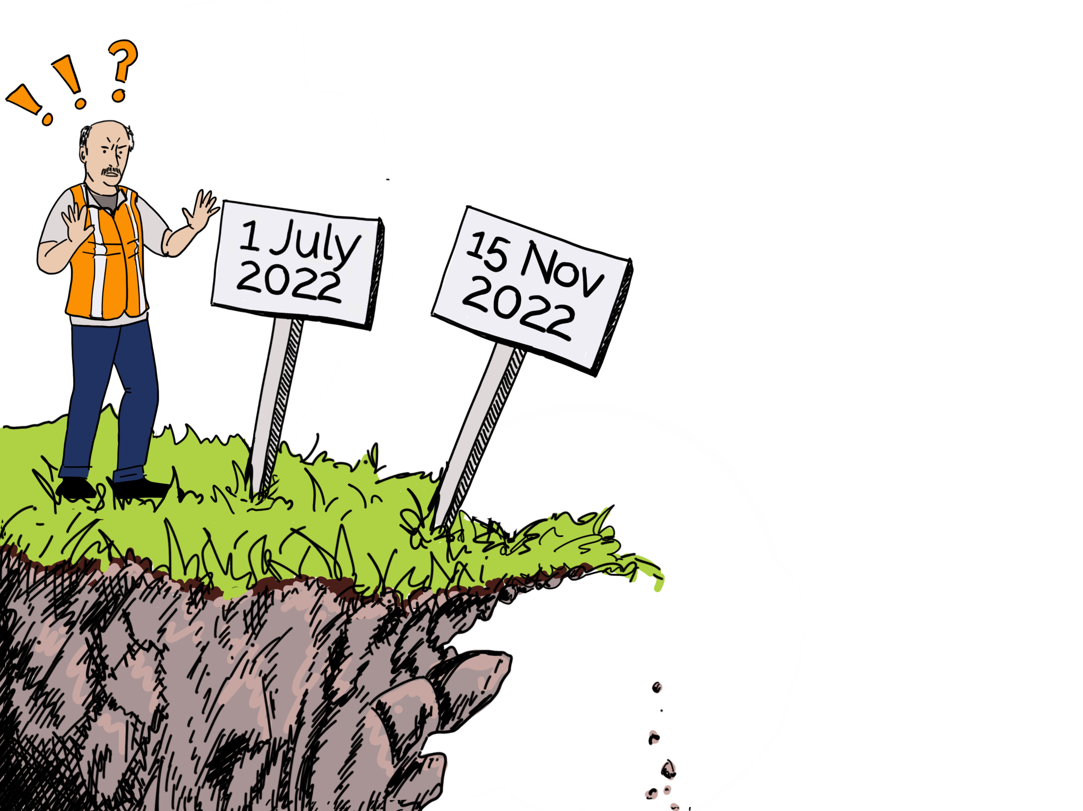
Common misconceptions
If your supply is registered and you don’t have an exemption, you must chlorinate by 1 July 2022….
15 November 2022…

Slide 18
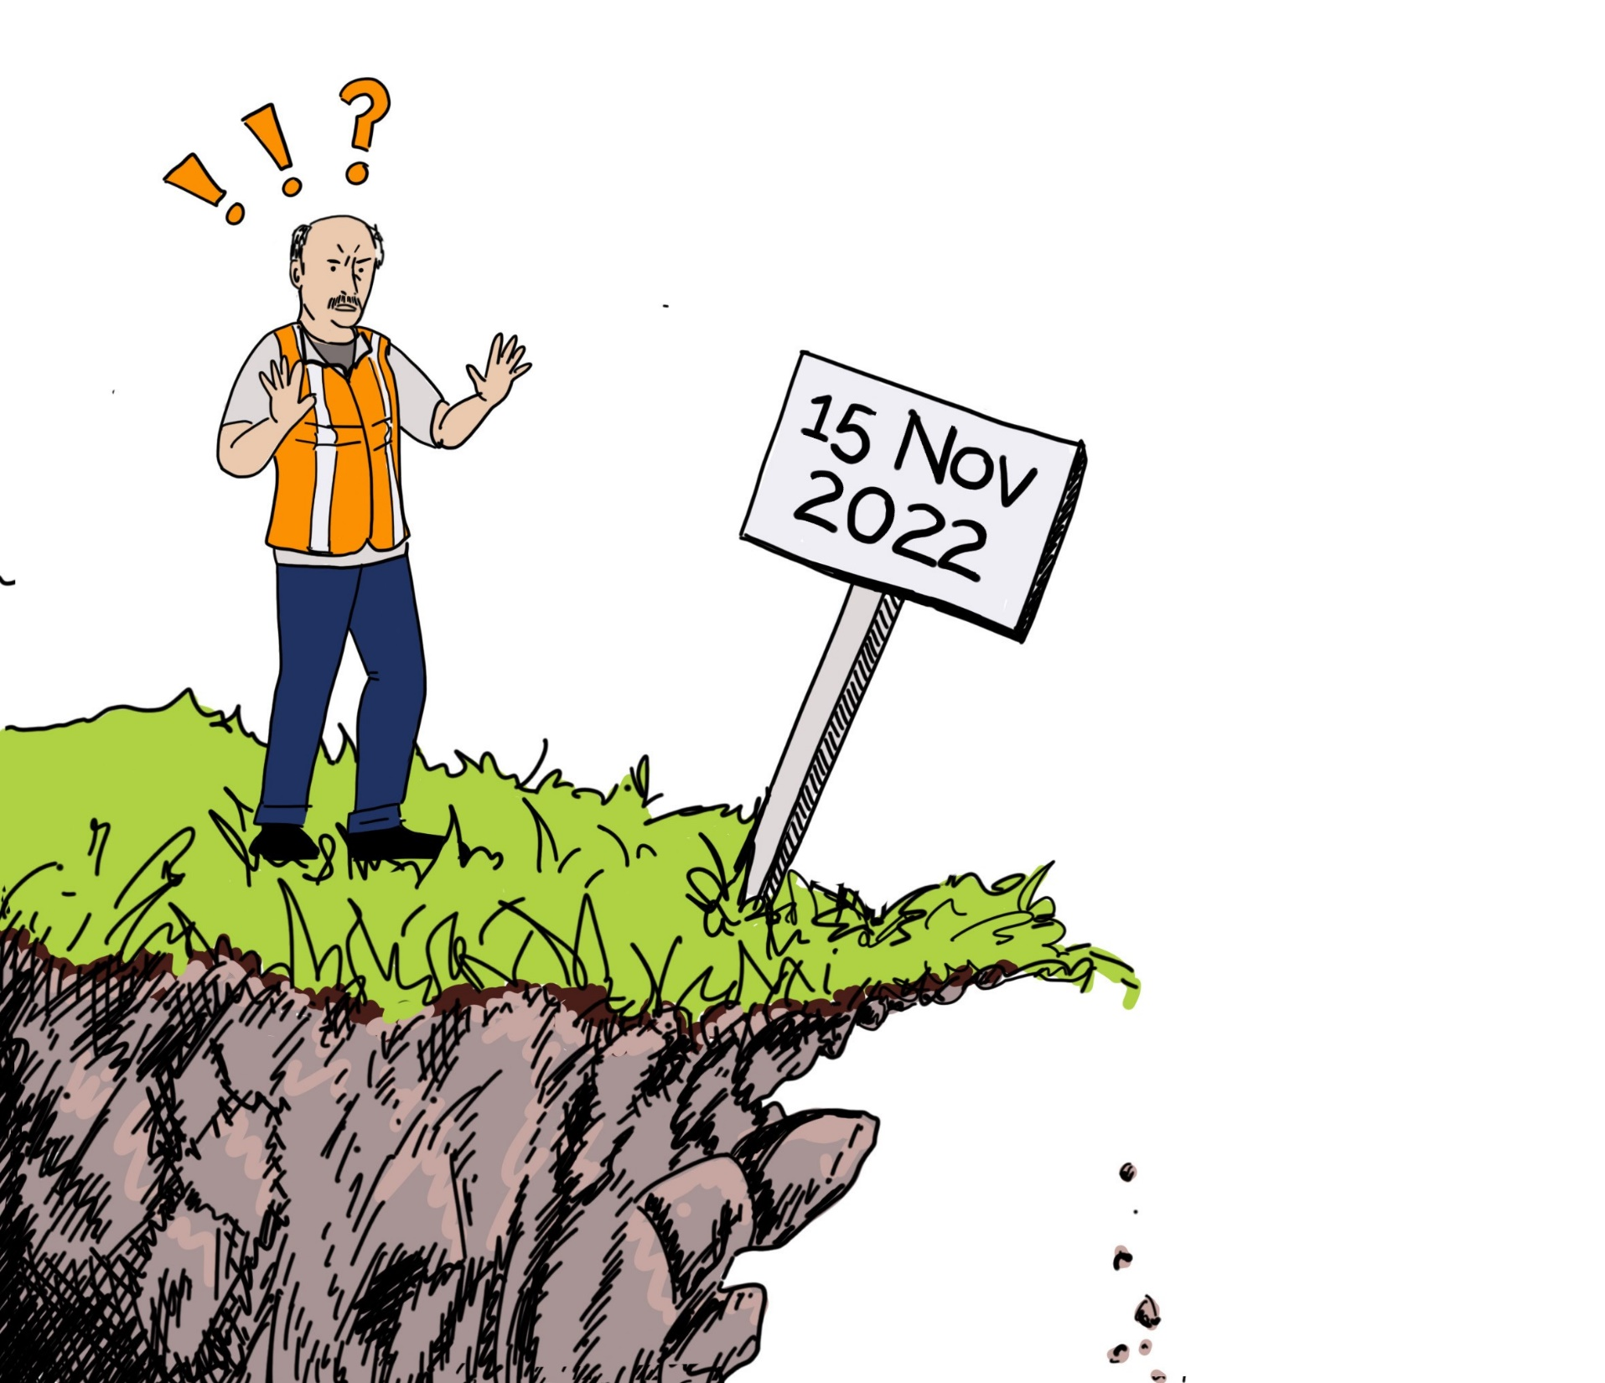
Common misconceptions
If you’re a registered supplier, you must resolve all the issues with your drinking water supplies by
15 November 2022

Slide 19
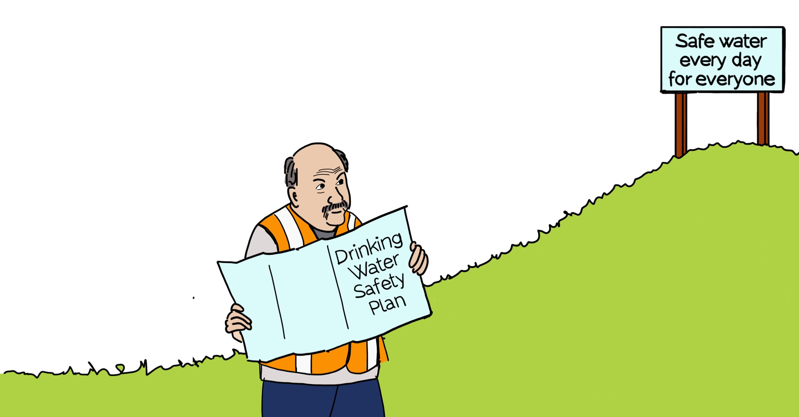
A continuous process of improvement
We don’t expect you to be perfect immediately! You still need to manage your risks and provide safe drinking water. Submitting your drinking water safety plan is a milestone in a continuous process of improvement.
Your Drinking Water Safety Plan should cover:
What your risks are
What your challenges are
Your timeline for meeting your risks and challenges

Slide 20
Unregistered water suppliers
20

Slide 21
Timeline
Unregistered drinking water suppliers have plenty of time. Up to four years to register and a further three years to fully comply with the requirements of the Water Services Act 2021.
These timeframes provide an opportunity for Taumata Arowai to work with our unregistered community to understand their needs and circumstances, and we are.

Slide 22
Unregistered pose our biggest challenge
Who manages supplies?
(including unregistered)
Population served by supplies
(including unregistered)
97%
86%
Notes:
Assuming 75K unregistered serving 500K people
NOTE: The absolute population served by councils is the same, the % population reduces, as the total population served by supplies increases

Slide 23
Rural Services Technical Working Group
The Three Waters Rural Supplies Technical Working Group was tasked by the Minister to provide advice to support policy development for rural drinking water supplies and rural communities.
The Group is expected to report in June.
Drawing from the concerns voiced by rural water suppliers the Group has been focused on two key issues of direct relevance to Taumata Arowai.
Mixed-use rural schemes
Very small supplies
Notes:
the Three Waters Rural Supplies Technical Working Group Working Group (Rural Group) was established, comprising members with experience in rural supplies and rural marae and papakāinga drinking water schemes. The Rural Group was tasked with identifying advice to support policy development related to rural drinking water supplies.
The Rural Group have engaged constructively as a group on the challenge and continue to believe strongly that transformational change in New Zealand's approach to management of the Three Waters is required.
Recommendations have been made that the Rural Group believe will result in the new approach more successfully addressing many of the concerns raised in relation to rural supplies and rural marae and papakāinga drinking water schemes.

Slide 24
Rural Services Technical Working Group
The Working Group has been focused on:
Recognising the need for mixed agricultural water and drinking water supplies to be able to access appropriate regulatory approaches.
Developing options to reduce the regulatory burden for small and very small suppliers.
A close examination of definitions that may constrain or allow the development of appropriate regulatory tools.

Slide 25
Common misconceptions
Unregistered drinking water suppliers have until November 2028 to supply safe drinking water.
All drinking water suppliers have a duty to provide safe drinking water right now.
It might be smart to take a test or two.

Slide 26
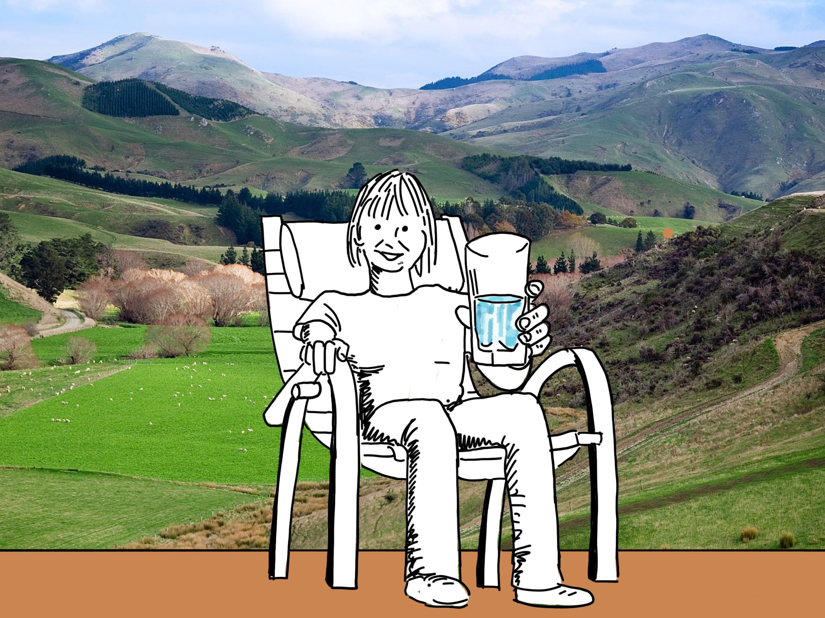
Next challenge for unregistered suppliers
Notes:
Stay in touch with us and your representative organizations
Maybe take a test or two over the coming years.

Slide 27
What’s next?
Three Waters Reform will have a big impact on our Kaupapa.
Our wastewater and stormwater functions commence in 2023.
Resource Management Act reform.
We need to work closely with the Department of Internal Affairs, the Ministry for the Environment, Iwi/Māori, local government and other stakeholders to understand these initiatives and work out how we fit with them successfully.

Slide 28
Ngā mihi maioha – thanks for your support
Notes:
Ngā mihi maioha – thanks with appreciation

