Slide 1
Airing our dirty laundry – an open account of our I&D journey
Becky Macdonald and Kate Simmonds

Slide 2
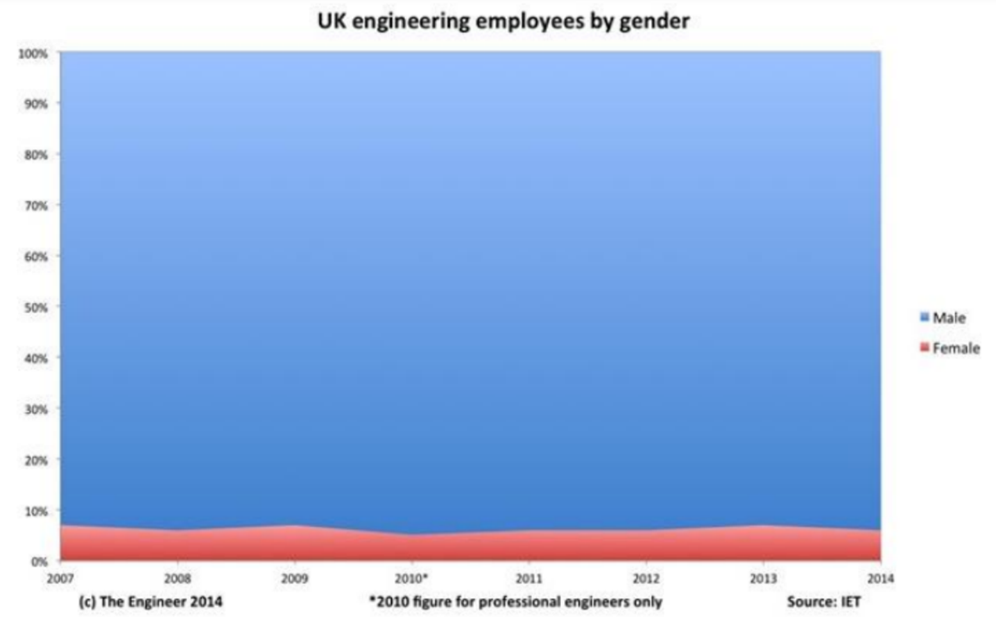
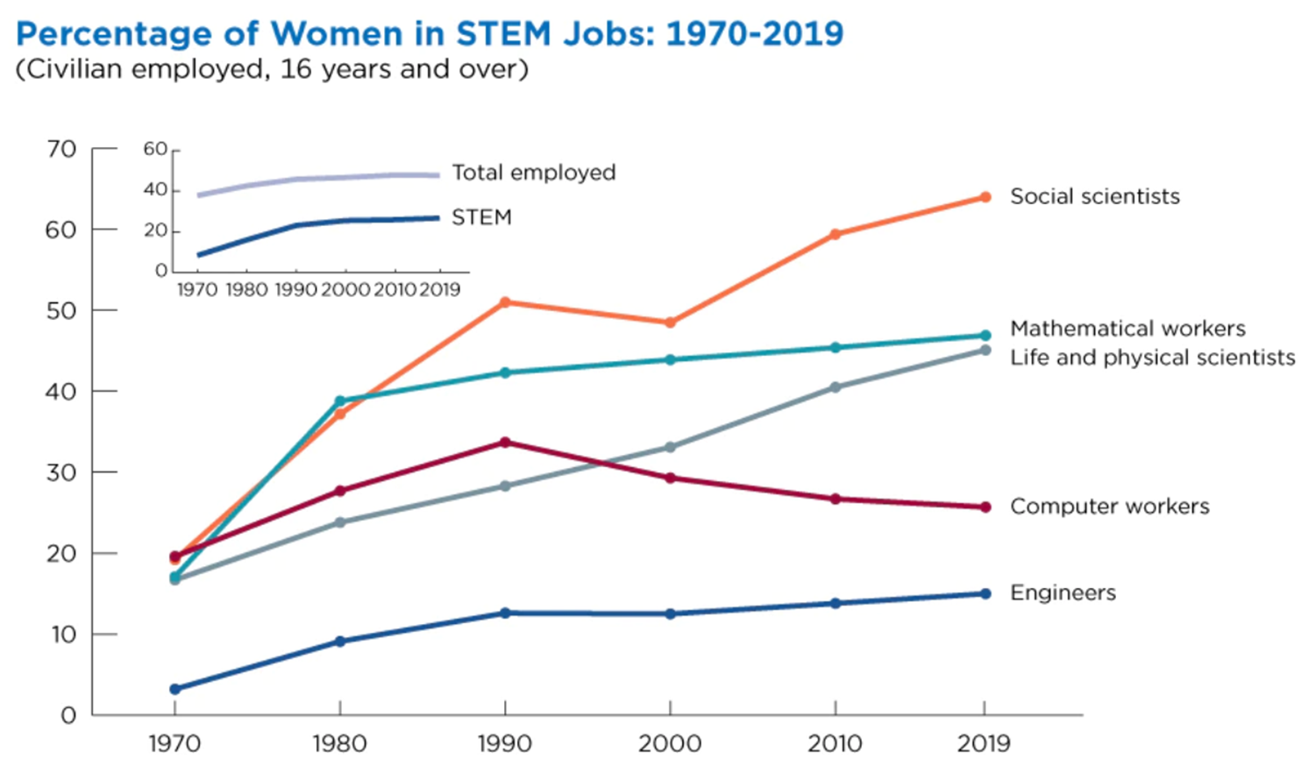
Introduction
Notes:
Today talk about our I&D journey at Jacobs. While our focus globally is on a broad diversity spectrum, today we are focussing on gender.​
Why is this even a topic for a paper? Things are getting better aren’t they? ​
No. has increased a lot in 50 years (from 3% to 15% globally on average). However, since 90’s No. has plateaued, only increasing by about 2% in the past 30 years. Will take 2 centuries for us to get to 1 in 3 engineers being women. Long way to go.​

Slide 3
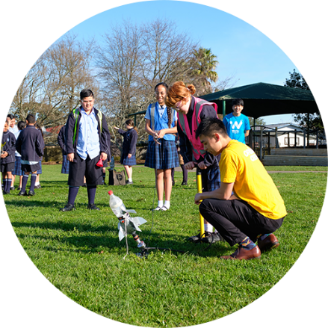
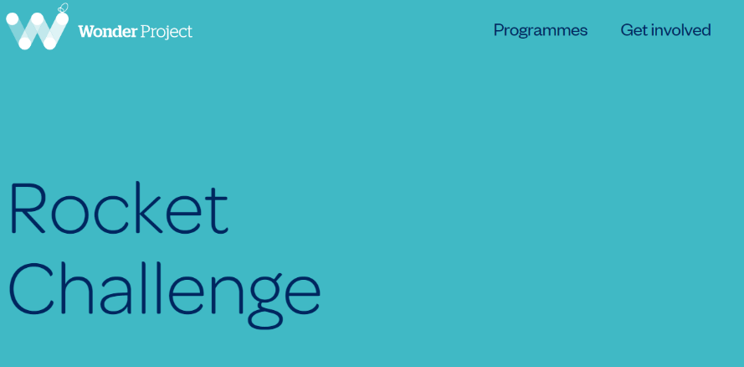
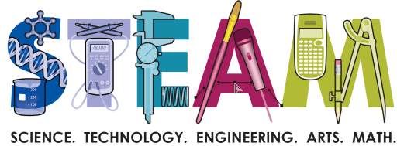
Scene Setting
Female Engineering Graduates
1954 = 1%
2020 = 23%
Female Engineering Graduates
Mechanical = 16.5%
Chemical = 37.7%
Female Engineers
2001 = 10%
2019 = 14%
~1 in 3 women leave engineering careers
Notes:
Becky
Global focus
Low numbers enter engineering and other STEM related degrees at Uni.
Attracting women to engineering. Need to do this young.
Focus on schools etc – lots of work on attracting students to STEM and we should support this. Rocket challenge etc.
We all have a role to play and should be advocates / role models / allies.
“It is our responsibility to support and promote our industry in schools, to better educate our youth about the opportunities that our sector can provide, and show that it is a space where diversity is being increasingly embraced”.
Perhaps a bigger concern than low #’s entering is the # leaving the industry (approx 1 in 3) – this is something we as an industry can address
Lead into next slides – so what does the impact of the lack of focus STEM look like

Slide 4
Scene Setting
Notes:
Really concerning statistic - Let it sit with you– 1/3 leave. Why do we care? Engineering is #1 skill shortage sector in NZ. Women = half possible work force. If we can increase that’s a lot more skilled resources. Will take time - 20 years. We need something more urgently​. Retention important and an obvious place to start​. As an industry need to make engineering a space women want to stay​.
We will share some actions to improve our gender balance and retention.​ deliberate and intentional.
But before we move into solutions, need to understand the issue.

Slide 5
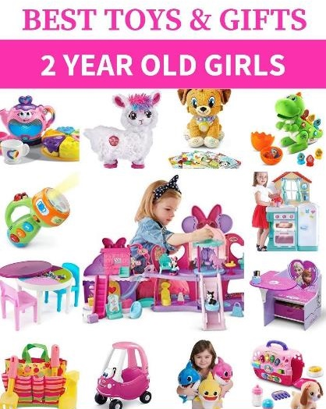
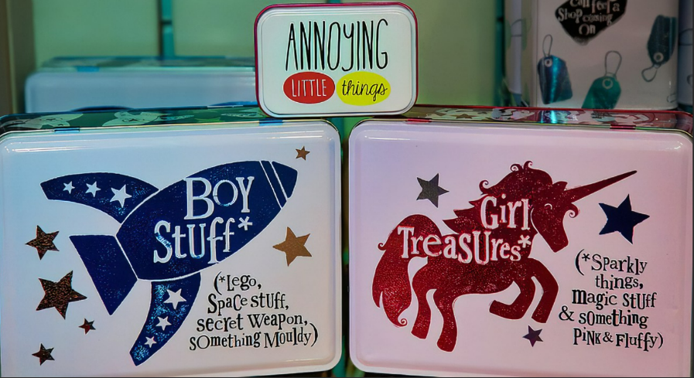
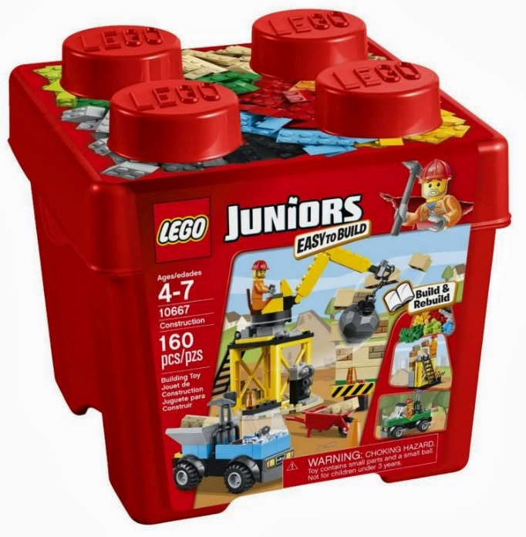
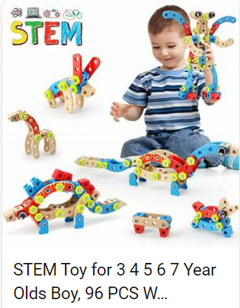
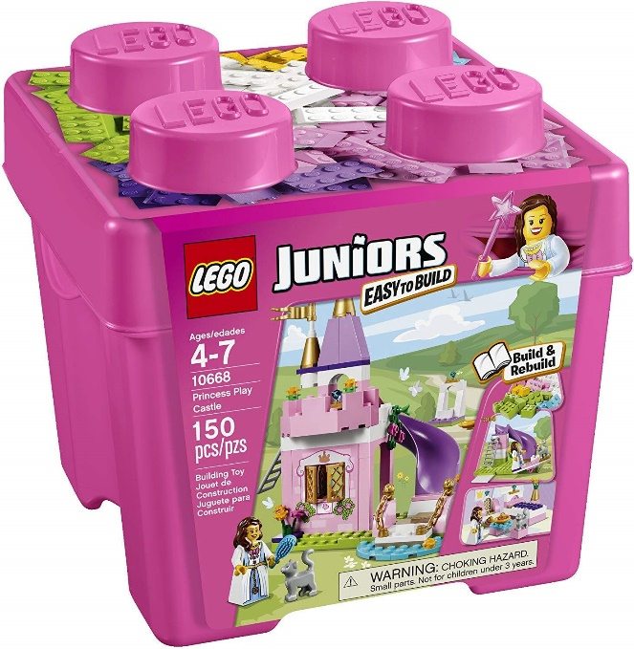
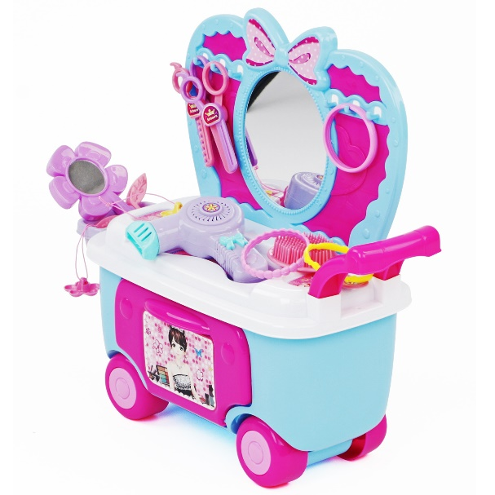
The Early Years
Notes:
Gender stereotyping starts early
Google search
Toys with wheels
Lego Junior
Stem toys …………… for boys

Slide 6
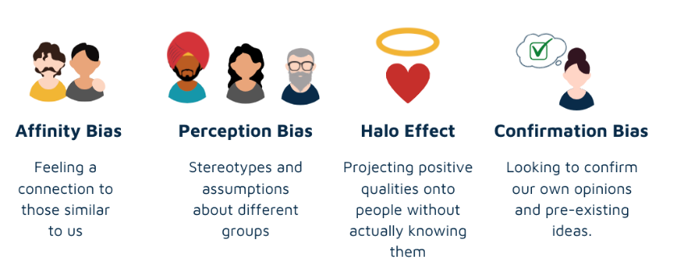
Unconscious Bias
Notes:
Stereotyping early in life impacts education and career decisions. Type of unconscious bias, which is a view we hold about certain groups of people without even realising it. “blind spot”, challenging to identify.
Risk to our industry. Negative consequence = homogenous workforce. Biased towards people similar to us. Unconsciously replicate the types of people already within the workforce. Diversity is key to creativity and innovation so this slows our industries growth potential.
10 types of unconscious bias that can negatively impact our workforce, 4 shown on the slide. Affinity bias. also be called similarity bias, is a bias towards those who are similar to us. Without even realising it – affinity bias means we are more inclined to fill roles with people who are like us. I’ll touch on how we address this bias in recruitment a bit later in our presentation. This is a great opportunity towards increasing diversity through more objective hiring processes.
However as Becky mentioned earlier, we still have that issue of 1 in 3 women leaving the industry. So why is that?

Slide 7
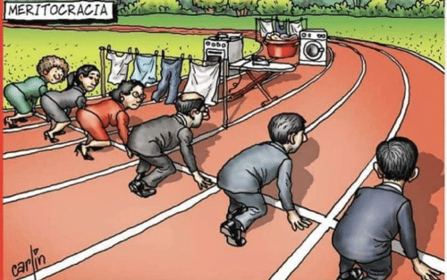
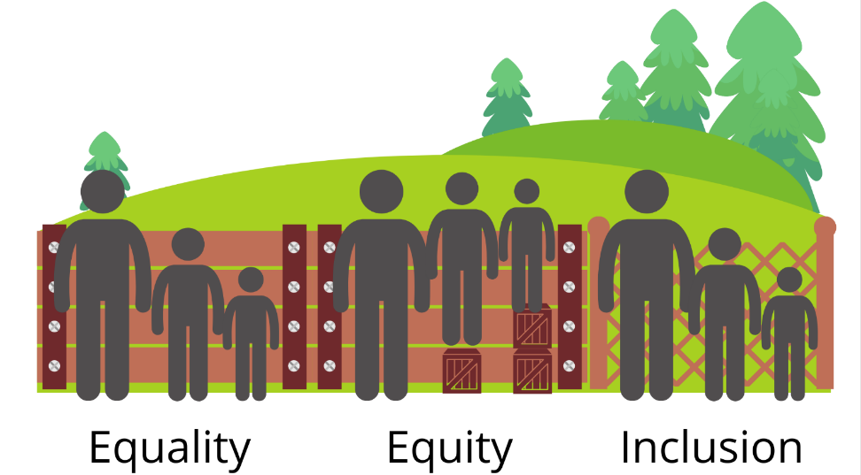
Why Women Leave?
60% of the women worked well past the birth of the 2nd child 90% left due to workplace problems
Notes:
Why do women leave?
Lack flexibility,
not feeling included,
unconscious bias,
lack of acknowledgement / leadership opps
Missing out
Why ????
Gender stereotyping in the workplace ……….. leads to revisiting ambitions ………… seeking alternative careers, to travel, or to have children and then not return.
Lead in to next slides – so what can we do to change the story?

Slide 8
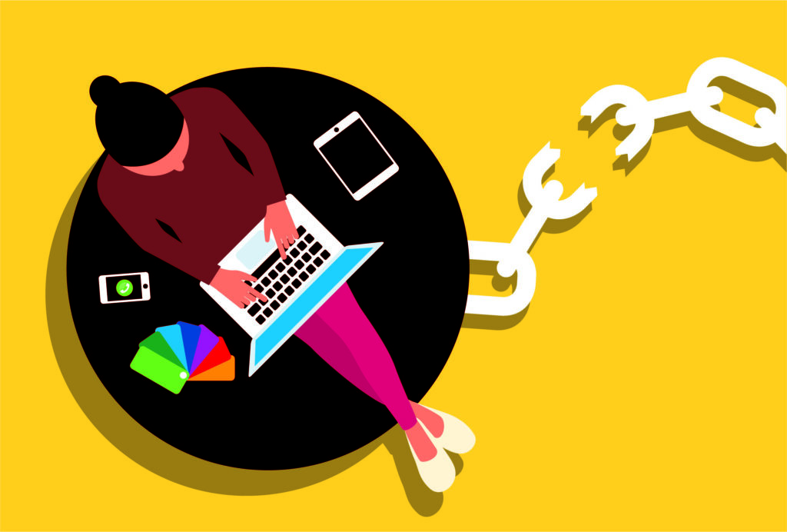
Strategies – Flexible Working
Notes:
Lots of reasons 1/3 of women leave the profession. The good news is, we can do something about it and we’re going to share some of the things Jacobs have done and the positive results achieved.
The first one Flexible Working. Silver lining from COVID Not just flexible hours, work from home, or to purchase leave. Public holiday swaps, to a date more aligned to your own belief system or culture. Going even further is not excluding candidates from roles due to paternity leave. We actively encourage people on paternity leave to apply for roles and support their promotion into leadership opportunities and recently have seen a number of women successfully promoted into leadership despite being about to go on maternity leave.

Slide 9
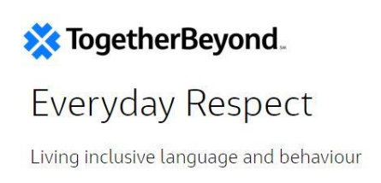
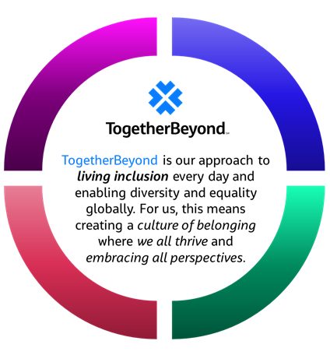
Strategies – Making a Commitment and Sharing It
40-40-20 Gender Balanced Workforce
From Unconscious Bias
To Conscious Inclusion
Notes:
Together beyond platform for inclusion across Jacobs
Jacobs employee networks bring people together across the world and drive the planned and intentional change to inclusion
Everyday Respect Campaign
Listen sessions (got pretty emotional but so important)
Follow through is
40:40:20 commitment – conscious commitment from the top to change at all levels in the company from junior through to our most senior
Confidence in calling out gendered statement – i.e. “gents”
Allies etc
We have a made a commitment and we are building strategies to implement across the company, in all geographies and all levels

Slide 10
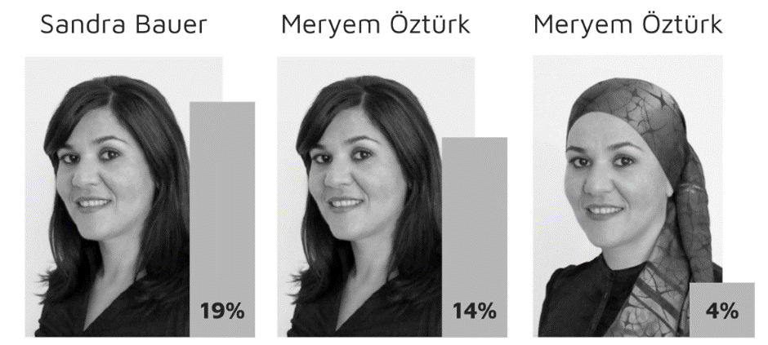
Strategies – Recruitment
Standardised questions
Omit names and photos
Skill based rather than hypothetical
Non-gendered advertising
Diverse interview panel
Notes:
Earlier I spoke about unconscious bias and how it impacts recruitment without us even realising. Studies show shortlisting of females for roles in engineering much lower than males –same CV’s have been provided with only the name changing, and the rate of males being selected for interviews are much higher than for females. The image on this slide shows the % of short lists made by the same candidate, decreasing as her name and image changed. These sorts of statistics are alarming and show how much unconscious bias can hurt diversity. So what do we do? The only way to make truly objective hiring decisions is to remove unconscious bias by design. Go through 5 steps. Does it work? Well we think so and we’re now going to present some of the positive outcomes we’ve seen as a consequence of our intentional gender diversity actions…

Slide 11
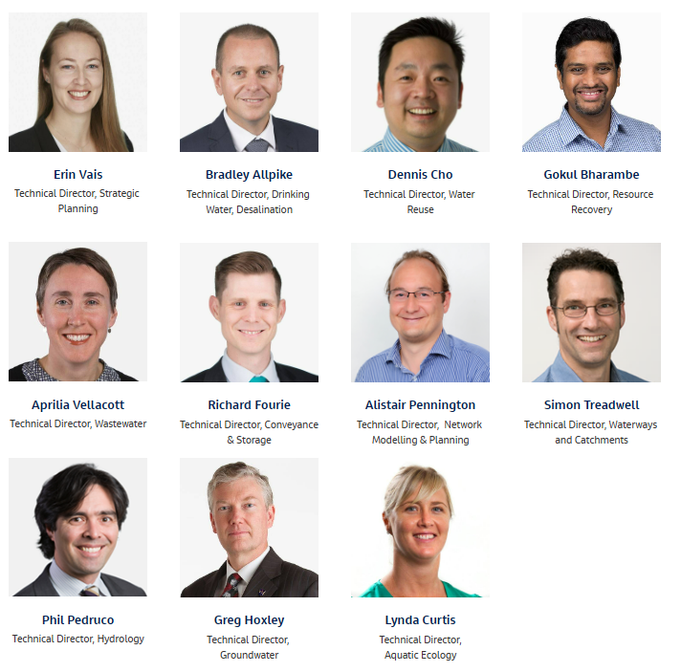
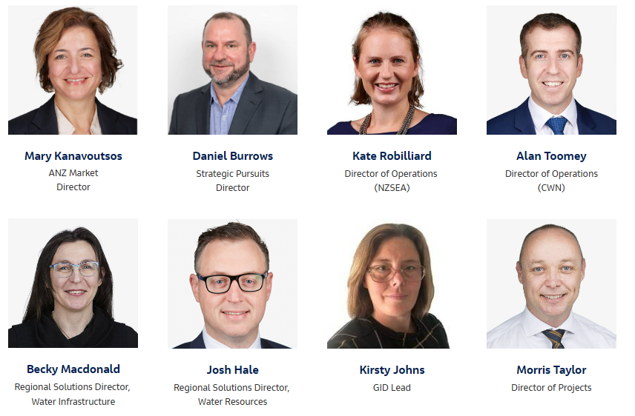
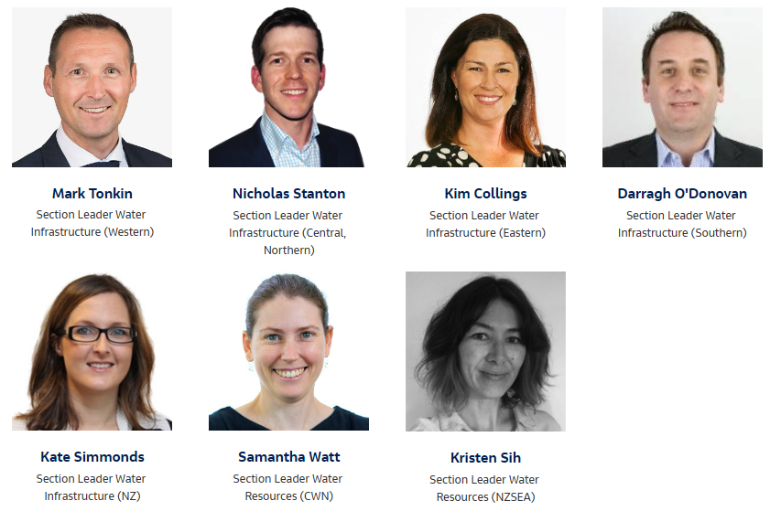
Diverse Leadership
Our Leadership Team – ANZ Water
Technical Leadership
Notes:
Our leadership team in 2022
Exceeds our 40:40:20 commitment
Technical is sitting at 27%, lagging behind, but we are proactively driving towards

Slide 12
Improved Staff Attraction & Retention
Notes:
People of diverse backgrounds will be more attracted to companies where they feel represented in that companies leadership. A review of your leadership model and a targeted plan of action for it to better represent our diverse peoples of Aotearoa is a great, although potentially confronting, first step. 38% women in leadership roles and we are seeing increased applications by women for roles. ​
We’ve also seen improved retention as a result of our actions. Our attrition rate is running lower than the average industry levels at the moment (about 20 – 30%) ours is 12% currently,

Slide 13
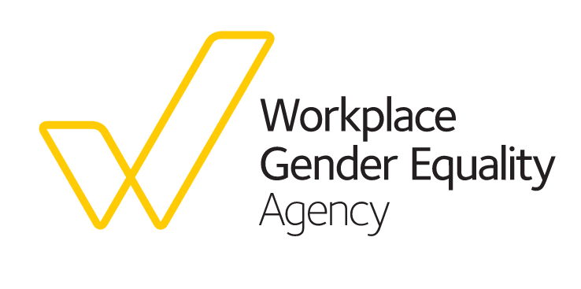
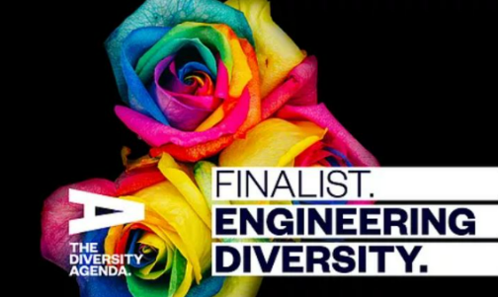
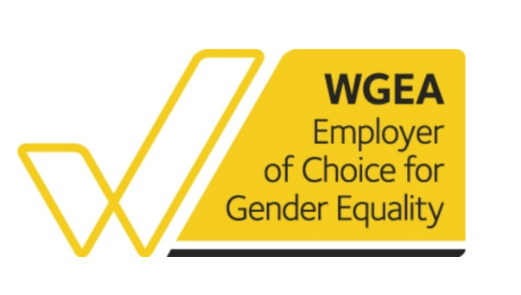
Awards & Industry Recognition
Notes:
Jacobs ANZ was awarded the Employer of Choice for Gender Equality (EOCGE) citation by Workplace Gender Equality Agency for the 6th year running
Jacobs were a finalist in the 2021 Diversity Awards in New Zealand.
Goes beyond NZ, with diversity awards around the globe, most recently acknowledgment at the prestigious British diversity awards
Consult Australia Champions of Change member,
Jacobs have publicly committed to deliberately transforming the gender equality story in our ANZ workplaces by creating a more inclusive, gender balanced and flexible culture.

Slide 14
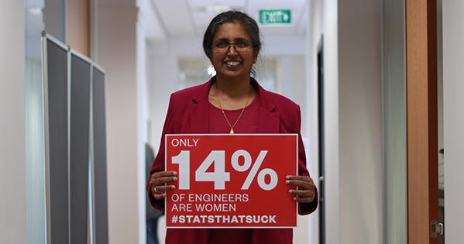
Summary
Notes:
The Engineering industry suffers from a lack of diversity. Women are significantly underrepresented with only 14% of engineers being female in New Zealand. In additional almost one third of women leave engineering, largely due to an inflexible work environment and a lack of recognition. ​
Evidence shows more diverse organisations are more successful and effective. Workplace inclusion is therefore a strategic imperative that increases operational performance. ​
It is important that STEM is attractive to younger children to increase the uptake as a whole, but even more so for under-represented groups in engineering such as females. But equally important is that we foster an industry where women want to work and stay.

Slide 15
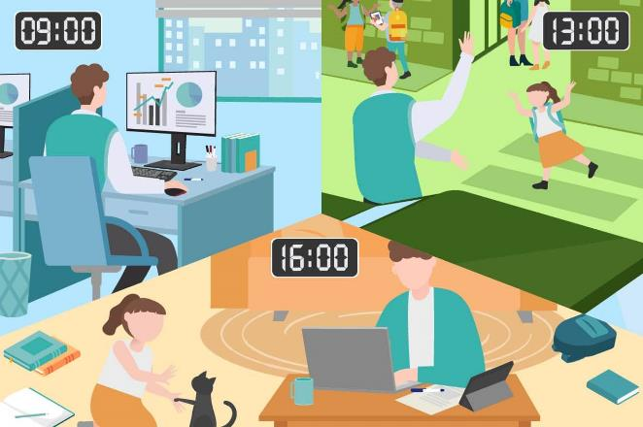
Conclusions
Unconscious Bias
Flexible Working
Notes:
2 key things to take away
Being aware of unconscious bias and changing it to conscious inclusion
Standard working day into flexible working
Moving from equality and equity to true inclusion, through a planned and intentional changes to the way we do things, such as
advertising for roles uses inclusive language,
interview panels are diverse, to help improve the diversity of our workforce.
embracing flexibility in the workplace
better support for those on parental leave.
But perhaps one of the key things is diversity at the top of our organisations, to lead by example not just in management, but in technical as well
This is a conversation we should be having more and not be afraid to speak up about. A more diverse and inclusive industry will help ensure that the engineering profession remains a productive, exciting, well-resourced and sustainable industry into the future.

Slide 16
Want to continue the conversation?
Come and say hello to the team at the Jacobs booth, location #125

