Slide 1
Unclassified
Water New Zealand Conference
Bill Bayfield | Chief Executive 19 October 2022

Slide 2
Ko wai, ko au, ko tātou
Ko te wai ahau, ko ahau te wai.
He whakaaturanga tātau nō te wai.
Ko te ora te wai ko te ora o te tangata.
He taonga te wai me tiaki.
Ko wai tātou.
Ko wai tātou.
I am water, water is me.
We are reflections of our water.
The health of water is the health of the people.
Water is a treasure that must be protected.
We are water. Water is us.
Notes:
Tēnā koutou katoa
Nō Ingarangi ōku tipuna.
I whānau mai ahau i Ghana, Africa.
Heoi, i tipu ai ahau i raro i te maru o Taranaki Maunga,
Ki te taha o Waiongana iti awa, i raro i te mana o Te Atiawa.
Kei Te Whanganui-a-Tara au e noho ana ināianei me taku hoa Rangatira, Maggie.
Ko wai ahau? Ko Bill Bayfield, te Tumu Whakarae o Taumata Arowai.
It’s a pleasure to be here

Slide 3
One year on… almost
3

Slide 4
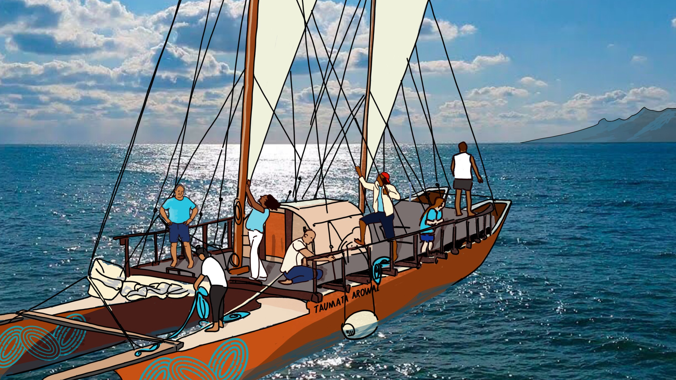
Notes:
6 months on felt like building a plane while flying it.
One year on feels like…sailing in a waka, working together with the sector to reach our goal of safe water everyday for everyone

Slide 5
We achieved what we said we would
Nov
Went live as the water services regulator for Aotearoa New Zealand
Went live with Hinekōrako - self service portal for suppliers and laboratories (followed by 7 upgrades)
He Pukapuka Orotau i Waenga i Te Poari Me Te Puna | MoU between the Board and Te Puna was signed
Apr
Began series of workshops on Te Mana o te Wai to build our internal capability
Held first public consultation to inform our regulatory approach
Dec
Held incident/emergency response exercise
Jan
Feb
Established Kāinga project team to begin engagement with Māori drinking water suppliers and developing partnerships with iwi
Mar
Launched the Taumata Arowai Public Register
2021
2022
Notes:
Nov 2021 – 2022 being regulator achievements
Covid environment

Slide 6
We achieved what we said we would
Sep
Oct
Nov
Won Leadership in Governance Award at the Te Hāpai Hāpori | Spirit of Service Awards
Began consultation on Network Environmental Performance Measures and Wastewater
Jul
Published Drinking Water Quality Assurance Rules
Published accountability documents: Drinking Water Regulation Report, SOI, SPE, CME
Jun
Published Drinking Water Standards, Aesthetic Values and Network Environmental Performance Measures
Staff onboarded across the motu: Whakatane, Opotiki, Kirikiriroa, Ōtepoti, Ōtautahi, Papaioea
One year old!
May
Most council suppliers verified in Hinekōrako
Aug
Published three Acceptable Solutions
Presented at 14 webinars hosted by Water New Zealand
2022
Notes:
Nov 2021 – 2022 being regulator achievements
Challenges: Covid environment, quality of data transferred from MoH

Slide 7
Ngā mihi maioha – thanks for your support
Notes:
I am proud of the work done to date
Excited for what we have and can achieve ongoing in working together with the wider water sector
Thank you for your support

Slide 8
What’s ahead?
8

Slide 9
We’ve heard you
Held our first public consultation in early 2022. Sought feedback on seven documents to help inform our regulatory approach.
2,098 submissions were received.
Lots of helpful, technical and practical feedback received, which has led to significant changes.
We’re currently consulting on the next set of Drinking Water and Wastewater Network Environmental Performance Measures.
There will be more public consultation to come including Lead levels in drinking water and Notifiable risks and hazards.

Slide 10
And made significant changes
Changed Acceptable Solution for Spring and Bore Drinking Water Supplies:
Shifted to end-point treatment to suit small supplies.
Removed the need for chlorination.
Added a new category to the Drinking Water Quality Assurance Rules:
Simplified rules for Very Small Communities who serve up to 25 people permanently and up to 50 people for 60 days per year.
Only require twice yearly microbiological testing.
Changed monitoring requirements:
Changed requirement to keep and transport samples at <6 degrees. Now only have a duty to take reasonably practicable steps to ensure they are no more than the temperature when sampled.

Slide 11
Rules, Standards, Aesthetic Values and Acceptable Solutions come into effect soon
New Drinking Water Quality Assurance Rules, Standards, Aesthetic Values and three Acceptable Solutions come into effect for registered suppliers on 14 November 2022 .
The Rules are not a one size fits all approach – the simpler the supply, the simpler the rules.
Acceptable Solutions are an easy and practical alternative to complying with the Water Services Act 2021. First of three Acceptable Solutions published. There will be more to come.
If you haven't already, visit our team at the Expo and check out the ‘Build my rules’ web app

Slide 12
Guidance for drinking water safety planning
All registered suppliers need to submit a Drinking Water Safety Plan or comply with an Acceptable Solution by 15 November 2022.
We’ve published guidance on our website to help suppliers with drinking water safety planning and source water risk management planning.
We’ll provide templates to help small and very small registered supplies prepare their plans.
Larger suppliers (500+) should be familiar with drinking water risk management and be well placed to provide Drinking Water Safety Plans by 15 November 2022.
We’ll support you all through this process.

Slide 13
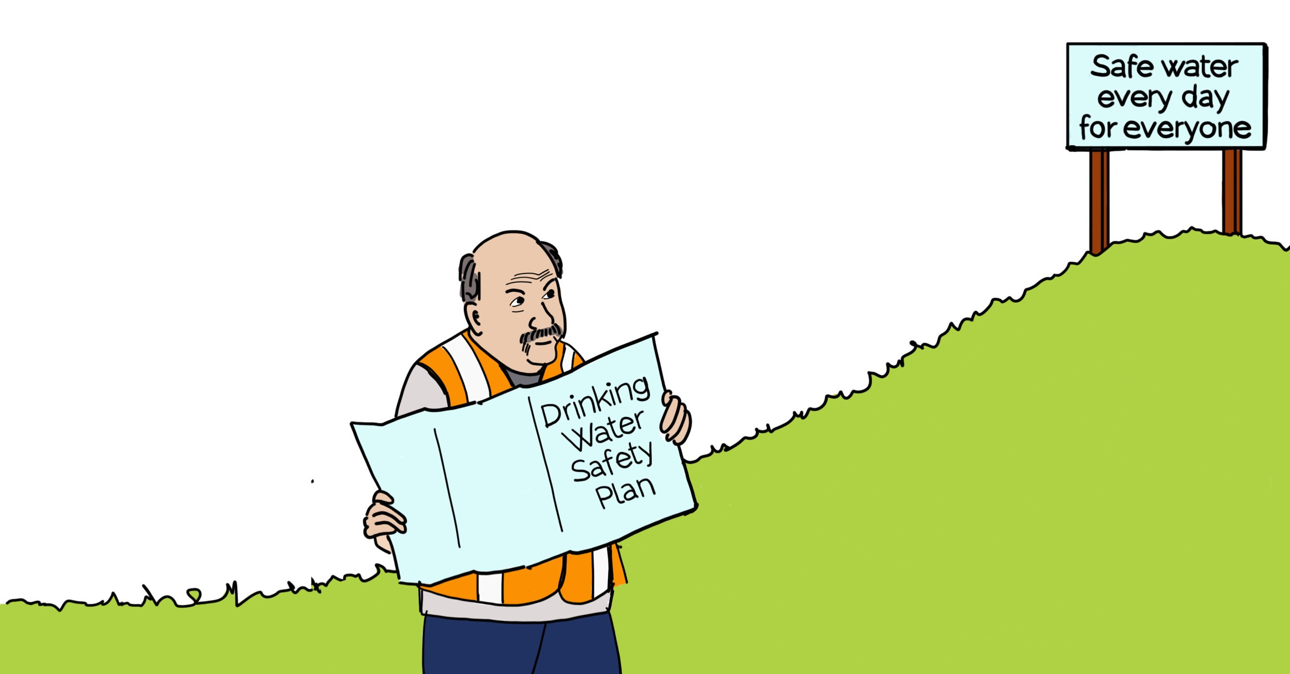
Drinking Water Safety Planning
A continuous process of improvement
We don’t expect you to be perfect immediately! You still need to manage your risks and provide safe drinking water. Submitting your Drinking Water Safety Plan is a milestone in a continuous process of improvement.
Your Drinking Water Safety Plan should cover:
What your risks are
What your challenges are, including Te Mana o te Wai
Your timeline for meeting your risks and challenges

Slide 14
Giving effect to Te Mana o te Wai
The requirement to give effect to Te Mana o te Wai is new and we know it will be challenging for some.
It’s a journey and may take longer to embed – Taumata Arowai will support you along the way – we’re on the journey too!
Have a go at including it in your:
Drinking Water Safety Plans
Source Water Risk Management Plans
Policies, processes and procedures.
“Te Mana o te Wai is about putting the health and wellbeing of the water first, while also providing for the needs of our people and communities.”
If you haven't already, visit our team at the
He Pukenga Wai | Te Mana o te Wai hub
Notes:
Look forward to you having a crack at this – integrating into your plans
Promote Te Mana o te Wai hub which is at the entrance of the expo at the conference – joint initiative with Mfe, DIA and a number of Iwi leaders

Slide 15
What’s further ahead?
15

Slide 16
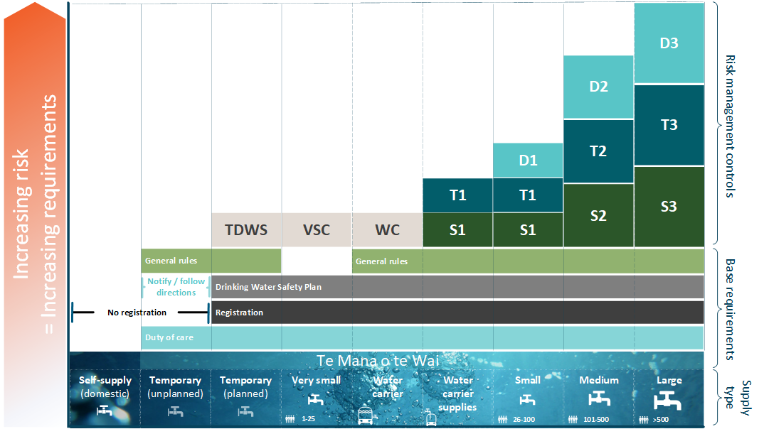
A supplier framework

Slide 17
Unregistered suppliers can relax
While it’s estimated there are 75,000 unregistered supplies, they only serve 500,000 people compared with 533 council supplies that serve 85% of the population.
Unregistered drinking water suppliers have a duty of care to ensure any drinking water they supply is safe to drink.
Unregistered drinking water suppliers have up to November 2025 to register with Taumata Arowai and November 2028 to fully comply with the requirements of the Water Services Act 2021.
These timeframes provide an opportunity for Taumata Arowai to work with our unregistered community to understand their needs and circumstances, and we are.
Notes:
We're focusing on local authorities first as biggest risk, unregistered small suppliers can relax

Slide 18
Wastewater and stormwater
While most of the Water Services Act 2021 came into effect on 15 November 2021, provisions relating to stormwater and wastewater are delayed until 4 October 2023.
We’re preparing for our responsibilities, but uncertainty and opportunity exists with the establishment of the new Water Services Entities in July 2024.
Consultation on Wastewater Network Environmental Performance Measures is happening now – get involved.
Our role relating to wastewater and stormwater is very different to our role as regulator of drinking water. We will be partnering with Regional Councils as they are the front-line regulator.

Slide 19
The Three Waters Reform will impact our kaupapa
The Water Services Entities Bills are currently going or about to go through parliament.
Taumata Arowai recognises that this is a significant period of transition for all in the sector.
Thinking and preparation as to how we will operate with the 4 proposed Entities is already underway. It will change things.
The transition is also changing how we are handling registrations, Drinking Water Safety Plans, incorporation of Te Mana o te Wai and of course the commencement of our regulation of wastewater and stormwater.
Our collective ability to achieve Tiakina te wai, hei oranga te katoa | safe water every day for everyone will be hugely enhanced by these changes and we must manage our regulatory requirements to ensure we collectively succeed.
Notes:
It's been six months since last conference, three waters becoming very real now

Slide 20
Thanks for your support
Almost a year on as a regulator – Ngā mihi for the support.
We’re still getting to know the sector and getting our regulatory framework right – Ngā mihi for the feedback.
Still excited as a regulator to work with all to ensure Te Mana o te Wai principles achieve the change we need for Three Waters in Aotearoa.
We’re committed to building our regulatory framework to work for all of us from service providers to communities.

Slide 21
Notes:
Resigned as CE of Taumata Arowai, leave January 2023
Reflections
Wanted to build a modern regulator. Have done this.
Te Mana o te Wai in legislation – that journey still continues.
Built the platform, now up to you. It’s a long journey.

