Slide 1
Enhanced Flood Data
Stormwater 2022
Te Roopu Wai Āwhātanga
Tower Chief Executive Blair Turnbull

Slide 2
Natural disasters are accelerating
45% floods
27% storms
Data from Insurance Council of New Zealand

Slide 3
The costs for communities are increasing
A third of flood and storm costs since 1965 were incurred in the last six years
Flood and storm costs in the last 10 years roughly equal the previous 45 years

Slide 4
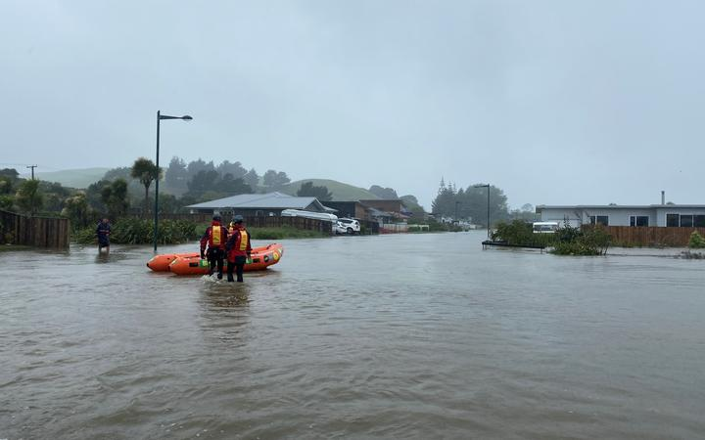
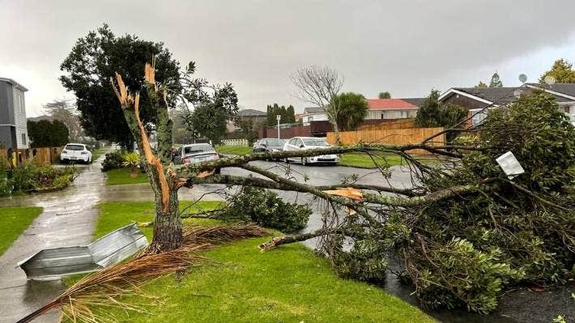
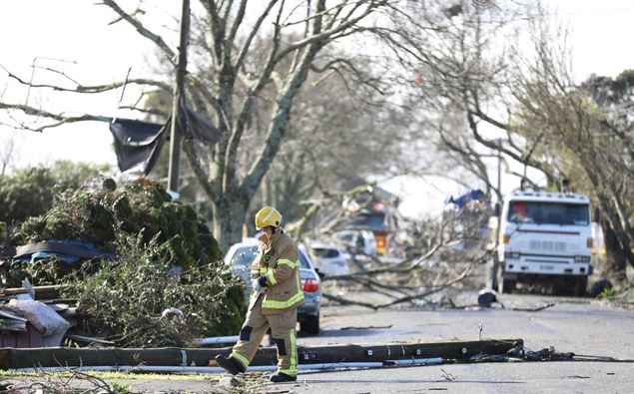
For flooding alone, in the last two years we've experienced...
Greater Wellington Floods ($5.37m)
Nov ‘20
North Island Flooding - including Wellington
($25.92)
July ‘21
Northland Flood ($44.19m)
July ‘20
West Coast Flooding ($97.2m)
July ‘21
Gisborne Floods
($3.37m)
November ‘21
$390m
Nov ‘20
Napier Flood ($87.72m)
May ‘21
Canterbury Flood ($46.44m)
July ‘21
Upper South Island Flooding ($17.35m)
August ‘21
West Auckland Flooding
($62.29m)
Image: Gisborne Flooding November '21

Slide 5
Addressing the country-wide challenge through partnerships and collaboration
Partnering with experts
New approach to partnering
RMS, global leader in risk data analysis:
30 years pioneering the catastrophe risk industry
Over 200 peril models
60 trillion data points in location intelligence API
120 Countries
Used by 9 out of 10 global reinsurers
Now supports Tower with both earthquake and flood risk expertise
Working with university data science faculties
Supporting Waikato University Bachelor of Climate Change
Engaging with a wide variety of stakeholders
Local and district councils
MPs and wider Government
NIWA and NZ Climate Change Commission

Slide 6
Leveraging data and technology to understand flood risk and help inform and educate our customers
Getting clever around data
Investing in technology
NZ first fully probabilistic pluvial & fluvial flood model
5 million data points
50,000 years continuous simulation of precipitation
350,000 simulated flood events
Supported with Tower claims data, 300k customers
140K customers online
Putting customers’ data into their own hands
Enabling risk transparency
Enabling insurance pricing transparency

Slide 7
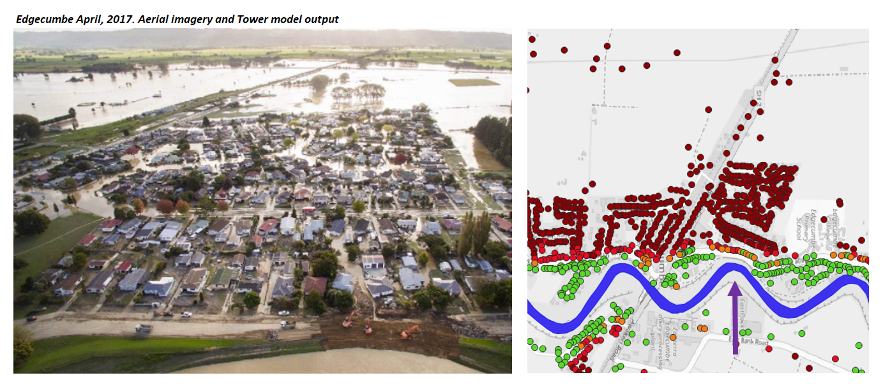
Edgecumbe
Edgecumbe April 2017 Aerial imagery and Tower model output
Notes:
Tower’s flood data incorporates historical flood experience within its modelling. Updated annually with all latest events
Model results for Edgecumbe are slightly counter-intuitive with lower flood risk addresses closer to the river and higher flood risk addresses further from the river. Two reasons for this:
1. Pluvial flood risk identified to be more prevalent in general on the lower lying floodplain at the back of the photo, particularly for rarer more severe flood events (as was seen in 2017 with heavy rain from ex-Tropical Cyclone Debbie)
2. Rangitaiki River stopbank flood defence helps to manage flood risk for river side properties. Such stopbanks are accounted for in the model, along with probability of failure based on their design parameters (photo shows how this stopbank failed in 2017).
Important for the public to be aware of all sources of flooding, not just river flooding which is perhaps more obvious/intuitive. And also to understand that flood defences are not 100% guaranteed, there is still a risk of failure and so understanding and preparedness is key

Slide 8
West Auckland (Kumeū)
Kumeū township August 2021
Aerial imagery and Tower model output
Notes:
Real life flood events are validated against model outputs, such as with the 2021 West Auckland floods that occurred after data was finalised for use in Tower’s current live flood risk rating.
Data from this real life flood event will be incorporated into the modelling process for the 2022 refresh, to further refine/enhance the model.

Slide 9
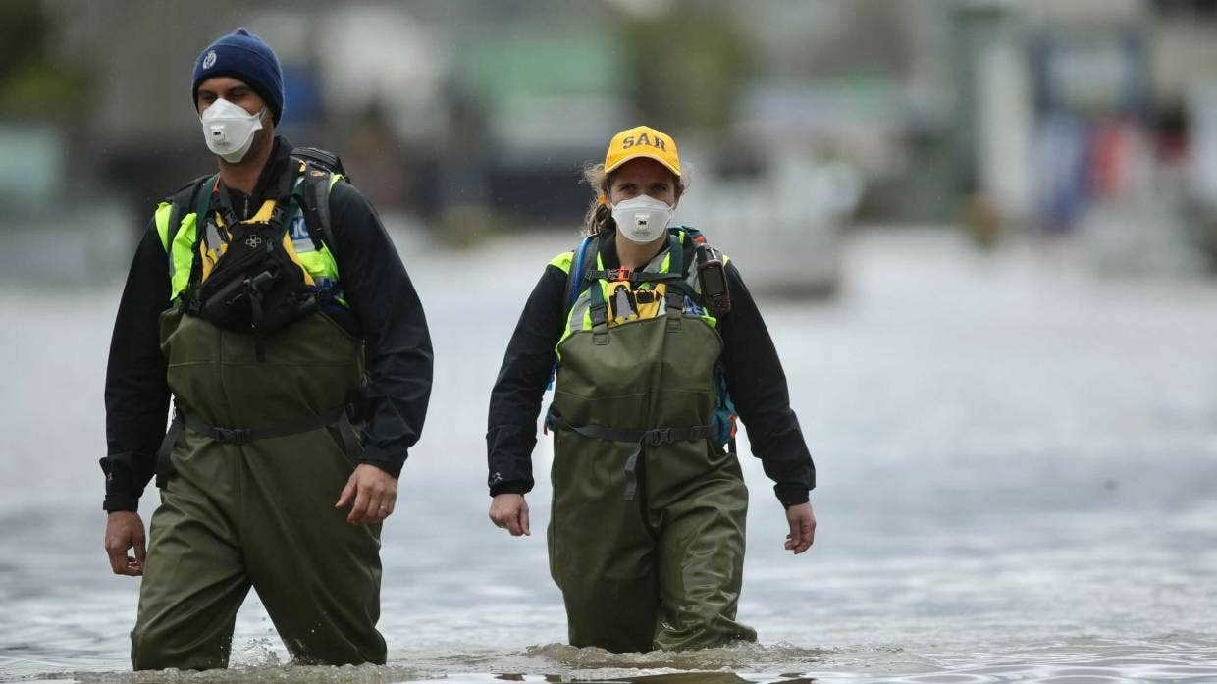
Some flooding can be avoided
50% of Kiwis think that it’s the Government’s responsibility to prevent frequent property flooding*
Factors within our control
Maintenance of water systems
Managed retreat
Not building in flood prone areas
*Based on Research commissioned by Tower, September 2021. Image: West Auckland Flooding August '21

Slide 10
Transparency is at the heart of our customer experience

Slide 11
Helping Kiwis understand the risks they face

Slide 12
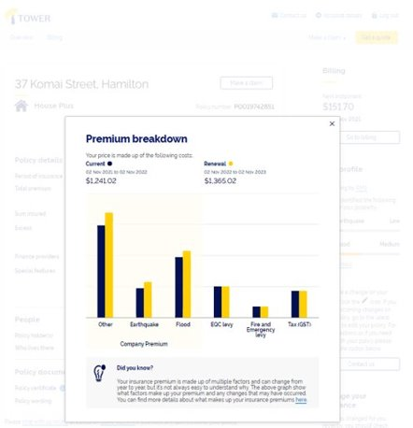
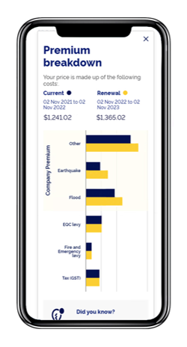
Premiums explained

Slide 13
Transparency with stakeholders
200+ Letters Sent
To every council Chief Executive, Mayor and MP in New Zealand.
Plus, Ministers and other key stakeholders such as; banks, regulators, insurance groups and climate change industry bodies.
Resulting in meetings with
10 District Councils and counting.
MPs and Ministers.

Slide 14
Stakeholders recognised
Tower’s forward-thinking approach.
The expertise of the flood-risk model.
The potential for possible use cases of Tower's modelling outputs.
Opportunities to work together to mitigate climate change
Stakeholders appreciated:
Tower's openness, transparency and commitment to long-term partnering throughout New Zealand's climate change journey.
All parties Tower met with wanted to continue conversations and collaborations around climate change

Slide 15
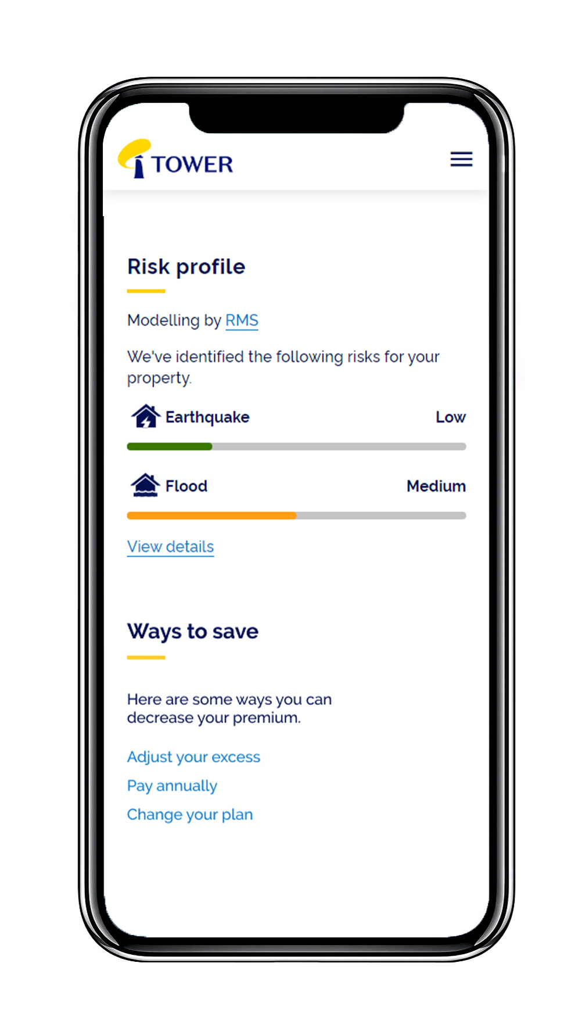
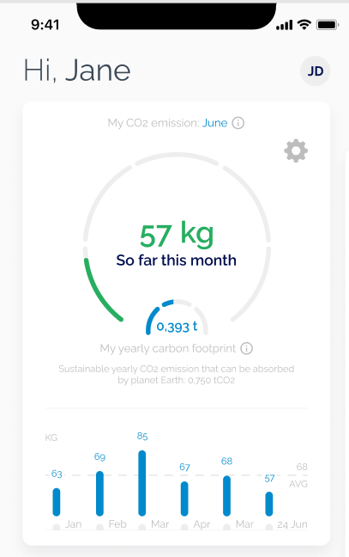
Supporting communities through climate change
$15,000 Sustainability Payment.
Insuring EVs, e-bikes, e-scooters.
Pacific parametric pilot.
31% reduction in carbon emissions FY20-FY21.
Further 21% reduction target by 2025.
Partnering well.

Slide 16
Ngā mihi

