Slide 1
AUCKLAND’S CENTRAL INTERCEPTOR: INNOVATIONS FROM PLANNING THROUGH DETAILED DESIGN
September 2017
Presented by:
Stephen Grace - Watercare
Nigel Kay - Jacobs

Slide 2
Agenda
Project overview
Where are we at?
Key project Issues
Innovative approaches to managing risk
Hydraulics, pneumatics
Geotechnical
Design Solutions
Where to from here.

Slide 3
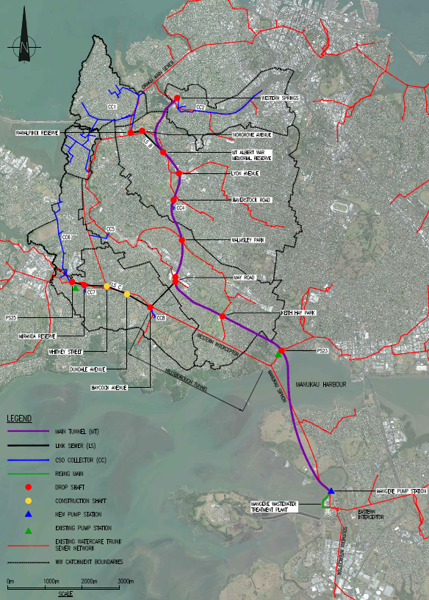
The Central Interceptor – what is it?
A deep sewer tunnel that conveys and stores wastewater from the combined sewer network
13km of Main Tunnel with internal diameter of 4.5m, driven by EPB TBM and segmentally lined
4.4km of Link Sewers ranging from 2.1m to 2.4m internal diameter, most likely pipe-jacked
16 shafts, up to 70m deep
A terminal pump station with 6 m3/sec capacity
Connection sewers and chambers

Slide 4
Where are we at now?
Detailed design complete
Request for Expressions of Interest in Q4 2017
Request for Proposal in Q2 2018
Contract Award Q4 2018
Construction commences 2019
Complete construction of Stage 1 in 2023
Complete construction of Stage 2 in 2025

Slide 5
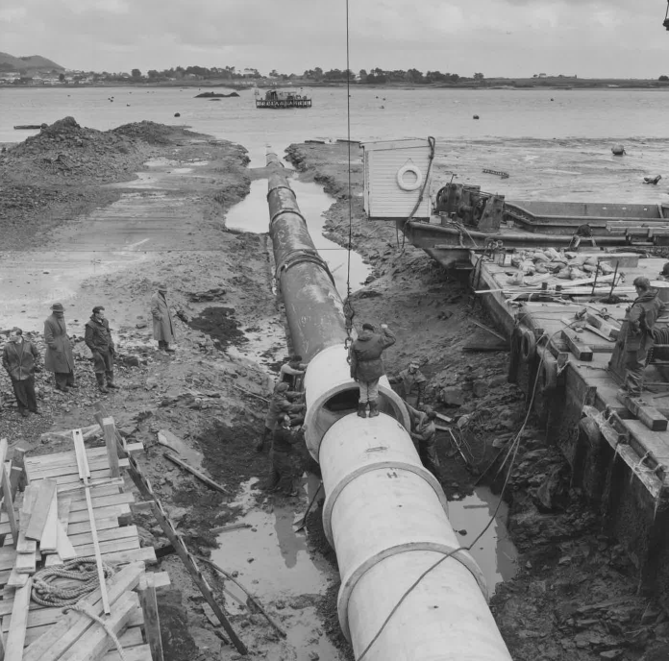
Key Project Issues
Ageing & vulnerable assets
Growth pressures
Collection and conveyance of large flows from Central Auckland to the treatment plant at Mangere
Ground conditions in the “City of Volcanoes”
Deep sewer tunnel – construction issues and future man entry for maintenance & inspections
Notes:
Western Interceptor rehab works in 2003 (Manukau Siphon) and 2014 (MH1 to MH5)

Slide 6
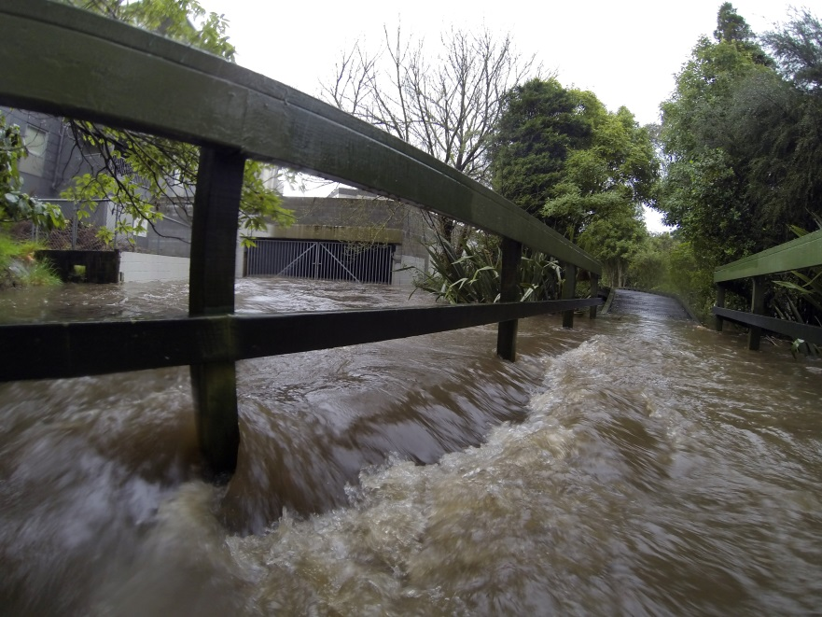
Combined Sewer Overflows
The Central Interceptor will relieve the combined sewer system by intercepting engineered overflow points and diverting the excess flow to the Mangere WWTP

Slide 7
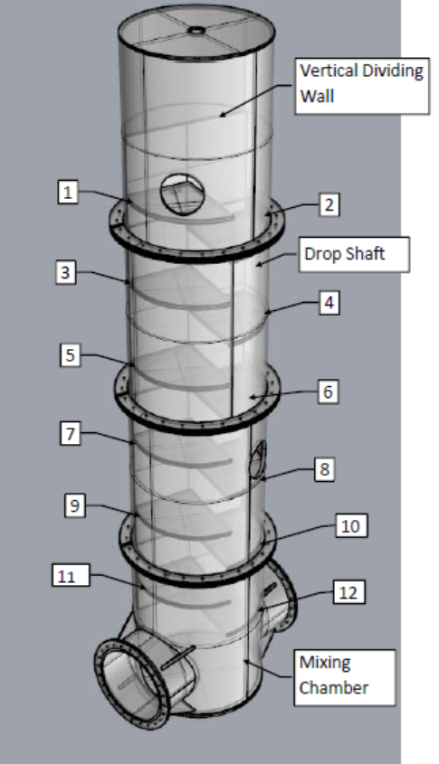
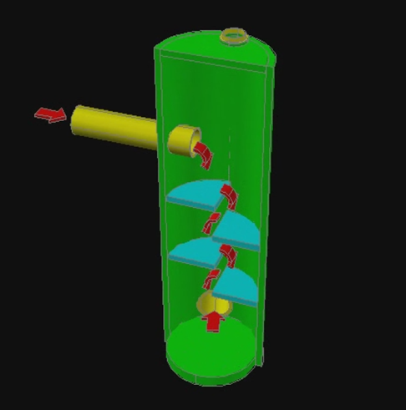
Innovative approaches to managing risk
Drop shaft selection is a cascade type
Reduces energy at each baffle step
Reduces air entrainment
Flow can be introduced at any level and cater for wide range of flow rates
Permit entry for inspection
Is largely self cleansing
Real time gates operated by hydraulic actuators
Instead of electric actuators -
Can store the energy for 2 cycles of operation – able to be operated in a power outage
Forced ventilation
Draws corrosive air to treatment facility where it can be managed
Notes:
A cascade drop offers the following advantages over a vortex drop with associated de-aeration chamber:-
1) No special inlet structure.
2) Effectively dissipates influent energy.
3) Reduces the level of air entrainment so that subsequent de-aeration chamber and vent are not required.
4) Offers the opportunity to provide an access down a single shaft as the cascade has wet and dry sides.
5) Allows for refinement of shafts to suit a wide range of influent rates.
6) Allows for multiple sewer entry points using one and drop method shaft.
7) Allows for inspection of baffles using aeration/nappe ports in the dividing walls.
8) Is largely self-cleaning.
9) Can be installed directly over the tunnel (as confirmed by the University of Auckland’s physical model), resulting in significantly lower construction costs.
10) The wet side allows for some limited ability to reduce surge.
Shelf spacing is dictated by flow rate and the amount and size of debris expected. Shelf length can be determined by hydraulics.
For hydraulics, the shelf length and spacing is determined based on the cascade drop Froude number which is calculated at 0.69 (becomes turbulent flow at Froude no = 1). To ensure that debris does not clog the cascade drop, the spacing of the shelves should be greater than the diameter of the largest pipe entering the drop shaft. To allow for irregularly shaped debris in the local sewers, a safety factor of 15% was placed on the largest diameter.
To keep the shelves solids-free, a 1% slope on the tops of these shelves can be used. Two innovations have been introduced for the CI project, being the use of an offset dividing wall and having the cascade shafts directly over the tunnel or link sewer center-line. The hydraulic performance of these innovations was confirmed by physical modelling at the University of Auckland fluids lab.

Slide 9
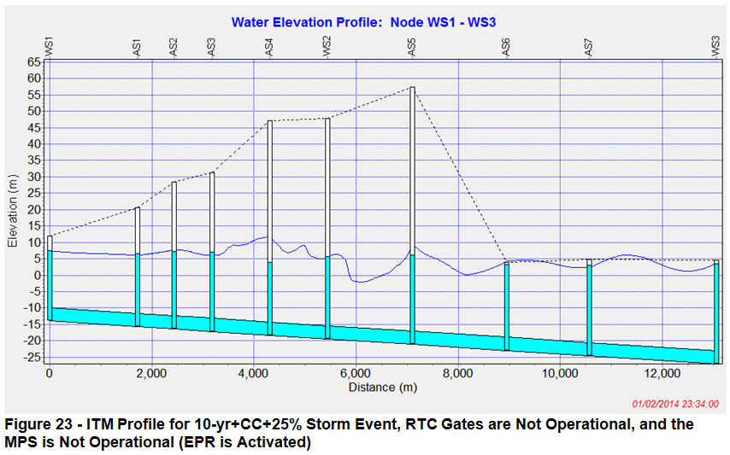
Innovative approaches to managing risk
Surge analysis:
Transient waves modelled using the Illinois Transient Model showed that surge governed the size of the tunnel. The surge wave was propagated when the water level rose to tunnel crown at the pump station and the subsequent reflection wave resulted in erratic water levels at the shaft locations.
RTC gates limited this effect.
Pneumatics:
Coupled with surge was the risk that geysering might occur particularly on the smaller shafts, so a vault with air dampers was incorporated to act as a shock absorber at select sites.
Notes:
The ITM Model reflects the Main Tunnel geometry only. Flows from Link Sewer C are included but the geometry is excluded since it is hydraulically disconnected from the Main Tunnel. This was a significant change from the Concept Design.
Three storm events were considered for the transient analysis as being the likely worst case scenarios for the highest inflow rates into the tunnel:
• 6 Months Design Storm Event (6 Months) with no allowance for Climate Change
• Historic storm event (Event 39) with no allowance for Climate Change
• 10 Year Design Storm Event including Climate Change (10yrsCC) and a 25% increase in impervious area
The effect of Climate Change increases the 10yr+CC+25% storm intensity by approximately 17%.
Flow instabilities, which can result in several undesirable pneumatic effects, are shown to occur on the 4.0 m ID tunnel for smaller storms. These hydraulic instabilities are absent for the 4.5 m ID tunnel for the same storms at the same shaft sites.
Based on all the analyses a 4.0 m ID tunnel increases the risk of surge-related phenomena occurring in the southern section of tunnel, compared with the muted surge behaviour predicted for a 4.5 m ID tunnel. Surge transients are therefore the parameter controlling on the size of the tunnel.
With no gates operational (i.e., all RTC gates have failed open) and the MPS operational, the ITM model predicts overflows at the EPR for the 10yr+CC+25% storm event, but not for the 6-month storm event or the Event 39 storm. Both the ITM and InfoWorks models predict that back-ups and overflows will occur in the system if all RTC gates fail simultaneously.
From the results of the transient analysis it can be seen that control of inflows to the CI and reliable gate operation are imperative to prevent overflows occurring at the EPR. Automatically actuated gates will need to be in place to ensure that inflows are shut off when the water level at the MPS reaches a defined trigger level.
Sensitivity testing using a celerity range from 100 m/s to 200 m/s had small to insignificant changes on the results. The range of celerities used for the modelling were confirmed as appropriate for a partially full concrete tunnel by our Challenge & Value reviewer (FlowScience) and the ITM model developer (Dr Arturo Leon).
The transient model took the hydrographs from Infoworks EUM3 model and used these as inputs into the ITM. For the ITM model, it is assumed that the EUM3 model accurately represents the flow rates. The effect of Climate Change increases the 10yr+CC+25% storm intensity by approximately 17%. Figure 5-2 shows the comparisons between flows entering the tunnel from the three storms assuming no RTC gates
The analysis is a single medium one dimensional model. The air is not inherently modelled. The model assumes the tunnel is infinitely vented. Elastic theory applies and it is assumed that the tunnel behaves as a continuous pipe.
The surge analysis was performed for the worst case scenario of the MPS not running at any time during the surge event.
The surge waves only form when the tunnel at least partially fills. Only discrete larger storms were analysed for the surge model as smaller storms like the 6 month does not fill the tunnel.
Celerity was based on an air entrainment value of approximately 2%. The physical modelling showed that the cascade drop structures had approximately 1.58% air and therefore the assumed celerity values of 100 to 200 m/s were ratified.

Slide 11
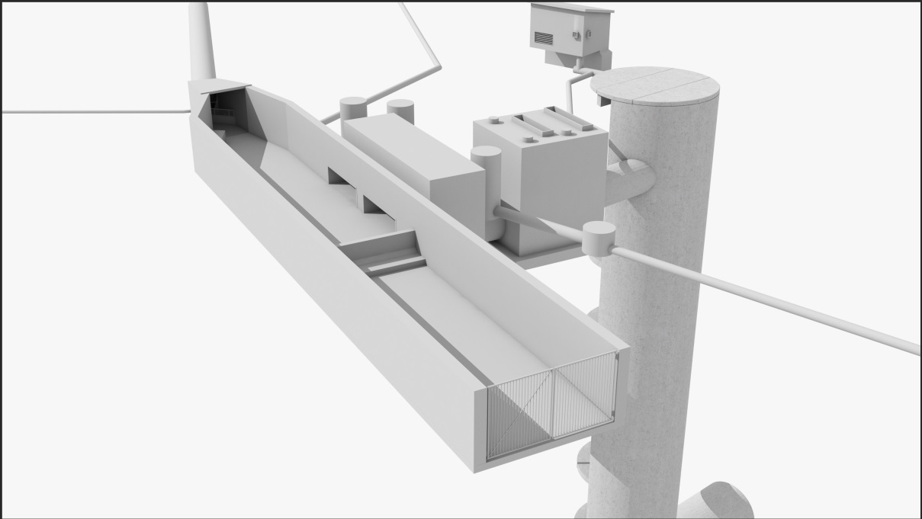
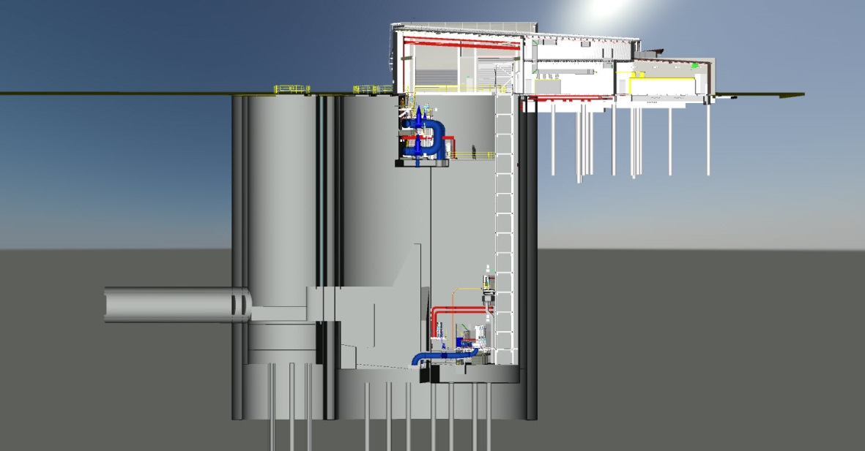
Innovations for Stakeholder engagement
3D Visualisations
Drone photography
Sharepoint portal for sharing documents
3D BIM model for Safety in Design and operability reviews for internal stakeholders
Notes:
Limitations of 2D engineering drawings for engaging with stakeholders
Static Boffa Miskell artistic impressions not easily updated
Buildmedia images – 3D visualisation of Lyon Ave shaft site in an App.
Navisworks BIM model of Mangere PS.

Slide 12
Managing geotechnical risk
Comprehensive investigation (>200 boreholes in 4 phases of ground investigation)
Varied ground conditions
Particular risks include:
Alluvium south of the harbour
Crossing below Manukau Harbour
Hard, fractured sandstone
Groundwater drawdown causing settlement of alluvium at shaft sites
Use of Geotechnical Baseline Report to allocate/share risk
Adoption of suitable design solutions and construction methods

Slide 13
Design solutions and construction methods
Earth Pressure Balanced TBM for main tunnel
MTBM for pipe-jacked Link Sewers
“Watertight” construction for shafts
Blind-drilling of the smaller-diameter, deeper shafts
Diaphragm wall for Mangere Pump Station
Connections to existing sewer system

Slide 14
Managing corrosion risk
Acid corrosion of concrete by sewer gas is a critical risk
Sampling and modelling indicated potential corrosion depth of 50-270 mm in 100-year life
Design solution is a combination of:
Forced ventilation to dilute sewer gases
Acid-resistant concrete in high risk zones
Sacrificial thickness of ordinary concrete in lower risk zones
Testing is underway to confirm the availability of suitable acid-resistant cements

Slide 15
Conclusion
Central Interceptor is a $1 billion interceptor sewer and deep storage tunnel to cater for Auckland’s population growth and improve wastewater system resilience and performance
A wide range of potential issues have been addressed via systematic planning and design
Construction is scheduled for 2019-2025

Slide 16
Thank you!

Slide 17
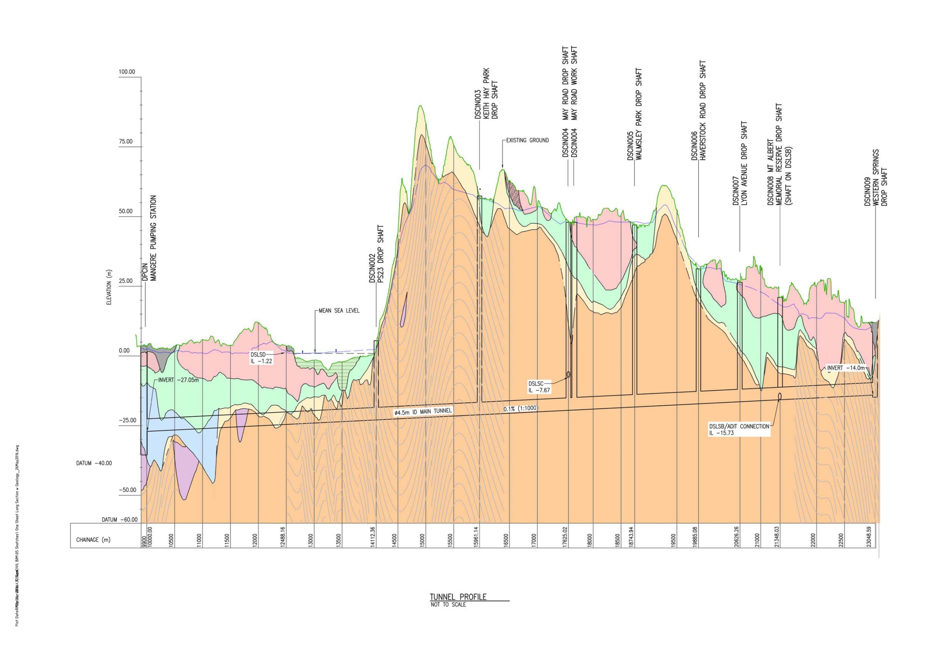
Managing Ground Risk

