Slide 1
Unclassified
Drinking Water Safety Planning
Source Water Risk Management Planning
24 March 2022

Slide 2
Ko wai, ko au, ko tātou
2
Ko te wai ahau, ko ahau te wai.
He whakaaturanga tātau nō te wai.
Ko te ora te wai ko te ora o te tangata.
He taonga te wai me tiaki.
Ko wai tātou.
Ko wai tātou.
I am wai, wai is me.
We are reflections of our wai.
The health of te wai is the health of te tangata.
Wai is a taonga that must be protected.
Ko wai tātou.
We are wai. Wai is us.
Notes:
Ray
Kia ora e te whānau.
Thank you for inviting us to join you today.
I’m going to start by reading one of our whakataukī, a cultural wisdom that inspires and guides our work.
Ko te wai ahau, ko ahau te wai
He whakaaturanga tātau nō te wai
Ko te ora te wai ko te ora o te tangata
He taonga te wai me tiaki
Ko wai tātou
Ko wai tātou
This whakatauki represents our own roles in the kaupapa of protecting the health of te wai and the health of te tangata, in balance; ko wai, ko au, ko tatou.
Each of us serve as a reflection point between tangata and wai to highlight the reciprocal relationship between the two.
Likewise, the taumata and the wai in our tohu (our brand logo) are balanced reflections of one another – they are one in the same.

Slide 3
What we will cover today
3
Overview
Ray McMillan, Head of Regulatory
Evolution of Water Safety Planning & Drinking Water Safety Planning
Jim Graham, Principal Advisor Drinking water
Water Services Act 2021 & Source Water Risk Management Planning
Alan Cooper, Principal Advisor Regulatory System
Pātai / questions
Opportunity to answer any further pātai / questions you might have
Notes:
Ray

Slide 4
Our whakatauki
4
Karangahia ngā ope | Be the voice of welcome
Whāngaia te iwi | Sustain the people
Ka hoki kōmuri ngā whakaaro kia anga whakamua te titiro | Turn our minds to the past to determine our way forward
Notes:
Ray
Having a te ao Māori perspective woven into the fabric of our organisation is important to us. We want to live and breathe our values intrinsically – and this is a both a challenge and an opportunity as we build our plane.
We’ve been really lucky to have been supported in this mahi.
These are our whakatauki that guide the way we want to be in the sector:
To be real and human – to welcome, to listen and respond.
To sustain the sector, with guidance, support and encouragement
To turn our minds to the past to determine our way forward – looking back to the Havelock North incident and others like it helps us to keep our focus on what’s important – it helps us keep our focus broad - to learn from overseas, to learn from our mistakes and others, and to track a careful path forward.
These are our promises to the sector and you should hold us to them.

Slide 5
Public consultation closing soon
We are currently seeking feedback on the following seven proposed documents:
Drinking Water Standards
Drinking Water Quality Assurance Rules
Drinking Water Aesthetic Values
Drinking Water Acceptable Solution for Roof Water Supplies
Drinking Water Acceptable Solution for Spring and Bore Water Supplies
Drinking Water Acceptable Solution for Rural Agricultural Water Supplies
Drinking Water Network Environmental Performance Measures
Your feedback will help to inform our decisions on the content of these documents. Submissions are open from now until 28 March 2022. Have your say at Te Puna Kōrero – our engagement and consultation hub (te-puna-korero.taumataarowai.govt.nz)
Following consultation and the analysis of submissions, we will share a summary of the feedback received and any changes as a result of the consultation process. It’s likely they will be implemented from 1 July 2022. The existing Ministry of Health rules will apply until then.
5
Notes:
Ray – reminder only 4 days left to have your say
On 17 January consultation began on 7 key documents
6 drafts of regulatory instruments that set out requirements.
Divided the current Standards into Standards and Drinking Water Quality Assurance Rules.
Acceptable Solutions are a new concept introduced in the Water Services Act 2021 (the Act). They provide owners and operators of some types of drinking water supplies with an approved ready-made option to meet their compliance obligations.
We’ve developed these documents in collaboration with sector reference groups from various drinking water supply types from across Aotearoa, along with international experts. The reference groups included representatives from Māori communities, rural agricultural water supplies, Federated Farmers and local authorities.
The final document is a discussion document setting out initial thinking around a proposal to introduce drinking water environmental performance measures.
The proposed documents we are consulting on are key foundations of the regulatory regime. They are targeted at drinking water suppliers and contain technical content that will guide the way drinking water is supplied safely to people in Aotearoa.
Consultation is open until 28 March.

Slide 6
Evolution of Water Safety Planning in Aotearoa
Unclassified
6
Notes:
Jim

Slide 7
The beginning.....
The concept of Water Safety Planning was introduced to New Zealand in 2001 after Dr Michael Taylor, who led the MoH drinking water quality programme, returned from a workshop in Adelaide, Australia.
The intent was to prevent an incident like that which occurred in Walkerton in 2000 from happening in New Zealand.
The first plans were written in 2003.
One of those was written in response to Cryptosporidium contamination of the Masterton drinking water supply.
Most plans were rudimentary and consisted of risk tables only.
7
Notes:
Jim
Note: Replaced 'Father' of drinking water in NZ to expert

Slide 8
Getting things moving.....
8
In 2005 the Ministry of Health (at that time the drinking water regulator) began developing resources to support the preparation of WSPs including videos, examples, templates.
Some plans were prepared but only by water suppliers that had an interest.
Notes:
Jim

Slide 9
Mandating WSPs....
9
In 2007 legislation was passed which required water suppliers providing water to more than 500 people to prepare a WSP.
The plans were submitted to Drinking Water Assessors who approved them (or did not).
The Drinking Water Assessors also assessed whether the plans were being implemented.
The Drinking Water Assessors used their power of approval as a lever to make water suppliers install barriers to contamination in their treatment plants.
Notes:
Jim

Slide 10
A WSP production line....
10
Many WSPs were prepared and by 2014 all municipal drinking water supplies (about 600) had prepared a WSP.
The Ministry of Health became more and more prescriptive about what a WSP should include and Drinking Water Assessors would not approve a plan unless it followed a particular format.
Engineering consultants prepared most of the plans for water suppliers and they followed the Ministry’s approach.
Notes:
Jim

Slide 11
But something was not right....
11
In 2012 a water-borne illness outbreak in the town of Darfield (population 2000) resulted in 150 notified cases of Campylobacter (actual number probably 3 times that).
In 2016 a water-borne illness outbreak in the town of Havelock North (population 15,000) resulted in 8,320 cases of Campylobacter and 4 deaths.
These outbreaks had clear similarities to the Walkerton event in 2000.
The WSP approach had been developed specifically to prevent this type of event. It didn’t!
It wasn’t the idea of WSPs that was at fault. It was the way they were implemented.
Notes:
Jim

Slide 12
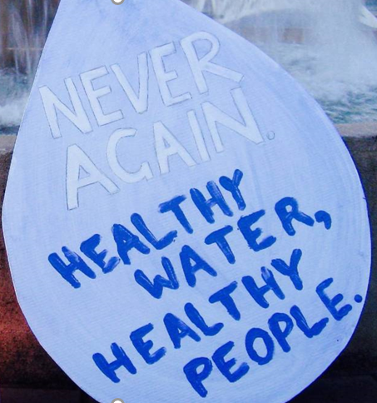
What were the Havelock North Inquiry findings about WSPs....
12
Many water suppliers were engaging consultants to prepare a plan primarily to overcome a compliance hurdle…approval by the Drinking Water Assessor.
The plans were not prepared primarily as a risk management tool.
The plans often highlighted the things that were good about a supply.
It was all about the plan……not risk management.
Many plans were put on a shelf and forgotten about.
Notes:
Jim

Slide 13
We’re taking a new approach
13
Taumata Arowai has been established as the new water services regulator in response to the Havelock North outbreak and Inquiry.
We don’t prescribe what a plan should look like or how it should be prepared.
We don’t approve Water Safety Plans. We review them.
It’s the water supplier's plan and they need to prepare something that they understand and that works for them.
We’re interested in how water suppliers are using their plans and managing risk.
Notes:
Jim

Slide 14
Water Services Act 2021: requirements
Unclassified
14
Notes:
Alan

Slide 15
Our approach to risk
Water suppliers understand their business the best, so are best placed to manage the risks that arise from it.
Encourage a broader approach to managing risk.
Use the risk management approach that best suits your context.
Focus on process of managing the risks to the water supply and how effective you are (not just the completion of a plan).
Outcome of the planning process is documented in the Drinking Water Safety Plan.
We will provide guidance, but the focus will be on drinking water suppliers taking accountability and conducting good risk management practices.
15
Notes:
Alan

Slide 16
Drinking water safety planning
Drinking water safety planning is a continuous risk management process focusing on identifying, assessing, and managing the risks across the whole drinking water supply system – from where the water is sourced to the point of supply to consumers.
Registered water suppliers must update their drinking water safety plan to reflect new requirements of the Water Services Act 2021. Section 31 lists what a drinking water safety plan must do.
Drinking water safety plans will be reviewed, but not approved.
Source water risk management plans form part of a drinking water safety plan and are a new requirement.
16
Notes:
Alan
Water safety plans vs planning – considerable work is underway to provide guidance on the Taumata Arowai approach, the culture change we want to see and our expectations of water suppliers.
Source water risk management plans (SWRMPs) – similarly, considerable work is underway to understand what will be required of water suppliers, how Te Mana o te Wai is taken account of in SWRMPs and the guidance that will be provided to water suppliers.

Slide 17
The importance of protecting source water
The Act defines a ‘source’ as the water body from which water is abstracted for use in a drinking water supply, e.g. rivers, streams, lakes, aquifers and rainwater.
Hazards that affect source water can contaminate the entire drinking water supply and cause illness to those who consume it.
Drinking water suppliers need to understand these hazards and the associated the risks these hazards pose to sources of the drinking water supply and manage these risks well.
A principle of the Act is that all persons with functions and duties under the Water Services Act must give effect to Te Mana o te Wai.
17
Notes:
Alan

Slide 18
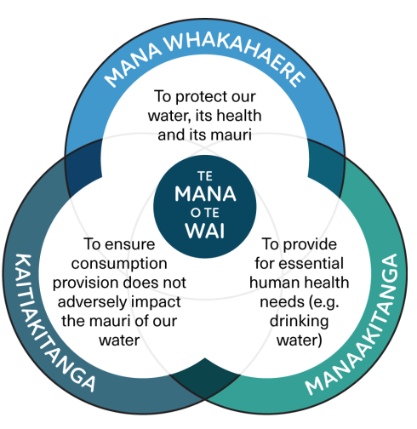
We take a lead from Te Mana o te Wai
18
The Te Mana o te Wai principles and hierarchy of obligations are about restoring and preserving the health, wellbeing, and balance between water, people, and the environment.
We are embracing this water centric approach and aspire to being a Crown leader in giving effect to Te Mana o te Wai.
Notes:
Alan
Māori have always taken a whole of system approach to water, looking at the whole picture from maunga to moana, or ki uta ki tai (from mountains to the sea).
This whole-of system approach recognises that the Te Ao Māori world view consists of fundamentals of tikanga, mātauranga Māori, and kaitiakitanga (to name a few).
There are whole knowledge systems embedded in how iwi/Māori do things, to protect and care for water in their rohe and takiwa.

Slide 19
Source Water Risk Management Planning
Unclassified
19
Notes:
Alan

Slide 20
Source water risk management planning
20
The Act details specific requirements to manage the risks to your source water in the form of a source water risk management plan. This includes:
Identifying any hazards that relate to the source water, including emerging or potential hazards
Assessing any risks that are associated with those hazards
Identifying how those risks will be managed, controlled, monitored, or eliminated as part of a drinking water safety plan
Having regard to any values identified by local authorities under the National Policy Statement for Freshwater Management that relate to a freshwater body that you use as a source of your drinking water supply.
Notes:
Alan

Slide 21
Understand your drinking water source
21
What do you know about activities in the catchment area? What activity occurs on your land and what hazards and risks to the source water can you directly control?
Talk to people in your community who may use the land around your supply and whether their use impacts your supply.
Obtain information about the values that relate to your source water under the National Policy Statement of Freshwater Management.
Increase your knowledge of mātauranga Māori and seek to involve mana whenua meaningfully in the management of risks to your supply.
Increase your knowledge of Te Mana o Te Wai and consider how you will maintain the wellbeing of your source water.
Notes:
Alan
What do you know, what can you see, what can I influence

Slide 22
Drinking Water Safety Planning
Unclassified
22
Notes:
Jim

Slide 23
Drinking water safety planning
23
There are specific requirements that a drinking water supplier must include in their drinking water safety plan as outlined in the Act. This includes:
Identifying any hazards that relate to the drinking water supply
Assessing any risks associated with those hazards
Identifying how those risks will be managed, controlled, or eliminated to ensure that drinking water is safe and complies with legislative requirements
Identifying how the drinking water safety plan will be reviewed on an ongoing basis, and how it will be amended, if necessary, to ensure that drinking water remains safe and complies with legislative requirements
Notes:
Jim

Slide 24
Drinking water safety planning
24
Identifying how the drinking water supply will be monitored to ensure that drinking water is safe and complies with legislative requirements:
Including procedures to verify that the drinking water safety plan is working effectively
Including a multi-barrier approach to drinking water safety that will be implemented as part of the plan
Including a source water risk management plan if required.
Where a drinking water supply includes reticulation, the requirement for the use of residual disinfection in the supply unless an exemption is obtained
Identifying how a supplier will meet the supplier’s duty to ensure that a sufficient quantity of drinking water is provided to each point of supply
Identifying how a supplier will respond to events and emergencies.
Notes:
Jim

Slide 25
Common approaches to risk management
25
There are many different risk management approaches. Choose one that works best based on the scale, complexity, and risks of your supply.
Some common approaches include:
The Plan-Do-Check-Act Cycle
ISO 31000 Risk Management
The bow tie method
World Health Organisation Water Safety Plan Guide.
Notes:
Jim
The Plan-Do-Check-Act Cycle: identifying hazards and risks to your supply and the measures you will use to prevent them occurring (Plan); implementing the measures to control the hazards/risks (Do); monitoring and measuring your processes and reporting your results (Check); then reviewing based on your learnings or to improve your processes (Act).
ISO 31000 Risk Management: an international standard that provides guidelines for managing risks.
The bow tie method: a visual representation of risk, mapped out as a bow tie shape with the top hazardous event in the centre, controls to manage the likelihood of the event occurring on the left-hand side and the controls on the right-hand side to reduce the consequences of the event and to aid in the recovery.
World Health Organisation Water Safety Plan Guide: A step-by-step guide to risk management for drinking water suppliers, using the likelihood/consequence risk assessment approach.

Slide 26
Taumata Arowai takes a new approach
26
Taumata Arowai is developing a risk maturity model which we will use to assess a municipal water supplier's ability to understand and manage risk.
It covers a range of areas including governance and leadership (including Te Mana o te Wai), management and planning, processes, infrastructure, assurance and review.
Our discussions with water suppliers are about how they see risk in their organisation, what processes they have in place to manage it and how they go about it.
Yes, they still must have a Water Safety Plan, but our interest around risk is much wider than that.
Notes:
Jim

Slide 27
Timeframe for registered suppliers
27
If you were previously registered with the Ministry of Health, then you have until 15 November 2022 to review and prepare a drinking water safety plan that complies with the Act.
Alternatively, you can comply with an Acceptable Solution.
Notes:
Jim

Slide 28
Timeframe for unregistered suppliers
28
Unregistered water suppliers have more time. You have until November 2028 to prepare a drinking water safety plan that complies with the Act.
Alternatively, can comply with an Acceptable Solution.
Notes:
Jim

Slide 29
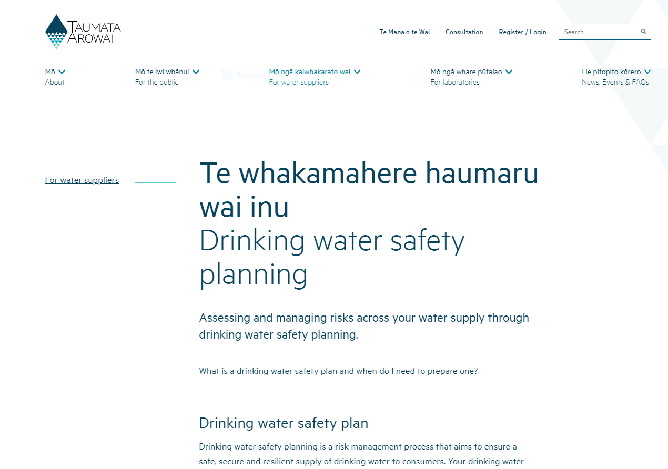
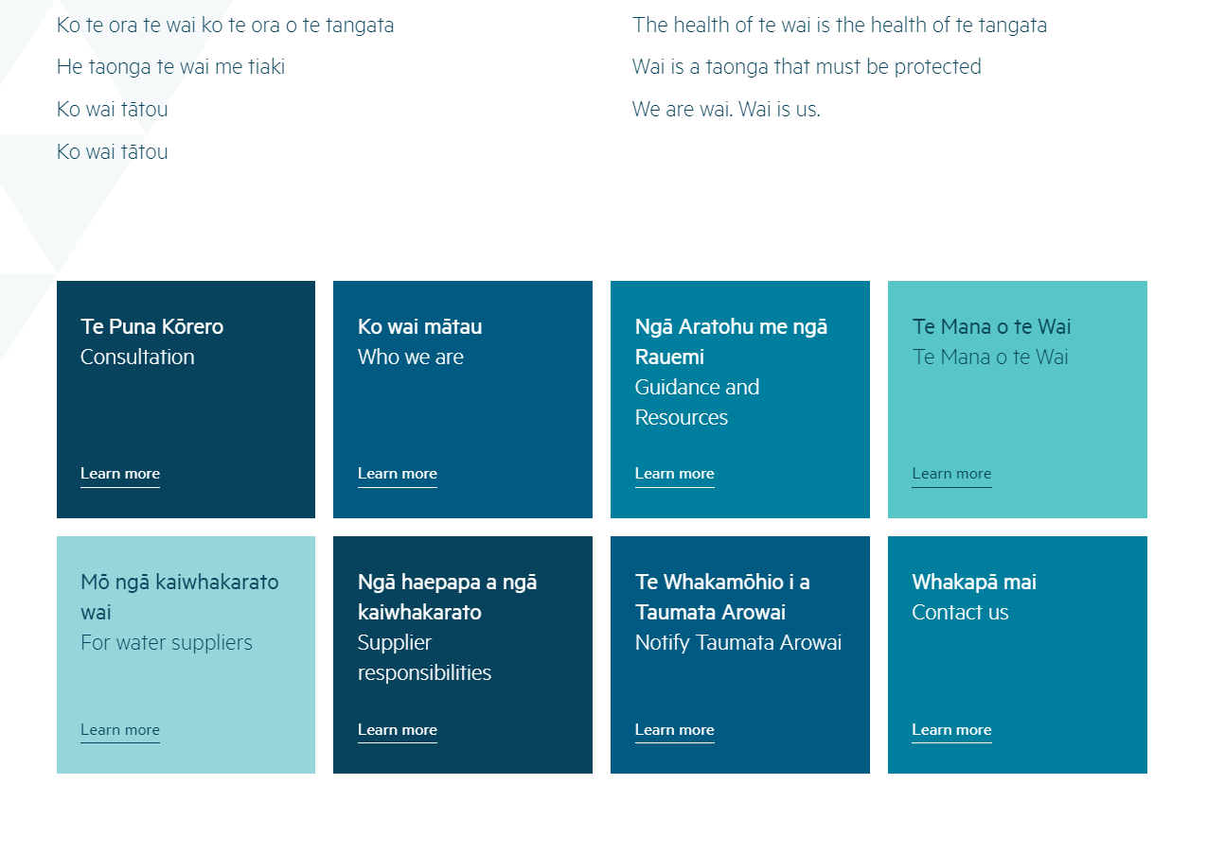
Guidance
29
Find out more and view our guidance on drinking water safety planning and source water risk management planning at www.taumataarowai.govt.nz/for-water-suppliers/drinking-water-safety-planning
Notes:
Jim

Slide 30
Pātai | Questions?
Unclassified
30

