Slide 1
Outcomes and lessons: Trading cost for complexity Freshwater Management Tool
Healthy Waters
Paradigm Morphum
Tom Stephens, Theo Kpodonu, Mahesh Patel, Peter Nowell, Nick Brown
Dustin Bambic, Hana Judd, Caleb Clarke
Notes:
Chance to briefly introduce team, explain our skillsets and

Slide 2
Outcomes & Lessons Freshwater Management Tool
Stormwater is costly & challenging
Management tools
Simple question – how to improve
Challenge – least cost & to target
Modelling solution – process-based, continuous & optimisable
Waterway Action & Investment Strategies needed
Water Reform = affordable
RMA Reform = compliance
Water & RMA Reform = outcomes
Notes:
Key messages:
Delivering first detailed action plans for stormwater contaminants using FWMT now
Talk builds on prior 4 years of development and presentations
Focus is on preparing StormwaterNZ members for those outputs - ensuring their use and value is understood
All facing major reform – centred on reducing costs and improving (Te Mana o te Wai) which foremost requires improved health/quality of our water. Outcomes (effect) and cost (efficiency) now the focus for all of stormwater.
Healthy Water approach focusses on improving outcome and reducing cost – reason for Freshwater Management Tool, a next generation waterway strategic planning and investment model. We are better prepared for the reforms with the FWMT.
End message – FWMT a tool, will reduce the work and costs, by strategic planning for action to deliver science-based effects.

Slide 3
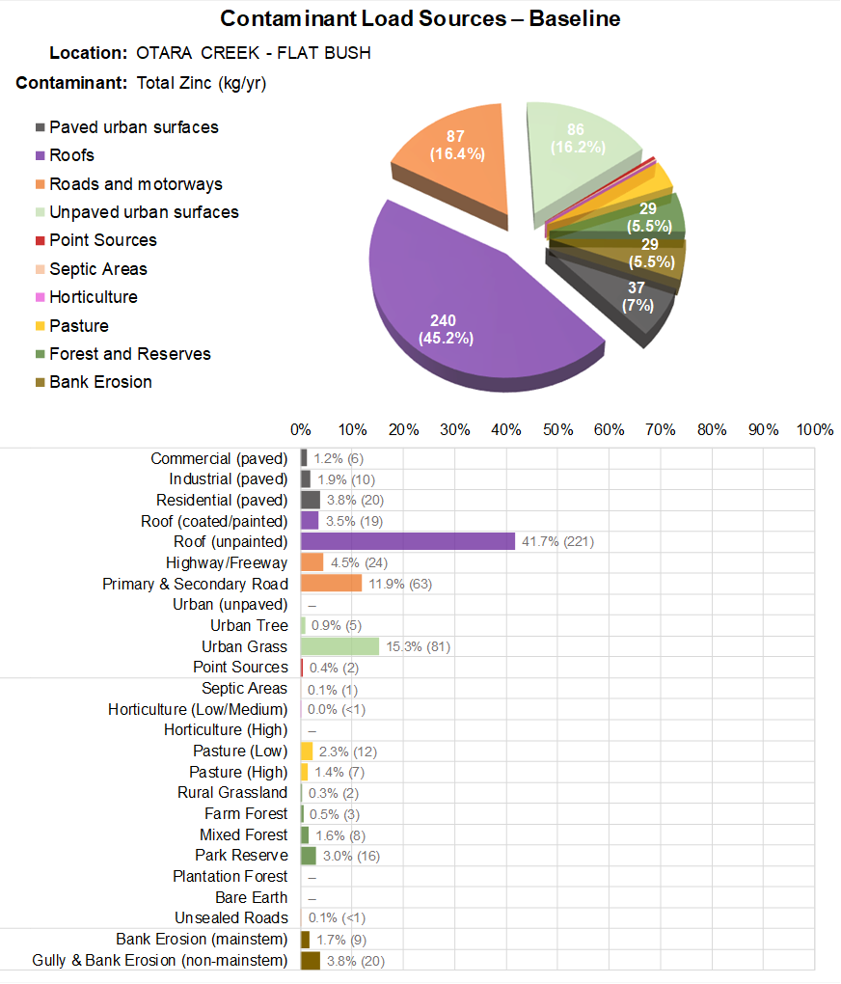
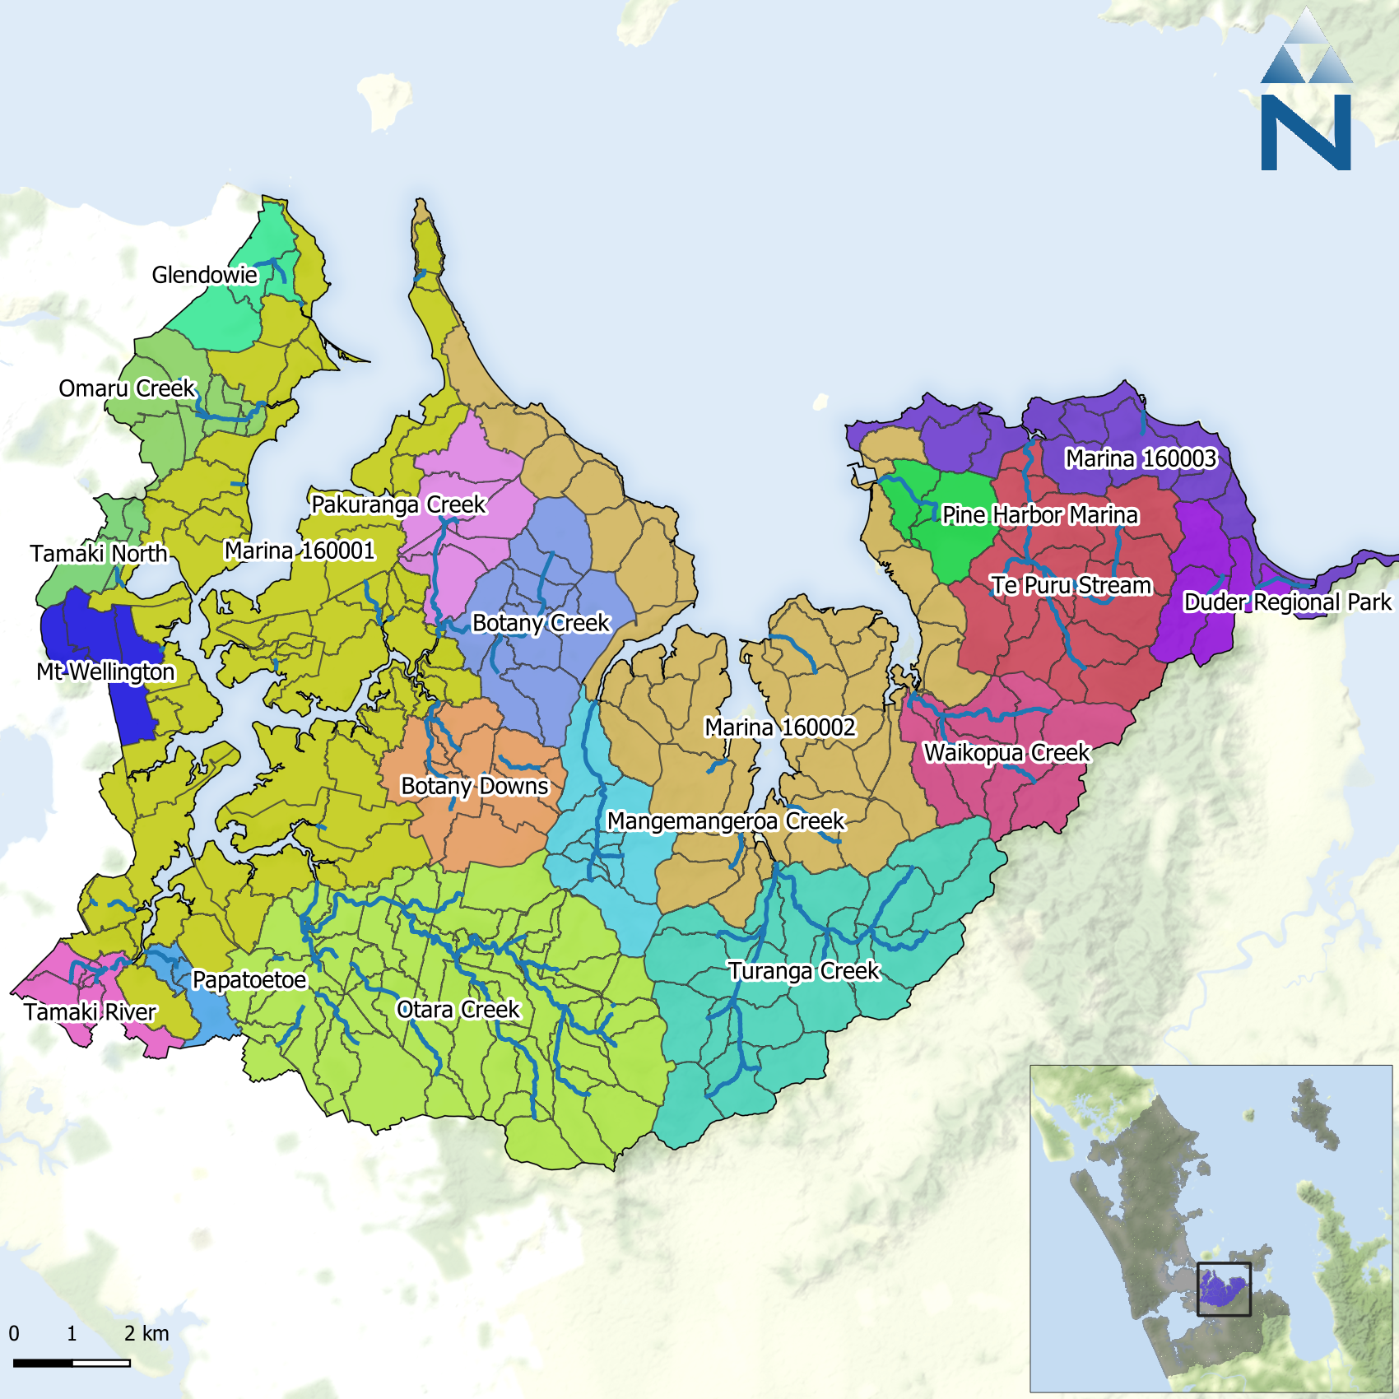
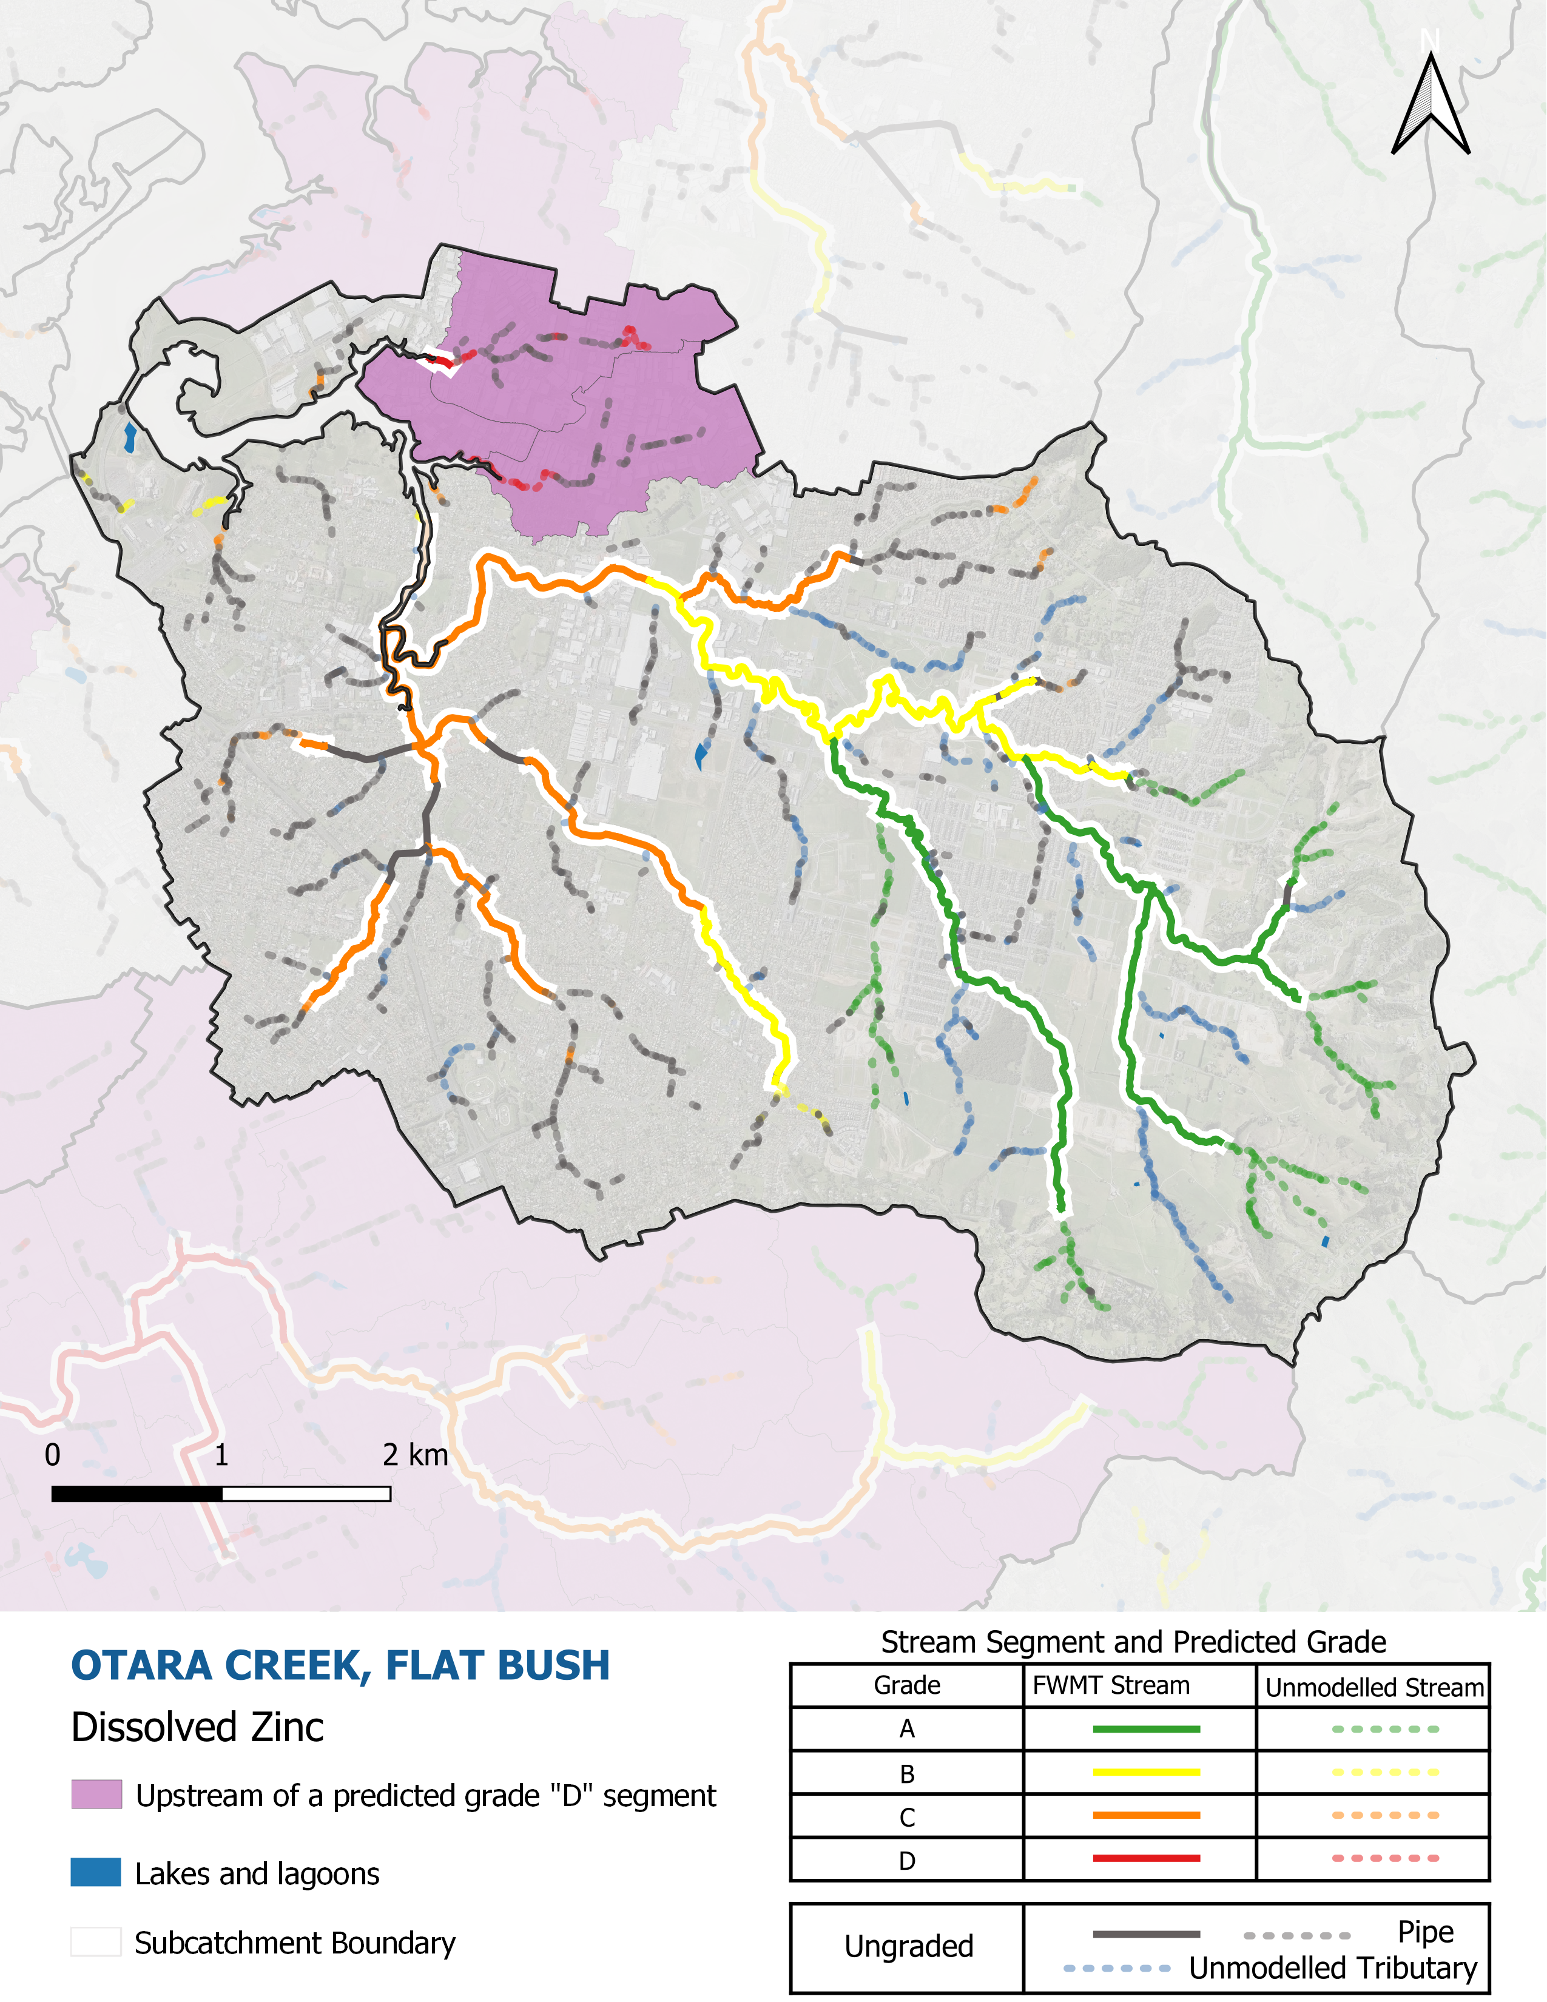
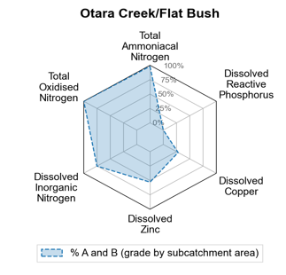
Freshwater Management Tool Choice matters – save ~75% of cost for urban water quality with “source controls”
Notes:
Key messages
Reminder FWMT is a 4-year old programme now – showing outputs from 2 years ago about “baseline state”.
Baseline and optimisation two key elements with baseline complete/improved and optimisation now piloted and in delivery (e.g., July for first set of rural WAI regionwide; September for first set of urban WAI regionwide)
Baseline information is revolutionary in of itself – improving knowledge of differences in water quality at timeframes and scales previously unable to be resolved, as well as developing causative understanding of what is causing those differences in water quality instream and throughout the stream network
Baseline information has been continuously improved and will soon be available in v1.2 including numerous improvements from event-scale observational data to better predict timing, peak flow and concentration regimes.
Baseline the fundamental start of the management process – need to identify where and when degradation occurring, to narrow down to critical sources and catchments to manage, before can then determine feasible interventions and begin to test amongst those for the least-cost solutions (optimal) that deliver the necessary changes to concentration and loads
Example – Otara/Flat Bush stormwater catchment, where DZn is in C or worse grade for half of streams and major source is urban roofing.

Slide 4
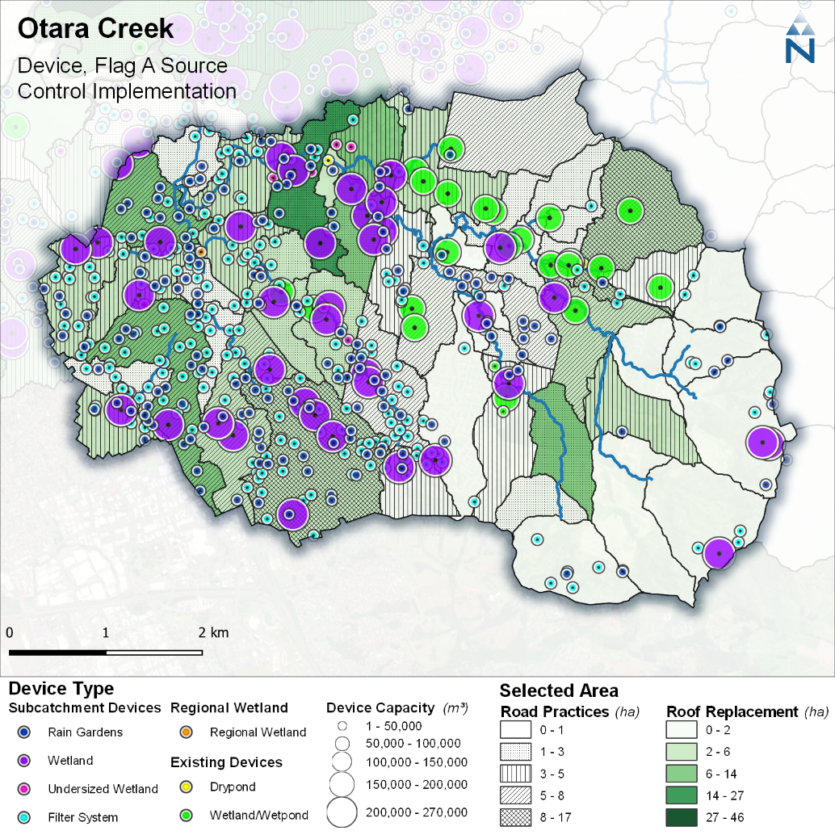
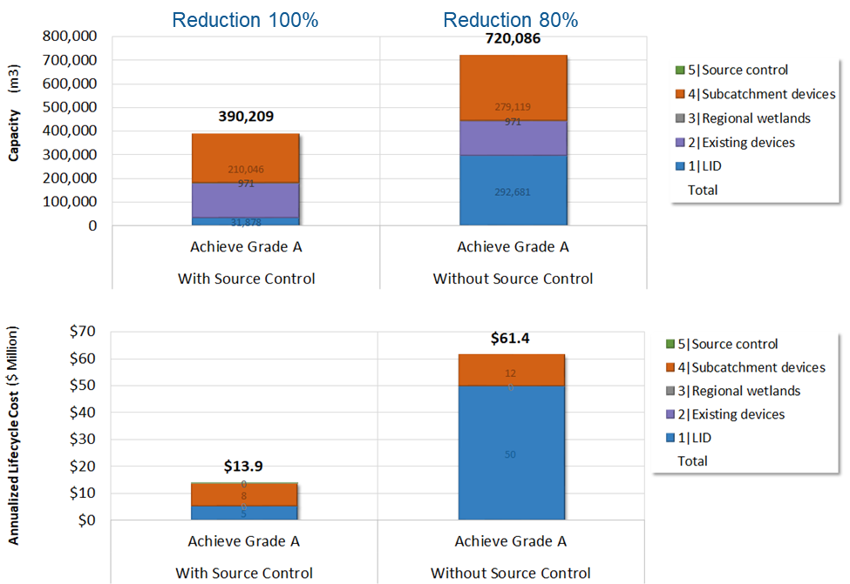
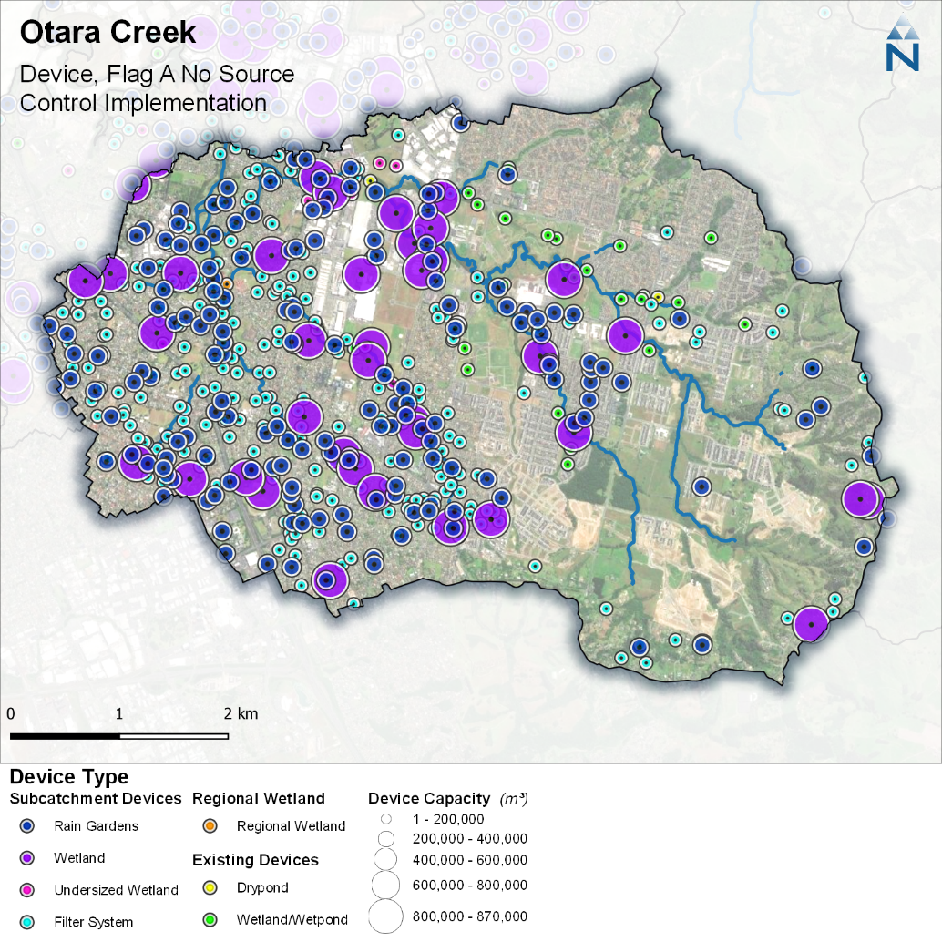
Freshwater Management Tool Choice matters – save ~75% of cost, be more targeted
Notes:
Key messages:
First key function of management tool is to identify feasible and least cost solutions, testing alternatives to direct strategic investment
Second key function is to guide implementation by allocating out least cost solutions geospatially and by action (mapped/graphical output)
FWMT considers both practices (greenstreets, roadsweeping, inert roofing adoption) and devices (raingardens, wetlands, ponds) across both urban and rural activities – example focussing on only urban interventions
Lesson here, that delivering an A-grade (99% protection of organisms from dissolved zinc toxicity) can cost nearly 6 times less (save 78%) in long-term (net present value $) if managing contaminants at source by roofing/roading controls are excluded from options.
Both sets of bar graphs show similar outcome – either 100% of exceedance loads (important concept to stress – loads lost at times when concentrations instream exceed the A-grade thresholds) or 80% of with latter the maximum possible reduction attainable without source controls.
Bar on bottom show costs are not similar at all – using net present value $ (important concept to stress – costs are based on 50-year lifecycle costs using standardised discounting rates and incorporating outlay+maintenance+renewal+land purchase) the cost of reducing all excessive zinc for A-grade using source controls and devices is $14M compared to $61M for 80% of exceedance loads but using only treatment devices.
All costs are the least – there are millions of alternative strategies that can be employed but deliver less treatment and/or greater cost.
Images on right demonstrate the allocation of that investment for the assessment point outcome – one showing source control uptake and other showing absence of. Similar device looking interventions but importantly note the differences in magnitude of device footprint.

Slide 5
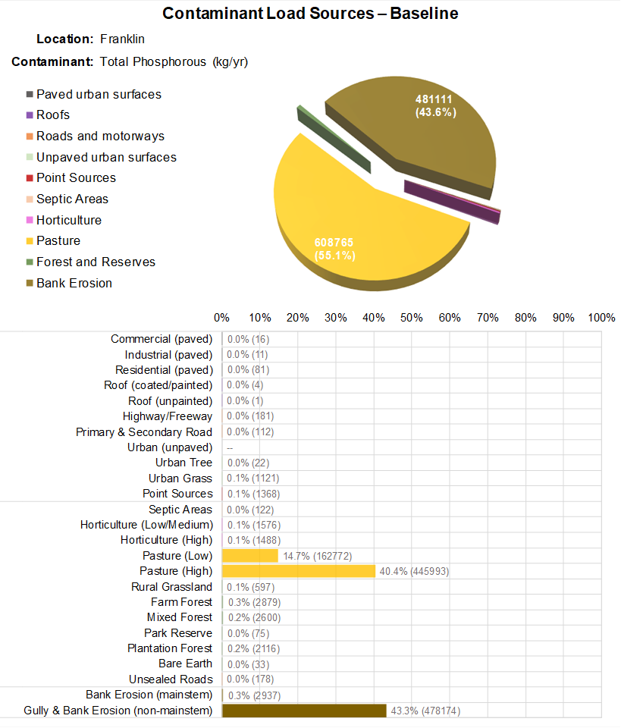
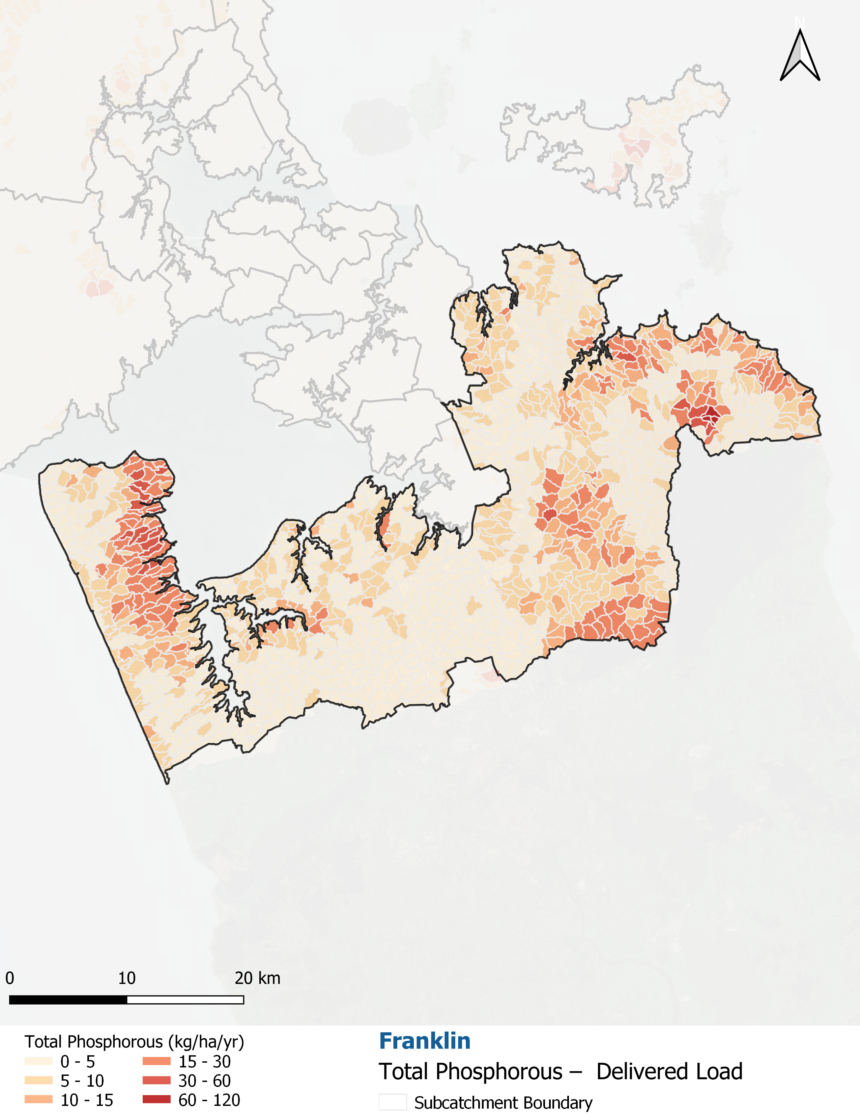
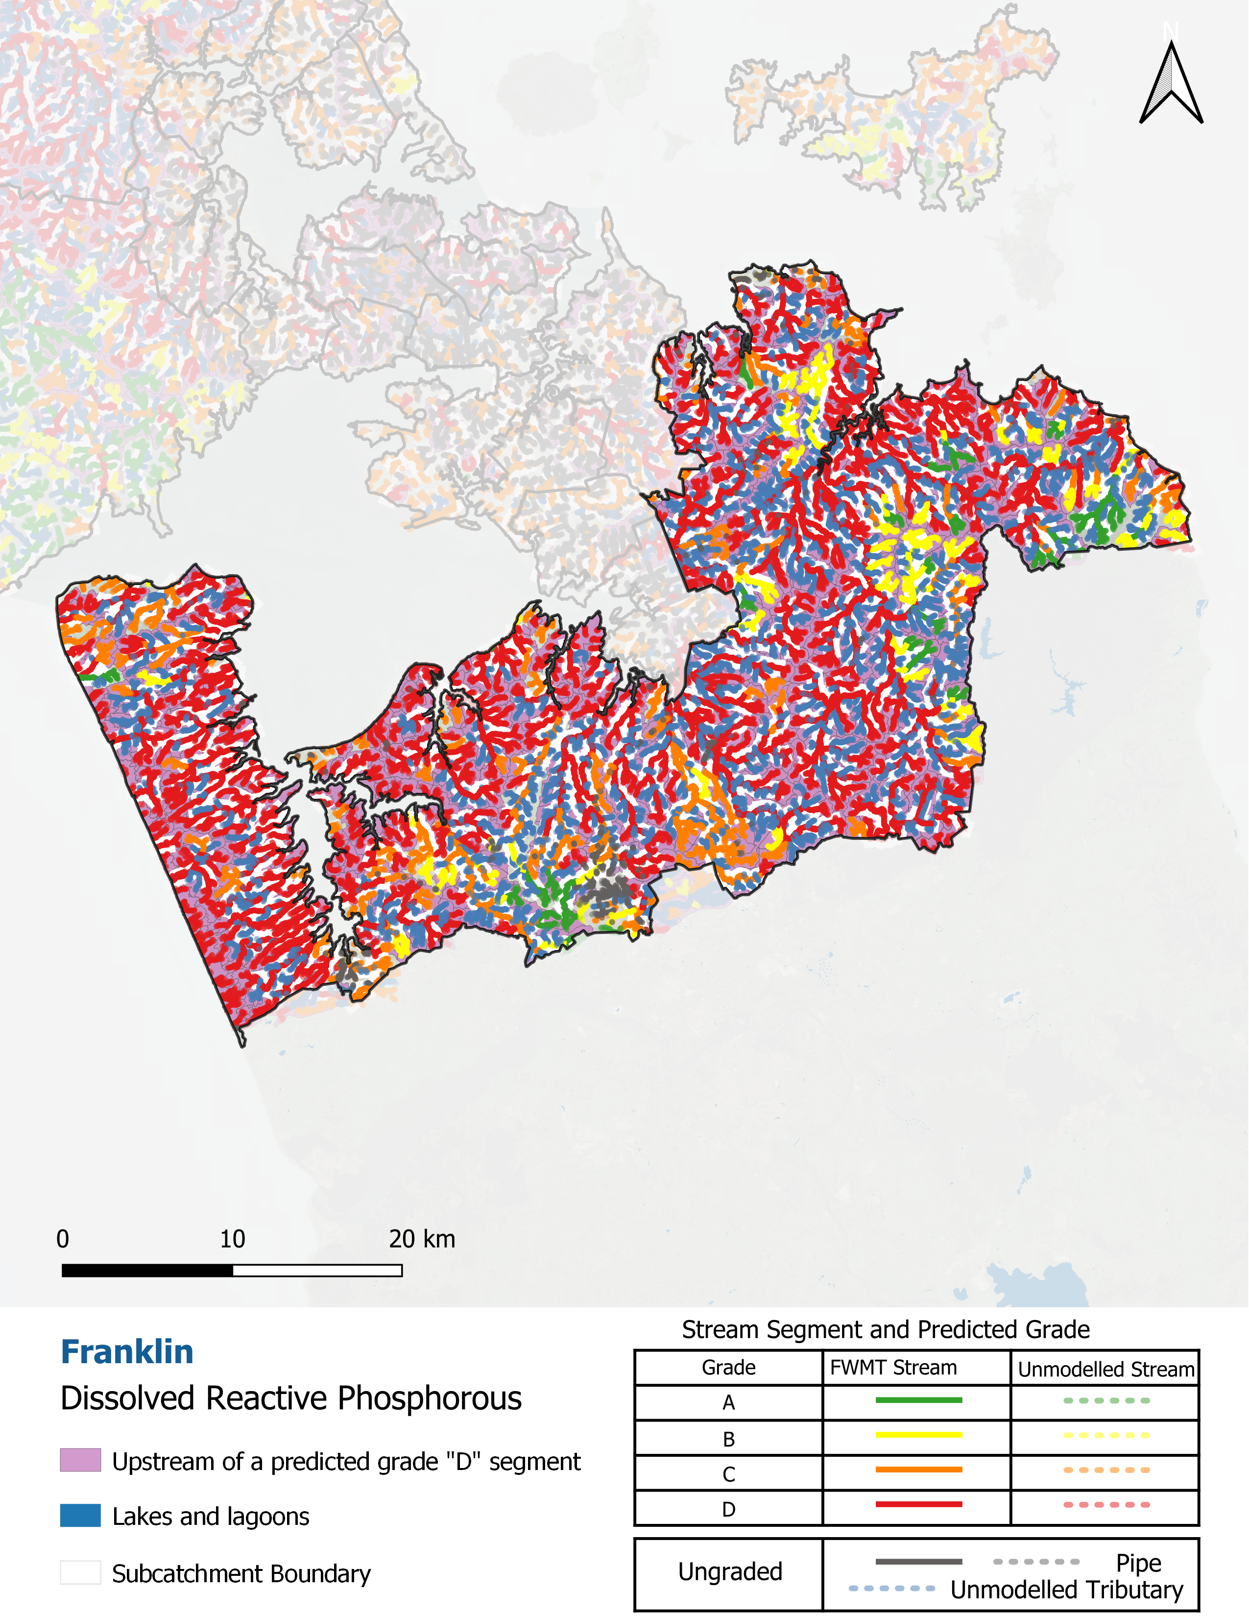
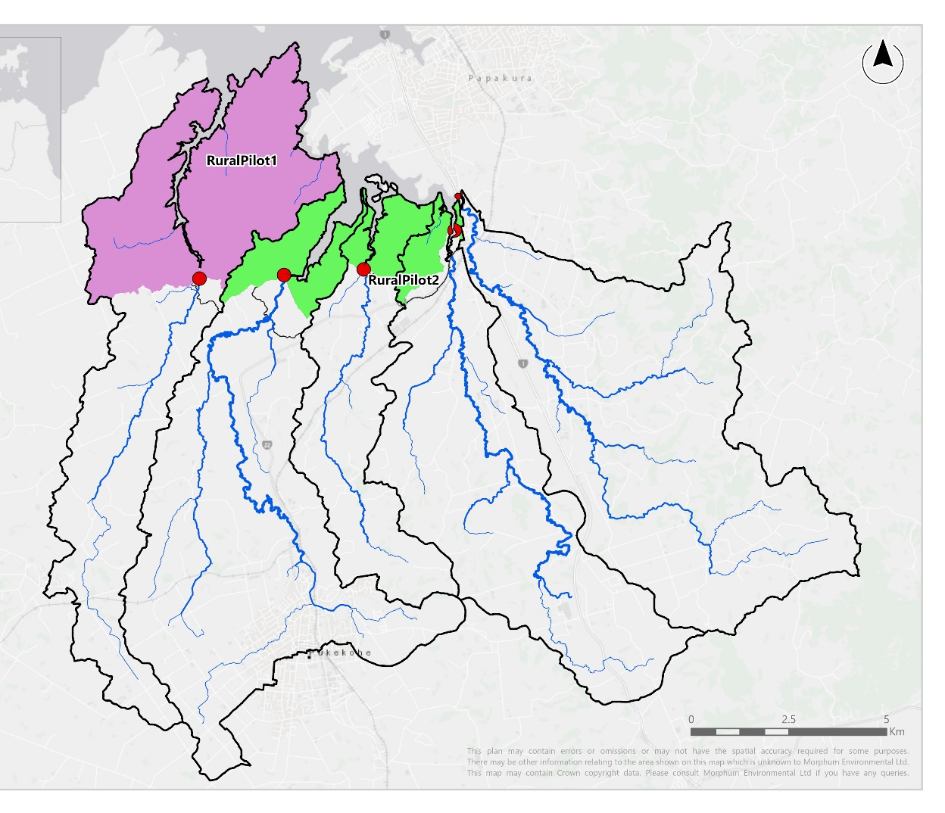
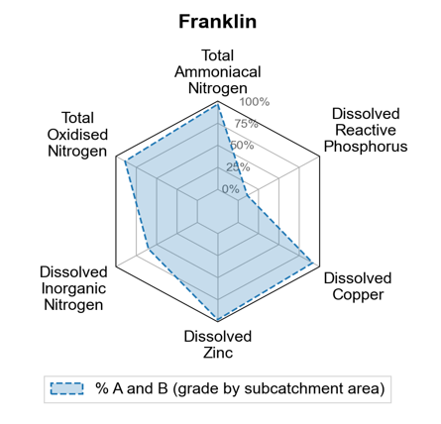
Freshwater Management Tool Targeting matters – save ~90% of cost for rural water quality
Notes:
Key message
Same functions required of FWMT in rural as per urban stormwater – requirement of integrated catchment management (ki uta ki tai)
Key option available to farmers and growers as the adoption of various suites of “good farming practice” that have differing tiers of difficulty with corresponding increasing cost and effectiveness (but also varying efficiency!)
In this example baseline state information has again been used to demonstrate the potential need for large changes in the concentration of a key nutrient in its bioavailable form (dissolved reactive phosphorus) that can lead to excessive plant and algal growth instream and in-harbour
Across five stormwater catchments draining to Manukau, clear large (90%) of streams in C or D grade for DRP and whose sources of phosphorus to stream are predominantly pasture and bank erosion (with most streams on pasture)
Exercise undertaken to determine how to reduce amounts of critical phosphorus being discharged to the harbour and corresponding improvement of stream water quality
Importantly, as with urban example, management here is geospatial and explicit – the optimisation (design of management strategy or WAI) is for outcomes at the assessment point (important concept that outcomes are optimised for assessment point and critical contaminant but with upstream changes and benefits throughout drainage area).

Slide 6
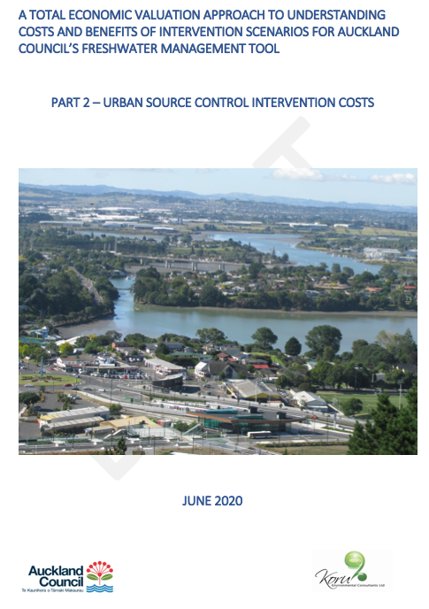
Freshwater Management Tool Targeting matters – save ~90% of cost for rural water quality
Notes:
Key messages:
Activities have differing practices they can implement without changing the actual land use, varying in cost and effect
In this example we applied a variety of uniquely costed sets of practices varying from low (M1), medium (M2) and high (M3) cost for each of dairying, beef and sheep and beef farms as well as unique options for several types of horticulture.
FWMT is based on broader modelling and observational studies throughout New Zealand to ensure the costs and general benefits of an intervention are known – these set the process-representation of the
Interventions in the FWMT have corresponding costs (lifecycle), opportunities (maximum adoptable extent or size of footprint for devices) and generalised benefits (effects on total contaminants – key concept, the optimisation is for losses of total contaminant from land but for those specific days and the magnitude therein essential to achieving a dissolved or reduced/oxidised contaminant concentration instream)
Generalised benefits are independently determined and whose basis (cause) is then translated into processes to ensure the modelling represents reality (e.g., alters build-up/availability or wash-off/loss to waterway)
Important distinction here is that M3 is a more diverse set of practices resulting in equivalent or larger benefit (reduction in contaminant) than earlier M1 and M2 (e.g., TSS doesn’t increase from M1 as M2 and M3 practices are for nutrients)

Slide 7
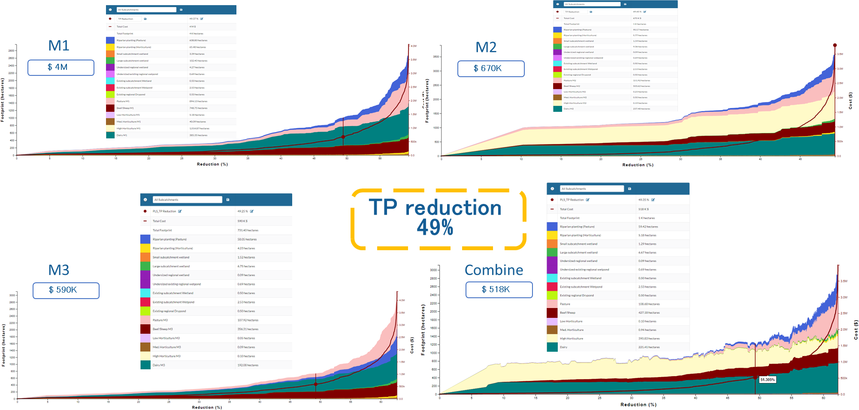
Freshwater Management Tool Targeting matters – save ~90% of cost for rural water quality
$4M
$0.7M
$0.6M
$0.5M
Notes:
Key messages
These graphs are WAI combined across all assessment points in the pilot area – defining the least-cost strategies to follow in all sub-catchments as a whole but based on individual sub-catchment specific results (those curves also exist) to reduce phosphorus losses from only those activities and times when downstream concentrations at assessment points are above the 95th% for an A-grade in DRP
Explain how to read graphs – red line is lifecycle costs, read on righthand axis and increasing with increasing reduction in TP; coloured curves are the distribution of any least cost solution across the various feasible interventions upstream of the assessment points (where bottommost colours signify the most efficient interventions and uppermost less, but whose combination is still the least overall cost for incrementally less TP loss to streams)
Focus on the three graphs M1-M3 which each contain x100 best solutions (important concept – each solution or point is a set of discrete interventions and corresponding costs in each sub-catchment that can be mapped, graphed or shared as a spreadsheet to add transparency and understanding of the optimal management choices in each sub-catchment)
Then note that all three have been arbitrarily set to achieving a halving in excessive phosphorus – so not quite achieving the A-grade but reducing half of the excessive loads and likely getting a B-grade.
So the same outcome (same reduction in TP) but noting that in one instance FWMT could only choose M1, then only choose M2 then only choose M3 options across all the various types of pastoral and horticultural HRU’s (land uses uniquely represented) across exactly the same total net area of those farm types in the catchments.
The same outcome, with the same amount of opportunity but restricting the choices has radically different costs – in this instance, it is considerably cheaper (by 8-fold or nearly 90%) to implement the harder GFP option (M3) on fewer farms than implementing the easier form (M1) on all farms.

Slide 8
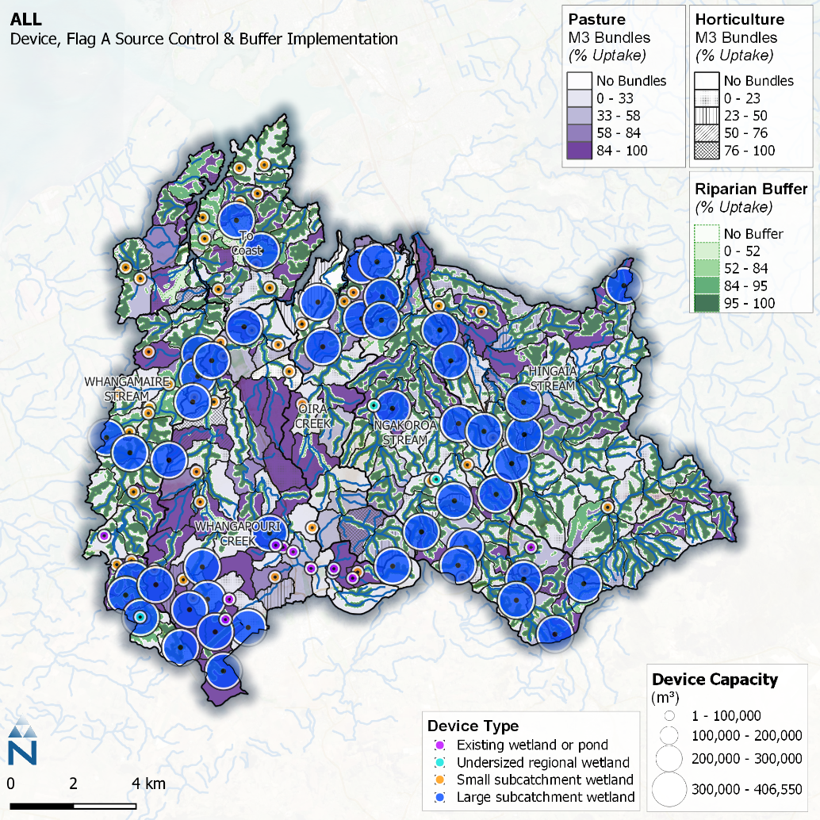
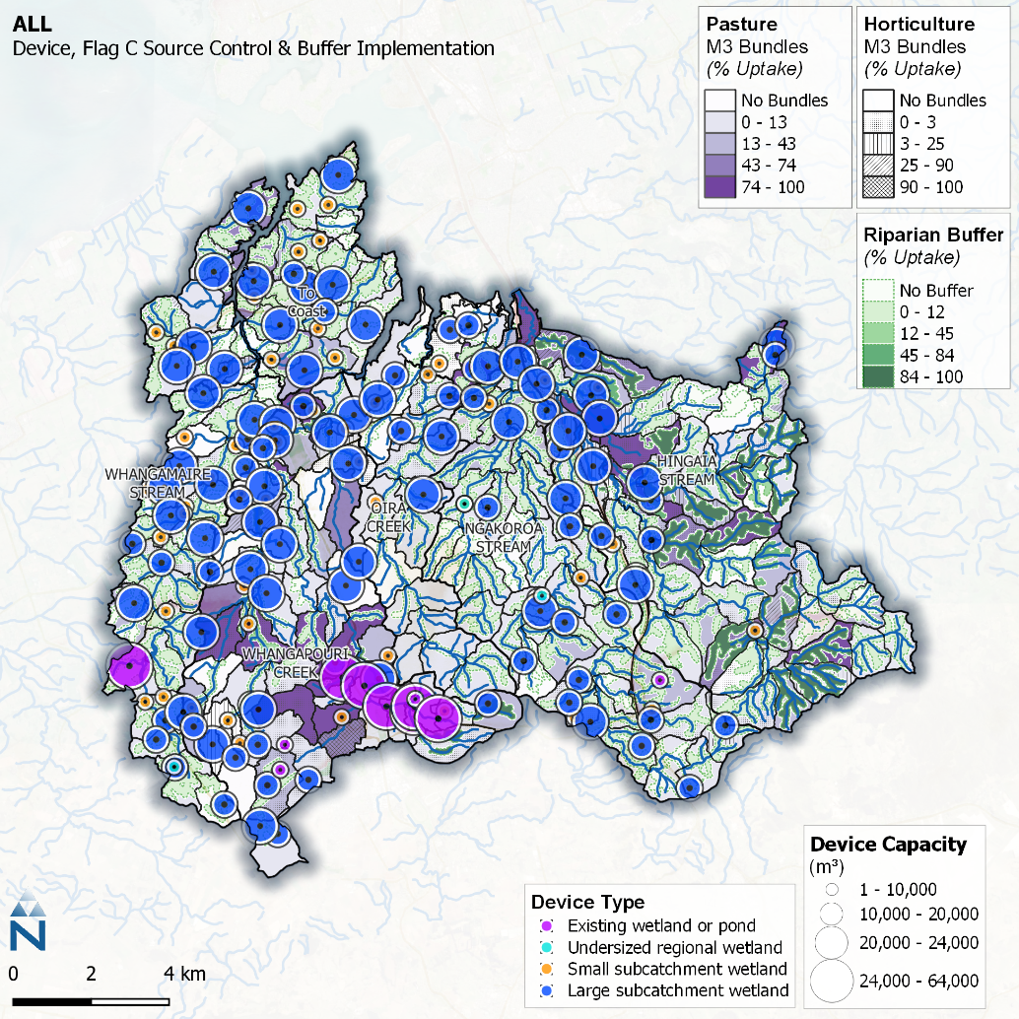
Freshwater Management Tool Targeting matters – save ~90% of cost for rural water quality
Notes:
Key messages
Any of the x100 best solutions in any optimisation output are sub-catchment specific information on the levels of investment (lifecycle cost), whom is investing and actions required to achieve outcomes
FWMT is an outcomes-focussed (management) tool and purposely designed to ensure complex decision-making within sub-catchments on differing types, scales or and locations for interventions
These maps are related to last images but this time for the M3 solution and for an A-grade in DRP at assessment points (e.g., 100% critical load removed at least cost)
Image on right shows the degree of opportunity taken up for A-grade (higher water quality) and image on left for C-grade (poorer water quality but still, improvement on baseline hence some cost)
The greater water quality improvement needed for A-grade reason for the stronger shading (higher % uptake of intervention opportunities) on right
All 100 points on optimisation curves contain a unique, least cost set of actions to implement and can be mapped, graphed or represented as a spreadsheet with information specific to each sub-catchment – strategic even if explicit

Slide 9
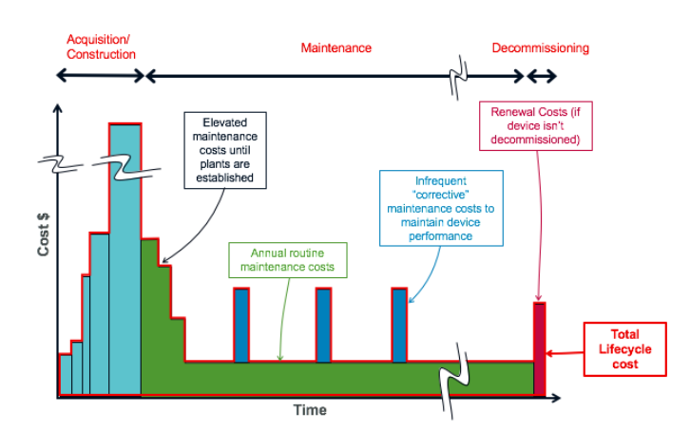
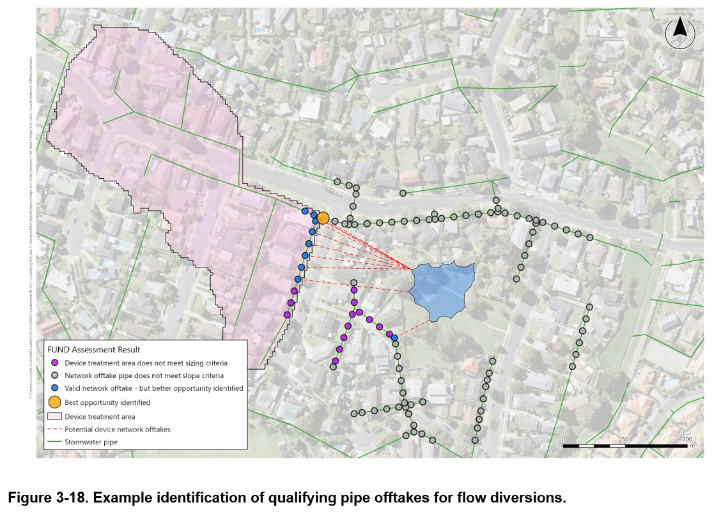
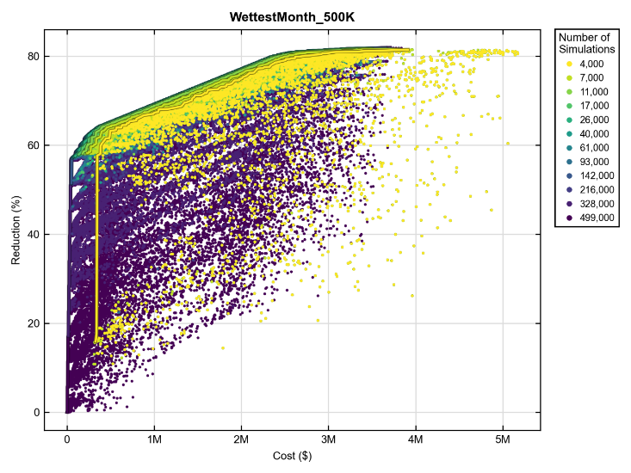
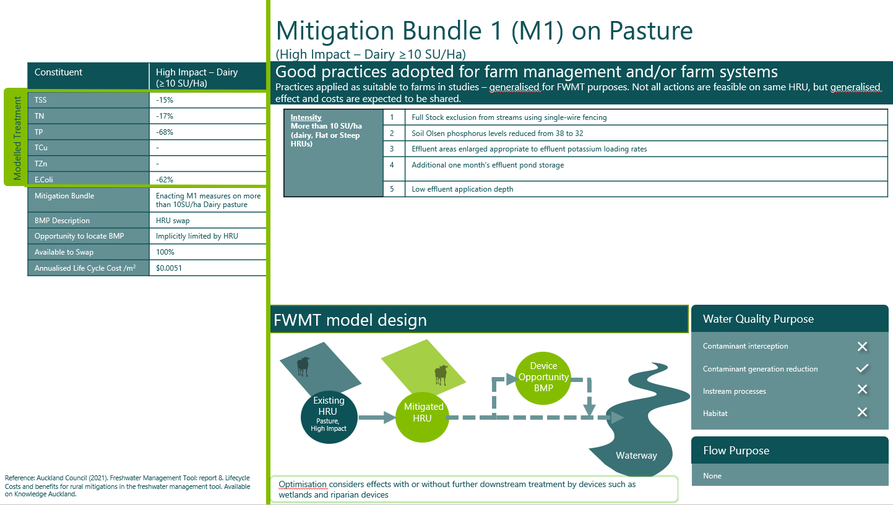
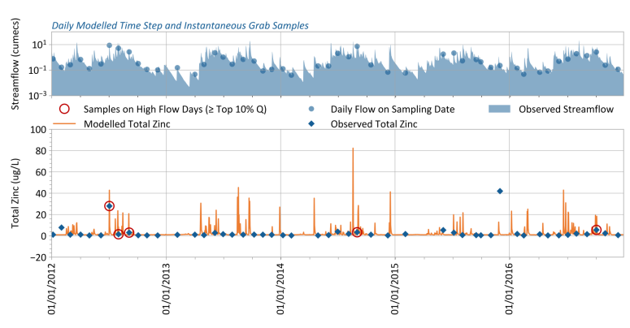
Optimisation Complex inputs & approach – purpose governs design, design governs use
Notes:
Key messages
Optimisation is complex – there are numerous steps, with differing options available in each and which can alter the optimisation outputs (e.g., can alter the selection of which interventions offer the most cost-effective means of managing a critical load).
Won’t have time to delve into all steps – key is simply that there are alternative ways to implement each step and in our instance we have always regionalised our steps (made consistent regionwide) as well as focussed our initial outputs (on operationally relevant water quality measures and on well proven mitigation choices).
Defensible simplicity guides our approach
Previous conference presentations have highlighted the development of various inputs to the FWMT including (1) lifecycle costs for x111 interventions; (2) opportunity mapping for all devices in each of 5,465 sub-catchments (footprints and treated areas for 100,000’s devices); and (3) mitigation cards determining how interventions must be represented by the process-modelling (e.g., whether to alter build-up and/or wash-off)
Will dive into the updated opportunity mapping – to remind how FWMT optimises on numerous discrete footprints and corresponding contaminant sources in upstream drainage areas (within sub-catchments)
Will dive then into the numerous steps involved in producing an optimisation curve – noting key here is that the steps involve 2-tier (key concept that optimisation happens both within and between sub-catchments) and various key steps from limiting design contaminant to best solutions to production runs to WAI at assessment point

Slide 10
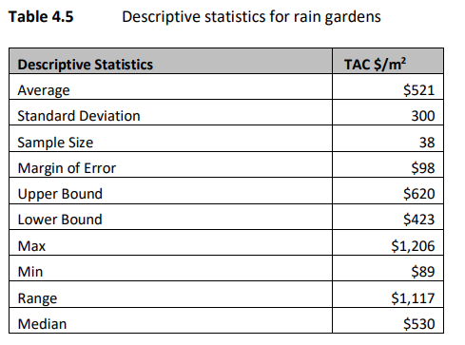
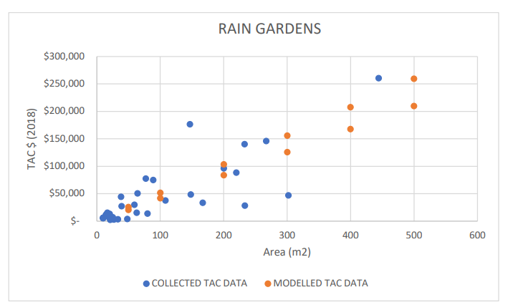
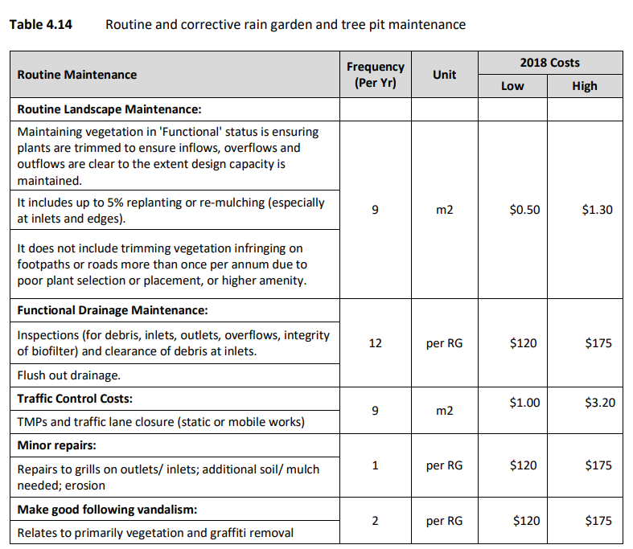
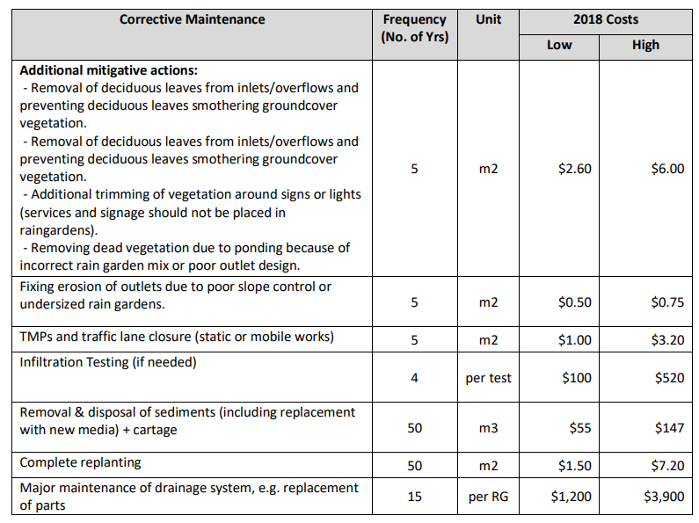
Optimisation Input complexity – lifecycle costing & size

Slide 11
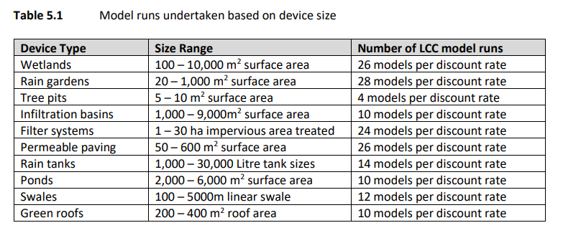
Optimisation Input complexity – lifecycle costing & standardised size

Slide 12
Optimisation Complex inputs & approach – purpose governs design, design governs use

Slide 13
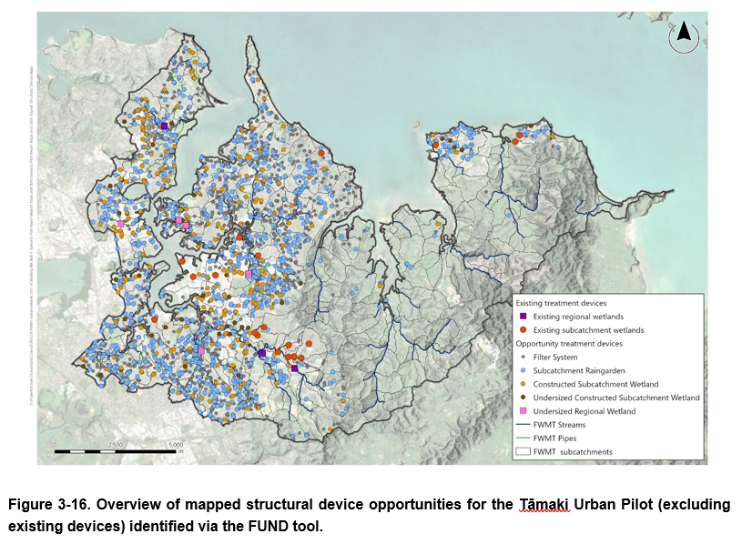
Optimisation Input complexity – opportunity mapping
Device siting exclusions | Justification | Data Source
Slope > 4% | 4% selected as compromise between device viability and not requiring excessive earthworks to create level site. | Auckland Digital Elevation Model (DEM) created as a 2m grid from various LiDAR data (AC, 2006)
Slope >50% (5 m buffer applied) | Recognises potential for creating unstable perimeter if excavation is too close to steep slopes (1V:2H). This criterion is a way of avoiding areas that would still qualify under the 8% condition near to steep slopes and retaining walls. | Auckland Digital Elevation Model (DEM) created as a 2m grid from various LiDAR data (AC, 2006)
Building outlines (5 m buffer applied) | It was assumed that public wetlands and raingardens will not be built within 5m of existing buildings. | Building Outlines (LINZ, 2019)
Waterbodies | It was assumed that reclamation of existing waterbodies would not occur to create new devices. | FWMT LULC v1.1 (Morphum Environmental, 2018)
Residential properties | It is assumed that construction of a wetland or raingarden would not occur across multiple residential properties. Commercial and industrial parcels are included as potential opportunity areas. | FWMT LULC v1.1 (Morphum Environmental, 2018)
Coastal inundation | Devices likely not be implemented where sea level rise predicted to occur | CoastalInundationControl (Auckland Council, 2019)
Significant Ecological Areas | Land disturbance is restricted within SEAs as per the Auckland Unitary Plan | SEA (Auckland Council, 2019)
Existing treatment facilities | It is assumed that future construction of wetlands or raingardens would not occur where flows are already treated. | swWaterTreatmentFacility (Auckland Council, 2019)
Road HRU | It is assumed that construction of a wetland or raingarden would not occur within live lane | FWMT LULC v1.1 Morphum Environmental 2018
Offtake Criteria | Justification | Data Source(s)
Pipe <100m from edge of potential device | Diversion pipelines greater than this length require multiple manholes and unlikely to be installed by directional drilling, therefore deemed too disruptive and expensive to construct. | SW Pipe Network (Auckland Council, 2019)
If network offtake within 2m of permanent stream or intersects an existing treatment facility, then remove opportunity | Treatment device opportunities unlikely to utilise offtakes crossing permanent streams or from existing treatment devices. | Permanent Streams Layer (Auckland Council, 2018) swWaterTreatmentFacility (Auckland Council, 2019)
Grade between pipe and device location >1.0% | Selected as minimum grade to allow adequate conveyance of stormwater to device. 1.0% recognizes that pipe invert is often inferred using pipe ground level as a proxy, incorporating error margin. Auckland design manual states 0.1% minimum grade for stormwater pipes | AC SW Pipe Network swPipe (Auckland Council, 2019) DEM (AC, 2016)
Assumed excavation depth of device footprint 1.5m | Assumed earthworks required to prepare device site location for constructed treatment opportunity. Earthworks that require excavation depth > 1.5m likely prohibited by costs/disruption and less likely to drain back into the network. | NA
Assumed pipe invert depth of 1.5m if no attribution exists | Pipe invert level was calculated using stormwater network invert levels where available (either from the pipe itself or any adjoining infrastructure such as manholes). 1.5m represents the typical balance between minimized earthworks/ safe trenching depth and minimum network covers. | NA
Treatment area exceeds 2500 m² | Based on min device area / treatment area ratios including viability of public device treating multiple private properties. | NA
Preferential network offtake opportunity – green and larger prioritised | Estimated device type is assigned based on device footprint to device catchment ratio. Device footprint / Network offtake pairs are prioritised by (i) device type and (ii) maximizing treatment area. Green infrastructure is prioritised over grey infrastructure. | NA
Extract Device Opportunity Footprints
Identify Best Opportunities in the Network
Delineate Device Catchments
Determine Routing Location
Assign Specific Designs
Determine Maximum Treatment Opportunity by HRU

Slide 14
Optimisation Input complexity – opportunity mapping

Slide 15
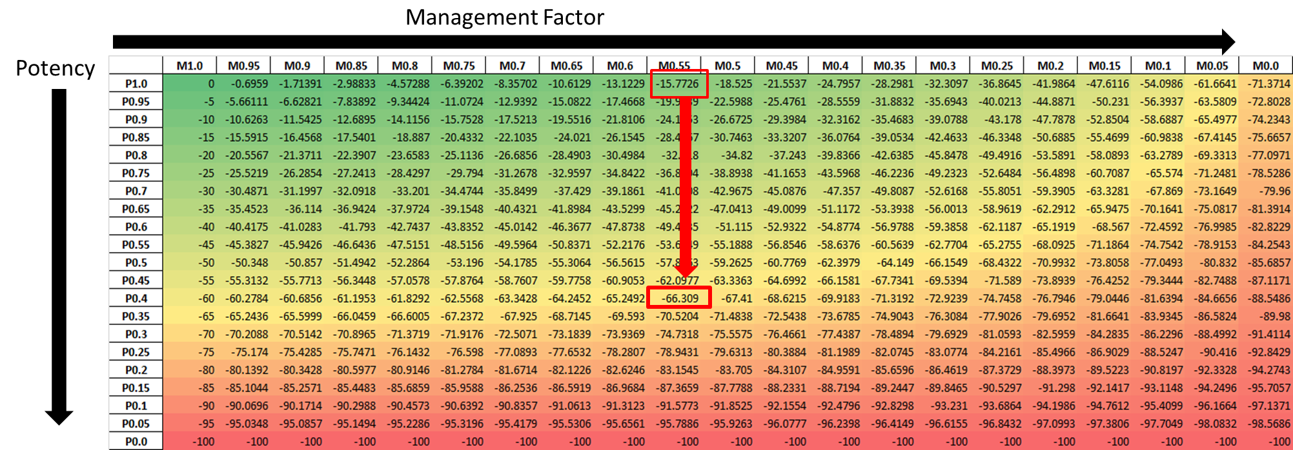
Optimisation Approach complexity – design & parameterisation of interventions

Slide 16
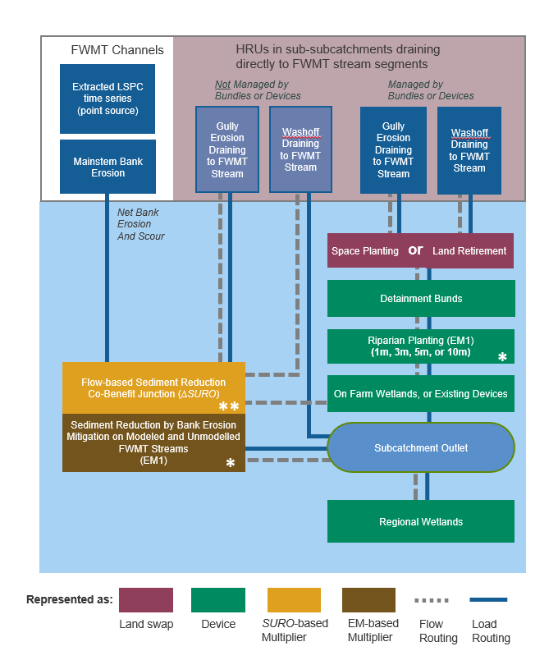
Optimisation Approach complexity – treatment train & stream erosion
Treatment trains - logical, diversify optimisation
Upstream interventions always first carriage; wetlands always last carriage
Bypass/untreated loads possible
Any combination of number of carriages (just order fixed)*
*(Exponentially increases optimisation difficulty)
Erosional benefits complex:
Unmodelled streams – directly attributed back to intervention (85% network)
Modelled streams – represented but unattributed (cumulative rather than local effect)

Slide 17
Optimisation Complex inputs & approach – purpose governs design, design governs use

Slide 18
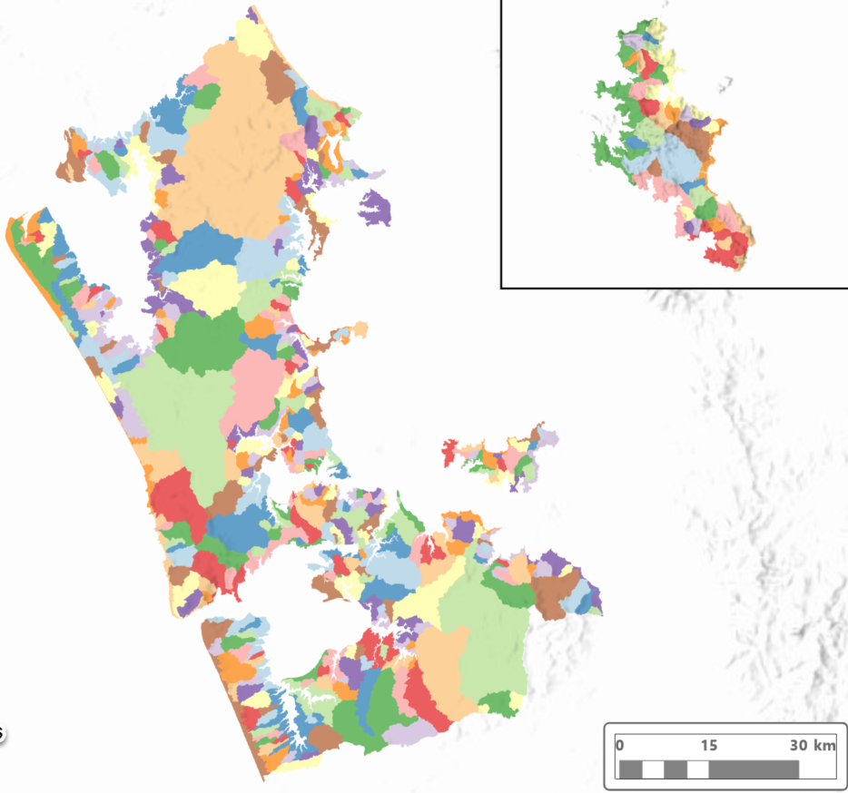
Optimisation Approach complexity – assessment points
CREs | 100% Rural | 100% Urban | Mixed | Total
Hibiscus Coast | 13 | 15 | 9 | 37
Islands | 54 | 4 | 5 | 63
Kaipara | 62 |  | 1 | 63
Mahurangi | 7 |  | 3 | 10
Manukau Harbour | 52 | 23 | 13 | 88
North East | 27 |  | 1 | 28
Tamaki | 8 | 12 | 5 | 25
Wairoa | 20 |  |  | 20
Waitemata | 4 | 45 | 9 | 58
West Coast | 28 |  |  | 28
Total | 275 | 99 | 46 | 420
Reminder “our” needs
Cumulative effects (integrated)
Critical effects (meet grade)
Optimisation (reduce cost)
Assessment points enable all three
Waterway Action & Investments are to “assessment point”
Larger streams (x3 sub-catchment min)
All or part of stormwater catchment
Coastal strips aggregated
Optimised for single contaminant (co-benefit)

Slide 19
Optimisation Approach complexity – library choices (rural or urban)
Intervention | HRU variants (differing cost +/- efficacy) | Design variants (further variation in cost +/- efficacy)
Good farming practices | High Impact Horticulture, Low/Medium Impact Horticulture, Dairy, Drystock | Low, Medium & High effort variants
Naturalised wetland | High Impact Horticulture, Low/Medium Impact Horticulture, Dairy, Drystock | <5 Ha footprint (fencing & planting if pasture; planting only if horticulture)
Rural constructed wetland | High Impact Horticulture, Low/Medium Impact Horticulture, Dairy, Drystock | >=5 Ha footprint
Decanting earth bund | High Impact Horticulture, Low/Medium Impact Horticulture
Riparian management | High Impact Horticulture, Low/Medium Impact Horticulture, Dairy, Drystock | Dairy & Drystock = >15 and <=15 degree cost variants (fencing) All = planted* and grassed variant (cost, efficacy) All = 1m, 2.5m 5m and 10m variant
Highly erodible land management | Dairy, Drystock | Space-planting Retirement in non-harvested forest
Intervention | Stormwater variants (differing cost +/- efficacy) | Design variants (further variation in cost +/- efficacy)
Stormwater (constructed) wetlands | Greenfield, brownfield | Low, Medium, High cost
Raingarden | Greenfield, brownfield | >20m2 by Low, Average, High cost
Treepit | Greenfield, brownfield | <10m2 by Low, Average, High cost
Swale | Greenfield, brownfield | Drained (*infiltration excluded) by Low, Average, High cost
Green roof | Greenfield, brownfield | Low, Average, High cost
Filtration system | Greenfield, brownfield | Low, Average, High cost
Raintank | Greenfield, brownfield | Low, Average, High cost
Street-sweeping |  | Low, Average, High cost
Catchpit cleaning |  | Low, Average, High cost
Roofing |  | Inert, Low-Zn alloy by Low, Average, High cost
Septic system |  | Low, Average, High cost

Slide 20
Optimisation Complex inputs & approach – purpose governs design, design governs use

Slide 21
Optimisation Approach complexity (Tier 1) – Best solutions
Optimisation begins in sub-catchment (“Tier 1”) in three steps
Design limiting contaminant – N, P, CU, Zn, E.coli…
Best solutions (3M → 100) – “limiting” load
Production run (100) – “critical” load
Best solutions choices
Limiting contaminant
Boundary climate 3M Short-period (average year*, 25-75mm design storm**, wettest month*)
Convergence
*Real, **Synthetic

Slide 22
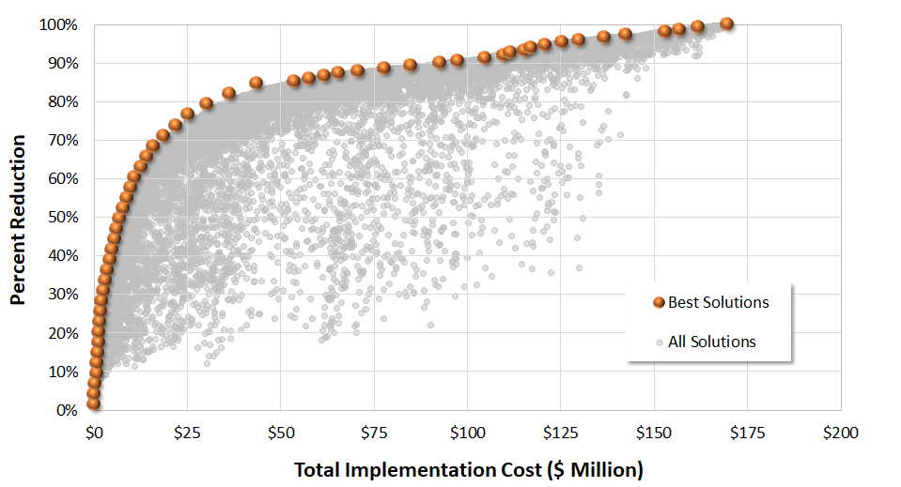
Optimisation Approach complexity (Tier 1) – Best solutions
This one is the most Cost-effective
All these solutions achieve the same Percent Reduction
Difference in Cost
$100 M

Slide 23
Notes:
Key messages:
Prepare to see FWMT outputs – geospatial, costed and effect-based changes in management needed to deliver on water quality objective
Water quality – RMA and AW reforms all require management of water quality to deliver on Te Mana o te Wai, with clear requirement to protect ecosystem health above all.
Water quality – RMA reforms (captured in AWR) also have shifted the focus of contaminant outcome being instream concentration regimes (acute, chronic) in addition to the continued management of loads being a operational requirement of stormwater management. Grades are the new reality of stormwater compliance.
FWMT and other management tools under development are purposely complex – the requirements facing stormwater are challenging and difficult to resolve to the scales (catchment) needed. Careful design needed to minimise unnecessary complexity.
WAI identify least/low cost actions, targeted (type, scale, where) for integrated water quality objectives – specifically for achieving instream concentration regimes for particular grades, at assessment points and from feasible upstream interventions that include devices and practices.
WAI are strategic outputs – resolved and based on fine-scale individual footprints and treatment areas, but whose design is purposely to arrive at AMP estimates and distribution of resourcing across catchments and interventions. Indicative and prompting, but not intended to simply be designed and implemented without further effort*
*Supportive of regulation but as you’ll see, too sophisticated and diverse to be used in regulation as is (e.g., regulatory frameworks normally require compliance simply with effect rather than intervention, and if regulating an intervention then tend to be uniform and untargeted across activity and catchments).

Slide 24
Lessons learned Management tools trade cost for complexity… necessary complexity
“Deliver outcome, save cost & ensure compliance”
Challenging & complex – stormwater is costly & diverse
Least-cost – 50-year lifecycle (optimised)
Action-based – x111 diverse interventions on x106 activities, across x5,465 sub-catchments (for infrastructure and practices)
Targeted – designed around critical times, sources and treatment needed
Integrated – regionwide mountains to sea
Strategic – action, scale, cost & outcome (by sub-catchment)
Are management tools essential to Entity services?
(…in Healthy Waters for AMP, LTP, NDC, WQTR)
Notes:
Key messages:
Prepare to see FWMT outputs – geospatial, costed and effect-based changes in management needed to deliver on water quality objective
Water quality – RMA and AW reforms all require management of water quality to deliver on Te Mana o te Wai, with clear requirement to protect ecosystem health above all.
Water quality – RMA reforms (captured in AWR) also have shifted the focus of contaminant outcome being instream concentration regimes (acute, chronic) in addition to the continued management of loads being a operational requirement of stormwater management. Grades are the new reality of stormwater compliance.
FWMT and other management tools under development are purposely complex – the requirements facing stormwater are challenging and difficult to resolve to the scales (catchment) needed. Careful design needed to minimise unnecessary complexity.
WAI identify least/low cost actions, targeted (type, scale, where) for integrated water quality objectives – specifically for achieving instream concentration regimes for particular grades, at assessment points and from feasible upstream interventions that include devices and practices.
WAI are strategic outputs – resolved and based on fine-scale individual footprints and treatment areas, but whose design is purposely to arrive at AMP estimates and distribution of resourcing across catchments and interventions. Indicative and prompting, but not intended to simply be designed and implemented without further effort*
*Supportive of regulation but as you’ll see, too sophisticated and diverse to be used in regulation as is (e.g., regulatory frameworks normally require compliance simply with effect rather than intervention, and if regulating an intervention then tend to be uniform and untargeted across activity and catchments).

Slide 25
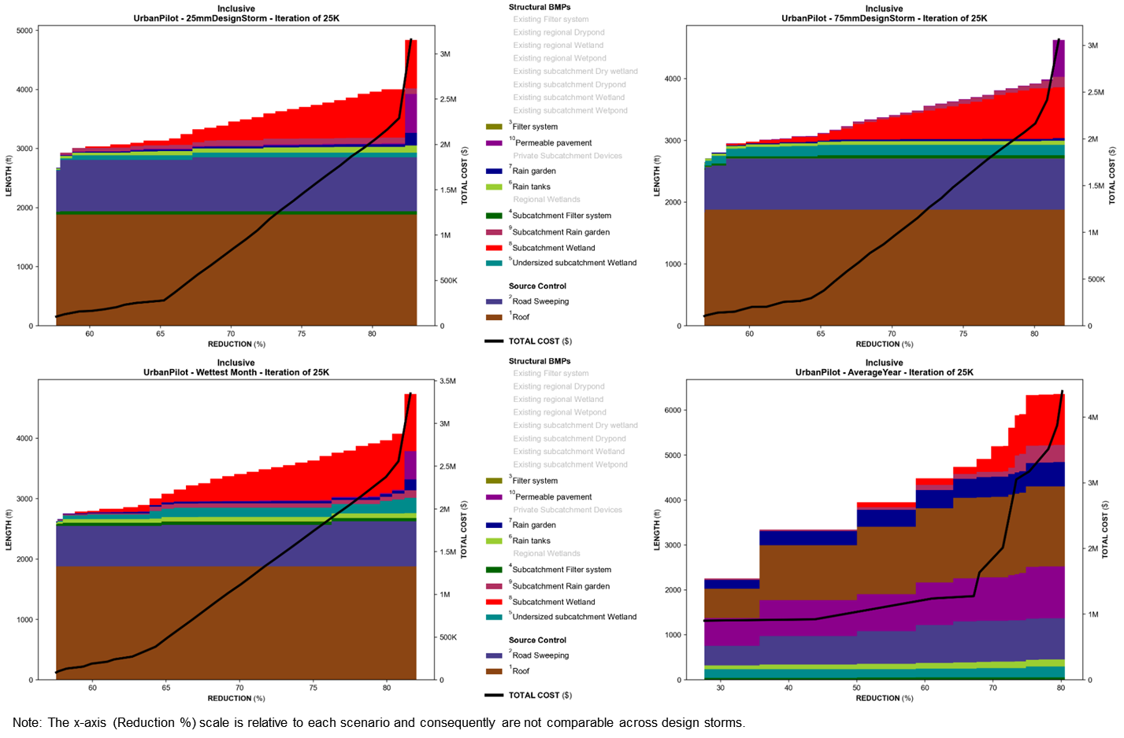
Optimisation Approach complexity (Tier 1) – Best solutions boundary condition choices

Slide 26
Optimisation Approach complexity (Tier 1) – Production run & critical condition
Acute (95th%)
Zinc
A-grade
Chronic (median)

Slide 27
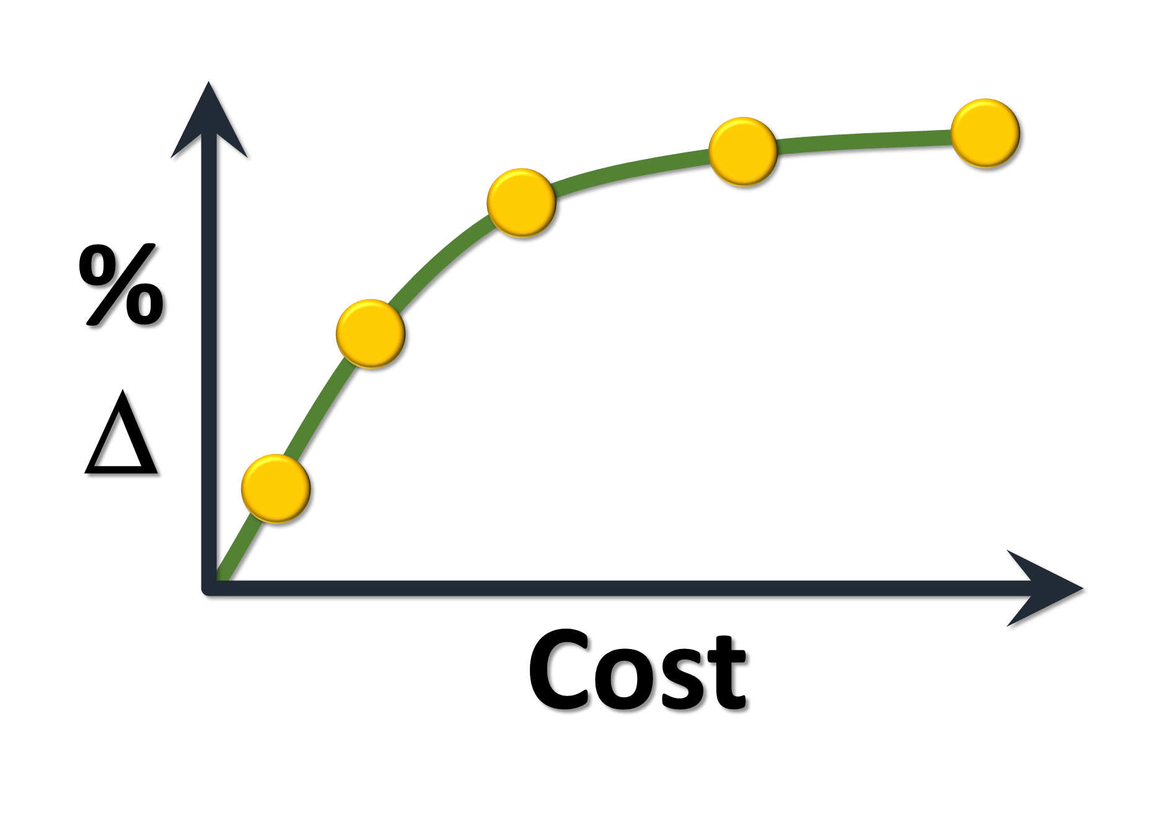
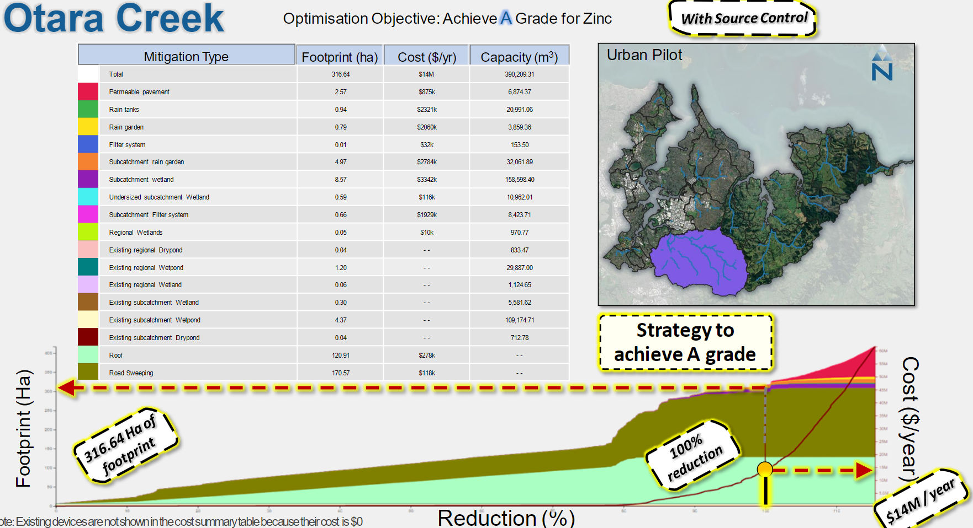
Optimisation complexity Integrated optimisation (Tier 2) sub-catchment → assessment point
n
6
1
subcatchment
…
5
3
A
3
4
2
subcatchment
B
…
1
n
Regional
wetland
B
Subcatchment
devices & source controls
A
subcatchment

Slide 28
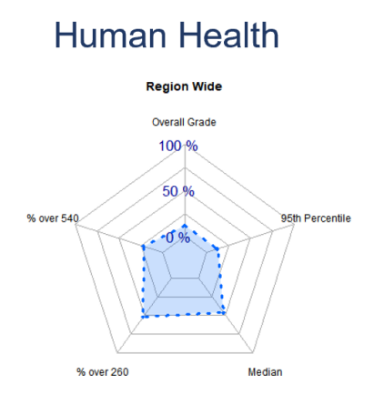
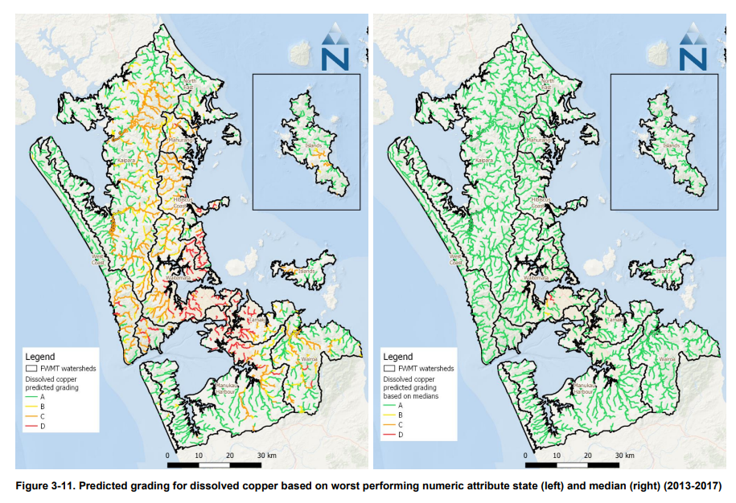
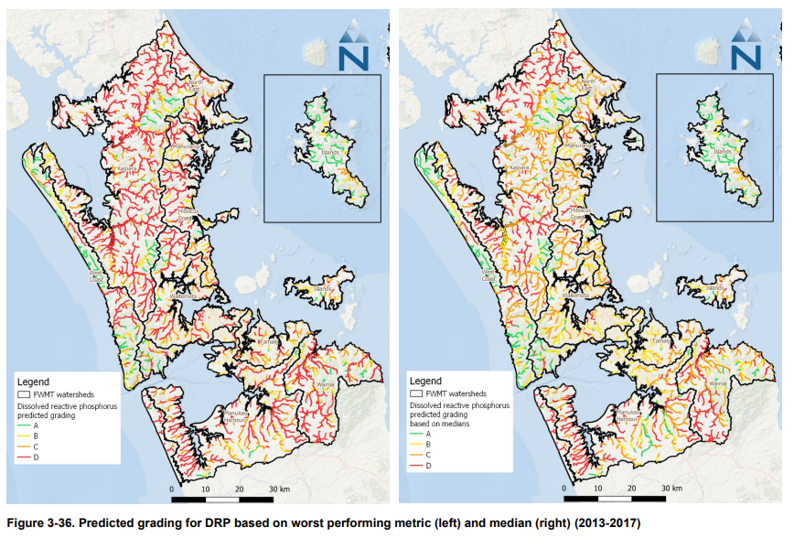
Freshwater Management Tool Strategic use & management design
Model purpose governs design – strategic planning key
Savings require management tools
Lifecycle cost
Devices – explicit feasibility (footprint, treatment area)
Baseline state (optimise on)
Limiting contaminant – exceedance condition
Best solutions – TP108 storm
Best solutions convergence – 3M to 100
Production run – 95th% concentration (permitted exceedance for 91 days in 5 yr)
Production run – for DIN, TAM, TON, DRP, E.coli, Dcu and DZn (single contaminant only)

Slide 29
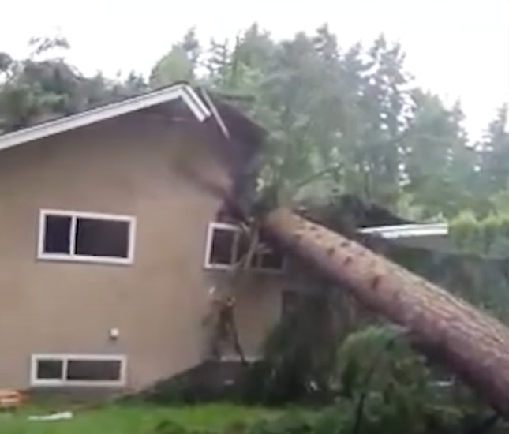
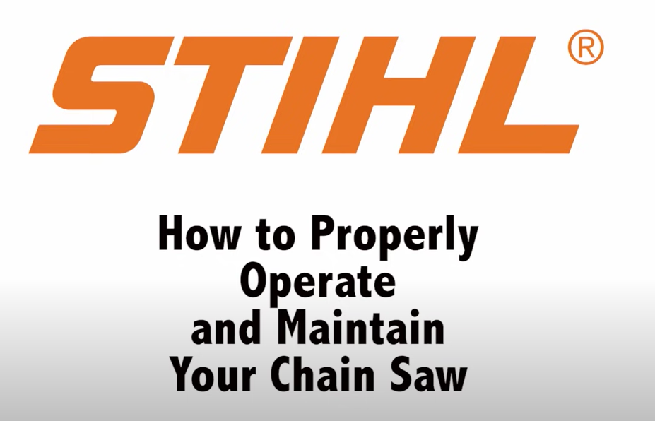
INSERT MODEL NAME
Model
Notes:
Thanks. To you, our supporters and our team.
See you all in the future, think we are kinda there now right?

Slide 30
fwmt@aucklandcouncil.govt.nz
Notes:
Thanks. To you, our supporters and our team.
See you all in the future, think we are kinda there now right?

Slide 31
Key messages & Thanks Management tools essential to reducing cost & delivering outcomes
Notes:
Key lessons:
Water quality varies
Options differ
Outcomes need action
Actions require investment
Investment tested for efficiency

Slide 32
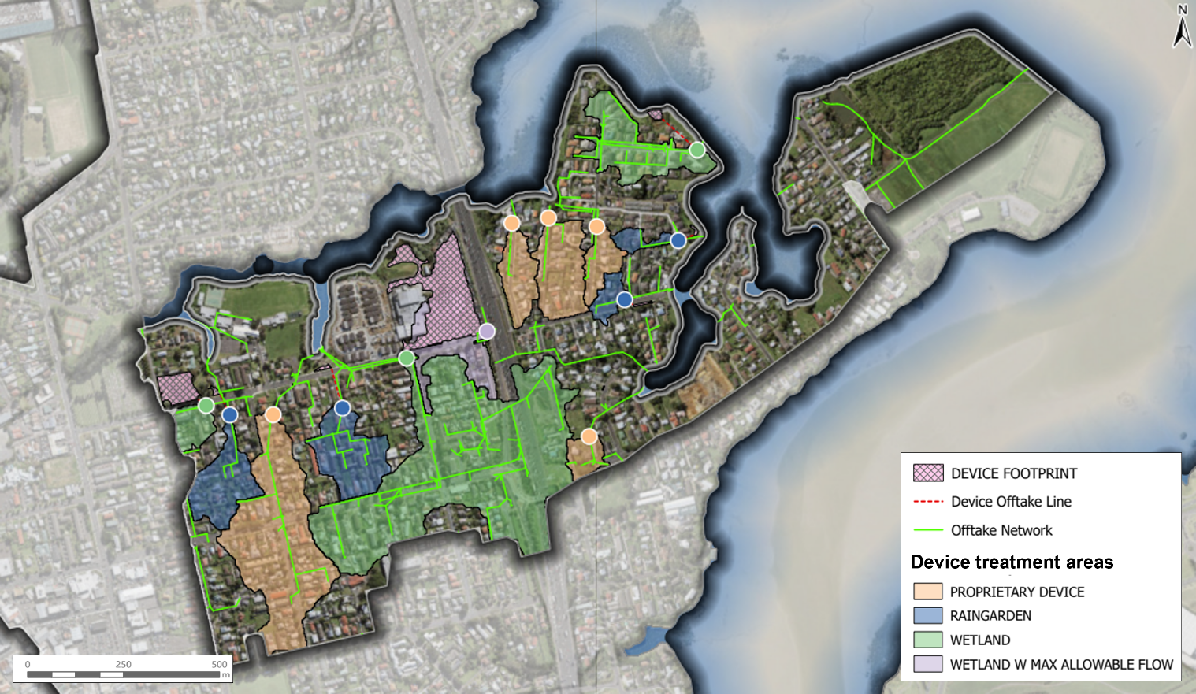
Freshwater Management Tool Powerful & valuable tool – purposely designed & defensibly simple

Slide 33
Optimisation Approach complexity – design & parameterisation of interventions

Slide 34
Optimisation Approach complexity – design & parameterisation of interventions

