Slide 1
What happened at Queenstown – an
object lesson for water supply authorities
Jim Graham | Chief Advisor, Water Science India Eiloart | Senior Technical Advisor
Dr Michael Butchard | Medical Officer of Health, Acting Clinical Director, National Public Health Service, Southern

Slide 2
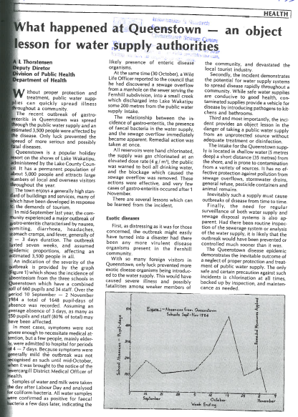
Notes:
Jim
What happened is exactly what happened in 1984

Slide 3
1984
Unclassified
“Third and most importantly, the incident provides an object lesson in the danger of taking a public water supply from an unprotected source without adequate treatment or disinfection.”
“Inevitably such a supply must cause outbreaks of disease from time to time.”
What happened at Queenstown – an object lesson for water supply authorities. 1985. Thorstensen. A. L. NZ Local Government
Notes:
Jim

Slide 4
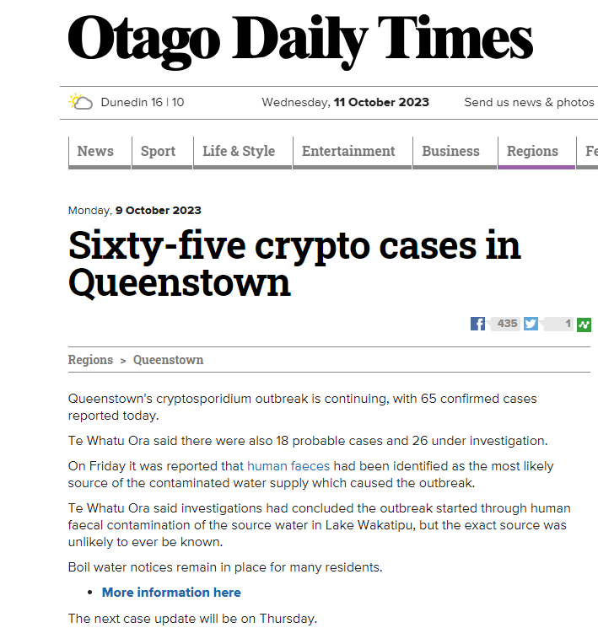
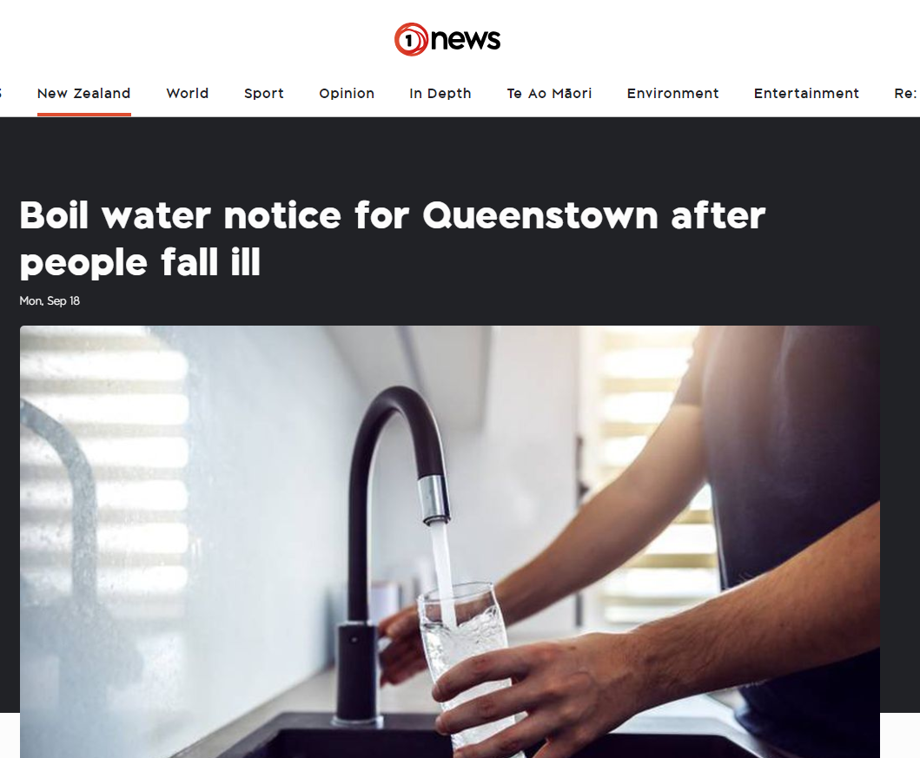
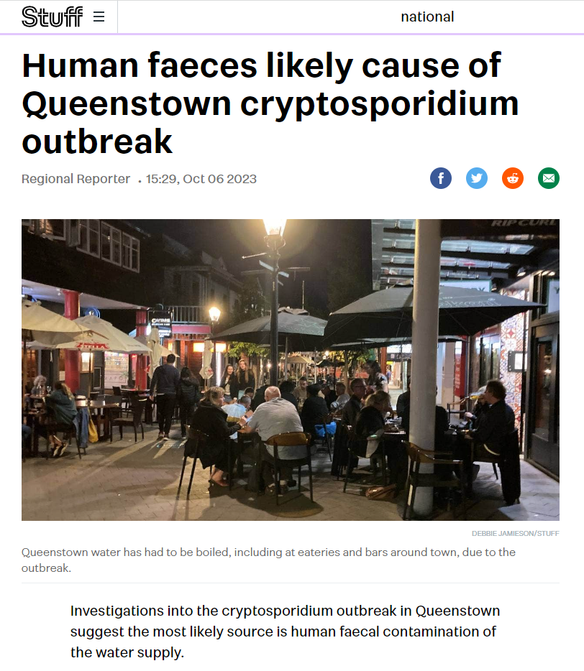
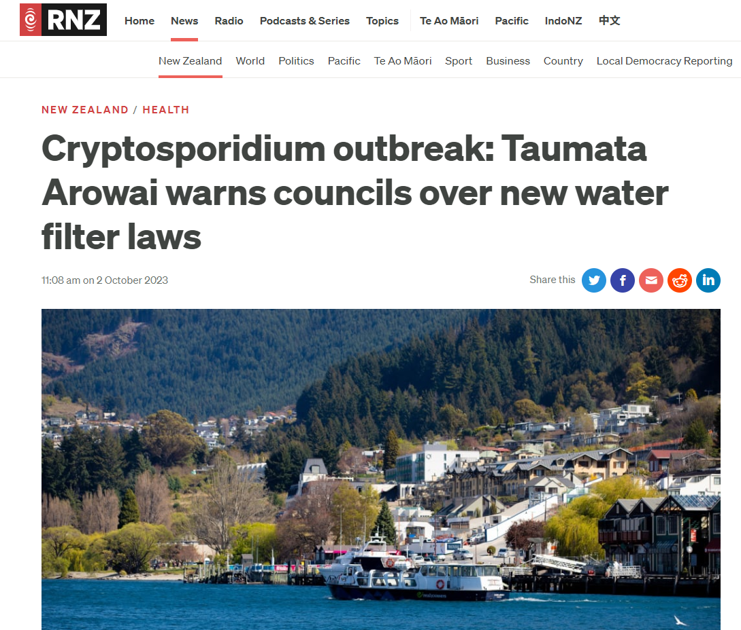
Today
Unclassified
Notes:
Jim

Slide 5
What is cryptosporidium?
Unclassified
Protozoa are single-celled organisms such as cryptosporidium and giardia, which can spread through drinking water supplies and make people sick.
The (oo)cyst form has a waxy outer shell that allows it to survive in the environment for long periods of time and makes it very tolerant to chlorine disinfection.
Notes:
Jim

Slide 6
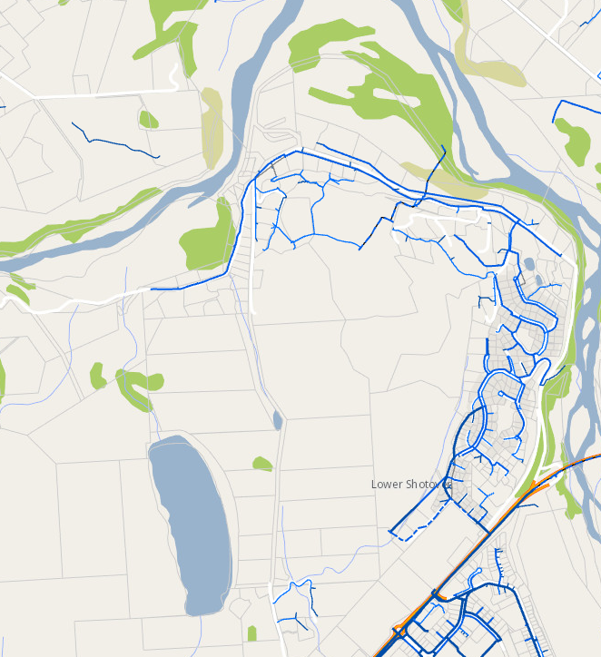
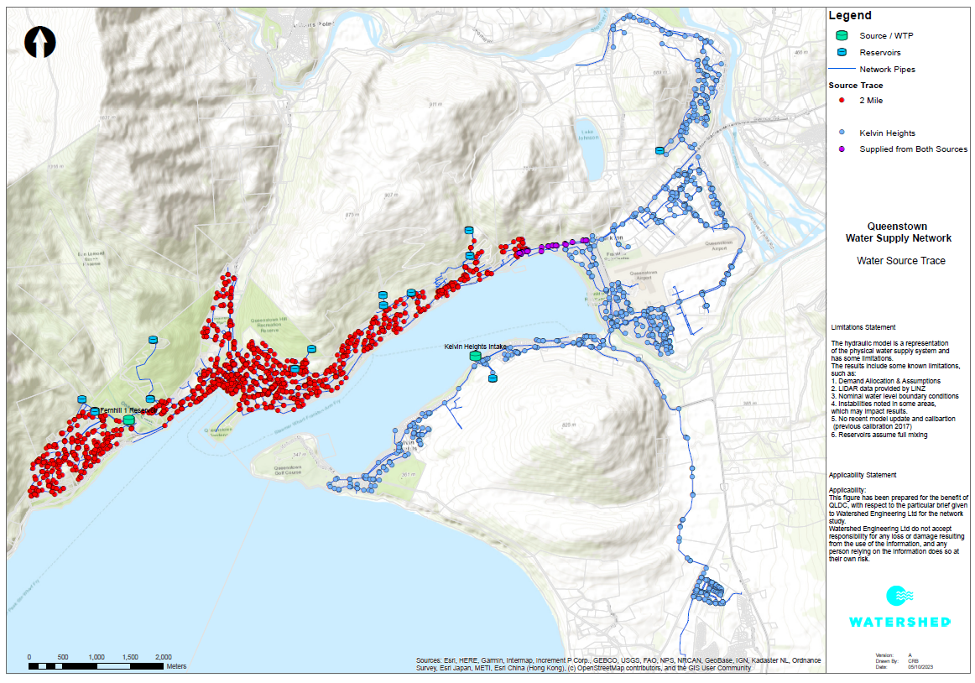
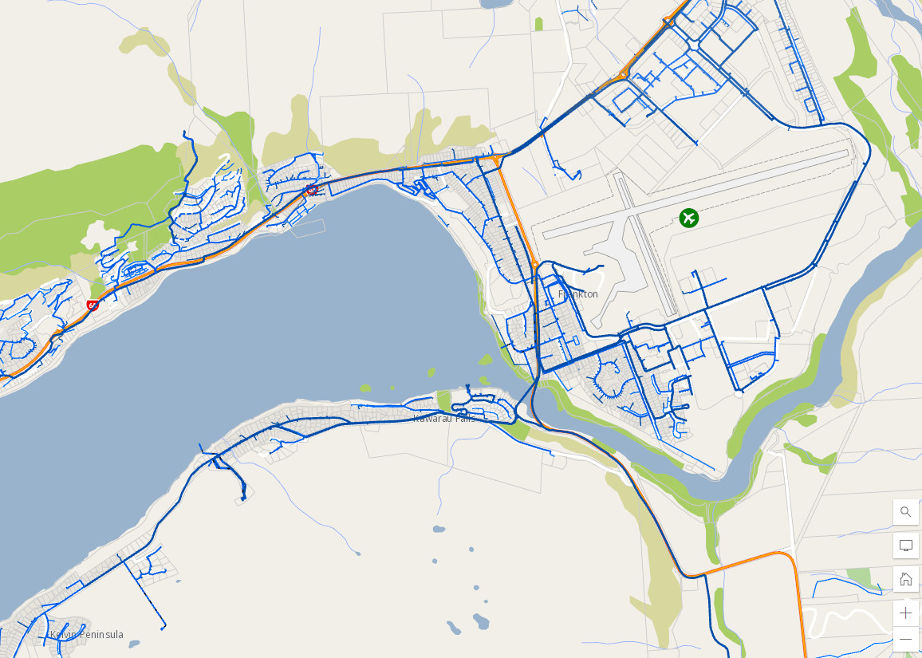
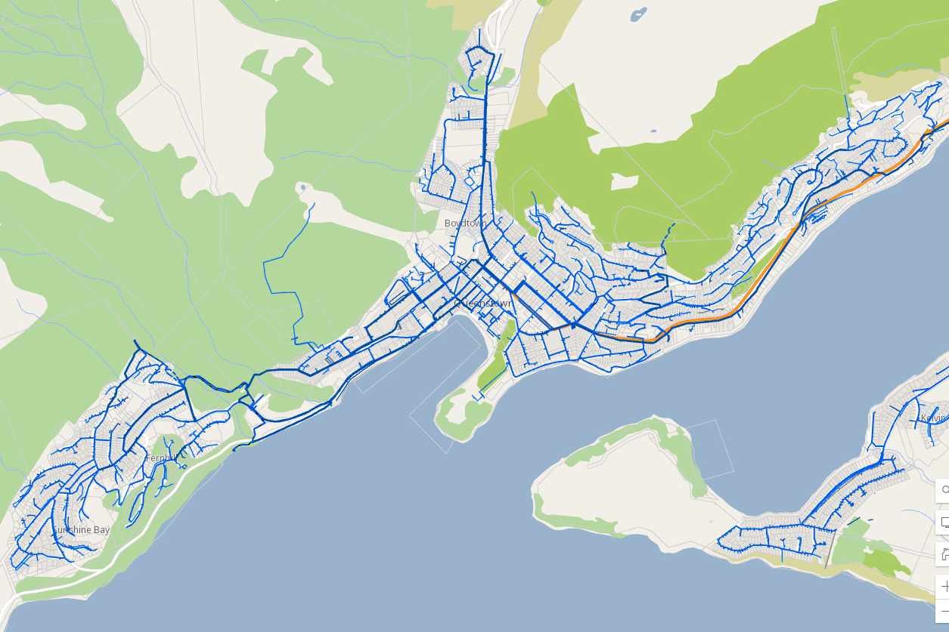
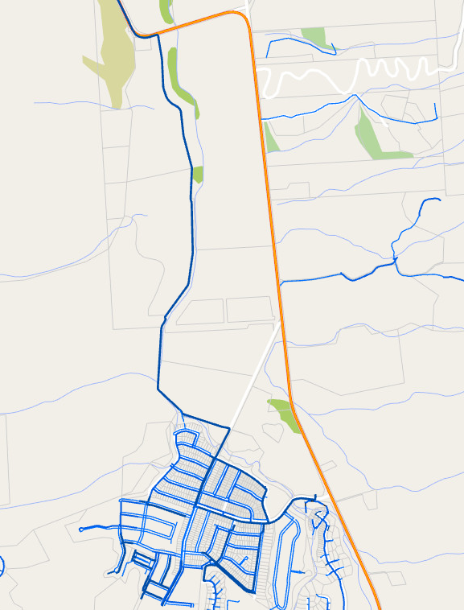
The Queenstown Supply
Unclassified
Sources: Water supply GIS – QLDC, Discharge consents – Otago Regional Council, Camp Street overflow photos - Veolia
Notes:
India – talking about aspects of supply to give context
Queenstown water supply walk through, point out queenstown cbd, airport, down to Henleys farm and up to Quail Rise.
Two intakes at the lake, KH and Two Mile
Been split along Frankton Road, creating these two separate supplies
What were we concerned about? Obvious surface water sources are more risky than groundwater sources, and these intakes are also located in populated areas near stormwater runoff and pressurised wastewater mains. Swimmers and boaties also have access to these locations.
As shown previously (?), most cases had the CBD in common, and so Two Mile as the plant without a protozoal barrier was a concern.
Prior to these two supplies being split, the two zones were not distinctly separated, and so it wasn’t clear who could have been affected. Map from hydraulic modellers on what is estimated to be that grey zone between zones.
As a faecal contaminant, we were interested in any potential wastewater discharges in the area. In circles we have recorded discharge consents in the area, either to water or sea, these can be for specific construction or other longer term activities. But we also have records of recent wastewater overflows in the area, one of which was at Camp Street in the CBD. Due to a sewer blockage, raw wastewater overflowed into an underground carpark, two retail businesses and up a gully trap and out on to the Police Station grounds. Veolia estimates that nearly half a cube of wastewater spilled, and a significant proportion of this ended up in Horne Creek which discharges into Lake Wakatipu.

Slide 7
Compliance order
Unclassified
Provides a set of actions a supplier must follow to ensure that serious risks to public health or legislative non-compliance are addressed.
Two-Mile water treatment plant: consumer advisory (boil water notice) to remain in place until either:
treatment for protozoa is in place and operating; or
an alternative supply of safe drinking water is made available to all points of supply
Kelvin Heights water treatment plant: consumer advisory to be lifted once we are satisfied that it is isolated from the rest of the Queenstown supply and performing effectively with clear test results.
Notes:
India
Served to council on 20 September 2023
Although the source of the outbreak was still unconfirmed, based this on the information available which was material risk as it relates to drinking water.
We also knew that the Two Mile water treatment plant was non-compliant, creating a risk of contamination that is not being appropriately managed.
Two Mile water treatment plant has no treatment for protozoa. The consumer advisory (boil water notice) for this part of the supply must remain in place until either:
treatment for protozoa is in place and operating at the Two Mile water treatment plant; or
an alternative supply of safe drinking water is made available to all points of supply ordinarily served by the supply.
The Kelvin Heights water treatment plant has treatment for protozoa. However, information recently provided to Taumata Arowai by Queenstown Lakes District Council has raised some doubts about whether this barrier is working. The consumer advisory for this supply will be able to be lifted once Queenstown Lakes District Council has satisfied Taumata Arowai that it is isolated from the rest of the Queenstown supply and that it is performing effectively.
On 5 October 2023, QLDC satisfied the requirements of the parts of the compliance order relating to Kelvin Heights. It subsequently lifted the boil water notice for the Kelvin Heights water treatment plant and distribution zone.

Slide 8
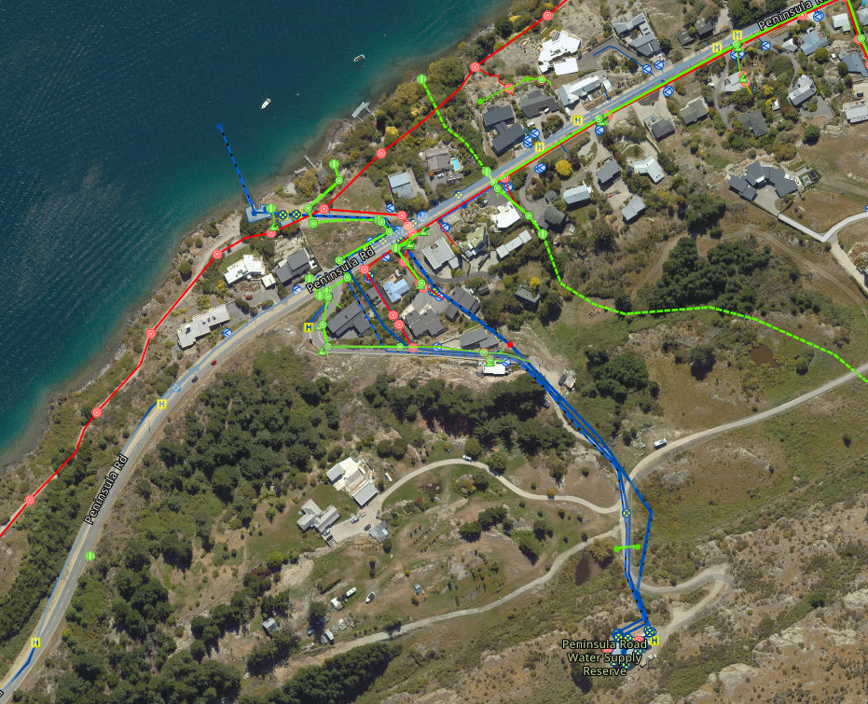
Kelvin Heights
Unclassified
Notes:
India
If Two Mile was the treatment plant without a protozoa barrier that was also supplying the area with the most cases, why did the compliance order extend to Kelvin Heights?
At the beginning of the outbreak, every possibility needed to be considered. And while Kelvin Heights has a protozoal barrier, there are still improvements required for compliance acknowledged by QLDC, and as a surface water source without filtration it remains susceptible to fluctuations in the source water quality.
Once Kelvin Heights was determined to be an unlikely contributor to the outbreak, the gaps in treatment and monitoring couldn’t be ignored in light of the protozoal illness.

Slide 9
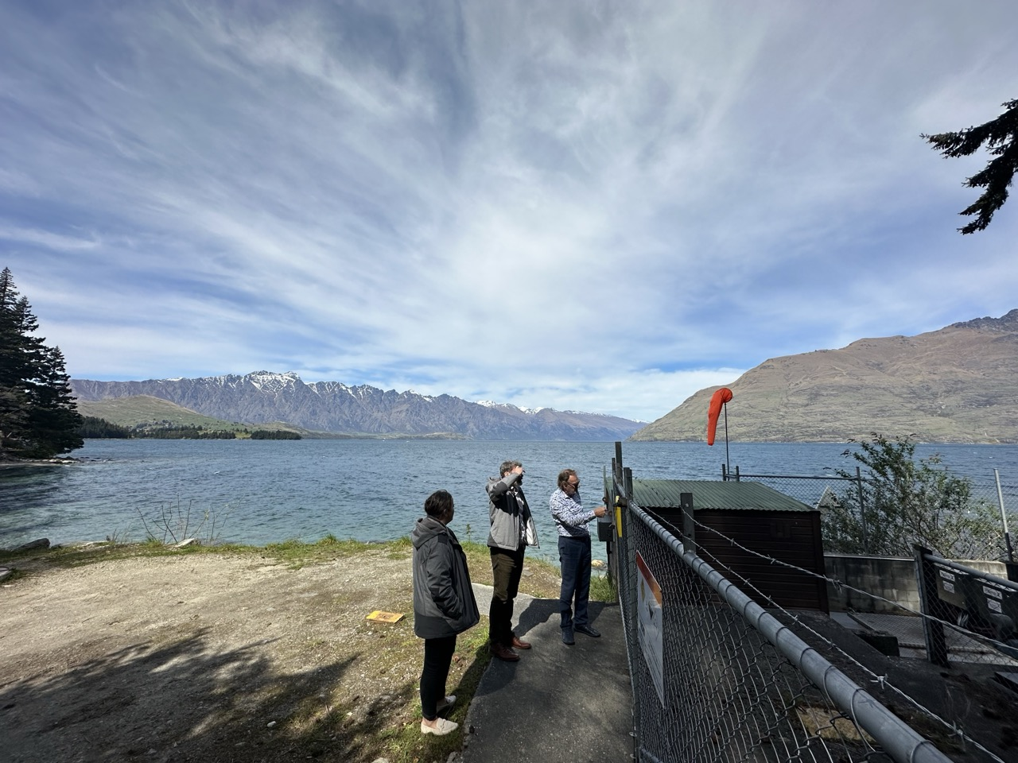
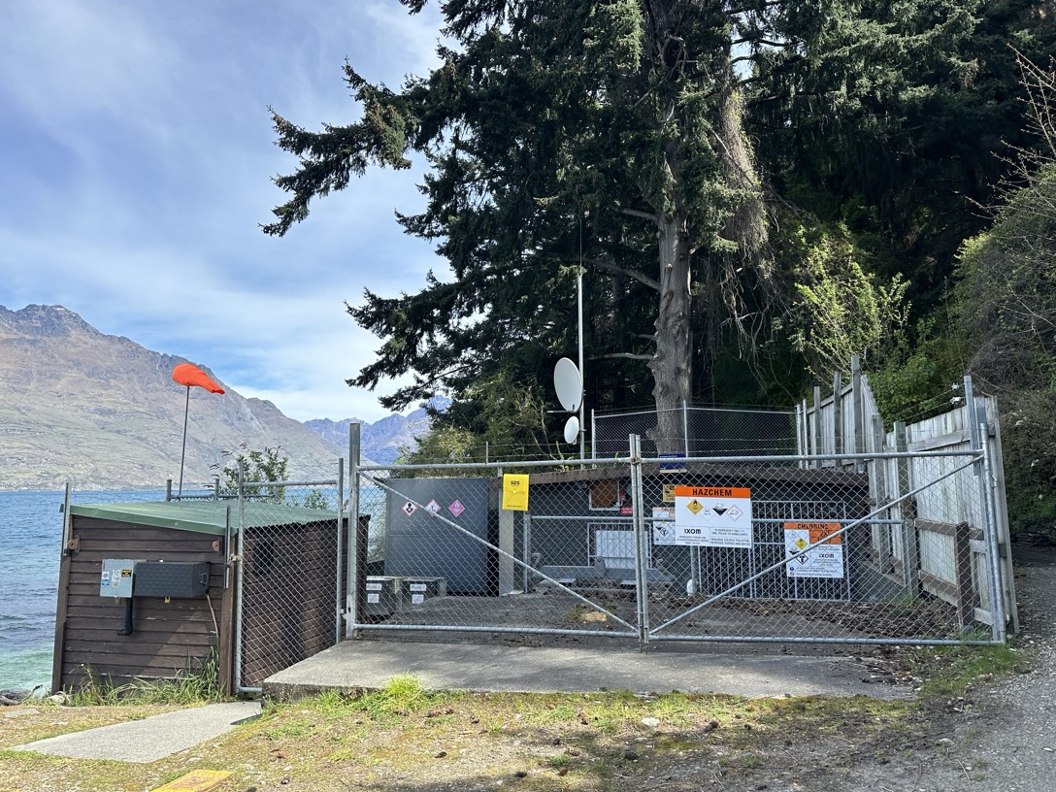
Two-Mile intake
Unclassified
Notes:
India
Water taken out of lake 35 metres from shore

Slide 10
Health led response Dr Michael Butchard Medical Officer of Health Acting Clinical Director National Public Health Service, Southern
Unclassified
Notes:
Dr Michael

Slide 11
Health led investigations
Epidemiological
Epi curve
Case investigations
Environmental
Geospatial mapping
Laboratory
Whole Genome Sequencing

Slide 12
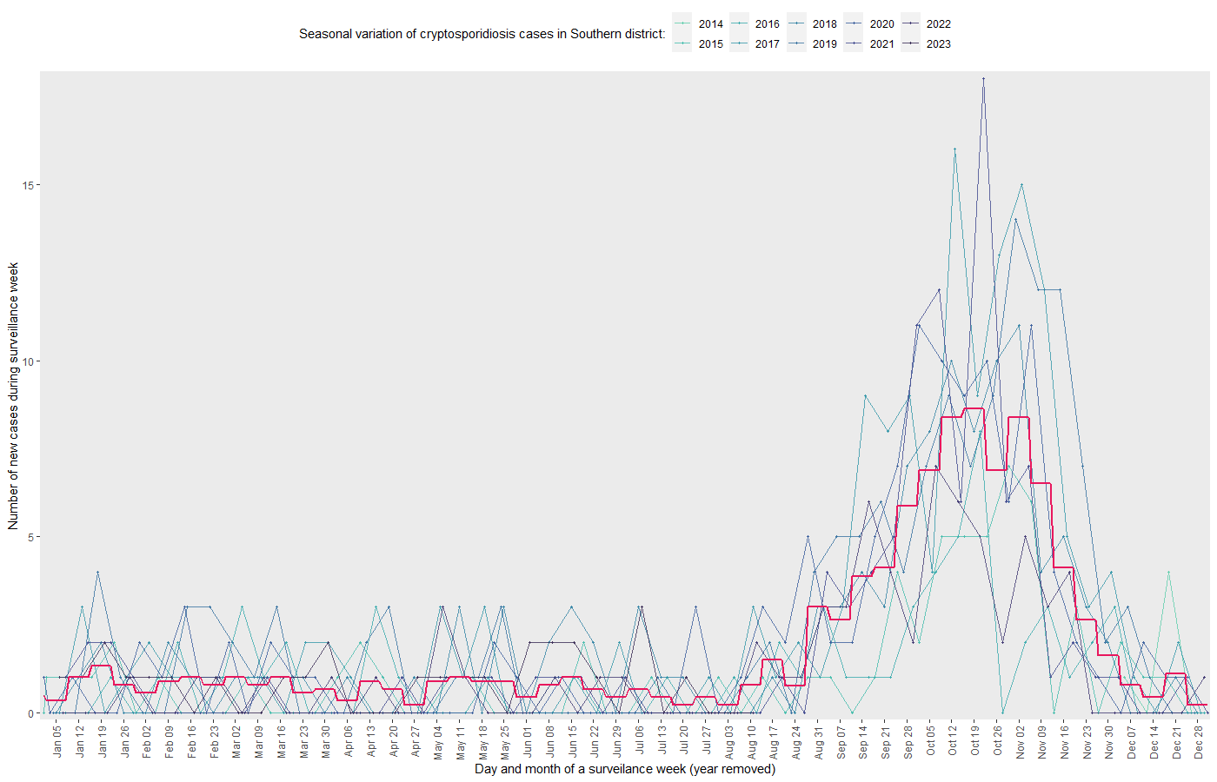
Epidemiological Investigation

Slide 13
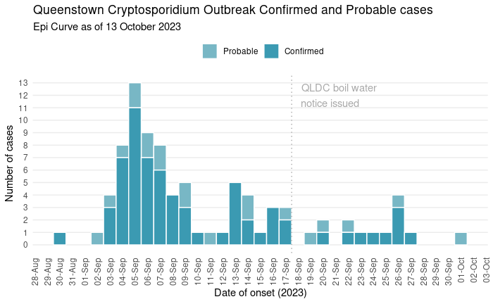
Unclassified
EpiCurve of 66 confirmed and 20 probable cases of cryptosporidiosis with completed case investigations, from 10 August 2023 to 0810hrs 13 October 2023 (dotted line indicates the date boil water notice was issued).
Notes:
Michael

Slide 14
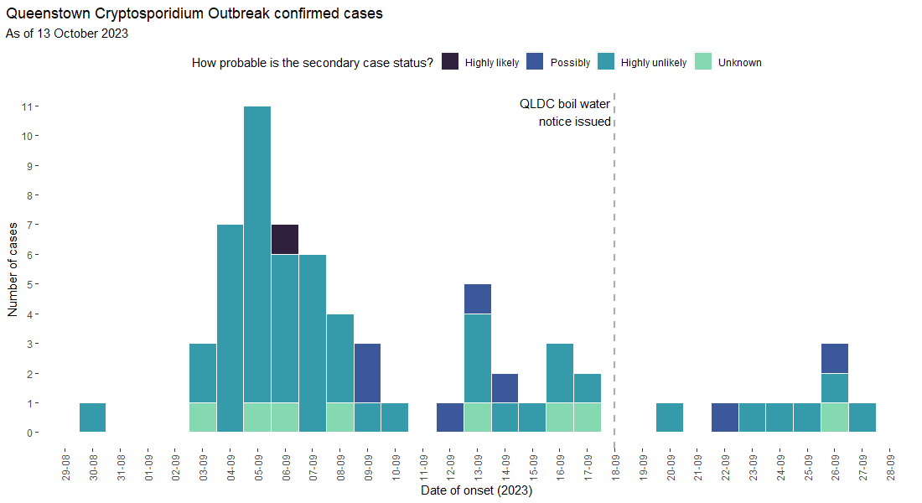
Unclassified
Notes:
Michael
The epidemic curve is most consistent with a continuous common source (or common site) epidemic pattern, whereby case illness presentations rise to an initial peak and fall but continue to arise for greater than one incubation period. Importantly, those arising after one maximum incubation period from the start of the minimum incubation period for the first case are not considered to be due to ongoing secondary person-to-person transmission. Considering the cryptosporidiosis incubation period range of 1 to 12 days, the primary source exposure has exceeded this, lasting a minimum of 18 days (29th August-16th September) and tailed off within one incubation period of the Boil Water Notice being implemented on 18th September. This is in keeping with a contaminated drinking water supply event.
Alternative hypotheses, that there has been an intermitted or continuous common site exposure other than contaminated mains drinking water (such as arising from a food premise) or a dispersed common source (e.g. food handler propagated or distributed local food/ beverage product) in the Queenstown area anytime from 29th August to at least 16th September have not been supported by local case questioning or extended case questionnaires (see hypothesis generating questionnaire section). Wastewater contamination of drinking water are further supported by environmental investigations (see environmental investigations section).

Slide 15
Case Interviews
Standard Case Investigation Form
Vast majority of cases interviewed with standard Case Investigation Form
No common source identified:
No common food or beverage,
No common food premises, events, or ski fields
No common food handler,
No common recreational water
Contact with farm animals rare
Extended hypothesis generating questionnaire
32 primary confirmed cases completed an extended hypothesis generating questionnaire
Food and beverage consumption matched expected patterns
No single types or sources identified
All 32 exposed to Two-Mile drinking water supply or the mixing zone.

Slide 16
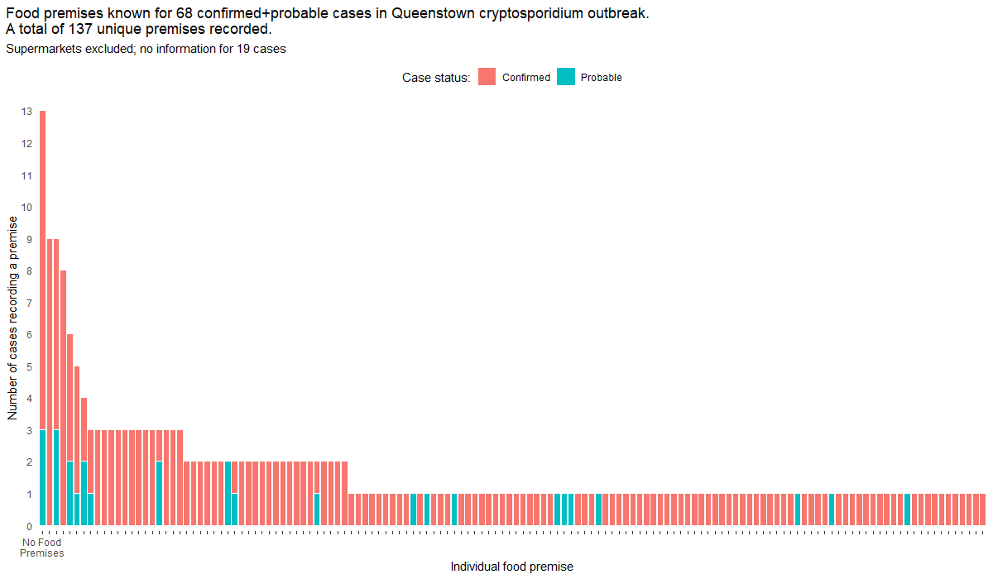
Food Premises

Slide 17
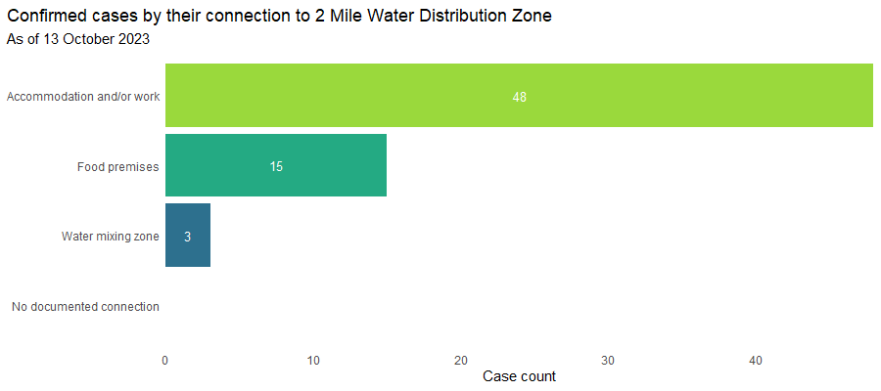
Connection to Two-Mile Distribution Zone

Slide 18
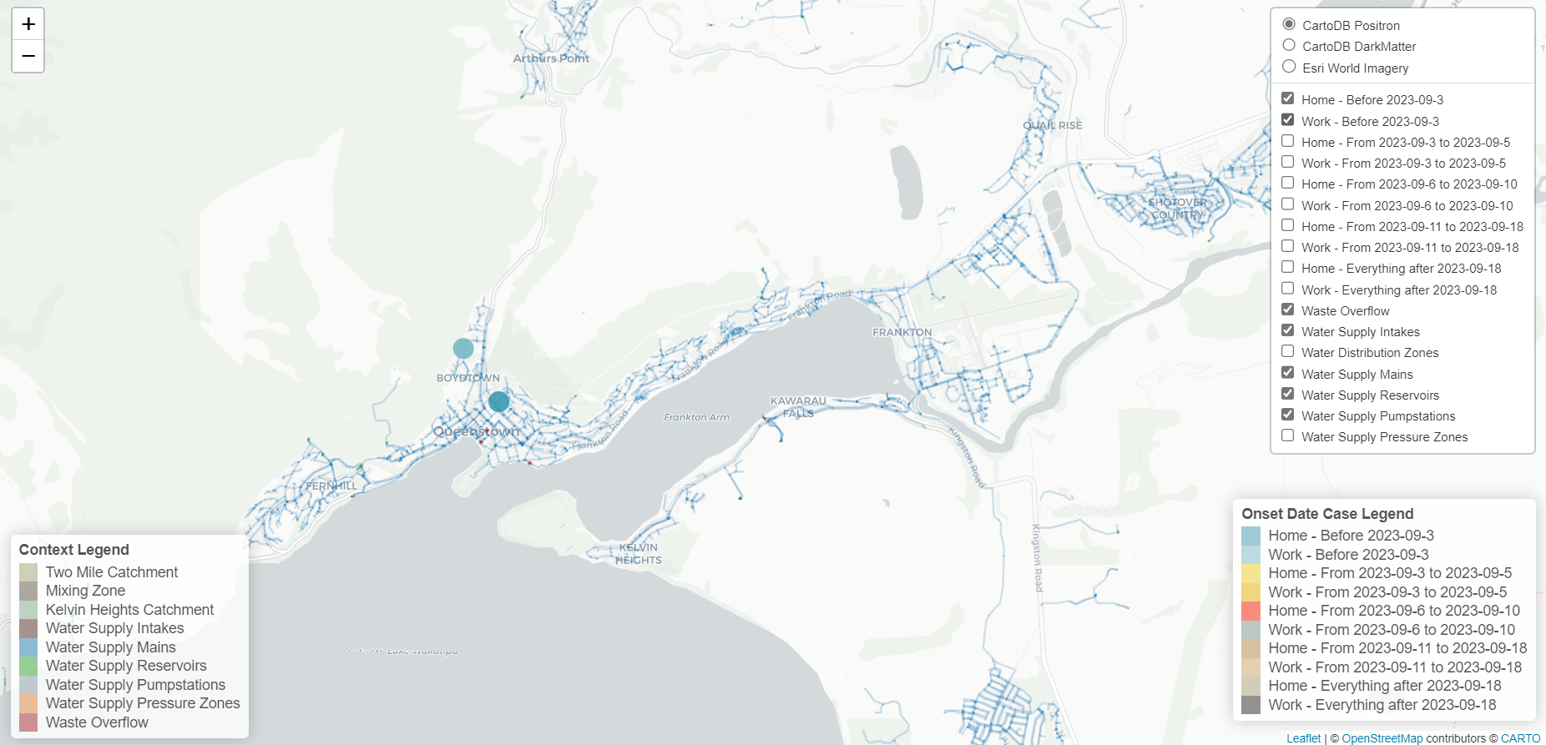
Geospatial mapping

Slide 19
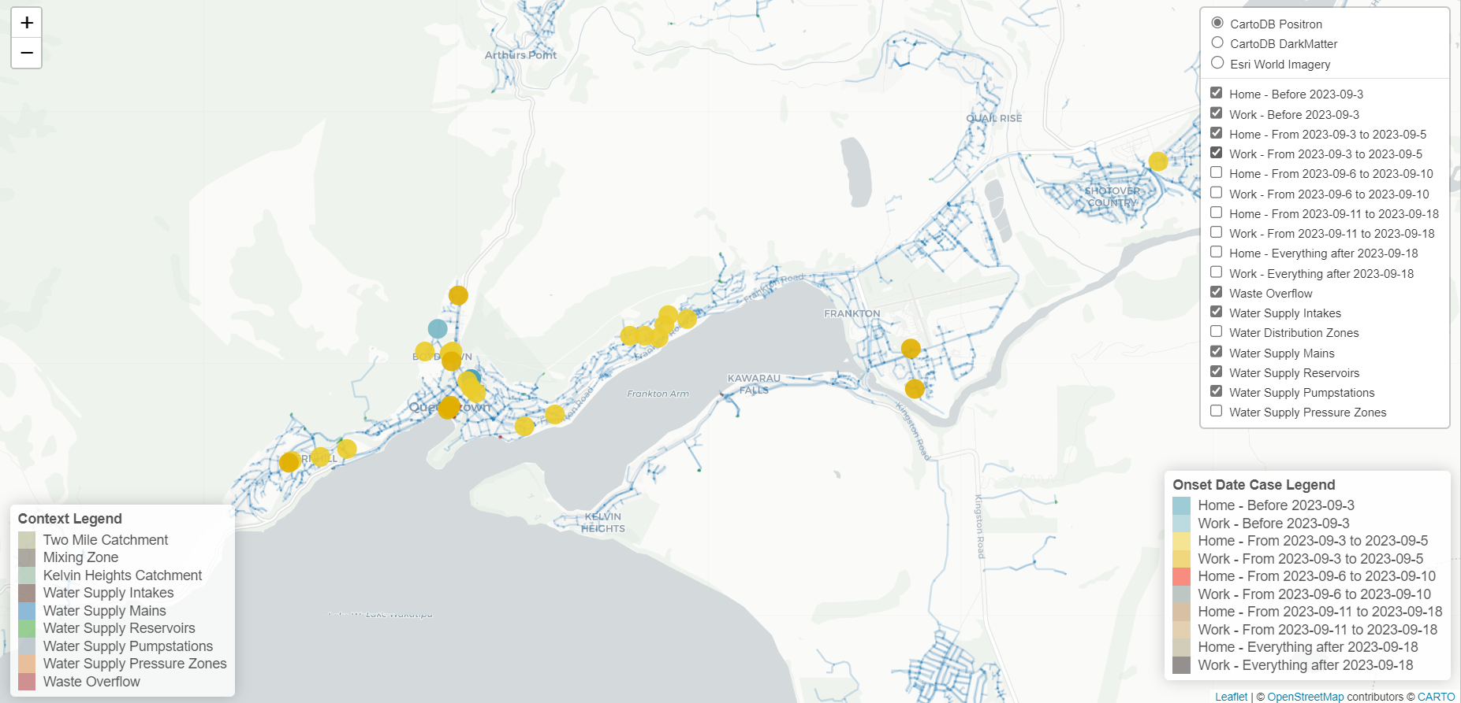

Slide 20
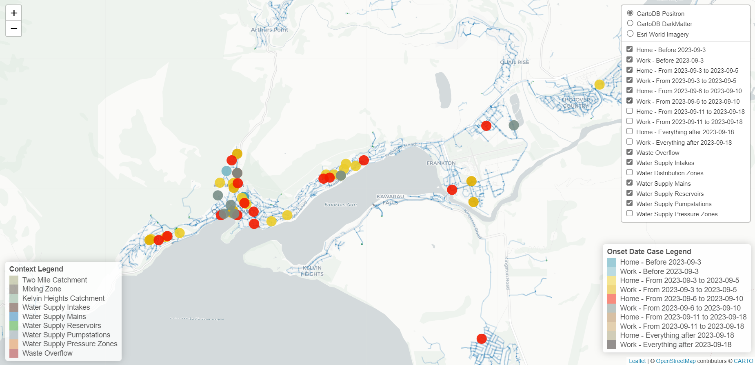

Slide 22
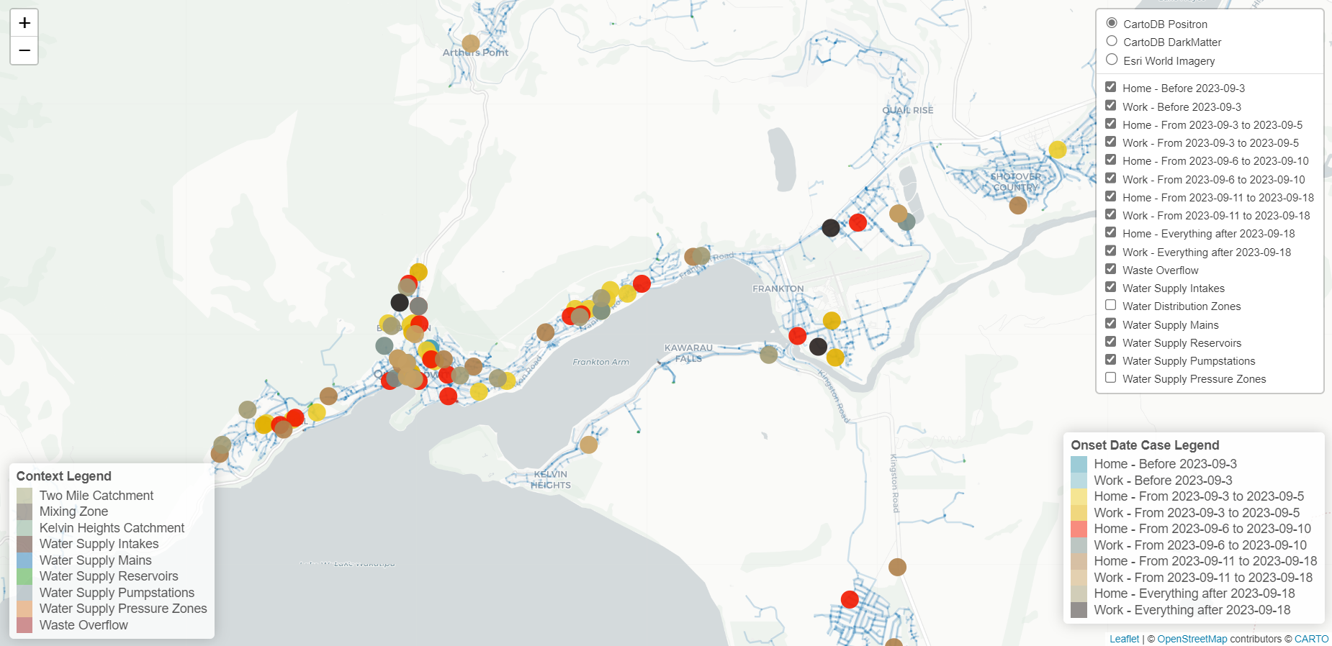

Slide 23
Geospatial mapping
Distribution of cases was rapid and widely distributed
Localised contamination event in distal reticulation network unlikely
Water contamination prior to the Two-Mile Water Treatment Plant more likely
Leading to slow release of contaminated reservoir water over time,
Subsequently dispersed widely through the network

Slide 24
Laboratory Findings
Cryptosporidium typing [Massey University]
31 cases of C. hominis Id (where genotyping is available)
16 of those are IdA20 (supports common source)
Human versus animal?
C. hominis predominantly human
C. hominis not circulating widely in NZ since Covid-19 restrictions, whereas typically zoonotic C. parvum continued
Lack of genetic diversity suggests more likely human contamination
IdA20 never previously detected in NZ before, either in humans or animals
Humans far more likely to import a new hominis strain than animals

Slide 25
Health’s Conclusion
Most likely hypothesis is a human faecal contamination of the source water, contaminating the Two-Mile Water Treatment Plant and reservoir, and subsequently widely dispersed through the network.

Slide 26
Taumata Arowai Response
Unclassified
Notes:
India

Slide 27
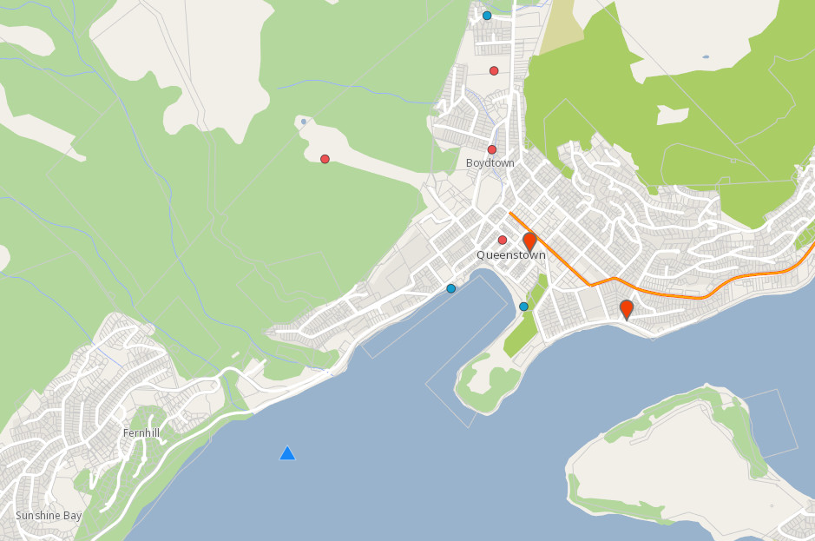
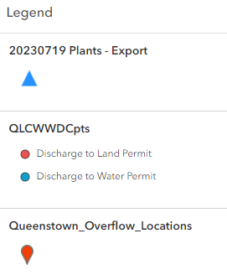
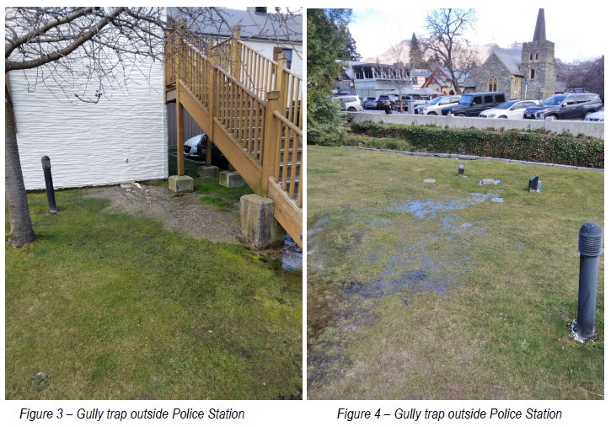
Wastewater overflows
Unclassified
Intake
Discharge consents
Wastewater Overflow Events
Sources: Water supply GIS – QLDC, Discharge consents – Otago Regional Council, Camp Street overflow photos - Veolia
Notes:
India – Health looking at cases, Taumata Arowai providing expertise on water
Queenstown water supply walk through, point out queenstown cbd, airport, down to Henleys farm and up to Quail Rise.
Two intakes at the lake, KH and Two Mile
Been split along Frankton Road, creating these two separate supplies
What were we concerned about? Obvious surface water sources are more risky than groundwater sources, and these intakes are also located in populated areas near stormwater runoff and pressurised wastewater mains. Swimmers and boaties also have access to these locations.
As shown previously (?), most cases had the CBD in common, and so Two Mile as the plant without a protozoal barrier was a concern.
Prior to these two supplies being split, the two zones were not distinctly separated, and so it wasn’t clear who could have been affected. Map from hydraulic modellers on what is estimated to be that grey zone between zones.
As a faecal contaminant, we were interested in any potential wastewater discharges in the area. In circles we have recorded discharge consents in the area, either to water or sea, these can be for specific construction or other longer term activities. But we also have records of recent wastewater overflows in the area, one of which was at Camp Street in the CBD. Due to a sewer blockage, raw wastewater overflowed into an underground carpark, two retail businesses and up a gully trap and out on to the Police Station grounds. Veolia estimates that nearly half a cube of wastewater spilled, and a significant proportion of this ended up in Horne Creek which discharges into Lake Wakatipu.
Wastewater overflow happened on 13 August 2023

Slide 28
Sampling
Unclassified
Chlorine demand sampling in CBD
Clostridium. spp testing in the distribution system
Cryptosporidium testing
Notes:
Jim

Slide 29
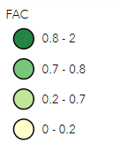
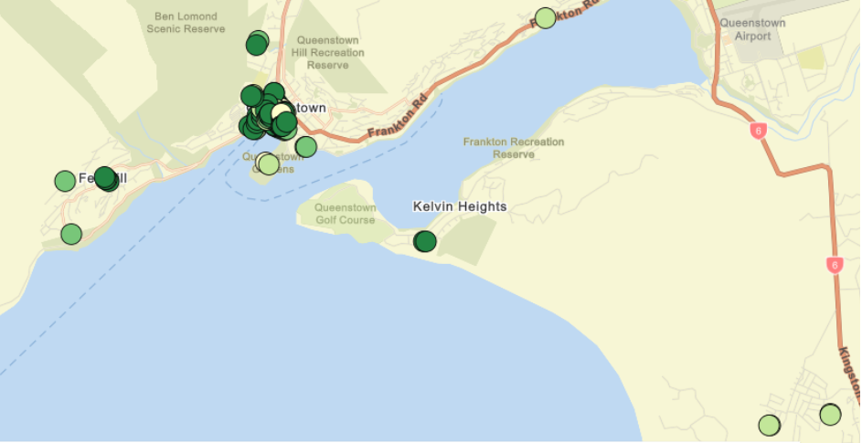
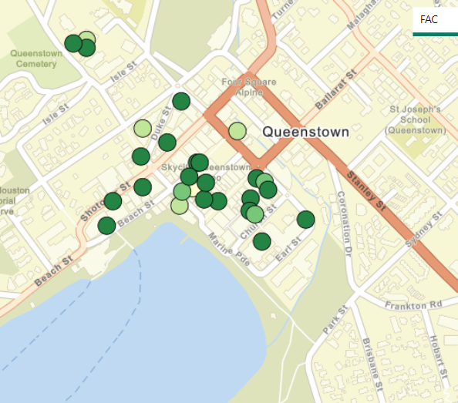
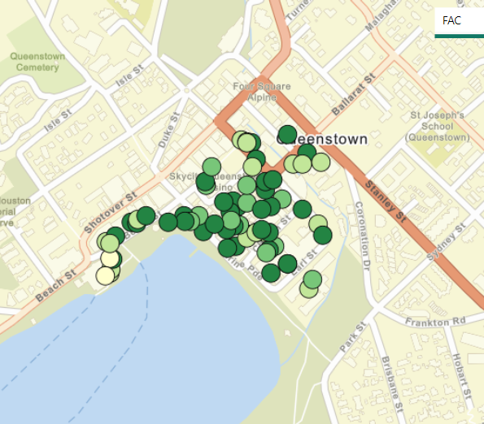
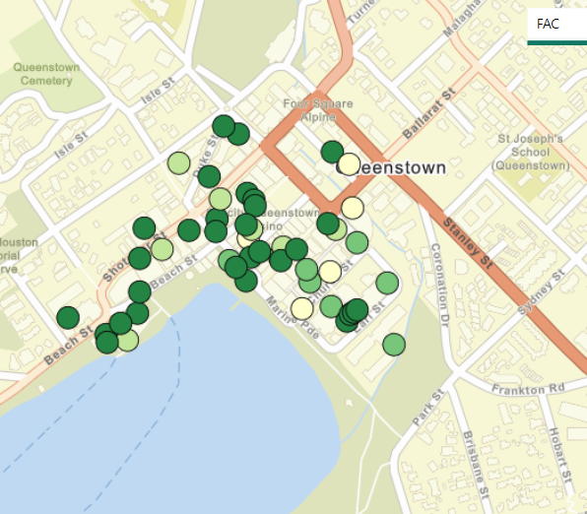
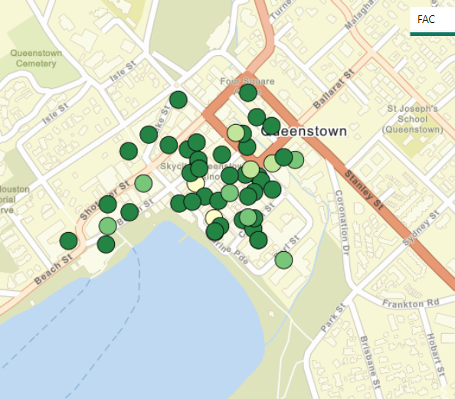
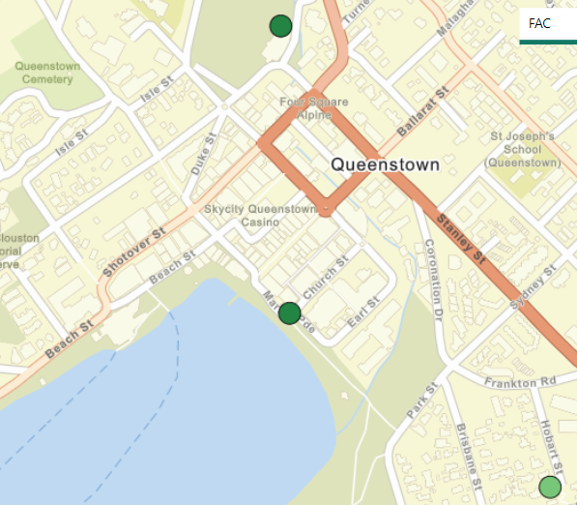
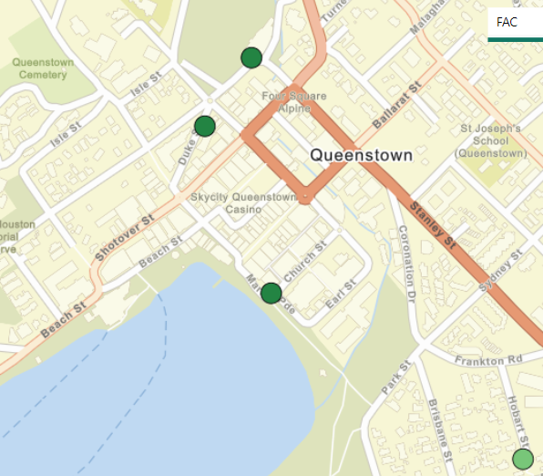
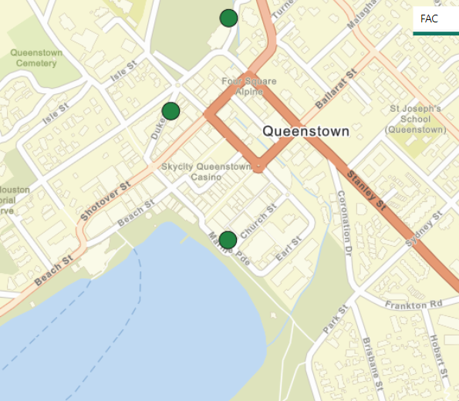
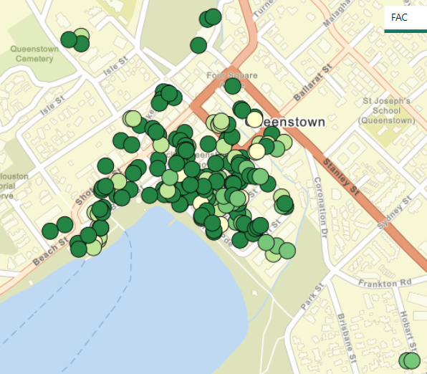
Chlorine demand testing
Unclassified
24 Sept
25
26
27
28
29
30
1 Oct
2
3
Notes:
Jim

Slide 30
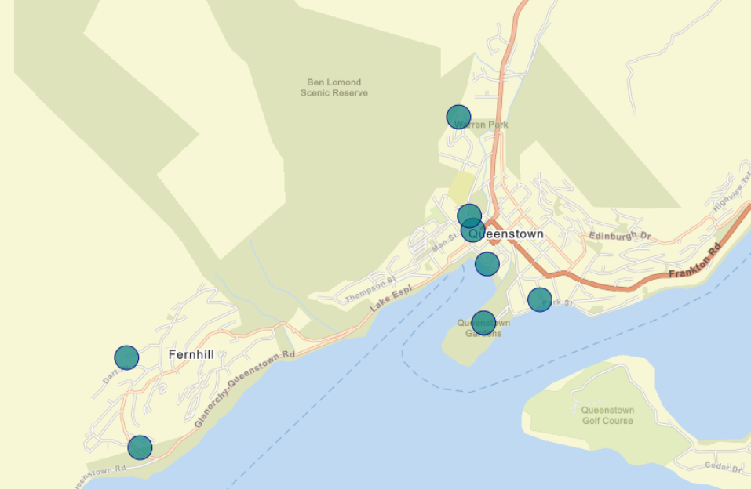
Clostridium. spp testing
Unclassified
Notes:
Jim

Slide 31
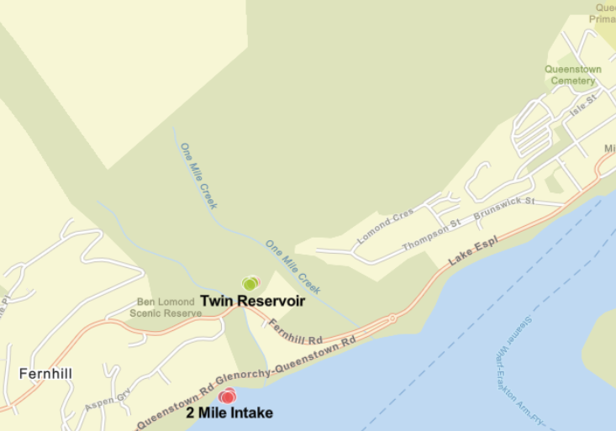
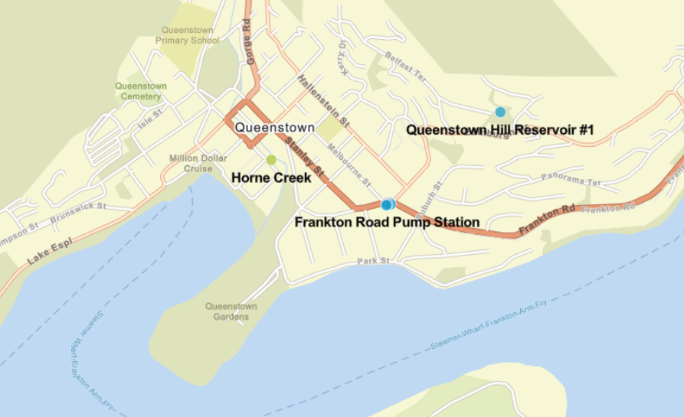
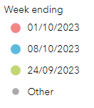
Cryptosporidium testing
Unclassified
Notes:
Jim

Slide 32
Six hypotheses
Unclassified
Ongoing and continuous contamination of the source water
Intermittent contamination of the source water
One-off contamination of the source water
Ongoing and continuous contamination of water within the network
Intermittent contamination of water within the network
One-off contamination of water within the network
Notes:
Jim

Slide 33
So, what happened? Probably…
Unclassified
One-off contamination of water at the intake
2. Contaminates the Fernhill reservoir
3. Low level contamination distributed over a period of time
4. Contaminated water restricted to Two-Mile part of supply
Notes:
Jim

Slide 34
What was our role?
Unclassified
Response was led by National Public Health Service Southern
Te Whatu Ora | Health New Zealand and Office of the Director of Public Health
Manatū Hauora │ Ministry of Health
ESR
Massey University Protozoa Lab
International experts
Queenstown Lakes District Council
Taumata Arowai
Notes:
Jim
Massive effort from a whole lot of agencies
Taumata Arowai role in an incident & emergency: monitor, engage, assist, or direct supplier responses as required to ensure the best outcomes for communities, providing a layer of coordination and liaison on behalf of the sector in multi-agency responses.

Slide 35
What does this mean for other suppliers?
Unclassified
We have written to suppliers making our expectations clear – you need to comply with Water Services Act 2021 and the Drinking Water Quality Assurance Rules
We have recently communicated our expectations and timeframes for compliance with protozoa barrier requirements:
For all water sources: plan and funding confirmed by 30 June 2024
For surface water sources: installation and operation by 31 December 2024
For bore water sources: installation and operation by 31 December 2025
We’ll shortly be doing the same for bacterial protection
We’ll take a similar approach when we see other risks
Notes:
Steve – setting expectations slide
This is not just a Queenstown issue. We need to ensure people have access to safe and reliable drinking water across New Zealand.

Slide 36
Questions?
Unclassified

