Slide 1
The Dark Side of Drinking Water
Scott Pearson

Slide 2
Regulations
Discharges
Consenting
Management Options
Summary

Slide 3
Regulations
Discharges
Consenting
Management Options
Quality Assurance Rules
NTU
^{FTW}
^{FILTER}
10%
Notes:
All recycle streams must be returned to the inlet of the plant (or upstream of the membranes where membrane filtration is used).
Recycle must be less than 10% of the instantaneous raw water flow. If a recycle flow of greater than 10% is required, separate treatment of the recycled stream is required to inactivate or kill protozoa and bacteria before the waste stream is returned to the inlet of the plant.
Turbidity monitoring is required to demonstrate that the recycle water has received effective solids/liquid separation.
Filter to waste is not considered within the 10% limit for a recycle stream
Where there is no filtration (sedimentation only), water cannot be recycled. Recycle is not stipulated for UV or Ozone processes, however these do not typically have a waste stream if used as only treatment process.
Generally, recycle of filter backwash and clarifier sludge is achievable providing that the instantaneous rate of 10% of the raw water flow is not exceeded. Where 10% of this instantaneous rate may be exceeded, separate treatment is required to inactivate protozoa and bacteria prior to any recycle. Our interpretation of this is that a secondary treatment process is required

Slide 4
Regulations
Discharges
Consenting
Management Options
Discharge Paths

Slide 5
Regulations
Discharges
Consenting
Management Options
Consenting Environment
Cl⁻
Al³⁺
pH
SS
A consistent approach - baseline accepted values?
Notes:
Aluminium: we have completed similar analyses and discussions with various consenting authorities relating to the ecotoxicity of aluminium. We have also noticed an inconsistent approach in the required measurement method of aluminium across regions, with a variety of total, acid soluble or soluble aluminium measurements required.
Chlorine: discharge requirements for chlorine are generally more consistent; however we have seen limits in consents between 0.2 and 1.0 mg/L. Although chlorine can be ecotoxic at lower concentrations, we consider a 0.2 mg/L limit appropriate due to the typical colorimetric method of testing, with accuracy of readings decreasing below this level.
pH: there is consistency in this area with typical limits being between a pH of 6 and 9.
Suspended solids: there is consistency in this area with typical limits being between 25 and 50 mg/L. We note that these limits are higher than typical wastewater discharges, however suspended solids may be considered as a surrogate for other contaminants so do not consider this as unreasonable.

Slide 6
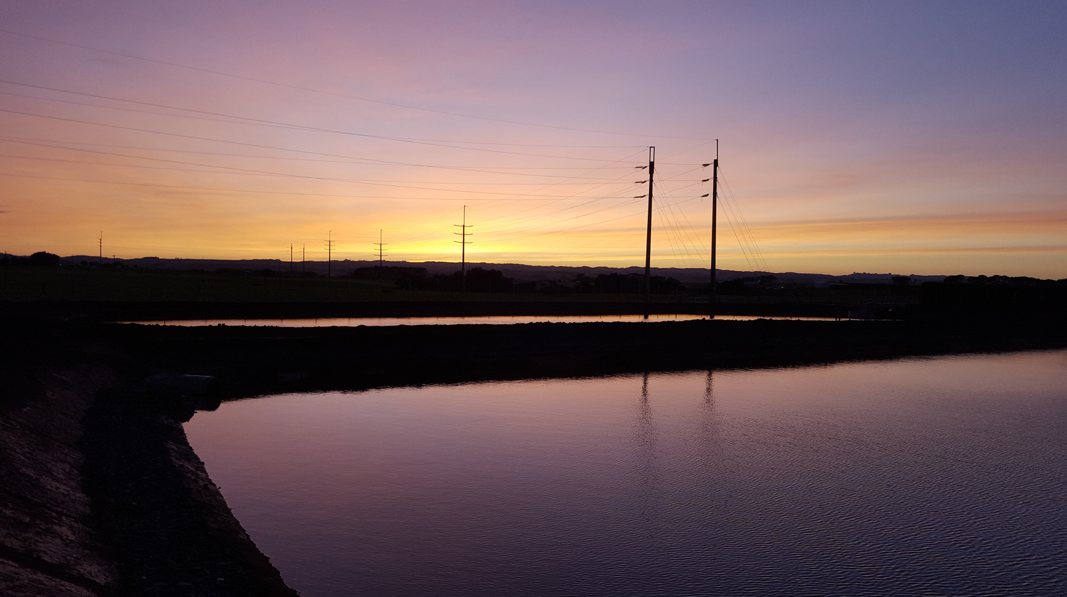
Waste Management Options

Slide 7
Regulations
Discharges
Consenting
Management Options
Typical Process
Coagulation
Clarification
Filtration
Disinfection
WTP Process
Routine Waste Streams
Clarifier Sludge
-Backwashing
-FTW / CIP

Slide 8
Regulations
Discharges
Consenting
Management Options
Waste Considerations
Water
Solids

Slide 9
Regulations
Discharges
Consenting
Management Options
Plant Recovery
~ 90 to 95% efficiency
97 to 99% efficiency
>99% efficiency
No recycle
Recycle of backwash streams, with or without settling
Recycle of settled backwash and clarifier sludge streams
~99.99% efficiency
Recycle of all liquid discharges, including dewatering process liquid streams. CIP waste removed from site.

Slide 10
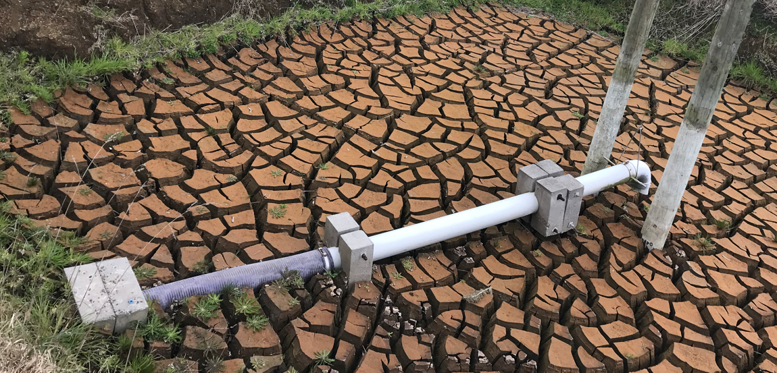
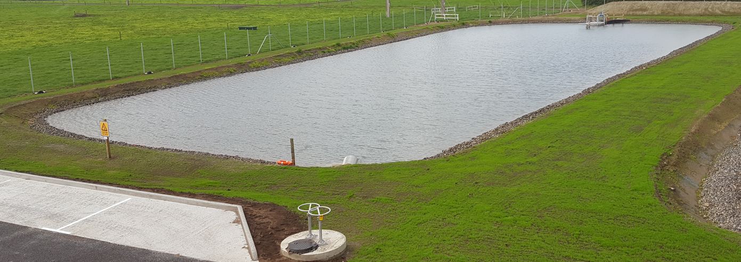
Regulations
Discharges
Consenting
Management Options
Settling Ponds
CAPEX
OPEX
RISK
>99.9% Eff.

Slide 11
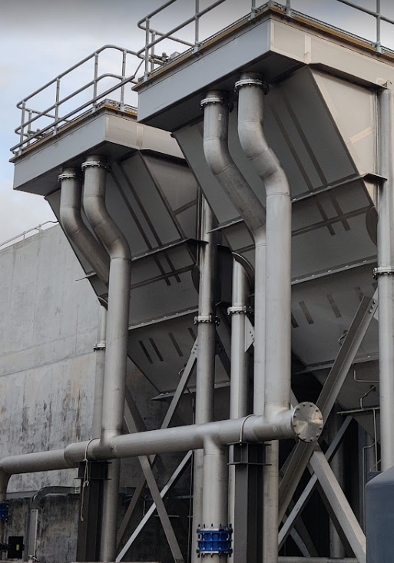
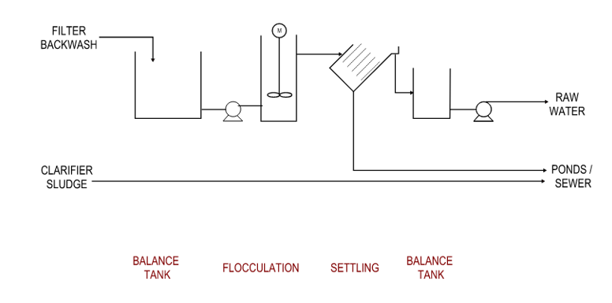
Regulations
Discharges
Consenting
Management Options
Backwash Settling
CAPEX
OPEX
RISK
>99%Eff.

Slide 12
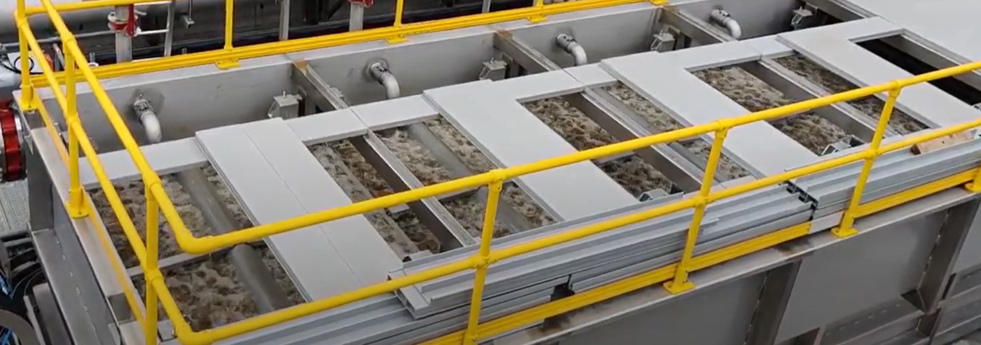
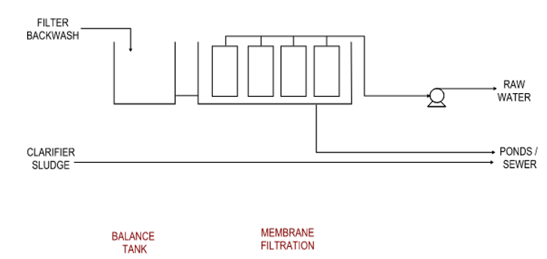
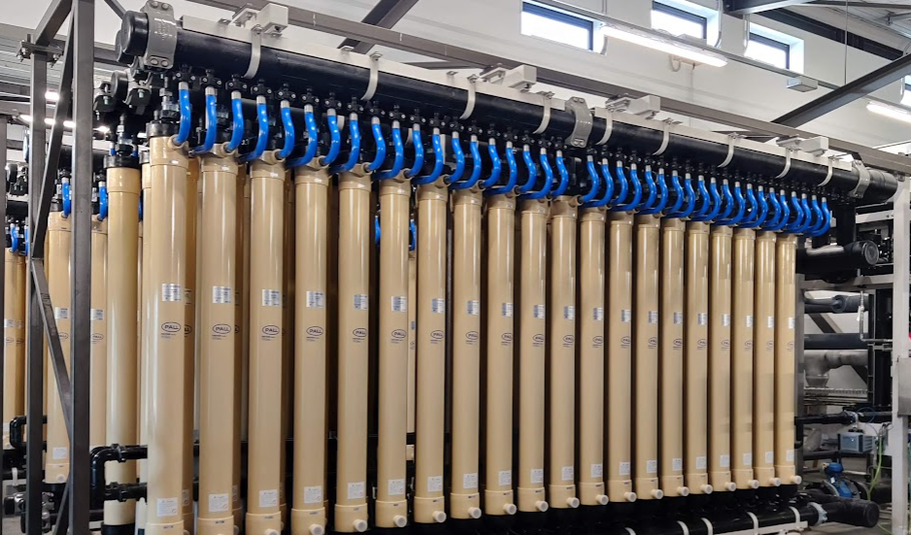
Regulations
Discharges
Consenting
Management Options
Second Stage
Membrane Filtration
CAPEX
OPEX
RISK
>98% Eff.
Notes:
Lower recovery with dirty water, higher quality.
Damage to fibres
May not require a secondary coagulant

Slide 13
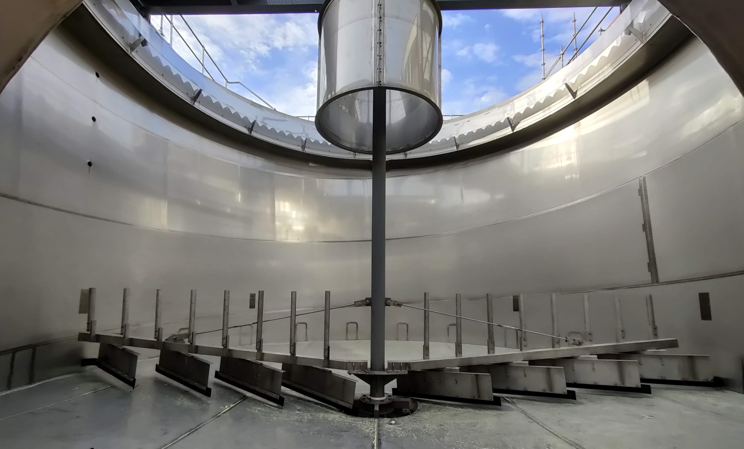
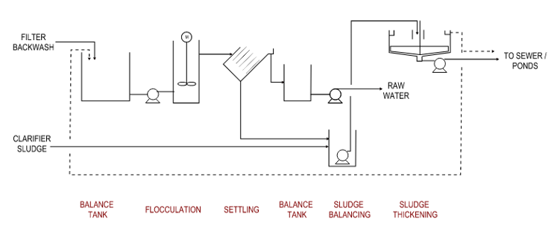
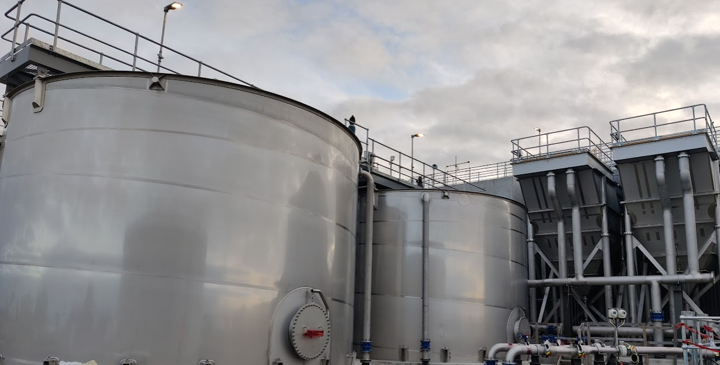
Regulations
Discharges
Consenting
Management Options
Settling and Thickening
CAPEX
OPEX
RISK
>99% Eff.

Slide 14
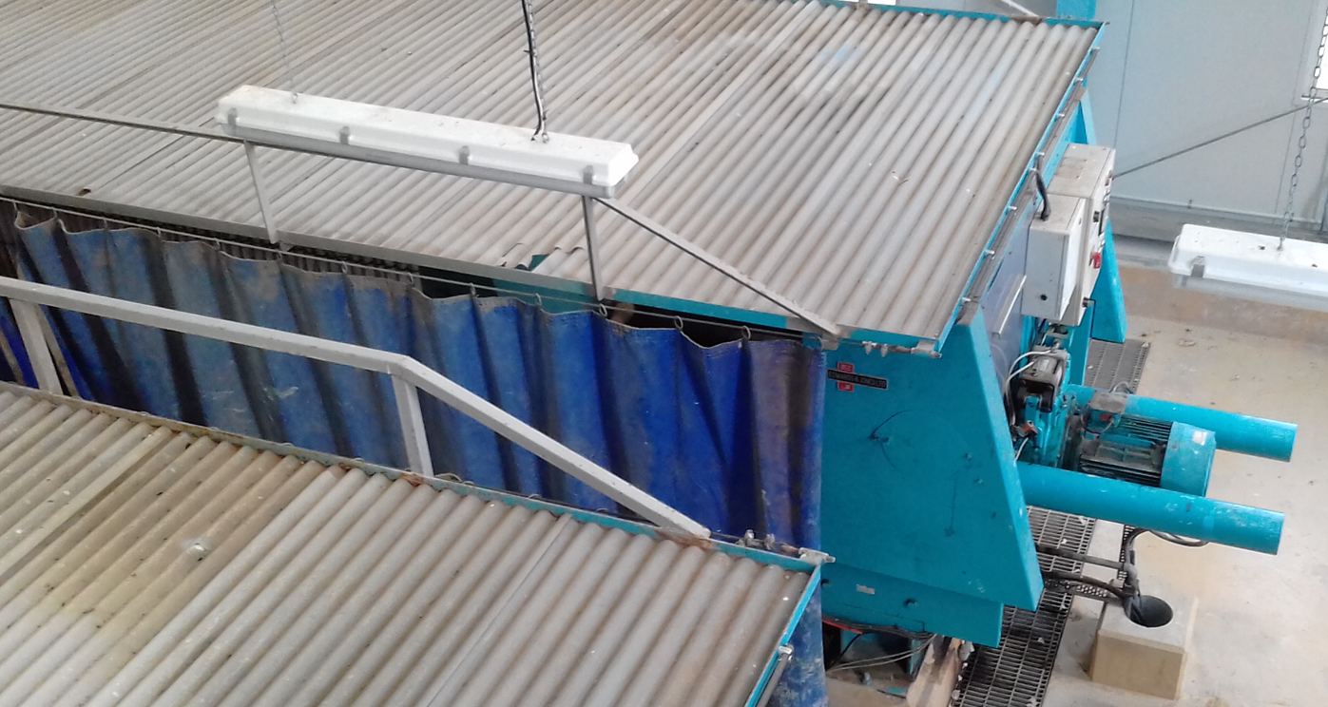
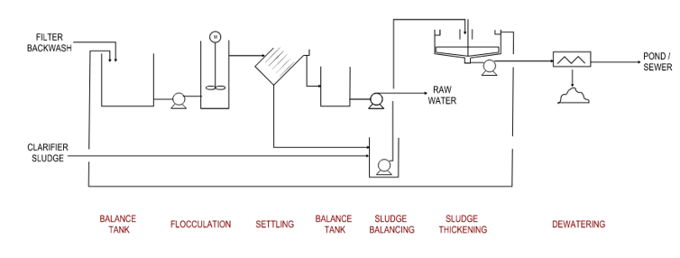
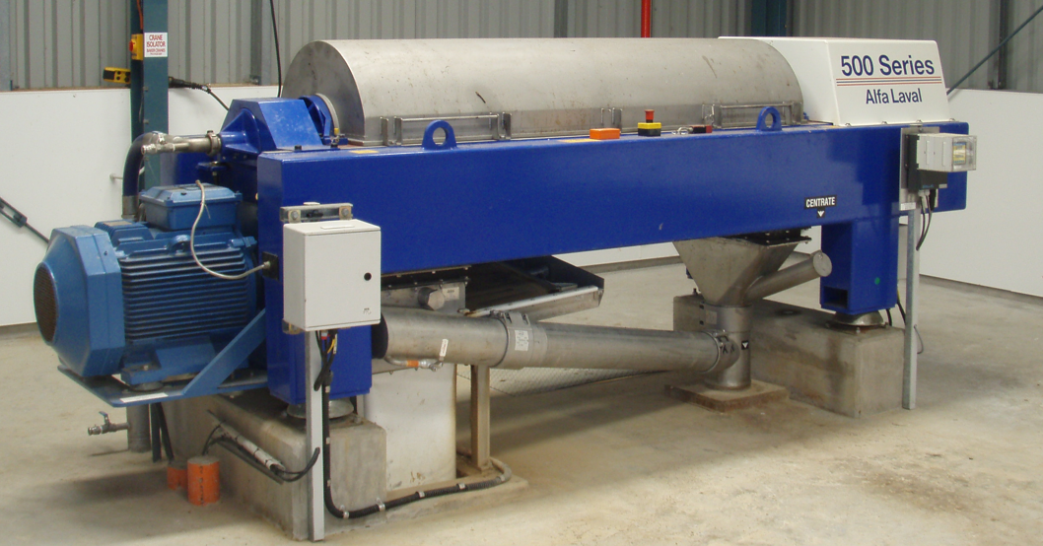
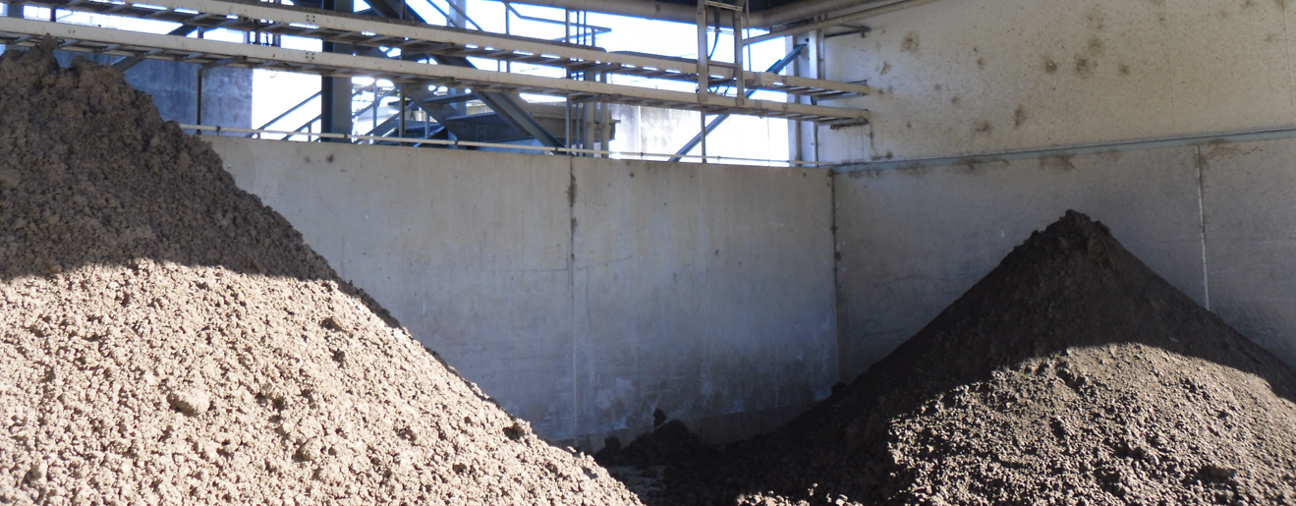
Regulations
Discharges
Consenting
Management Options
Settling, Thickening
and Dewatering
CAPEX
OPEX
RISK
>99.9% Eff.

Slide 15
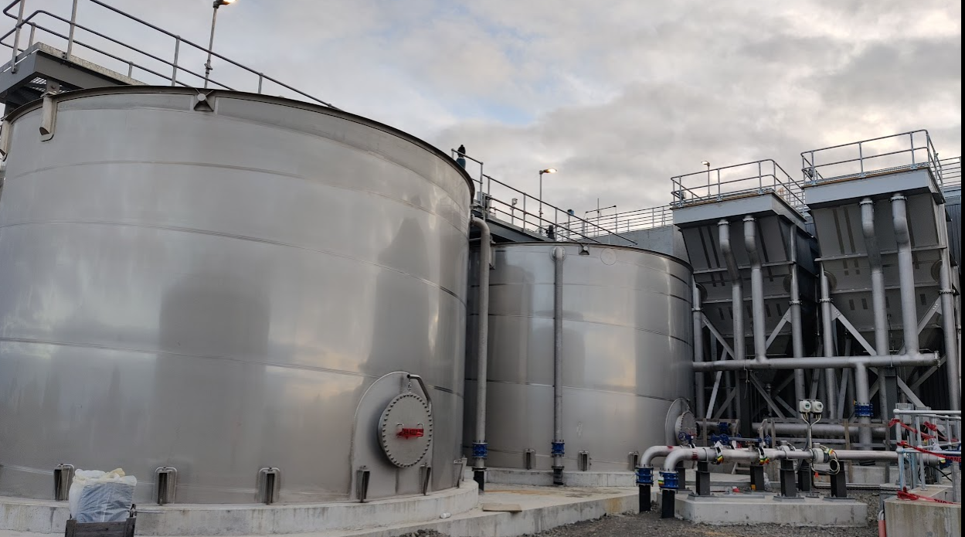
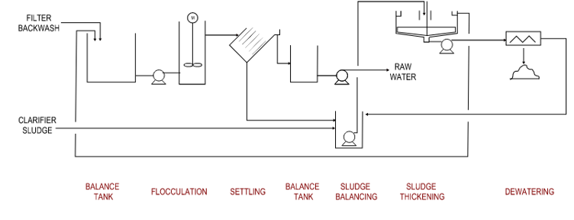
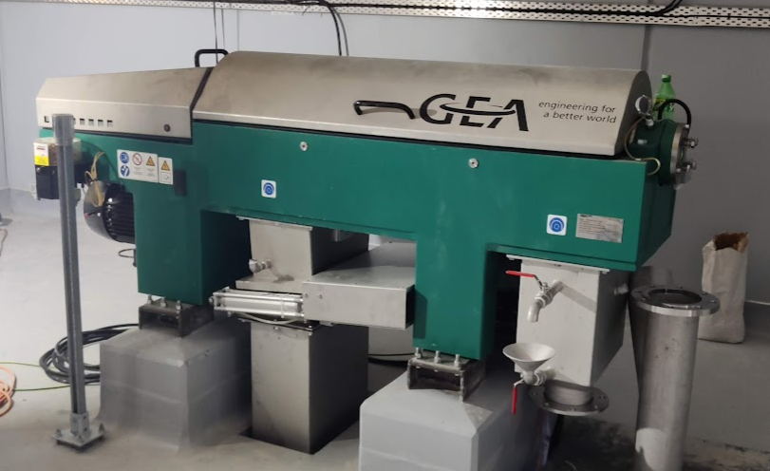
Regulations
Discharges
Consenting
Management Options
Zero Liquid Discharge
CAPEX
OPEX
RISK
~ 99.99% Eff.
Notes:
Polymer and acrylamide
Process upset = shutdown

Slide 16
Conclusions
Regulatory Consistency
Increasing Re-use = more risk
Know your process
Know your site
10%
Notes:
Polymer has acrylamide
Risk to membrane plants

Slide 17
Questions / Pātai
Scott.pearson@beca.com

