Slide 1
Implementing Mahinga Kai as a Māori Freshwater Value:
A kete for implementing mahinga kai in the context of the National Policy Statement for Freshwater Management 2020.
Prepared for the Ministry for the Environment
Individuals and organisations acknowledged for their contributions:
Mahinga kai practitioners and consultants: Barry Matuku, Hurimoana Haami, Marlene Benson, Sam MacDonald, Anne-Maree McKay, Sam Tamarapa, Dr. Shaun Awatere, Dr. Kepa Morgan, Hera Gibson, Tu O’Brien, Mananui Ramsden, Ian Ruru, and Ray Farmer.
Regional Council staff, in particular: Dave Allen (Auckland Council), Mananui Ramsden (Environment Canterbury), Nicola Green, Kataraina O’Brien, Gina Mohi, and Anaru Vercoe (Bay of Plenty Regional Council).
Ministry for Environment-led project team: Alba Jelicich (Project Manager) Dave Allen (Auckland Council), Claire Graeme (MfE), Lyn Harrison (Atahaia Consultancy Ltd), Kataraina O’Brien (Bay of Plenty Regional Council), and Christina Robb (Happen Consulting Ltd).
Technical guidance: Dr. Mahina-a-rangi Baker (Te Kōnae Ltd).
Illustrations: Anakura Kingi-Taumaunu.
Link: Implementing-mahinga-kai-as-a-Maori-freshwater-value.pdf (environment.govt.nz)
Notes:
The guideline document
Authors and contributors – the guideline is the product of many hands. Ian Ruru is unfortunately not able to make it today because of Covid. However, we hve Emily Afoa at the conference… Also, Dr Mahina-a-rangi Baker at the conference, her technical input was extremely valuable. There is a long list of contributors, and I don’t have time to go through them all. However, just want to specifically also recognise Mananui Ramsden who is from Otautahi, and Ngai Tahu.
Acknowledging all who had a hand in producing the kete

Slide 2
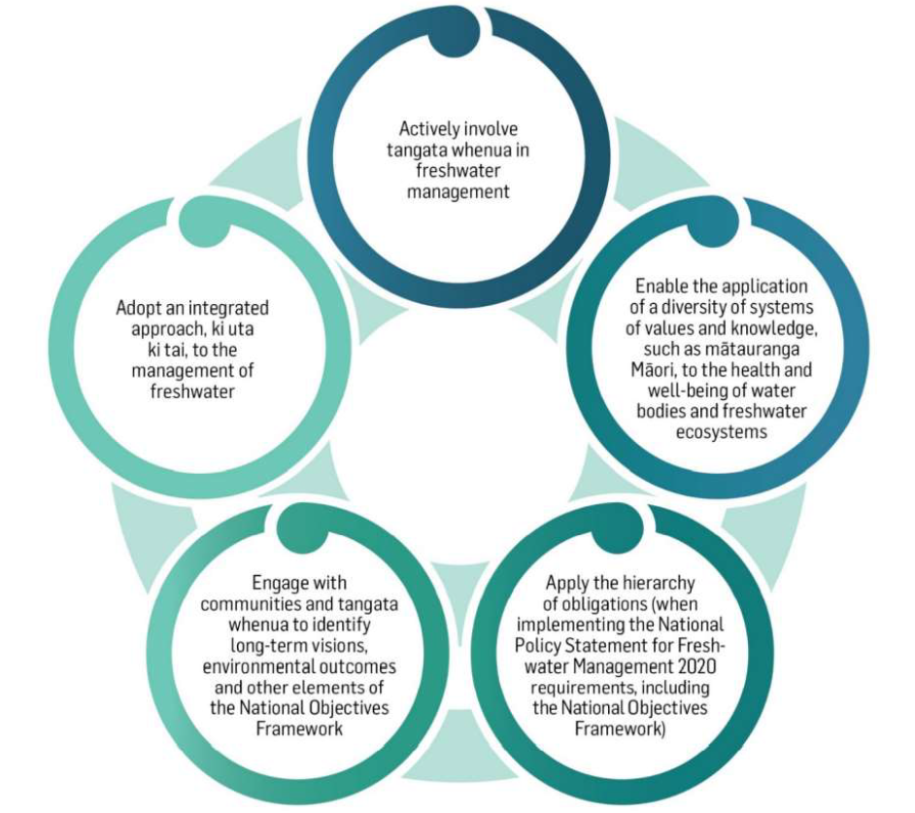
National Objectives Framework / NPS-FM 2020
Compulsory value
Giving effect to Te Mana o te Wai
Notes:
One of the most significant changes from the previous NPS-FM 2014 (amended 2017) is the inclusion of mahinga kai as a compulsory national value in the NPS-FM 2020.
Elevating Mahinga kai to a compulsory value promotes Māori measures of freshwater health to the same status as other compulsory biophysical values.
The new freshwater planning system now gives greater recognition to values that Māori hold for freshwater.
Another key step-change of course is the inclusion of Te Mana o te Wai.

Slide 3
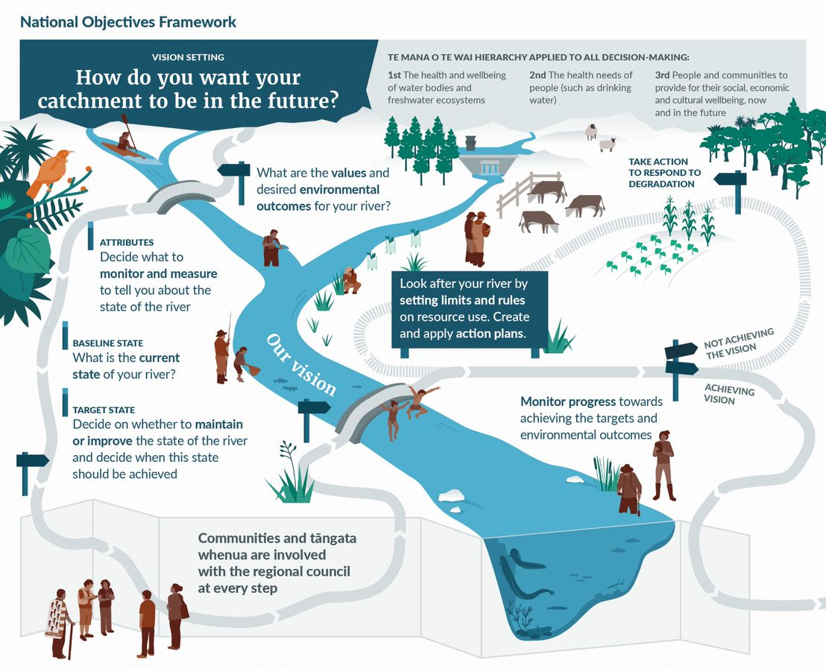
Notes:
Just state that Mahinga kai now needs to fo through the same process as all other compulsory national values

Slide 4
National Objectives Framework / NPS-FM 2020
Governance
Stewardship
Care and respect
Notes:
Considering Te Mana o te Wai …. This fundamental concept includes six Principles…
The Principles are expressed for Tangata Whenua and Tangata Tiriti… Mana whakahaere, Kaitiakitanga, and Manaakitanga. And Governance, Stewardship, and Care and Respect.
Mahinga kai is intrinsically connected to Te Mana o te Wai - The principles of mana whakahaere, kaitiakitanga, and manaakitanga are integral to Mahinga kai and underpin tangata whenua relationships and connections with the wai.

Slide 5
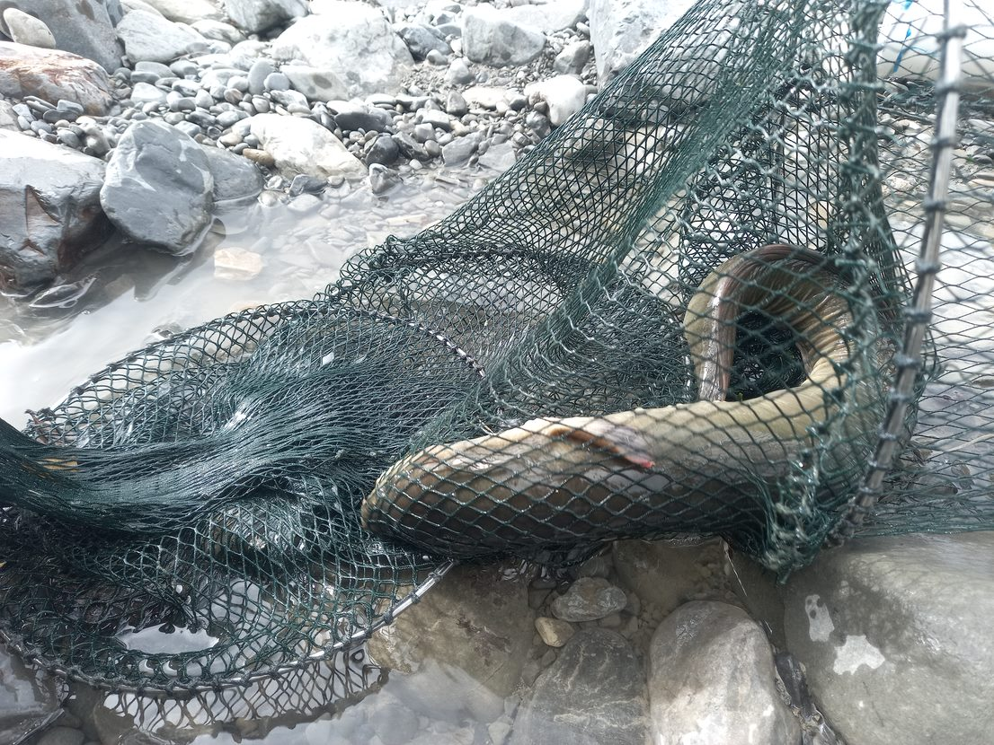
What does the term Mahinga kai mean to you?
Notes:
Imagine visiting your local favourite river, going there with extended family, spending time together in the water fishing and collecting shellfish, children playing in the mud, making sure only to take what you need… and all this with your grandparents and ancestors looking over you, with you doing what they did in the way they did it when they were alive.... Then taking that food back to your community, sharing it with family and friends, and visitors.
That is mahinga kai. Yes, the life in the water is important, but Mahinga kai can’t exist without the relationships with and connections to the water.

Slide 6
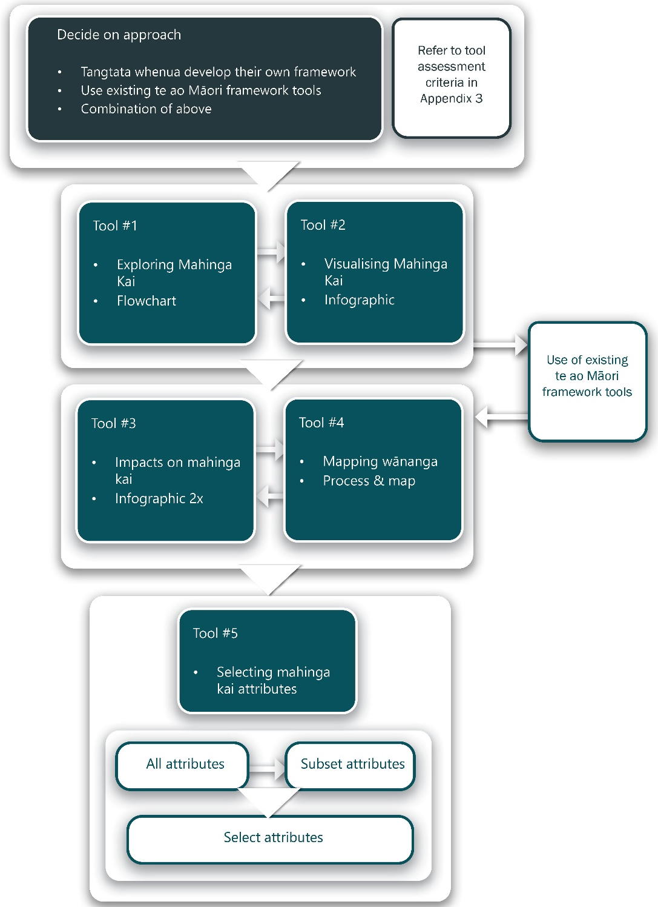
The kete
Notes:
The kete is catered towards Mahinga kai practitioners, tangata whenua, and councils.
It includes a range of intuitive and technical content.
It reflects the intricate complexity of the topic, and its human / relational element.
Quickly list the contents and with some context where necessary / good
Quickly show that there is also guidance on how best to use the kete
It is complex…

Slide 7
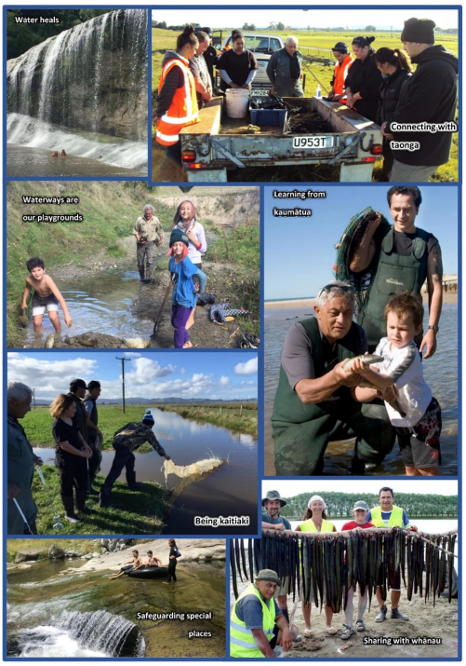
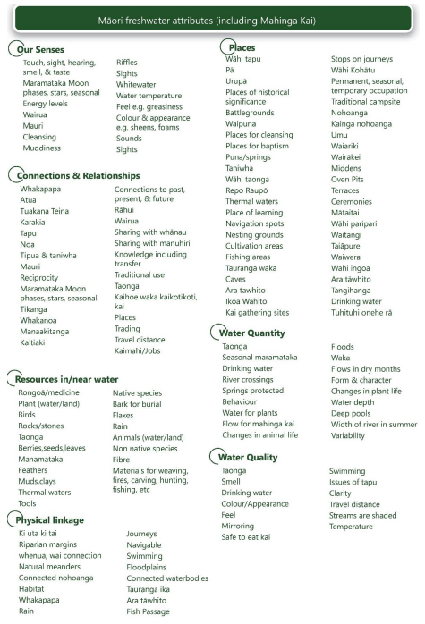
Visualising mahinga kai
Mahinga kai 101
Mahinga kai connects people with place, tangata with whenua
Mahinga kai is inter-generational
Mahinga kai is a holistic and integrated value
Biodiversity? Water quality? Water flows?
Notes:
Mahinga kai is determined locally by tangata whenua; the mātauranga resides with tangata whenua; it is about the cultural customs and practices of mana whenua – that is why only mana whenua can identify their Mahinga kai values
Showing the human element
Describing the differences in how Western Science and tangata whenua view biodiversity, water quality, and water flows (providing examples)

Slide 8
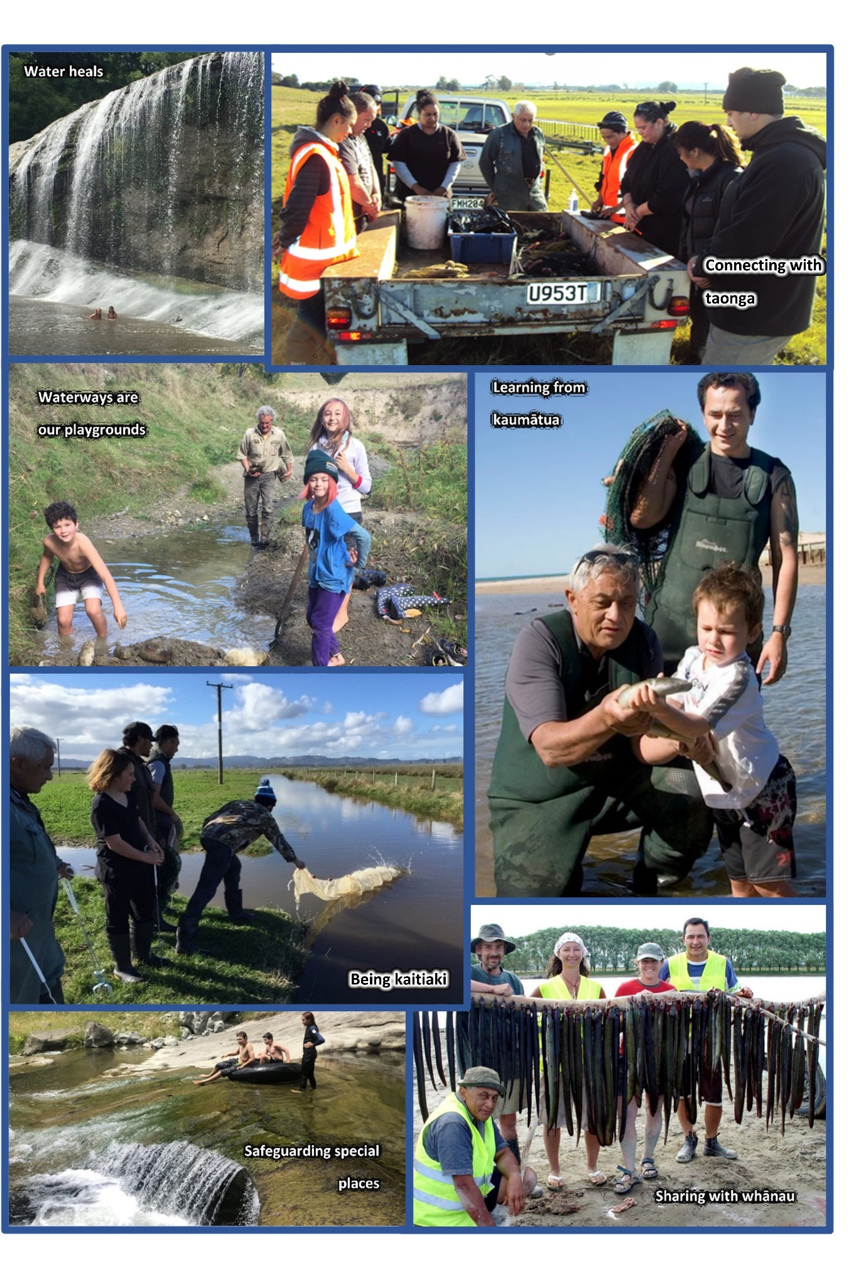
Visualising Mahinga kai
Notes:
In prep for next slide – what do you think impacts on Mahinga kai?

Slide 9
Impacts on Mahinga kai
Notes:
We are most familiar with visible / physical impacts

Slide 10
Impacts on Mahinga kai
Notes:
We are least familiar with visible / physical impacts

Slide 11
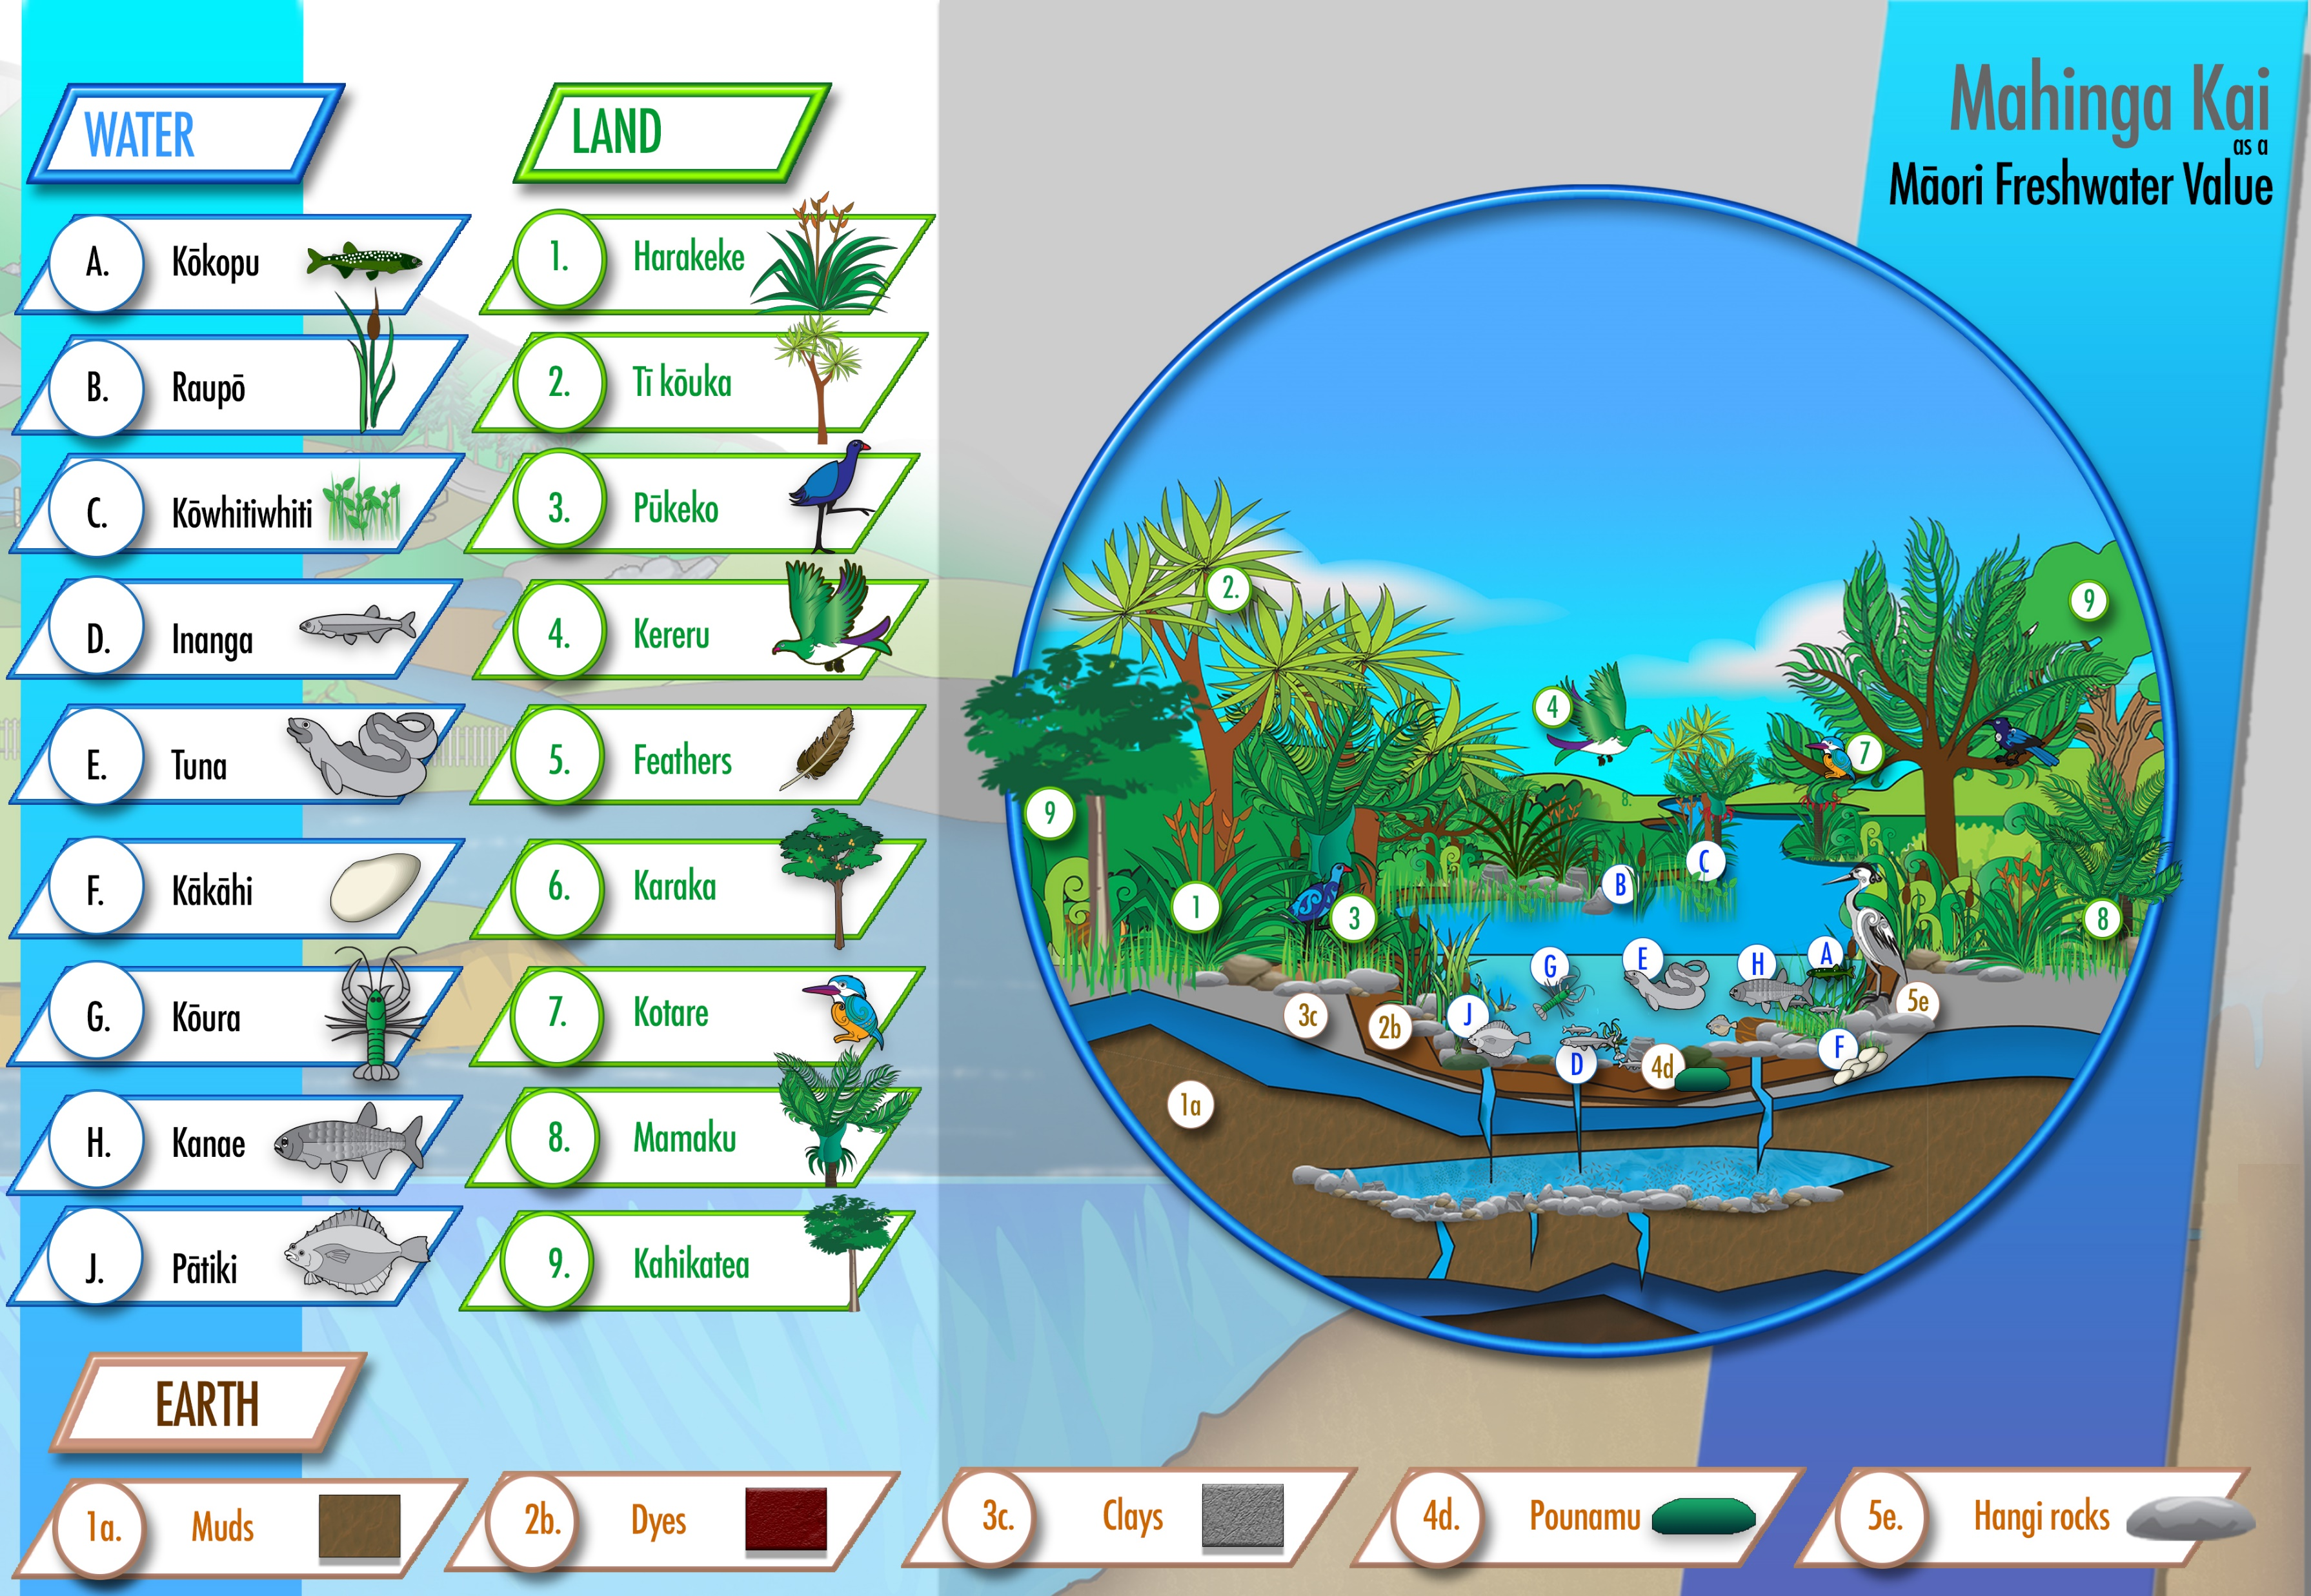
Mahinga kai resources
Notes:
Use this slide to show the ‘diversity’ of Mahinga kai ‘resources’

Slide 12
Mahinga kai water bodies
Notes:
Use this slide to show the ‘diversity’ of Mahinga kai water bodies i.e., that is applies across the full range
Also, use the opportunity to talk about ki uta ki tai

Slide 13
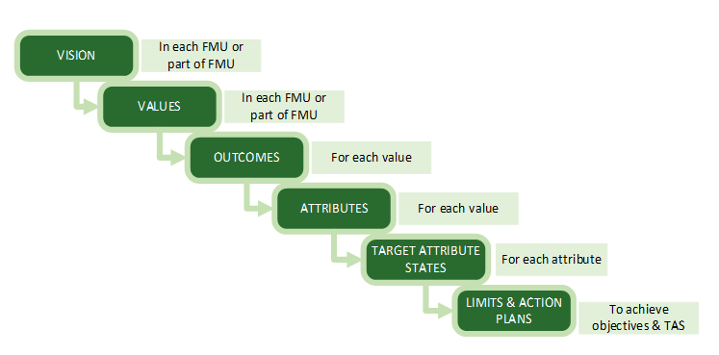
Taking Mahinga kai through the NOF process
Guideline includes an example
Recognises the critical need for effective egagement
Notes:
The guideline includes a step by step guide
It includes an example of practical application of Mahinga kai at all of the NOF steps
Note that it includes examples of attributes
Explain the importance of authentic engagement – note that the guidance also provides step-by-step guidance on engagement for the purpose of going through the NOF process
What does success look like?

Slide 14
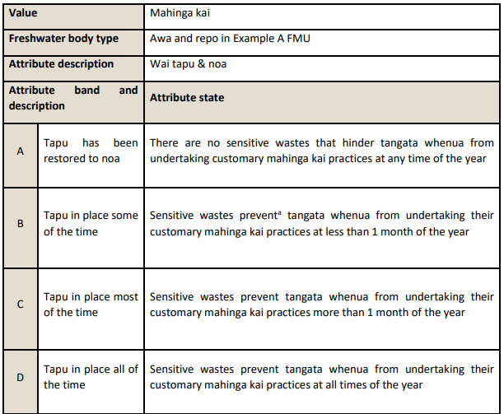
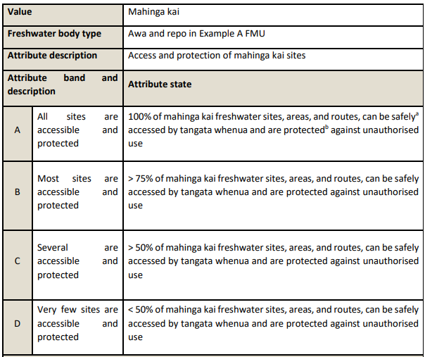
Attributes

Slide 15
Thank you
Notes:
Not to go through but just to show the attendees that it exists

