Slide 1
Robert Keessen, Abel Immaraj, Andrew Chapman, Peter Gillam
Shaping Cities with Precinct based Water Schemes
How does it work?
Notes:
Kia ora, Good afternoon everyone. My presentation today is about shaping our cities with water. I have a confession to make. I love water. I tell my friends that if I am not working on Water, I’m sailing over it or swimming in it.
I want to tell the story that precinct based water schemes are really providing the opportunity to do this well. So what do we need to do to get this to work. I will draw on my experiences , and then relay the advances made in recent times using projects my colleagues in Aurecon have been involved with, Abel Immaraj who is from Queensland in Australia and is currently based in Auckland as well, Andrew Chapman in Melbourne and Peter Gillam in Sydney

Slide 2
Shaping Cities with Water
Why it matters…
Notes:
So why is this important. Its about liveability right? As Board member once said, What is this word”liveability” its not even in the Oxford dictionary
Well if your city wants to be competitive in the global market you will be keeping an eye on the ‘liveability rankings published by economic institutes.
But if you are more like me, you are probably noticing that as our cities become bigger, the residents loose the things they cherish, their sense of community and connection with nature. Precinct planning is about turning this around and making our cities liveable again.

Slide 3
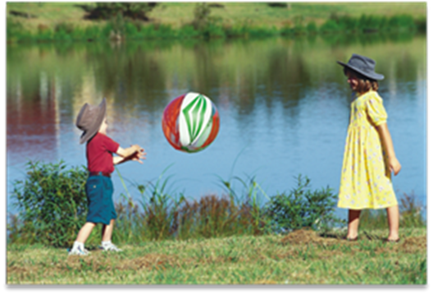
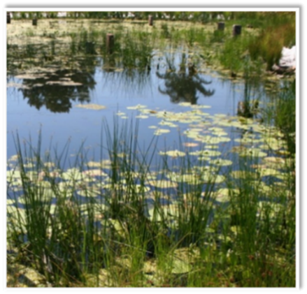
The changing needs of the city
Water infrastructure delivers essential services (water sanitation and drainage)
But our communities want healthy environments and community wellbeing as well
Notes:
Water infrastructure has by and large been successful in delivering public health of a water supply and sanitation system. Our communities are now looking to go the next step to healthy environments and a sense of wellbeing in our cities.

Slide 4
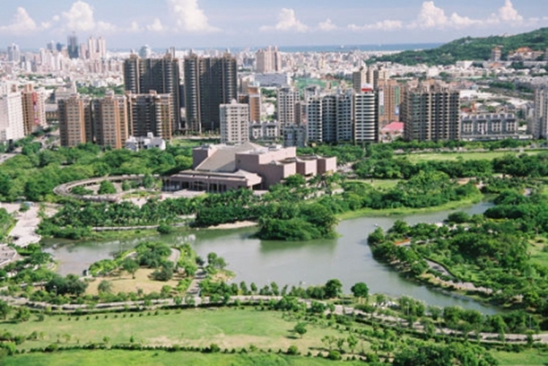
What the academics say
Water sensitive cities is a concept developed in the last decade to support the ambition of making cities more liveable.
’Water sensitive cities’ is a direction for good urban development.
Important principles:
Look at every form of water as an opportunity
The built environment should supplement and supports the function of natural environment
Water needs to be considered in city stakeholder’s decision-making and behaviours
Source : The Delft Institute of Water
Notes:
This is not new. Its been around for a while. The Delft Institute of Water, an internationally recognised leader in the water industry based in the Netherlands set the message that urban development needed to deliver ’Water sensitive cities’, where
every form of water is seen as an opportunity,
the built environment support, (not detracts) from the natural environment, and
the city stakeholders should be involved in the process.
This was quite visionary around the turn of the century, bearing in mind the prevailing ethos was to capture water, use it one and throw it away (what were we thinking). But as history since then has shown, this has not been easy to do in practice.

Slide 5
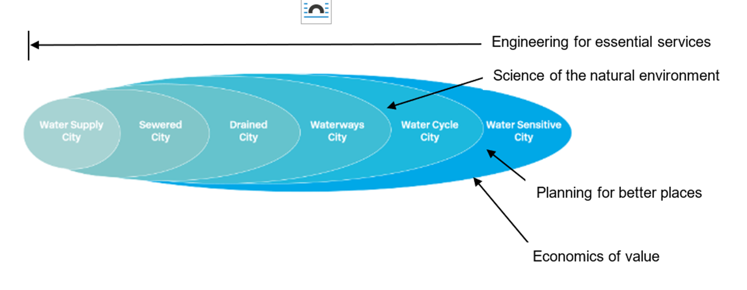
How water can shape our cities…
Source: Water Sensitive Cities Australia (WSCA)
A multidisciplinary research-to-practice partnership within the Monash Sustainable Development Institute, continuing the mission of the CRC for Water Sensitive Cities
Notes:
The CRC for Water Sensitive Cities in Australia developed the concept that the water sensitive city was the next step in the evolution of water planning,
from water supply, sewerage and drainage,
to a city working around its waterways, then the catchments
and then to a ‘Water Sensitive” city.
This progression takes an increasingly multi-discipline approach, shown here with my black text overlays here, from an industry which primarily driven by engineering, to one which needs science, planning and economics

Slide 6
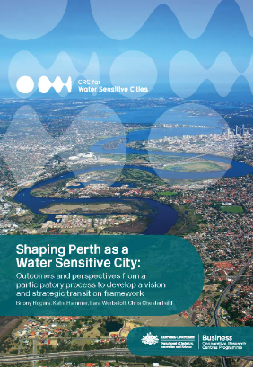
What is a Water Sensitive City?
It provides the water security through efficient use of diverse available resources;
It enhances and protects the health of waterways;
It mitigates flood risk and damage; and
It creates public spaces that collect, clean, and recycle water.
Source: Water Sensitive Cities Australia (WSCA)
A multidisciplinary research-to-practice partnership within the Monash Sustainable Development Institute.
Ccontinuing the mission of the CRC for Water Sensitive Cities
Notes:
The CRC says that achieving a water sensitive city is about
Providing water security and the use of diverse resources;
Enhancing and protecting the health of waterways;
Mitigating flood risk and damage; and
And creating public spaces that collect, clean, and recycle water.

Slide 7
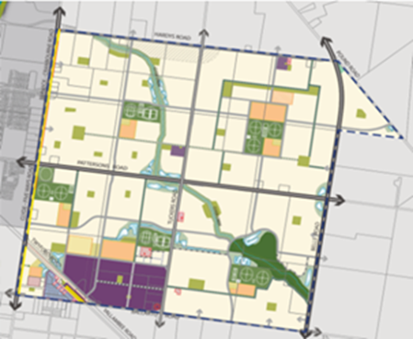
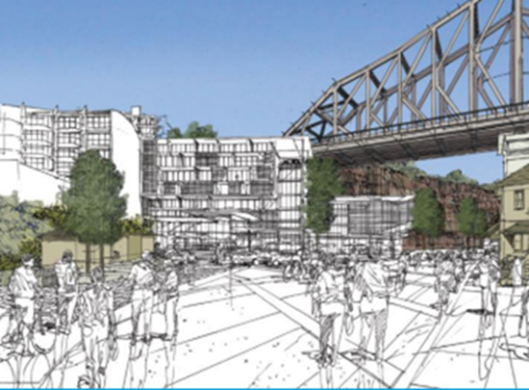
What is ‘a precinct’ or ‘place-making’
An urban precinct:
Is community centred
Has vibrant activity
With a sense of place
Placemaking:
Has public areas and infrastructure which is greener, accessible and climate resilient
Creates places where people dwell longer
Creates a sense of identity within the community
Notes:
Precinct planning is really a urban planning term, used to describe a renewed focus on local community infrastructure. Its less about creating suburbs that people leave I their cars each day to communities with vibrant activity (employment, and community based activity) and places to dwell around walkable distances. To make it useable people want places that are green, accessible and climate resilient.
Urban planners are looking to us in the water industry to help create this.

Slide 8
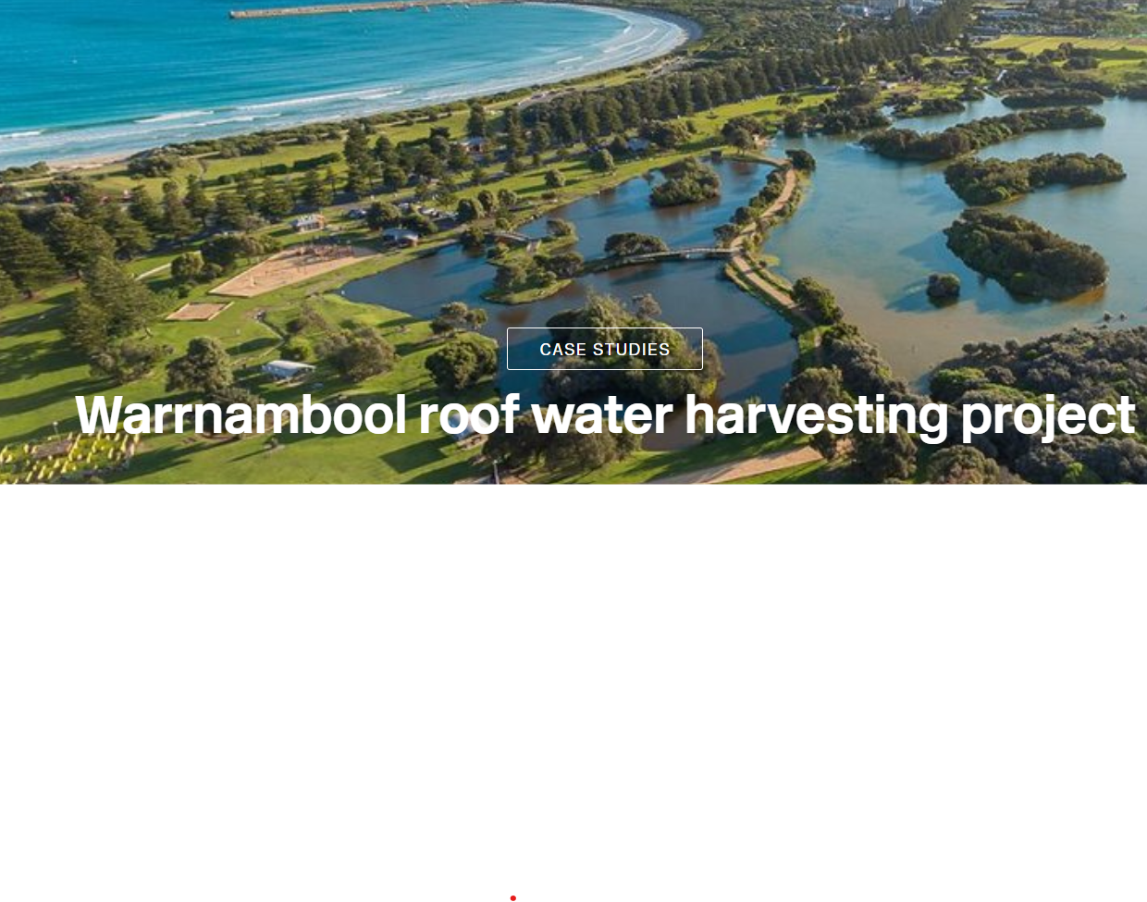
How this relates to water management…
The total water cycle can be managed locally (stormwater, water wastewater recycled water)
Local water sources to boost supply (Reuse)
Add value to public open space with water in the landscape
Introduce more nature based solutions
Source: Water Sensitive Cities Australia (WSCA)
Notes:
Precincts also resonate with water planners. Its easier to manage the total water cycle in precincts rather than centralised systems. Stormwater can be managed on a local level and there is less need for large distribution networks.
This example is a scheme where rainwater collected from roof drainage is stored in a precinct scale common storage and used as a secondary water supply source to conserve drinking water supplies. Not only was it the lowest cost solution to augment water supplies, it became an attractive feature of the local area.

Slide 9
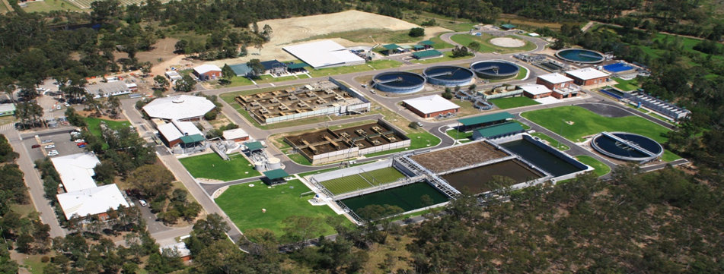
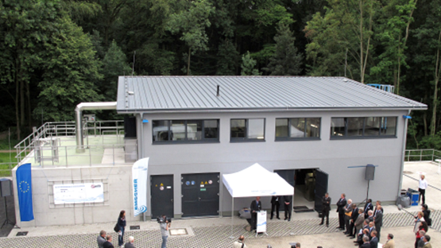
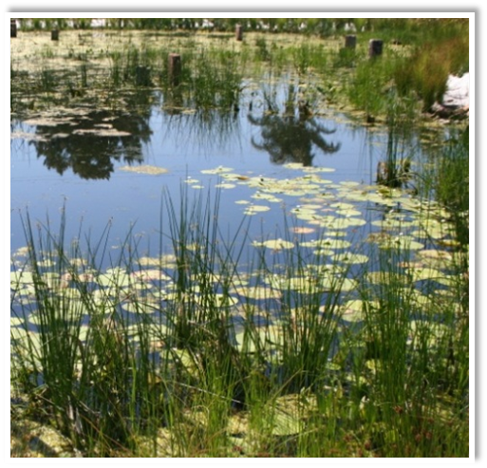
So how do we deliver a ‘Water sensitive city”?
Large scale (centralised) infrastructure solutions alone cannot deliver this value.
Precinct scale nature based solutions in conjunction with centralised infrastructure can.
From
To
Notes:
I was working in Corporate Strategy in Sydney Water in 2011when they were being criticised for no embracing water sensitive cities approach. It was technically viable approach and economically viable but in practice. Some saw it as a comparison between centralised and decentralsed solutions, but the best schemes tended to be a hybrid of the two, with precinct scale solutions embedded within centralised networks
But these schemes were difficult to get approval for. They were considered risky, due to issues around regulation, pricing and funding. WE needed to get stakeholders support.
I left Sydney Water in 2016, and I am pleased to report that considerable gains have been made since then.
I am going to use three case examples of how these risks were overcome, the Western Sydney Aerrotroplis, Gold Coast Water and wastewater in Queensland , and Fishermans Bend in Melbourne

Slide 10
Delivering precinct-based water solutions
How it works….
Vision (Water management supports the vision for the precinct)
Integration (IWCM stormwater and water/wastewater utilities)
Collaboration (Incorporate water in urban plans)
Flexible and Adaptive (Keep your options open to allow innovation )
Economics (Around Value and cost efficiency)
Value Capture. (Funding mechanisms)
Notes:
The six key factors that overcame these risks I believe were:
1 Setting a vision for water that supports the vision for the precinct
2 Combining stormwater and utility services in an integrated water management plan
3. Collaboration with urban planners in particular
4. Being flexible enough to adapt to change as it happens in the future
5. Building the economic case around value and cost efficiency, not just lowest cost of essential services
6 Using Value capture as a funding mechanism

Slide 11
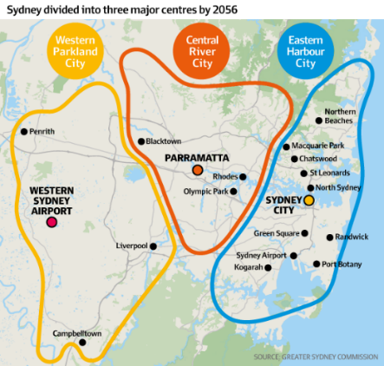
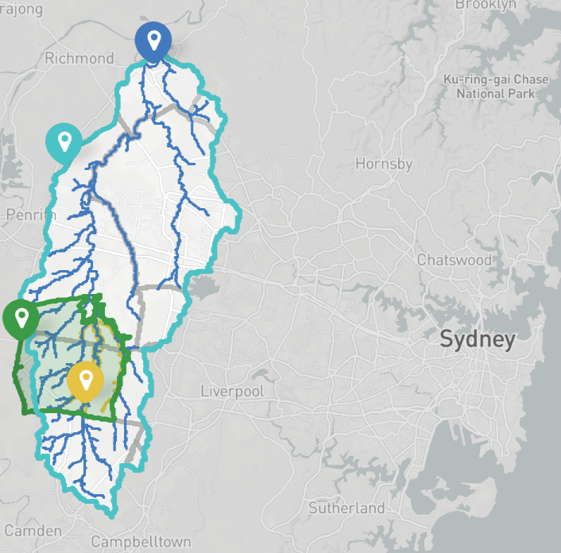
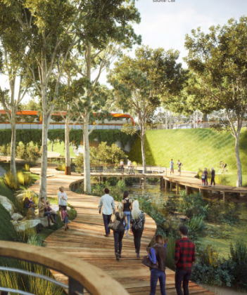
1. Create the Vision
Greater Sydney
The vision for is to create a metropolis of three cities, including a new city called the Western Parkland City, where water would provide greening and cooling of the parklands.
Western Parkland City, and the Western Sydney Aerotropolis
Western Parkland City
The feature of the was the spine of South Creek re-imagined to provide new cool and green neighborhoods and centers with generous open space in a parkland setting
‘Aerotropolis precinct’
Part of the Western Parkland City, that needed a vision for water that supported the wider planning vision for the city
Notes:
The first key factor is creating the vision, and the Western Sydney Aerotropolis is a good example. The vision by the Greater Sydney Commission was for a third city in the Sydney Basin called the Western Parkland City.
The conversion to cool and green neighborhoods in a parkland setting was going to be a challenge. Right now it is a series of cow paddocks that gets very hot and dusty in summer, and will get hotter with the urban heat Island effect
Sydney Water had a big part in shaping this vision by re-imaging South Creek to be a centrepiece of the parklands around the city .

Slide 12
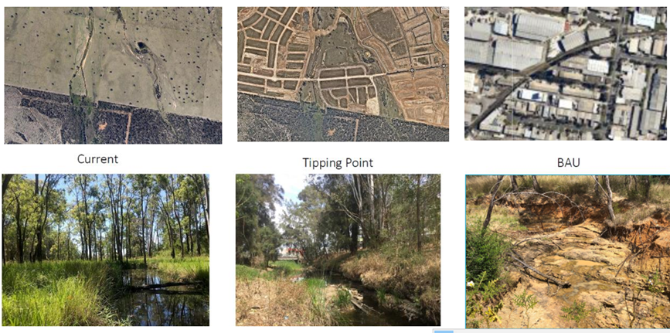
2. Integrated Water Management
Western Sydney Aerotropolis
Maintain the integrity of South Creek
(Source: Dan Cunningham, Sydney Water, Peter Gillam Aurecon)
Notes:
The team at Sydney Water were instrumental showing that it could be done. I must give credit to Phil Birtles and Dan Cunningham from Sydney Water and Peter Gillam from Aurecon who did this.
The initial driver was to preserve the morphology and ecology of the creek running through the centre of the precinct (South Creek). Importantly they brought together the stormwater aspects of the water cycle and the water supply needs together into a Integrated water management plan,
These great images were used to illustrate how the increased flows from development had the potential to ruin the integrity of the creek .

Slide 13
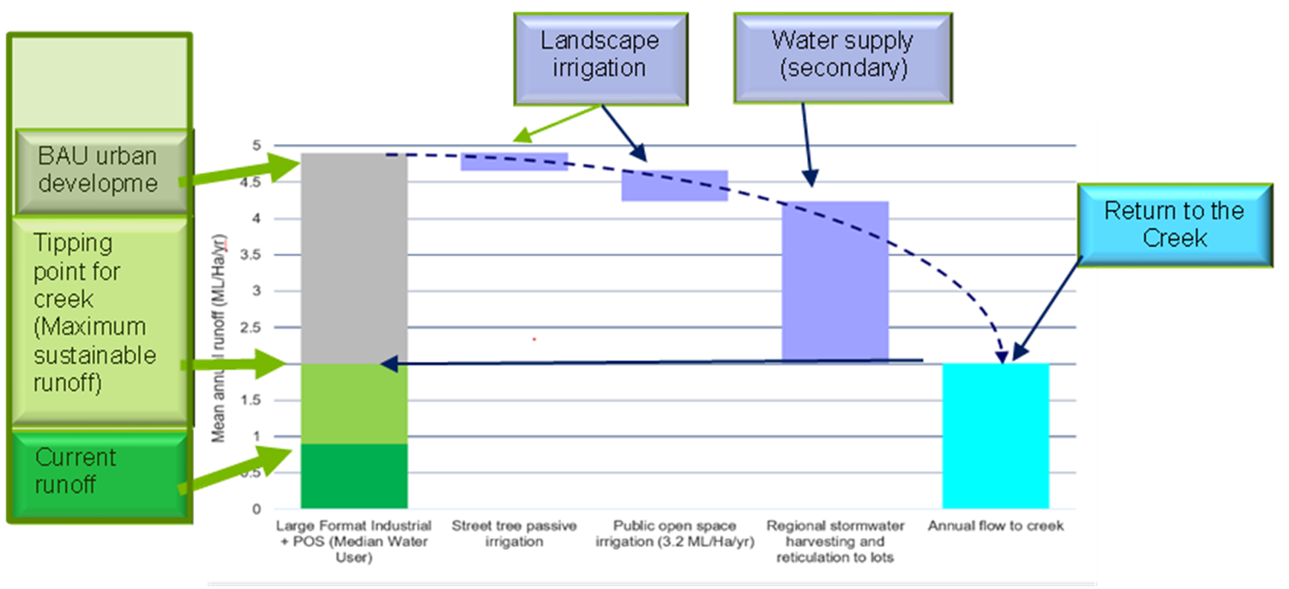
Water Balance
Runoff volumes
Even with WSUD, Water flow in South creek would increase 5 - fold
Stormwater harvesting needed to reduce runoff to sustainable levels of around a 2-fold increase
Notes:
To illustrate why this happens, a water balance showed that runoff volumes would increase 5 fold after development, even with standards of stormwater controls. For the Stormwater buffs in the room, this was total water volume into the creek, not the instantaneous discharge which we are used to measuring.
Post development stormwater volume would need to be reduced to around a two fold increase in volume for the creek to be sustainable. A lot of work was done to figure out how to achieve this, and as you can see in the diagram, the solution was to capture the water and use it for landscape irrigation and as a source of water for secondary water supply.
Bingo, All of a sudden we have created a double benefit. Not only would this scheme save the creek, but would provide the source of water for blueing and greening the landscape, and another source of water for a secondary water supply.

Slide 14
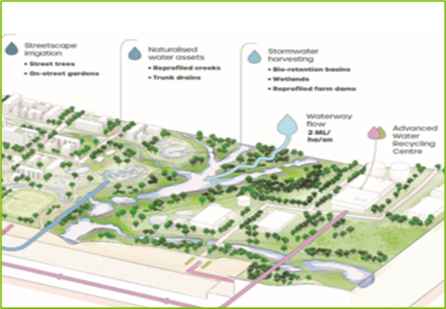
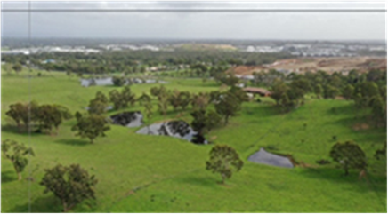
How do you capture so much water?
Convert existing farm dams Make water a feature of the precinct plan
Conversion
Multiple benefits
Ecological value of waterway
Improved public open space
Secondary water supply of recycled water for residents
Notes:
So the obvious question that needed to be answered was, how do you sore this amount of water? Again the work was done to show it could be achieved by maintaining existing farmland dams and building new water features in the urban landscape. Water would become a feature of the landscape.
Bingo, another benefit. It would help create the attractive parkland landscapes the planners wanted for the parkland city.

Slide 15
3. Collaborate collaborate collaborate
Land allocation for water management
within Western Sydney Aerotropolis
(Source NSW Govt.(d)
Western Sydney Aerotropolis Precinct Plan)
Notes:
The third important aspect of precinct based solution that can not be under-estimated is the importance of collaboration. Water planners needed to market this to the stakeholders so they not only wanted it, and were also prepared to do what was needed to make it work. In particular, significant amount of land needed to be allocated to accommodate the water storage and treatment.
And the result is shown here in the diagram where the Precinct Plan shows all the land allocations for water management in green.

Slide 16
4. Adaptive Planning (create flexibility)
Precinct based plans take time and are uncertain
Flexibility to allow innovation and changes with time.
Investment strategy to
keep options open for the future
minimizes infrastructure becoming redundant in the future.
Adaptive Planning aims to:
identify the most desirable investment pathway
understand the decisions that need to be made ahead of time
build the capacity to foresee and manoeuvre between pathways
Notes:
The fourth key aspect is Adaptive Planning, because not all projects start on a blank sheet of paper like the Western Sydney Aerotropolis. Development of water management is a highly uncertain process. We don’t know how quickly populations will grow, and which areas will be developed first. We have got an idea, but we don’t know what climate change is going to do. And it’s a reasonable bet that technology solutions will be quite different in 30 to 50 years time compared to what they are today
Adaptive management techniques have been developed for just this situation. It is a technique used to identify the most desirable investment pathway, but keeps other options open so that there is flexibility to adapt if things change. The key is to know when decisions need to be made, so you can changing tack if necessary.

Slide 17
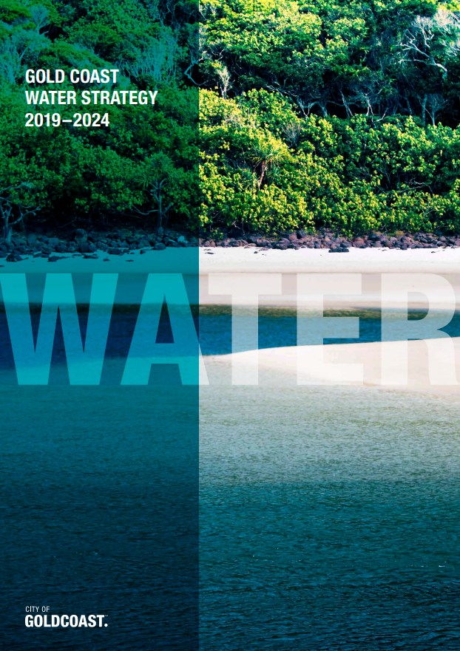
Adaptive Planning
Gold Coast Water and Wastewater
Identfied local schemes for a more sustainable liveable city
Considerable uncertainty of how where or when they would be implemented
Decisions on augmenting capacity of centralised infrastructure would depend on how many of these schemes were successful.
Keep your options open……
Notes:
The Gold Coast in Queensland aspire to maintain their close relationship with water, which is what people come there for. Gold Coast Water and wastewater could see the potential for precinct-based water opportunities, but were aware that schemes may not be successful immediately, and may emerge with time as willingness, innovation and technology evolves. The last thing they wanted to do was to build large scale infrastructure today that locks the precincts into todays technology solutions for another 50 years.
Gold Coast Water and Wastewater knew that a deterministic plan was never going provide the flexibility needed They identified the precincts where they saw the best opportunities, and created adaptive plans for each precinct. The region as a whole also had an adaptive plan, whereby the upgrades to centralised infrastructure were contingent on how many precinct scale schemes were successful.

Slide 18
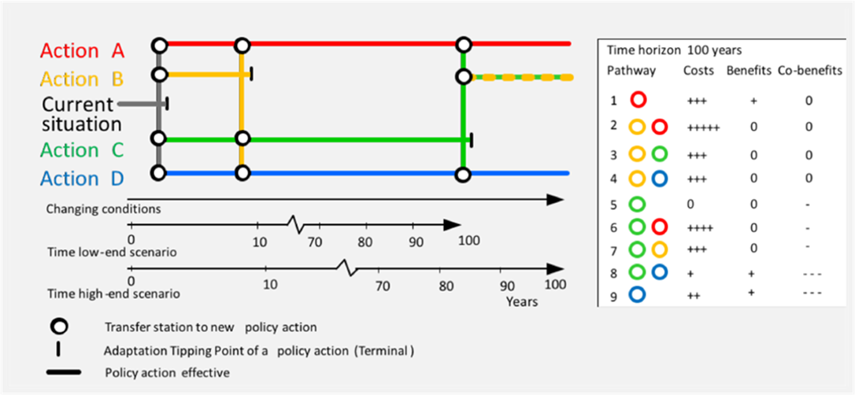
How Adaptive Planning works
Source: Deltares /Aurecon
Tipping points – when actions are needed
Lead times for implementation
Decision dates
External signals to be monitored
Knowledge gaps to be filled
Plans in consultation with stakeholders and the community
Notes:
My colleague Abel Immaraj from Aurecon is championing Adaptive planning methods in partnership with Deltares, the leading Dutch consultancy. I only have time to give you an overview of how it works here today. There is more in my paper, and you are free to talk to Abel about it after this session.
So in response to a particularly challenge with uncertainties, such as providing water services to a growing region you could do a number of things ranging from building new centralised infrastructure to a desalination plant ( high up-front investment in an uncertain future) , servicing with a series precinct scale recycled water sources, or building new rainfall dependant water sources. Doing all these at once is not possible of course, so you ned to select a preferred pathway, monitor the situation and adapt as needed.

Slide 19
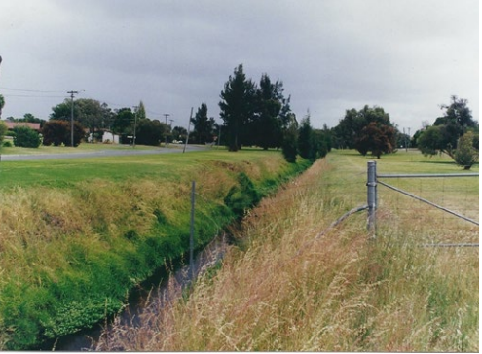
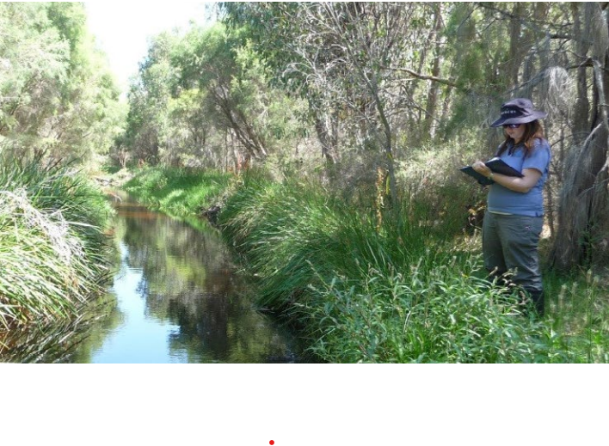
5. Build the economic case around value
Bannister Creek WA went
from this…
Customer value
Value of ‘blue and green’ public open space (property value)
Value of drought-proofing properties with a recycled water source
Value of Water conservation
Environmental Value
Value of an enhance the natural aquatic environment
Value of resilience to climate change
Value of nature based solutions to reduce carbon inherent in hard infrastructure
…To this.
Adding 4.4% to value of properties within 200m
Source: Water Sensitive Cities Australia (WSCA)
Notes:
The fifth factor that enables precinct based water schemes is to building the economic case around value.
Up until now business cases tend to be based on the lowest net present cost to deliver to minimum standards. But when we are factoring in liveability and sustainability, the business case needs to be around best value, which is not necessarily the cheapest one. So we need to be able to express value of water in terms of range of benefits including blue and greening, drought proofing , water supply security, value of the natural environment , resilience, and climate change. Thanks to the research and investigations done in recent years, we now have a body of knowledge to quantify these.
One of the benefits that is trickier to quantify of course is the value of water conversation. I cover in some detail in my paper because the value of water conservation varies depending on how much water you have in storages at the time. If your dams are almost empty, the value you put on water conservation is much higher than if they are empty. So I suggest there is a way around quantifying the short run and the long run value of water into the business case that our economists and finance departments will understand.
On the topic of the value of green and blueing of public open space. One of my favourite examples of thee value of a natural waterway is at Bannister Creek in WA where a drain was converted to a natural waterway. A economic study showed that the value of properties within 200m increased by 4.4% compared to other properties further away. That’s about $30,000 per property. So these values are real…. (people are paying for them), they are significant and should be included in an economic case around value.

Slide 20
Cost efficiencies of precinct systems
Capital
Economies of technology > Economies of scale
Avoided costs to centralised systems
Operations and maintenance
Lower cost and less disruptive to maintain
More resilient
Notes:
The cost of local precinct scale infrastructure compared to centralised infrastructure has been a much debated topic. Suffice to say that the economies of scale of centralised infrastructure is now being overtaken by the economies of new technology and control systems.
Small modularised treatment plants that are controlled remotely are being adopted by private sector utilities in buildings and precincts in Sydney at similar costs to centralised systems.
Precinct based systems take the pressure of existing centralised systems that are straining under the load of infill growth.
We are also now starting to understand that large system are actually more costly to maintain in their old age than a series of small ones, and small systems are more resilient

Slide 21
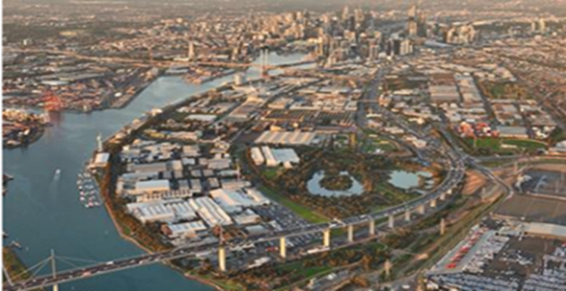
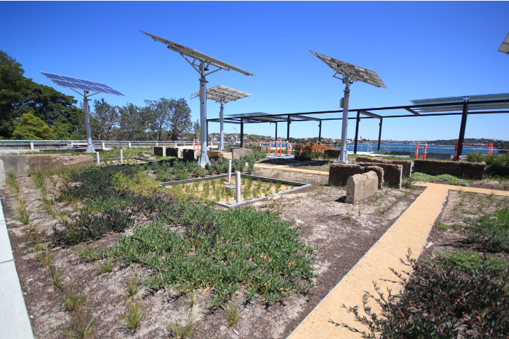
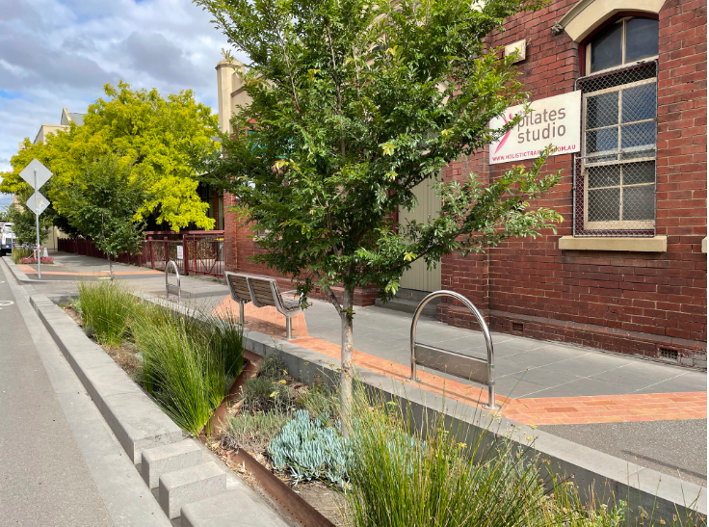
6. Financing through ‘Value Capture’
Show the uplift value is more than the cost
Work with stakeholders to establish willingness to pay
Build water into the financial plan for the development of the precinct
Establish mechanisms for beneficiaries to fund
Notes:
The sixth and last factor I wish to highlight is Financing through Value Capture
Value capture is widely used in transport projects. For example, the cost of a new transport line can’t be recouped through ticket sales, but the project delivers a wider benefit to development around stations. Value capture is about recovering some of this land uplift value to make the project financially viable.
Fishermans Bend is a large urban renewal project covering approximately 480 hectares in the heart of Melbourne. Expected to be home to approximately 80,000 residents by 2050. The proponents of the scheme worked with community and stakeholder over a 12 month period, to develop services and liveability of the 5 precincts in the redevelopment. This included one of the most advanced water schemes in Australia, with:
Water recycling plant and third pipe network for residential re-use.
Water sensitive urban design for stormwater, including distributed storages in open space, raingardens and tree pits.
Rainwater detention (to reduce flooding) with green roofs, green walls, and smart rainwater tanks in individual buildings
Roof rainwater retention (capture, storage and treatment) for re-use.
Andrew Chapman developed the scheme, and most importantly lead the work which lead to it being funded. So the steps are to show the uplift value of the scheme is greater than the cost, establish willingness to pay through the stakeholders and then build the business case and the funding mechanisms that allow the beneficiaries to make their contribution to the costs.

Slide 22
Economics and finance
Fishermans Bend Melbourne
Economic analysis demonstrated a positive benefit cost ratio for the estimated $5 billion+ of infrastructure across all services (that included water)
Funded through Growth Areas Infrastructure Contribution Charges at key development stages
Western Parkland City:
Achieving the Parkland City objectives cost $2 billion more than the baseline $24 billion for water (less than 10% extra).
Excellent value for making the Western Parkland City a viable / liveable city
Funded through rates and charges (stormwater and utilities)
Notes:
At Fishermans Bend the water scheme was included in the business case for all services, totalling $5 billion which was shown to have a positive benefit cost ratio. In terms of funding, Victoria has set up a funding mechanism called the Growth Areas Infrastructure Contribution Charge. This is typically levied at key points in the development planning process such as rezoning, when the properties increase in value, which is when they are best able to make their contribution .
Similarly in the Western Parkland city, the marginal additional cost of a Water Sensitive City was less than 10 % higher the baseline servicing option. Which was considered excellent value for considering how it would transform this city into the Parkland City planners envisaged. In this case the additional 10% would be funded through stormwater and utility charges.

Slide 23
Conclusion
Water can shape our cities…… and our quality of life in them
I hope I have provided some insight today into how precinct scale solutions provide a great opportunity to this ……
Notes:
So I hope that I have ben able to provide you with some insight into how others in the industry have been addressing the challenges of delivering water sensiotve cities through precincts.
In closing, I would like to conclude that we in the water industry can shape our cities. It takes a bit of effort, a bit of finesse and a lot of collaboration, and when we do …. It creates a better city for us and for our future generations

Slide 24
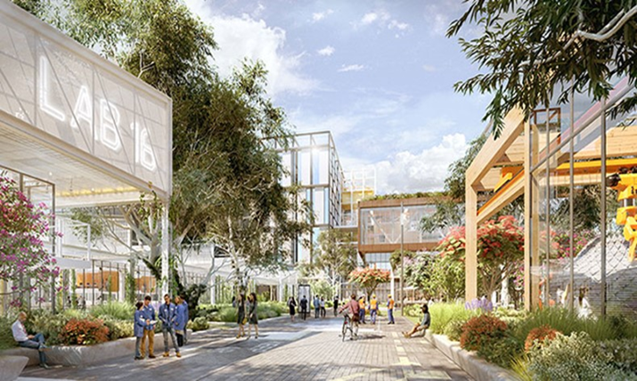
Fishermans Bend Melb. Integration across scales
Precinct scale
Water recycling plant and third pipe network for residential re-use.
Street scale
Water sensitive urban design, including distributed storages in open space, raingardens and tree pits.
Building scale
Rainwater detention (to reduce flooding) with green roofs, green walls, and smart rainwater tanks in individual buildings
Rainwater capture, storage and treatment for re-use.

Slide 25
Creating the vision
Fishermans Bend, Melbourne
Fishermans Bend is an unparalleled opportunity for urban renewal on the doorstep of Melbourne’s CBD. The vision for the area is to be “a thriving place that is a leading example for environmental sustainability, liveability, connectivity, diversity and innovation.”
The Water Sensitive City Strategy was built around
water being managed as a resource, and to improve climate resilience, boost biodiversity and urban ecology, and reduce pollution from storm water runoff.

Slide 26
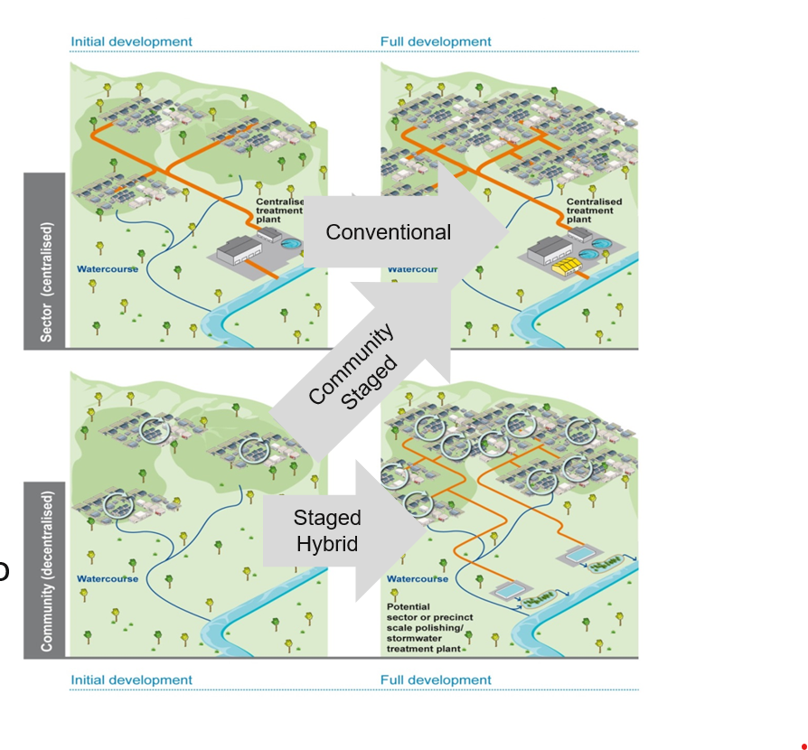
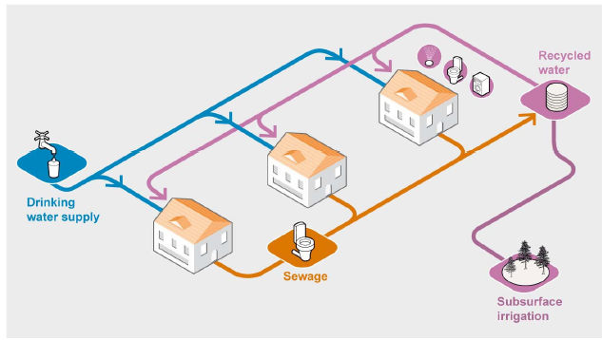
Where we got to 2015/16
Hybrid, local and centralised schemes work
Notes:
To many at the time it was a case of centralised versus decentralise solutions. But this is not the case. On the Water Smart Communities project I was running best solutions were hybrid schemes: small scale systems embedded within centralised systems. Hybrid solutions had a number of advantages including the ability to stage investment to match the pace of growth.
But precinct solutions were still considered to be too risky to be adopted as a mainstream servicing solution. We needed to work with external stakeholders including pricing, regulatory and planning stakeholders to get the projects over the line. Since then we have been involved in several precinct based water schemes, including Western Sydney Aerotropolis, Fishermans Bend in Melbourne and Gold Coast Water and Wastewater in Queensland. So what I plan to do is outline the key factors that made these schemes successful.

