Slide 1
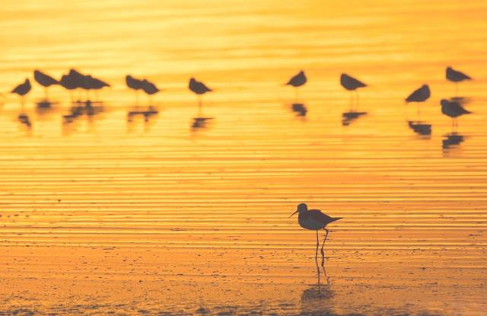
60 Years of Migratory Bird Management on the Manukau Harbour
Chris Garton
Environmental Scientist
Chris.Garton@water.co.nz
021 674 940

Slide 2
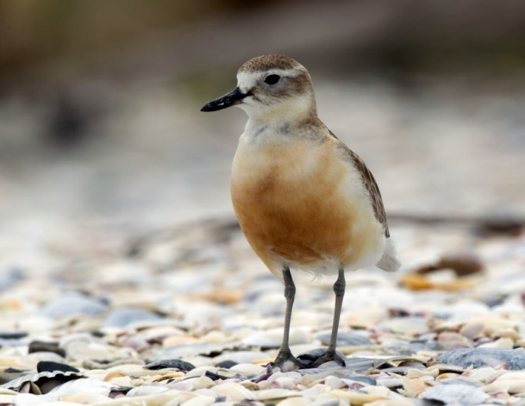
In the next 20 minutes …
Conservation & Utilities – Why it matters
The Manukau Harbour, Birds, People & Watercare
How we undertake
bird management
Choices

Slide 3
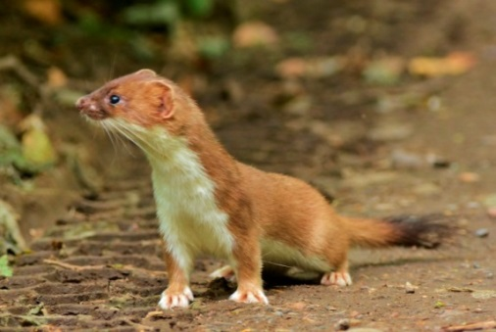
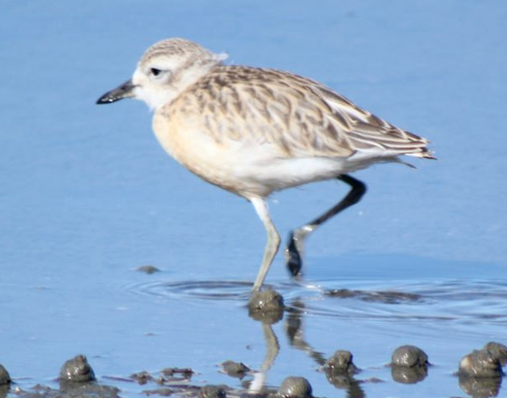
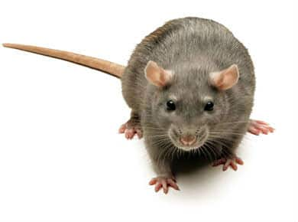
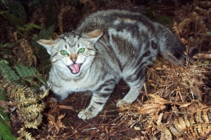
What is Conservation?
Conservation = Choices
vs

Slide 4
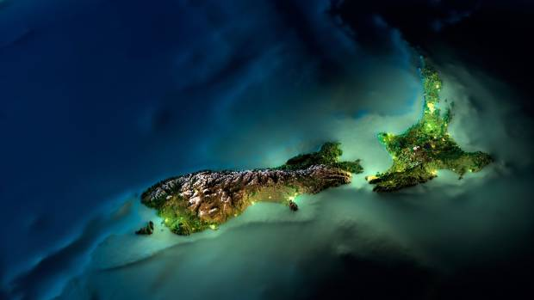
Conservation & Utilities?
All Utilities are located in our Environment
The world is changing
We need to think differently

Slide 5
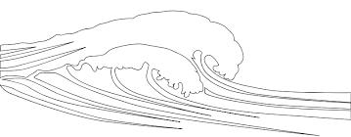
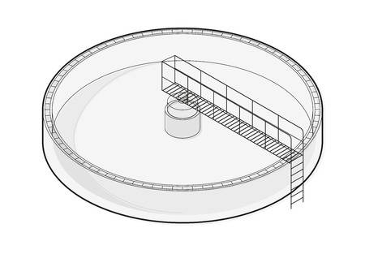
The Characters in this Story
Manukau Harbour
Birds
Mangere WWTP
People

Slide 6
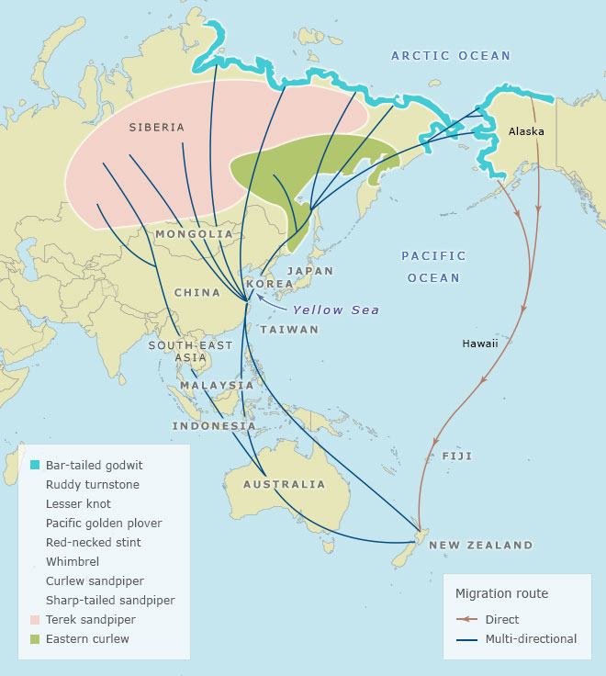
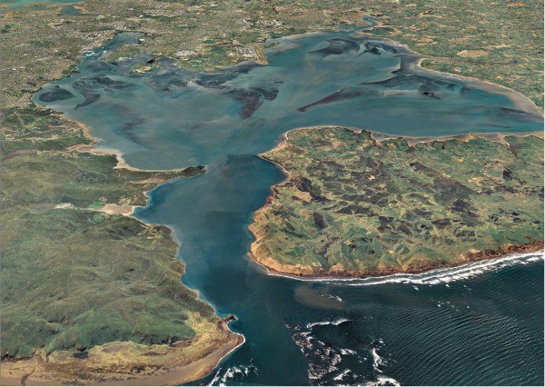
The Manukau Harbour
The most important harbour for wading bird species in NZ
25% at any time
60% pass through in their life

Slide 7
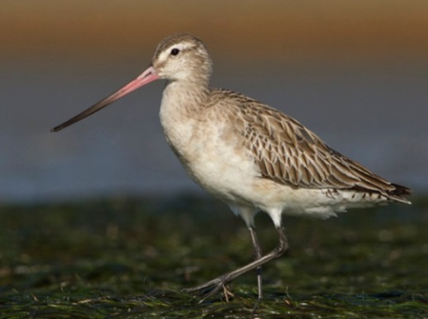
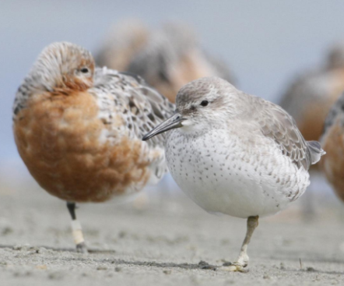
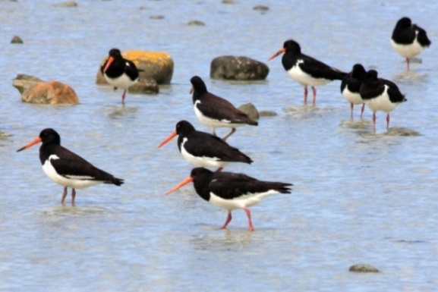
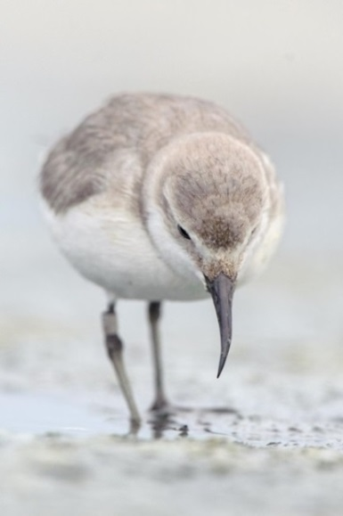
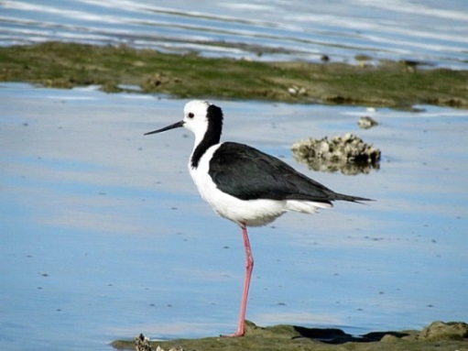
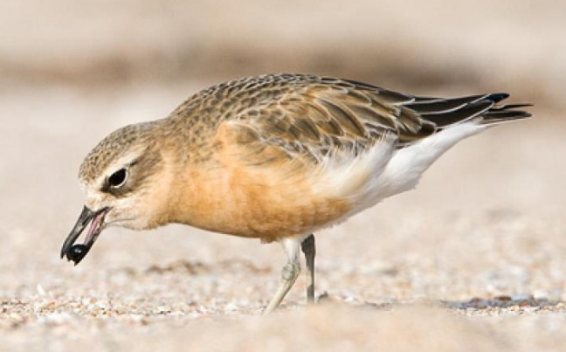
Wading Birds
Summer Shift
Winter Shift

Slide 8
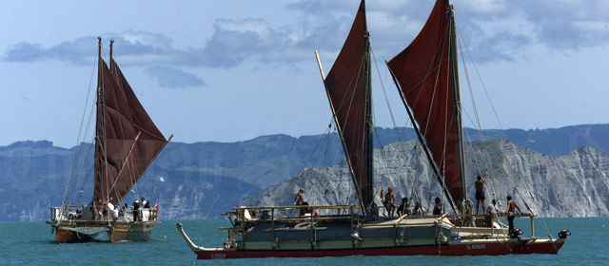
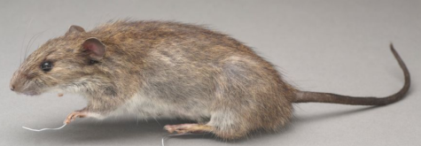
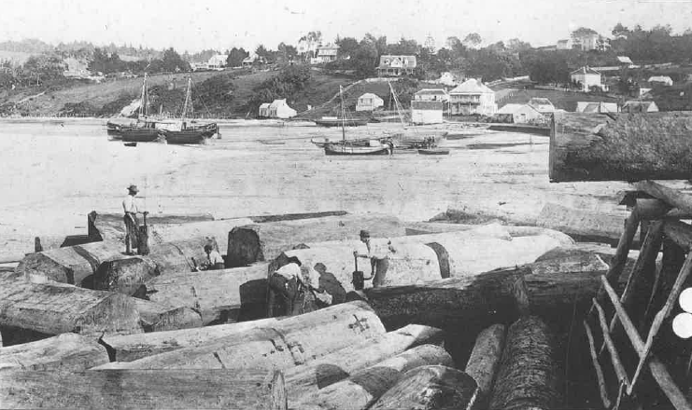
The Harbour and its People
Manukau = ‘wading bird’
Manu = ‘Bird’, Kau = ‘to wade’
Raw Wastewater Discharges into the Harbour

Slide 9
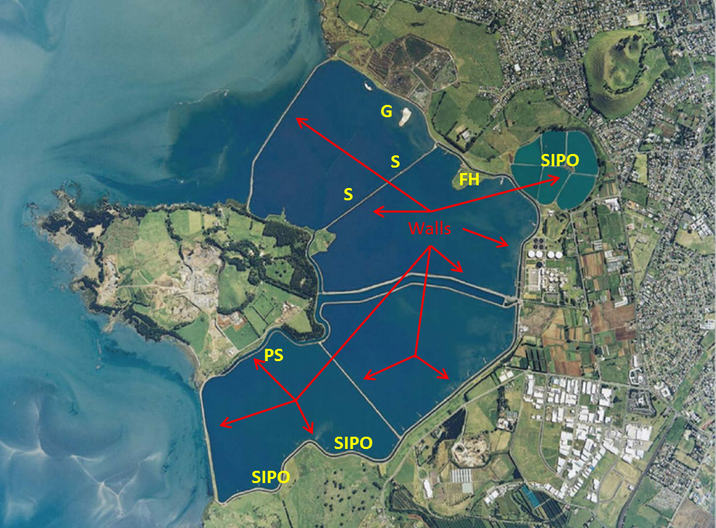
The Mangere WWTP

Slide 10
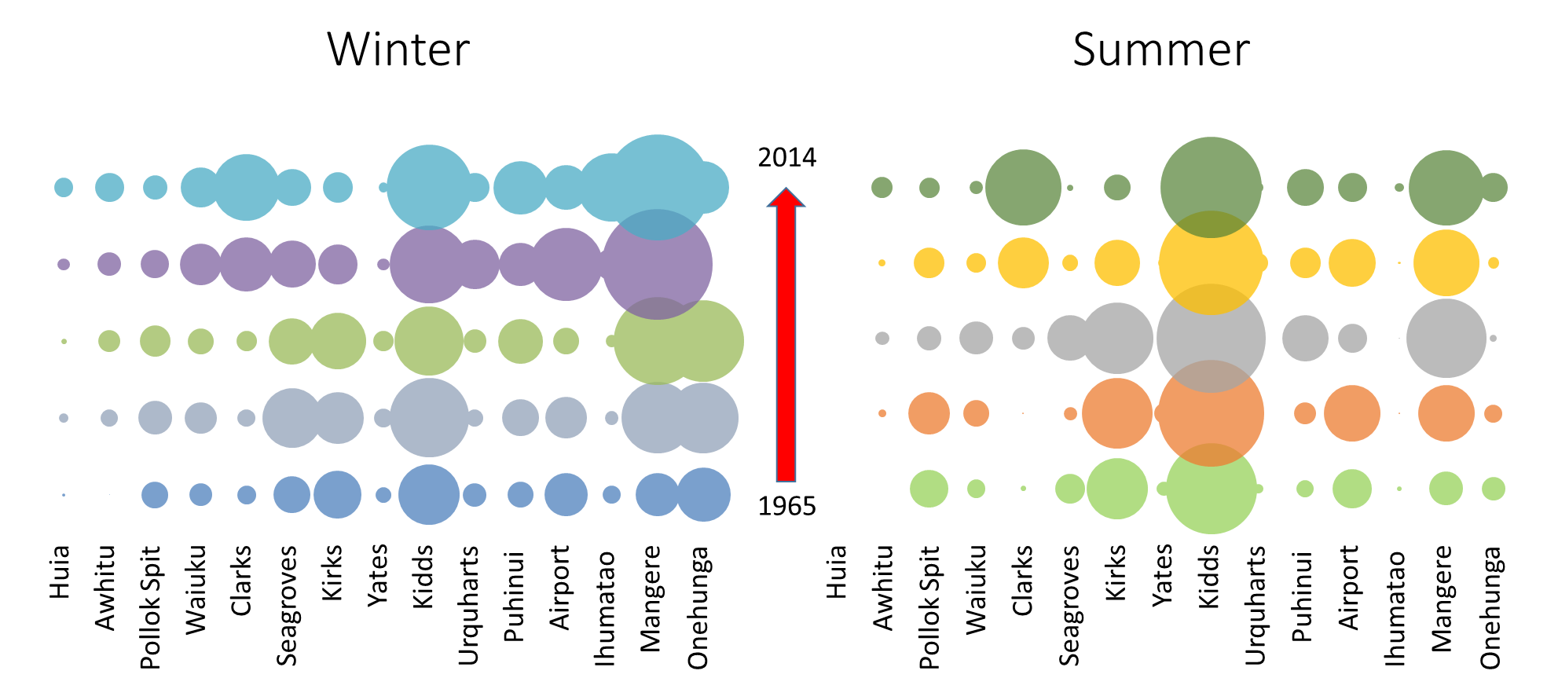
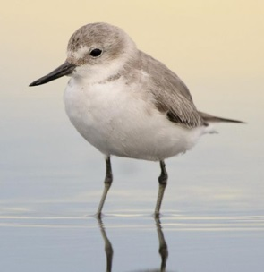
The Importance of Mangere WWTP
25% of the world population

Slide 11
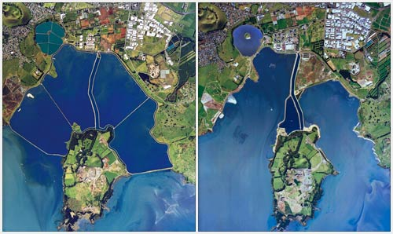
Choices
1960-2003
2003-onwards

Slide 12
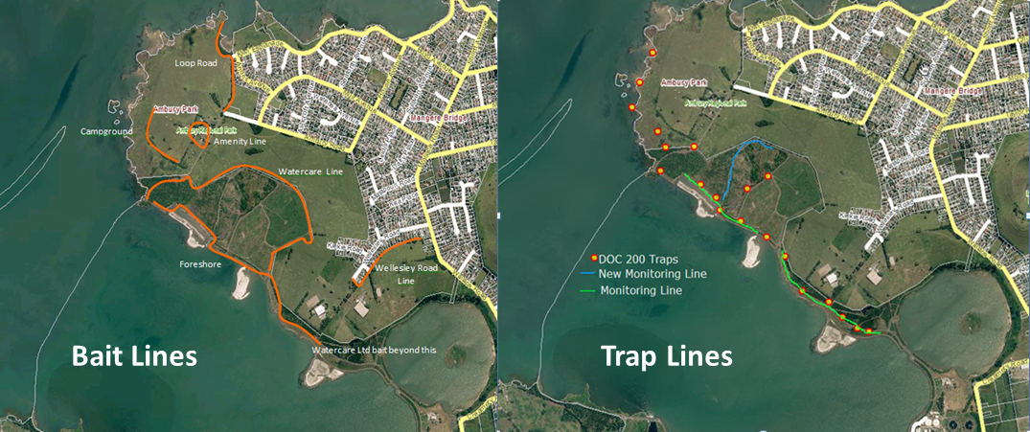
Predator Control
Doc 200 Traps, brodifacoum, periodic pulses of diphacinone
(volunteers)
Regular rabbit shoots and warren destruction – (professionals)

Slide 13
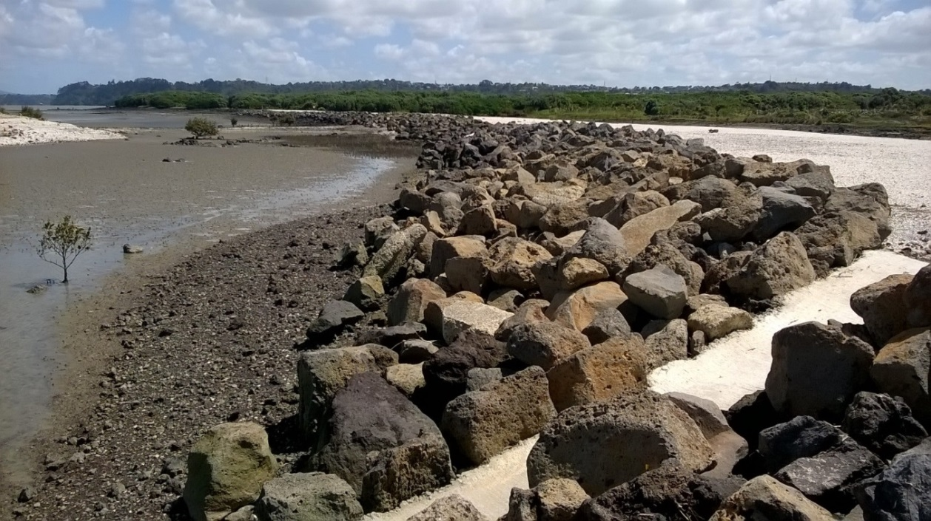
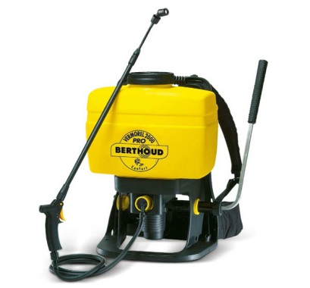
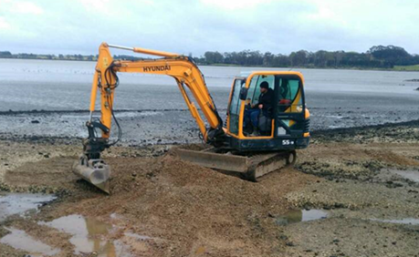
Maintenance – Weeds & Erosion

Slide 14
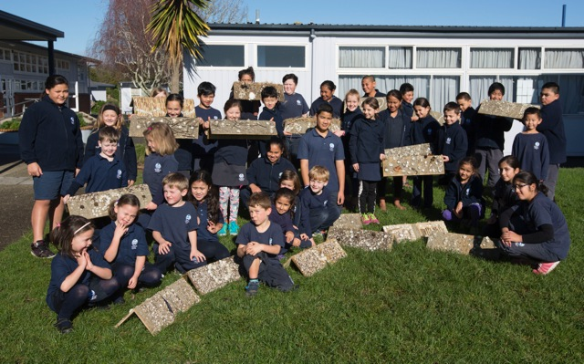
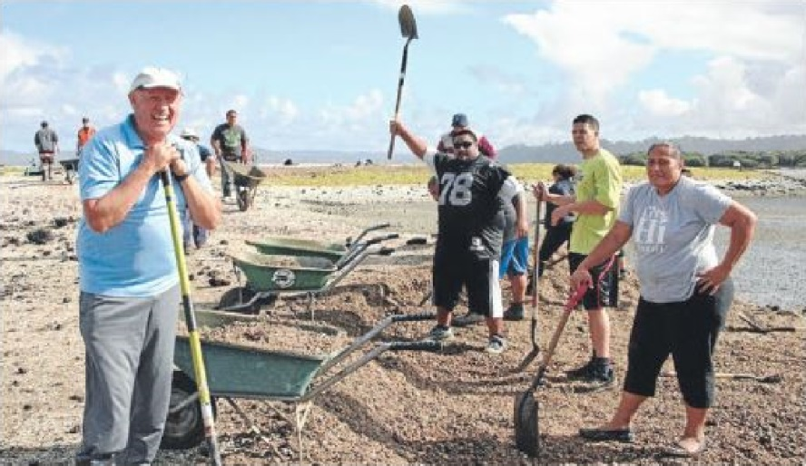
Public Engagement
Schools
Church & Community Groups
Volunteers

Slide 15
Success?
NZ Dotterels - 2018
8 Breeding Pairs
6 confirmed fledglings
(national average = 0.5 per pair)

Slide 16
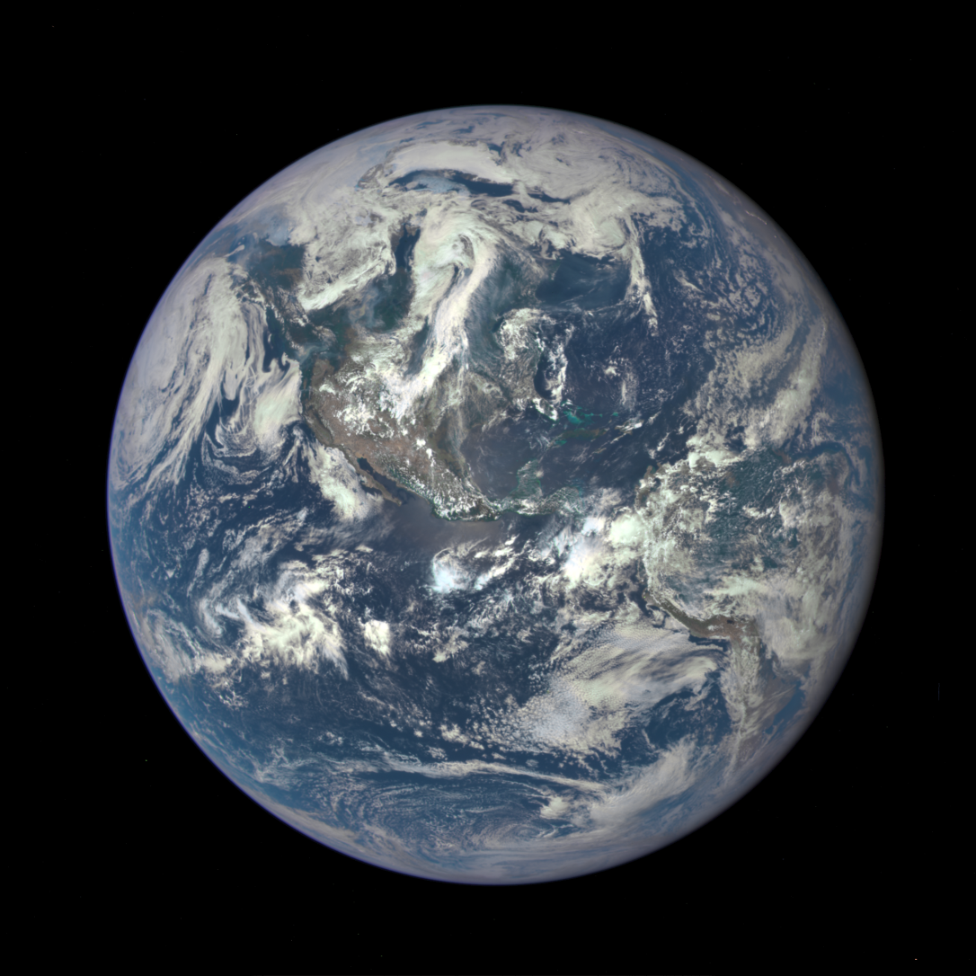

Slide 17
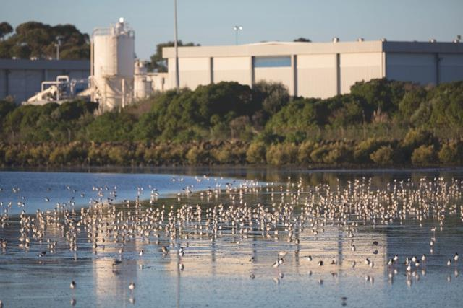
Thank you
Chris Garton - Environmental Scientist, chris.garton@water.co.nz, 021 674 940

