Slide 1
The asset planning cycle. What might digital transformation look like?

Slide 2
Karakia Timatanga
Whakataka te hau ki te uru Whakataka te hau ki te tonga Kia mākinakina ki uta Kia mātaratara ki tai E hī ake ana te atākura he tio, he huka, he hau hū Tihei Mauri Ora! | Cease the winds from the West Cease the winds from the south Let the breezes blow over the land Let the breeze flow over the ocean Let the red tipped dawn come with a sharpened air A touch of frost, a promise of a day! Sneeze, the breath of life!

Slide 3
Agenda
Introduction (Rachael Casey)
Setting the Scene
National Performance Review (Lesley Smith)
Taumata Arowai’s Regulatory Reporting Approach (Michael Howden)
WSE Asset Management Planning (David Wyllie)
Exercises
Exercise 1 - 30min: What is our vision for the future?
Exercise 2 - 30min: How can we share this vision?

Slide 4
Introduction
Rachael Casey

Slide 5
Introduction
Who are SWIG?
Bring people together to increase the capacity of the water sector to adopt digital and smart water initiatives and solutions.
Digital and Smart Water initiatives and solutions use data to improve water service delivery.
Share collective knowledge and experience, collaborate on work towards standards and consistent approaches

Slide 6
Introduction
Today's Workshop
The design of new regulators and new water services entities provides an opportunity to leverage our data and digital technologies, to transform our asset planning cycle, make better investment decisions, and drive efficiencies throughout the supply chain.
Through digital transformation comes better outcomes for water, people, and our communities.
The Water NZ SWIG is inviting conference attendees to co-design a picture of what the future of the asset planning cycle might look like.
Today's objectives
Co-design a shared vision
Grow our community of practice in this area

Slide 7
National Performance Review
Lesley Smith

Slide 8
https://www.waternz.org.nz/NationalPerformanceReview
National Performance Review
"Ka mua, ka muri"
"walking backwards into the future"
2008/09
2021/22
Limitations
​
(Audit reports​ available)
Variation amongst service providers
Data confidence
Data availability​
58/64
Water Service Providers
What will be useful going forward
Established definitions
Data
Data confidence
Reporter
Data Source
Comments
Lessons learned - adaptable nimble processes
Determining baselines
Notes:
"Ka mua, ka muri" "walking backwards into the future"
What information has been previously gathered
Overview of performance metrics
Fields collected
Data
Data confidence
Reporter
Data Source
Comments
Who has participated in the past
Limitations
Variation amongst council systems
Data availability
Audit reports
What can be useful going forward
Established definitions
Determining baselines
Lessons learned - adaptable nimble processes

Slide 9
Taumata Arowai’s Regulatory Reporting Approach
Michael Howden

Slide 10
Register
Surveys
Network Environmental Performance Measures
Drinking Water Safety Plans
Pūrakau
Research
Mātauranga Māori
Audits
Consumer concerns
Whakapapa
Maturity Model
Notifications
Monitoring
Lessons from Incidents
Local data
Notes:
So how is this going to come together?
I find it interesting to thing about out name
Taumata is used to refer to a summit or gathering around an important area of focus
Arowai gives that focus to water
Just as high peaks collect rain, so to I hope that we can collect data, which will then flow across of the motu.
Some of these flows will join mighty rivers, making a pathway for system wide change throughout Aotearoa.
But these flows may also combine will smaller tributaries, carrying rich local knowledge that may sensitive, unique or sacred, but still valuable to a particular community.
We all have a roll to play - SWIG
So how is this going to come together?
Collecting together a wide range of data…
Including data you don’t even know about yet.
As well as sharing some of it with us, so
You will using this data to drive your own performance,
And also to guide your conversations with others, where through which you will hopefully uncover stories to help you

Slide 11
Regulatory Data Reporting
Who | What | Legislation | When
Supply Registration | Drinking Water Suppliers | WSA s54(2) + (3) | 15 Nov 2021
Notifications | Drinking Water Suppliers | WSA s21(2)(b) + s22(2)(b) | 15 Nov 2021
Notifications | Laboratories | WSA s73(2) + 75(1)(g) | 15 Nov 2021
Drinking Water Safety Plans | Drinking Water Suppliers | WSA s31 | 15 Nov 2022
Monitoring | Drinking Water Suppliers | WSA ss37 + 44(3) | 1 Jan 2023
DW Network Environmental Performance Measures | Drinking Water Network Operators | WSA s146(2) | 1 July 2022
Wastewater Network Registration | Wastewater Network Operators | WSA s144(1)(a) | Future
Stormwater Network Registration | Stormwater Network Operators | WSA s144(1)(b) | Future
Consumer Complaints | Drinking Water Suppliers | WSA s38(1)(c) | Future
Drinking Water Abstraction Points | Regional Councils + Territorial Authorities | WSA s45(2) | Future
Source Water Quality + Quantity | Regional Councils | WSA s46 | Future
WW/SW Network Environmental Performance Measures | Waste / Storm Water Network Operators | WSA s146(2) | Future
 | Who | What | Legislation | When
Provides Data To | Public | Public register of drinking water supplies | WSA s55(4) | April 2022
 | Public | Public register of wastewater networks | WSA s144(4) | Future
 | Public | Public register of stormwater networks | WSA s144(4) | Future
 | Public | Annual drinking water regulation report | WSA s137 | 1 July 2022
 | Public | Annual reporting on DW networks’ env. performance | WSA s147 | 31 Dec 2023
 | Public | Annual reporting on WW/SW networks’ env. performance | WSA s147 | Future
 | Regional Councils + Territorial Authorities | Drinking Water Abstraction Points | WSA s45(1) | Future
 | Regional Councils | Source Water Quality | WSA s44(3) | Future
 | Drinking Water Suppliers | Risks & Hazards | WSA s45(4) | Future

Slide 12
Water Data Ecosystem
Taumata Arowai
Mana Whenua
Regional Councils
Local Councils
Water Services Entities
Private Suppliers
Council Suppliers
Transition
Drinking
Waste + Storm
Operate?
Public
 | Who | What | Legislation | When
Provides Data To | Public | Public register of drinking water supplies | WSA s55(4) | April 2022
 | Public | Public register of wastewater networks | WSA s144(4) | Future
 | Public | Public register of stormwater networks | WSA s144(4) | Future
 | Public | Annual drinking water regulation report | WSA s137 | 1 July 2022
 | Public | Annual reporting on DW networks’ env. performance | WSA s147 | 31 Dec 2023
 | Public | Annual reporting on WW/SW networks’ env. performance | WSA s147 | Future
 | Regional Councils + Territorial Authorities | Drinking Water Abstraction Points | WSA s45(1) | Future
 | Regional Councils | Source Water Quality | WSA s44(3) | Future
 | Drinking Water Suppliers | Risks & Hazards | WSA s45(4) | Future

Slide 13
Water Data Ecosystem
Central Government
Central Govt. Supplies
Climate Chg. Comm.
DIA
MBIE
MfE
Taumata Arowai
Economic Regulator
Treasury
Mana Whenua
Water NZ
Regional Councils
Local Councils
Water Services Entities
Private Suppliers
Council Suppliers
Transition
Consultants
Drinking
Waste + Storm
Operate?
Contractors
Public
 | Who | What | Legislation | When
Provides Data To | Public | Public register of drinking water supplies | WSA s55(4) | April 2022
 | Public | Public register of wastewater networks | WSA s144(4) | Future
 | Public | Public register of stormwater networks | WSA s144(4) | Future
 | Public | Annual drinking water regulation report | WSA s137 | 1 July 2022
 | Public | Annual reporting on DW networks’ env. performance | WSA s147 | 31 Dec 2023
 | Public | Annual reporting on WW/SW networks’ env. performance | WSA s147 | Future
 | Regional Councils + Territorial Authorities | Drinking Water Abstraction Points | WSA s45(1) | Future
 | Regional Councils | Source Water Quality | WSA s44(3) | Future
 | Drinking Water Suppliers | Risks & Hazards | WSA s45(4) | Future

Slide 14
30+ years of AMP’s in the UK in 4 mins
David Wyllie

Slide 15
Change of focus through the AMPs
1990
2025
AMP 1
AMP 2
AMP 3
AMP 4
AMP 5
AMP 6
AMP 7
Short term thinking
Longer term thinking
Asset Location
Asset Condition
Performance Assessment
What do we need to do NOW
Value for Money/ Affordability
Innovation/ Data Driven Approach
Optimization, TOTEX
Customers
Resiliency
Environment
Society
Notes:
Where are our assets - standardising STC25
What state are they in – CCTV
Performance Assessment – water (DG2, DG3) wastewater (DG5), modelling

Slide 16
Observation
Over the last 30 years the UK moved from buses falling into holes in the road caused by sewer collapses to fatbergs blocking sewers.
Structural to Serviceability

Slide 17
Our aspirations for digital transformation of asset management planning
Exercise 1 – 20 minutes

Slide 18
Exercise 1
In groups of 4-6 people, over 10 min to discuss and record:
What is your vision for the future?

Slide 19
Describing our future vision for digital transformation of asset management planning
Exercise 2 – 40 minutes

Slide 20
Exercise 2
For another 20 min, develop your future vision further.
Try to answer:
What actions we must take?
What challenges will we overcome?
What roles will Mana Whenua have?
Who will contribute?
What are we missing now?
What do we need to get rid of?
What don't we know?
You will have 2 min to report back
Consider
Organisations​
People
Practices​
Skills​
Technology ​
Data
Collaboration

Slide 21
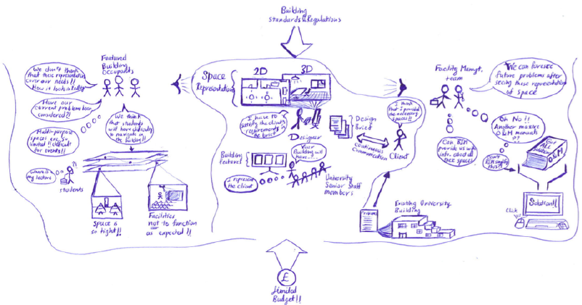
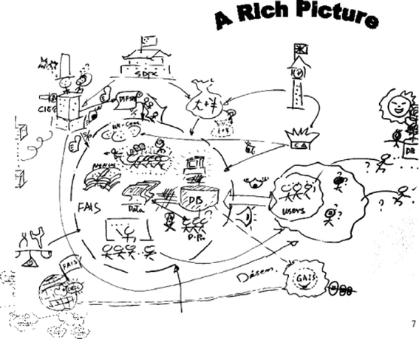
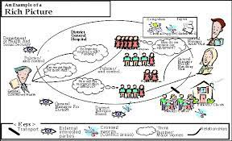
Rich Picture
Collectively groups draw (on flipcharts with markers) what the broader regulatory reporting / asset management planning might look like, including the organisations, people, data, assets, systems.

Slide 22
Workshop Closing Ideas
Michael Howden

Slide 23
Closing Ideas

Slide 24
SWIG get involved!
Rachael Casey

Slide 25
SWIG get involved!
Join the SWIG
Committee
(katrina.guy@waternz.org.nz)
Join the SWIG LinkedIn Group
Join us for lunch!

Slide 26
Karakia Whakamutunga
Te whakaaetanga e Te whakaaetanga e Tēnei te kaupapa ka ea Tēnei te wānanga ka ea Te mauri o te kaupapa ka whakamoea Te mauri o te wānanga ka whakamoea Koa ki runga, koa ki raro Haumi e, hui e, tāiki e! | It is completed, it is done We have achieved our purpose And completed our forum Let the purpose of our gathering rest for now Let the vitality of our discussions replenish We depart with fulfilled hearts and minds Bonded in our common goal and unity!

Slide 27
Thank you

