Slide 1
UNCONSIOUS BIAS IN INVESTMENT DECISION MAKING
Adrienne L Miller

Slide 2
What we’ll cover
Looking Out - where are we societally, and as a sector?
Looking Forward – what is the future looking like?
Looking Back - how did we get here?
Central theme: the concepts that underlie investment decision making across society have been based on flawed concepts
Notes:
I’ll start LOOKING OUT. We’ll take stock of where we are at see that historical underinvestment is even more visible
with considerations for those running organisations having changed organisations need to serve our changing societal needs and bear the consequences of their actions
Social licence becomes an issue where
behaviour diverges too far from stakeholder expectations or They don’t take accountability for impacts
LOOK FORWARD and look at whats in front of us with the need for climate change impacts the need for asset resilience in the context of much greater stakeholder scrutiny
Last well LOOK BACK taking a bit of a flyover back across the territory we’ve travelled to get to this point and how we might’ve got to here. It’s a case of having been a little Shortsighted When I say short sighted I mean in both terms of distance
from what has (traditionally at least) been regarded as its core responsibility (and what has instead been regarded as falling into the public domain)
from today in terms of time horizons.
The concept of shareholder primary and a solely profit focussed purpose can only be sustained when we take a fairly shortsighted view of the ambit of a company’s activities and what it is and should be responsible for.
Mark Carney, who I’ll mention a bit more later, in when I apply all this to Climate change responsiveness, calls these
the tragedy of the commons and
the tragedy of the horizon

Slide 3
Looking Out
© Adrienne Miller
Notes:
In this next section we’re looking out to what is happening in society In this section well look at mainly at how perceptions from stakeholders around what any enterprise (including Asset owners)) should be responsible for is changing the landscape for those organisations and ’
those that run them (
The key message is its no longer just about complaince
.
It takes many good deeds to build a good reputation, and only one bad one to lose it. ~ Benjamin Franklin
Where executives and do not manage these risks, they have the potential to migrate onto balance sheets and manifest as (less custom, approvals, regulatory blockages, loss social licence)

Slide 4
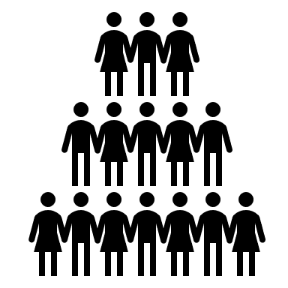
Looking Out 1 Stakeholder
Shareholders/investors
Customers/
Consumers
SM
Financiers
Staff
© Adrienne Miller
© Adrienne Miller
Notes:
Many of you will have heard me previously speak on this
Customers are increasingly not just the passive recipients of goods and services
they are re discerning “consumers” with expectations not only of the goods and services they buy, but the companies that produce them
Staff too have expectations of their employers
They want their companies to do more than provide a paycheck. They want them to do good & act with purpose (especially millennials & younger)
Stakeholders are people too and they’ve started to develop a conscience
All this expectation is amplified by SOCIAL MEDIA- a democratised & easy access platform for
good and bad, skewing views inside echo chambers
that makes it hard to distinguish between fact and fiction
(The IRL scenario becomes hard to discern)
.
Customer centricity is a buzzword for good reason
Consumer experience of TECH has both enabled more and raised the bar on expectations on what can be done and by when Its 24/7 immediacy & responsiveness.

Slide 5
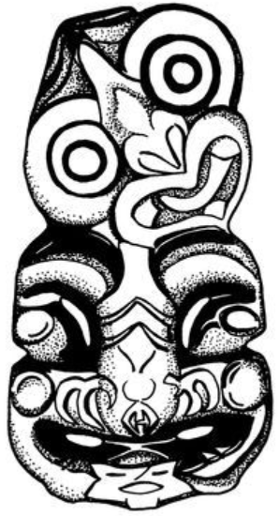
Looking Out 2 Supply chain
© Adrienne Miller
Notes:
What do they care about, these stakeholders?
The immediate and far flung reaches of an organisation’s supply chain and that’s not just source of goods and services
It’s labour force practices,
the impact every single linkage in the supply chain
Has on environment, carbon emissions, the way they treat the communities in which they work and cultures they encounter along the way;
their involvement in less well regarded activites (itself a moving target… . the list goes on
Its mostly about applying an ethical human centric lense. Who is most impacted and how can that be ameliorated
And here in NZ how they deal with issues around Te Tiriti Waitangi, matters that impinge on Te Ao Maori ….respect for Maori and other cultures and Matauranga Maori

Slide 6
A sense check?
© Adrienne Miller
Notes:
At this point I can imagine some of you are thinking - Does this really matter?
Is this real isn’t this broader outcomes and stakeholder stuff just a fad?
What about the law and compliance surely that’s what I need to be focussing on
The law is not there in all places yet, but its catching up fast (and arguably already there on Climate change which Ill come to shortly)
We’ve seen this compliance versus reputation thing play out for a number of NZ entities. Cast your mind back to the news and items on one cooperative criticised for its fully compliant “ghost farms” (as the media so eloquently named them). Another beloved brand found to its horror that deep into its supply chain, it was providing services to the Saudi Arabian Navy. Yet another had to grapple with a landfill fully consented in 2003 but vulnerable to sea level rise/waste stockpiles and the spectre of future contamination
In each case the approach taken likely enhanced shareholder return, but it didn’t find favour with wider stakeholders, impacting brand and having potential to impact their social licence.
Adopting only a compliance based approach isn’t enough.
Other examples:Rio tinto /BHP: Aboriginal cave art AMP : appointment of Boe Pahari as CEO (despite known sexual harassment claims)

Slide 7
Looking Out 3 - How is the Water sector faring?
© Adrienne Miller
Notes:
What do they care about, these stakeholders?
The immediate and far flung reaches of an organisation’s supply chain and that’s not just source of goods and services
It’s labour force practices,
the impact every single linkage in the supply chain
Has on environment, carbon emissions, the way they treat the communities in which they work and cultures they encounter along the way;
their involvement in less well regarded activites (itself a moving target… . the list goes on
Its mostly about applying an ethical human centric lense. Who is most impacted and how can that be ameliorated
And here in NZ how they deal with issues around Te Tiriti Waitangi, matters that impinge on Te Ao Maori ….respect for Maori and other cultures and Matauranga Maori

Slide 8
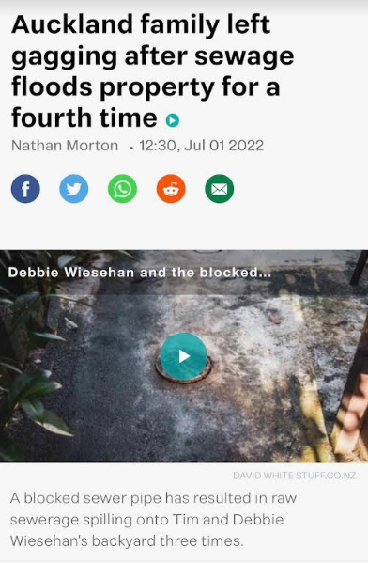
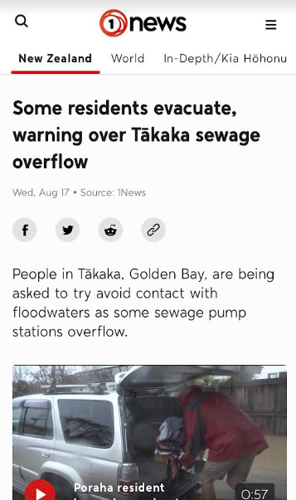
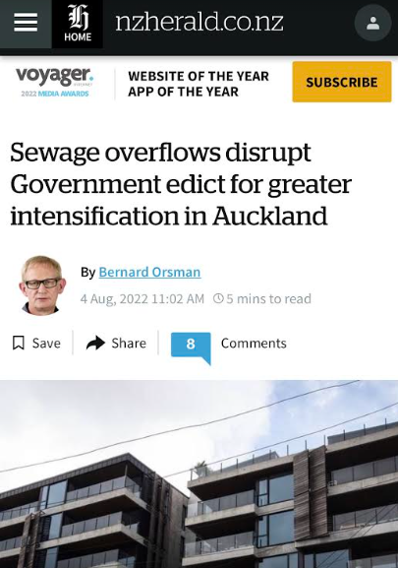
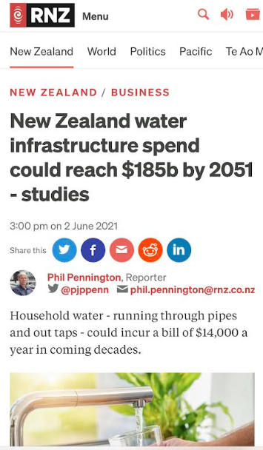
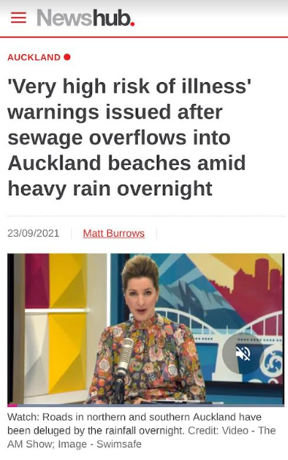
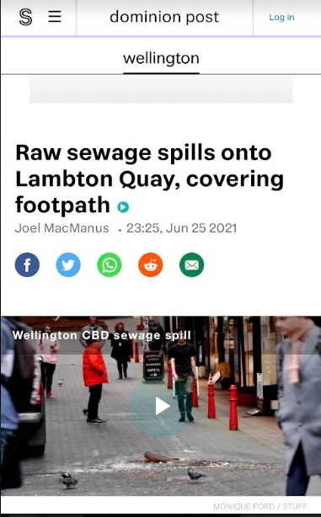
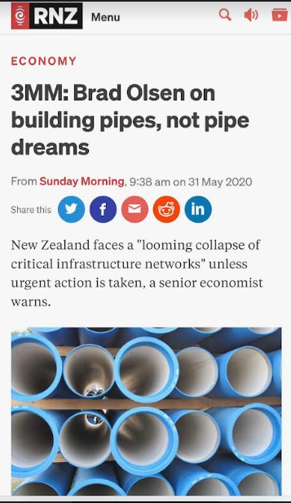
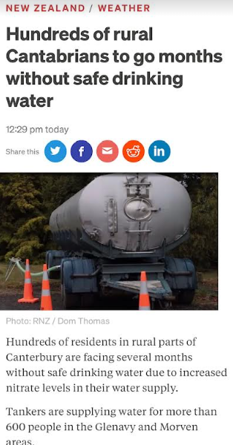
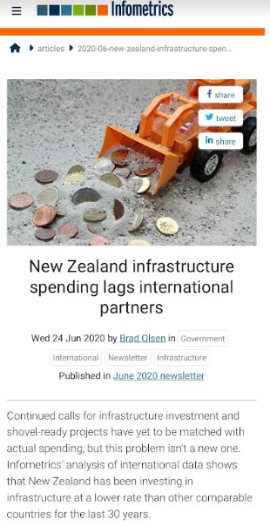
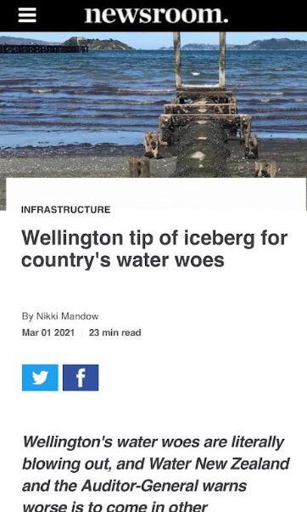
Weather report : Clouds on Horizon!!
Weather report
…

Slide 9
Looking Forward

Slide 10
*Capital
Looking Forward
Te Tiriti
Physical world/Biodiversity Environment/Climate change
Te Ao Maori
* Nature
*Te Triti
Matauranga Maori
* Culture
Law, regulatory requirements
International treaties
Te Ao Maori
Cultural matters
*Legal
Human rights
Stakeholder perceptions
* Human
Continued access to capital and insurance, desire for a stable financial system and civic society
*Capital
Media /Social media
*Technology
* Media
Technology/AI
© Adrienne Miller
Notes:
So where is it that we will see further change and what brings that change ?
Well there are a range of factors relevant to change in the short to medium term that alter the landscape in which companies operate (some are causes, some are contexts, others again are capital nsurance and system stabilityare requirements for doing business)
(Importantly youll see the law is only one of them)
Weve already talked about a number of these already. Theres not today time to discuss them all.
I like now to hone in on one in particular which is the impact of the physical world and climate change as I think it is indicative of where well go on the others eventually. To date as weve seen with stakeholder considerations disclosure on climate related impacts has been voluntary and variable.
In that context its useful to touch on some concepts Mark Carney explains very well. We need to understand these factors before we look forward to the short to medium term future
(Evidence suggests that entities that respond to these broader issues and adopt risk mitigation and strategies that take them into account perform better financially too)

Slide 11
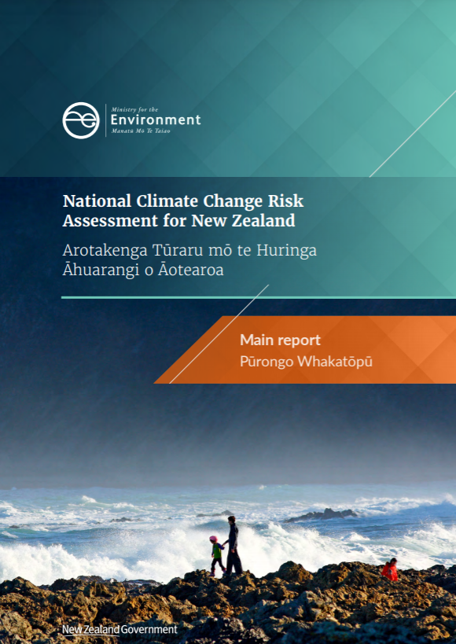
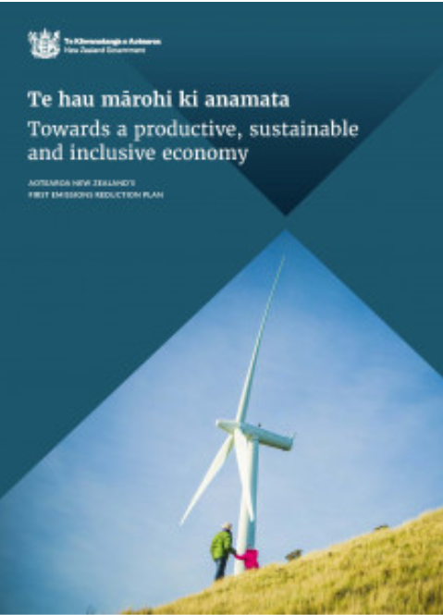
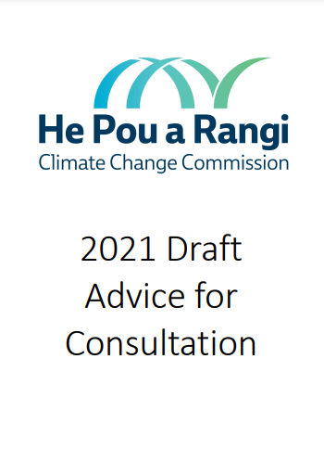
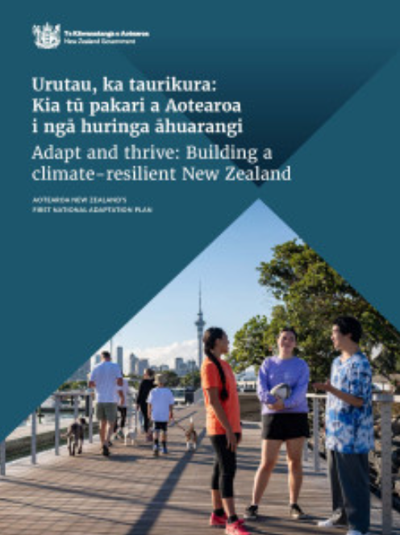
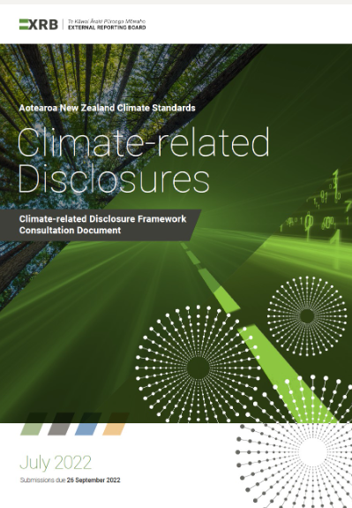
Looking Forward

Slide 12
Looking Out & Forward Summarised - Its a bumpy ride
Today organisations need to look beyond their immediate operations & Financial ROI
They ignore wider stakeholder concerns at their peril
Going forward, theres also Climate mitigation and adaptation transition risk & resilience to think of
© Adrienne Miller
Notes:
We’ve seen how stakeholder considerations can impact Brand & reputation impacting perceptions of both customers and staff. And also the focus of the public sector.
Unattended, these risks, have the potential to migrate onto balance sheets and manifest as
less custom/patronage/work won,
Impact on approvals,
Other regulatory blockages/exemptions,
and in an extreme case, in loss of social licence)
Although we have a degree of conceptual removal between the individuals managing a company and the corporate entity itself there is also increasingly the potential for personal taint.
In essence its about Companies doing what stakeholders expect them to do and stopping doing , or taking responsibility for, the impacts of their activity.
These stakeholder concerns are ignored by companies and their directors at their peril.

Slide 13
Looking back: How did we NOT see the issues with our aging infrastructure & under-investment coming?
© Adrienne Miller
Notes:
In many cases the upgrades to the infrastructure were in year 10 of the AMP. Its just we never seem to get to year 10
Id posit that the reasons is we have adopted approaches which Mark Carney calls the tragedies of the commons and the tragedies of the horizons

Slide 14
Looking Back
“The tragedy of the Commons”
Current practice
Public sphere
Private sphere
Costs to tax payer of addressing “externalities
Profits for Shareholder
© Adrienne Miller
Notes:
Who is this Mark Carney? Hes a Canadian economist and banker and former Governor of the Bank of England that founded the Task Force against Climate Related Financial Disclosure (TCFD). He is renowned for his explanations around the way climate change could put at risk the stability of our financial systems and his proposals on how we might address that. He has explained very clearly why we have historically been slow to move on these issues despite their magnitude
One of concepts he talks about is the tragedy of the commons the fact that we tend not to value the negative impacts or externalities (even the name suggests they are someone else’s problem!) companies because because they largely fall into a space we think of as the public domain.
. All of us collectively bear the effects of negative impacts and the cost of rectifying them rather than those costs being priced in to the P&L of the corporates causing them (a netting off being required because very often the cost of these externalities exceed the profits being generated)
Conversely he says we fail to place a value on a positive outcomes like the existence of native forest until it is consumed in business enterprise

Slide 15
Looking Back
“The tragedy of the horizons”
FY 1
FY 2
FY 3
FY 4
FY 5
FY 6
FY 7
FY 8
FY 9
Cost of addressing risk
Time
© Adrienne Miller
Notes:
The tragedy of the horizons, another of his theories ,explains corporate and systemic inaction on a known risk in this cases the risks posed by climate change adaptation and mitigation
He observes that because of the short term way we view business risk and the horizons that apply (which are usually only two to three years out on any financial or insurance cycle even when we can clearly see an upcoming risk and know that the cost of remedying that risk increases the closer we get to it we have no motivation to address the risk now
because we personally/organisationally are only responsible for the next X financial cycle(s).

Slide 16
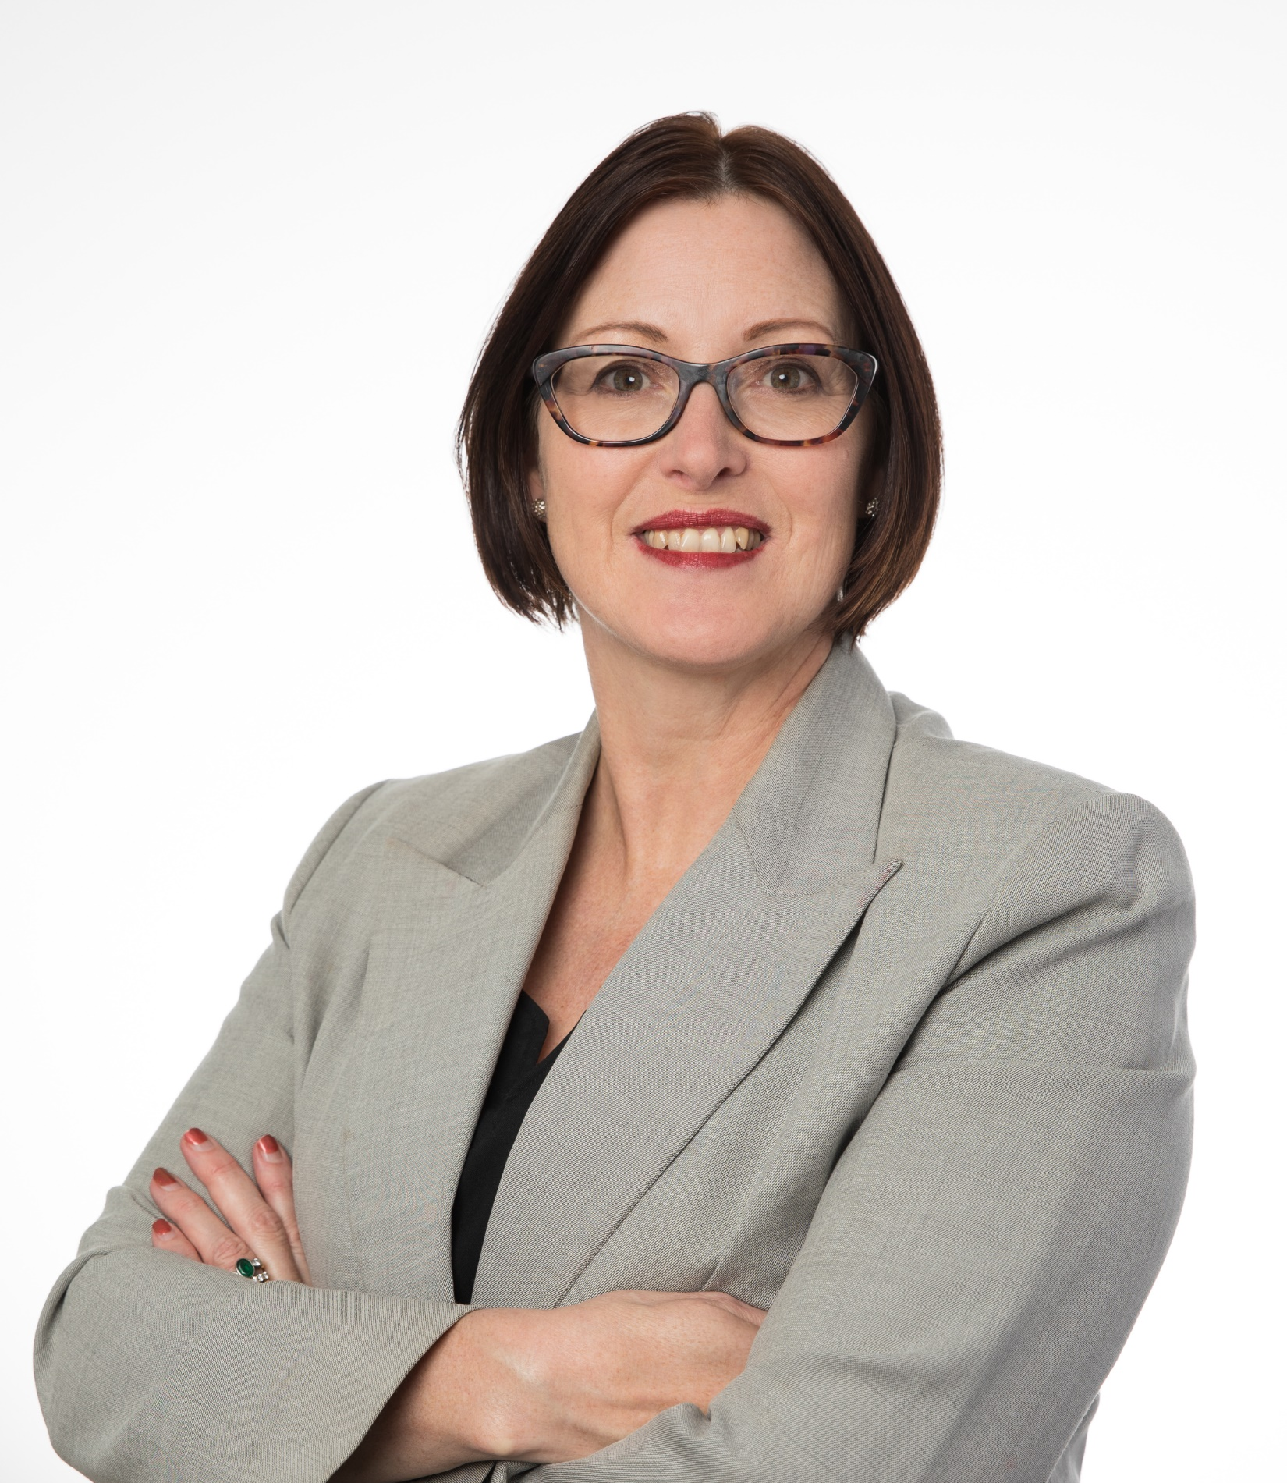
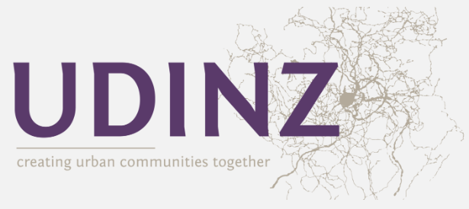
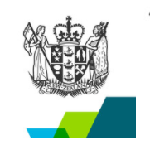
Questions?
© Adrienne Miller
Notes:
Tena koutou katoa
Adrienne Miller toku ingoa

