Slide 1
Reducing Opex, Sensor Drift and Emissions through digital twin application
Notes:
APRA Intro

Slide 2
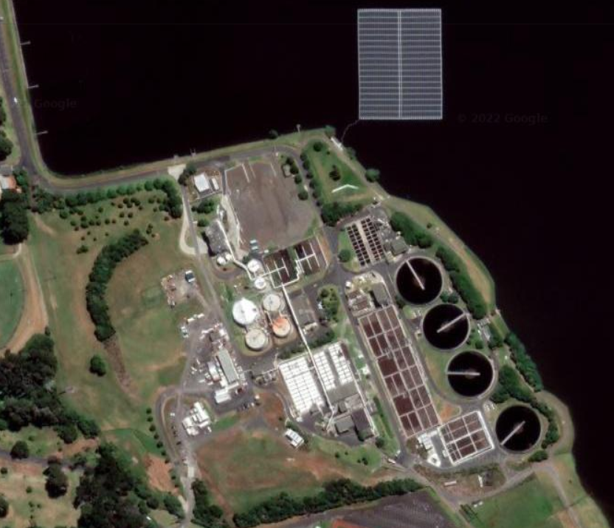
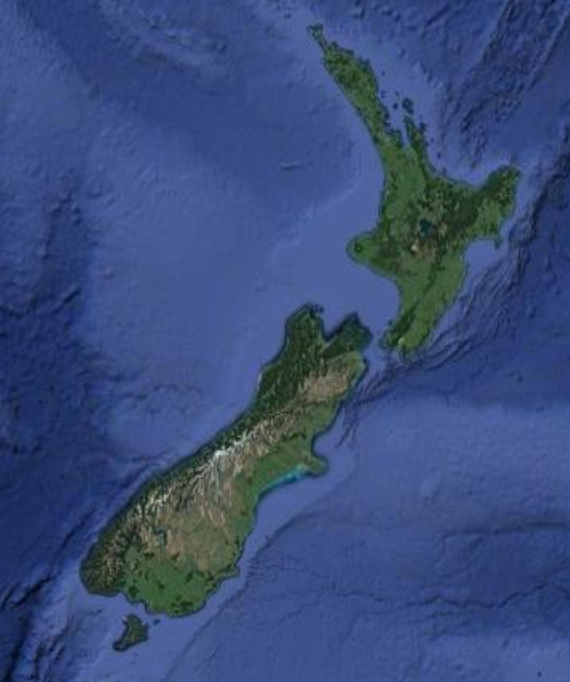
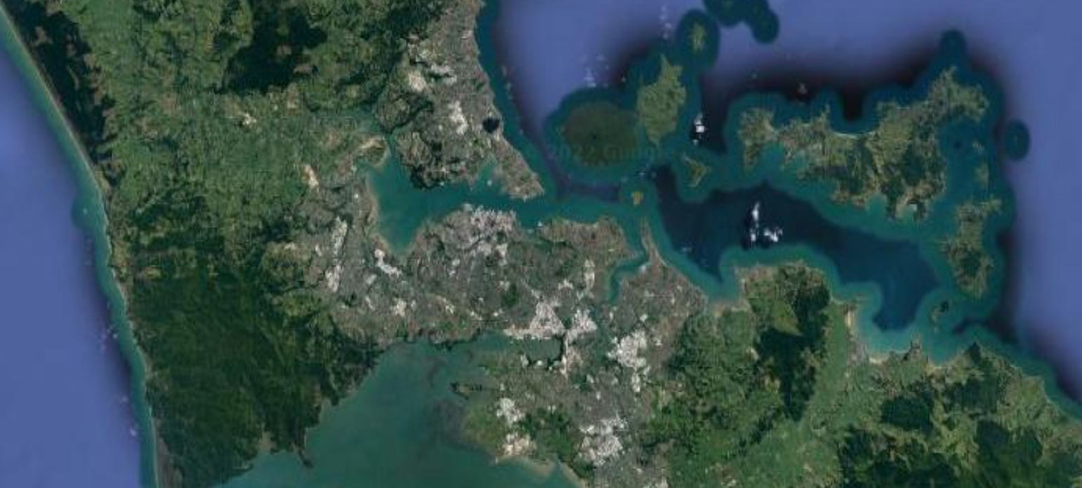
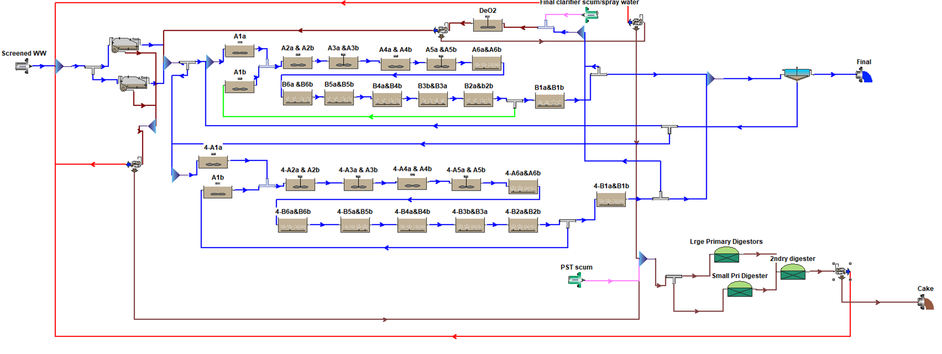
Rosedale Wastewater Treatment Plant, Auckland

Slide 3
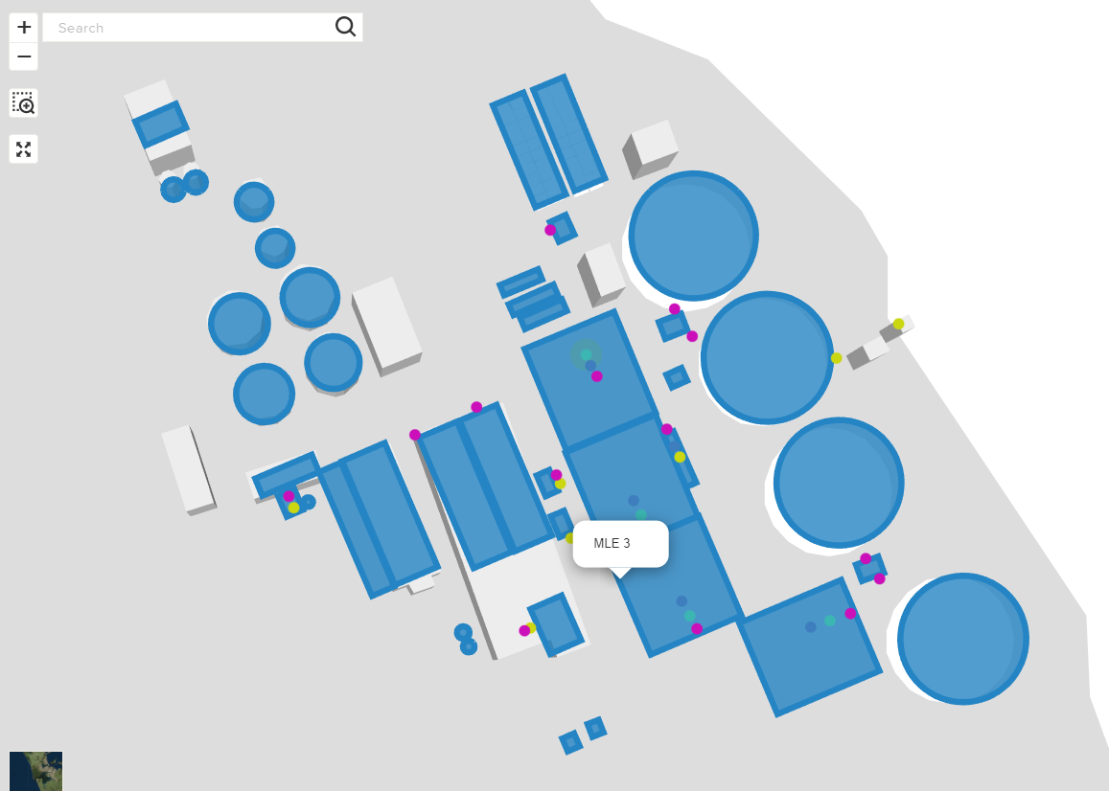
A little bit of History
Digital twin (DT) developed in 2020 to support commissioning of a new 4th MLE (Modified Ludzack-Ettinger) process
DT focused on:
Developing virtual scenarios for operators to trial different operating conditions.
Determining clarifier capacity and optimisation options.
Prediction of weather impacts on plant performance.
Notes:
Mott MacDonald were engaged by Watercare to design a 4th MLE. In 2020 a digital twin (DT) of the plant was developed in Moata to support commissioning of the MLE and associated plant.
Mott MacDonald and Rosedale WWTP operations have worked as an integrated team to enhance the DT, focusing on a number of plant pain points. The initiatives included:
Supporting optimisation of MLE set points by developing virtual scenarios for operators to trial different operating conditions.
Determining clarifier capacity and identifying options to optimise operation using an operational clarifier calculator.
Prediction of weather impacts on plant performance by deploying a Machine Learning model that predicts influent flow.
Through these investigations the potential benefits of a digital twin were demonstrated.
The wet weather flow tool predicts 48 hours of influent flow to determine impact on effluent quality. The tool was successfully deployed and provides accurate predictions but has limited utility at Rosedale which is resilient to wet weather events.
I will come on to the other initiatives in a moment

Slide 4
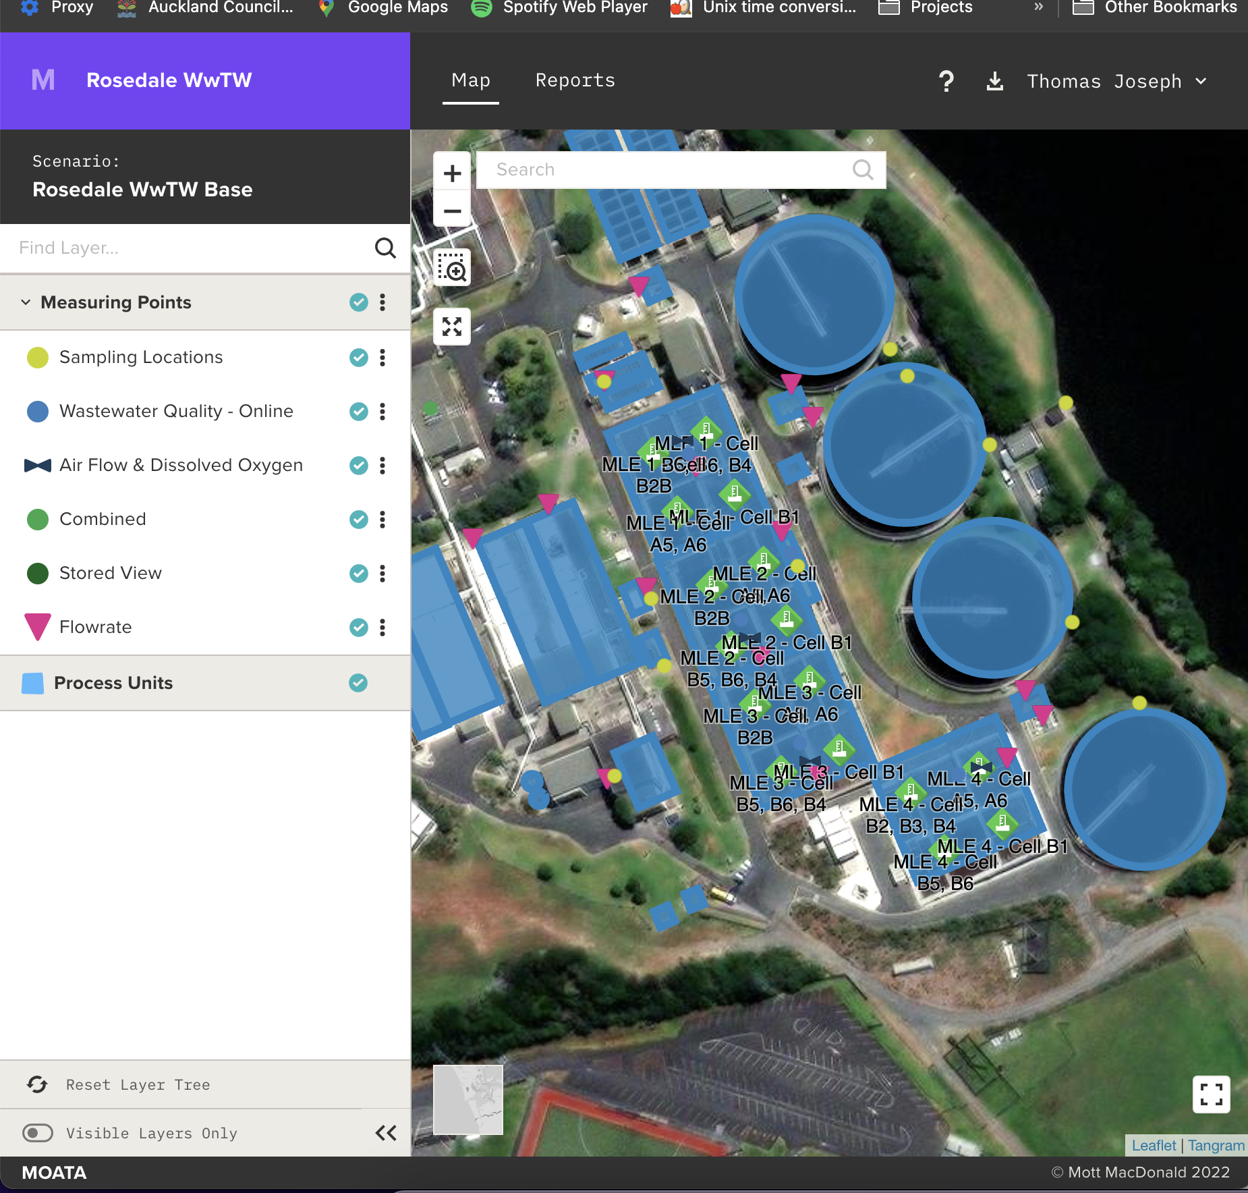
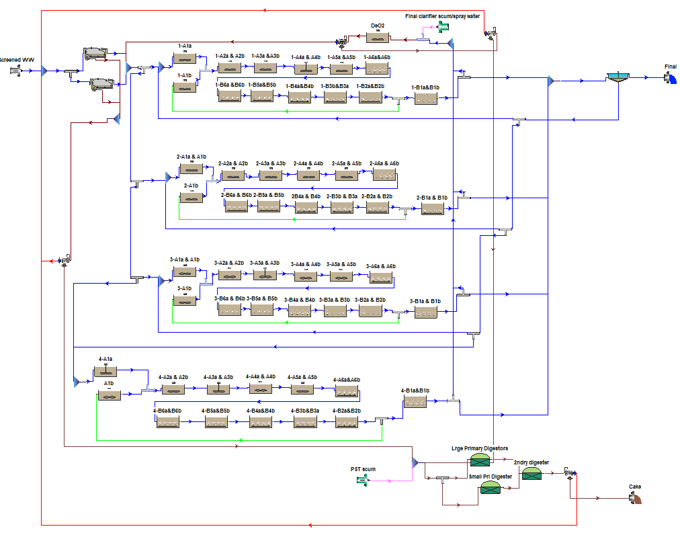
The backbone of the twin
Notes:
Tom will explain the tool in more detail later, but for now:
Moata imports data directly from sampling results & telemetry via PI.
Calibrated models simulate plant performance based on near real-time plant information. Historic maintenance and operations data is used to train and develop the models.
Model results for real, virtual and predictive scenarios are stored and surfaced through Moata.
The team view trends and insights through the Moata User Interface.
A core component of the Rosedale Digital Twin is a live Biowin Model. BioWin is a wastewater treatment process simulator developed by Envirosim that ties together biological, chemical, and physical process models.
The BioWin model was operationalised with an API developed between Moata and Envirosim to push/pull plant data and model results. The existing BioWin model was developed pre-2020 for the design upgrade. A well-calibrated model is crucial for the accuracy of these results and there are ongoing efforts to improve calibration, including an intensive sampling survey due to be carried out this month.
Note that MOATA is not tied to a particular software, and will work with other simulators such as SUMO.

Slide 5
What if we could use the twin to enhance existing data and reduce operational emissions and cost

Slide 6
“Real” data has problems
Real data is incomplete
Real data is expensive
Real data is biased
Notes:
Real data is incomplete: AI needs both large and diverse datasets, but real data is often incomplete, excluding infrequent scenarios that are critical for AI performance.
Real data is expensive: It is hard to collect, integrate, store and maintain.
Real data is biased: Even if data perfectly reflects reality, it can encode biases present in the real world that we would like to remove.
Real data is restricted: Regulation is increasingly limiting data use for AI.³

Slide 7
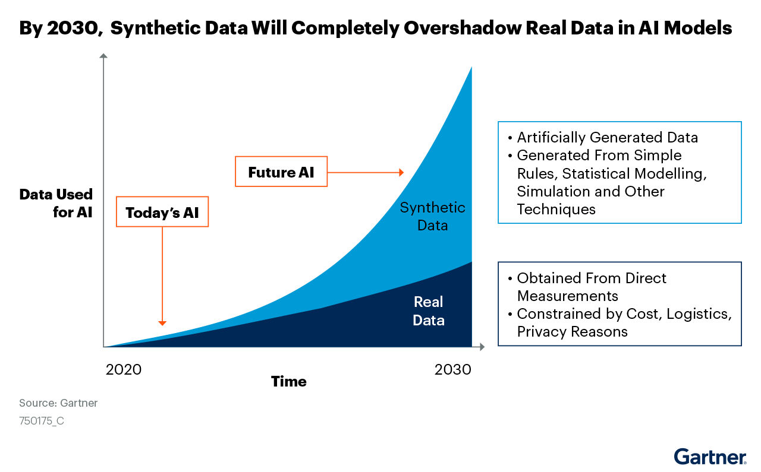
Synthetic data has a major part to play

Slide 8
More information not just data
1
3
Onsight Measurement
Data generated from domain driven modelling
Data
Modelling
Synthetic Data
Intelligence (ML/AI)
2
4
Domain knowledge
Supports data hungry ML
Drive smarter data collection
Learn
5

Slide 9
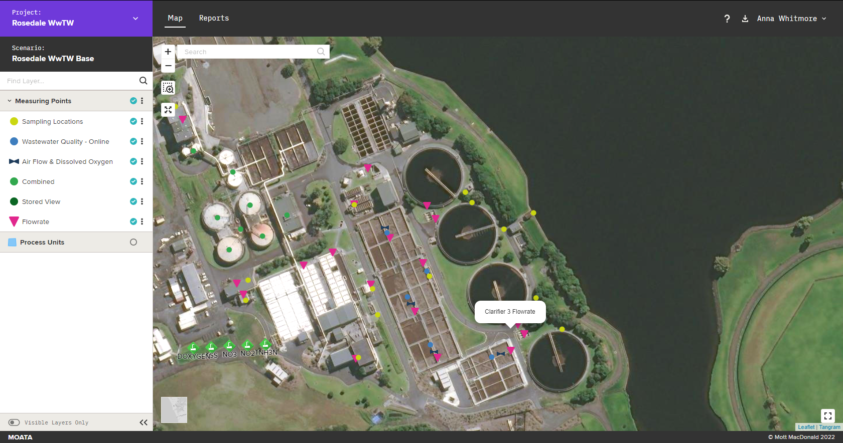
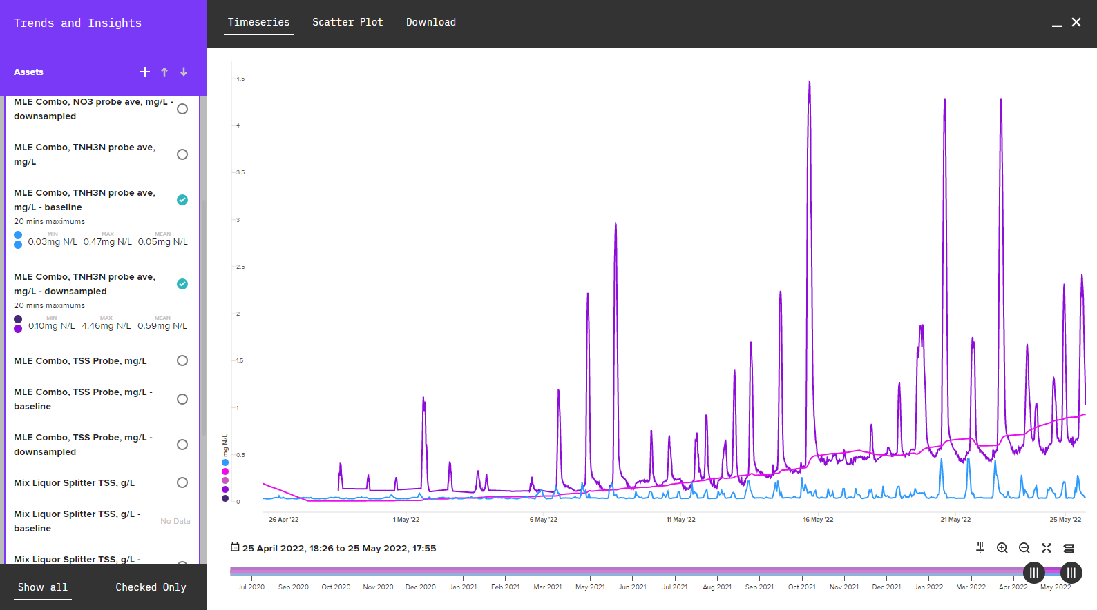
Rosedale WWTP digital twin topology
Data sources
Moata Platform
Synthetic Data
SCADA Data
Rosedale biological model
Laboratory sample Data
Sensor analytics framework
N₂O Monitoring Data
Predictive Weather Data
Intelligence
Machine Learning Models
Maintenance records
Watercare opex reports
Alarming Framework
End Users
Rosedale operations team
Notes:
Mott MacDonald were engaged by Watercare to design a 4th MLE. In 2020 a digital twin (DT) of the plant was developed in Moata to support commissioning of the MLE and associated plant.
Mott MacDonald and Rosedale WWTP operations have worked as an integrated team to enhance the DT, focusing on a number of plant pain points. The initiatives included:
Supporting optimisation of MLE set points by developing virtual scenarios for operators to trial different operating conditions.
Determining clarifier capacity and identifying options to optimise operation using an operational clarifier calculator.
Prediction of weather impacts on plant performance by deploying a Machine Learning model that predicts influent flow.
Through these investigations the potential benefits of a digital twin were demonstrated.
The wet weather flow tool predicts 48 hours of influent flow to determine impact on effluent quality. The tool was successfully deployed and provides accurate predictions but has limited utility at Rosedale which is resilient to wet weather events.
I will come on to the other initiatives in a moment

Slide 10
How do we use the twin to improve sensor reliability
Biological Modelling
Statistical Modelling
Machine Learning
Ammonia
N2O
CH4
DO
Suspended solids
Nitrite
Nitrate

Slide 11
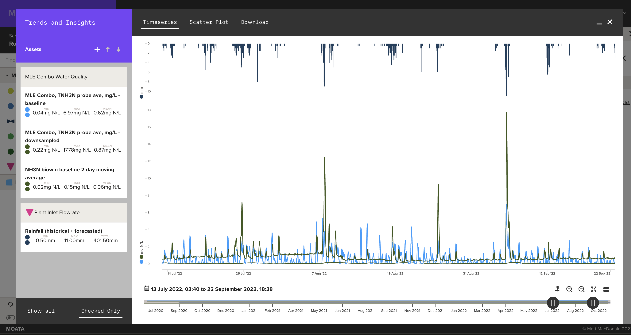
Detecting Ammonia drift with the biological model
Ammonia instrument
Modelled ammonia
Notes:
The biological model allowed us to compare predicted trends with actual sensor data in real time. This first highlighted the issue with ammonia sensor drift and showed that it was common for the ammonia probe to malfunction.

Slide 12
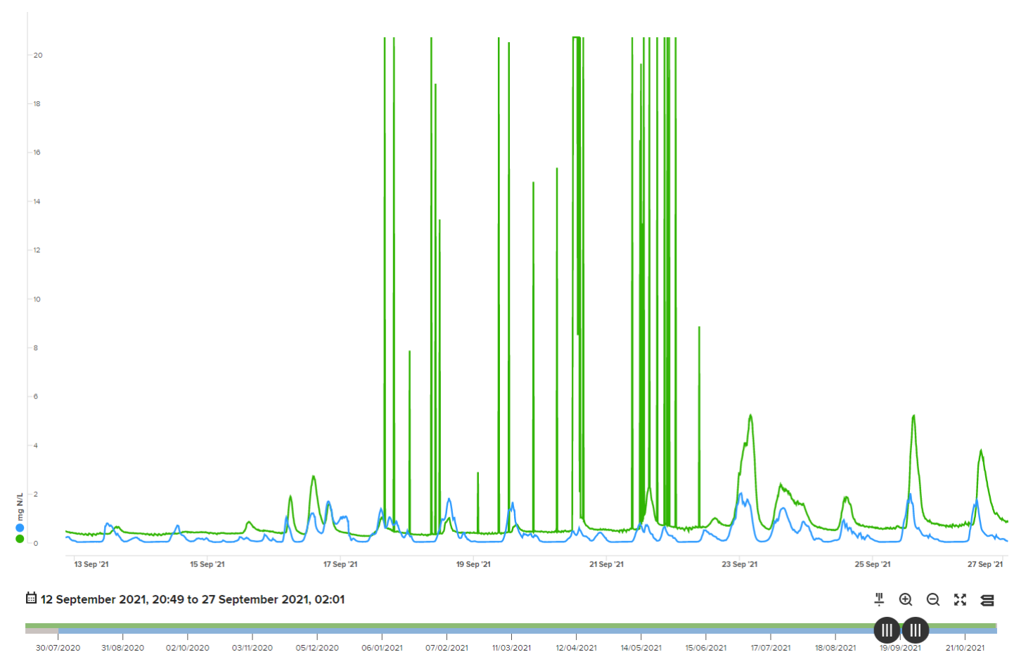
Detecting Ammonia drift with the biological model
Ammonia instrument data
Modelled ammonia value
Notes:
The biological model allowed us to compare predicted trends with actual sensor data in real time. This first highlighted the issue with ammonia sensor drift and showed that it was common for the ammonia probe to malfunction.

Slide 13
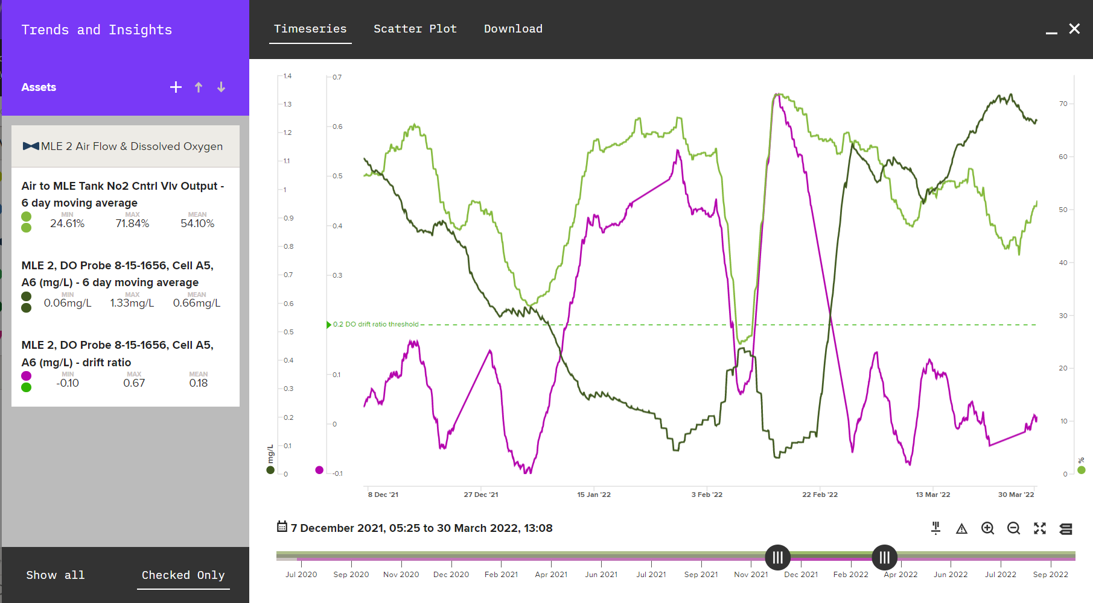
Detecting DO drift with statistical modelling
Airflow
DO
Drift ratio
Notes:
Example of where the DO is consistently low while the value output is increasing.
Present weeks not days to show trends
The drift ratio is calculated using two steps:
1. We 'normalise' the data - for both traces, valve and probe, we normalise based on the trace range for the last six days. I.e. if the probe is reading the highest value it's read in the last six days, we'd output 1; If it was the lowest in the last six days, it'd be 0.
2. We then compare these two normalised values, by subtracting the normalised probe from the normalised valve. As such our value is:
- high: when DO probe is lower than valve position would suggest
- low: when the DO probe is higher than the valve position would suggest
We know if our calculated trace is rising, that our DO valve is reading lower and lower and the valve is more and more open - signalling drift.
It's very hard to identify drift just by looking at the traces as;
- They can be quite erratic with the valve switching between open and closed and the effect this has on the DO (we fix this with windowing)
- We're looking for a change in the relationship between them, meaning you have to not only consider the relative gradients not the relative values but changes in the relative gradients over time

Slide 14
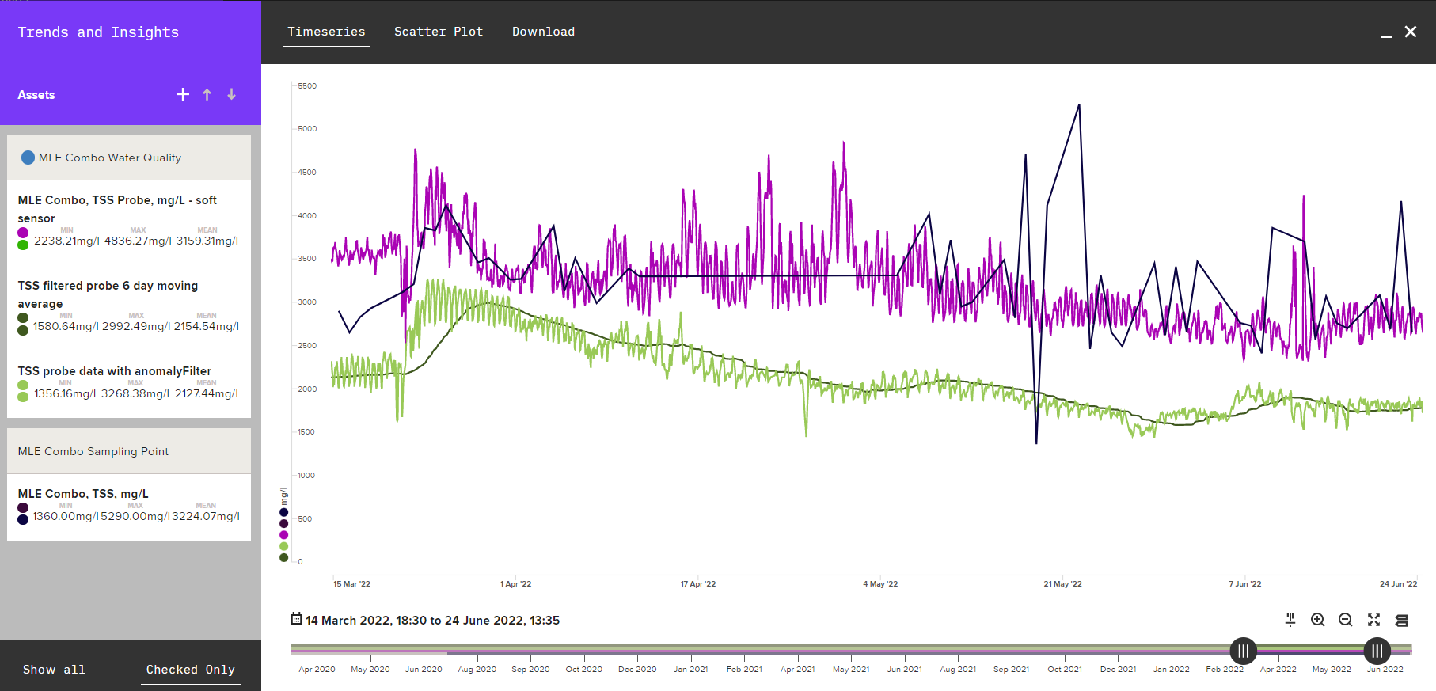
Building a more reliable synthetic data from ML model
Airflow
Lab samples
ML Model
DO
Probe
Drift ratio

Slide 15
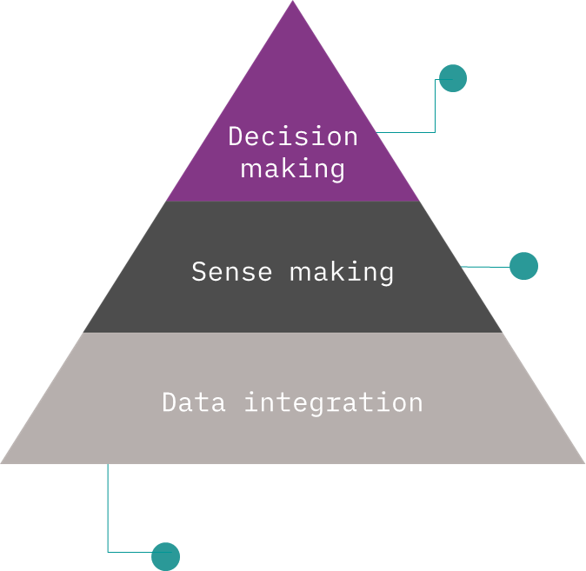
How can we use synthetic data reduce our operational emissions & cost?
How could we understand this...?
Consumables calculated from SCADA
Process modelling
N₂O monitoring
What data would power this…?
Chemical consumption
Energy consumption and rates
Solids production and disposal
Process Emissions
Labour and maintenance costs
Notes:
Sensors prone to drift including DO, ammonia, nitrate, nitrite and TSS.
Poor visibility of plant performance.
Potentially impacts effluent quality, operating costs, GHG emissions.
Watercare’s Climate Change Strategy targets for emission reductions:
Reduce operational greenhouse gas emissions by 50% by the year 2030
Net Zero emissions by 2050
Improving efficiency and reducing operating costs is a key driver for Watercare.
Need to baseline, monitor, target and control Opex & GHG sources.

Slide 16
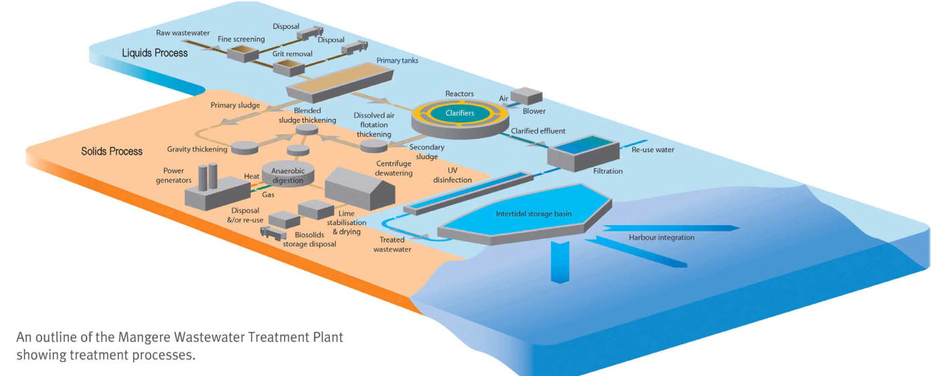
GHGs from WWTPs
N₂O 298
CH₄ 28
Relative Global Warming Potential (AR5)
N₂O
CO₂ 1
CH₄
CO₂
Nitrogen
Carbon (BOD)
Nitrification / dentification reactions
Treatment plant
Effluent disposal to land/water
Biosolids disposal to land
Sludge treatment
Sewer
Anaerobic conditions or treatment processes
Sludge / biosolids treatment
Biosolids disposal
Effluent disposal to water
Biogenic CO₂ accounted for separately
Transport, fuel use, chemical production, soap feed stocks (incl. non-biogenic)

Slide 17
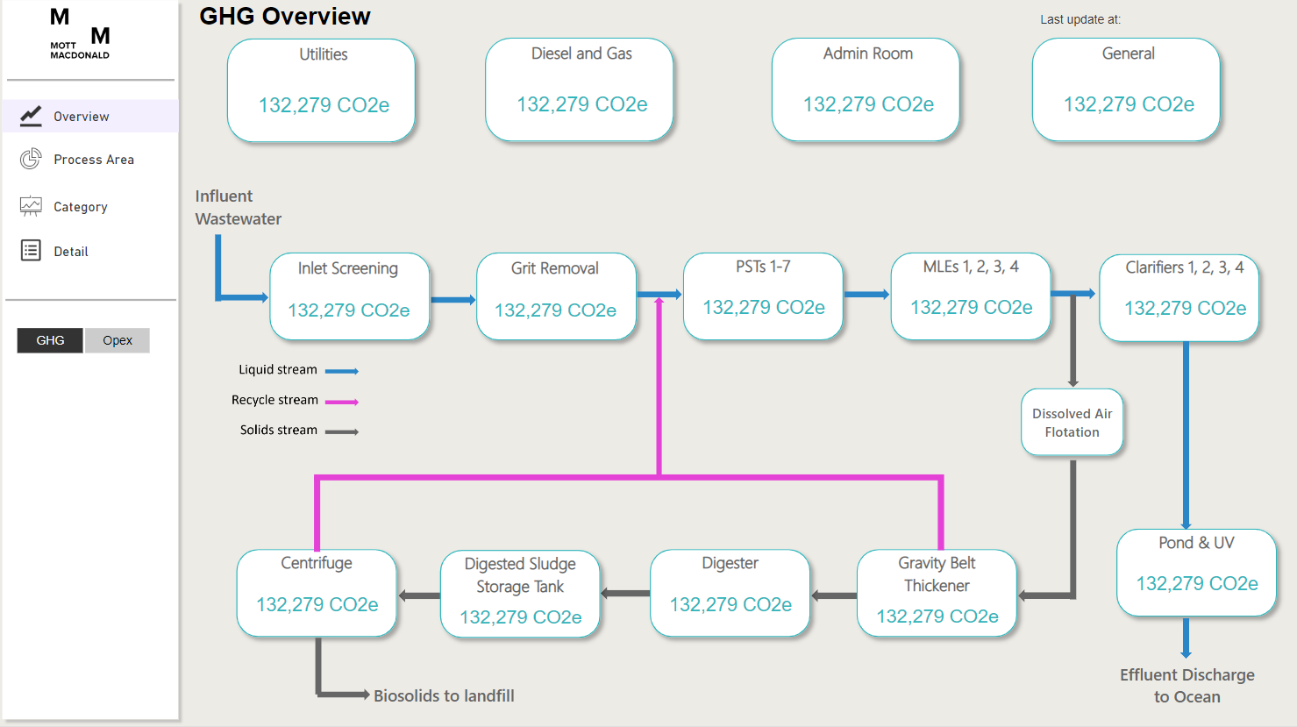
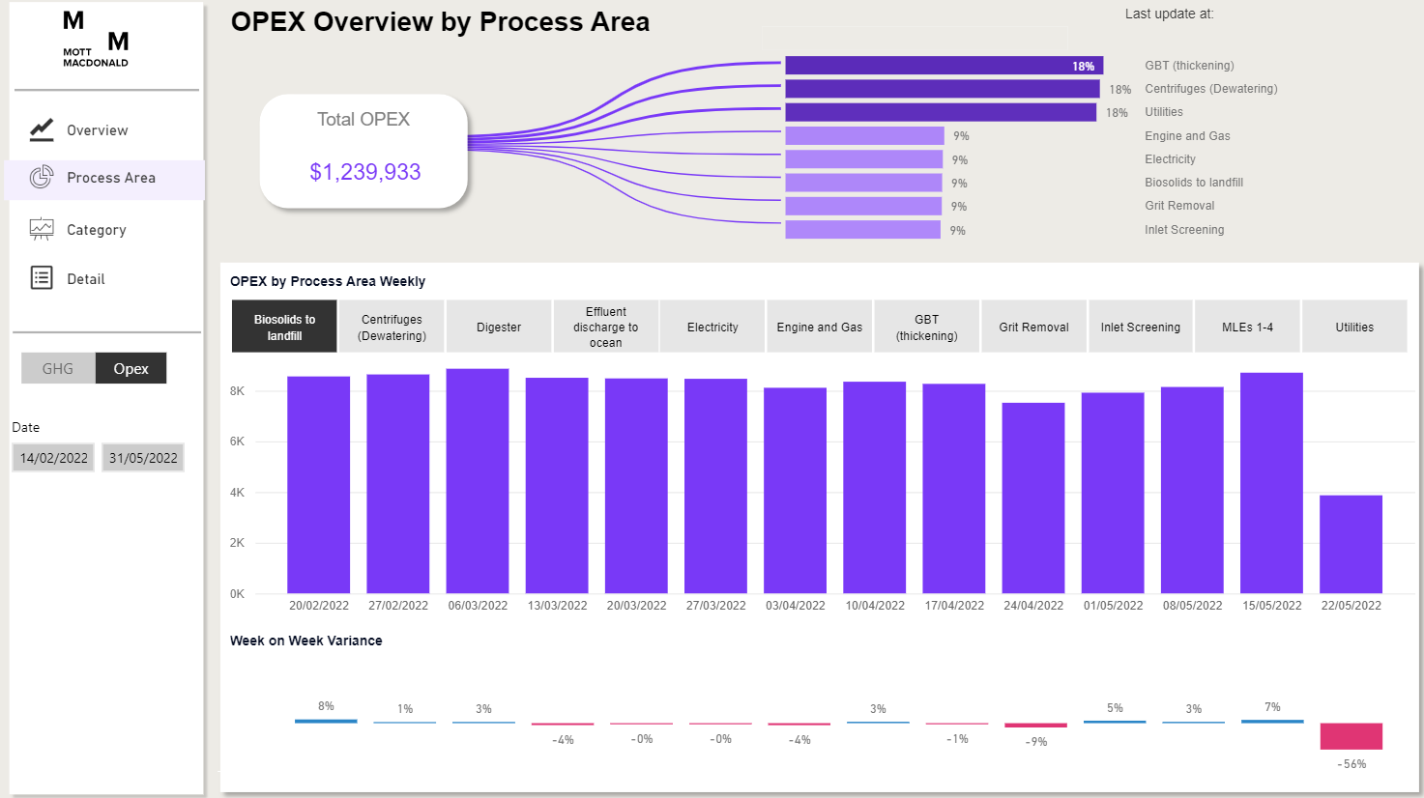
Dashboard development
Using the synthetic data from from the twin combined with opex from the plant we developed operational dashboards to highlight emissions and opex hotspots across the treatment plant.
Notes:
The green house gas and opex dashboards developed through with following methodology:
Review of process areas to identify GHG/Opex plant sources e.g. chemicals dosing, fugitive methane emissions, electricity consumption. Details on the data sources is provided overleaf.
Develop baseline calculations for each source to convert to a daily cost or CO2 equivalent value. E.g. calculating biogas emissions using the Water NZ Carbon Accounting Guidelines for Wastewater Treatment: CH4 and N2O methodology.
Developing data pipelines to import real-time plant SCADA data, laboratory results and plant opex reporting data into the digital twin.
Codifying the baseline calculations to enable real-time calculation of plant GHG / opex expenditure.
Dashboard design and development – surfacing calculation results through a clear, simple dashboard.
These dashboards enable plant operators and engineers to identify GHG and opex hotspots, trial control strategies and understand the complete impact on the plant.

Slide 18
Notes:
Daily report on value broken down by process area or category
Over 50 data sources and 30 unique calcs required
See process emissions contribution
50% 2030 target / 73% of their business emissions from process emissions
Literature and theoretical values are still heavily relied globally
There is a real need to better understand what these emissions are

Slide 19
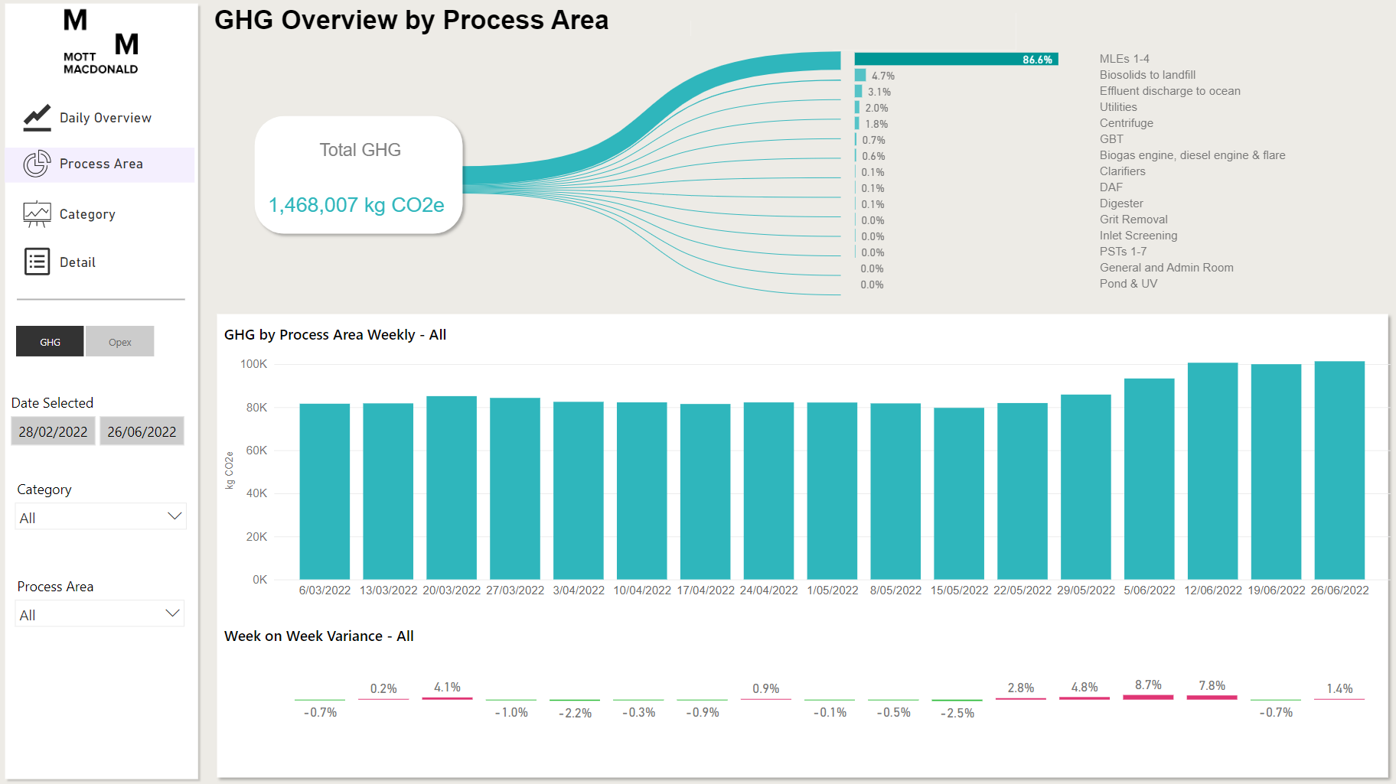
Notes:
Daily report on value broken down by process area or category
Over 50 data sources and 30 unique calcs required
See process emissions contribution
50% 2030 target / 73% of their business emissions from process emissions
Literature and theoretical values are still heavily relied globally
There is a real need to better understand what these emissions are

Slide 20
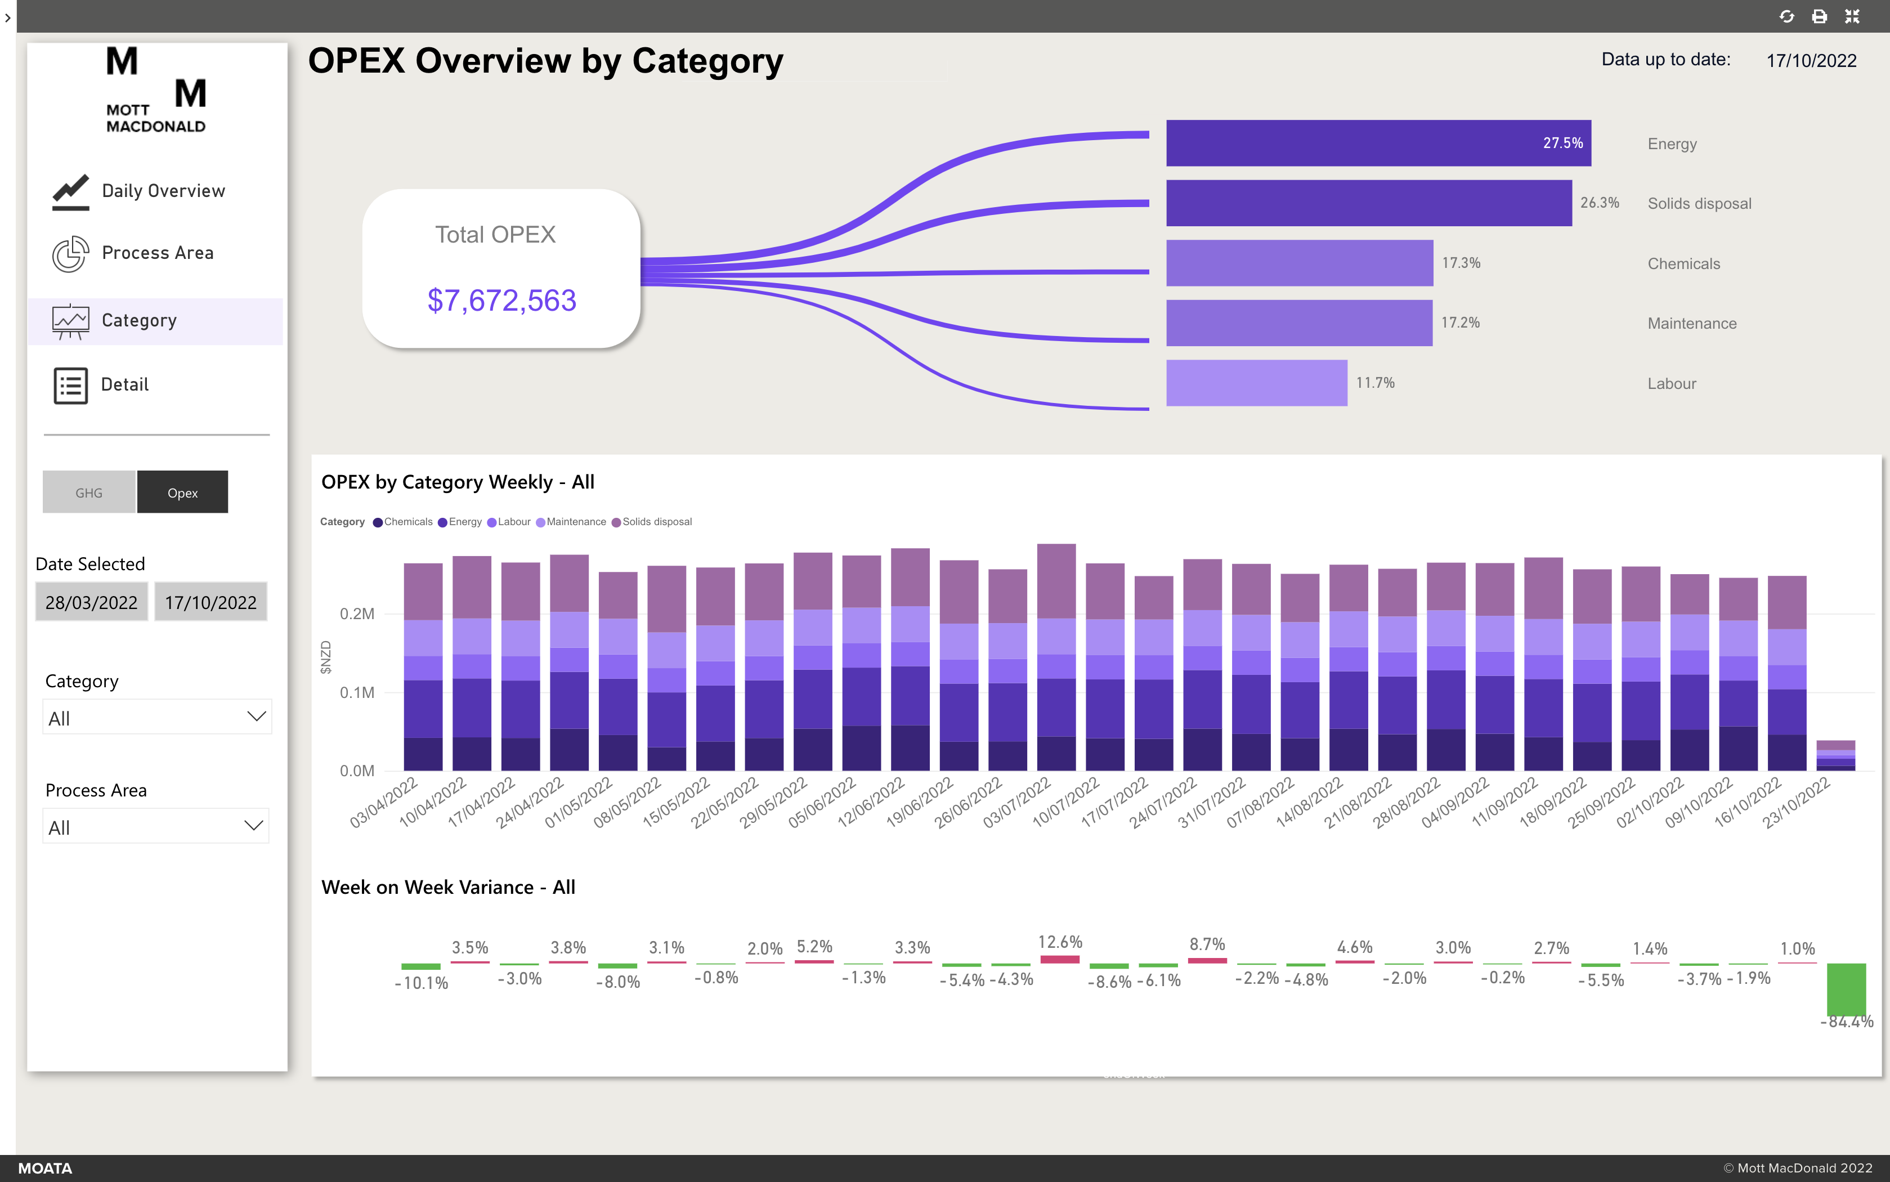
Notes:
Daily report on value broken down by process area or category
Over 50 data sources and 30 unique calcs required
See process emissions contribution
50% 2030 target / 73% of their business emissions from process emissions
Literature and theoretical values are still heavily relied globally
There is a real need to better understand what these emissions are

Slide 21
Next steps
N₂O and Opex:
Complete N₂O monitoring at Rosedale and further validate the biological model.
Trial controls strategies to reduce Opex/GHG.
Improve Opex data granularity.
Soft sensors:
Working with Ops Team to improve reliability.
Continue to develop N₂O soft sensors to reduce reliance on physical monitoring.
Roll-out soft sensors for other critical parameters.
Scale:
Improve Watercare knowledge of actual plant emissions.
Move to Operational Control as BAU.
Expand across Watercare sites.
Notes:
We see this becoming a larger focus for water companies

Slide 22
Anna Whitmore (Mott MacDonald)
Kenny Williamson (Watercare Services Ltd.)
Glenys Rule (Watercare Services Ltd.)
Owen Flanagan (Mott MacDonald)
Evan Harwin (Mott MacDonald)

Slide 23
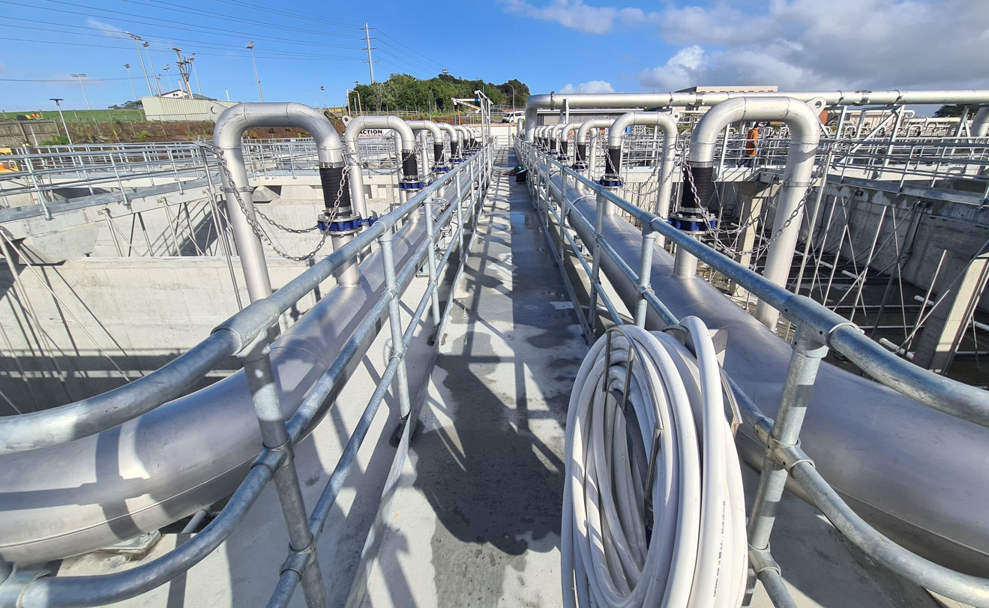
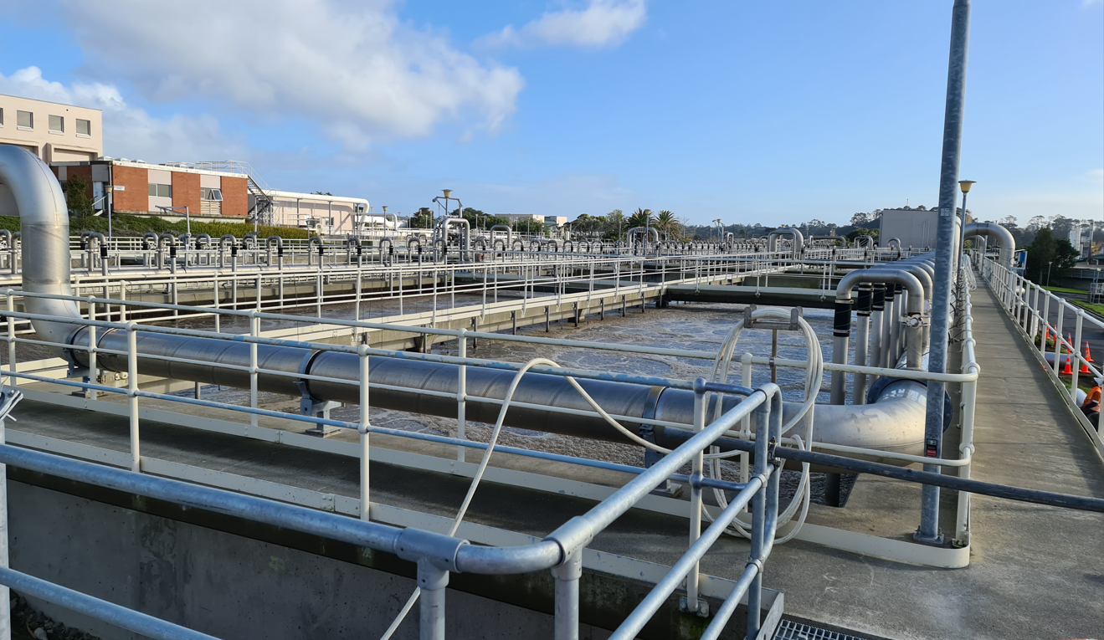
N₂O Monitoring campaign
It’s very complex to measure WWTP emissions
Notes:
Sites are complex industrial sites with many safety risks

Slide 24
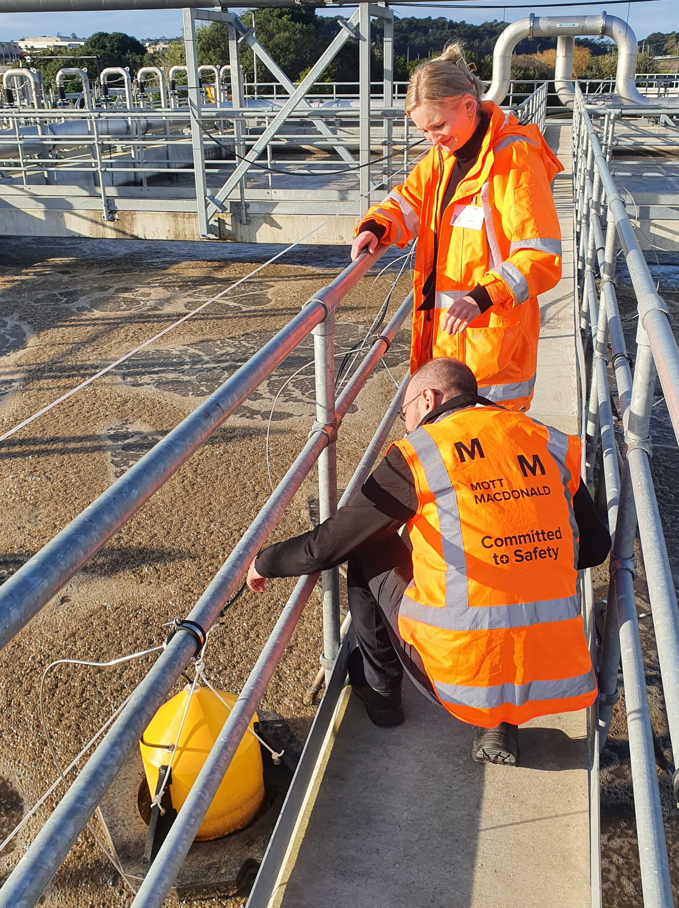
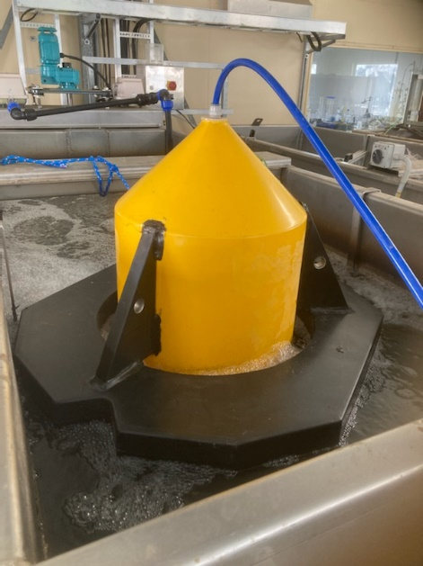
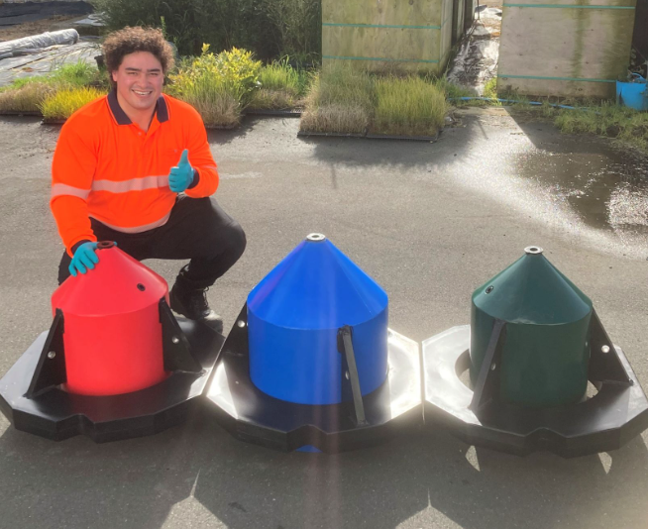
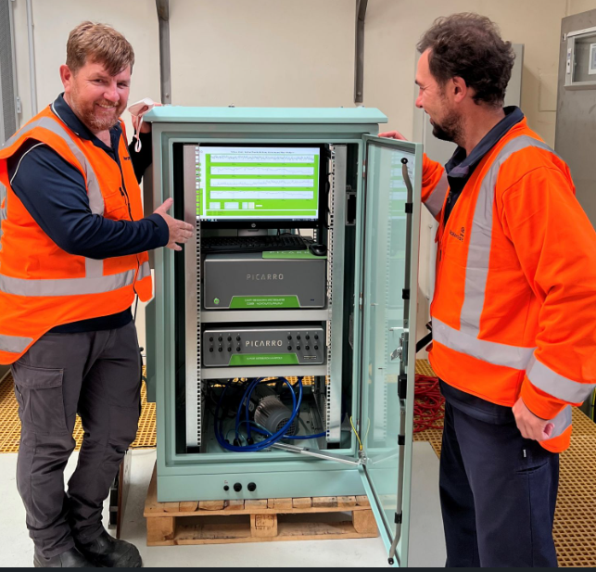
N₂O Monitoring campaign
How do you monitor N₂O emissions?
Equipment needed – hoods
Benefits Off-gas vs. Liquid
Capturing spatial variations
Notes:
Watercare purchased two Picarro off-gas N₂O monitors to begin monitoring across Watercare sites, with an aim to improve understanding of process emissions.
A monitor was made available for the Rosedale innovation programme to monitor emissions on MLE 4.
This has enabled the comparison of measured vs modelled N₂O emissions. At the time of developing this report, monitoring is ongoing, therefore final comparison of the two methods is to be completed.
By incorporating N₂O results into the sitewide GHG dashboard it has also generated insight into what proportion of GHG is generated from the reactor.

Slide 25
N₂O Monitoring campaign
It’s very complex to measure WWTP emissions
Notes:
Complex biological pathways to produce N2O - current understanding. Still evolving.

Slide 26
N₂O Monitoring campaign
It’s very complex to measure WWTP emissions

Slide 27
Global connections
1
Scottish Water
Developing SW process emissions monitoring strategy
2
Severn Trent Water
Discussion started with Melbourne Water to understand current process emissions strategy. Links made with Queensland university and IWA process emissions group
3
PUB
Singapore water team organising client knowledge sharing forum with PUB and others.
4
Other UK Water companies
Discussion started with Severn Trent and Thames Water.
Notes:
Water companies are keen to collaborate on this and share data / monitoring best practice Our USP in this space is our ability to help with the data capture / management piece & modelling.
To solve the global issue of climate change, we need to work globally, share information and learnings, and work q

Slide 28
“[Mott MacDonald] has brought the combination of process background and digital knowledge to the Low Carbon Wastewater Treatment value stream. Watercare had identified that process emissions from treatment processes are not well understood, and sought to develop tools and protocols to generate an emissions baseline and characterisation. [Mott MacDonald] has demonstrated the mindset of unearthing possibilities and options to help Watercare turn this aspirational goal into a practical solution.”
- Watercare Production Manager

Slide 29
So what?
Results
Why is this a problem that needs to be solved?
The analysis of the MLE probe performance indicates frequent drift events occurring across all parameters. Probe performance and resulting data quality impacts the following:
WWTP performance – plant data is used by operators to make operational decisions, and by controls systems to adjust set points. If decisions are based on poor quality data the WWTP performance will be suboptimal, and the risk of non-compliance increased.
Process emissions - DO is a important parameter in the production of N₂O – too high or too low and the risk of production increases. DO probes are typically unreliable and intensive to maintain. Providing a method to identify drift events will improve data quality and enable trialling of N₂O control strategies.
Energy cost – the Opex dashboard indicate that the MLEs contribute ~ 35% of total electricity consumption, ~ $25,000 per week. A 0.5mg/L reduction in DO across an MLE equates to ~ $63,000 annual savings in electricity cost. Reliable DO sensors enable better control of blower power consumption, and has significant savings potential.
Maintenance regimes – Current maintenance routines are based on scheduled investigations at regular intervals. Soft Sensors and drift detection mean that technicians can resolve issues as they arise, thus increasing data quality by reducing the time to intervention and saving labour costs on redundant maintenance (~$15.
Reduced sampling and instrument requirements – soft sensors have the potential to replace or reduce the need for sampling and instrumentation on site, reducing Opex.
Digital twin enablement – the Rosedale Digital Twin is driven by real-time SCADA data. The accuracy of the probe data directly impacts the accuracy of the digital twin.
Quality data is fundamental to plant performance.
To optimise operation and reduce green house gas emissions, Rosedale WWTP needs accurate, trusted data to inform decision-making.
This workstream has demonstrated that soft sensors have the potential to improve quality data through early detection of drift.
Summary of drift events
Performance Metric | Count
Sensor drift correctly identified | NH3 = 1 TSS = 1 (TBC)
False positive – alarm triggered when no drift occurred | NH3 = 1 (triggered from wet weather event. Wet weather exception added to alarm where rainfall > 20mm in x hours.)
False negative – drift occurred and no alarm triggered | 0

Slide 30
Soft sensor development framework
Data analysis
Model development
Drift detection
Performance monitoring
Review historic probe data to understand quality
Identify historic events by reviewing Infor maintenance logs and interviews with plant operators / instrument technicians
Apply statistical filters to probe data to remove anomalies and outliers
Develop a modelled soft sensor of the parameter to predict the parameter value.
Model agnostic approach meaning soft sensor may be generated from a machine learning (ML) model or a Biological model.
Both methods require quality input data and process expertise to develop and tune the models
Compare long-term trend between the physical probe data and soft sensor.
Set threshold and configure alert to plant operators via text and/or email when threshold has been exceeded
Configure alert metrics include no. of days for rolling average, wet weather alarming exceptions, and divergence threshold between physical probe and soft sensor data.
Alarms sent to Watercare operators team when threshold crossed.
Rosedale operators check probe and report:
Sensor drift correctly identified
False positive
False negative
Results recorded and alert configuration adjusted as required.

Slide 31
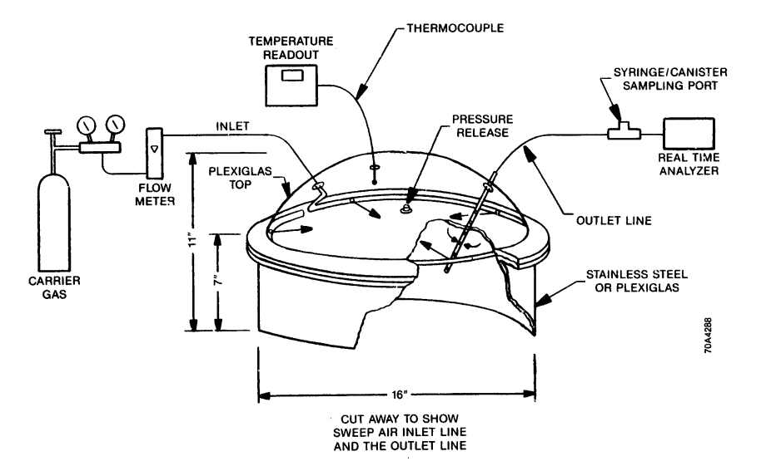
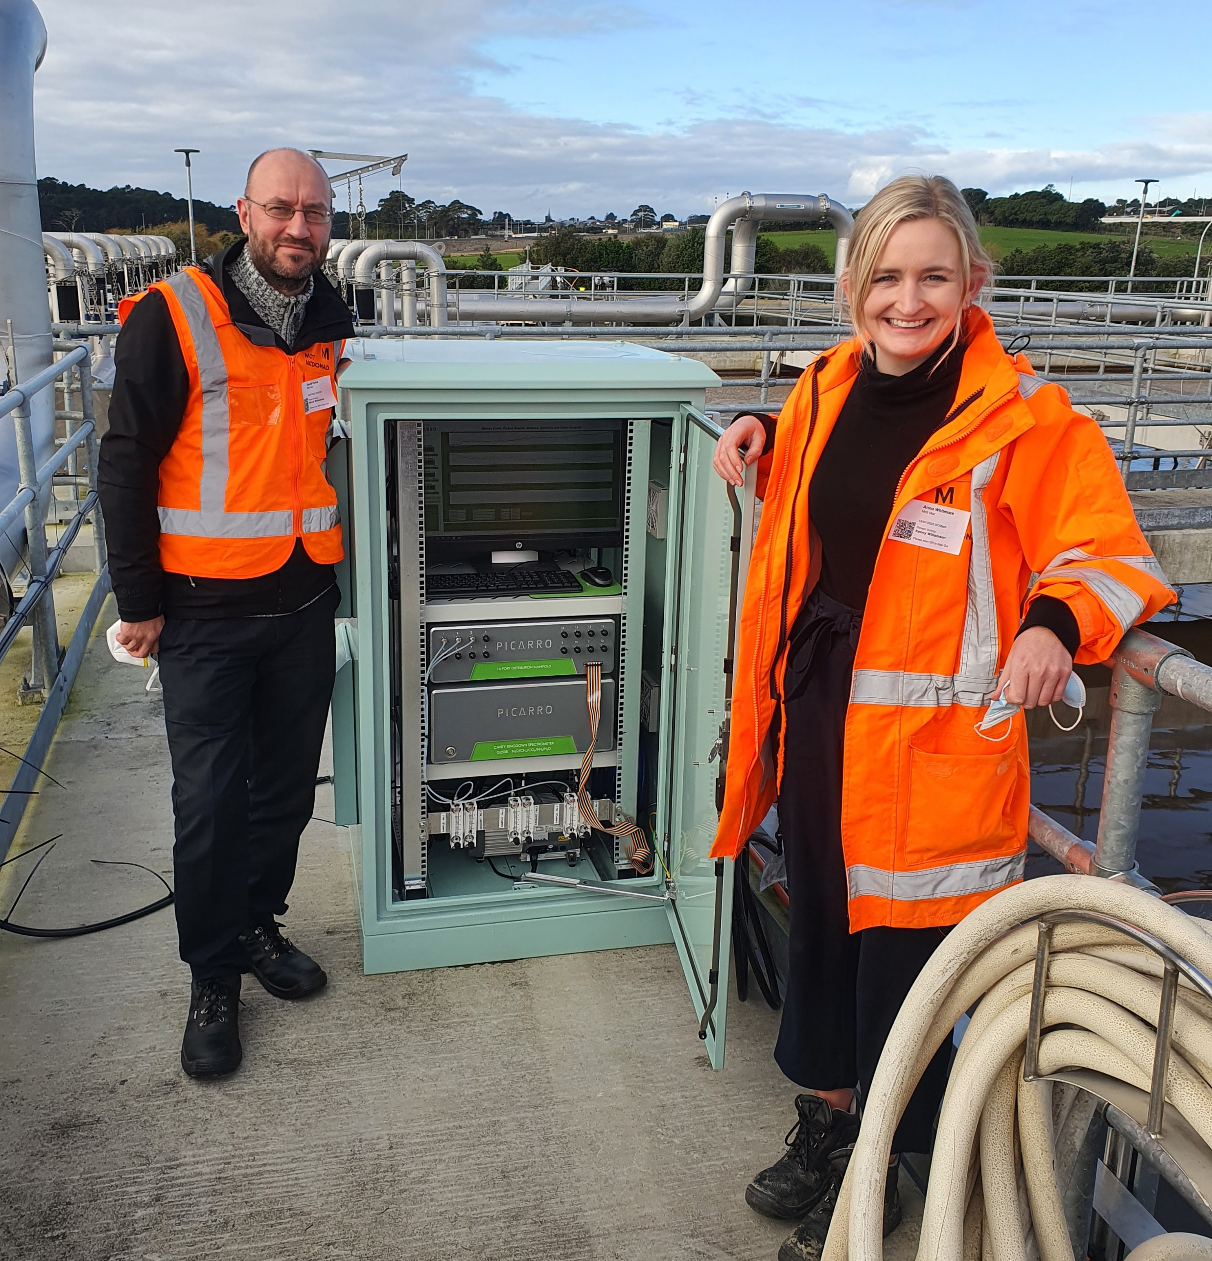
N₂O Monitoring campaign
Notes:
A lot specialist equipment as off gas measurement required
Only project they have right now where measuring actual N2O data on site
The reports currently using a live biowin model to determine GHG
Part of this work will be to validate the model against the actual data
That data will be quite valuable to MM as the combination of online modelling + monitoring hasn't been done before

Slide 32
N₂O Monitoring campaign
It’s very complex to measure WWTP emissions
Notes:
Sites are complex industrial sites with many safety risks

Slide 33
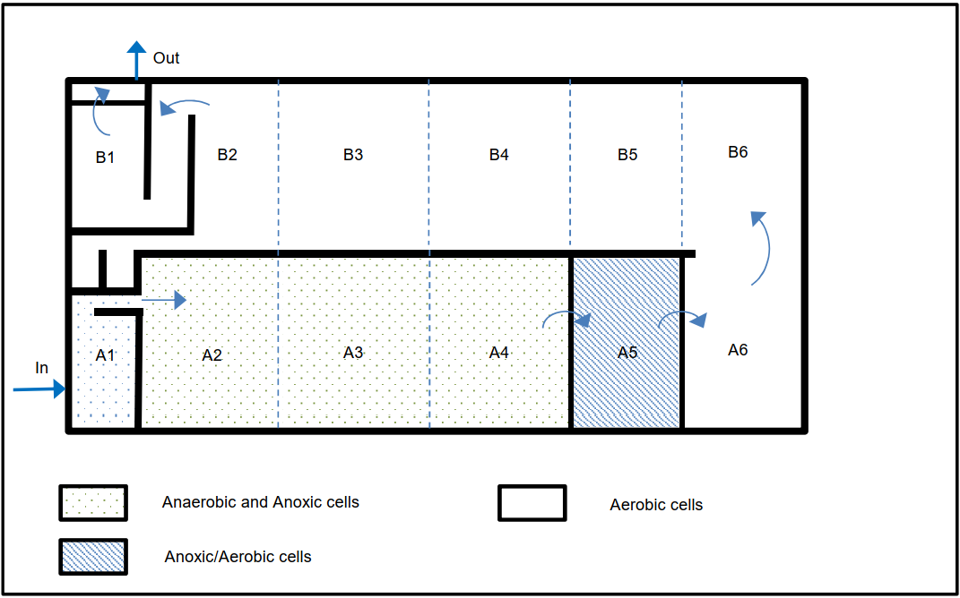
N₂O Monitoring campaign
It’s very complex to measure WWTP emissions
Notes:
Complex to N₂O in full scale plants and lack of standardised measurement methods has resulted in N₂O emissions being largely based on modelled results or estimations.
The Rosedale WWTP MLE’s use biological nitrogen removal to treat wastewater, producing N₂O process emissions.
GHG emissions sampling and monitoring plan
This document specifies the Rosedale WWTP GHG monitoring requirements for determining N2O and CH4 emissions from the MLE’s. The sampling requirements, including supplementary parameters required and equipment specifications are applicable to any biological treatment reactor.
Intensive sampling and monitoring plan guidance
This document defines the Rosedale WWTP sampling and monitoring plan to support optimisation of the digital twin. The guidance defines sampling locations, sample types, parameters to be tested and constraints / recommendations.

Slide 34
N₂O Monitoring campaign
How do you monitor N₂O emissions?
Equipment needed – hoods
Benefits Off-gas vs. Liquid
Capturing spatial variations
Notes:
Watercare purchased two Picarro off-gas N₂O monitors to begin monitoring across Watercare sites, with an aim to improve understanding of process emissions.
A monitor was made available for the Rosedale innovation programme to monitor emissions on MLE 4.
This has enabled the comparison of measured vs modelled N₂O emissions. At the time of developing this report, monitoring is ongoing, therefore final comparison of the two methods is to be completed.
By incorporating N₂O results into the sitewide GHG dashboard it has also generated insight into what proportion of GHG is generated from the reactor.

