Slide 1
MOVING TOWARDS A PROACTIVE WAY OF PREDICTING WATER QUALITY
Bridget Armstrong, Theo Sarris, Louise Weaver, Judith Webber, David Wood

Slide 2
introduction
Global pop. - 2.5 billion (1950) - 8 billion (2022)
Demand for freshwater resources
Potential for contamination of rivers, lakes, groundwater systems
High pop. density
Waste disposal to land
Intensive land practices
Chemical use/spills
United Nations "Water use has been growing globally at more than twice the rate of population increase in the last century, and an increasing number of regions are reaching the limit at which water services can be sustainably delivered”
Notes:
Last 30 years averaging 10% every 10 years
More ppl = more water needed for food production : energy generation : drinking water – focus of this talk
Contamination from: high pop. farming : chemical usage : waste disposal :

Slide 3
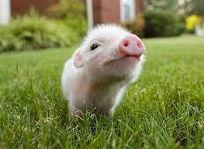
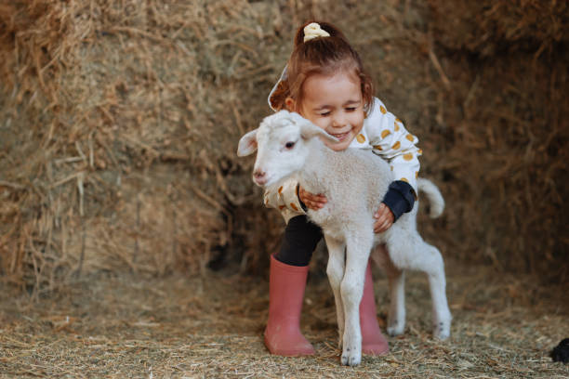
ESSENTIAL:
Groundwater is monitored for:
Harmful chemical contaminants & pathogens…
To protect human and animal health
istock / Getty Images

Slide 4
GROUNDWATER - monitoring
Lab tests
Chemical analytes | Nitrate, phosphate, chloride, iron etc.
E. coli | Indicator of recent human or animal waste contamination
Current tests – not measured in real-time
So…. indicate past problem if issues detected
And… contaminant potentially in the community

Slide 5
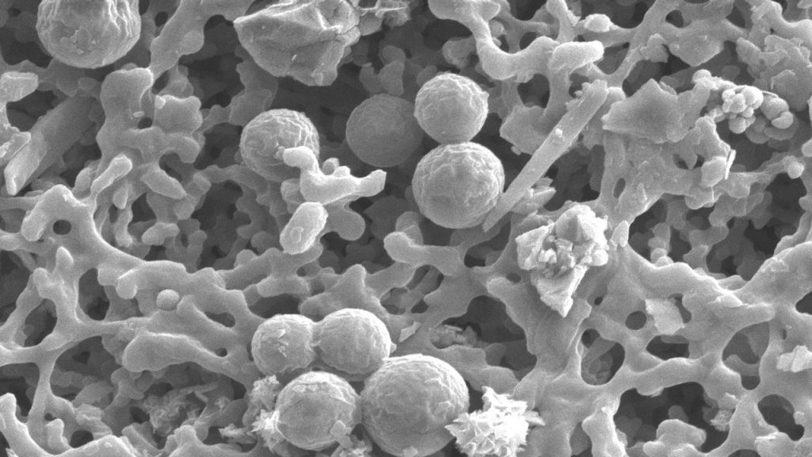
Aquifers contain microbial communities:
Well adapted to living in nutrient-poor environments
Changes in aquifer chemistry results in:
Changes in abundance and types of microbes depending on their ability to adapt and metabolise chemical compounds
Changes in microbial diversity:
Indicate pollution presence and degraded aquifer conditions
https://www.auckland.ac.nz/en/news/2020/04/21/secret-life-of-our-aquifers.html

Slide 6
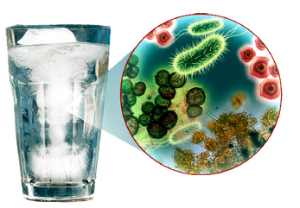
STUDY AIMS:
To model microbial diversity with field and chemistry parameters using:
Predictive modelling tools
To find key organisms that could predict contaminant presence
https://water.unl.edu/

Slide 7
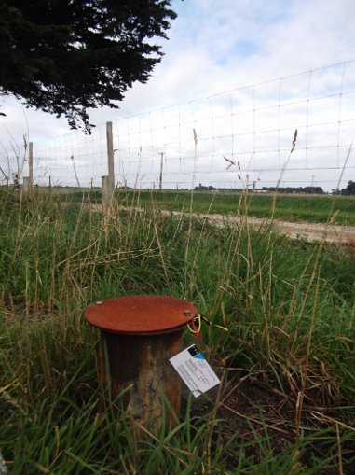
Groundwater samples - 49 wells
Feld parameters:
pH, temp, dissolved oxygen, redox, etc.
Chemistry: Major ions
Nitrite, nitrate, total nitrogen etc.
Extracted DNA: ID bacterial diversity of groundwater
DNA sequenced
Taxonomy assigned: Silva bacterial database
https://www.mainlynostalgic.co.nz/

Slide 8
Data analysis
Plotted bacterial abundance present in gw samples
Decide on contaminant to study: Nitrate
Set nitrate levels using Maximum Allowable Value (MAV)
In alignment with the World Health Organisation guidelines
MAV classification: simple dataset to initially test
 | Nitrate-N (mg/L) | Category | Recommendation
MAV | 0 - 1 | Optimal | Optimal to drink
 | 1 - 11.3 | Safe | Safe to drink
 | > 11.3 | Not safe | Not safe to drink
Notes:
Other std split nitrate levels into finer increments but chosen MAV for this talk as very simple categories
The National Policy Statement on Freshwater (NPS-FW) on freshwater management requires regional councils to identify water quality limits to manage values of our aquatic ecosystems.
Beach Action Value (BAV) for issuance of public health advisories

Slide 9
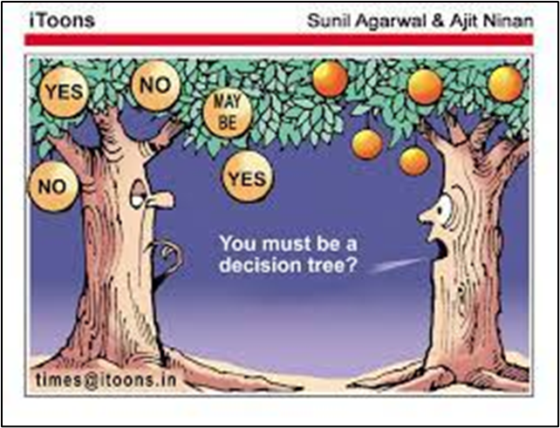
modelling
Modelled data against MAV nitrate levels… using…
Classification and Regression Tree (CART) AND Random Forest
To predict nitrate levels from bacteria present

Slide 10
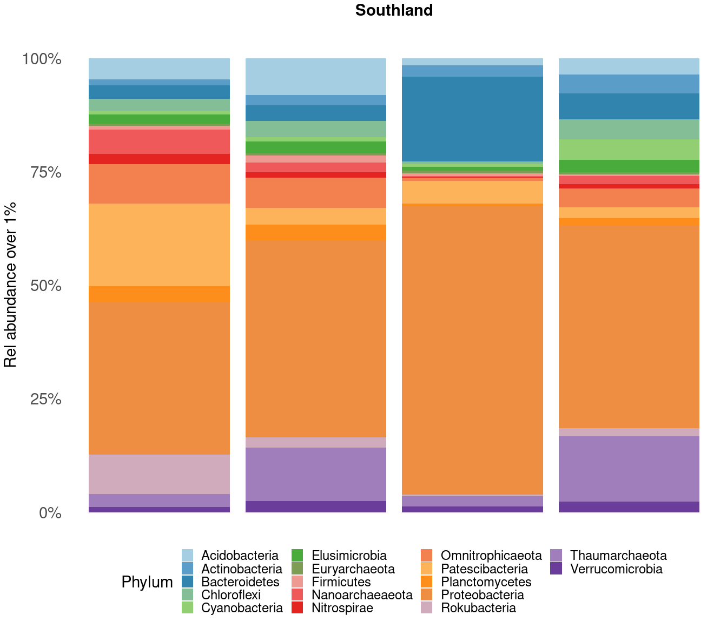
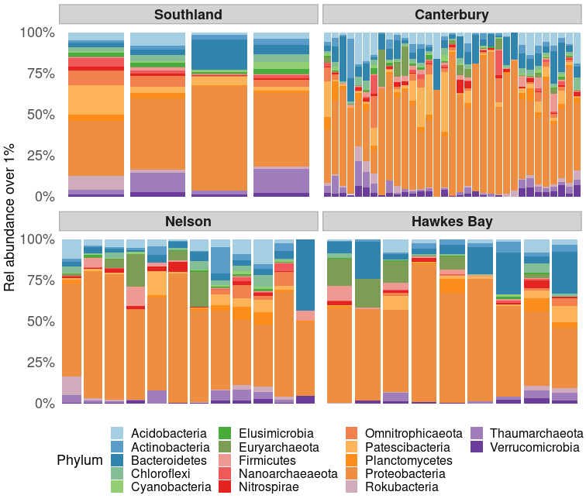
bacterial abundance plot
17 bacterial phyla - present at over 1% relative abundance
Most abundant Phyla
Proteobacteria
Thaumarecaeota
e.g. Southland
Across all wells common Phyla were present
So…
No difference in bacterial diversity…
But relative abundances varied
Notes:
Proteobacteria is the most diverse bacterial phylum
phylum Proteobacteria, represent the most frequent bacteria in drinking water,
Bacteroides inhabit the digestive tract; - fecal indicator?
Patescibacteria like low nutrient conds, from soil. prevalent in groundwater,
Being dominated by a few phyla (Bacteroidetes, Proteobacteria, Planctomycetes, and Thaumarchaeota), the taxonomic profiling of groundwater metagenomes
Thaumarchaeota and Bathyarchaeota as groundwater autotrophs
Thaumarchaeota are important contributors to ammonia oxidation in terrestrial habitats - mmonia-oxidizing organisms
Microorganisms are almost the only inhabitants in the groundwater environment³, and they have an important role in cycling nutrients and constituents through their metabolic activity⁴
microorganisms in aquifer ecosystems are sensitive to environmental changes and thus can be a useful indicator to biomonitor pollutants⁹. It is generally known that groundwater is more stable and cleaner compared to surface water, which occurs because of the filtration process through the aquifer material (i.e., gravel, silt, sand, clay) that leads to natural attenuation processes in the groundwater,
Proteobacteria, Firmicutes, Thaumarchaeota and Euryarchaeota.
Members of the Thaumarchaeota phylum play a key role in nitrogen cycling
Euryarchaeota removal of methane,

Slide 11
Classification and regression tree (CART)
Decision tree – creates a training model used to predict nitrate classification
Trees are used to see what variables are impt for making a good prediction
Pruned to show most impt variables
Proteobacteria
Thaumarecaeota
https://towardsdatascience.com/
Notes:
, 3. prune tree
Prune back the tree to avoid overfitting the data. Typically, you will want to select a tree size that minimizes the cross-validated error, the xerror column printed by printcp( ).
Prune the tree to the desired size using
prune(fit, cp= )
Specifically, use printcp( ) to examine the cross-validated error results, select the complexity parameter associated with minimum error, and place it into the prune( ) function. Alternatively, you can use the code fragment
fit$cptable[which.min(fit$cptable[,"xerror"]),"CP"]
to automatically select the complexity parameter associated with the smallest cross-validated error.
The leaf nodes of the tree are the outcome variable which is used to make predictions.

Slide 12
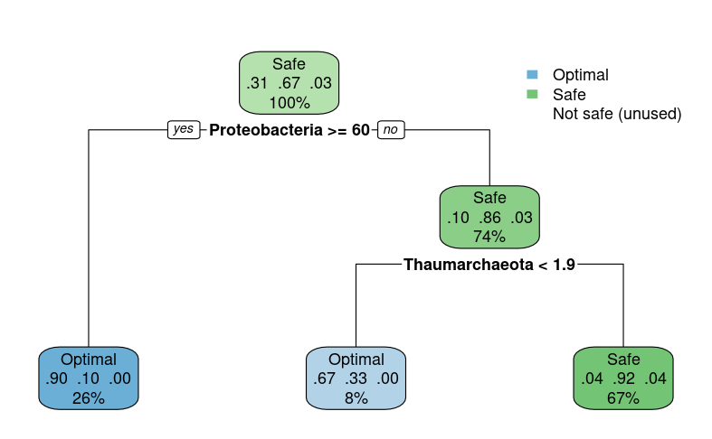
CART tree model
Root node – training data set
100% classified as safe to drink
GREATER than 60
LESS than 60
Decision making node
Sub node
74 % of samples fit into
this split
LESS than 1.9
GREATER than 1.9
Sub node
Leaf node
Leaf node
90% confidence in this prediction
Notes:
The first node (root node) is the training data set, classifying the entire dataset (100 %) as below MAV (Figure).
The internal node (decision-making node) splits into two sub nodes based on the threshold value of the relative abundance of Proteobacteria.
When the relative abundance of Proteobacteria was greater than or equal to 60, the groundwater nitrate level was categorised as pristine with a probability of 90 %.
When Proteobacteria had a relative abundance of less than 60, the groundwater nitrate level was classified as below MAV with an 86 % certainty. Seventy-four percent of the groundwater samples fit into this split.
This node divides further based on the best feature of the sub-group, and this final node (leaf node) holds the decision. Thus, if the relative abundance of Thaumarcheota was less than 1.9, then the groundwater was pristine (67 % accuracy). If the relative abundance of Thaumarcheota was greater than 1.9, the groundwater sample was below MAV (92 % accuracy). From the Thaumarcheota decision node, eight percent of the groundwater in this study was classified as pristine, and 67 % was below MAV.
#########################################################################
We can also see we only have the categories “below MAV” and “Pristine” which is good for NZ groundwater but does make the tree even more simple.
All of our data was below MAV (100%), top light blue box. – the root node.
We can then split our data into two decision nodes – Below MAV and Pristine based on the relative abundance of Proteobacteria present
If Proteobacteria has relative abundance GREATER than 60 we have pristine gw and we have 90% confidence in this prediction and 26% of our gw samples fit into this split.
If proteobacteria have a relative abundance of LESS than 60 we can predict our gw is Below MAV, BUT we only have 11% confidence of this prediction.
So…… to further identify our Below MAV data we need to look at another Phyla – Thaumarcheota.
If Thaumarcheota is had a relative abundance over 1.9 we can say it is a pristine groundwater and 8% of our data fitted these conditions.
The overall accuracy of our tree model is 89.7%

Slide 13
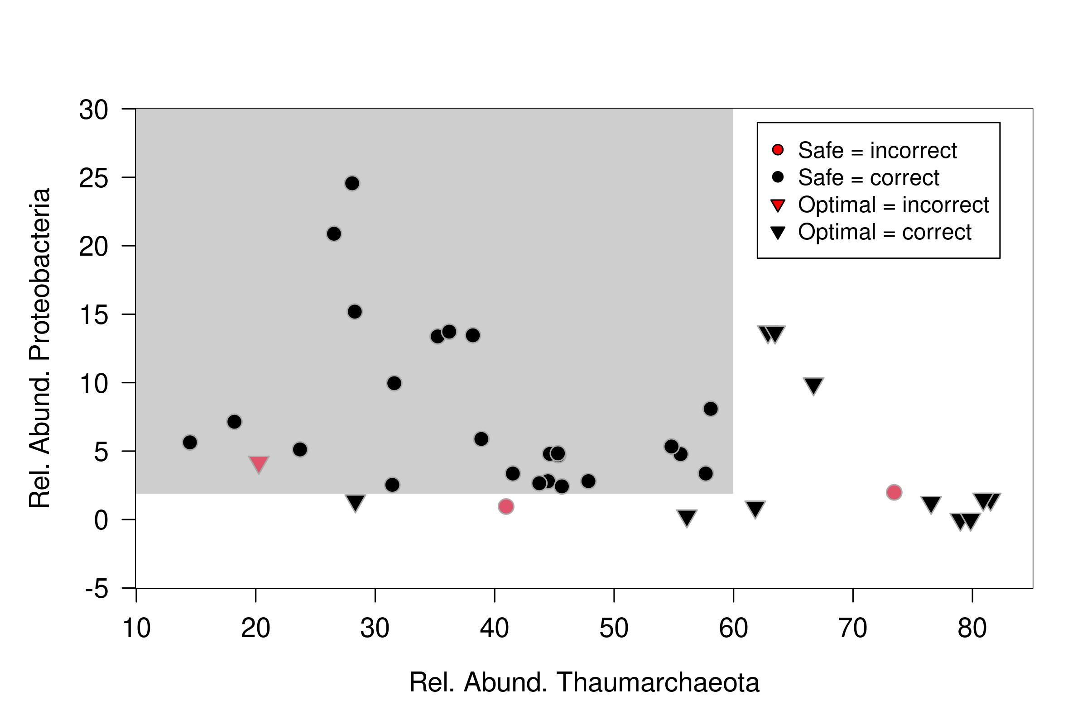
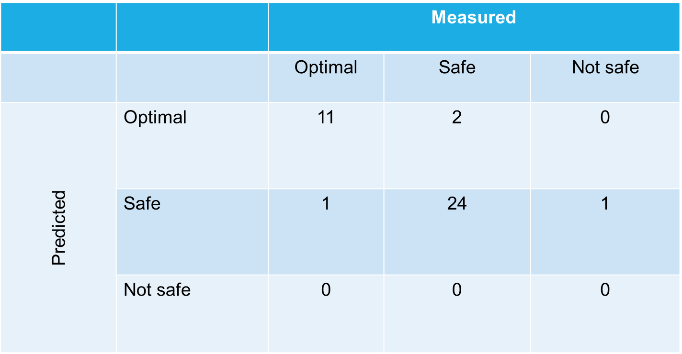
Confusion matrix (CART model)
Initial model predictions VERY simple
But…
Indicates it is possible to predict nitrate levels from microbial diversity data
Shows how well the tree made the nitrate predictions when groundwater dataset was classified according to Phyla (bacteria) present…
Safe
Optimal
Notes:
10.3 % incorrect

Slide 14
Cross validation (CART model)
Used to assess how well the model performs on unseen data
Split the data into two sets
Train and Test (90:10)
Training set - training and creating the model
Testing set - dummy production environment to test:
Predictions
Evaluate the accuracy of the model
RESULT:
Incorrectly classified 23.1 % of samples

Slide 15
Random Forest
Made up of multiple decision (CART) trees i.e. a “forest” of trees!
Trained with 1000 trees using the training dataset
Fit and assessed for classification accuracy - using apparent error rate
Identified number of times model got classification wrong
https://towardsdatascience.com/

Slide 16
Cross validation – unseen data
 | % correct classified | % incorrect classified
Random Forest | 89.5 | 10.5
CART tree | 76.9 | 23.1

Slide 17
Conclusions
Groundwater samples were classified according to Phyla (bacteria) and…
CART classification and Random Forest models:
Correctly predicted the nitrate classification… most of the time
Random forest had better prediction accuracy than tree model
Notes:
Random Forest is effectively a group of CARTs generating many random CART models while also taking a random selection of the variables provided to build each CART within the forest.
Because Random Forest is based on the CART method, it will give similar outputs to CART, but with differences. Therefore, it is unsurprising that both the CART classification and Random Forest models gave similar results in this study.
While the initial model predictions are straightforward, they indicate that it may be possible to predict nitrate levels from microbial diversity data. The subset data used in this study had limited groundwater samples with above MAV nitrate levels. The next step in this study is to test the entire dataset in CART and Random Forest and test groundwater samples with a more extensive range of nitrate concentrations. We are also investigating predictions of nitrate levels on a higher level of microbial diversity, e.g., genera, beginning to look at the other critical predictors for overall groundwater health and test the robustness of using these predictors over a range of regions across New Zealand. The aim is to continue testing machine learning platforms to ultimately develop an in-line sensor that could detect changes in the abundance of selected microbes to predict contamination of groundwater resources.

Slide 18
NEXT STEPS:
Expand current database - more geographic locations​
Test samples - wider range of nitrate levels (> 11.3 mg/L)
Prediction on higher level of microbial diversity e.g., genera
Identify more key predictors​ & test robustness
Develop an in-line sensor/probe
To detect microbes of interest that could predict contaminant presence
IMDB
Notes:
Random Forest is effectively a group of CARTs generating many random CART models while also taking a random selection of the variables provided to build each CART within the forest.
Because Random Forest is based on the CART method, it will give similar outputs to CART, but with differences. Therefore, it is unsurprising that both the CART classification and Random Forest models gave similar results in this study.
While the initial model predictions are straightforward, they indicate that it may be possible to predict nitrate levels from microbial diversity data. The subset data used in this study had limited groundwater samples with above MAV nitrate levels. The next step in this study is to test the entire dataset in CART and Random Forest and test groundwater samples with a more extensive range of nitrate concentrations. We are also investigating predictions of nitrate levels on a higher level of microbial diversity, e.g., genera, beginning to look at the other critical predictors for overall groundwater health and test the robustness of using these predictors over a range of regions across New Zealand. The aim is to continue testing machine learning platforms to ultimately develop an in-line sensor that could detect changes in the abundance of selected microbes to predict contamination of groundwater resources.

Slide 19
Acknowledgements
Funding: ESR Data Accelerator program:
Helping Scientists to use data science to analyse “BIG” data
Dr Louise Weaver (Science Leader) for doing the program with me
Bridget Armstrong and Dr David Wood for being amazing mentors
Thanks for listening!
https://wallpapersafari.com/
Getty Images/ Zane Chambers

Slide 21
A bit like the Star Trek Tricorder...​Sounds like fantasy BUT…
Portable qPCR instruments:
Liberty16 - (ESR) tested and compared performance to full-size lab qPCR instrument
Results: similar repeatability and sensitivity for the detection of targets in known and blind freshwater samples
BioFire FilmArray - Extracts DNA and performs qPCR amplification in the field to ID organisms present
Disadvantage – currently only one sample at a time
Star Trek
Reference: Craig Billington, Gayan Abeysekera, Paula Scholes, Paul Pickering, Liping Pang. (2021). Utility of a field deployable qPCR instrument for analyzing freshwater quality. Agrosystems, Geosciences & Environment. Vol 4(4)
BioFire Diagnostics; https://www.biofiredx.com/

Slide 22
Random Forest
The Out of Box (OOB) estimate of the error for the Random Forest model was 12.82 %
Notes:
Predictions using Random Forest.
Circles indicate groundwater below MAV, red = incorrect prediction, black = correct prediction
The triangles indicate pristine groundwater. Black indicates when our prediction was correct looking at Proteobacteria and Thaumarchaeota present and red colour indicates when our prediction was incorrect.
Grey area, where predictions should fall if below MAV
White area, where predictions should fall if we have pristine gw
RF correctly predicted 83% of pristine gw and 96% of below MAV nitrate levels.

Slide 23
STUDY AIMS:
To model microbial diversity with water & field chemistry using:
Predictive modelling tool - Random Forest
To find key organisms that could predict contaminant presence
https://water.unl.edu/
Questions:
1. Can microbial diversity be used as an early warning of upcoming changes in water quality?
2. To see key organisms be used to produce a real-time device to measure groundwater BEFORE it is used…

