Slide 1
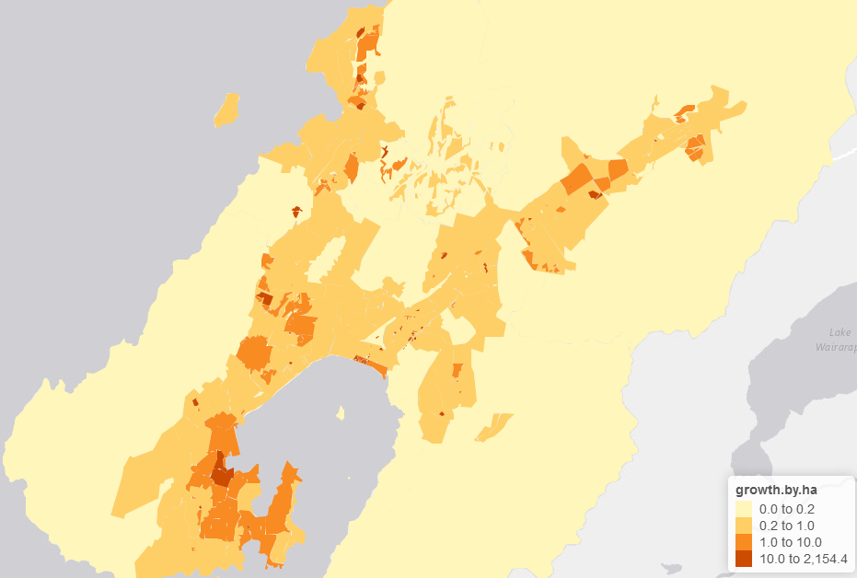
Wellington Water
NPSUDC
Water Supply

Slide 2
We assessed if the current infrastructure has enough capacity for the forecasted population growth and we developed some useful tools along the way.
Notes:
Storage and network, present to 2047. Storage based on guidelines. Network based on modelling, minimum pressure only.

Slide 3
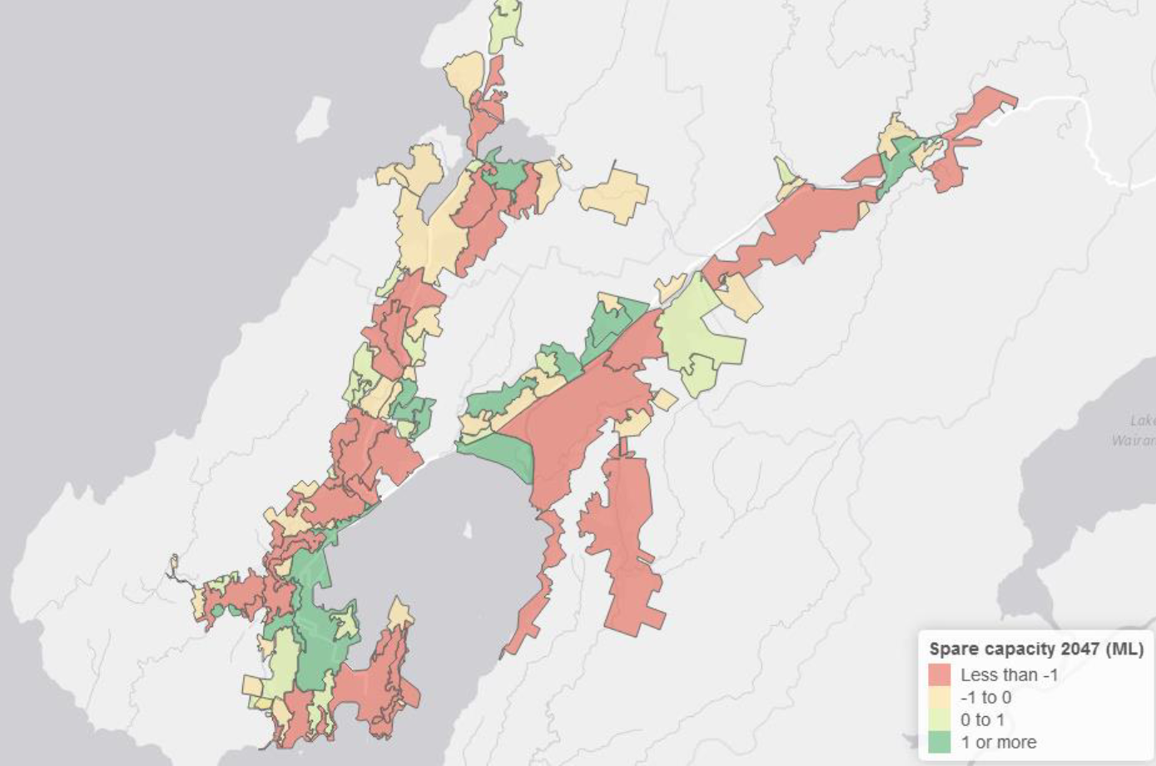
Spare Storage (2047)
Interim results for illustration only

Slide 4
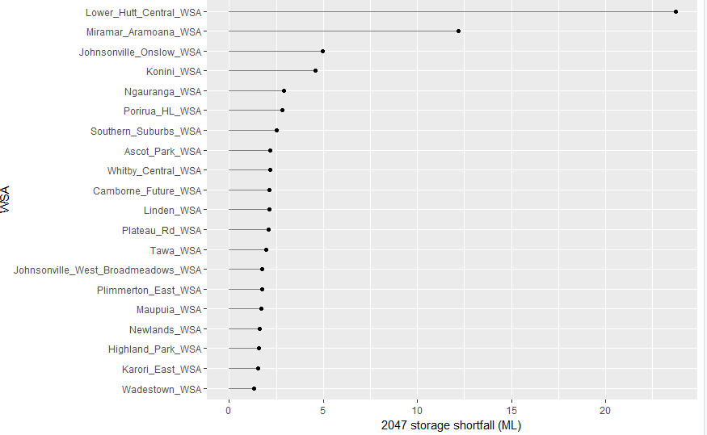
Storage shortfall (2047)
Interim results for illustration only

Slide 5
SCADA flow
Function sets
Current PDD/dwelling
Previous demand analyses
Current ADD/dwelling
Existing and planned storage
Night flow
Current leakage
Storage assessment
Meters shapefile
Current commercial demand
Present and future storage requirements
Billing data
SGA
Future dwellings
Current dwellings
Development sites
Future population
Dwelling and population forecast

Slide 6
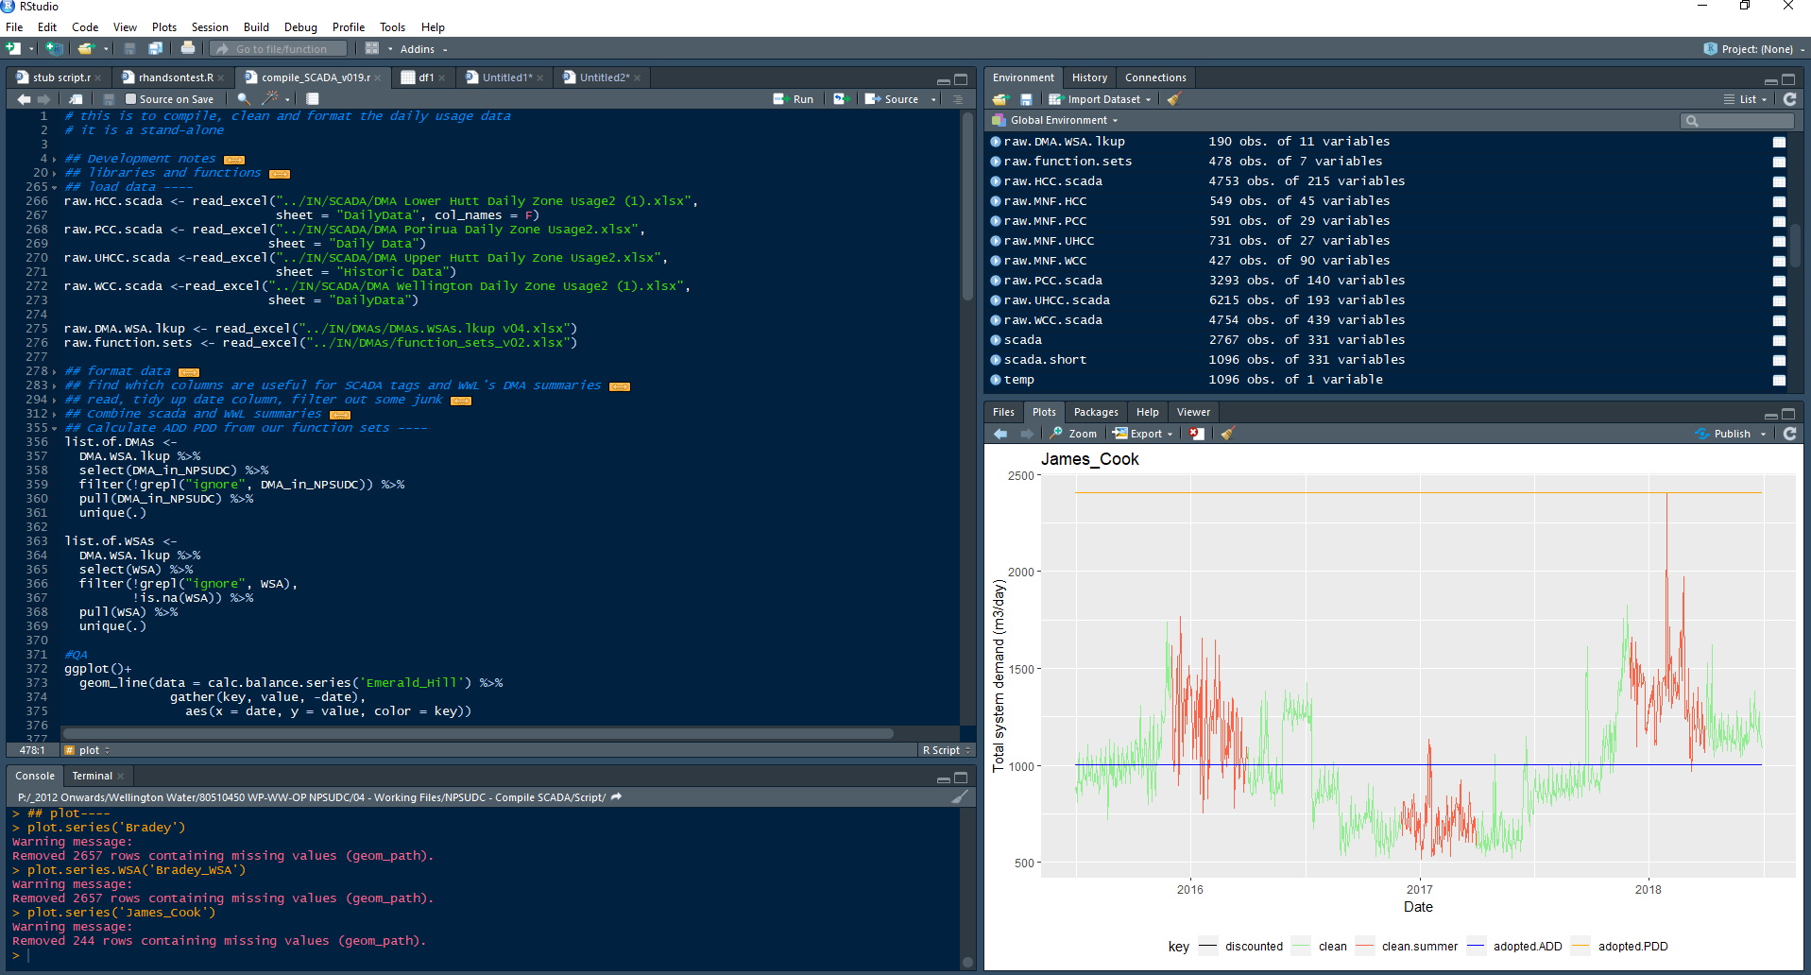

Slide 7
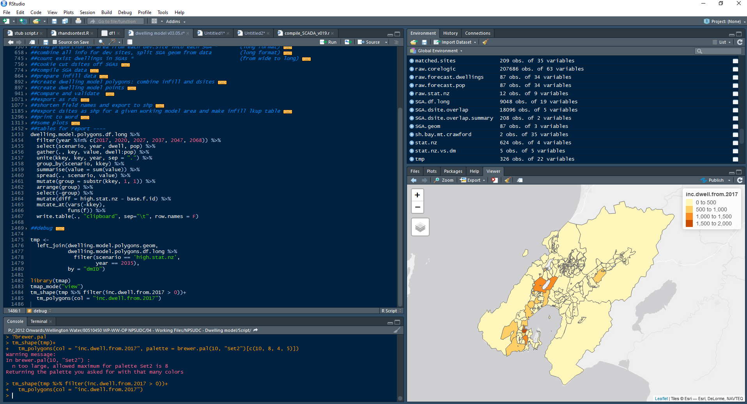

Slide 8
Dwelling Model

Slide 9
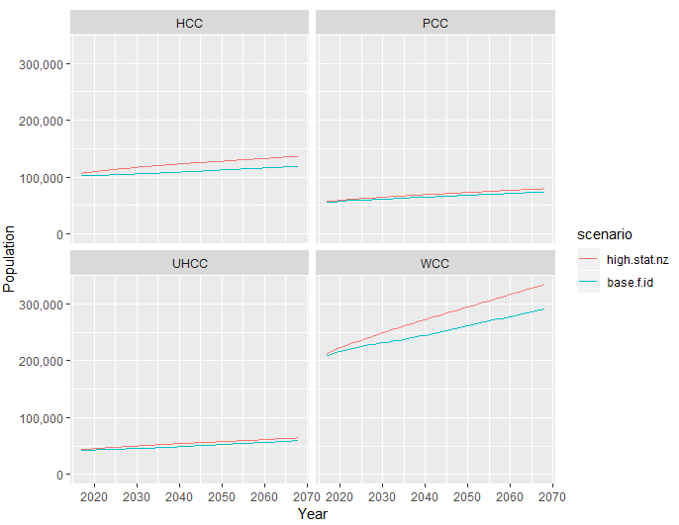
Dwelling Model

Slide 10
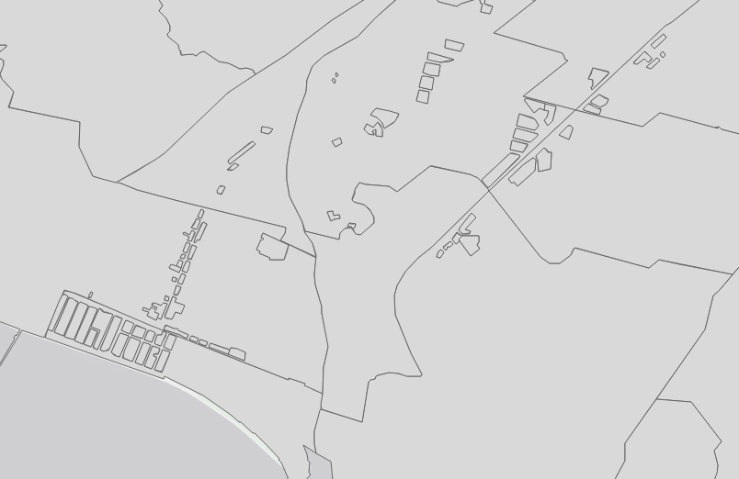
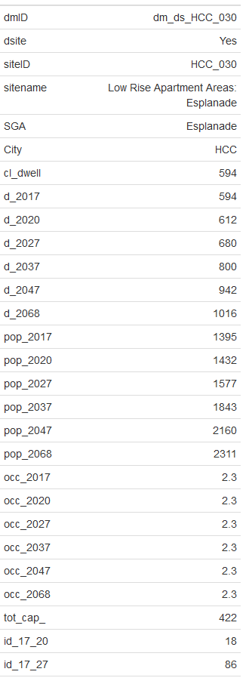
Dwelling Model

Slide 11
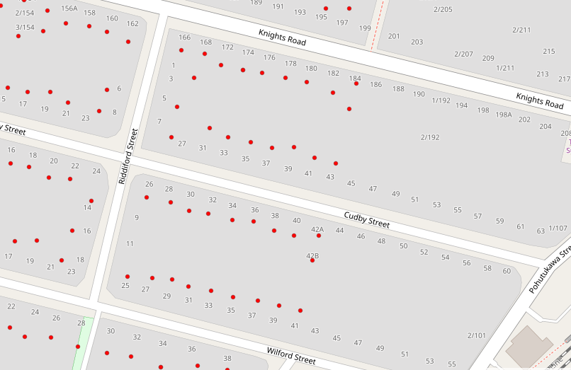
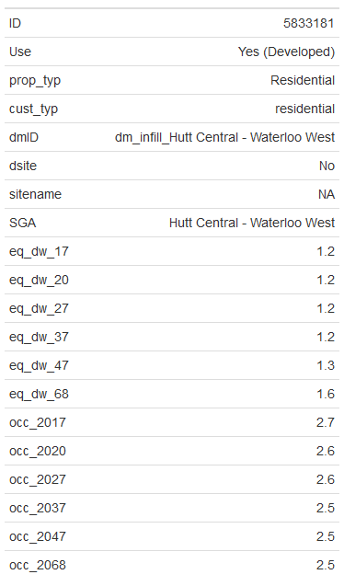
Dwelling Model

Slide 12
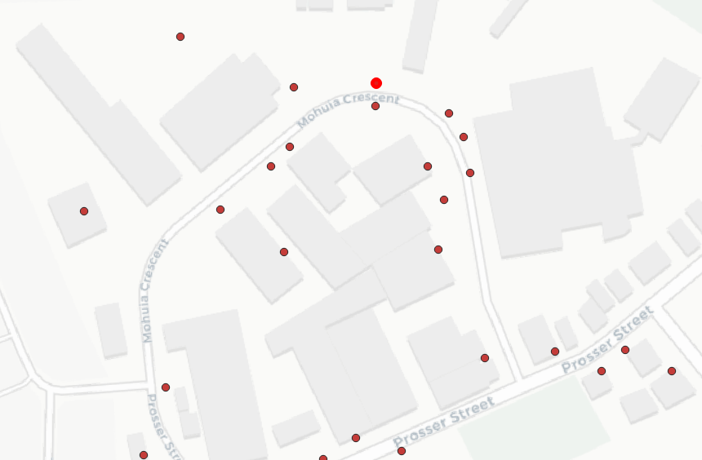
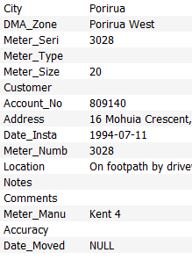
Metered Customers

Slide 13
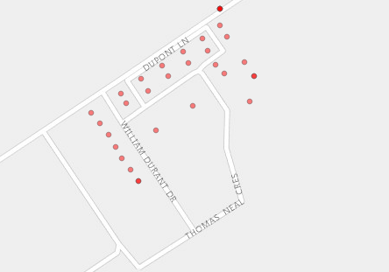
Metered Customers UHCC
Geocode

Slide 14
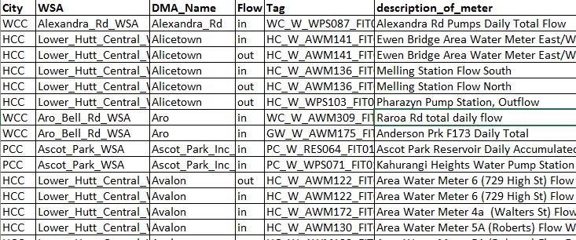
Demand Analysis

Slide 15
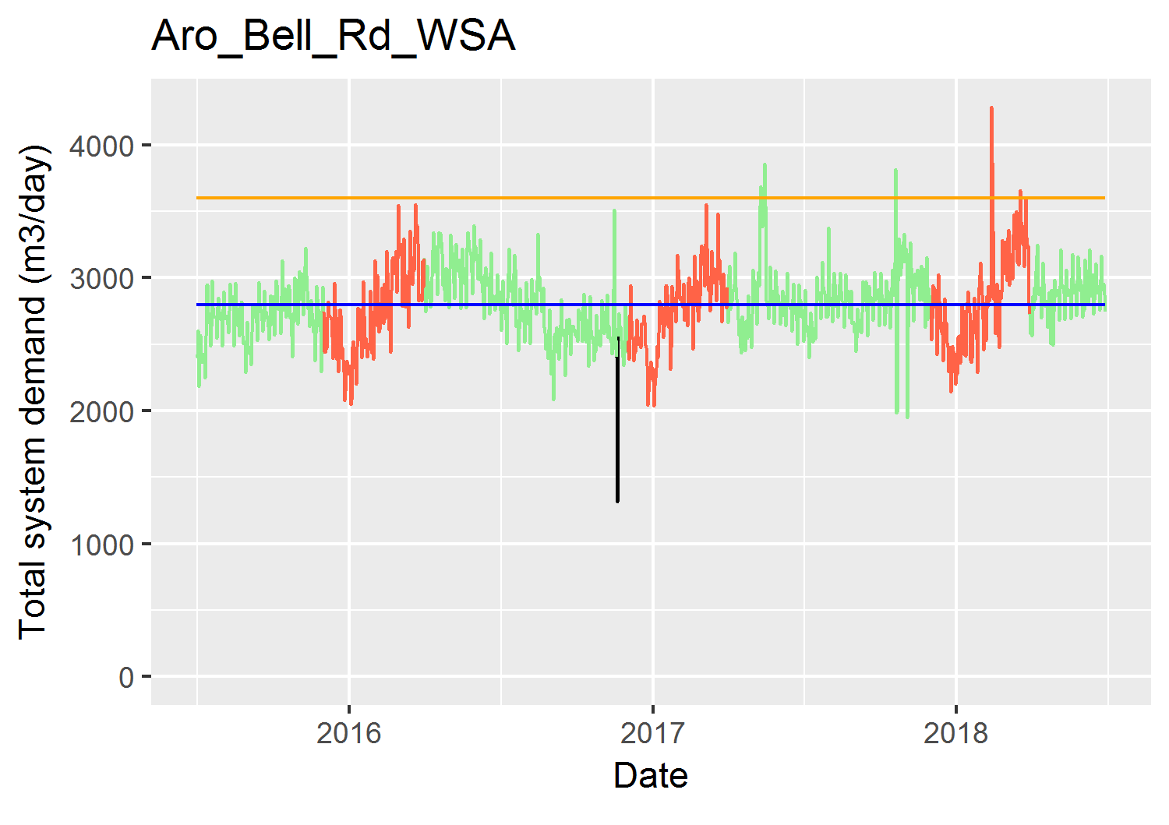
Demand Analysis

Slide 16
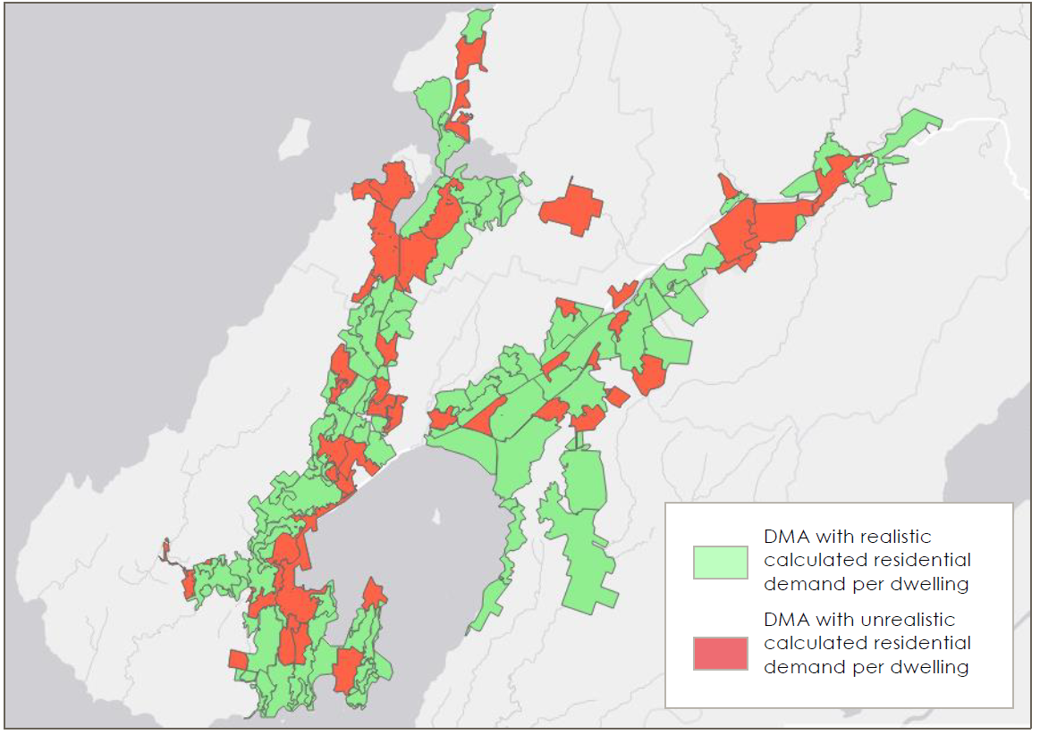
Demand Analysis

Slide 17
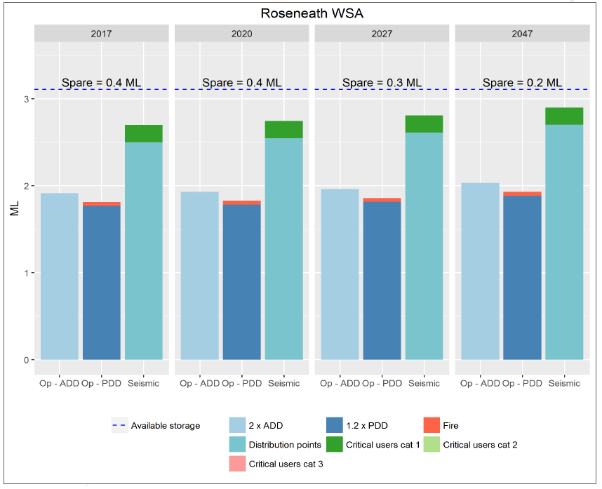
WSA Assessment

Slide 18
SCADA flow
Function sets
Current PDD/dwelling
Previous demand analyses
Current ADD/dwelling
Existing and planned storage
Night flow
Current leakage
Storage assessment
Hydraulic model
Meters shapefile
Current commercial demand
Present and future storage requirements
Billing data
SGA
Future dwellings
Current dwellings
GIS
Development sites
Future population
Dwelling and population forecast

Slide 19
SCADA flow
Function sets
Current PDD/dwelling
Previous demand analyses
Current ADD/dwelling
Regional demand analysis
Night flow
Current leakage
DMA / telemetry validation
Meters shapefile
Current commercial demand
Network and reservoir planning
Billing data
SGA
Future dwellings
Current dwellings
Development sites
Future population
Dwelling and population forecast

Slide 21
Thank you

