Slide 1
DELIVERING THE DESIRED BENEFITS OF WATER REFORM THROUGH PROGRAMME MANAGEMENT
WaterNZ Conference, Christchurch 2022
Grant Cooper and Alan Mackintosh
Notes:
E nga Mana,
E nga waka,
E nga reo,
E Rau Rangatira Ma
Tena Koutou, Tena Koutou, Tena Koutou katoa
Thank you so much for the kind introduction….
My name is Grant Cooper and it’s a pleasure to be able to speak to you today on the subject of Programme Management, specifically how the desired benefits of water reform could be best delivered by adopting a programme management approach.
Over the course of the next thirty minutes or so Alan and I will share our thoughts based on our collective experience working with multiple water entities across the UK and Australia.
I’ll begin by exploring an opportunity for the Crown to adopt a programme management approach by developing a single set of objectives and benefits to set the water companies up for success, while Alan will share lessons learnt from his experience of initiating and delivering major capital programmes in the water sector

Slide 2
What is programme management and why is it an important concept for delivering the benefits of water reform?
Strategy
Organisations
Define
Objectives
Organisational focus areas
Identify & define
Portfolios
Align with
Identify & define
Programmes
…are primarily focused on delivering…
Benefits
The measurable improvement resulting from the outcome(s)
Outcomes
The effect attributable to the output(s)
Identify & define
Are platforms for the delivery of
Projects
…are primarily focused on delivering…
Outputs
Delivery
Product, service or facility delivered
Notes:
So, what is programme management and what value can it add to water reforms
Fundamentally Programme Management connects strategy and delivery
Programmes ensure that what is being delivered at the project level aligns with the objectives set at the organisational level.
Programmes are therefore primarily focused on delivering the outcomes and benefits that align with the organisation’s objectives.
In much the same way that an organisation’s Board will ask two fundamental questions each time they meet. Those being
How are we progressing against our strategy, and
Do we still have the right strategy
…a Programme Manager will ask themselves two similar questions
How are we progressing against our benefits, and
Do we still have the right benefits
As a programme manager my primary currency is benefits
My interest is not so much in building things. I’m far more interested in building the right things
In this respect benefits management is a key tool in the Programme Managers toolbox
A successful programme will identify the right benefits and stay true to them, keeping in mind that a benefit is only a benefit if it aligns with the organisation’s objectives
Viewing water reforms through this lens, it’s not a huge leap of faith to contend that benefits management will play a significant role in determining whether or not the water companies deliver on their objectives, and by extension whether or not the reforms will be success.

Slide 3
What is programme management and why is it an important concept for delivering the benefits of water reform?
Crown
Define
Identify & define
Strategy
Organisations
Objectives
Organisational focus areas
Identify & define
Portfolios
…and…
Identify & define
Programmes
…are primarily focused on delivering…
Benefits
The measurable improvement resulting from the outcome(s)
Outcomes
The effect attributable to the output(s)
Identify & define
Are platforms for the delivery of
Projects
…are primarily focused on delivering…
Outputs
Delivery
Product, service or facility delivered
Notes:
So this is where our model becomes interesting. Our expectation is that guidance will be provided to each Chief Executive in the form a Ministerial Letter of Expectation or similar
The question at this point becomes how much autonomy should the Water Companies have in developing their own strategic objectives, based on this guidance, and expressing these in terms of benefit statements that will resonate with customers
Or should the Crown be prescriptive in specifying the strategic objectives and desired benefits for each water company?
Our developing position is that, notwithstanding important local consideration that will influence how things will be delivered, the Crown should grasp the opportunity to provide consistent guidance across the 4 water companies, prescribing the why, articulated as common objectives and desired benefits captured in essentially facsimile Letters of Expectation to each WSE Chief Executive.
This approach recognises that fundamentally customers should expect to receive the same level of service, regardless of location.
Implementing common benefits, with common measures and KPIs, across the country will also support transparent performance reporting providing further comfort to customers.

Slide 4
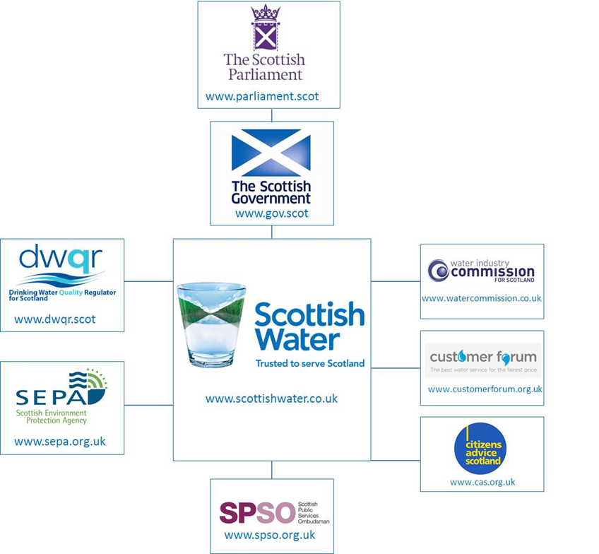
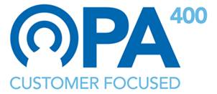
Scottish Water benefited from the strategic direction provided by Ministers and the benefits framework embedded within the OMG, OPA, OMD and CEM
The Output Monitoring Group (OMG) is responsible for monitoring the delivery of Ministers’ objectives. Chaired by the Scottish Government. Attending by SEPA, DWQR, WICS, Commission, the Consumer Futures Unit, the Scottish Public Sector Ombudsman (SPSO) and Scottish Water
Output Monitoring Group
Overall Performance Assessment: Asset Performance (Water and Wastewater) and Customer Service (service-level related measures)
OMD
Overall Measure of Delivery: Delivery Performance (Earned Value based measure)
Customer Experience Measure: Measure of Scottish Water’s interactions with customers
Notes:
As it happens there is precedent for such an approach, both internationally in the water sector and locally in the disaster recovery and regeneration sector here in NZ. In fact, the fabulous facility we’re all currently enjoying was delivered under such an arrangement, But more on that later.
To the international experience.
In the UK, the Economic regulators in England and Wales and Scotland implemented a number of composite measures that drove water company decision-making and investment prioritisation. These composite measures initially focused on asset performance and customer service (in the form of the Overall Performance Assessment or OPA) and delivery performance (in the form of the Overall Measure of delivery or OMD).
These two early measures would later be supplemented in Scotland by the Customer Experience Measure or CEM which reinforced Scottish Water’s commitment to placing the customer at the heart of decision-making. I recall during my time with Scottish Water that meetings would often end with an agenda item asking “how do the decisions made here today benefit our customers?” You can imagine how effective this statement was in keeping both the benefits and the customer front of mind.
The Output Monitoring Group (OMG), chaired by the Scottish Government, was also established to monitor the delivery of Ministers’ objectives, providing an element of governance over Scottish Water’s performance
Collectively these measures hugely influenced, if not determined, Scottish Water’s strategic direction and desired benefits.
This is a good example of an approach that had evolved over a period of time.
For NZ Water reform there’s a great opportunity to implement a similar framework from day one

Slide 5
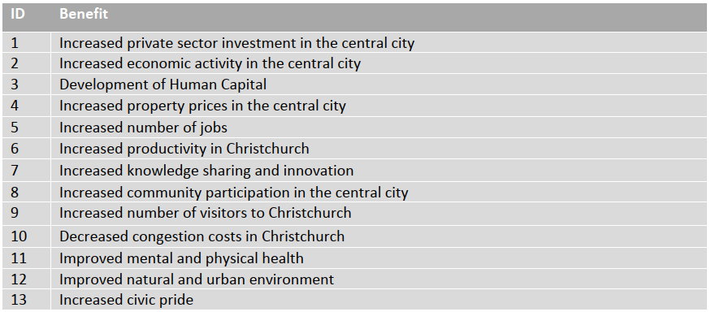
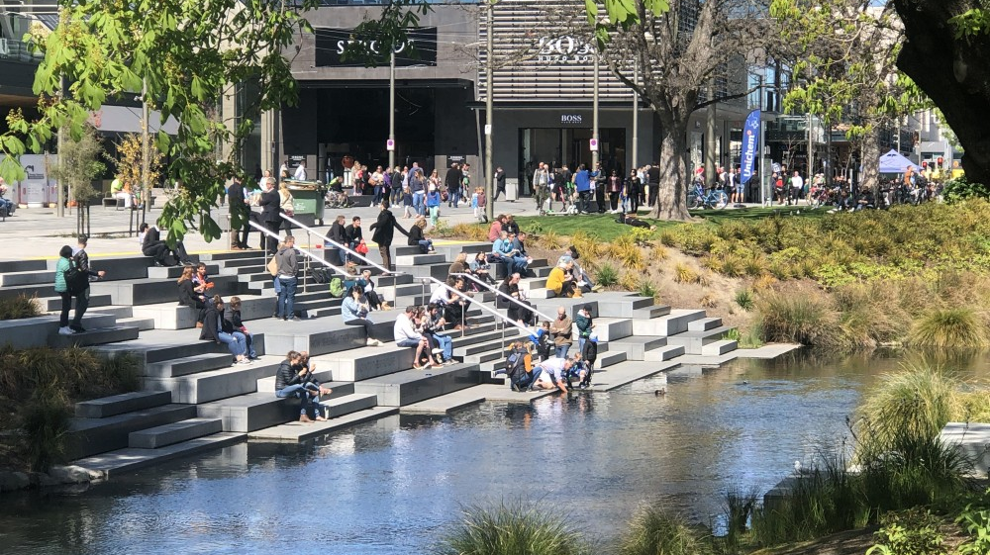
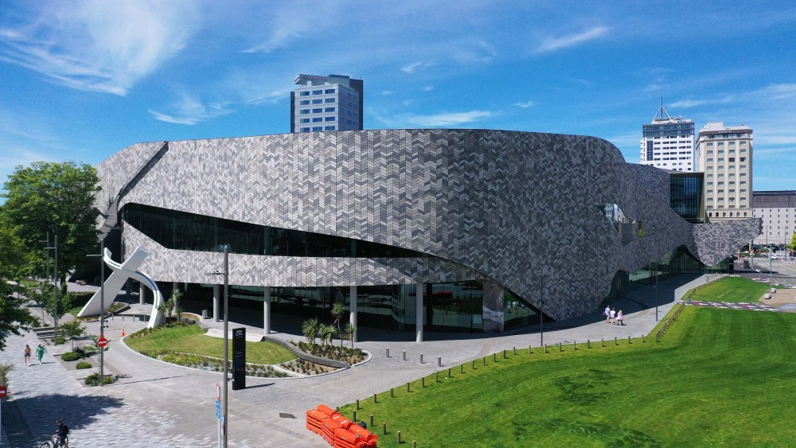
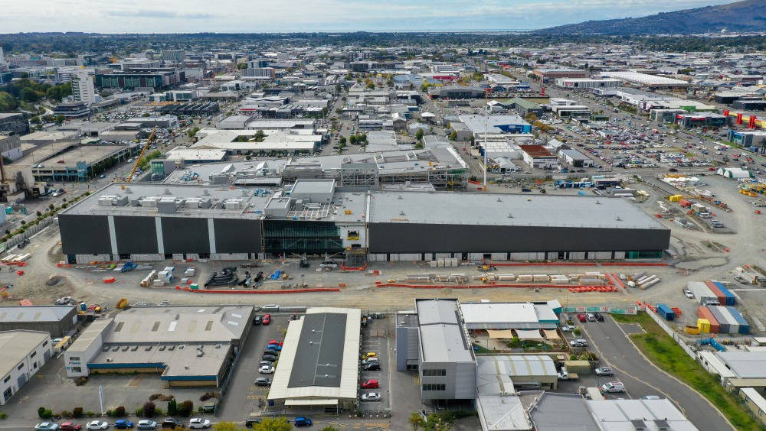
Ōtākaro Ltd benefited from the strategic direction provided by Joint Minsters and the benefits framework provided by the Central City Recovery Plan
Notes:
The other, more local example relates to our very own Otakaro Ltd, which, as the successor organisation to CERA, was tasked with completing delivery of the Crown-funded anchor projects.
Established as a schedule 4a company, Otakaro’s objectives were set by Joint Ministers via a letter of expectation, and the desired benefits were specified by the Christchurch Central Recovery Plan.
The CCRP was remarkably balanced in its approach covering the full range of wealth factors – Financial and Physical Capital, Natural Environment, Social Cohesion and Human Capability
One of the keys to success for Otakaro was embedding benefits management within their delivery framework.
Benefits were not simply something you referred to at business case stage and then again at completion.
Instead they were reported on throughout delivery providing regular assurance that the identified initiatives were delivering the planned benefits
As an example ….
This is a good example of a heavily prescribed approach paying dividends

Slide 6
The Living Standards Framework provides a ready made objective set from which a national set of water reform benefits could be derived
Improved network resilience/ redundancy
Improved asset reliability
Reduced environmental impact
Improved access to Three Waters services
Improved operational efficiency
Government Policy Statement
Financial and Physical Capital
Wealth of Aotearoa New Zealand
He Ara Waiora
Improved capital efficiency
Natural Environment
Improved catchment management
Social Cohesion
Improved customer experience
Human Capability
Improved security of supply
Improved drinking water quality
Living Standards Framework
Improved watercourse/ waterbody health
Increased Innovation
Improved knowledge share
Notes:
Which brings me to my last thought starter, if the Crown is to provide direction, what is the most appropriate framework for deriving objectives and a national set of benefits.
Having operated under a number of different frameworks, including the Six Capitals, in the UK, Australia and here, the Living Standards Framework stands out (to me) as a great starting point for developing a water-sector specific framework, from which water company objectives and benefits could be derived
Overtly aligning with the Living Standards Framework would appear to be appropriate given the scale of investment and the significant impact that reforms could have across all four wealth factors.
As a programme manager who has worked on nationally significant programmes, one of the great frustrations has always been the absence of a NZ Inc benefit set.
The LSF goes some way towards addressing this gap.
No-one’s going to defend it as complete for the purposes of water reform but it’s a great place to start.
The emphasis for each programme will be different water reform certainly has the potential to shift the dial significantly on the Financial, physical, natura environment and Human capability wealth factors
It will continue to evolve over time, as will our appreciation of what drives improvements in well-being.
Investing in development of a Government Policy Statement on Water will help translate these wealth factors into desired benefits.
Whatever the future iterations of the living standards framework, it’s hard to imagine a scenario where the investment in the water sector over the next 30 years will provide anything but opportunity to materially shift the dial of the wealth of Aoteraoa New Zealand.

Slide 7
BUILDING AND EXECUTING THE CAPITAL PROGRAMME

Slide 8
Building the programme
Providing continuous high quality drinking water
Investing in future water services
Protecting and enhancing the environment
Supporting New Zealand’s economy and communities
Customer engagement
HIGH
Long term interruptions to water supplies
Drinking water quality
Internal flooding
External flooding
Short term interruptions
Visible leakage
MEDIUM
Sewer maintenance
Customer service
Carbon emissions
Business price issues
Taste and odour
Pollution incidents
Bathing water quality
Discolouration
LOWER
River water quality
Iron works/covers
Low pressure
Communication
Odour
Examples of customer priorities
Notes:
Building an evidence-led capital programme where the benefits framework is clearly defined is one of the key outputs from the WSEs’ business planning process.
involving customer targeted activities, speaking with customers to find out what they think, listening to their views and building these into its plans

Slide 9
Our experience and industry research shows that programs tend to fail due to organisational rather than technical reasons
Ill-defined strategy, governance, and procurement during initiation/planning phase
Poor decision making
Failure to understand and
manage risk and uncertainty
Lack of committed leaders and organisational capability
Inadequate understanding and management of stakeholders
Lack of supply chain integration and coordination
Causes of poor programme performance¹
¹ What are the causes and cures of poor megaproject performance? A systematic literature review and research agenda; Denicol, Davies and Krystallis, 2020
Notes:
There has been a significant amount of research into the challenges faced by major infrastructure programs, from government audits to surveys and academic studies. AECOM has team with University College London’s Megaproject Delivery Centre, and their director, Dr Juliano Denicol, and their research backs up the real life experience of our team of senior program professionals who believe that the causes of program failure (and many do fail or face significant challenges) is rarely technical and usually organisational by nature.
There are a great deal of very clever engineers and other technical experts who will find a solution, only if they have the right organisational environment in which to operate. We will discuss some aspects of this later in the discussion, but I have a number of personal examples to illustrate this point.

Slide 10
Features of successful programme management
Articulation of the Delivery Strategy to achieve critical Programme outcomes
Definition of the future commercial and operating model for the assets
Development of the Delivery Model and Organisation Design
A defined Initiation to build the team and playbook for successful delivery
Integrated digital systems to support timely decisions
Performance management to connect delivery to outcomes
Development of Sustainability and ESG components for the programme and its assets
Collaboratively developed Programme Management Plan to provide the rule book for delivery
Lifecycle stakeholder engagement from concept to operations
Technical expertise for future-looking, best-in-class guidance
An integrated supply chain to increase certainty of delivery
Notes:
Given what that academic research - supplemented by our own internal experiences - tells us, we’ve defined the core components in the AECOM Way of program management to ensure the best possible chance of delivering program success.
There are 11 core components that encompass this, covering a range of items, that you can see here. Each component will have a differing level of emphasis depending on the nature of the program, the stage in the lifecycle, and the regulatory and market environment it sits in. This should be seen as a toolkit to draw on – addressing the unique needs of each program. They are all different.
Understanding the relative importance and status of each of these components is critical, which is why we refer to a Program Maturity Assessment, a flexible and agile means to establish an organisational baseline on which to plan for future phases of the program in a prioritised and focussed way.

Slide 11
Building confidence in Water Reforms
The Delivery Strategy feeds the Delivery Model and Organisation Design
Articulation of the Delivery Strategy to achieve critical Programme outcomes
Definition of the future commercial and operating model for the assets
Development of the Delivery Model and Organisation Design
A defined Initiation to build the team and playbook for successful delivery
Integrated digital systems to support timely decisions
Performance management to connect delivery to outcomes
Development of Sustainability and ESG components for the programme and its assets
Collaboratively developed Programme Management Plan to provide the rule book for delivery
Lifecycle stakeholder engagement from concept to operations
Technical expertise for future-looking, best-in-class guidance
An integrated supply chain to increase certainty of delivery

Slide 12
Enabling Water Industry Transformation
Laying the groundwork through programme management
Creating Water Industry of tomorrow
Standardisation
Process Improvement
Technology adoption
Lower tolerance of failure
Knowledge sharing
Integration & collaboration
Building Trust
Benefits Management
Experimental
Innovative
Technology development
Knowledge creating
Knowledge exploiting
Accelerated learning
Disruptive
Recognise different mindsets
and skillsets – attract talent
Transformation

Slide 13
Thank you.

