Slide 1
Colin Roxburgh
total coliforms in public water supplies: case studies in the pursuit of elimination
Waimakariri District Council

Slide 2
My Background
Local Government engineer for 15 years
Water Asset Manager for 6 years
Have experienced first hand benefits of both good and bad water supplies from a young age
My passion is to ensure everyone receives safe and reliable water

Slide 3
Presentation Overview
Background in the use of total coliforms as part of water supply management
Changes following the Havelock North contamination event
Determination of an appropriate target for total coliform levels
Necessary management tools to enable the adoption of an ‘elimination strategy’
Case studies:
Woodend
Kaiapoi
Conclusions
Future projections

Slide 4
Background
Prior to Havelock North, total coliforms were given very little attention, and their relevance discounted as there was no maximum acceptable value
Post this event, a clear conclusion was that they are a vital pre-cursor to an event, that could have led to earlier interventions.
This realization led to an evolution over the coming years in the way they are used.

Slide 5
Determination of an appropriate target level
With the realization that total coliforms should be paid attention to, the next question is what level should be an appropriate target.
First step was simply to start observing data and looking at patterns
No common open public data source to allow comparison with others, at least within New Zealand
Some international publications provided some guidance, or at least published figures.
AWWA (American Water Works Association) referenced levels in US of no more than 5% of samples with coliforms, Health Canada no more than 10%
DANVA (Denmark) have an annual publication (Water in Figures) which gives “microbiological incidents per 1 million m³. Very difficult to compare.
Ultimately the conclusion is only a target of zero detections makes sense. A zero baseline makes the detection of changes far easier.

Slide 6
Case Study 1: Woodend Water Supply
This supply historically had coliform detections within about 20% of samples, with levels around 1 – 2 per 100mL.
This had been attributed to a biological manganese removal filter creating a living (but non-pathogenic) treatment process, allowing coliforms to exist, making them a lot less useful as an indicator organism.
They were still tracked, but previously the regular low level detections were accepted as part of the normal baseline.
In 2022, a key reservoir was being repaired (while online) following inspection, and during this process a detection of 40 coliforms per 100 mL was found.

Slide 7
Case Study 1: Woodend Water Supply
Initial Response
Following the high detection, an immediate meeting was held to consider the response:
IRP reviewed
Emergency chlorine implemented in parallel with comprehensive sampling
Instant communications with community (E-text / email, Facebook, elected members, front counter staff).
When sampling results came through, cause was able to be better understood.

Slide 8
Case Study 1: Woodend Water Supply
Source
Filter
Reservoir (Pegasus Res)
Transfer Line
Woodend Res
Woodend Retic
Repair, drain, sterilise, flush
Close Valve
Close Valve
Pegasus Res B
Pegasus Retic
Open Valve

Slide 9
Case Study 1: Woodend Water Supply
Source
Filter
Reservoir (Pegasus Res)
Transfer Line
Woodend Res
Woodend Retic
Resample
Open Valve
Open Valve
Pegasus Res B
Pegasus Retic
Close Valve

Slide 10
Case Study 2: Kaiapoi Water Supply
History:
High quality artesian sources supply scheme from two headworks.
Generally low levels of coliforms, with only occasional detections. Did have some frequent ‘presence’ detections back in 2017, but after scheme flushing these went away.
Reports were that historical detections were due to some build up in pipework that were removed by flushing.
2022 Event:
Coliforms detected at greater than any previous levels (> 20 per 100mL).
Flushing initially undertaken, followed by re-sampling, assuming a similar pattern to 2017 would follow with these levels then dropping again.
Instead, sampling during and immediately after flushing had even greater levels of coliforms.
This was not expected, and it was clear a different response was needed.

Slide 11
Case Study 2: Kaiapoi Water Supply
Response:
Meeting held with asset management, senior managers, operations team, and operators.
Unexpected repeated high coliform counts resulted in emergency chlorination systems being implemented.
In parallel with chlorination system being implemented:
System split in two with strategic valve closures (to isolate south and north parts of network)
Comprehensive scheme sampling (to collect data just before chlorine entered reticulation). This including samples from a number of fire hydrants, not just normal sample points.
Scheme wide communications including elected members, Facebook, front counter and website information.
Expert drinking water specialist advice sought.

Slide 12
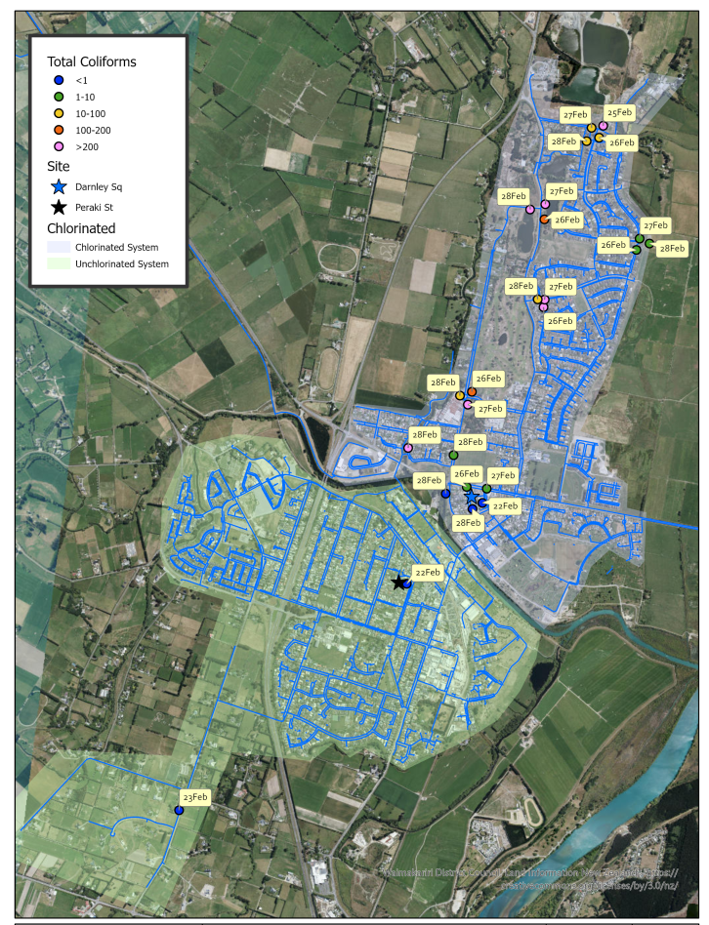
Case Study 2: Kaiapoi Water Supply
Results of sampling and investigations:
Water quality leaving headworks remained good
Coliforms were detectable at high levels within the reticulation
Adequate pressure maintained.
No likely sources of backflow identified.
No major maintenance events, review of ‘cut-in’ hygiene forms looked good.
There had been a fire event, but still adequate pressure.

Slide 13
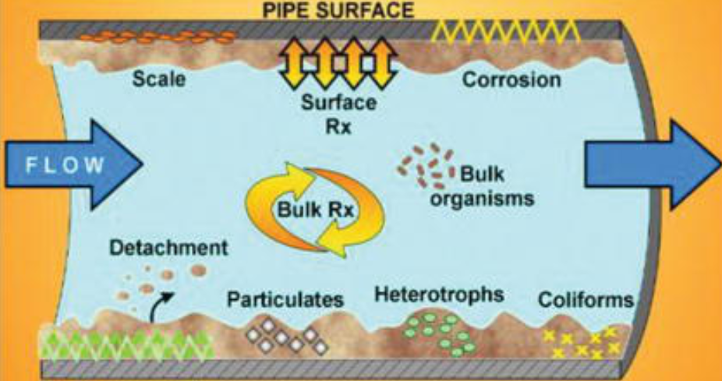
Case Study 2: Kaiapoi Water Supply
Source of coliforms:
Biofilm thought likely source, with no other plausible theory.
Expert advice obtained suggesting very unlikely to be parthenogenic.
Management of issue:
Continued chlorination undertaken, at increased dose, with intensive flushing, to scour out biofilm.
Chlorine then carefully removed, with intensive sampling.
All coliform detections ceased, and about 6 months of very good sampling achieved.

Slide 14
Case Study 2: Kaiapoi Water Supply
Next steps:
After the initial success of the biofilm chlorination and flushing, detections have returned.
Further chlorination has taken place, as well as the introduction of more sophisticated monitoring systems:
Genetic analysis of the water, to be absolutely sure about the source. First results confirm non-pathogenic.
Continuous monitoring equipment to be installed in the reticulation system
Continuous high intensity pressure transient loggers being installed
The above will provide greater certainty about the precise source of the detections, and real time ability to respond to any changes.

Slide 15
Conclusions
Response
In both cases, the response benefited from:
Alerting systems of water quality results
Incidence response plans to provide guidance
Collaborative relationship with operators and internal staff to rapidly workshop a response.
Good system knowledge of operators, able to quickly change the operation of a scheme to ensure the rapid introduction of chlorination, and collection and processing of sample results.
Differences
Woodend followed a more traditional path, where an issue was identified, fixed, and the issue resolved.
Woodend also showed that low level detections should not be tolerated, with a zero tolerance possible even with schemes with traditionally regular detections.
Kaiapoi was more complex, requiring a more complex long term response.
Both cases showed the benefit of coliforms in highlighting issues other parameters could not (i.e. turbidity, pH, conductivity, and FAC levels gave no indication of a change), BUT;
Ultimately, the Kaiapoi event also showed the limitation of coliforms with more complex events, but also the potential of new emerging technologies.

