Slide 1
Kevin Werksman, Managing Director – Water, Aurecon
USING THE CIRCULAR ECONOMY
POTENTIAL PATHWAYS
GOULBURN VALLEY, VICTORIA, AUSTRALIA

Slide 2
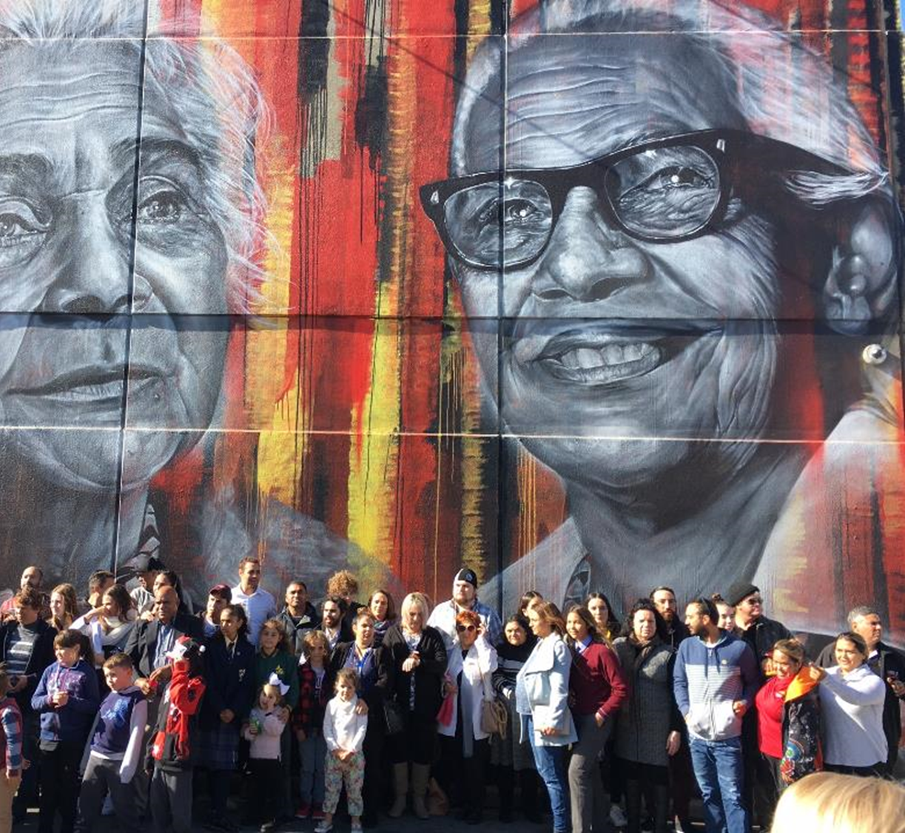
Acknowledgement of Country

Slide 3
A powerful collaboration to bring circular economy to life

Slide 4
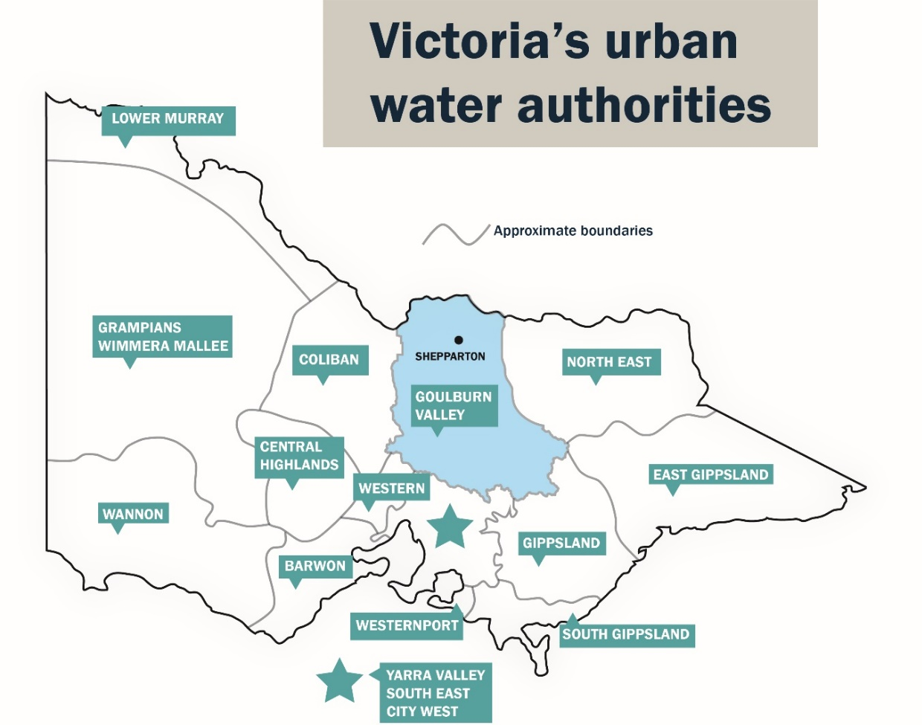
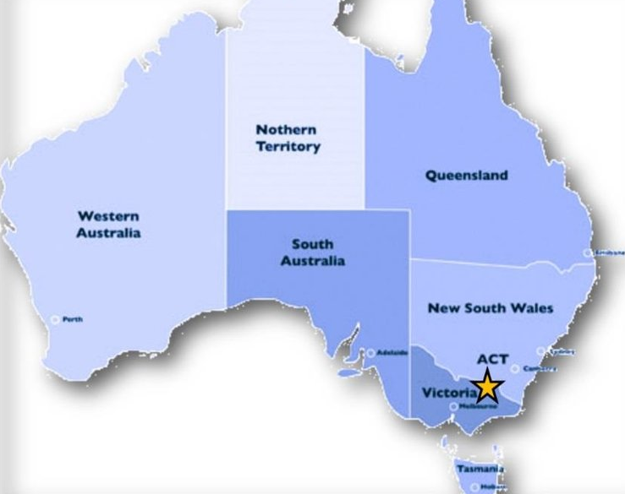
Goulburn Valley Background

Slide 5
$75m turnover
Lowest typical bills in Australia (BOM)
Large and diverse asset base $1b
Service population of approx. 130,000
Service many major industrial customers
Goulburn Valley Background

Slide 6
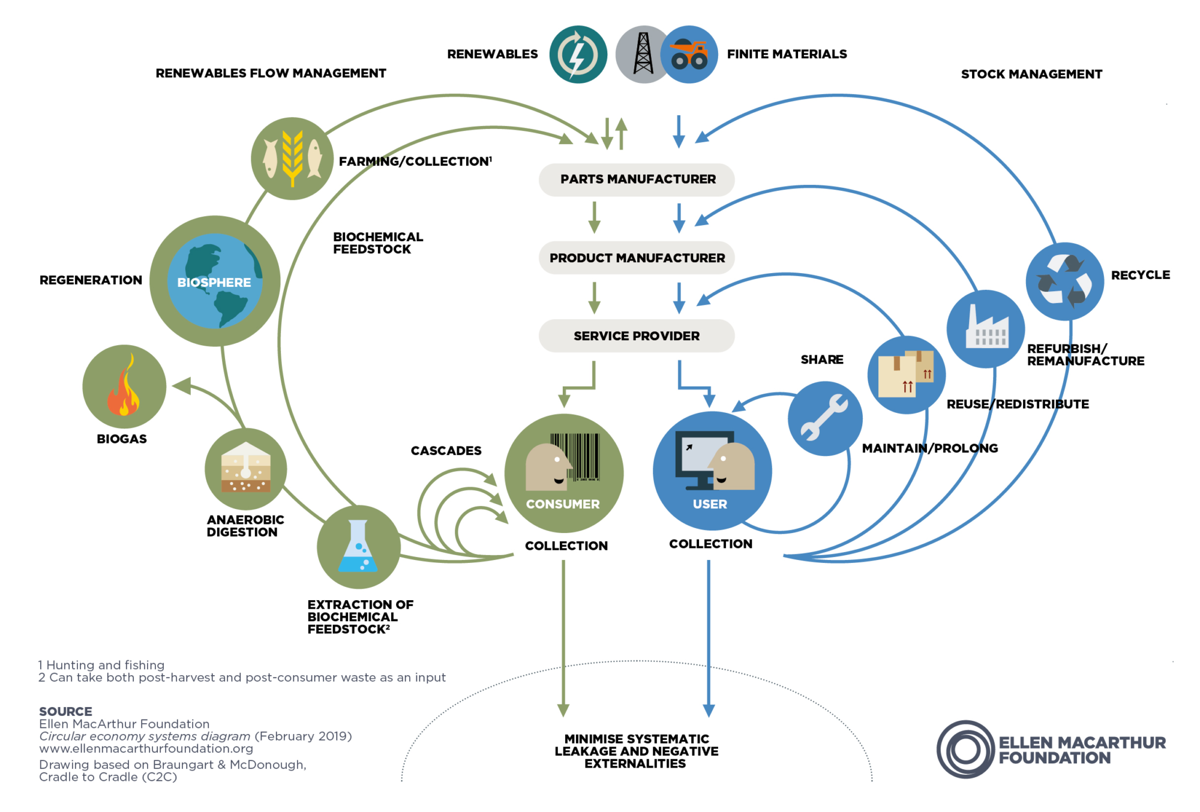
Defining the Circular Economy
Maintain the value of materials for as a long as possible by:
Designing out waste and pollution
Keeping products and materials in use for as long as possible
Regenerating natural systems

Slide 7
The Circular Economy incorporates 8 Sustainable Development Goals

Slide 8
An organized, collaborative and aspirational community transition to a low carbon, circular economy
Regional prosperity – benefit existing and attract new business
Emissions reductions
Jobs and resilient economy
What is this project about? Why?

Slide 9
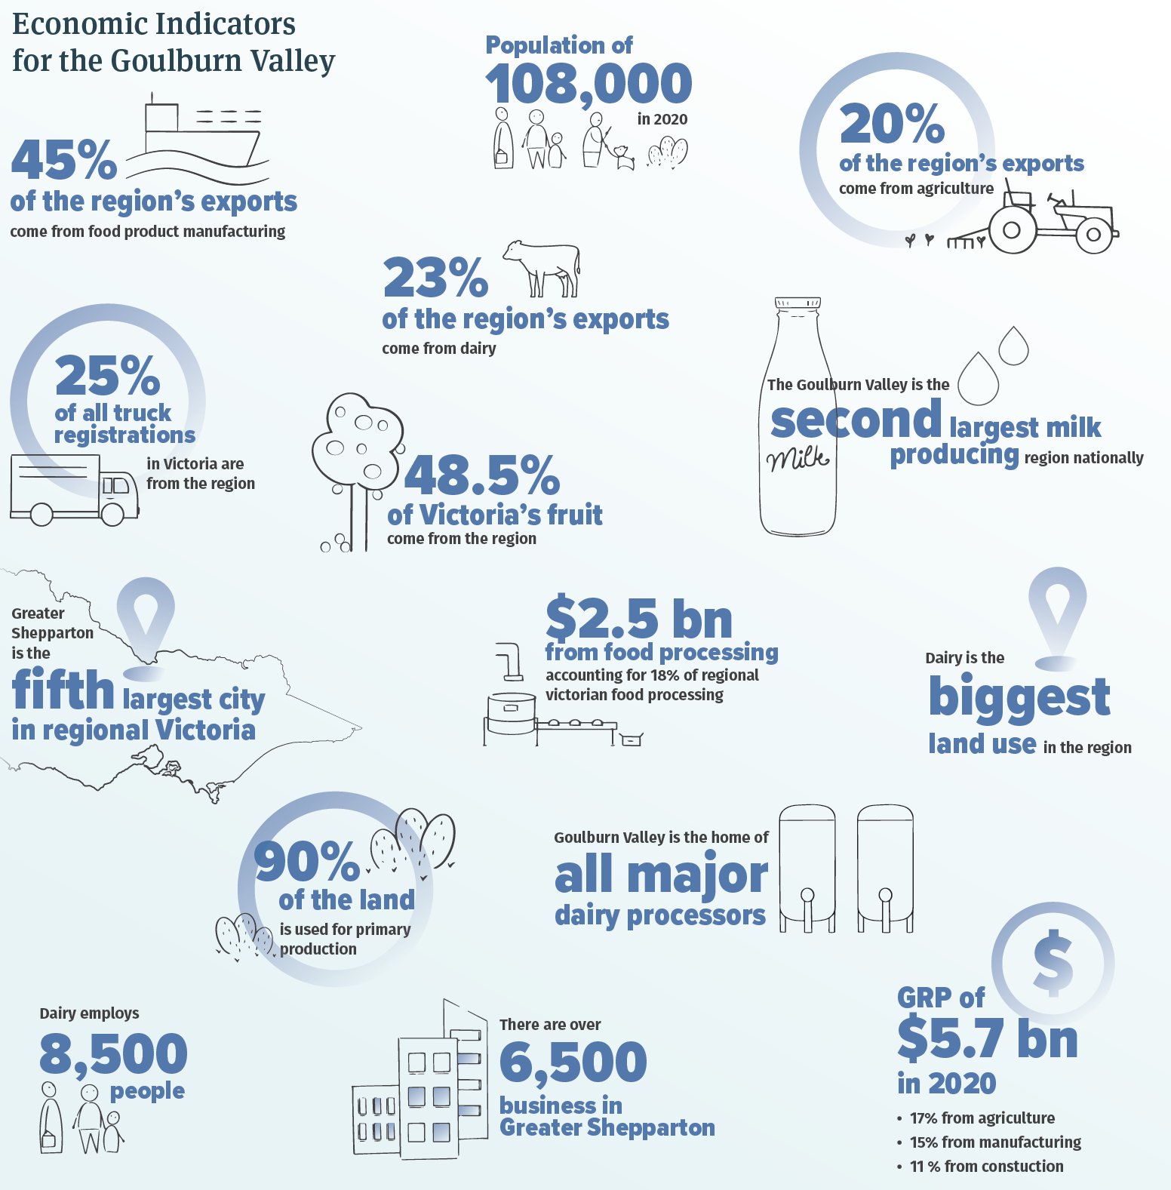
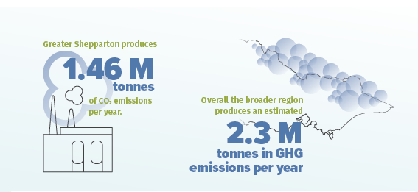
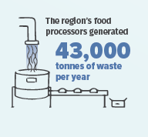
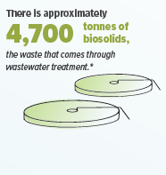
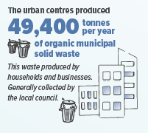
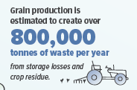
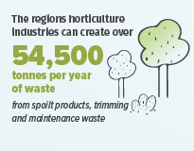
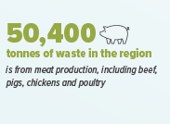
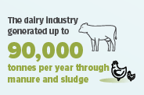
Why is it Important?

Slide 10
Timeline
2020
Goulburn Murray Resilience Strategy
(GBRP, RDV)
Aug. 2020
Community Thought Leadership Workshop - Ross Garnaut and John Hewson
(GVW, C4GS)
Jan. 2021
Circular Economy Working Group Forms
(GVW, C4GS, GSCC)
Apr.–Dec. 2021
Aurecon works with GV business community to understand opportunities
Aurecon, GVW, C4GS,
Apr. 2021
Aurecon joins the Circular Economy Working Group
Dec. 2021
White Paper – Embedding Regional Resilience Through the Circular Economy
GVW, C4GS, GSCC, GMRS Taskforce
July 2022
Media launch

Slide 11
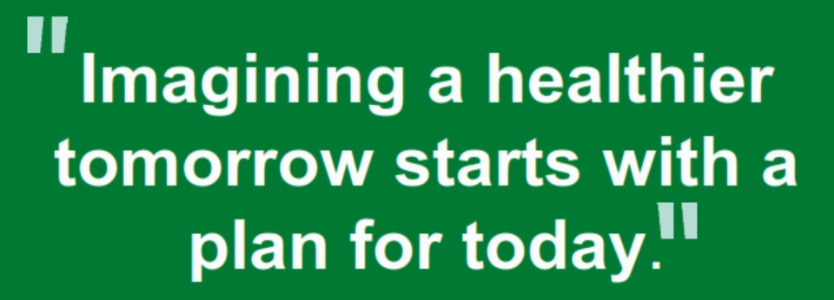
Noumi
“noumi's involvement in the circular economy initiative in the Goulburn Valley region reflects not only its presence in Shepparton as a business, but also its broader commitment to sustainability/ESG as part of its ESG strategy, the Healthier Tomorrow Plan.
The strategy is currently in development but will consider circular economy opportunities in its operations and supply chain such as waste-to-energy projects, water recycling and packaging sustainability. A healthier tomorrow starts with a plan for today”
Rob McDonald – Group Head of Safety, Environment and Operational Risk

Slide 12
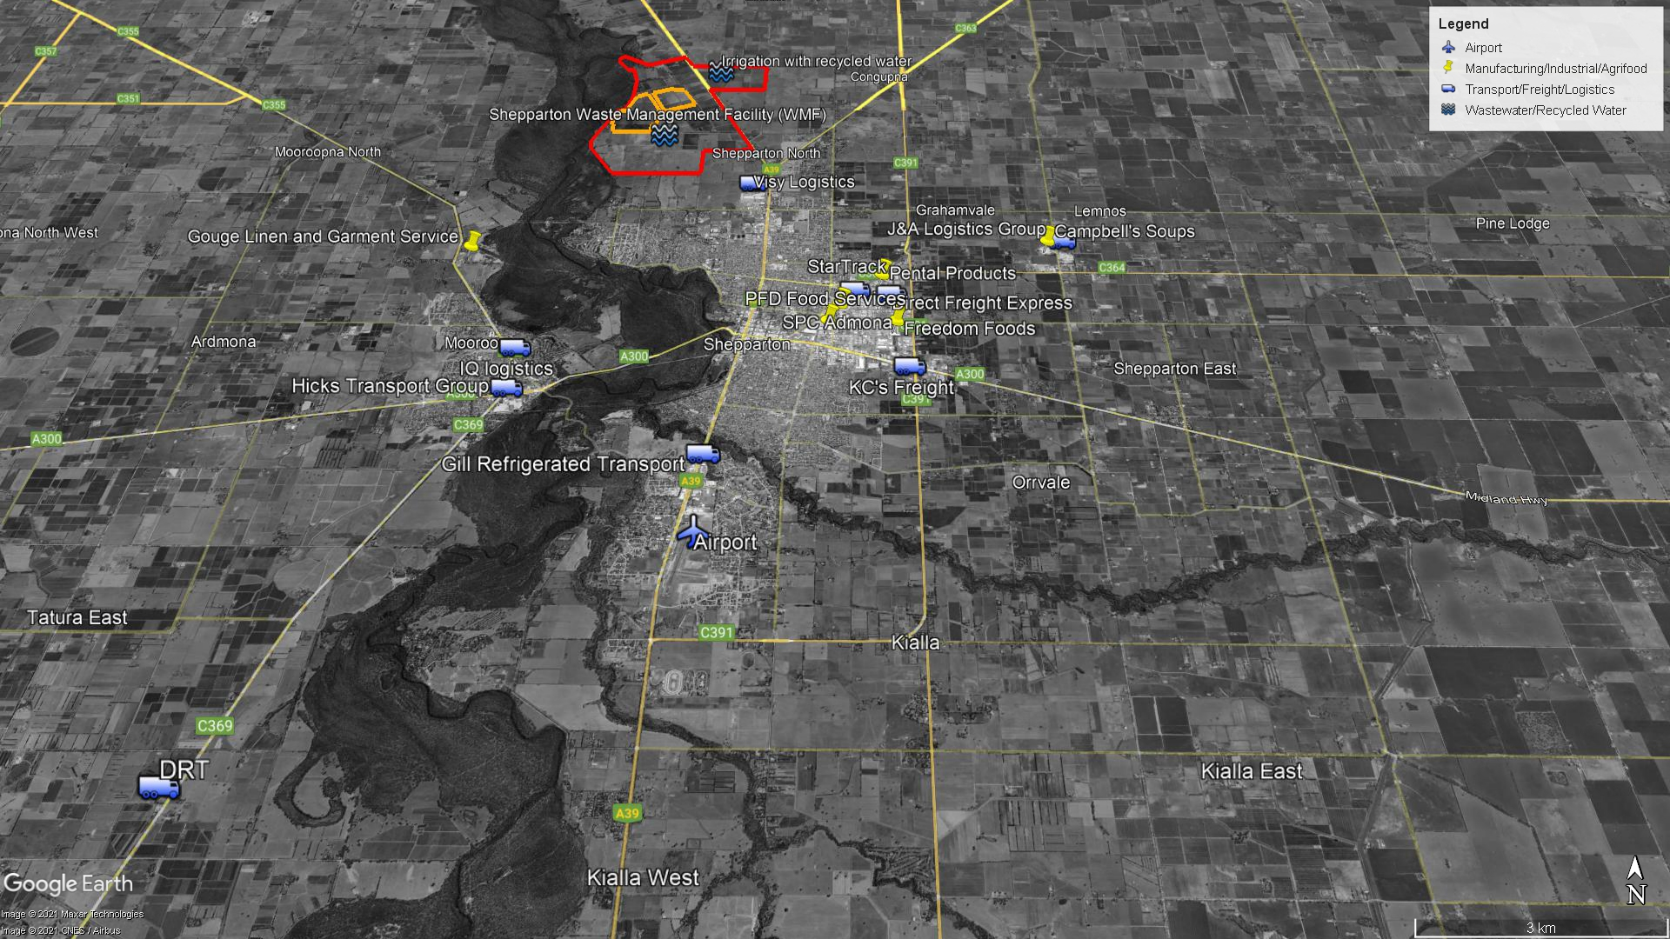

Slide 13
The concept and approach
Collaborative
with stakeholders
Thinking in terms of the System
Multidisciplinary
Identifying the challenges and current needs of the industry within Goulburn Valley
Building a network for action
Bringing a wide range of disciplines and perspectives to the project team.
Engineering, policy, economic development, customer engagement, waste management, communications design.
Looking at how we need to connect up the system differently
How roles and responsibilities might shift
Knowing there’s no “one place” to start

Slide 14
Released late 2022

Slide 15
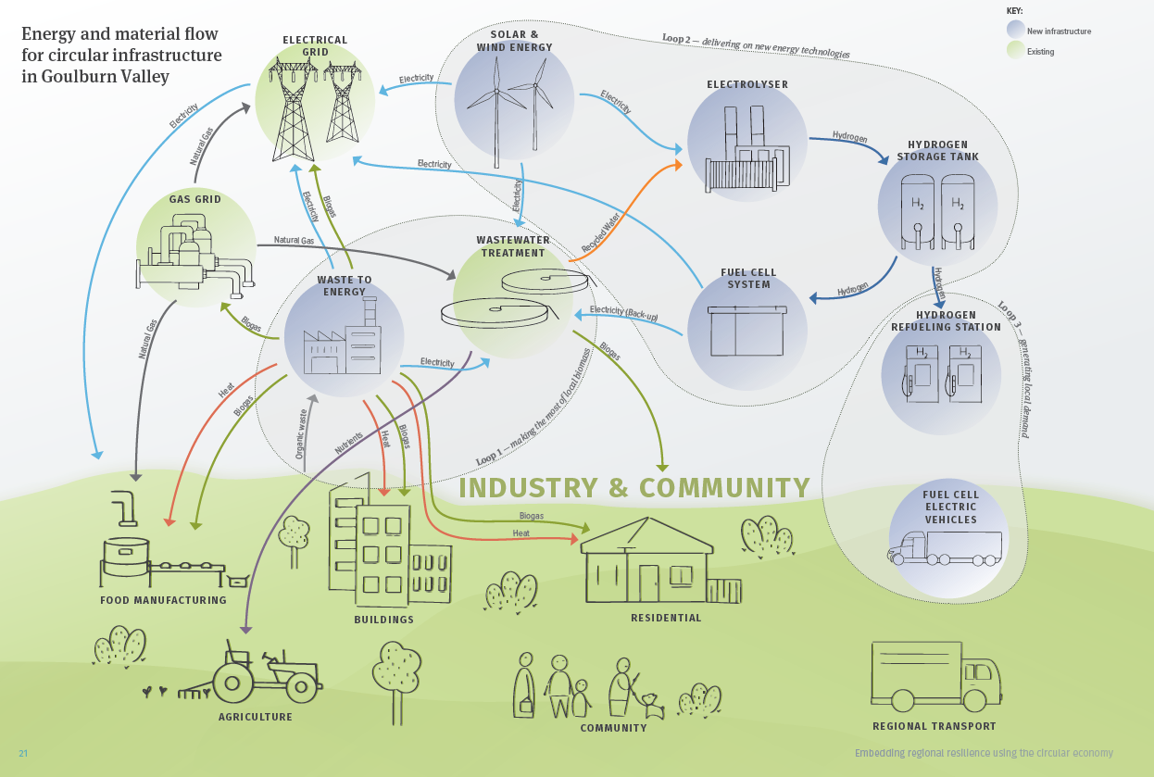

Slide 16
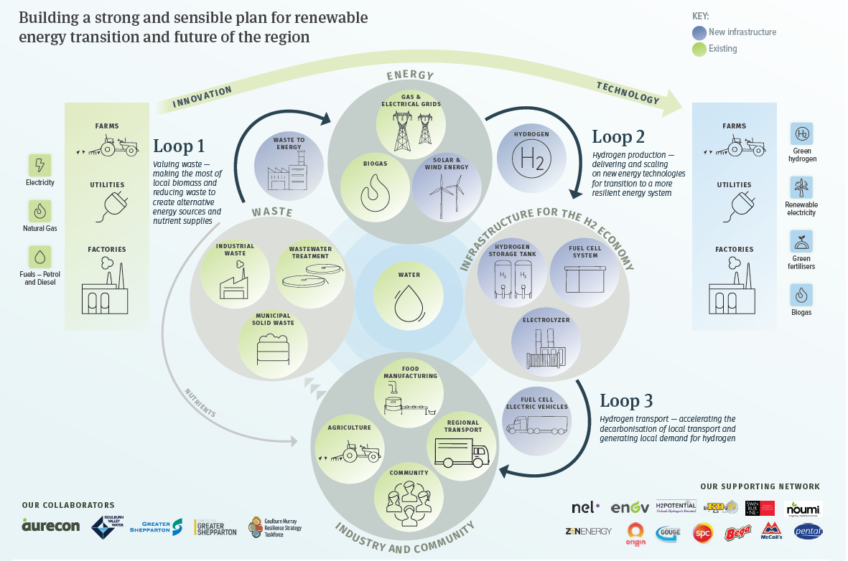

Slide 17
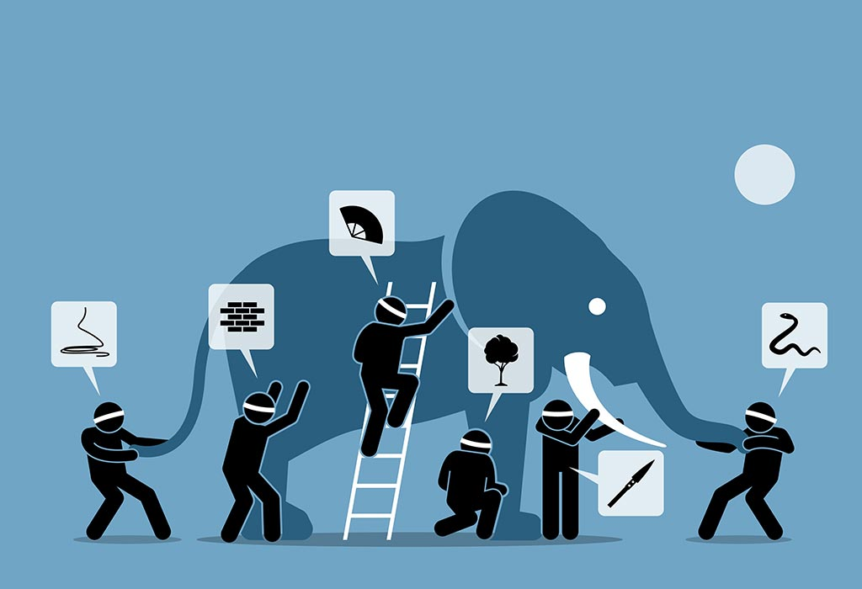
Challenges so far
Rapidly moving policy environment
Focusing on solutions rather than building place based approach
Information – sharing commercial information on waste and energy demand
Separation of waste, energy and water in govt and reg approaches
Alignment of stakeholders
Resourcing

Slide 18
Australian water corporations – a powerful vector to a more circular economy?
Non competitive
sharing information and approaches
Fewer constraints on IP protection
Government owned
networked,
commercial stability
Access to alternative forms of capital for higher risk projects
Connection to customers and community
Place based and embedded with local industry
Relationships with key stakeholders (customers, government and regulators)
Access to research and advocacy
Land ownership
Call to action!

Slide 19
Thank you

Slide 20
Any Questions?
Acknowledgements:
Sarah Thomson, Goulburn Valley Water
Nicole Wallace, Goulburn Vally Water
Linda Nieuwenhuize, Committee for Greater Shepparton
Sharon Terry, Greater Shepparton City Council
Angela Kelly, Aurecon
Noriko Wynn, Aurecon
Matt Stewart, Aurecon
John Poon, Aurecon
Kevin Werksman, Aurecon

Slide 21
