Slide 4
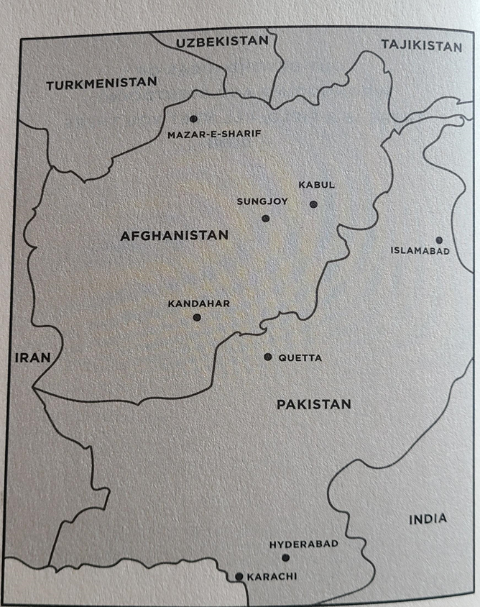

Slide 5
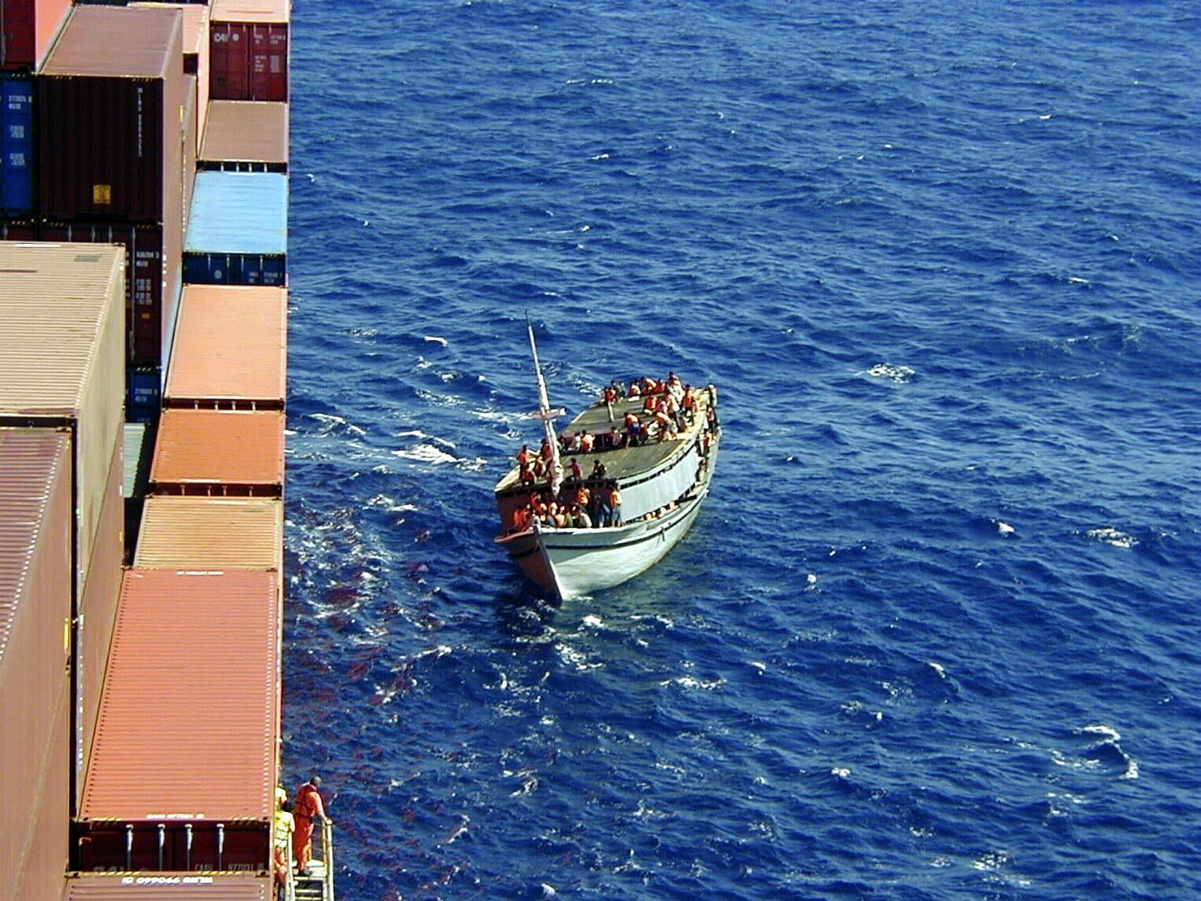

Slide 6
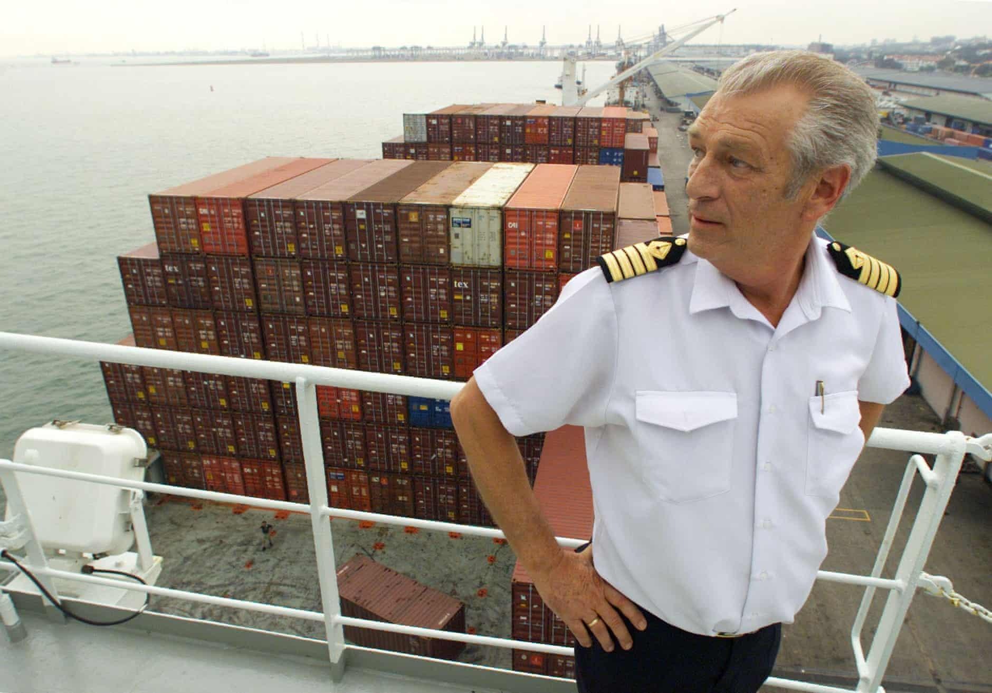
Captain Arne Rinnan during the Tampa affair. Source: Wilhelmsen/AP

Slide 7
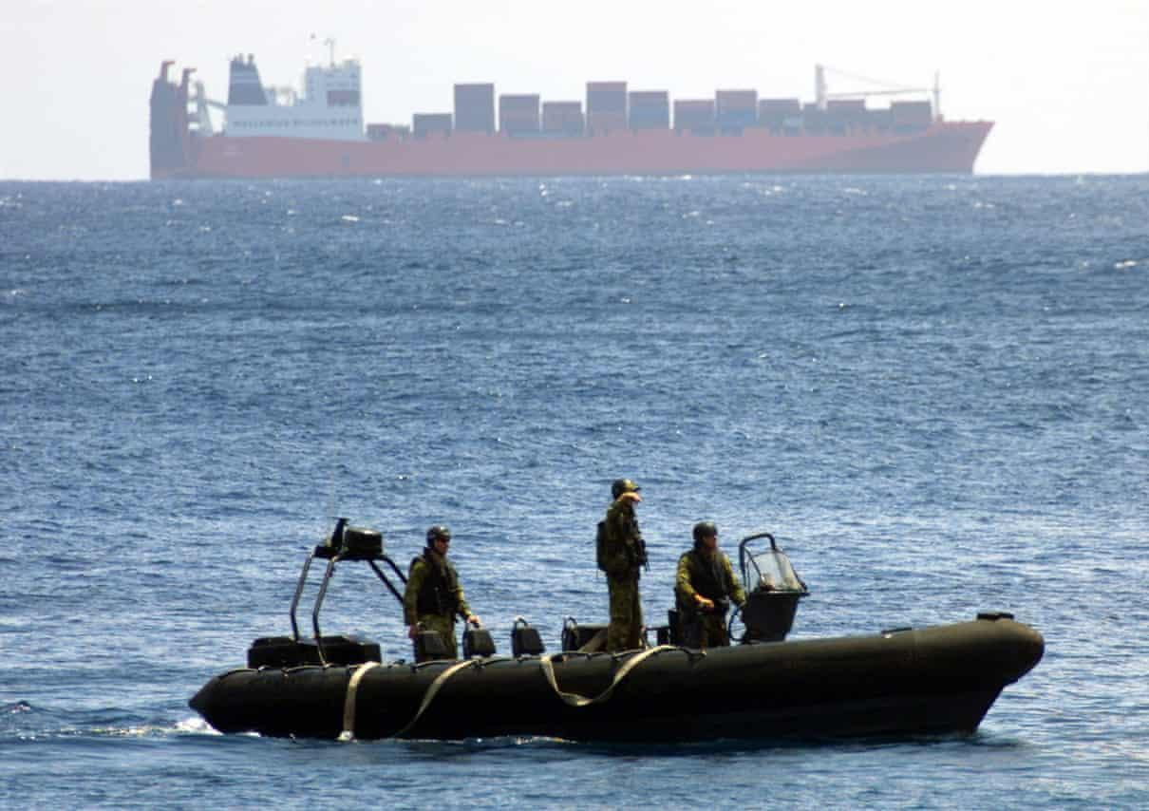

Slide 9
