Slide 1
Cost-effective sampling devices for stormwater and urban streams
MBIE Envirolink Tools Project
Jennifer Gadd, Juliet Milne, NIWA; Claire Conwell, GWRC
Notes:
Today I'm going to share with you our prgress on an Env link tools proj. This proj came about bc of increased need by councils to gather info on state of urban streams and urban stormwater. This is due to requirements for network discharge consents, planning and monitoring under the NPS-FM and increased scrutiny on the state of waterways in urban areas.

Slide 2
?
Notes:
Along with that has been the increased awareness that given the variability of contaminant concentrations in stormwater, collecting a grab sample from a waterway 2-3x a year is not really suitable for determining long-term averages and loads. What’s more, this method is not necessarily useful for comparing to criteria for acute toxicity or to consent limits. At the same time, moving to a/s for all monitoring projs is not feasible – not for smaller, resource-poor councils, & not for larger councils with greater # of waterways. So what is needed is a method or a # of methods tthat fall somewhere in between these two. And such methods do exist, they just either haven't been extensively used in NZ, or havent been regularly applied to urban waters and stormwater.

Slide 3
MBIE Envirolink Tools Project
Aim: To increase the uptake of sampling devices by regulators that enable improved monitoring of urban waters and collection of more robust water quality data.
?
Notes:
So this project, championed by Claire Conwell at GWRC, was developed with this aim:
The project has had a gp of RC reps who have steered direction & we have used reviewers with expertise in the different devices.

Slide 4
Project Plan
Selection of appropriate passive sampling devices;
Intensive testing in the field against autosamplers (Phase 1);
Testing in the field at a greater number of sites (Phase 2);
Development of guidance and including videos demonstrating field protocols.

Slide 5
Devices Tested
Nalgene stormwater sampler bottle
Siphon sampler bottle
DGT (diffusive gradients in thin films)
ChemCatcher
Sorbisense Sorbicell

Slide 6
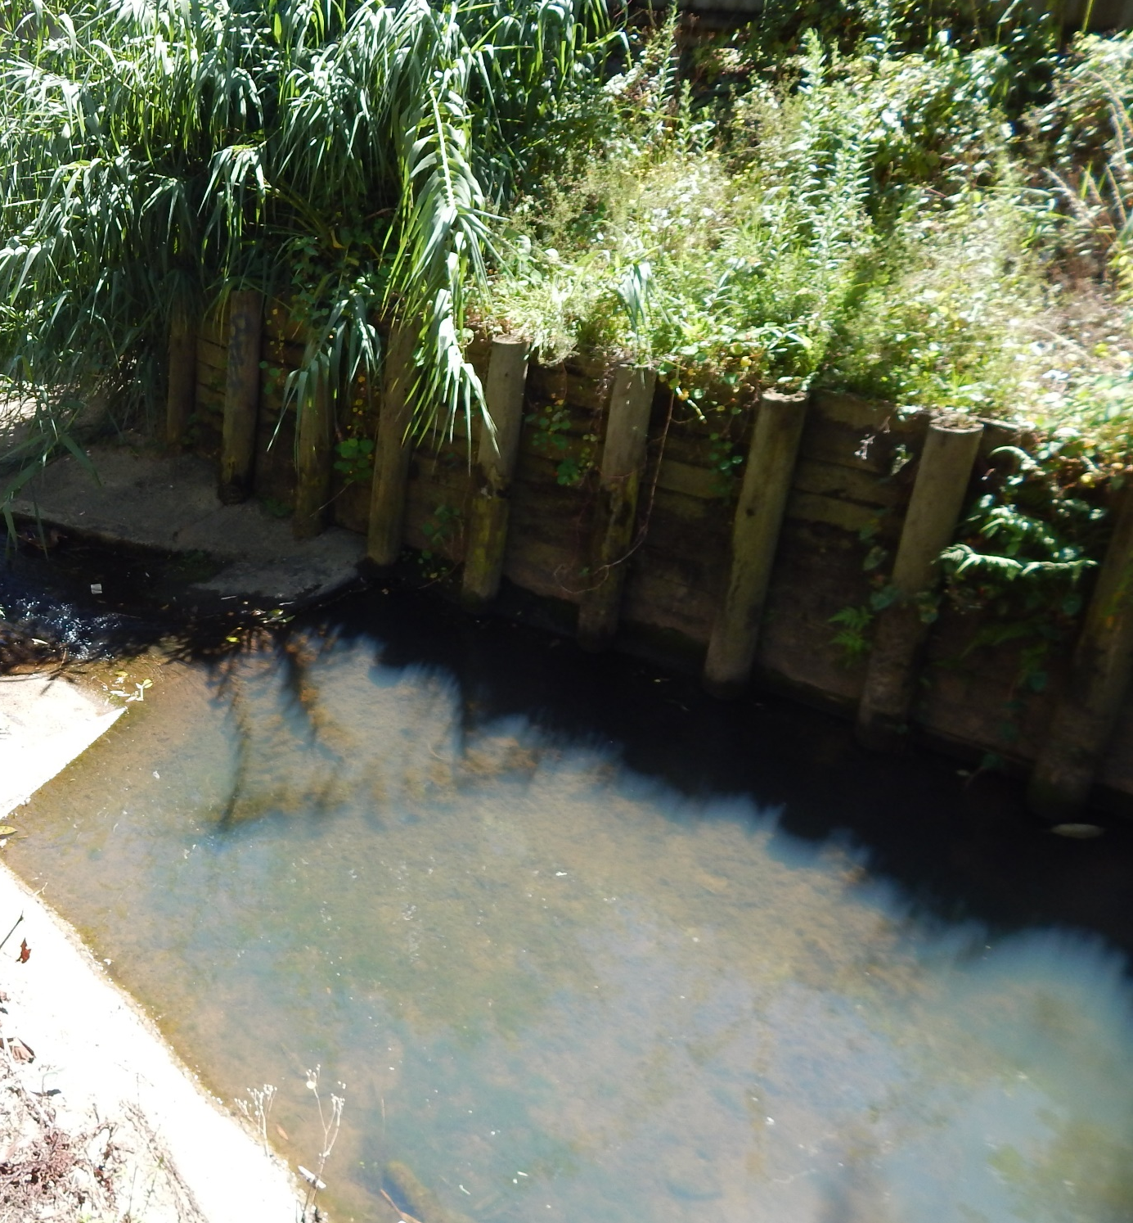
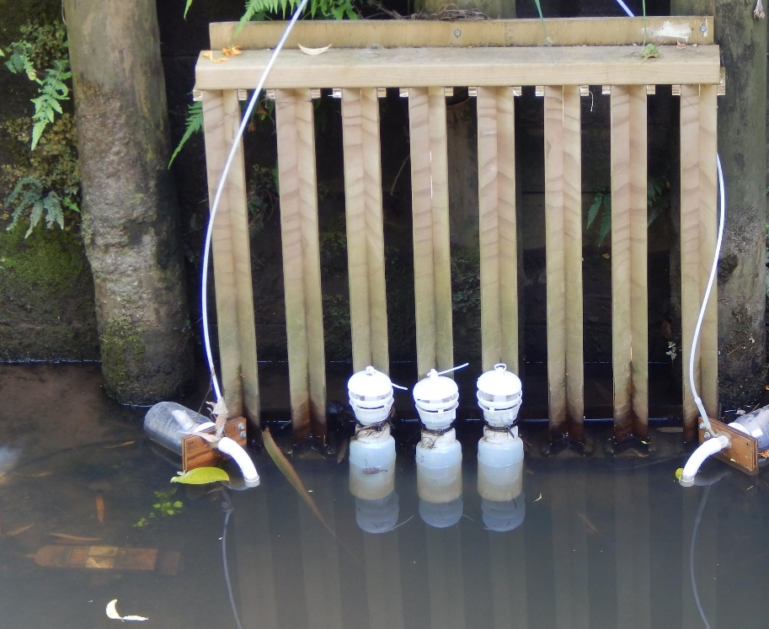
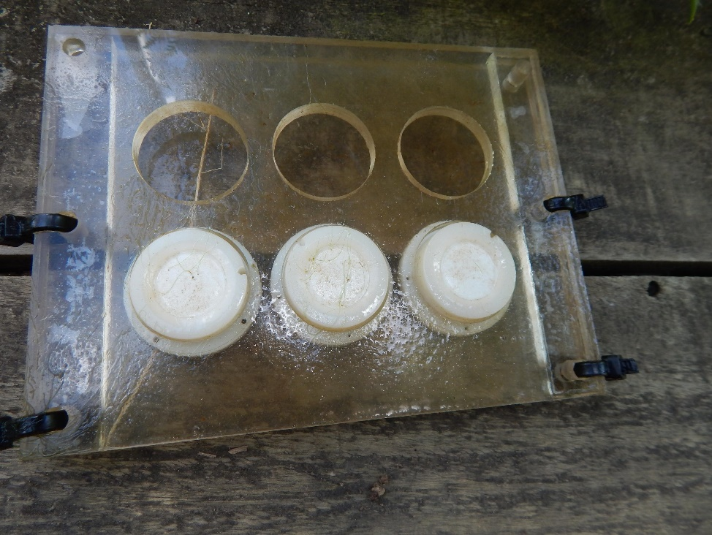
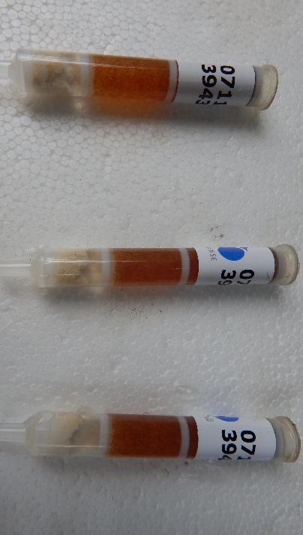
Whau Stream test location

Slide 7
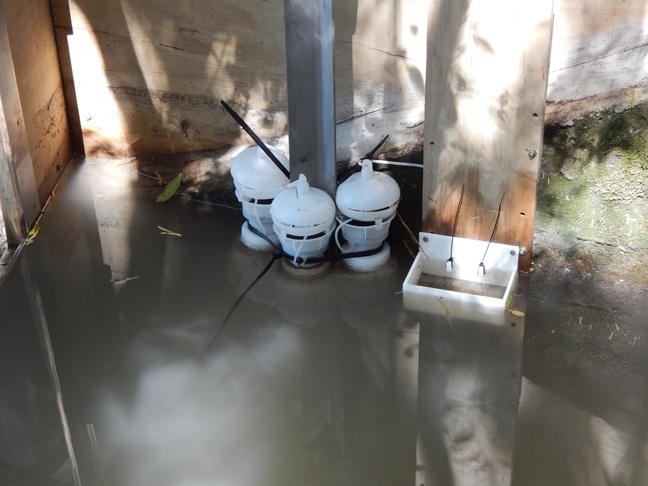
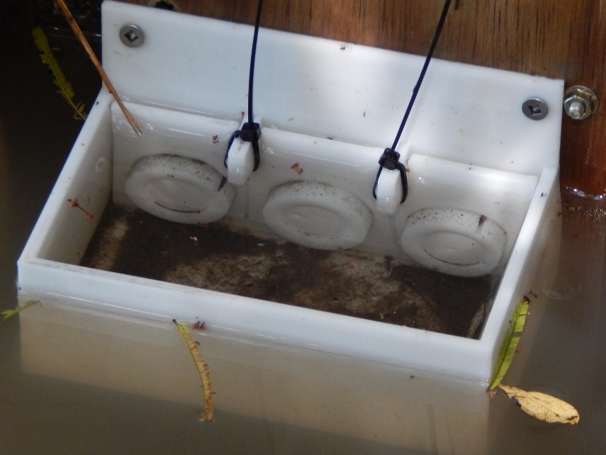
Akatea Road stormwater test location
Notes:
At each of the two sites we had autosamplers installed. We tested the 5 devices and measured contaminants in samples collected with these and in the samples from the a/s.

Slide 8
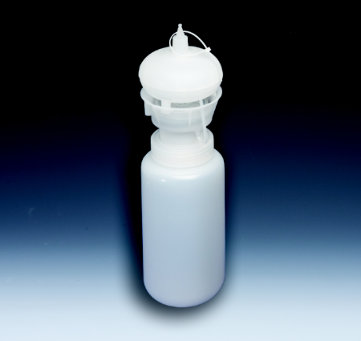
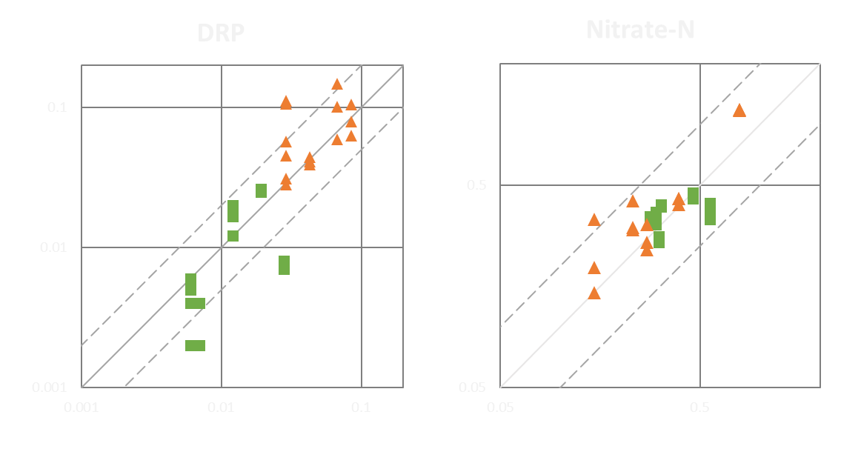
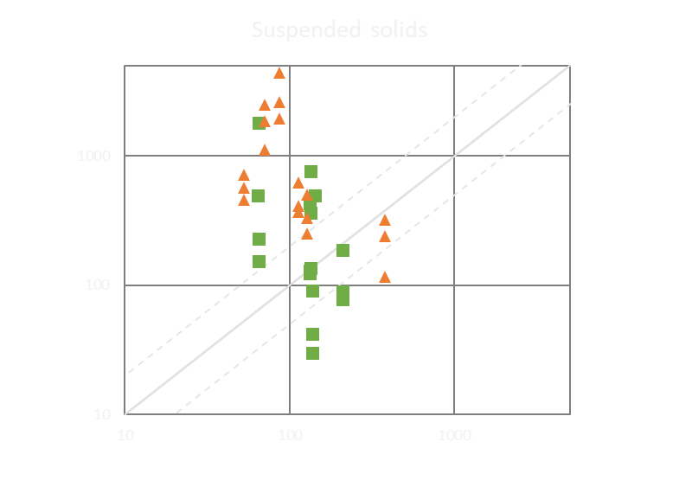
Nalgene Stormwater Sampler Bottles
Suspended solids
Stormwater
Conc. in Nalgene sampler bottle (mg/L)
Stream
Conc. in autosampler bottle (mg/L)
Conc. in autosampler bottle (mg/L)
Notes:
On to some results, for the stormwater samples in orange and stream in green. For these plots, each dot represents a different nalgene sample bottle. The concs in the a/s bottle is across the bottom, and the concs in the nalgene bottle on the left axis. If concs were the same in a/s and Nalgene, all markers would fall on this solid line. If concs were within a factor of 2, they would fall between the dotted lines. So immediately you can see that they don't especially for SS. We had some very high SS concs in nalgene bottles, not in a/s. On the otherhand for DRP and NO3n there was fairly good agreement

Slide 9
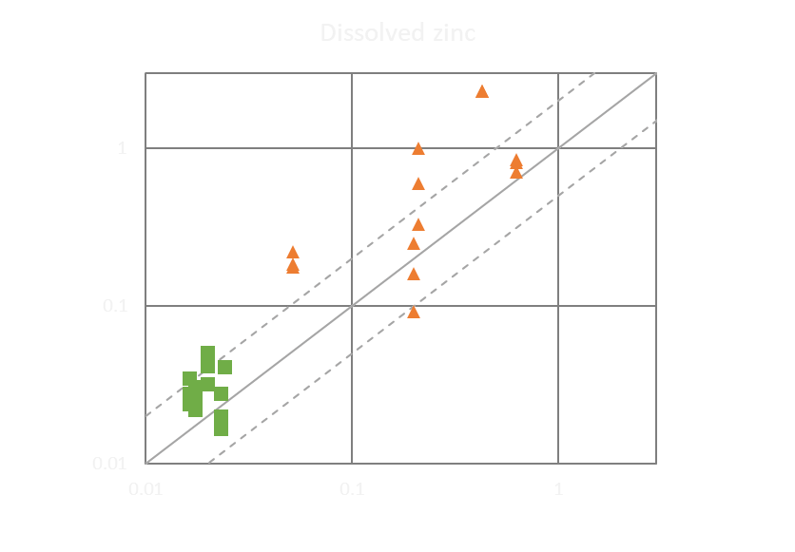
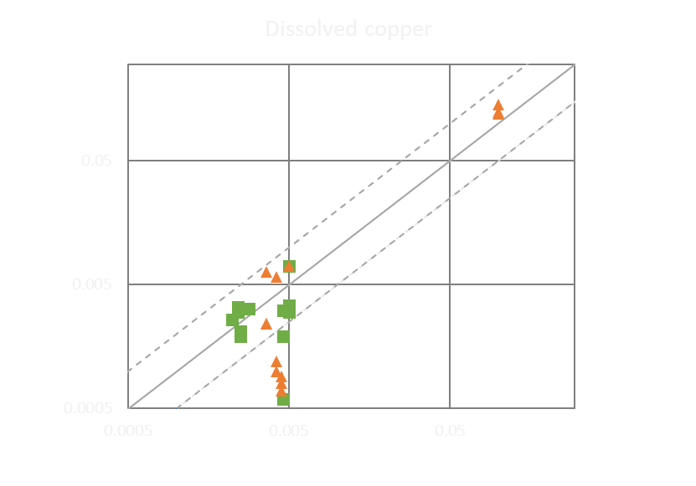
Nalgene Stormwater Sampler Bottles
Conc. in passive sampler bottle (mg/L)
Stormwater
Stream
Conc. in autosampler bottle (mg/L)
Conc. in autosampler bottle (mg/L)
Notes:
And here for dissolved zinc and copper there was fairly good agreement, with a few exceptions.

Slide 10
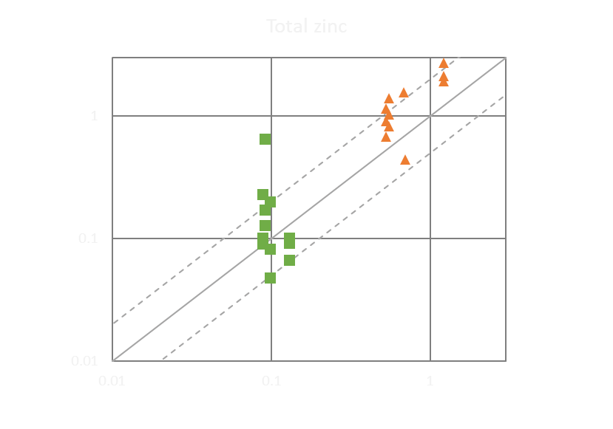
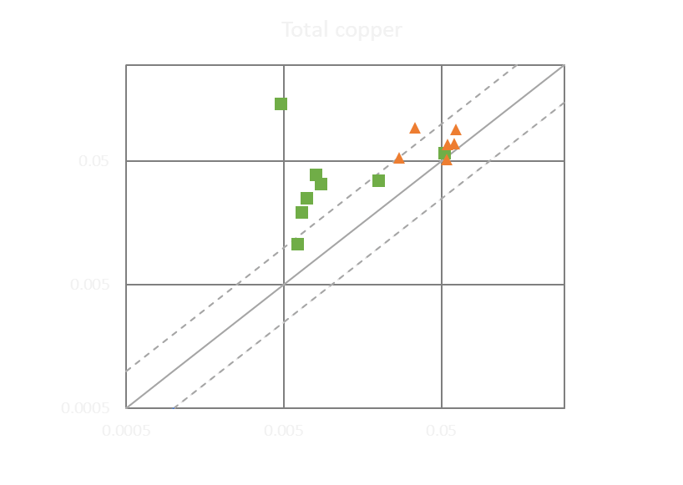
Nalgene Stormwater Sampler Bottles
Conc. in passive sampler bottle (mg/L)
Stormwater
Stream
Conc. in autosampler bottle (mg/L)
Conc. in autosampler bottle (mg/L)
Notes:
And fairly similar results for total zinc, though not so good for total copper.

Slide 11
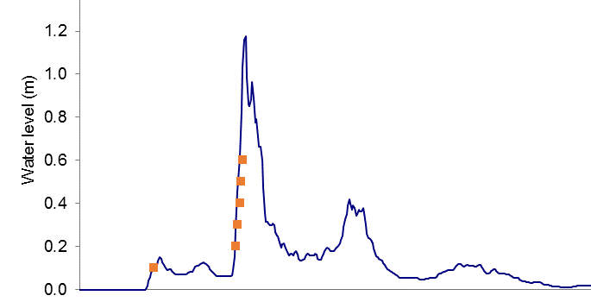
When to use sampler bottles:
When not* to use sampler bottles:
Manual grab sampling not feasible:
Site is too far from office
Rain occurs outside office hours
Too many locations to get around
Shallow depths (< 200 mm)
For average concentrations across entire event
Samples collected on rising limb only

Slide 12
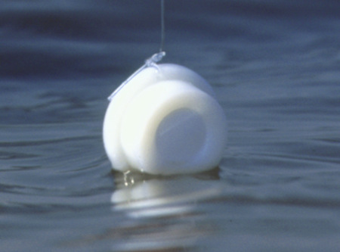
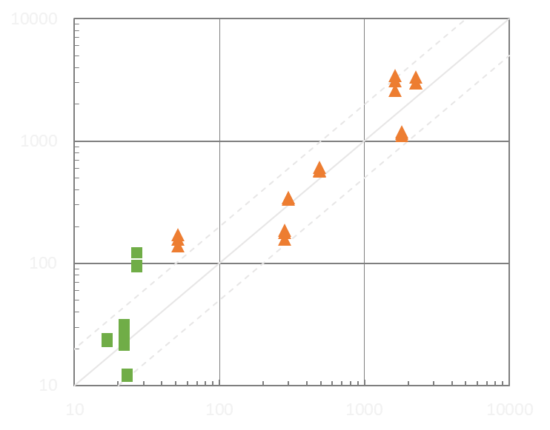
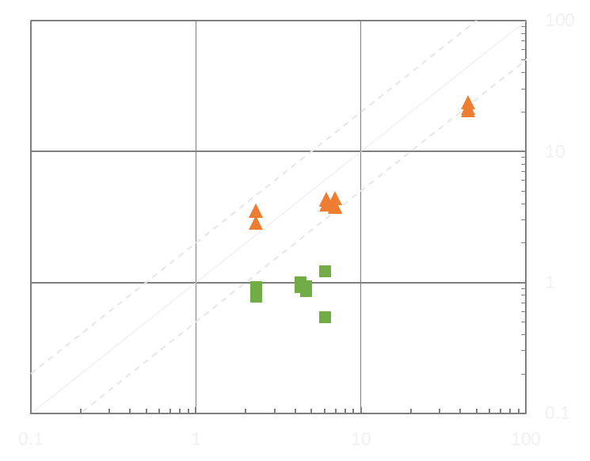
DGT Metal Results
Dissolved Zinc Dissolved Copper
Metal concs. from DGTs (µg/L)
Stormwater
Stream
Metal concs. from autosampler bottles (µg/L)

Slide 13
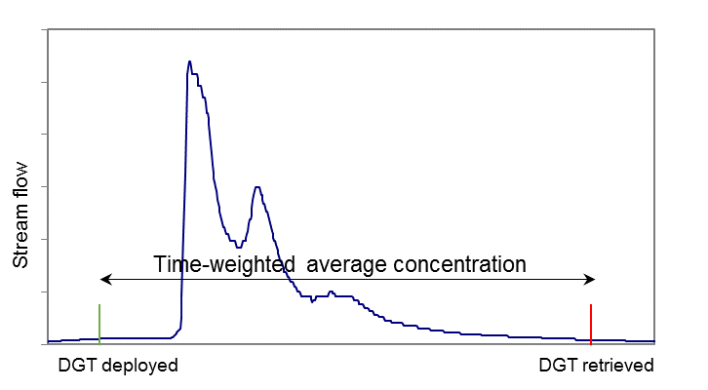
When to use DGTs:
When not to use DGTs:
For average concs (baseflow, or storms)
Toxicity assessment
For maximum concs.
Total metal concs in stormwater*

Slide 14
Devices assessment
Device | Cost of device & analysis | Ease of use | Reproducibility of results (variation between replicates) | Reliability of results (variation from autosampler)
Nalgene Stormwater Sampler bottles | $ | ✓ | ✓ | ✓ - ✓✓✓
Siphon sampler bottles | $ | ✓ | ✓ | ✓
DGTs (diffusive gradients in thin films) | $$ | ✓✓✓ | ✓✓✓ | ✓✓
Chemcatcher | $$ | ✓✓ | ✓✓✓ | ✓✓✓
SorbiCell | $$$ | ✓ | - | ✓

Slide 15
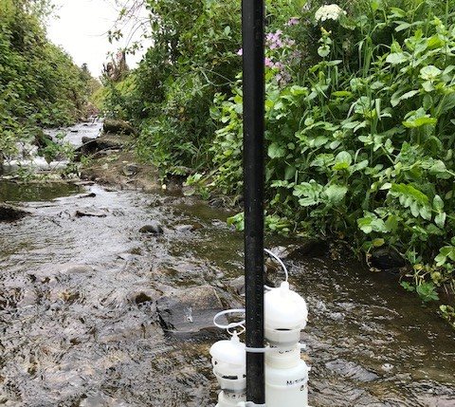
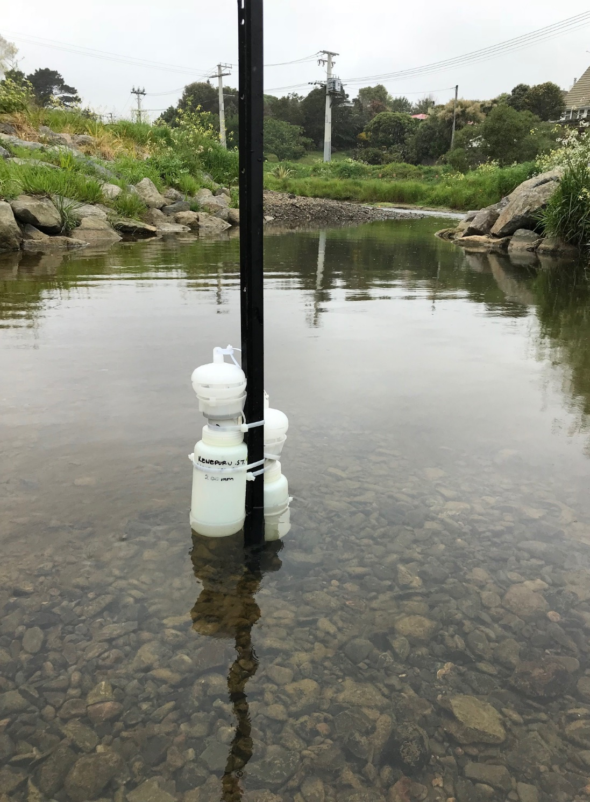
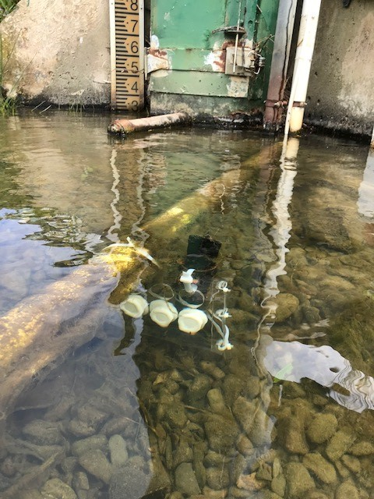
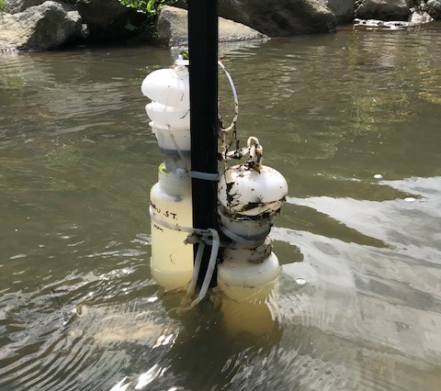
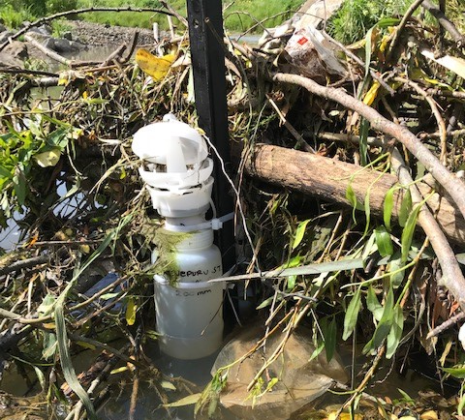
Testing by GWRC

Slide 16
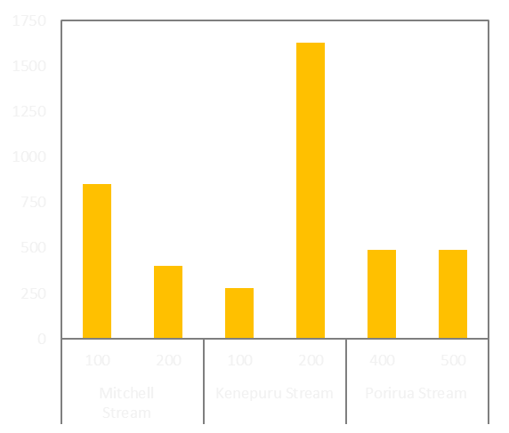
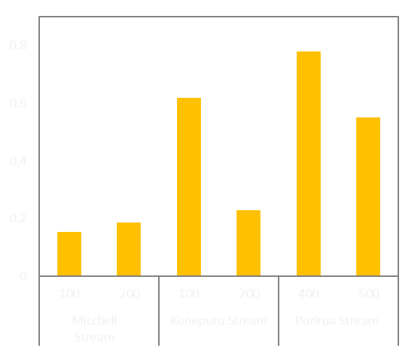
SS & NO3-N from Nalgene Stormwater Sampler bottles
Suspended solids conc. (mg/L)
Nitrate-N conc. (mg/L)
Bottle height
(above baseflow)
Notes:
SS results were variable between sites but also extremely variable at Kenepuru Stream, indicating more samples need to be collected here to get a true picture of the sediment concentrations. Concs were very high in the bottles, much higher than measured in samples collected at the same time by an autosampler .
For nitrate concentraions, they were also variable in Kenepuru Stream, but more consistent in Mitchell Stream and Porirua Stream. And concnetrations were much closer to those in samples collected by the autosampler. These results, with lower nitrate-N in Mitchell Stream, mid-range in Kenepuru Stream and highest concentrations in Porirua Stream agree with the findings from 12 months of grab sampling in these streams.

Slide 17
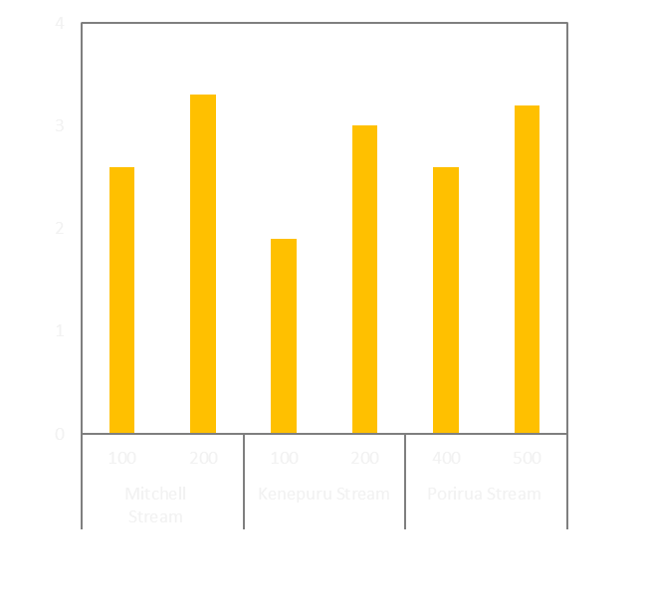
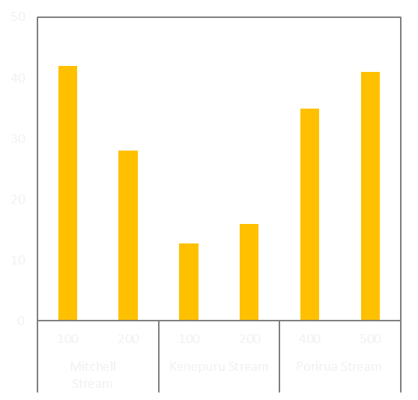
Metals from Nalgene Stormwater Sampler bottles
Dissolved copper conc. (µg/L)
Dissolved zinc conc. (µg/L)
Bottle height
(above baseflow)
Notes:
Copper concentrations varied little between the two samples in each stream, in between streams and compared to the autosampler samples. Dissolved zinc on the otherhand was higher in Mitchell Stream and Porirua Stream than in Kenepuru Stream. The pattern of concentrations was similar to that for the baseflow sampling, but the concentrations measured here were higher, as you'd expect during a storm.

Slide 18
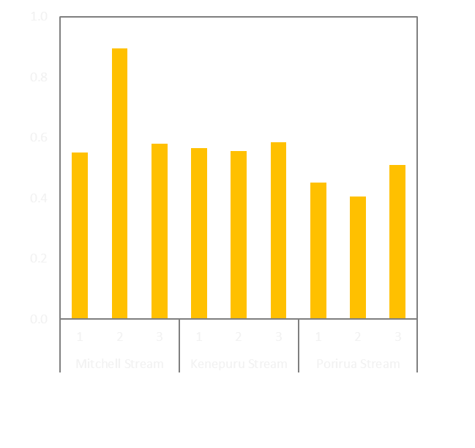
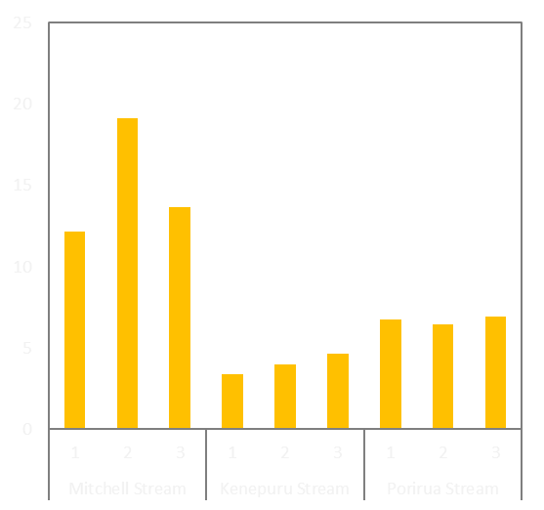
Metals from DGTs
Dissolved copper conc. (µg/L)
Dissolved zinc conc. (µg/L)
Notes:
Now on to the copper and zinc concentrations calculated with the DGTs. There were 3 replicates deployed at each site, hence the numbers 1,2,3. These showed fairly consistent concentrations between replicates. For copper, as with the water samples, there was little difference between the three locations. But for zinc, the concentrations in Mitchell Stream were about double those in Porirua Stream. You may have noticed that the concentrations of zinc here are much less than measured in the Nalgene bottles – around 7 ug/L in the Porirua Stream, compared to 35-40 ug/l in the nalgene bottles.

Slide 19
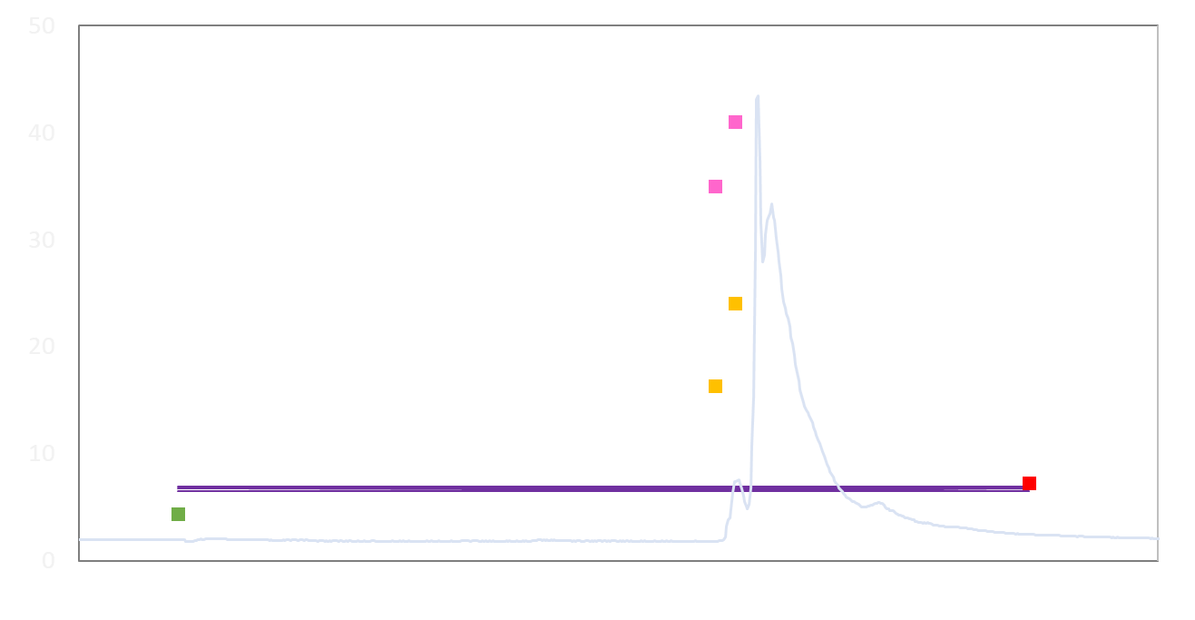
Porirua Stream Results
Zinc concentration (µg/L)
Water samples from Nalgene bottle
and
autosampler
Time-weighted average conc. from DGT
DGT removed, grab sample collected
DGT installed, grab sample collected
Notes:
That’s because the DGTs are providing the concentration integrated over time, a time-weighted average. In the case of this storm, the DGTs were deployed the day before the rain event, and the rain event was quite small and short-lived. So of the time the DGT was installed, more of it was baseflow conditions than storm conditions.

Slide 20
What else?
Deployment in Otepuni Stream, Invercargill, stream and stormwater outlets:
DGT results show metals increase downstream, highest concs at stormwater outlet
Nalgene bottle results show increase in SS and E. coli downstream, and input from stormwater outlets
Deployment at stream pump stations, Napier and Hastings
Nalgene bottle results replicated earlier findings of high zinc in Ruahapia Stream
More results yet to come….

Slide 21
What next?
Environment Canterbury / CCC currently testing
NIWA preparing guidance document
Instructional videos being updated
All to be hosted on website, available in July 2019
https://www.niwa.co.nz/ sampling-urban-streams-stormwater

Slide 22
Technical Advisors: Dr Mike Stewart, Streamlined Dr Will Bennett, Griffith University Dr Hubert de Jonge, Sorbisense Testers: GWRC Field staff Wendy Purdon; Ailsa Robertson, Stu Easton, Jacobs HBRC and ES field staff
Acknowledgements
Regional Council Steering Group: Adam Uytendaal, ORC * Anna Madarasz-Smith, HBRC Claire Conwell, GWRC Marcus Cameron, AC * Michele Stevenson, ECan Roger Hodson, ES * No longer on steering group
Contact:
Jennifer Gadd
+64 21 536644
Jennifer.gadd@niwa.co.nz

Slide 23
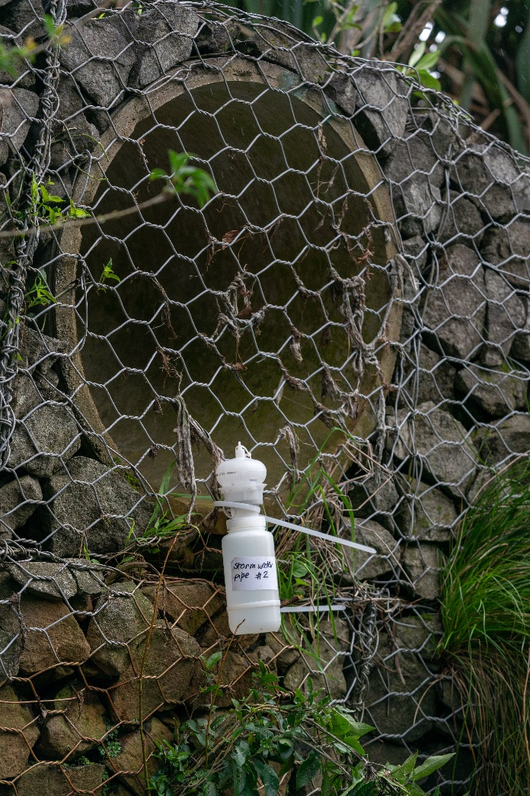
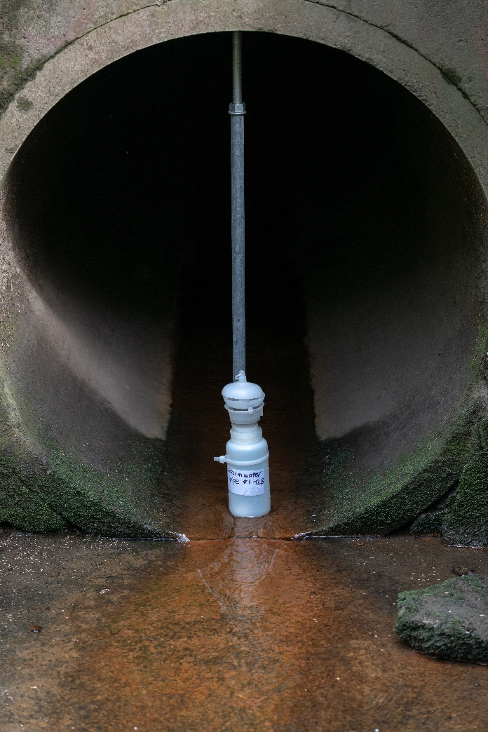
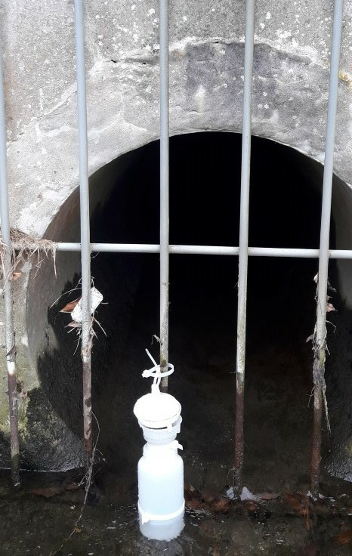

Slide 24
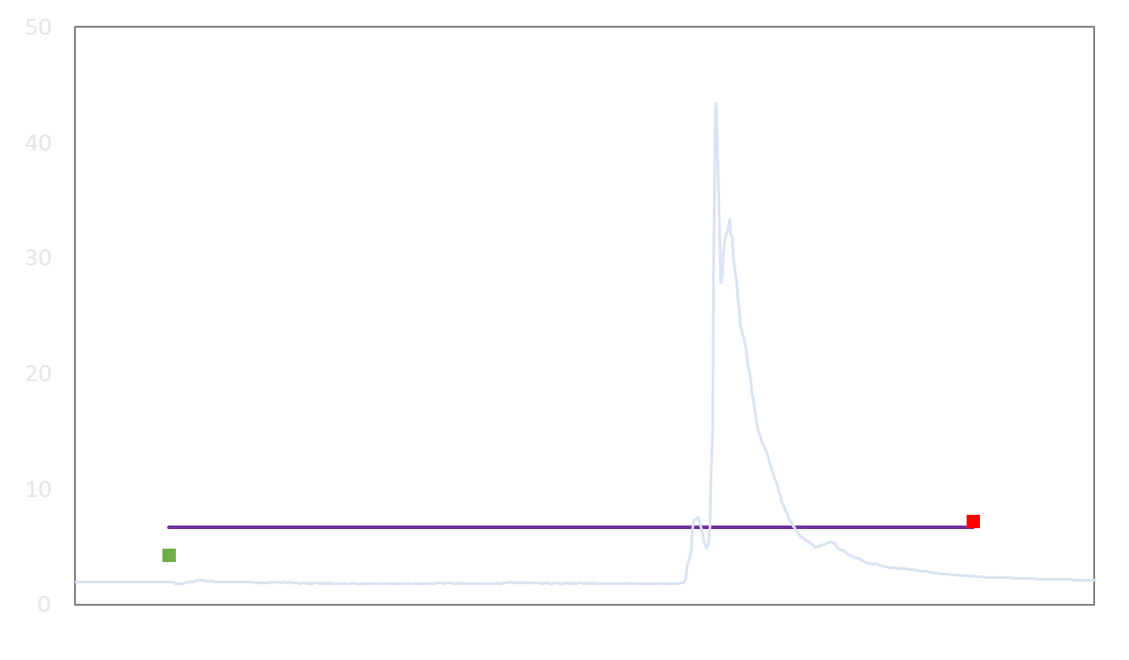
Porirua Stream Results
Zinc concentration (µg/L)
Assume grab reflects post-storm conc.
Time-weighted average, peak
Assume grab sample reflects pre-storm conc.
Time-weighted average, full deployment

