Slide 1
Working Together
Operators and Modellers
to improve efficiency
March 2019
Zoran Pilipovic and Mike Dunstone

Slide 2
Overview
The Premise
Case Study 1 (Lincoln Swanson)
Case Study 2 (Albany)
Case Study 3 (Takapuna/Northcote)
Tips for Success

Slide 3
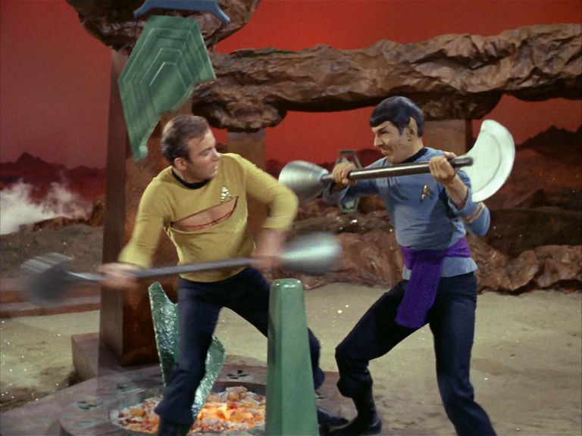
The Premise
We don’t always get along

Slide 4
The Premise
If we work together we can be successful
What we do:
Optimised Solutions
Links to strategic plan
Customer impact assessment
Control and operation
Outcome:
New Approaches and ideas
Well rounded future proof
solutions
Happy Customers

Slide 5
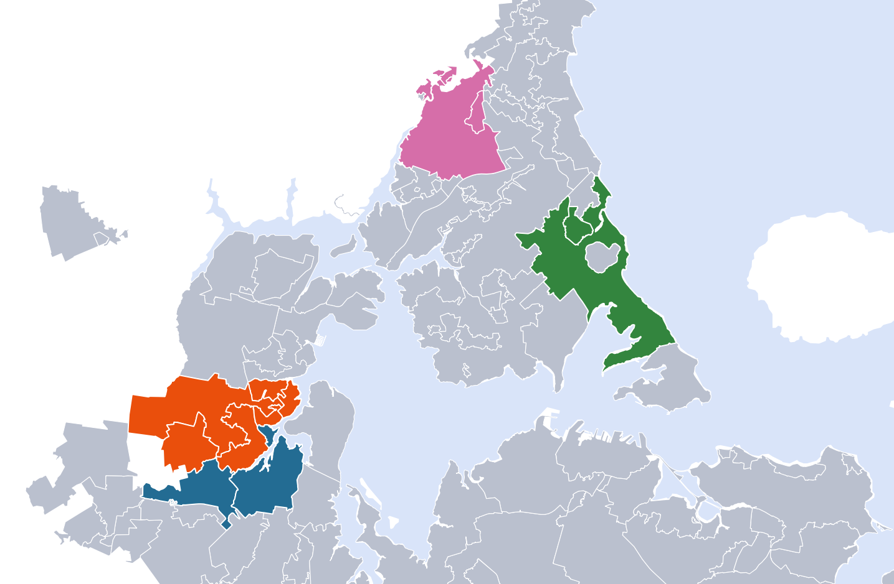
Case Studies - Overview
Case Study 2
Albany
Case Study 3
Takapuna and Northcote
Case Study 1
Lincoln/Swanson

Slide 6
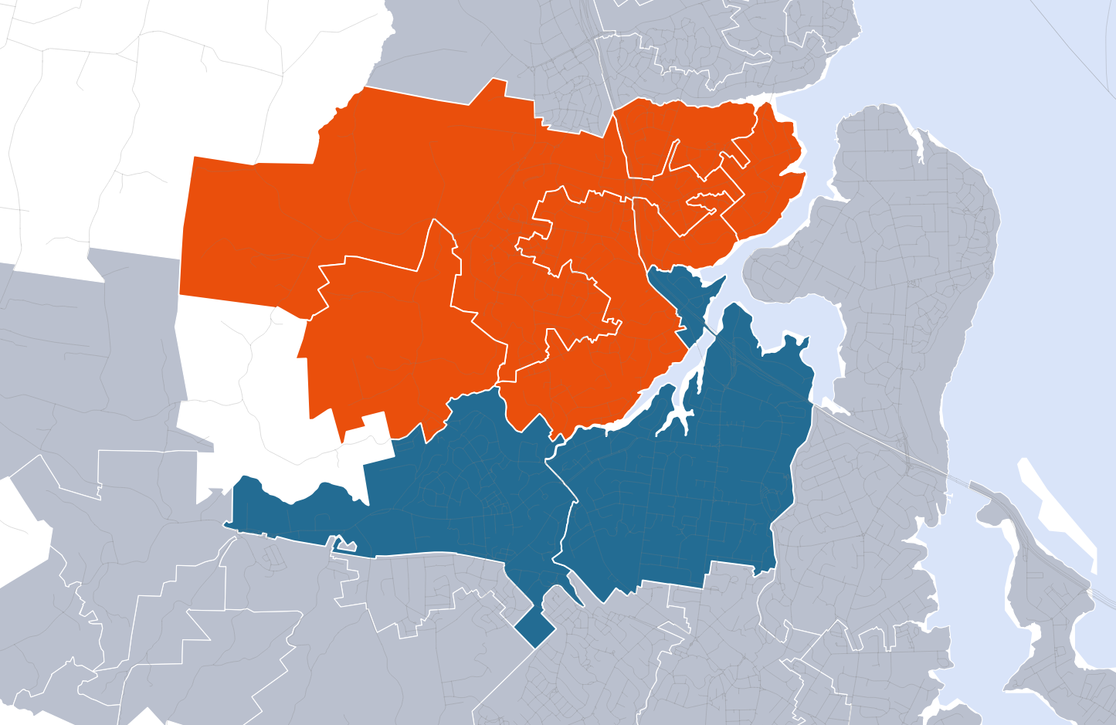
Case Study 1 – Lincoln Swanson
Massey
Issues:
The biggest zone in WA had no alternative supply
Hospital, shopping malls,
schools were effected.
Commissioning of Triangle Rd PS could create dirty water issues
HGL 135m
PRV
HGL 101m
HGL 75m
HGL 75m
Swanson
Lincoln

Slide 7
Case Study 1 – Lincoln Swanson
Massey
Solution:
Utilized oversized assets in Massey Zone.
New PRVs installed.
Additional supply and more efficient system to LZ established.
Triangle Road
HGL 135m
A.V.
Pipework
PRV
PRV
PRV
HGL 101m
HGL 75m
HGL 75m
Lincoln
Swanson

Slide 8
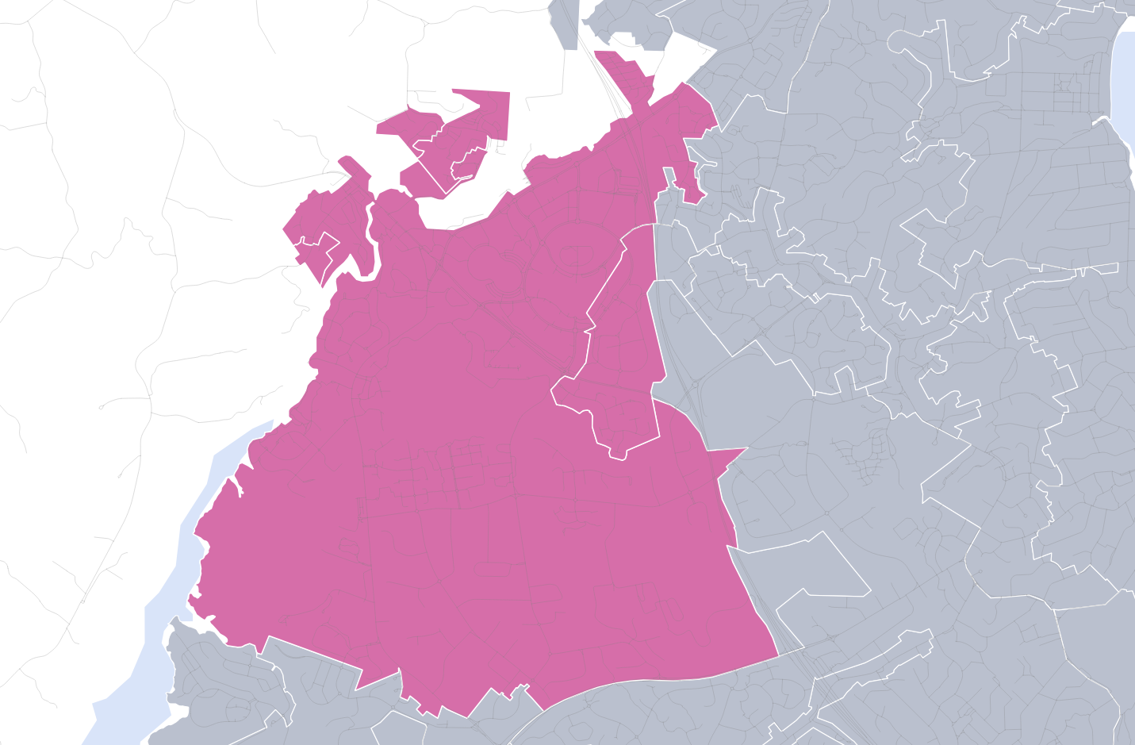
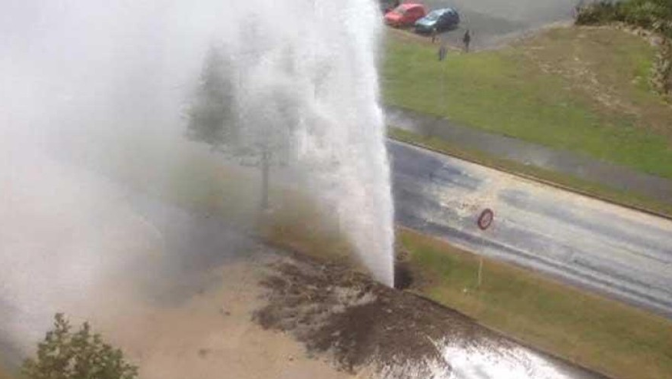
Case Study 2 – Albany
Issues:
Burst water main in Albany
Shopping centre shut down
No alternative supply
Albany
HGL 80m

Slide 9
Case Study 2 – Albany
Three valves
Solution:
New PRVs
New pipework
Three new valves
Alternative system established
PRV
Albany
HGL 80m
PRV
Pipework
ZV removed

Slide 10
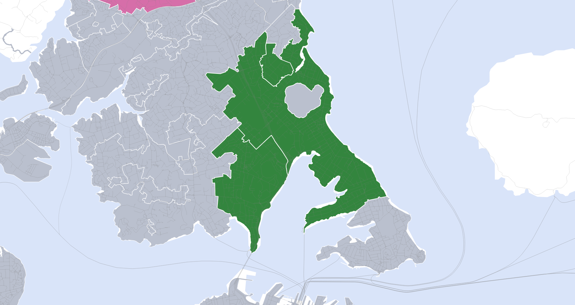
Case Study 3 – Takapuna and Northcote
Takapuna
Issues:
Takapuna and Northcote zones were exposed to higher and unstable pressures
PRV

Slide 11
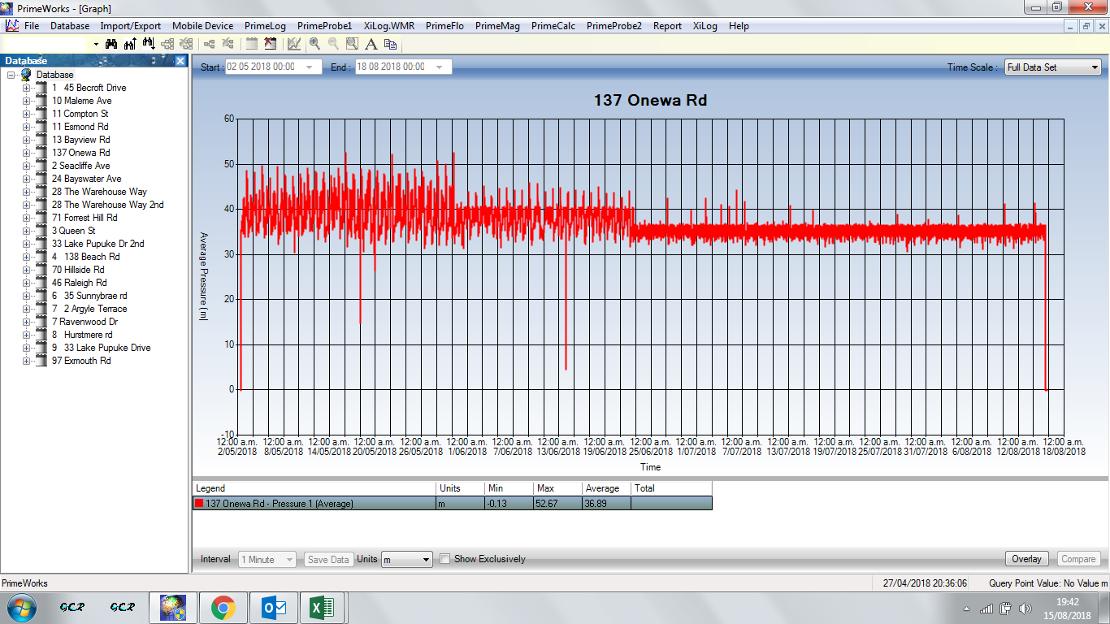
Case Study 3 – Takapuna and Northcote
Solution:
PRVs installed at 7 bulk supply points
Pressures reduced
PRV
Takapuna
PRV
PRV
PRV
PRV
HGL 80m
Northcote
PRV

Slide 12
Tips For Success
Communication is key
Make sure everyone’s on the same page
Respect each others strengths (and weaknesses)
Build knowledge culture

Slide 13
Working Together
Operators and Modellers to improve efficiency
March 2019
Zoran Pilipovic and Mike Dunstone

