Slide 1
initial response in an Emergency: Christchurch WWTP fire
Dr Becky Macdonald – Jacobs NZ Ltd
Adam Twose – Christchurch City Council
Patrick Cantillon – Christchurch City Council
Duncan Farish – Jacobs NZ Ltd

Slide 2
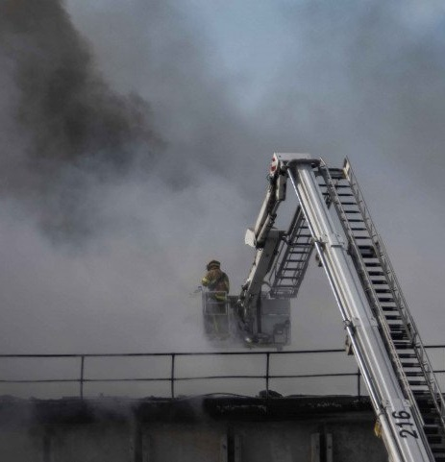
Agenda
Background
The fire event
An adaptive response approach
Immediate emergency response
Medium term solution
Where we are now

Slide 3
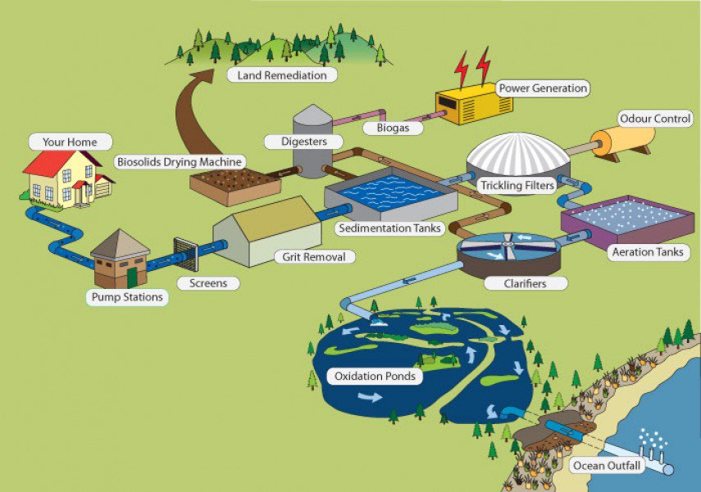
CWTP – Pre Fire
Trickling filter plant
55m diameter
28,000m³ PVC plastic media
5.4m³/s
70% BOD removal

Slide 4
The Fire
https://youtu.be/vPwt8slaFYI

Slide 5
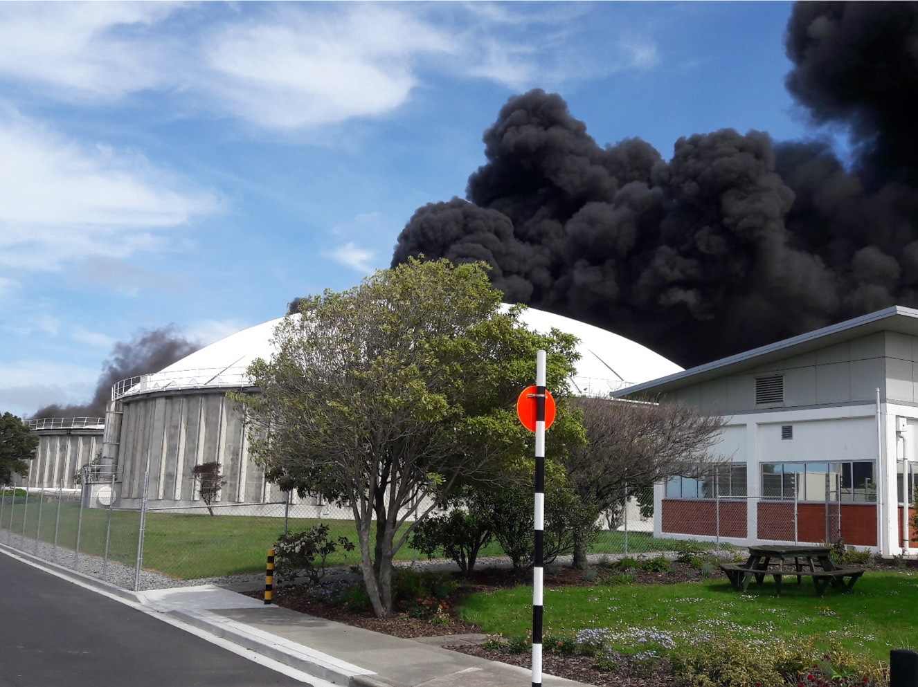
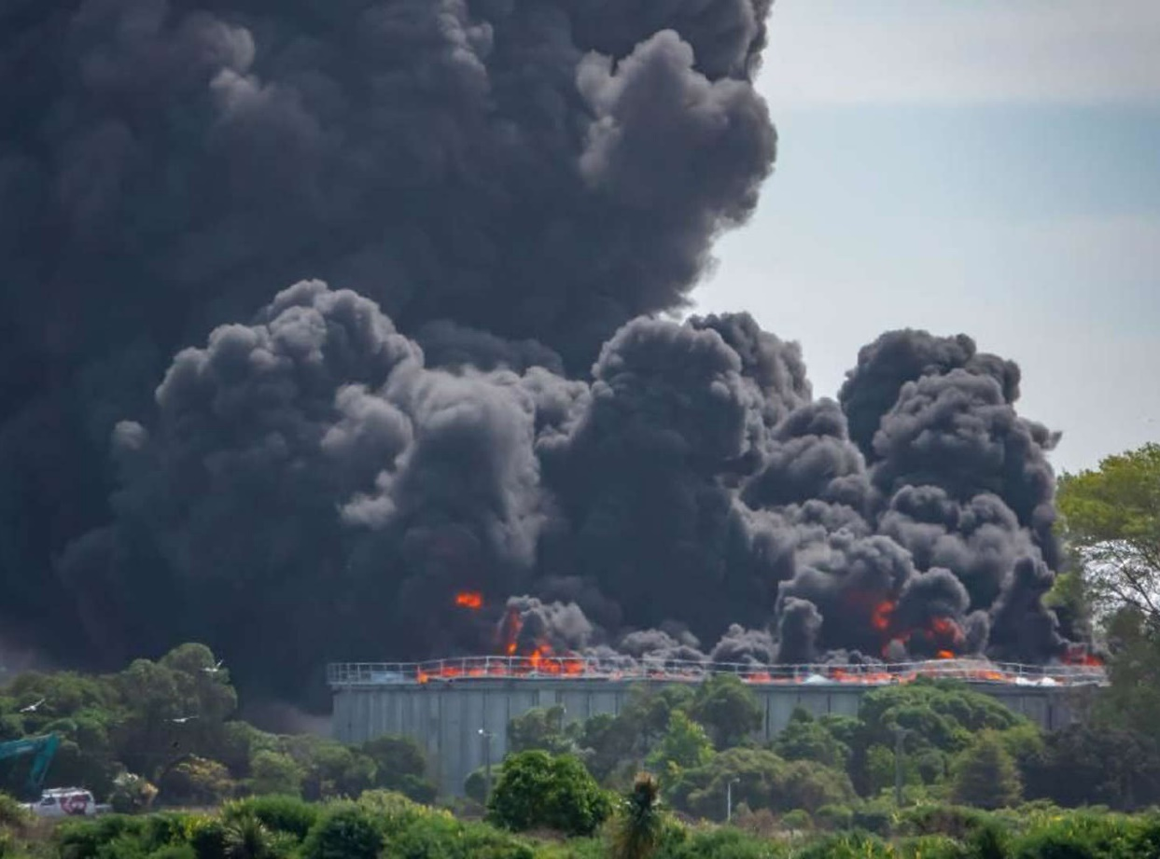
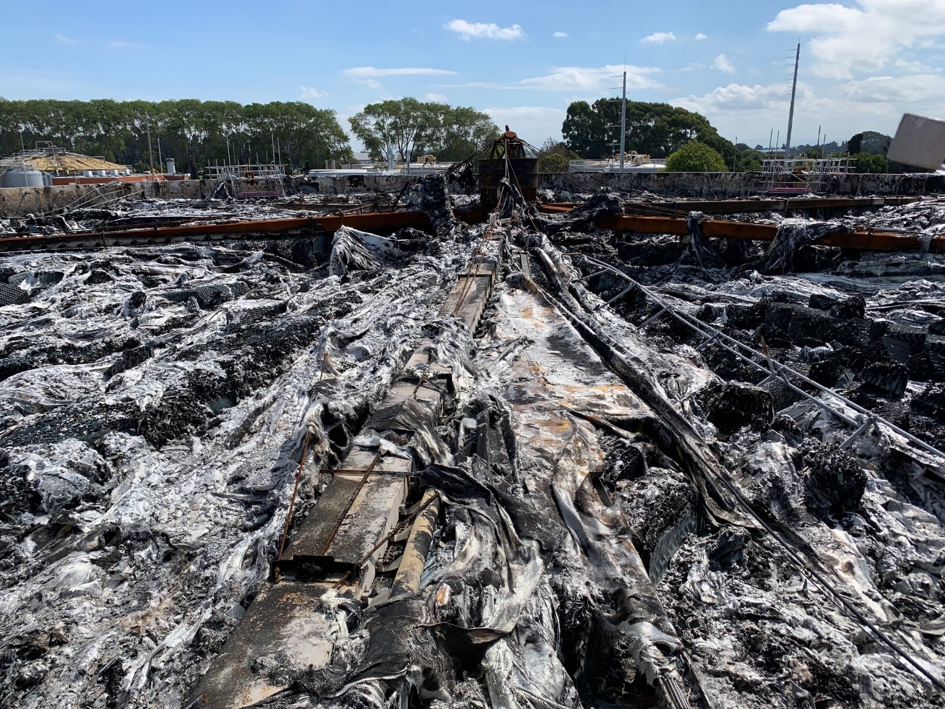
The Fire – in photos

Slide 6
CWTP – Fire Damage
Trickling Filter inoperable
Odour control compromised
Biology poisoned in treatment
Biology poisoned in ponds
WAS contaminated
Digesters compromised
Flow restricted

Slide 7
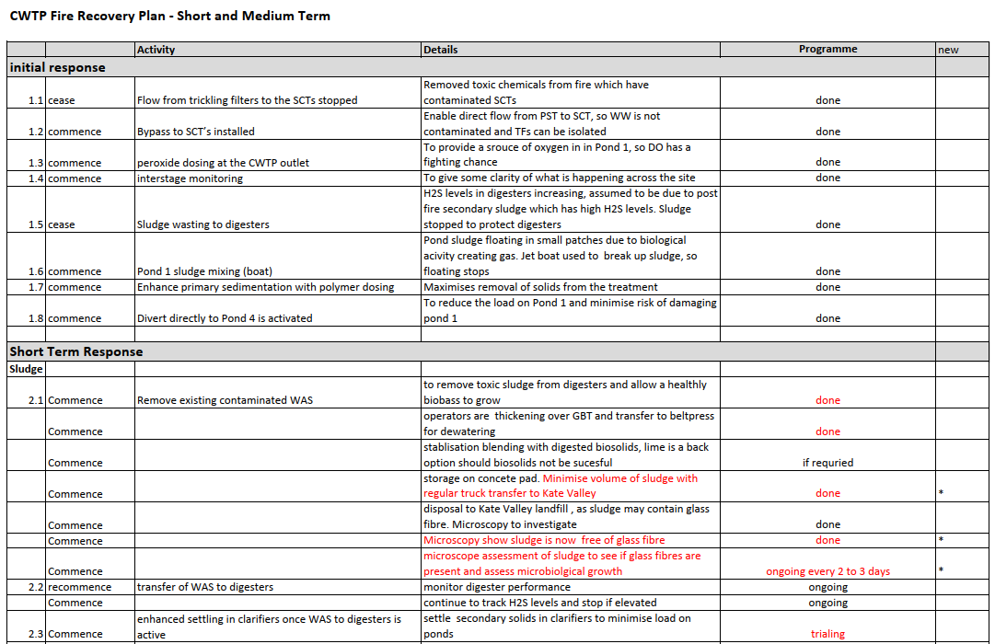
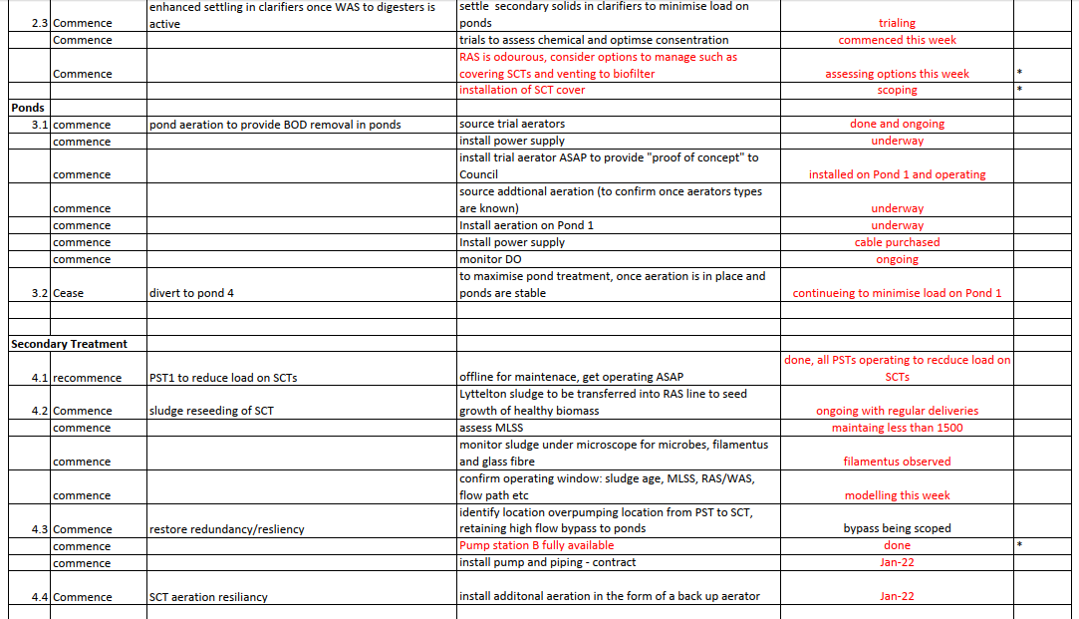
An Adaptive Emergency Response
Notes:
Becky
Emergency situation. is always a variable changing landscape.
Changing information can be overwhelming
The first challenge was the tame the flow of information
Make a plan! And I do like a good plan
Start with the urgent things
What needs to happen – commence, cease, continue
Give it a name
Provide details – which changes and grows as you find more
Give it a “programme”
For CWTP we sorted things into 3 timeframes
Immediate/urgent
Short term
Medium term

Slide 8
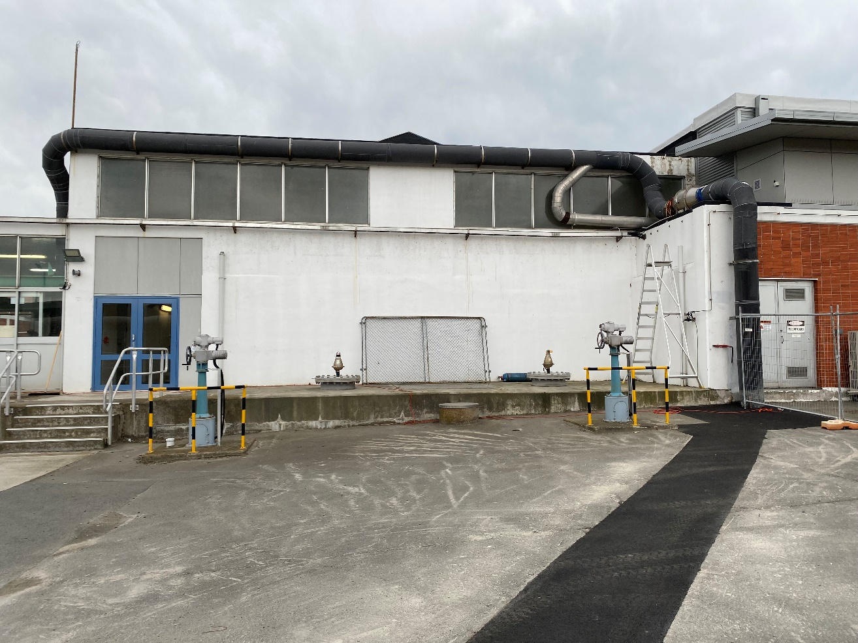
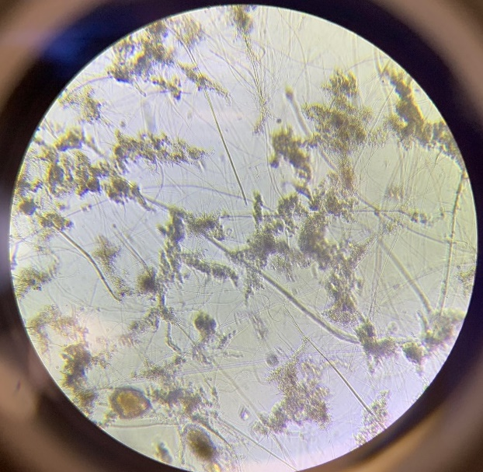
Immediate Emergency Response
Reinstating odour control
Screen Room
Trickling filter disconnection
Biology protection
Primary treatment enhancement
Notes:
What does the immediate response look like:
Screen room odour control was connected to the TFs – reinstatment
New ducting from the inlet works to connect to undamaged foul air system, conveyed to the biofilter
Wastewater was used as part of the fire control in TFs
Flows through to aeration basins and then to the ponds.
No bypass from 1°, to 2° ………….. Only bypass to Ponds
Toxic byproducts of combustion killed off the biology
Construction of new gates to positively disconnect TFs
Secondary treatment significantly compromised, so maximise primary treatment
Alter flow path through PSTs to optimise
Introduce polymer dosing to inlet channel – post screens to maximise TSS capture

Slide 9
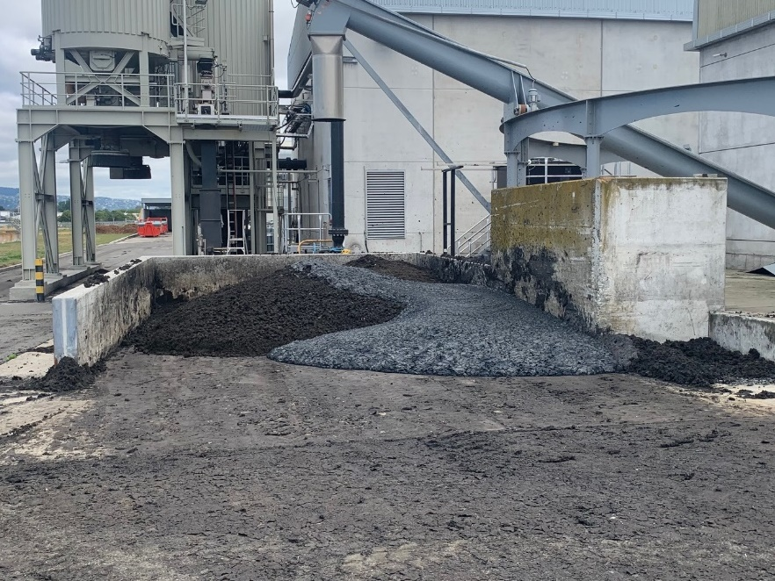
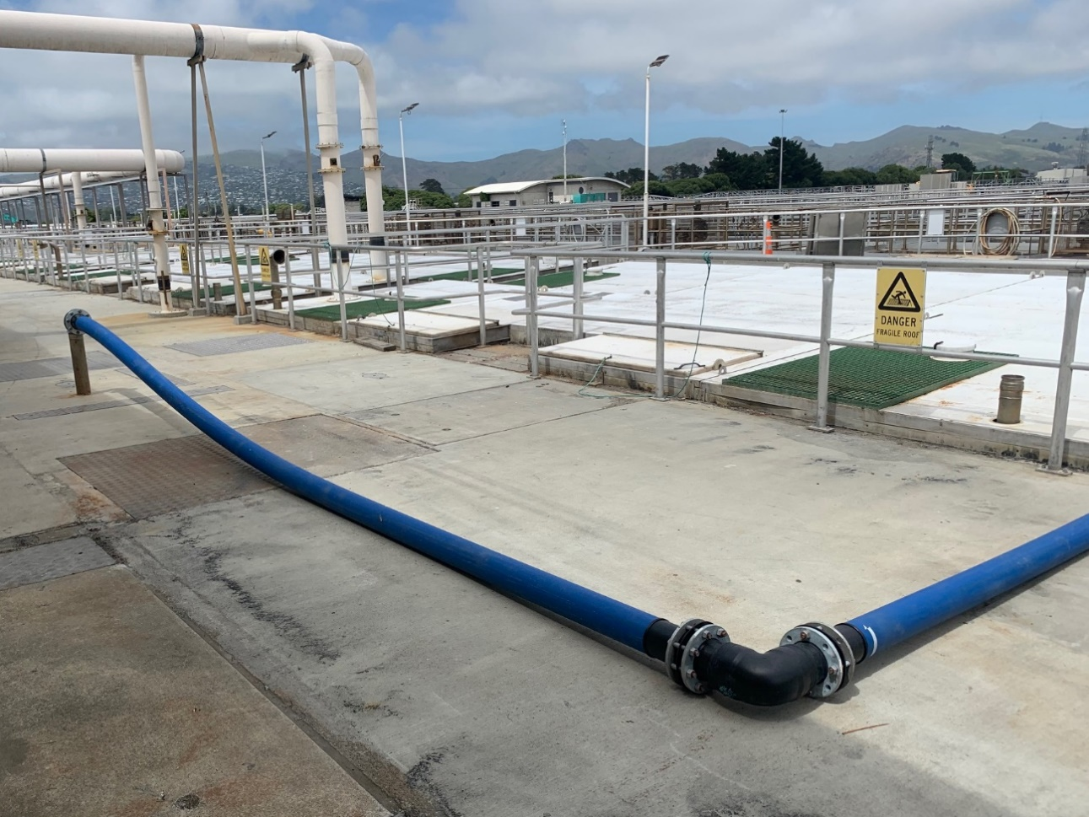
Immediate Emergency Response
WAS diversion
Digester treatment protection
Notes:
The toxic byproducts of combustion had a negative impact biology of the digesters
Increasing pH, H2S etc.
Glass fibres from roof compromising biosolids reuse
Divert 2° to landfill, but cannot take dilute wet sludge
Tie into sludge hopper post Belts
Retrofit overland path to belt presses
Sequence 2° sludge dewatering for disposal and digester biosolids for reuse
Hard work for shift engineers, swapping between very different raw materials
Once sludge cleared out, no more 2³ sludge being generated, reset to normal

Slide 10
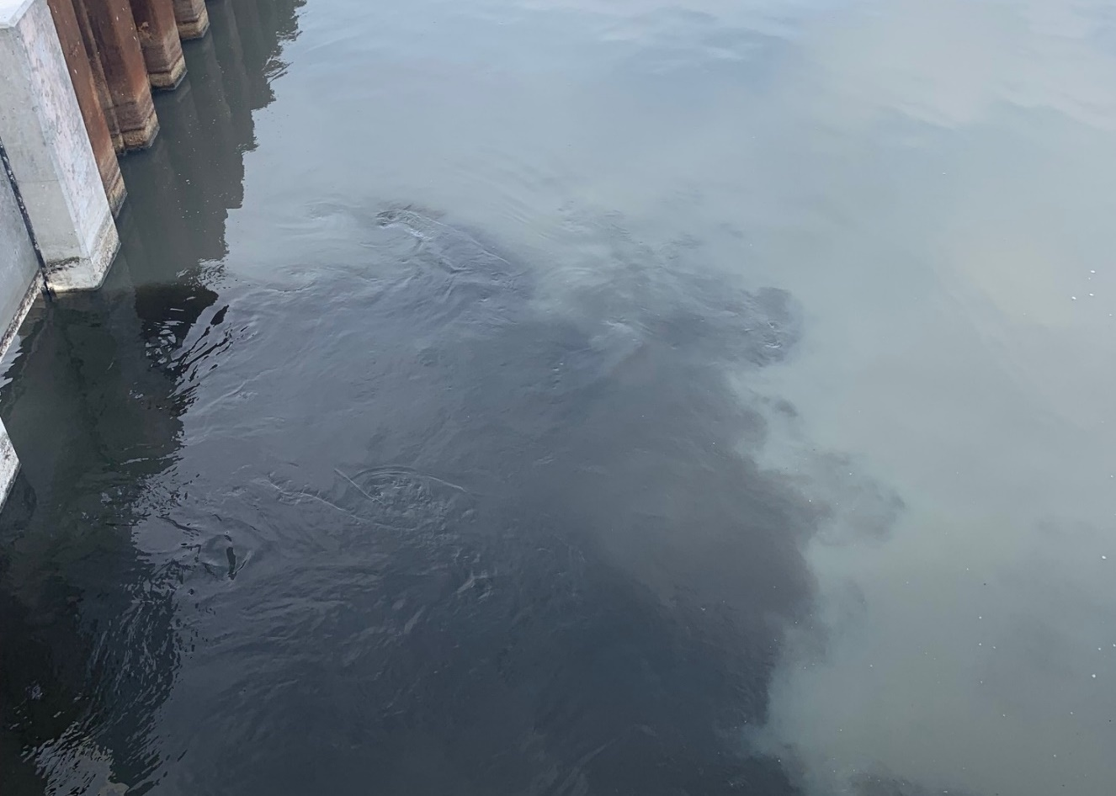
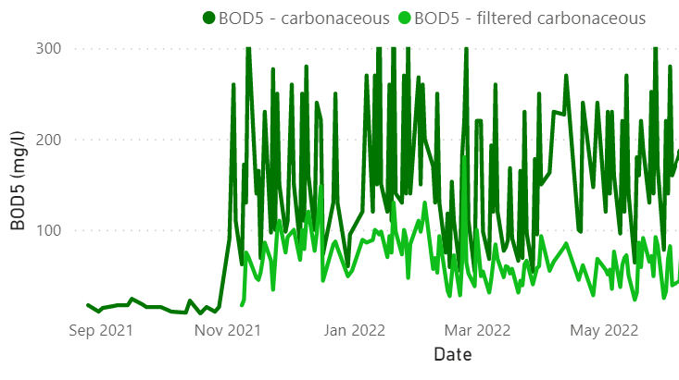
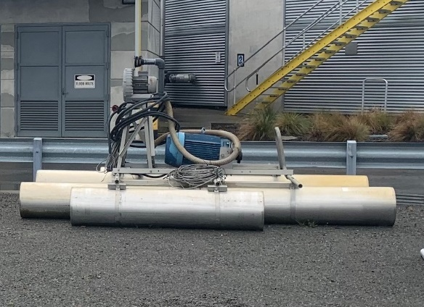
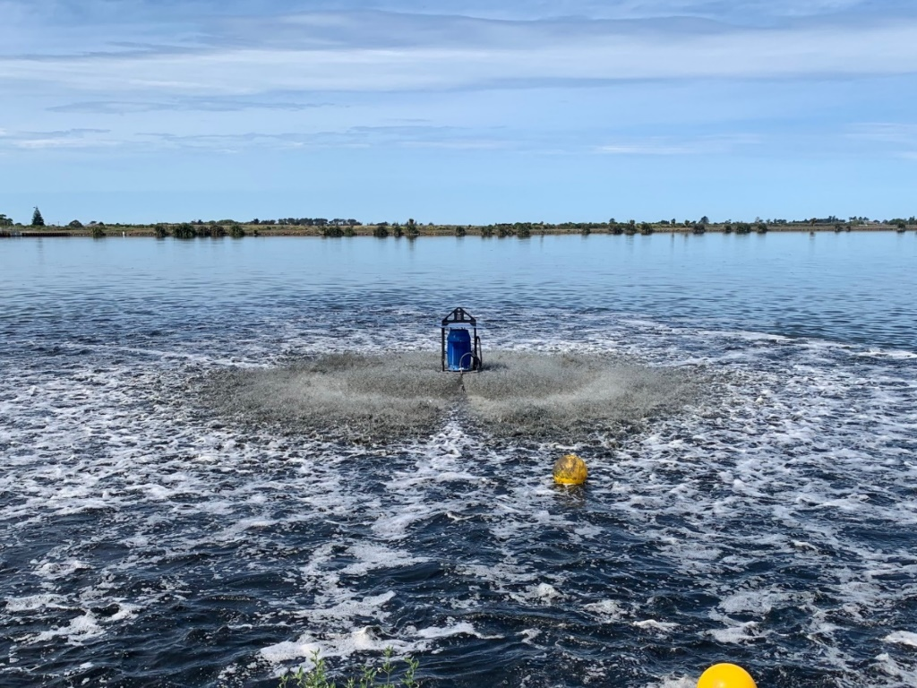
Immediate Emergency Response
The Ponds
Toxic influent
High BOD load
Aeration
Notes:
So the ponds ………….
Also impacted by the toxic byproducts of combustion
Ponds went black
DO plummeted, due to the lack of algae and the higher than normal BOD and high TSS carry over
Sludge built up on Pond 1, floating to surface leading to odour
Installed aeration, for 2 reasons
to break up sludge and aerate,
to reduce short circuiting
Call to the industry was answered– but we need very large units
Big thank you to Fonterra/Tasman for the lend of the Takaka aerator
Big thank you to ICC for their mothballed directional aerators

Slide 11
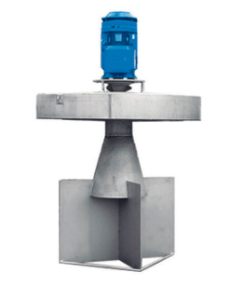
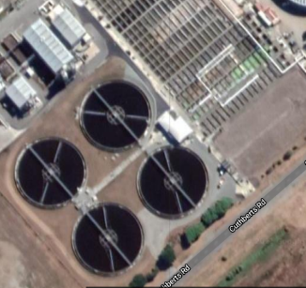
Restoring Secondary Treatment
Options Assessment
Level of treatment
Risk of odour
Retrofit into existing infrastructure
Development of the robust design basis
Consideration to operations and maintenance
Resilience in remaining plant
Constructability/Implementability
Supply chain (don’t believe everything suppliers tell us)
Power supply
Consenting
Costs
Notes:
What about secondary treatment
Assess the options
Used SUMO model to quickly assess the treatment impact different configuration options
Winner was
Refurbish clarifiers as aeration basins
Install 600kW aeration
Maximise aeration in SCTs
Maximise throughput of remaining 2° clarifiers
Install aeration on ponds to provide resilience
Install a TF bypass to maximise flow to 2°

Slide 12
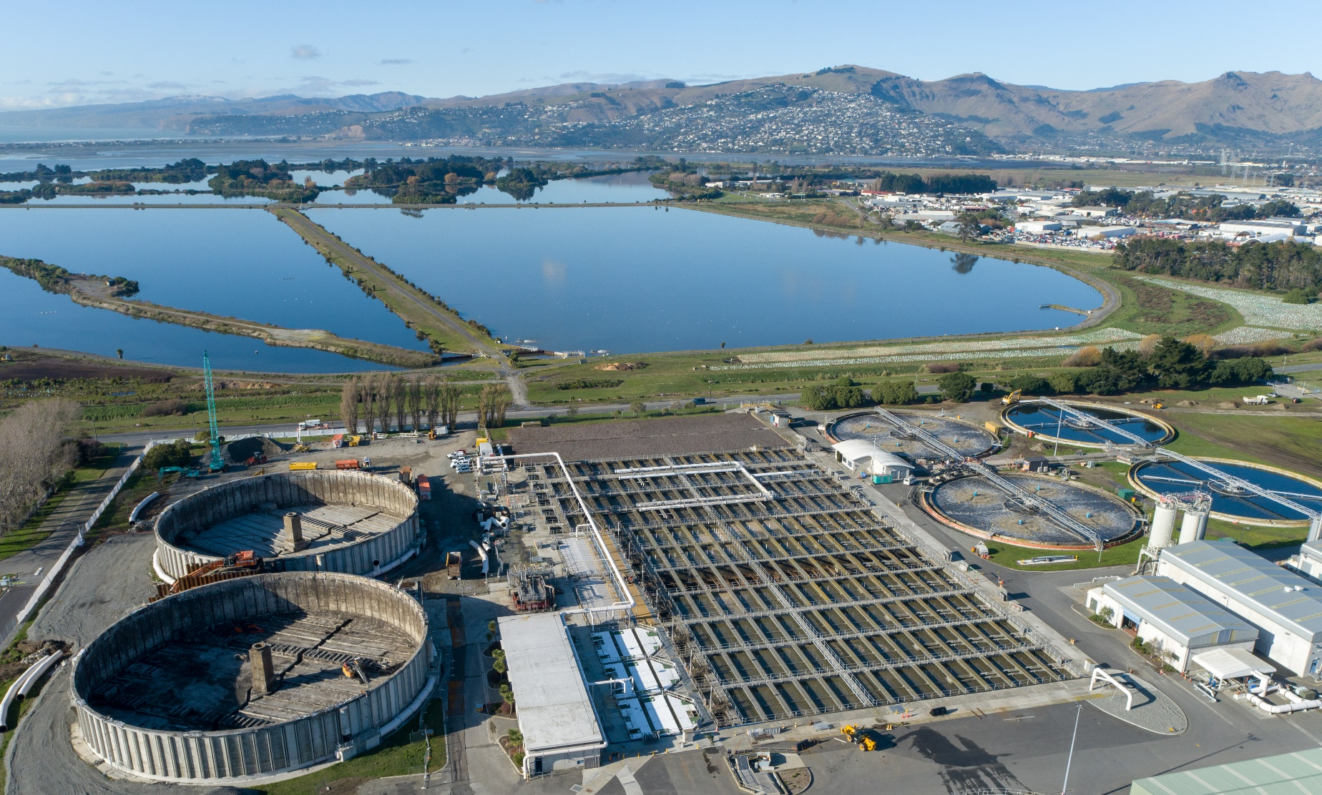
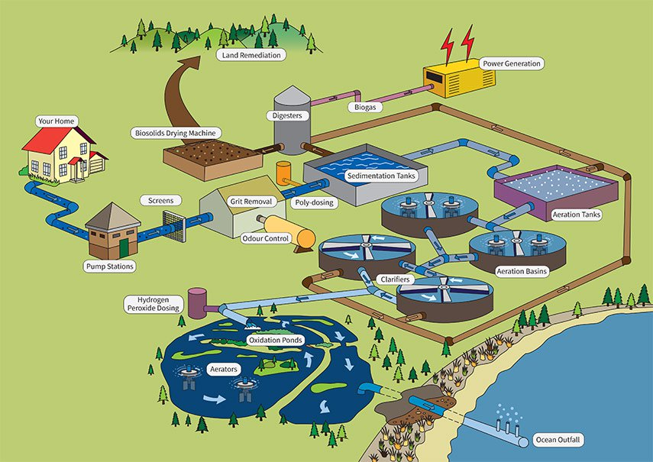
CWTP Today
Aerated clarifiers
Trickling filter bypass
Pond aeration
Come back for next years exciting installment !

Slide 13
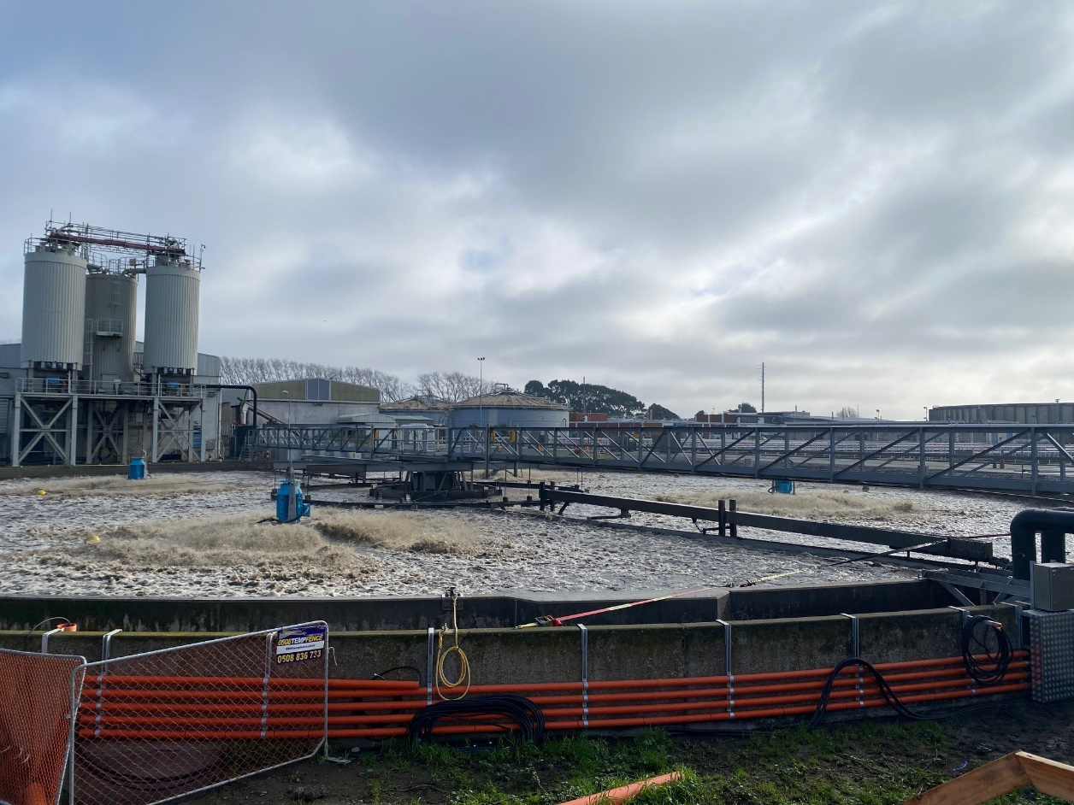
Acknowledgements
CWTP Shift Engineering team,
CWTP Maintenance Team,
CWTP Operations team,
Martin Polglase, Blair Potter, Michael Croucher, and Adrian Seagar (CCC)
SEIPP Construction
Svetlana Khasanyanova, Richard Greenwood, and Jack Deeley (Jacobs)

Slide 14
Thank you

Slide 16
Want to continue the conversation?
Come and say hello to the team at the Jacobs booth, location #125

