Slide 1
Notes:
Welcome to this update on the Transformation workstream and our work to date on readying a Transformation strategy with your input
My name is Ian Cathcart I’m Seconded to NTU from WDC and prior to that 20 years with Veolia Water around the world
started on the tools as a leakage technician and sampler in London
since arriving in NZ 20 years ago wanted to see our industry grow and our people grow.
We make a difference every day serving our communities with three waters services
how can we do it better and make it a career of choice for the next generation

Slide 2
Transforming the Three Waters Industry
Reform will provide the foundation to respond to systemic challenges
“Inherent Transformation”
Scale of the challenge requires industry transformation
“Visionary….”
Context for change
Three Waters Reform
1
Notes:
NZ three waters system is facing significant challenges and will continue to do so without transformational change.
Among so much change in the industry this for me is one of the most exciting parts! So let’s get you involved…. Big opportunity - Can we lead the world in water….?
Context for change….. 2 parts
Inherent – a new platform for asset management and workorder management on Day one – this in itself with be transformational for some Councils

Slide 3
Aspirational, pragmatic and implementable
Respond to existing barriers and challenges
Imagine the future possibilities
Blueprint for success
Medium to long term horizon
Co-developed with industry - whole of industry view..
Transforming the Three Waters Industry
Terms of reference
Three Waters Reform
2
Notes:
This has the backing of the Minister – regular briefings and transformation is what is sought
Terms of reference …..
So what’s the vision for transformation?

Slide 4
Transformation Vision
Wai – a life force that is fundamental to the health and wellbeing of all New Zealanders
Water perceived as an entitlement – Reality is our water resources are under pressure
Reassert the primacy of water as a life force - Te mana o te wai.
We’re looking at a reset not a tweak….
Three Waters Reform
3
Notes:
Not doing what we’ve always done
So what have we been doing……

Slide 5
Where are we at?
Targeted engagement completed
Identification of barriers, challenges and opportunities
Development of the Draft Transformation Themes Report
Wider stakeholder engagement, catalyst for feedback
Three Waters Reform
5
Notes:
Rio Tinto, Spark, Vodafone, Transpower,Fonterra
Health and RMA reform
Consultants, contractors, local councils and suppliers
standardization – manholes, valves,
Consider climate Change and Resilience

Slide 6
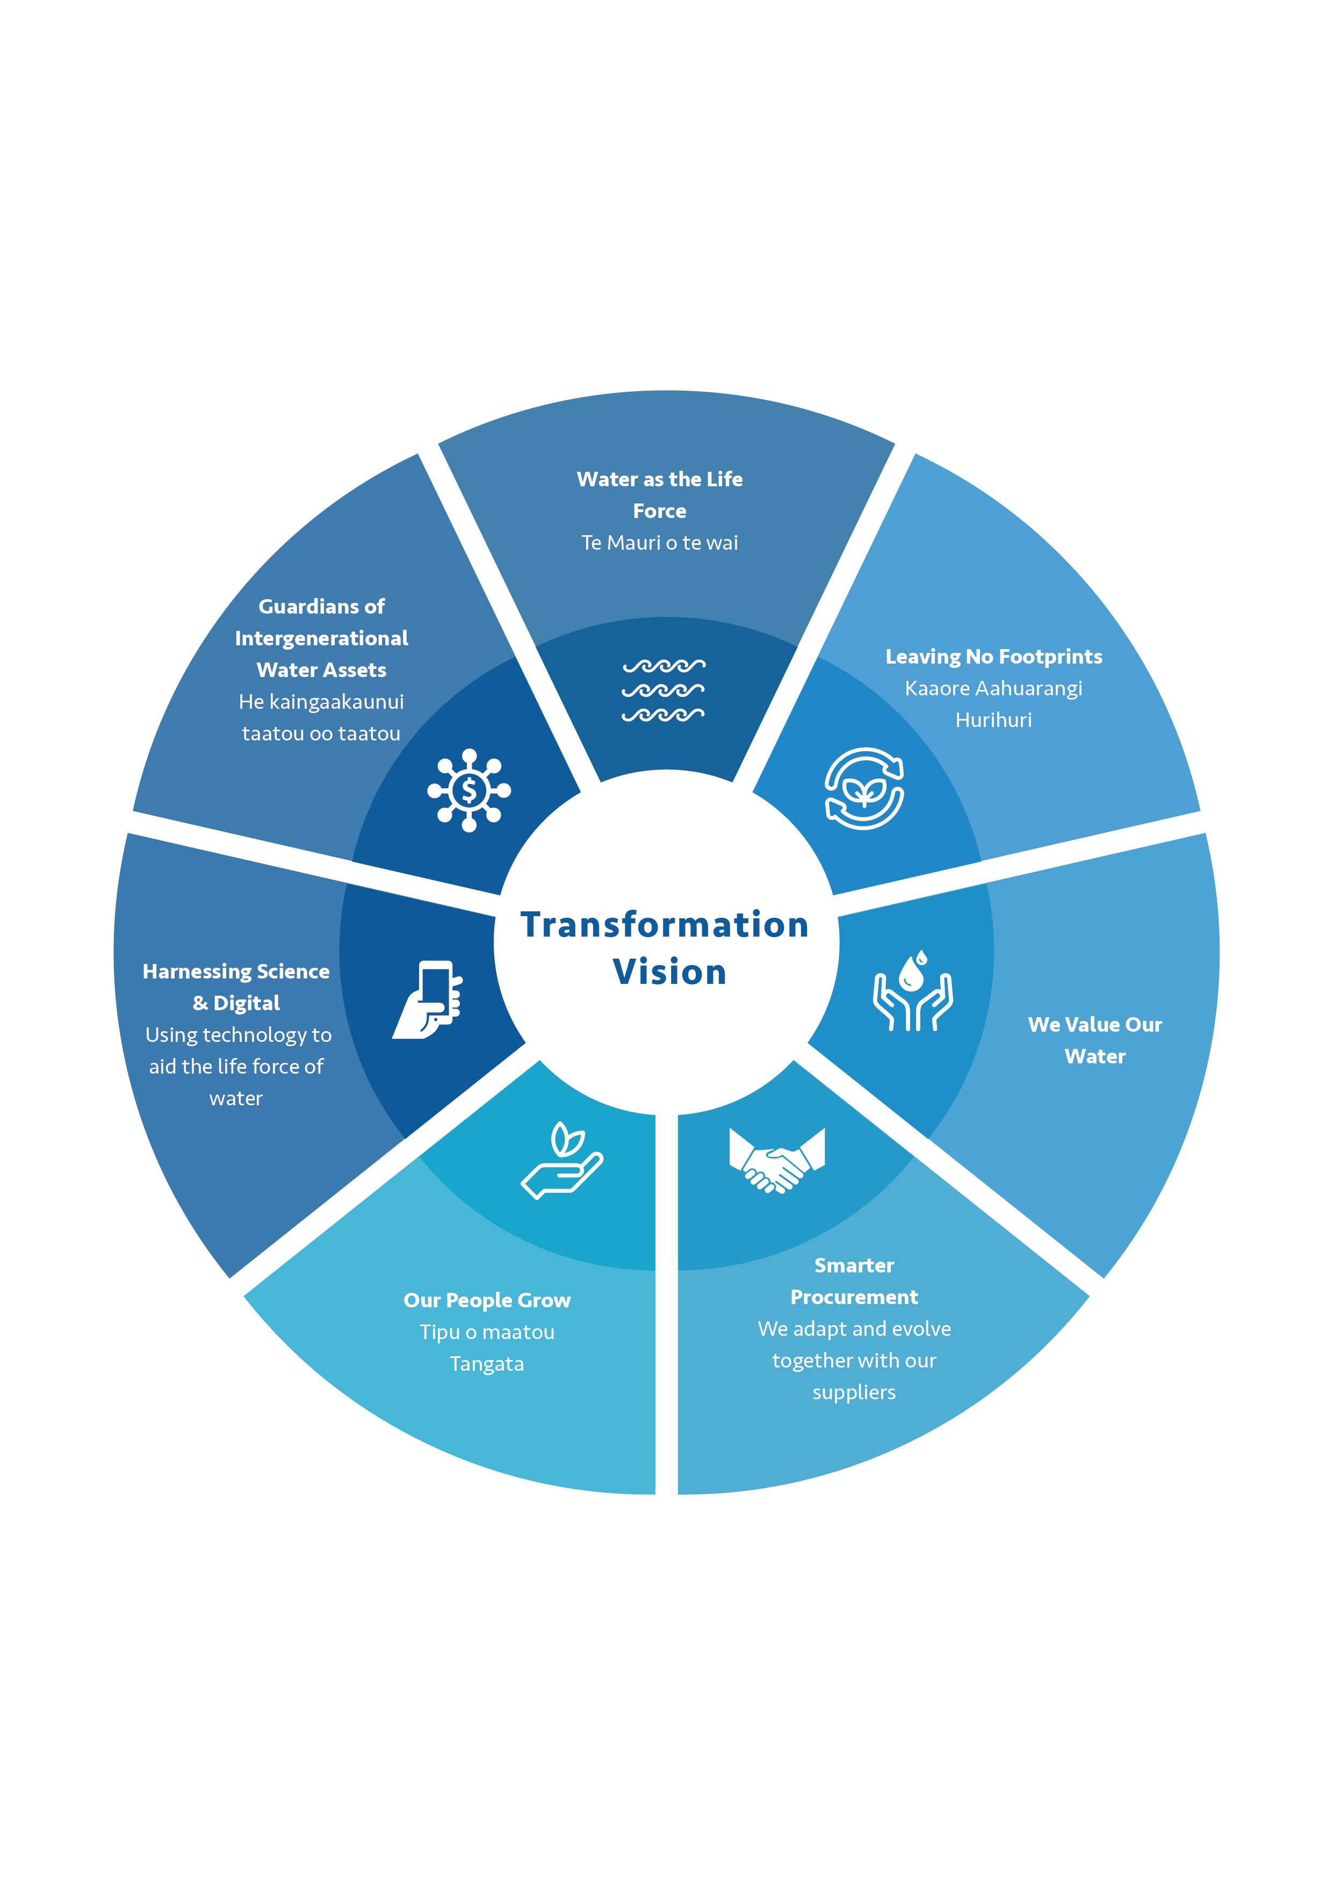
Draft Transformation Themes Report
Seven initial Pou…
Three Waters Reform
6
Notes:
Water footprint and carbon accounting practiced, circular economy approach
Water Neutrality on new developments, use highly treated reclaimed wastewater
Procurement, value local relationships with targets for local and SME spend
People grow – most exciting (elaborate later further some ideas) how about a vision of Safer Smarter workplaces
Data and digital – opportunities galore, mind bogles at what we can do – apply kiwi ingenuity – INNOVATE
Guardians – long term, not focused on three year political cycles
This is MASSIVE – we can use this reform as a platform for the NZ industry to take the best from every area of the world and become the LEADER IN WATER
Built on Te Mana O te Wai and great people it’s an wonderful prospect and I hope you share my EXCITEMENT!

Slide 7
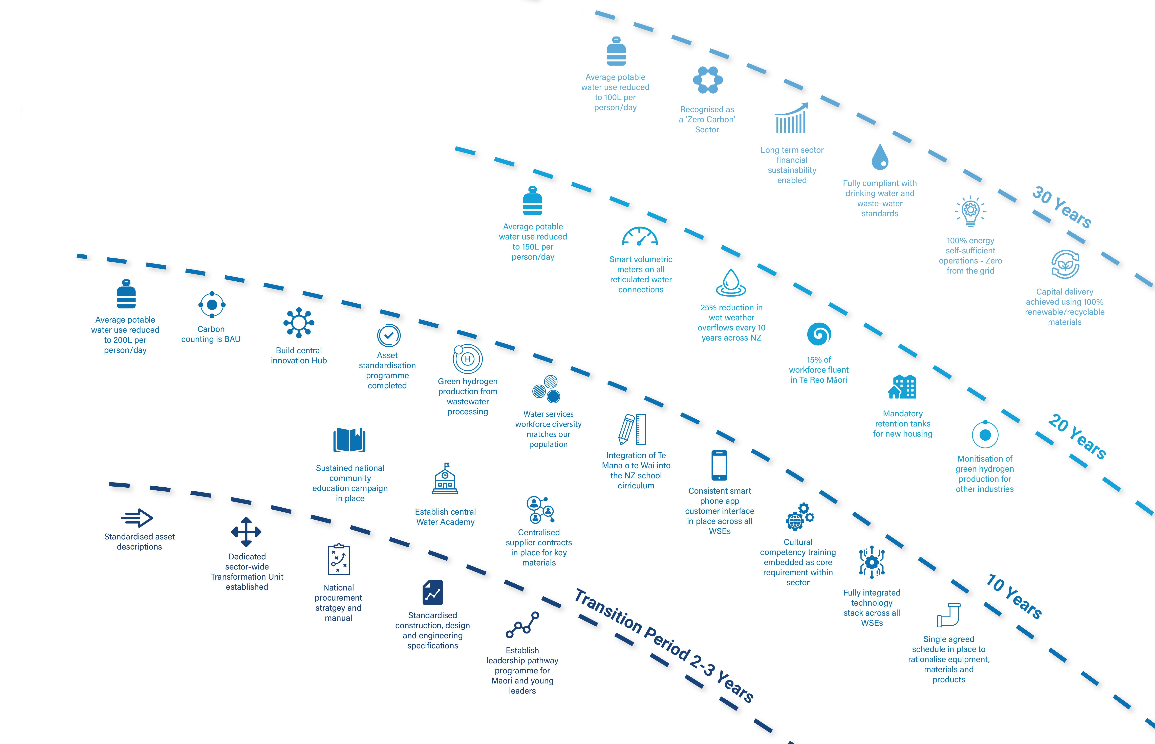
Draft Transformation Themes Report
Three Waters Reform
7
Notes:
FOCUS here on the waves of activity --- AND there are many more – I’ll touch on a few next slide
Inherent is first and in all honesty we do have to look at Day 1 and make sure we don’t fail. Realistic seamless transition. Set in place this STRATEGY for Transformation in parallel.

Slide 8
Draft Transformation Themes Report
Our people grow..
Three Waters Reform
7
Notes:
Imagine a new industry where….we have
And a country where…..

Slide 9
Draft Transformation Themes Report
Tech and visionary
Three Waters Reform
7
Notes:
Imagine a new industry where….we have
And a country where…..
IMPORTANTLY this is just a selection, A TASTER - a catalyst for your input
SO TIMELINE AND PROCESS…..

Slide 10
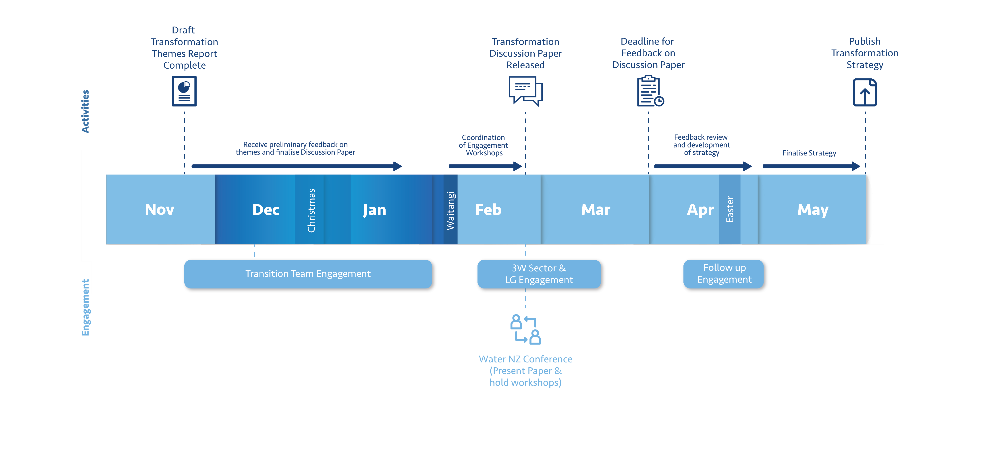
Next Steps
JUNE/JULY
Three Waters Reform
8
Notes:
Release of the DTTR
Engagement process
Feedback opportunity
Development of the final strategy

Slide 11
Next steps
For the industry by the industry
Work in progress
Iwi/Maaori
Representation Governance and Accountability working group
Visionary – so please get involved, released Mid March
Webinars, workshops conversations on the Pou
Chance of a lifetime!
Three Waters Reform
3
Notes:
IN CLOSING
Create an industry that you’d want your children to be part of…
And let’s seize the opportunity and drive the change I’m sure you all are eager to see…!
Imagine a Future headline….
“NZ leads the world in water management...” where people clamour to hear about the way we do things!
And with that I’ll open up to questions and observations and I have Fraser Robertson from the project team to assist.

Slide 12
Questions / Observations
Three Waters Reform
8
Notes:
Release of the DTTR
Engagement process
Feedback opportunity
Development of the final strategy

