Slide 1
Streamlining flood risk advice for Land Development

Slide 2
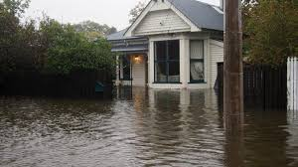
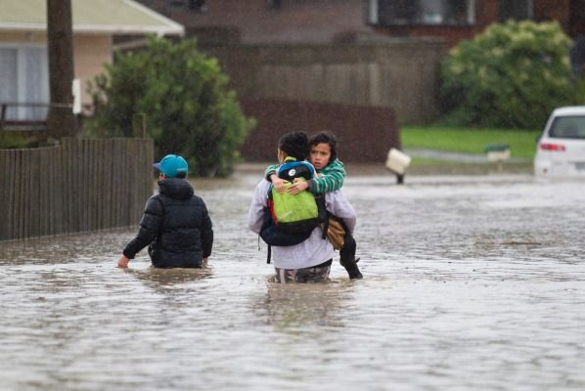
Significant flood events are becoming more regular affecting more and more people
These problems could have been avoided if adequate risk identification and planning was carried out before building
Our aim is to influence council planning and land development to minimise flood risk avoiding mistakes of the past

Slide 3
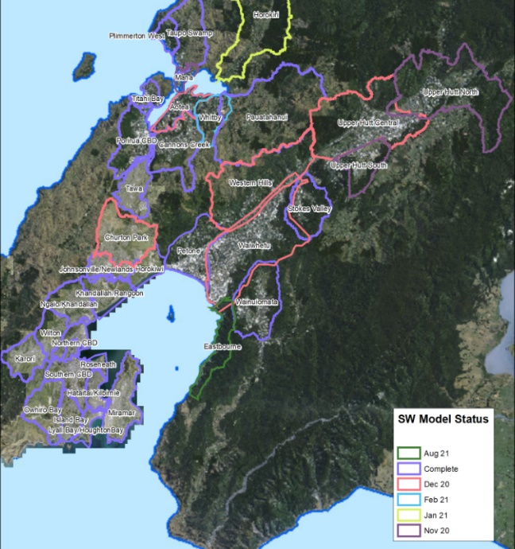
Wellington Water Modelling Program
Inline with this aim Wellington Water is carrying out flood modelling and mapping program spanning Wellington Region
Notes:
Flood risk management has a range of activities which underpins modelling – therefore important to udnerstand

Slide 4
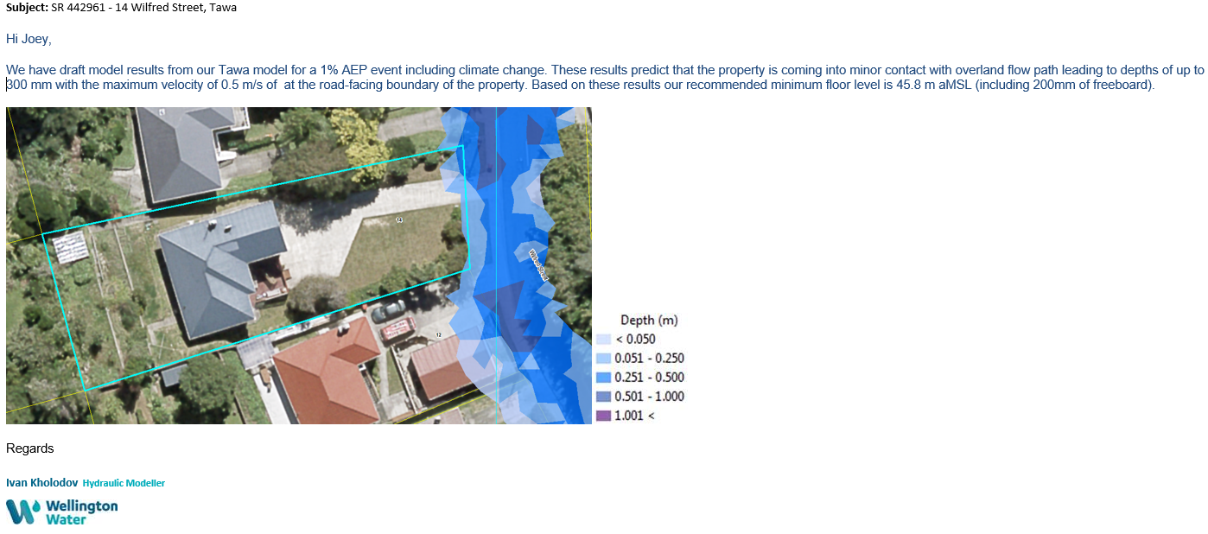
Flood Modelling Advice for Land Development - Beginning

Slide 5
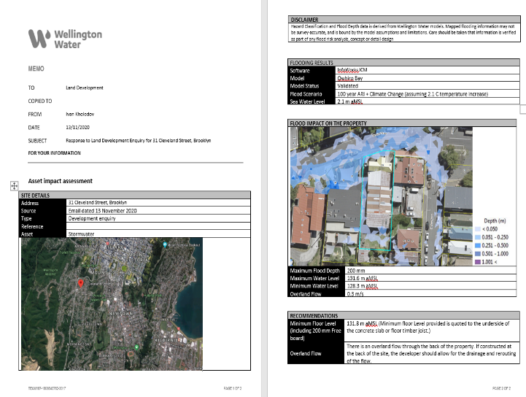
Flood Modelling Advice for Land Development - Progression

Slide 6
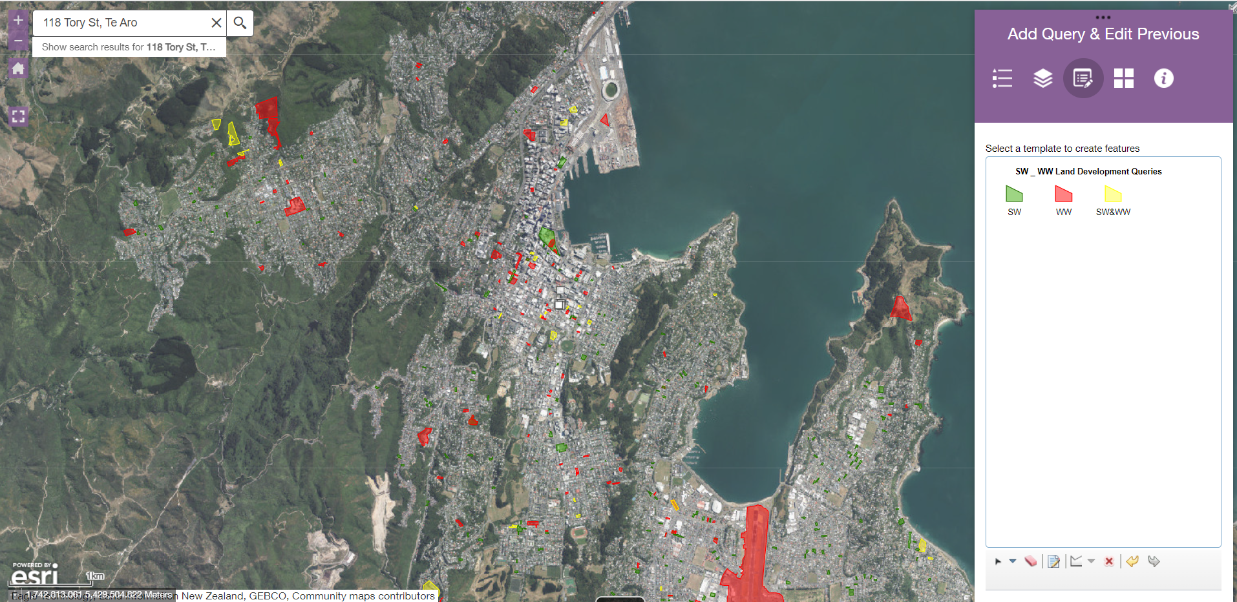
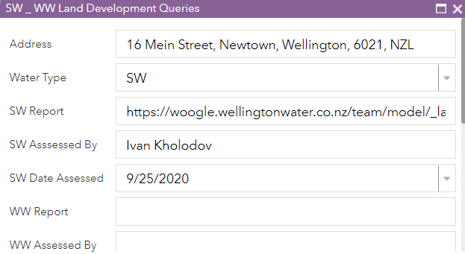
Flood Modelling Advice for Land Development - Progression

Slide 7
Land Development vs Rest of the Business
Network Investigations & Operations
Land Development
So… What’s the solution?
Notes:
Objectives could be flood forecasting, flood mapping, operational control structures
Design etc

Slide 8
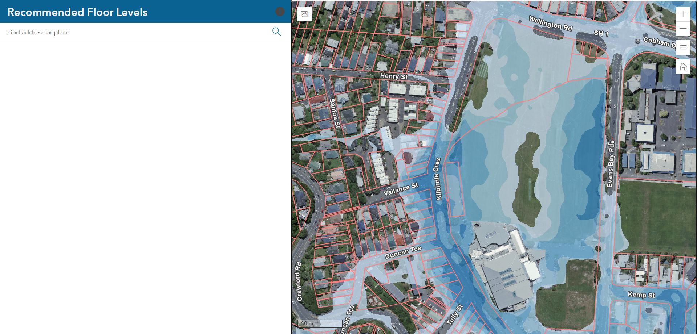
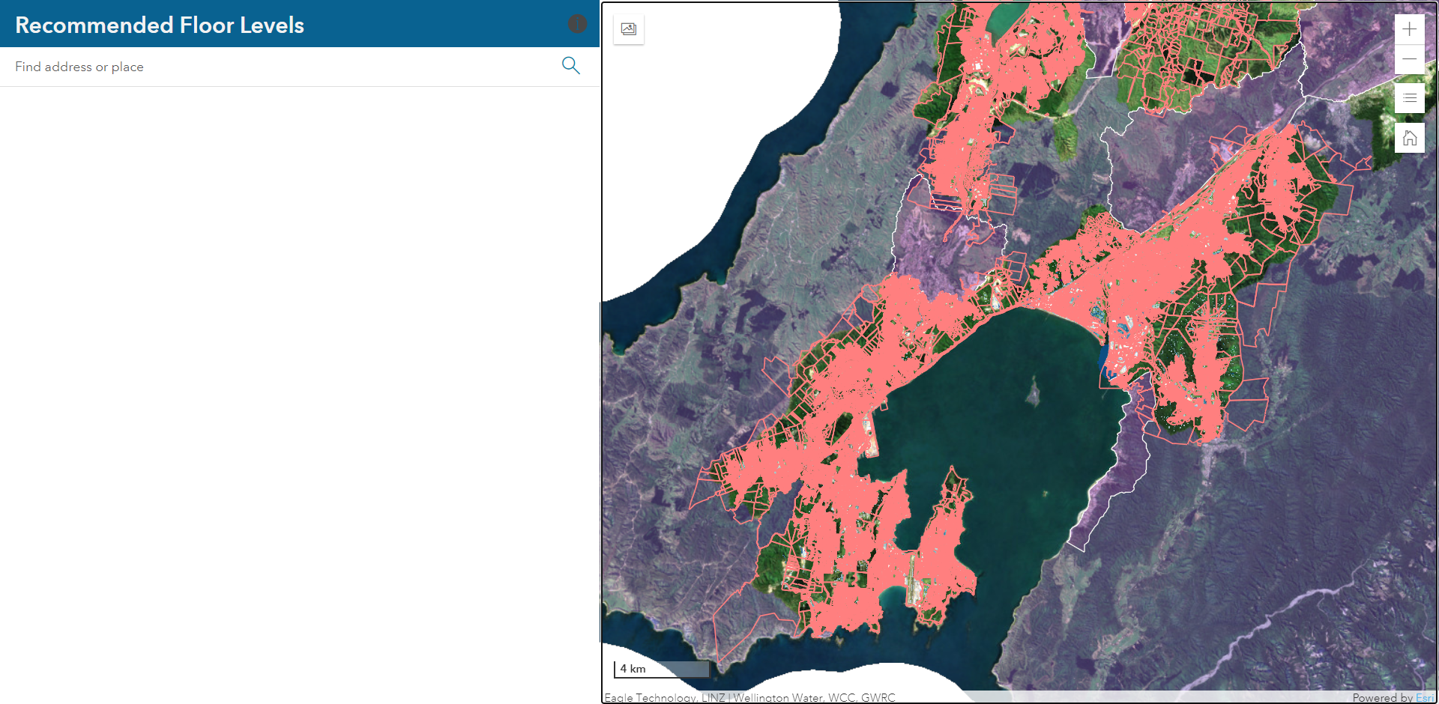
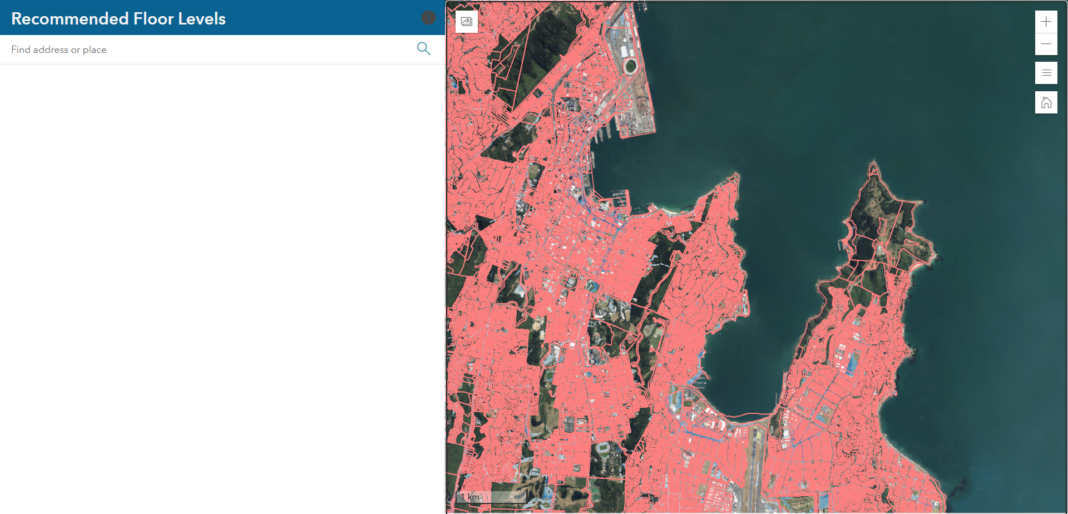
Minimum Floor Level advice APP
Enter address
or Click on the map
Notes:
!D solves I dimensional st venant equations solving them at a point – single water level, velocity erc at cross-sectioms and also the types that affect flows ( structures, cross-section, roughness, tides, junctions etc), inflow
Generally ise these for defined channnles, rivers streams.
Soles 2dimensional equations of flow – ie if your flowspreads out to
Usually calaculates water depath, flwo and velocity on a grid or mesh
Requires usually an terrain model or bathymetry of channels
No need to predefine flow routes and more accurate on the variation on the 2d floodplain

Slide 9
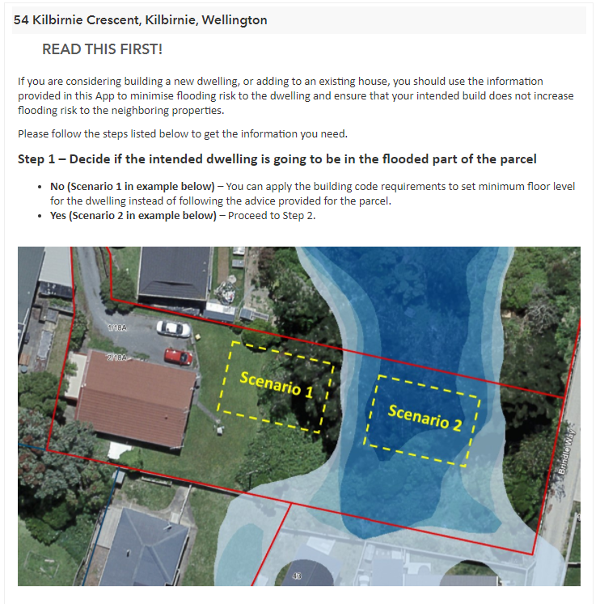
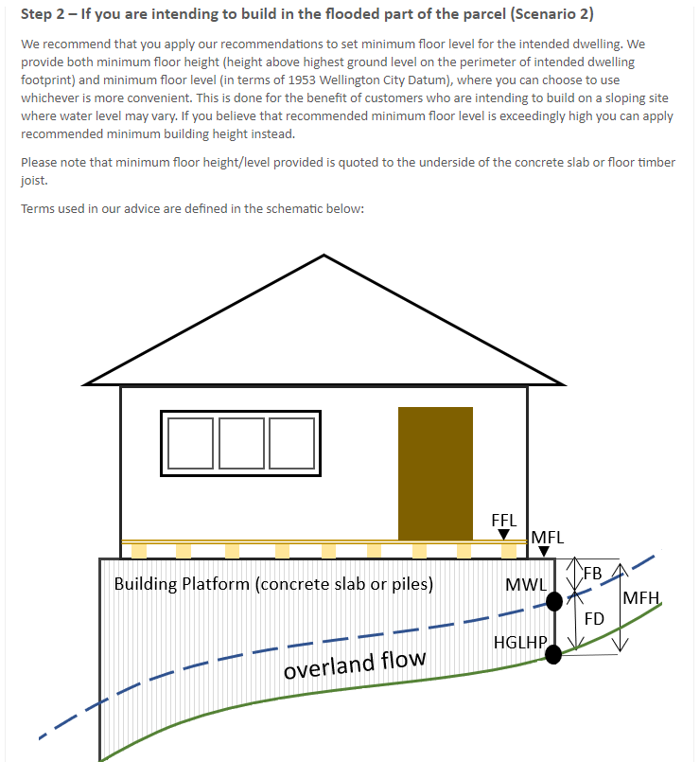
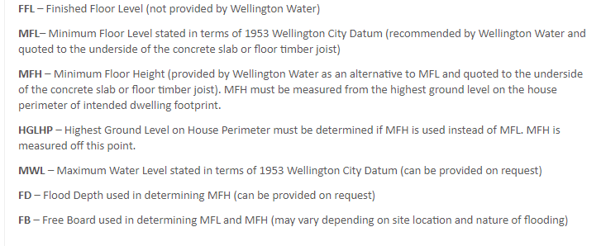
Minimum Floor Level advice APP - Report
Notes:
Data requirements

Slide 10
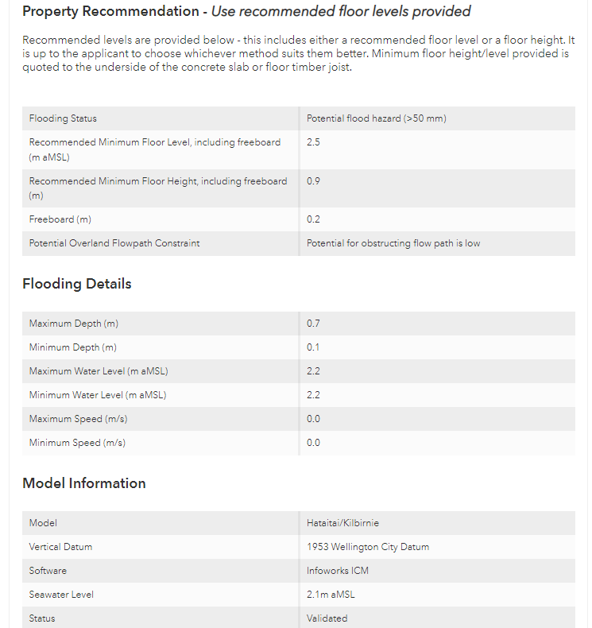
Minimum Floor Level advice APP - Report

Slide 11
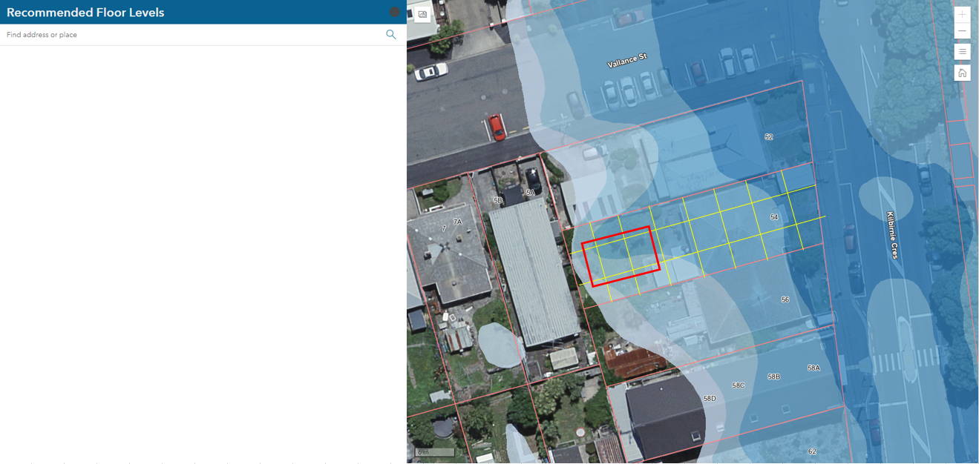
Flood Modelling Advice for Land Development - Future
Generate report

Slide 12
In Conclusion
this App has already reduced workload on the Modelling Team, and it is hoped that once it is available to the public, will reduce the workload by as much as 90% at which point only detailed assessments will be done in-house.
It is hoped that one day Modelling Team can fully focus on modelling tasks such as building/updating models and working on modelling investigations.

