Slide 1
Andreas Fischer & Louis Ortenzio
Piloting an MBBR to treat pond effluent for nitrogen removal
Lutra
Notes:
Thank you very much for coming to my presentation.
My name is Andreas Fischer, and I am the Innovation Lead and a senior process engineer at Lutra.
This presentation is about moving bed biofilm reactors, or MBBRs.

Slide 2
Contents of this presentation
Why MBBR in New Zealand
Basics of MBBR
Our pilot plant
Plant performance and analysis
Notes:
MBBR = Moving Bed Biofilm Reactor
In this presentation, I’m going to cover
why MBBR is interesting for New Zealand
the basics of MBBR.
I’ll show our MBBR pilot plant
and discuss results from two on-site trials

Slide 3
Why is MBBR interesting for New Zealand
Parameter | Old Limits (mg/L) | New Limits (mg/L)
TSS | 30 | 5
cBOD5 | 20 | 5
Ammonia | 55 | 1
Total Nitrogen | n/a | 3
Total Phosphorus | n/a | 1
Notes:
Many wastewater plants in NZ are oxidation pond based.
Oxidation ponds usually perform well for BOD removal, but often struggle to remove nitrogen such as ammonia and nitrate.
As effluent nutrient loading becomes a greater focus across New Zealand, resource consent conditions will become significantly more stringent. Many oxidation pond based treatment plants will need significant investment to increase the effluent quality and decrease the risks of non-compliances.
Recently, a few new technologies have been introduced in New Zealand, such as bio blocks, membrane aerated biofilm reactors, or MABRs, and moving bed biofilm reactors, or MBBRs.
Of those three technologies, MBBR has a long track record for nutrient removal and has been in use for over 30 years. There are thousands of installations world wide. It’s a reliable, compact, well proven and cost-effective solution to remove nitrogen from wastewater.
Globally, many MBBRs are installed downstream of oxidation ponds to remove nitrogen, and this is exactly why they are interesting for New Zealand.
Combining an oxidation pond with an MBBR allows to reuse existing infrastructure. This is good for the carbon footprint, and results in lower capital and operational costs.
------ Next slide ----

Slide 4
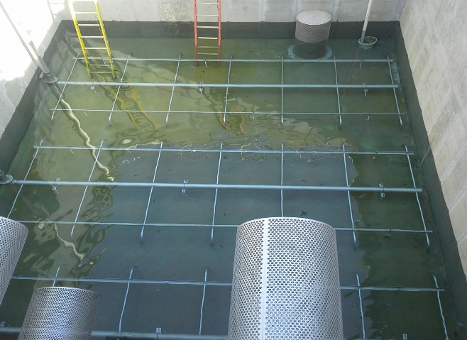
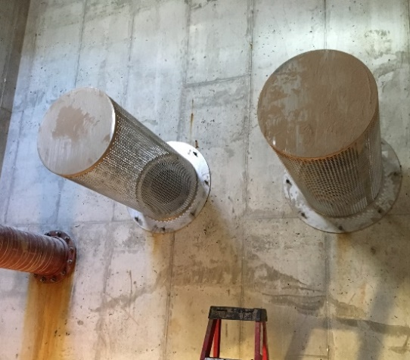
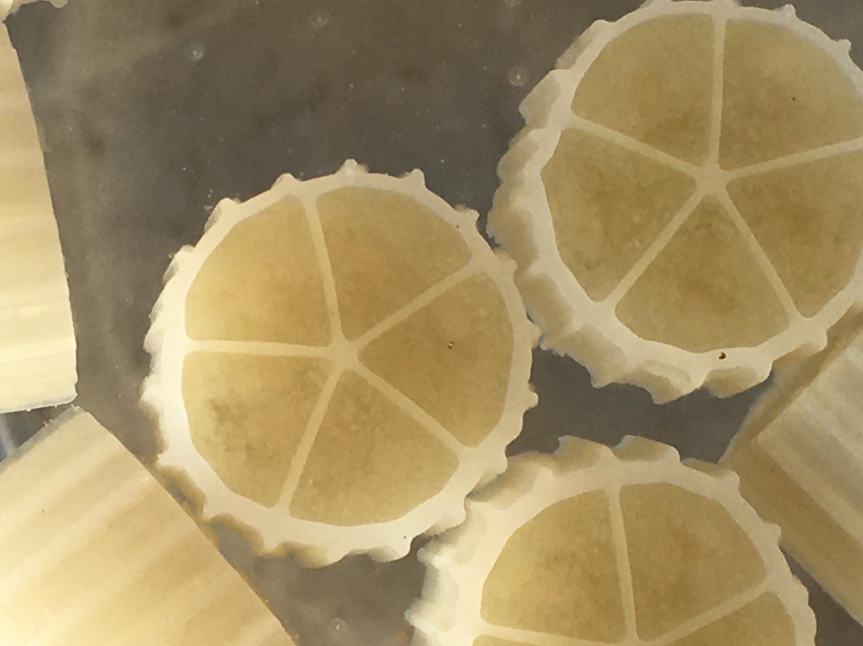
Basics of MBBR
Notes:
MBBR is a biofilm process using free floating carrier media. Media is kept in bioreactors through retention screens.
MBBR typically operates in aerobic environments for BOD removal and nitrification, and anoxic environments for denitrification.
There are other applications such as anaerobic mbbr’s and several configurations, but conventional BOD removal and total nitrogen systems are the most common globally.
MBBRs typically have a short hydraulic retention time of 20 to 60 minutes. They operate well at low temperatures and are resilient when experiencing shock loads and toxic substances.

Slide 5
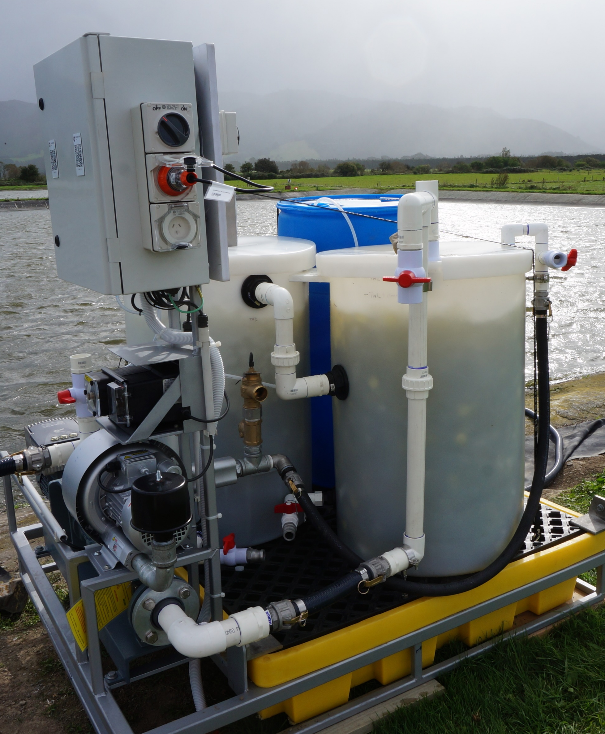
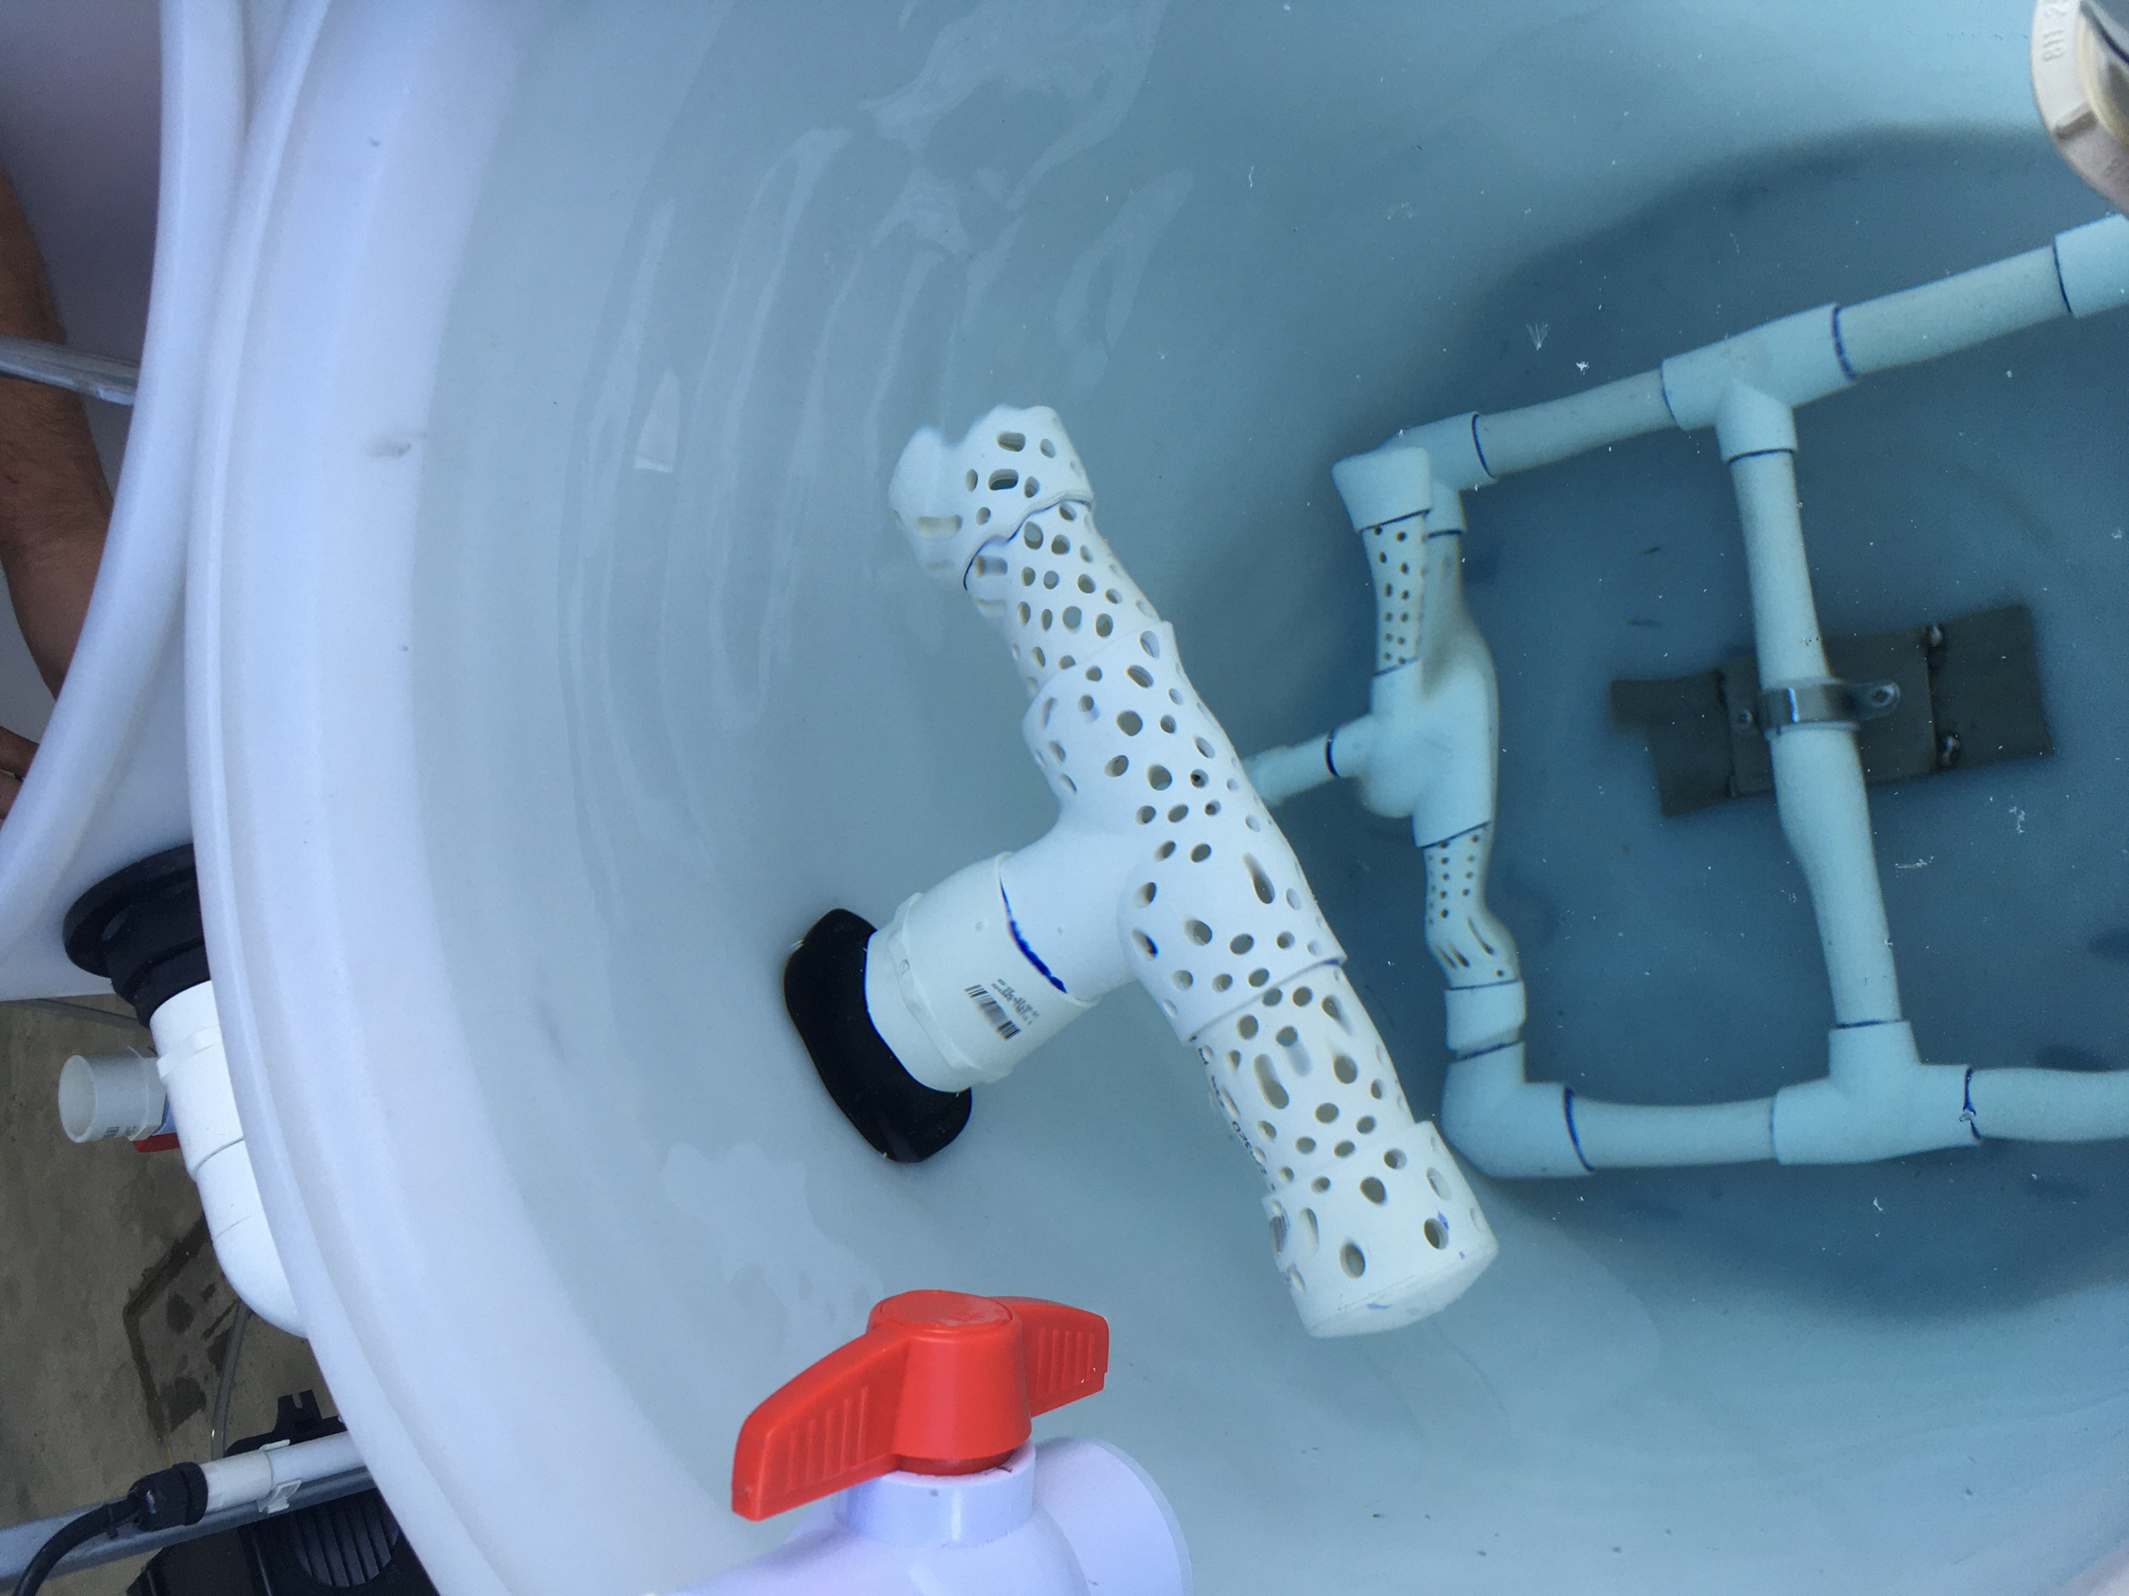
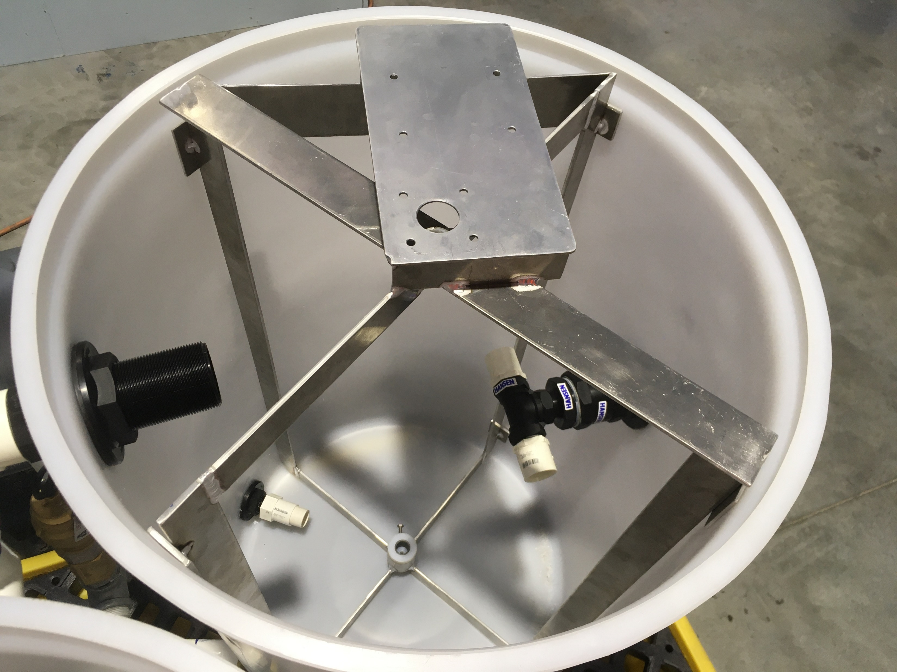
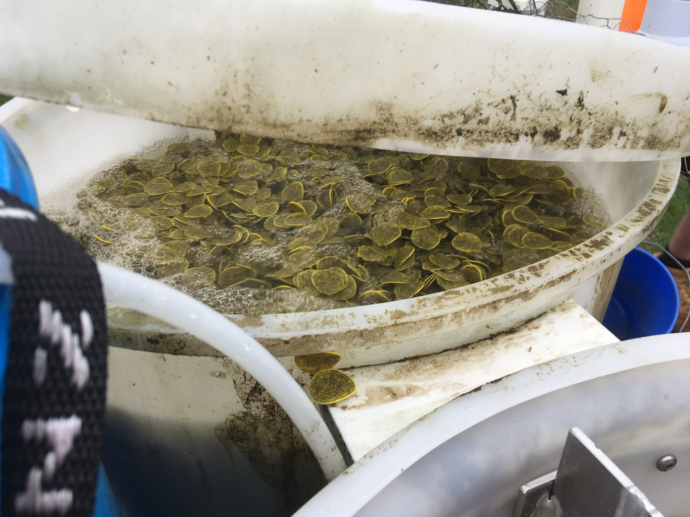
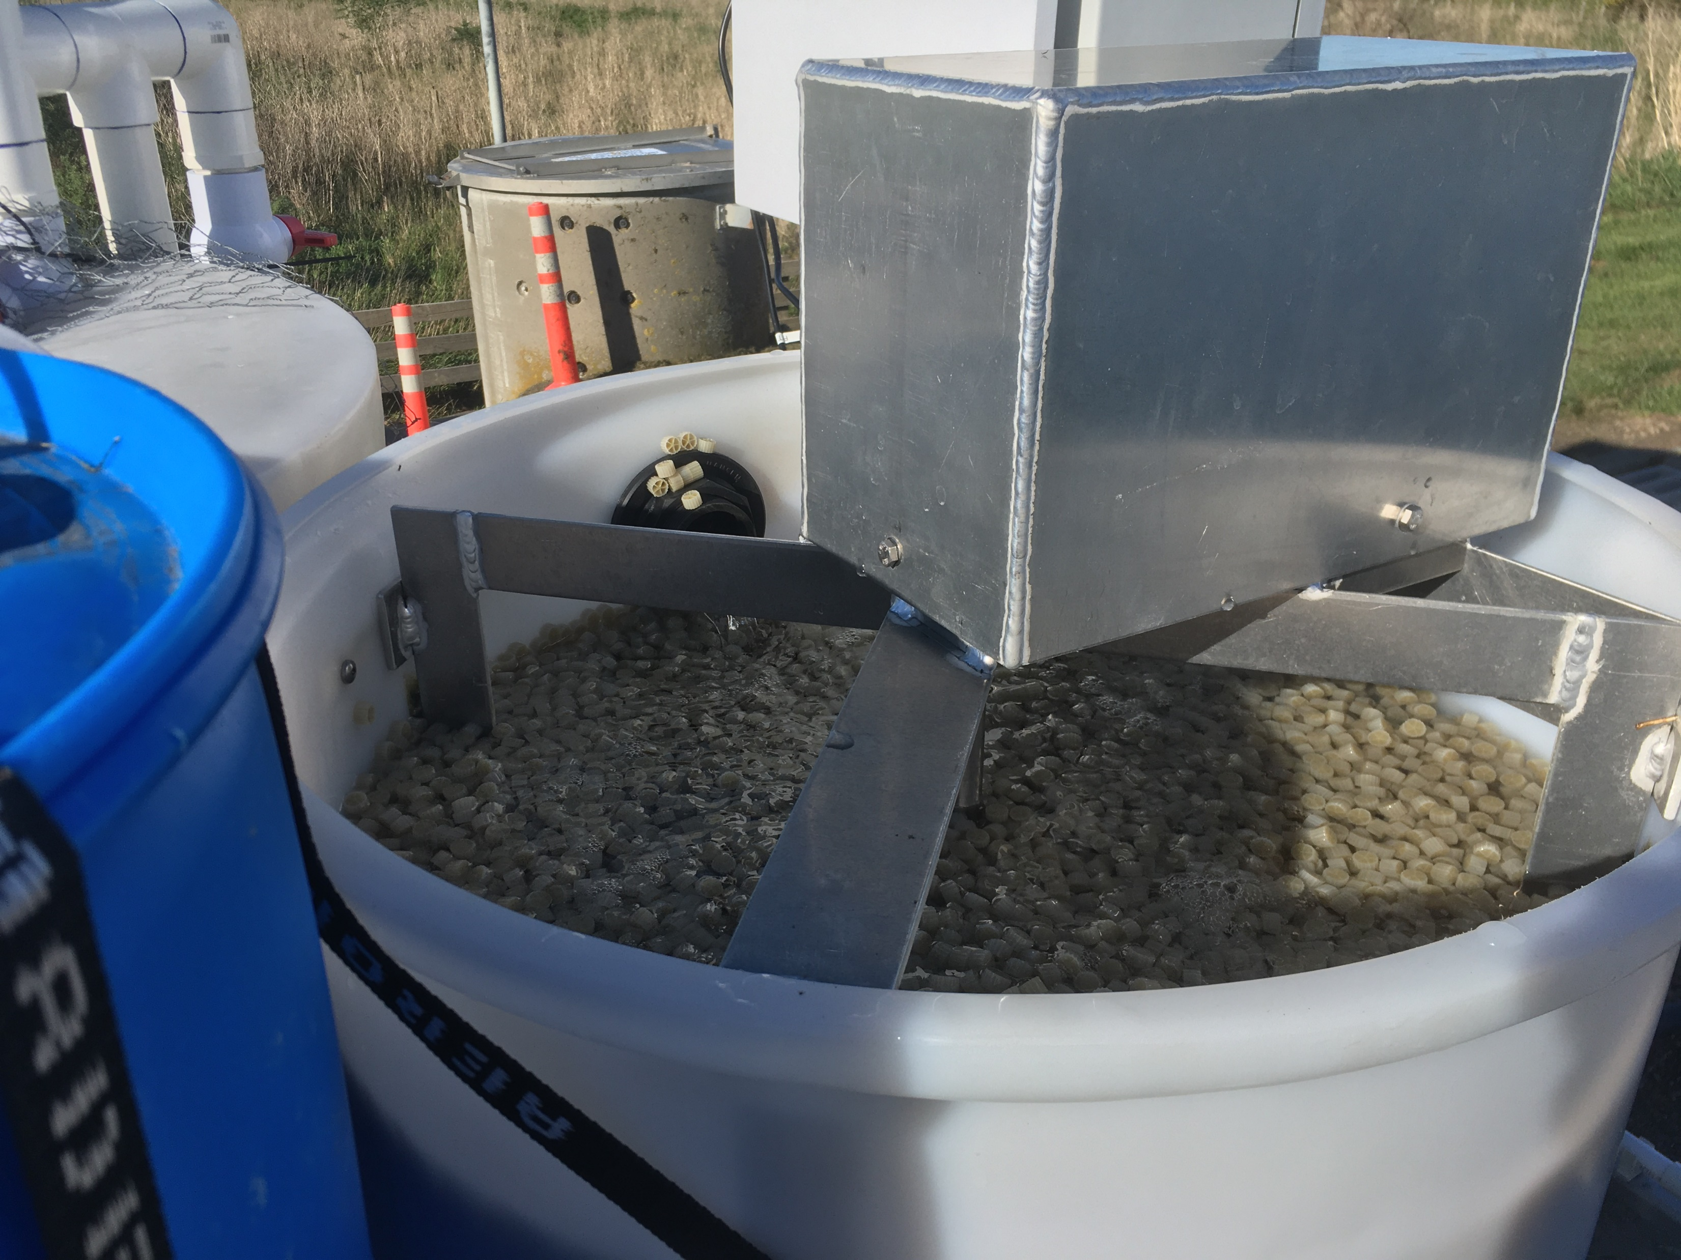
Why a pilot plant?
Notes:
So why did we decide to built a pilot plant?
There are 4 reasons
(do fingers)
there are big changes in nutrient restrictions coming to wastewater plants
from our professional experience, we know that MBBR is effective at providing this nutrient removal, and particularly in pond applications where it’s used around the world
there is reluctance in NZ to adopt technologies that are “unproven in NZ” because of a general risk aversion. With piloting we mitigate that risk by directly measuring design parameters which will help the full scale plant design.
Piloting is super fun, if you have chance to do it, you should do it
And this is our pilot plat in all its cobbled together glory
--- next slide ---

Slide 6
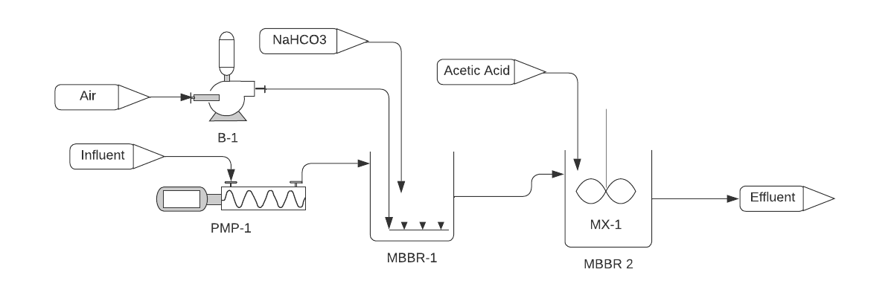
Pilot plant design
TAN → NO_{X}
NO_{X} → N₂
Parameter | Unit | Reactor 1 | Reactor 2
Flow | L/min | 5.6 to 10.1
Tank liquid volume | L | 230 | 230
Media volume | L | 90.5 | 93
Media fill ratio | % | ~40 | ~40
Media effective surface area | m²/m³ | 1,000 | 500
Total media surface area | m² | 90.5 | 46.5
Notes:
The pilot plant has two reactors. The first reactor is aerobic for nitrification, and the second is anoxic for denitrification.
Wastewater is pumped into first reactor and aerated. There is an allowance for alkalinity dosing. It flows by gravity into the second reactor.
The second reactor is mixed by a locally fabricated mixer, and a chemical dosing pump feeds acetic acid as a COD source into it to support denitrification.
We had about a 40 % media fill ratio. In the first reactor we used a relatively unconventional, new media type from Mutag, and you see pictures of it later.
The second reactor had a conventional media type, a K-1 equivalent which has been around for 30 years and is well understood.
--- next slide ----

Slide 7
Surface area removal rate (SARR)
$$SARR=\frac{Pollutant removal (g)}{surface area \left(m2\right)×day (d)}$$
Notes:
As mentioned before, we wanted to reduce risk for full scale designs, and one of the most important design parameters is the surface area removal rate, or SARR. So We’ll talk about SARR a good bit throughout the rest of the presentation.
SARR is defined as pollutant removed per day per media surface area, and is quantified in grams per square meter per day.
A higher removal rate means less media is needed and this means a smaller reactor footprint.
The photo on the left shows the Mutag media in the first reactor, on the right the K-1 type media in the second reactor.
The Mutag media has a higher specific surface area than the K-1 type media, which means more biomass can grow on it. We did that because nitrification is a slower process than denitrification, so we wanted more biomass in the first reactor to be able to feed the second reactor with nitrate.
Because there are so many installations worldwide, there is a lot of data to predict the SARR under different conditions.
Two of the most important SARR influence factors are
Temperature
Substrate concentration which could be pollutant, dissolved oxygen, acetic acid.
--- NEXT SLIDE----

Slide 8
Trial background and objectives
Trial A – finished, duration 4 months
1 Period 1: maximise SARR at low temperatures (~11 °C)
2 Period 2: meet ammonia and nitrate effluent of 1 mg N/L at low temperatures (~11 °C)
Trial B – in progress
3 Maximise SARR at higher temperatures (~17 °C)
Check if there is nitrification inhibition by a trade waste compound
Notes:
Let’s have a look at performance data from our pilot plant.
We have done two trials. Trial A is finished and lasted 4 months over this winter. Trial B is still in progress.
I’m going to show three sets of data from those two pilot studies.
In Trial A, we had two objectives.
In Period 1: maximise SARR at low temperature (11 C), without necessarily meet a target effluent concentration
In Period 2: the effluent to meet less than 1 mg/L of both ammonia and nitrate at low temperature (11 C)
Trial B:
maximise SARR at a higher temperature (~17 C) to meet a relatively high total nitrogen limit of 30 to 40 mg/L
there has been evidence of a inhibitory compound in the trade waste going to the plant, so we also wanted to see how this influenced the SARR, if at all. We didn’t think it would, but it’s an easy risk to mitigate by piloting.
Everybody got this? When I practiced the presentation, everybody told me they didn’t get that point, so I’m just making sure that we are all on the same page.
--- next slide ---

Slide 9
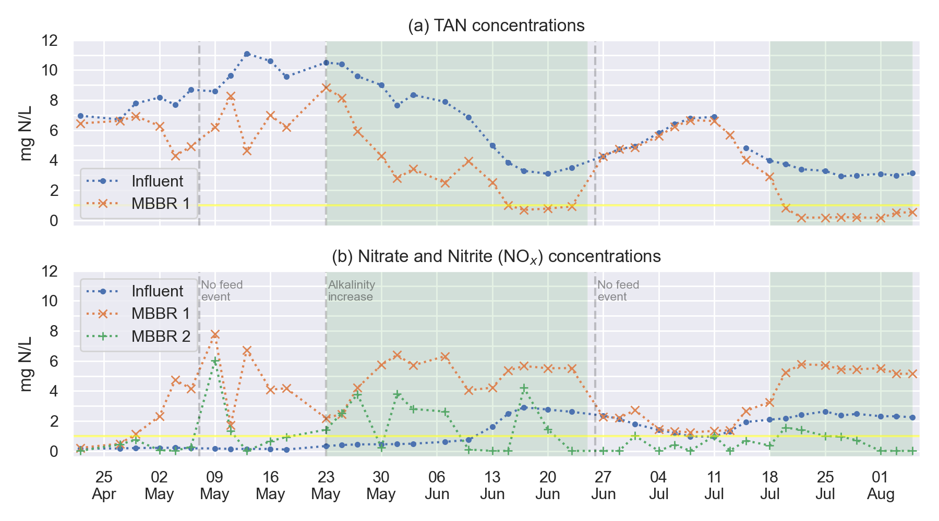
Results Trial A - Concentrations
Period 1:
maximise SARR
Period 2:
1 mg/L TAN in effluent
1 mg/L NOx in effluent
Nitrifier die-off
Notes:
Here are concentration results from Trial A.
A quick note: in the following graphs, you will see TAN, which stands for “total ammoniacal nitrogen”. When I say ammonia, I mean TAN.
Top graph shows ammonia concentrations in the influent and after the first reactor.
The lower graph shows the nitrate and nitrite (or NOx) concentrations in the influent, first reactor and second reactor.
The yellow lines show the target effluent concentrations for the second period.
First we had the start up period, and it took around 3 weeks for biofilm to establish from scratch.
The we move into Period 1 where we maximised SARR without necessarily meeting a target effluent concentration. The system degraded quite a bit of ammonia and the produced nitrate, and at the end, the ammonia effluent concentration is below 1 mg/L.
Then we move into the period where we killed all our nitrifiers due to a process upset and it took around 3 weeks to re-establish the biomass.
Finally, we move into period 2 where we meet the 1 mg effluent target for ammonia and nitrate quite comfortably.
--- next slide ---

Slide 10
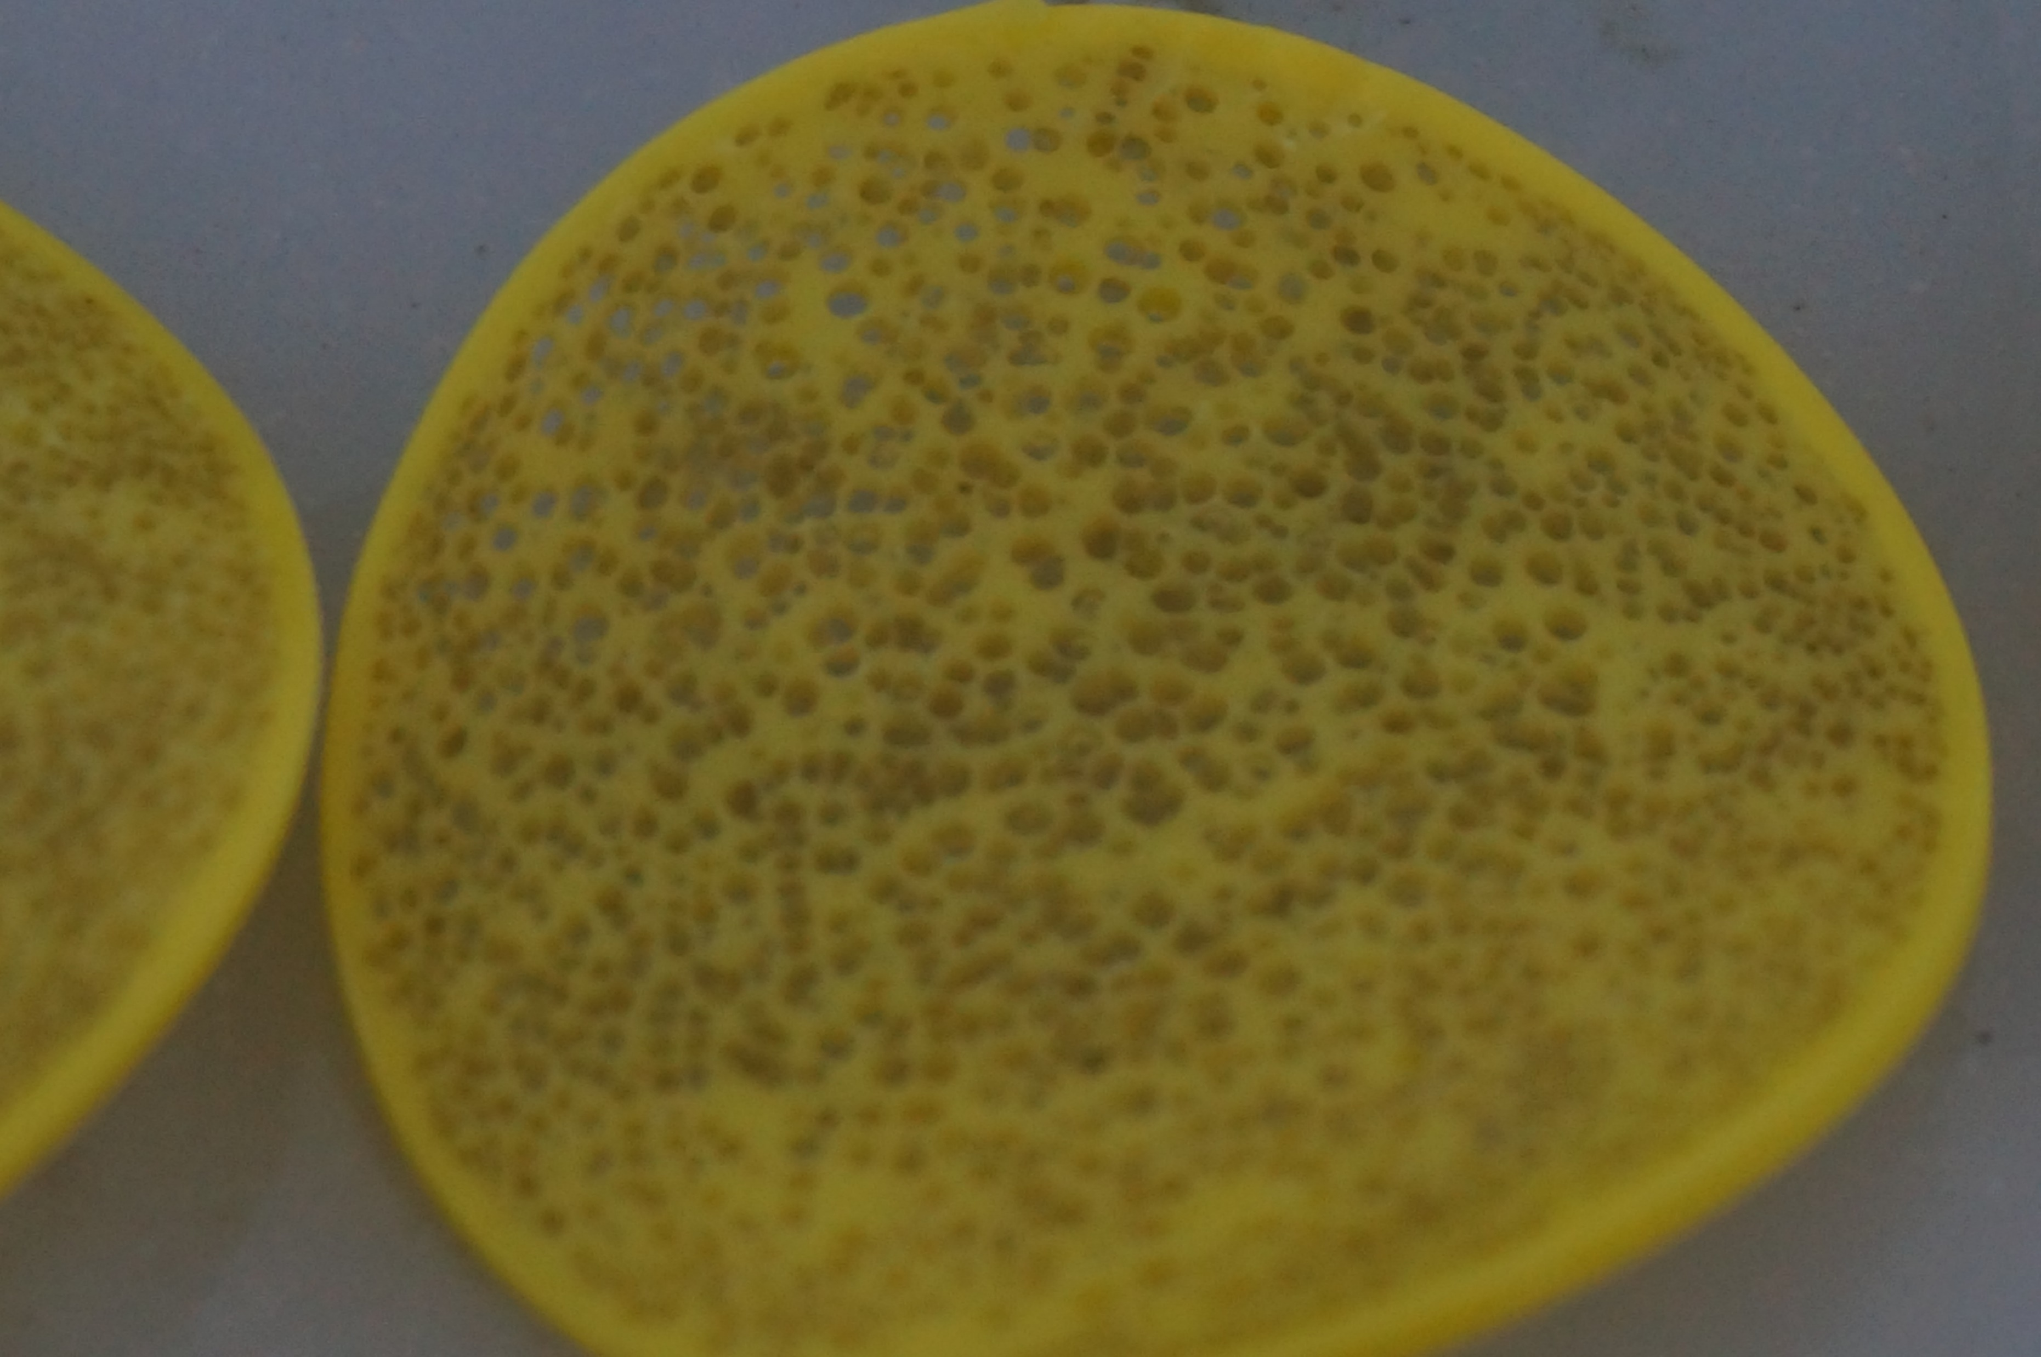
Pilot plant media – first reactor (nitrification)
16 days
31 days
43 days
62 days
88 days
106 days
Notes:
These are photo of the biofilm development in the first reactor during trial A.
It’s nothing really exciting, but everybody likes to see these pictures.
We can see that the media gradually becomes more overgrown with biofilm.
It’s like the equivalent of bug porn.

Slide 11
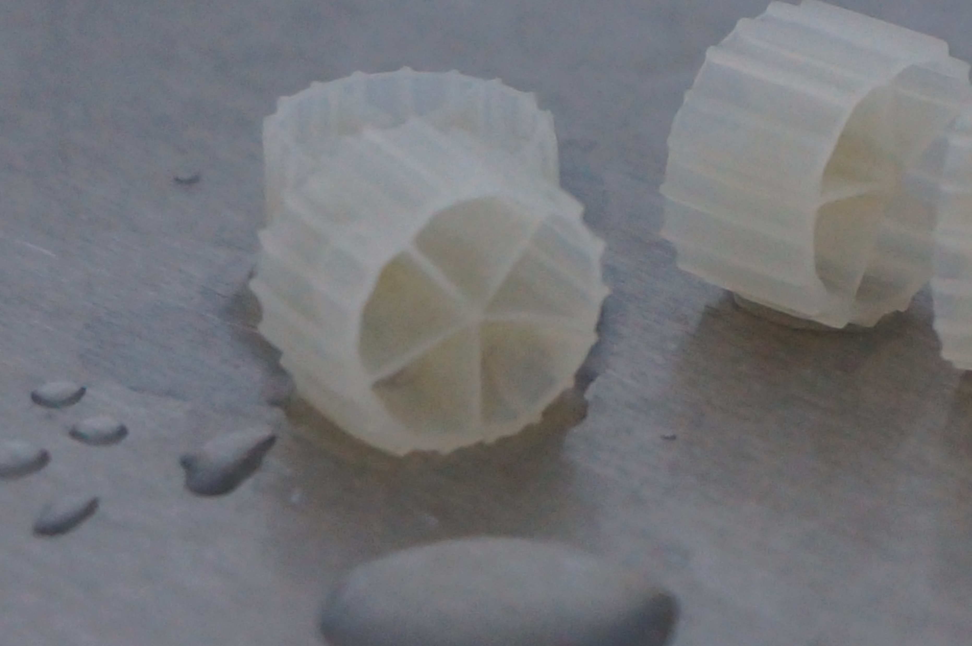
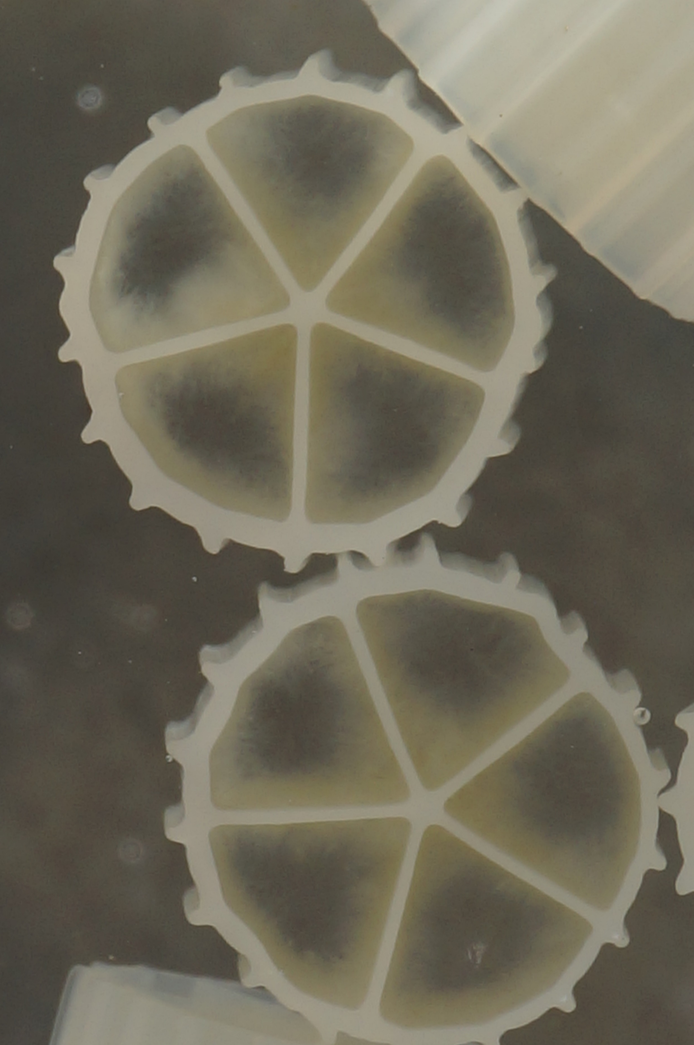
Pilot plant media – second reactor (denitr.)
16 days
31 days
43 days
62 days
106 days
Notes:
This is the biofilm in the second reactor media.
The denitrifier biofilm is typically a bit fluffier than the nitrifier biofilm, which can be seen well in these photos.

Slide 12
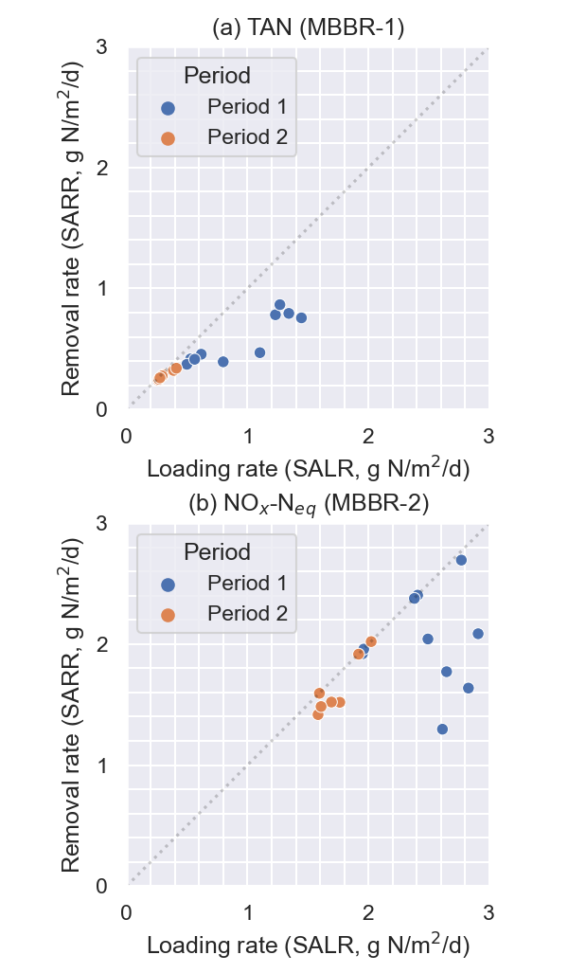
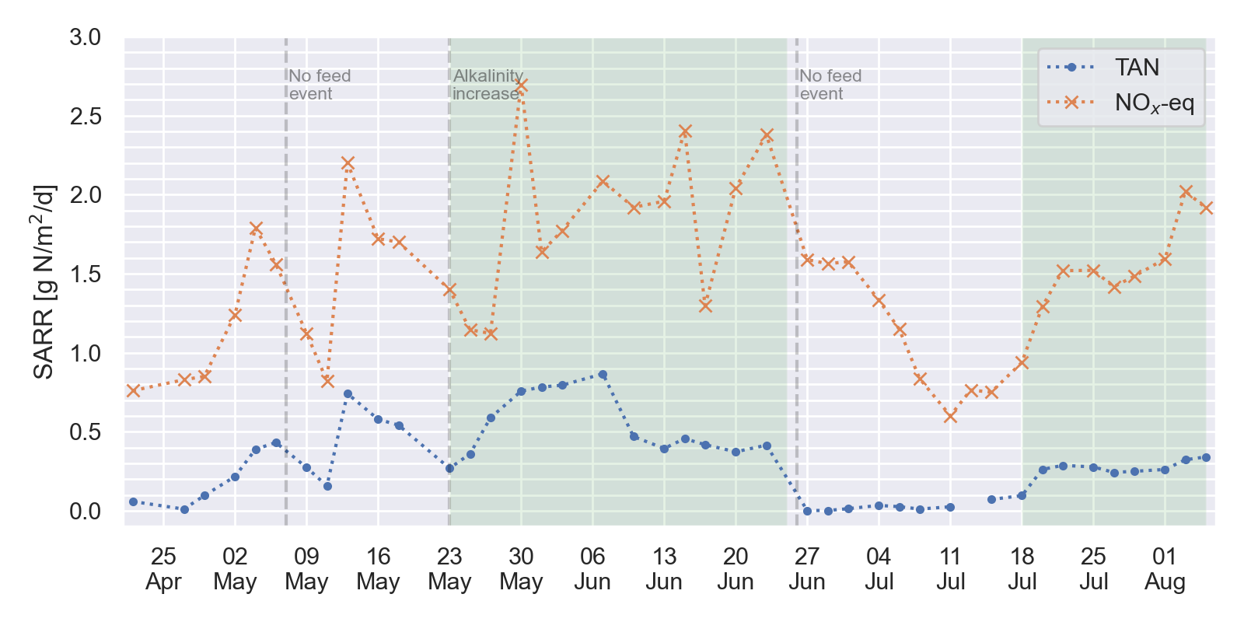
Results Trial A – Measured SARR
Period 2:
1 mg/L TAN in effluent
1 mg/L NOx in effluent
Nitrifier die-off
Period 1:
maximise SARR
Notes:
Let’s have a look at the measured SARR rates.
For graph on left, the blue line shows the nitrification SARR. The orange line shows the denitrification SARR.
We can see right away that the denitrification rate is significantly higher than the nitrification rate.
We can see that Period 1 had a higher SARR than period 2, because of the substrate limiting conditions in period 2.
These SARR rates are pretty typical, and can be estimated through conventional design guidelines.
Graph on right: surface area loading rate versus surface area removal rate.
If a dot lies on the line across, it means that everything that was loaded into the reactor was being removed.
The two Periods 1 and 2 can be clearly distinguished in both graphs.
The top graph shows the nitrification stage. It shows that in Period 2, we operated the reactor in a way so that we could remove almost all ammonia, and this meant operating at lower loading rate and thus lower SARR.
In Period 1, the reactor achieved a higher SARR, without removing all ammonia from the effluent.
The lower graph shows the denitrification stage. This graph shows that the denit stage probably has more capacity, because the highest point is close to the dotted line.
--- next slide ----

Slide 13
Results Trial A – Summary
SARRs
Removal ratios
Parameter | TAN SARR | NOx SARR | NOx-eq SARR | TAN removal | NOx removal | NOx-eq removal | Temp.
Units | g/m²/d | g/m²/d | g/m²/d | % | % | % | °C
Period 1 | 0.57 | 1.23 | 2.02 | 64% | 74% | 82% | 11.1
Period 2 | 0.28 | 0.96 | 1.64 | 91% | 90% | 94% | 11.7
Notes:
This table shows average values of measured SARRs and overall pollutant removal ratios for Period 1 and Period 2.
As mentioned before, we can see that the SARR for denitrification is higher than for nitrification.
In Period 2, we see high removal ratios but lower SARRs, that’s because of substrate limiting conditions where we are basically running out of pollutant to remove.

Slide 14
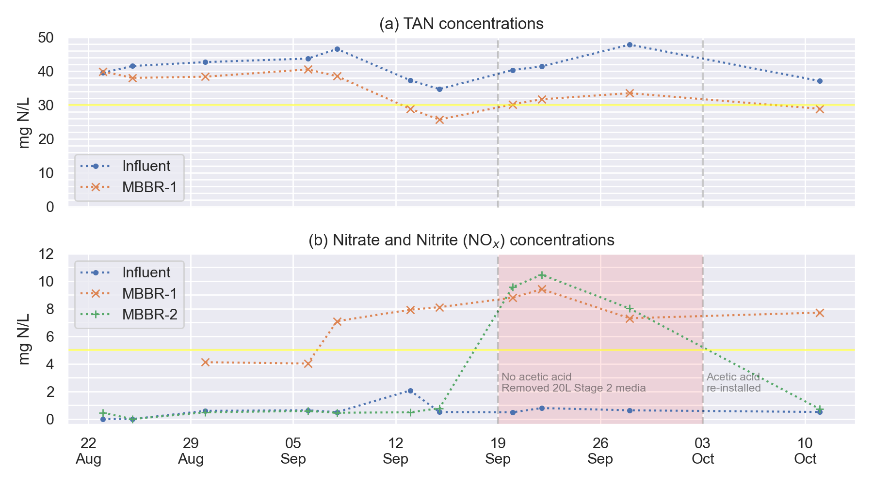
Results Trial B - Concentrations
Notes:
Here are results from Trial B. The trial is still running, and we are still making some process changes.
The top graph shows the ammonia concentrations in influent and first stage effluent. The yellow line shows the target effluent concentration of 30 mg/L. We can see that the reactor is reaching its target concentration.
The lower graph shows the NOx concentrations in influent, first stage, and second stage effluent, with the yellow line showing the 5 mg/L target.
The reactor is well below its target, except for the period in red where the acetic acid dose pump failed. After it was repaired, we reached our target again.
--- NEXT SLIDE ---

Slide 15
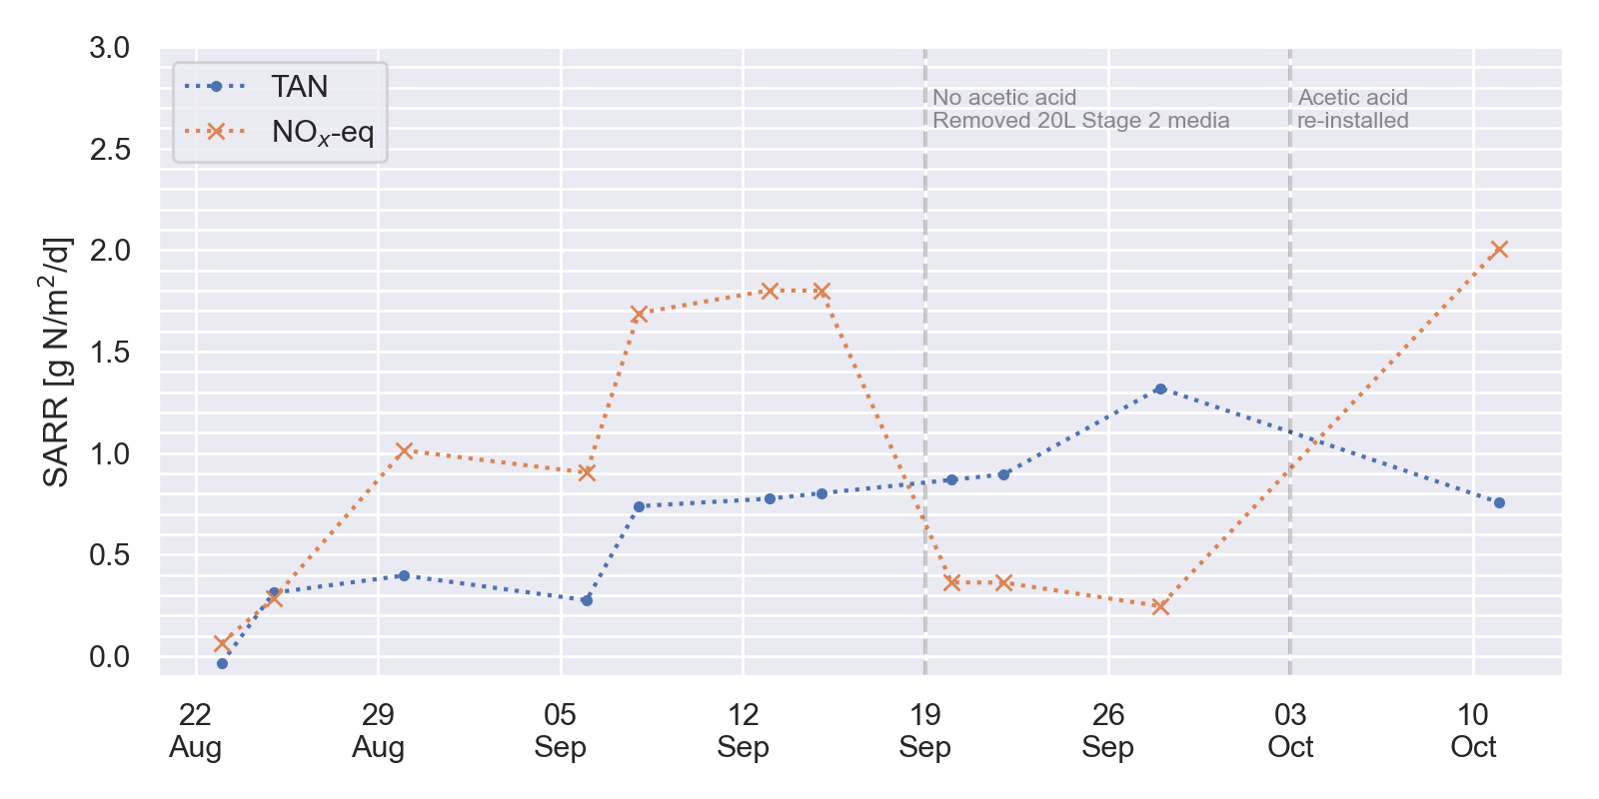
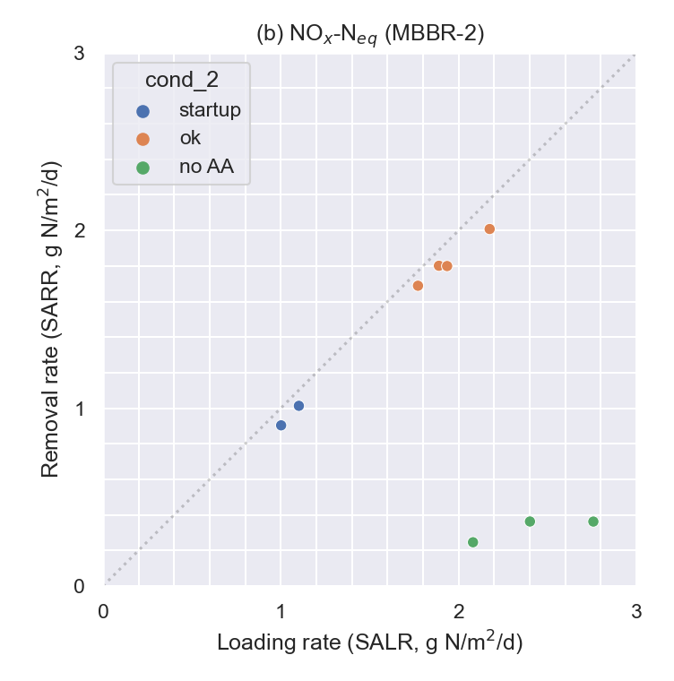
Results Trial B - SARR
No evidence of nitrification inhibition.
Notes:
These are the SARR values for Trial B.
On the left graph, the blue line is nitrification, orange denitrification
Again, for nitrification, these are typical rates for a highly loaded system with a lot of excess substrate.
The loading/removal graph on the right shows the denitrification. We can clearly see the period where the acetic acid wasn’t dosed, and there was hardly any removal. What the graph also shows is that when it’s working, it pretty much removes all the nitrate that is fed into it.
So we haven’t reached the system’s capacity yet. To push the SARR up, we have recently removed 20 L of media from stage two, which means the remaining biofilm has to degrade the same amount of pollutant. We hope that eventually we can push the SARR up to almost 3 grams / m2 / day.
In terms of a toxic inhibition of nitrification, we haven’t seen this in the data. An MBBR looks suitable to treat the wastewater for nitrogen removal.
--- Next slide ---

Slide 16
Results Trial B – Summary
SARRs
Removal ratios
Parameter | TAN SARR | NOx SARR | NOx-eq SARR | TAN removal | NOx removal | NOx-eq removal | Temp.
Units | g/m²/d | g/m²/d | g/m²/d | % | % | % | °C
Trial B | 0.88 | 1.35 | 1.82 | 24% | 92% | 94% | 17.0
Notes:
And this table shows again the mean values for SARRs and removal ratios. This only includes data where the pilot was operating well, meaning after start up period, and for denitrification we have excluded the period where the acetic acid failed.
Like in the other trial, the denitrification SARRs are higher than the nitrification SARRs.
The ammonia removal ratio is so low because we target a much higher effluent limit of 30 mg/L.
The nitrate removal ratio shows that most of what the first reactor produces is degraded in the second reactor.

Slide 17
Comparison of results
SARRs
Removal ratios
Trial A
Parameter | TAN SARR | NOx SARR | NOx-eq SARR | TAN removal | NOx removal | NOx-eq removal | Temp.
Units | g/m²/d | g/m²/d | g/m²/d | % | % | % | °C
Period 1 | 0.57 | 1.23 | 2.02 | 64% | 74% | 82% | 11.1
Period 2 | 0.28 | 0.96 | 1.64 | 91% | 90% | 94% | 11.7
Trial B
Parameter | TAN SARR | NOx SARR | NOx-eq SARR | TAN removal | NOx removal | NOx-eq removal | Temp.
Units | g/m²/d | g/m²/d | g/m²/d | % | % | % | °C
Trial B | 0.88 | 1.35 | 1.82 | 24% | 92% | 94% | 17.0
Notes:
And here is a comparison of the results from Trial A and Trial B.
For the nitrification SARR, the influence of temperature and substrate limitation is clearly visible.
The rate in Trial B is higher because of warmer temperatures and the higher effluent limit.

Slide 18
Conclusions
Notes:
What are the main conclusions that we can draw from our pilot tests?
Trials show that an MBBR is able to remove nitrogen from oxidation pond effluent to a low concentration of ammonia and nitrate.
The measured SARR rates follow conventional MBBR design guidelines, so the wastewater in New Zealand is not that different after all.
In a full scale application, the MBBR may need to be combined with other technologies. If the discharge conditions require phosphorus removal, this could be implemented with chemical precipitation. If TSS removal is required, you combine it with a membrane filtration system.
So, if your organisation has an oxidation pond that struggles to remove nitrogen, I hope that this presentation has shown you an effective process to consider.
Thank you very much for your attention.

