Slide 1
One consent for Auckland
What a region wide network discharge consent means for Auckland.
Paula Vincent
Auckland Council, Healthy Waters Department

Slide 2
Overview
What is it?
Significance of a single consent
Benefits of the consent
Flexibility and certainty
Adaptive management
Q and A

Slide 3
What is it?
The NDC will provide for Auckland's growth using best practice stormwater management to maintain and improve the Auckland environment.
Authorises the diversion and discharge of stormwater from the existing and future public stormwater network.
Covers existing discharges, upgrades of network and future urban zone.
Process based consent.
One consent for Auckland. May 2019,

Slide 4
Significance of a single region wide NDC
A single consent for all discharges from Auckland’s public stormwater network.
Future focussed - includes Future Urban Zones
Adaptive management of effects of discharges.
One consent for Auckland. May 2019,
One consent for Auckland. May 2019,

Slide 5
Key benefits
1) Creates certainty yet is flexible
2) Aligns with other Healthy Waters initiatives to create adaptive management
One consent for Auckland. May 2019,

Slide 6
Certainty and flexibility
Certainty
Duration – 35 year consent
Consistent requirements across region
Clarity for consent users
Flexible
Follow Schedule 4 or apply BPO in Stormwater Management Plans (SMPs) or own consent
Different requirements for different scenarios
SMPs allow for site specific adaptation.
One consent for Auckland. May 2019,

Slide 7
Discharge consents under AUP
One consent for Auckland. May 2019,

Slide 8
Stormwater Management Plans
SMPs are the tool for authorisation under the NDC
If SMP already adopted for an area – follow that
If no SMP prepare one to demonstrate Schedule 4/BPO
Schedule 8 outlines process for adopting SMP.
Different process:
if discharging into SEA,
affecting third party, either works on property or more stringent requirements.
Adopt via plan change or s127.
One consent for Auckland. May 2019,

Slide 9
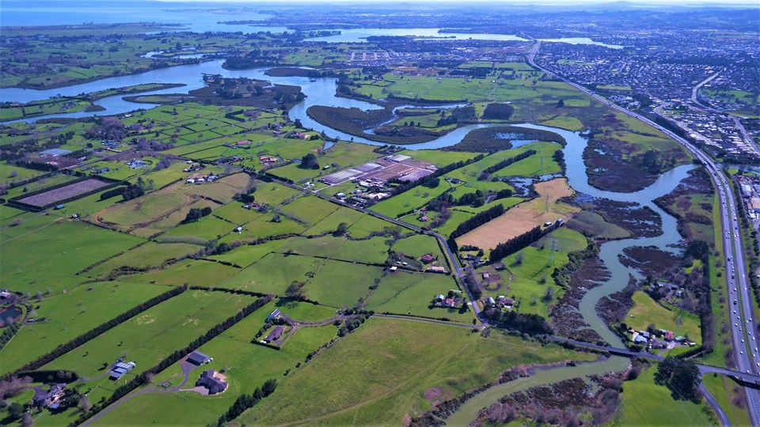
Future Urban Zones and SEAs
Discharge into Significant Ecological Areas (SEAs) a significant discussion point during the hearing.
Future Urban Zones mostly discharge into SEAs.
Manage effects of discharge via Stormwater Management Plans (SMPs).
Options to adopt SMPs in SEA discharge areas.
One consent for Auckland. May 2019,

Slide 10
Adopt SMP via Schedule 8
Discharge into SEA?
No
Structure Planning
(greenfield)
Adopt SMP via plan change or s127
Yes
Prepare SMP
Adopt SMP via Schedule 8
Development Plans
SMP already adopted?
No
Follow SMP
Yes

Slide 11
Adaptive management
Consent aligns with other Healthy Waters and Council activities.
Predicted stormwater outcomes can be compared with monitoring data to tell us if how we manage stormwater is helping us meet NDC objectives and outcomes.
Regular, transparent reporting of how Healthy Waters is meeting consent objectives and outcomes.
One consent for Auckland. May 2019,

Slide 12
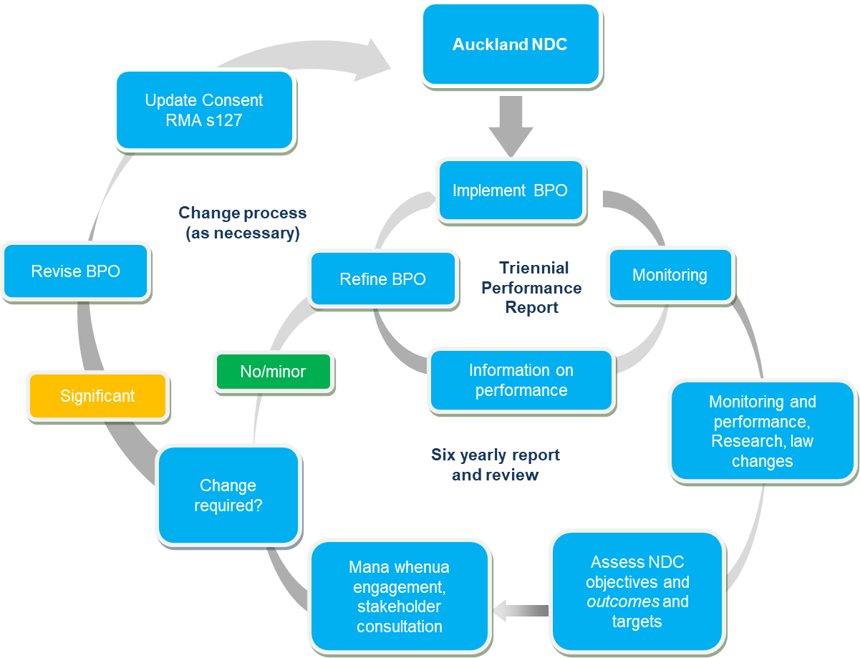
One consent for Auckland. May 2019,

Slide 13
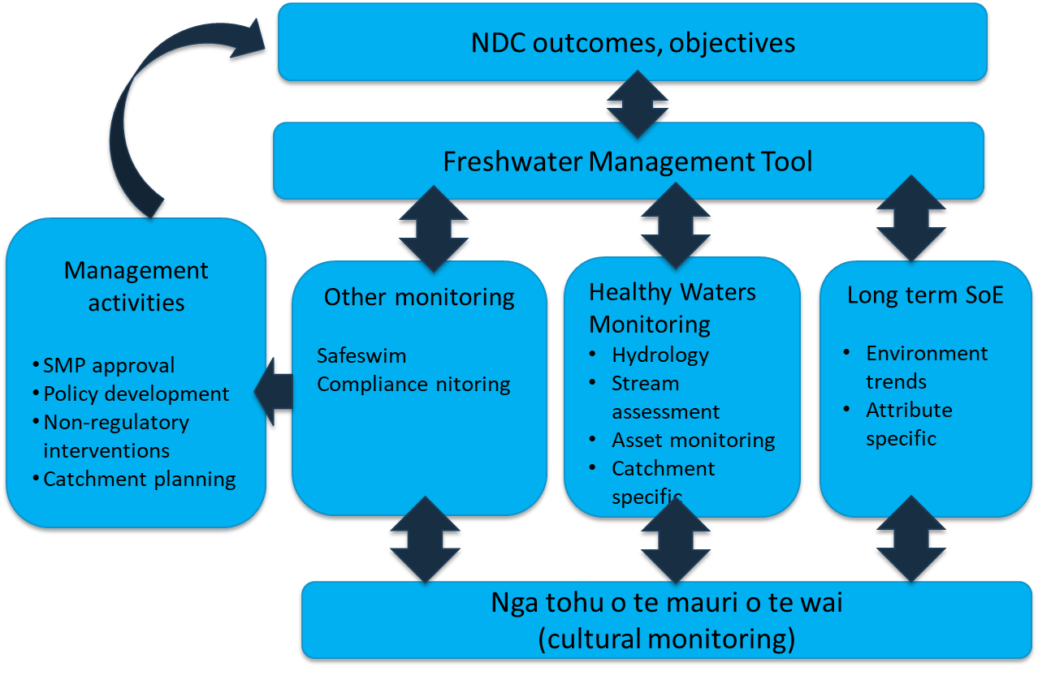
Monitoring and Performance
One consent for Auckland. May 2019,

Slide 14
Summary
Updated requirements for stormwater will apply across all of Auckland,
Predicted stormwater outcomes can be compared with monitoring data to tell us if how we manage stormwater is helping us meet NDC objectives and outcomes.
Regular, transparent reporting of how Healthy Waters is meeting consent objectives and outcomes.
Email HWDevelopment@aucklandcouncil.govt.nz with questions
Visit Auckland Design Manual for information and updates http://www.aucklanddesignmanual.co.nz/regulations/technical-guidance
One consent for Auckland. May 2019,

Slide 15
Acknowledgements
Big thanks to the team who got us to this point
Katja Huls, Nick Vigar, Shaun Jones, Andrew Chin, Allan Leahy, Kris Fordham, Martin Neal, Greg Akehurst, Ian Mayhew, Gerald Lanning and Gemma Chuah.
One consent for Auckland. May 2019,

Slide 16
Questions?
One consent for Auckland. May 2019,

