Slide 1
A Coupled Wetland Biofilter: The Best of Both Worlds
Dale Paice

Slide 2
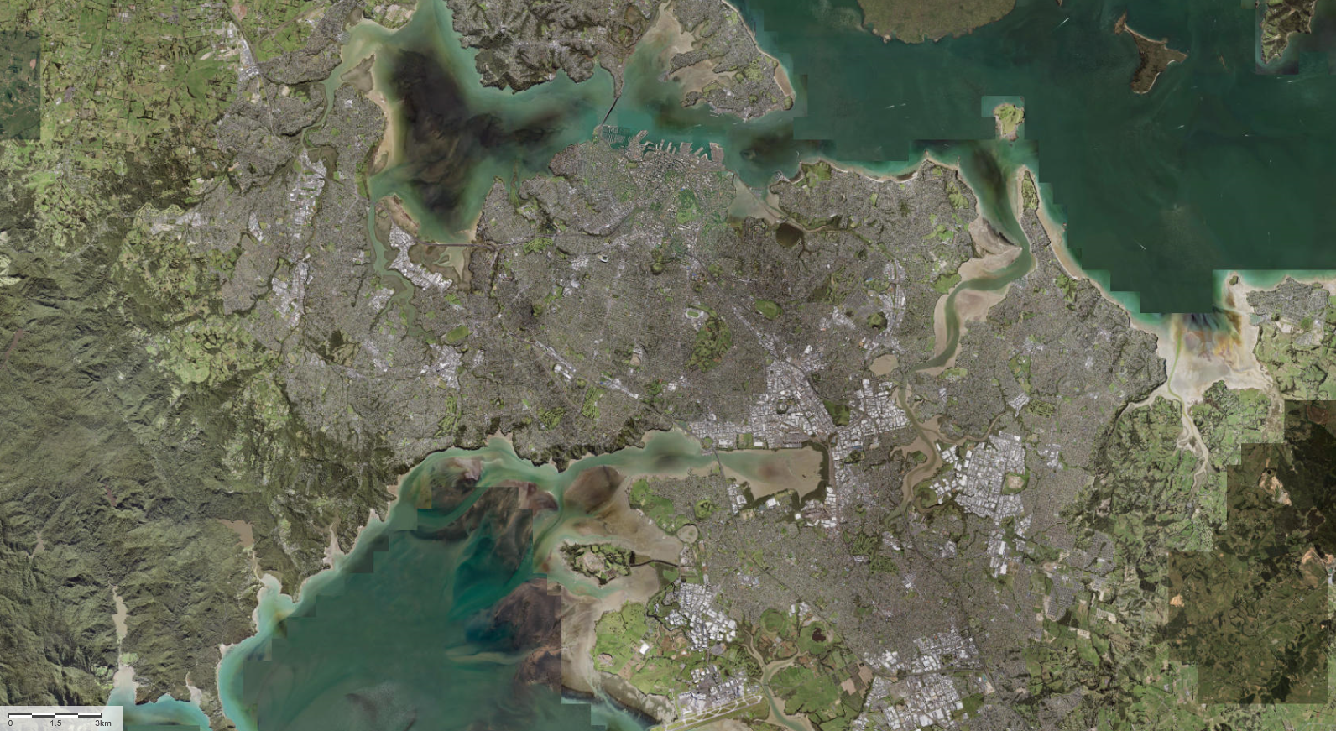
Location

Slide 5
East West Link
2015
East West Link route option selection
Imperative to avoid reclamation unless…

Slide 6
History
4) Miami stream / green stream / co-opting

Slide 7
4) Miami stream / green stream / co-opting

Slide 8
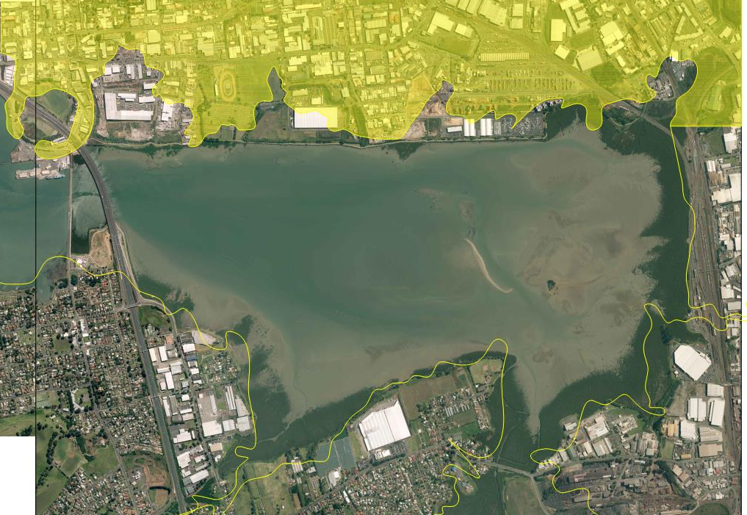

Slide 9
NZ Farmers Fertiliser site
Yuasa Batteries
Auckland Anodisers
Quality Electroplators
Dominion Oil Refinery
Reclaimed coastal land including Waikaraka Cemetery and Pike’s point

Slide 10
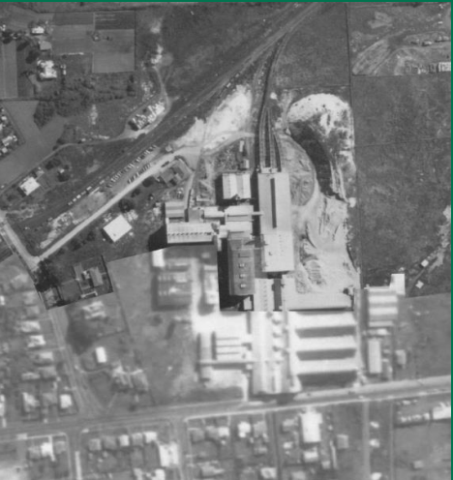
NZ Farmers Fertiliser site
1910 to 1984.
Converted rock phosphate to superphosphate fertiliser using sulfuric acid.
Potential contaminants: copper, sulphate, cadmium, fluoride, phosphorus, low pH.

Slide 11
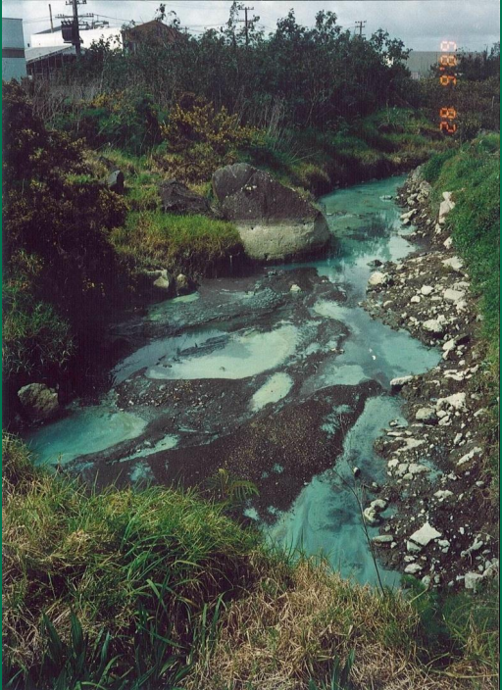
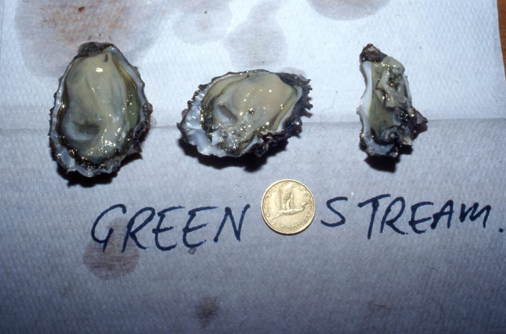
4) Miami stream / green stream / co-opting

Slide 13
Landuse

Slide 14
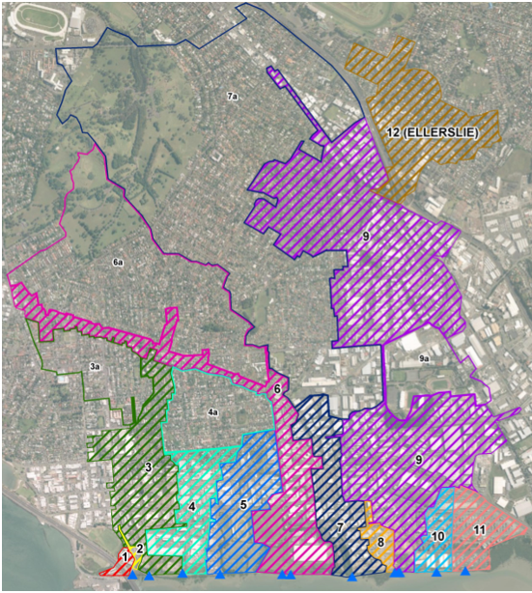

Slide 15
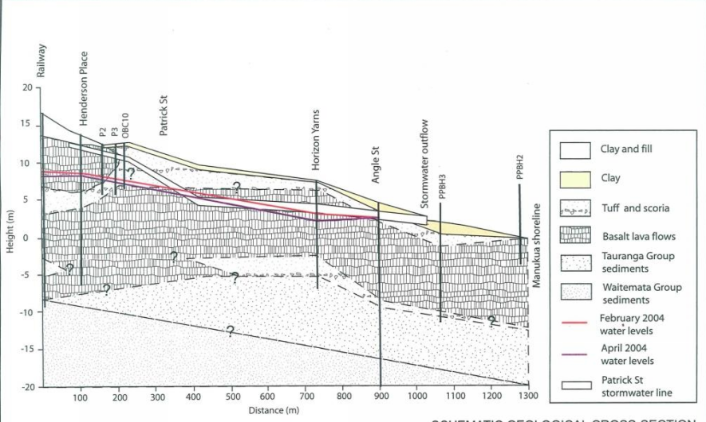

Slide 16
The Wetland-Biofilter

Slide 17
Treatment Train Configuration
Fresh water environment
Marine environment
WETLAND
BIORETENTION
LARGER STORM EVENT
SMALL STORM EVENT
(e.g. <1month)
ROAD
PUMP
MUDCRETE
Treated water outlet
MARINE SEDIMENTS
BEDROCK

Slide 18
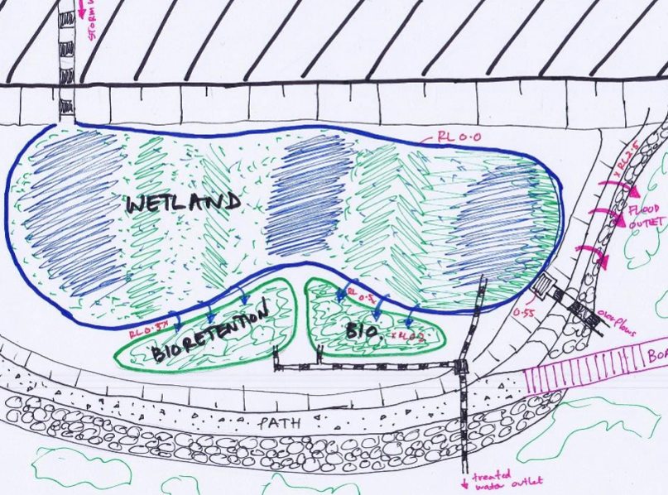

Slide 19
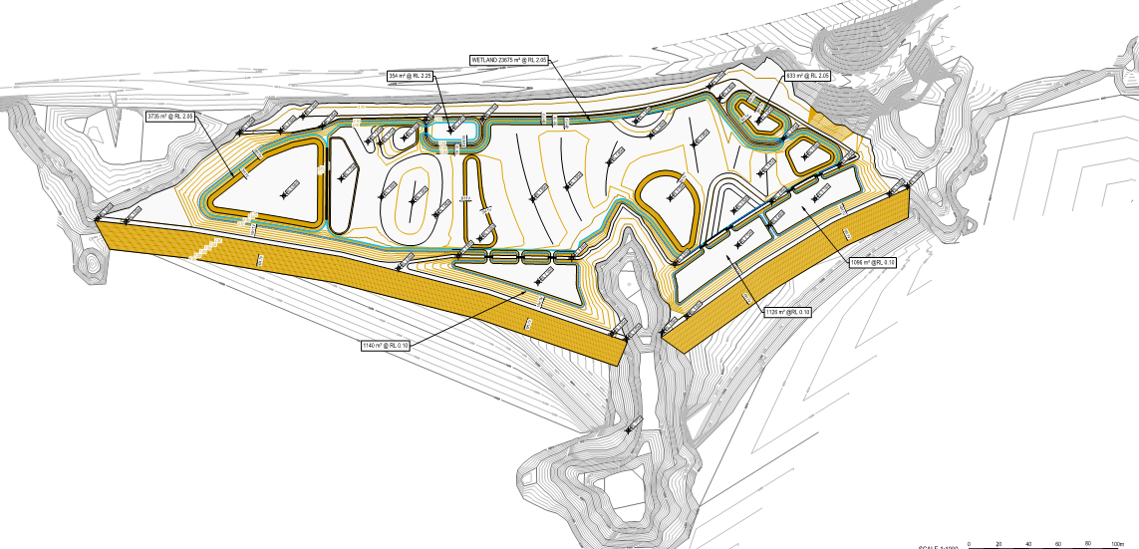

Slide 22
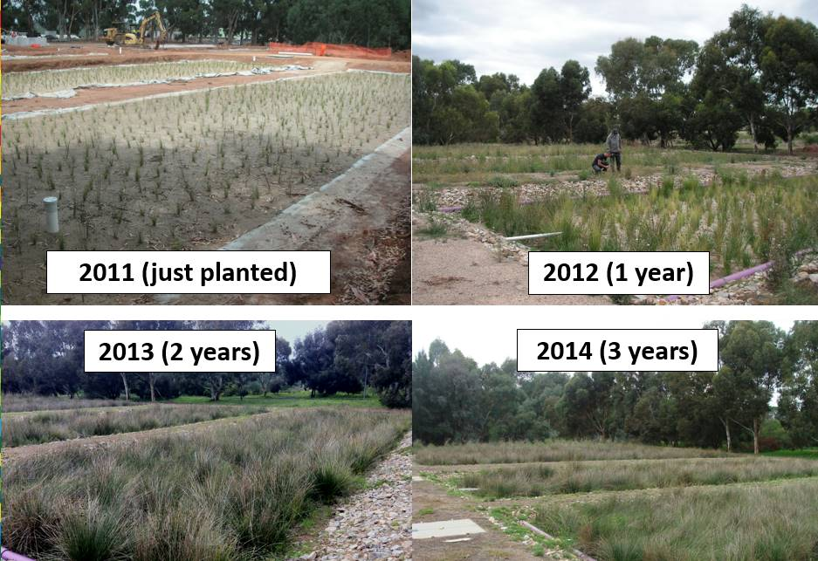

Slide 23
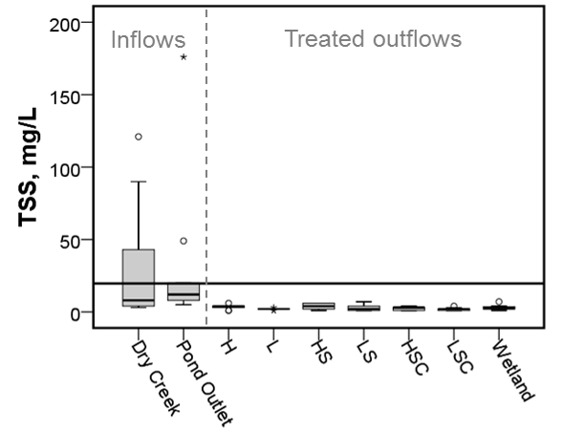
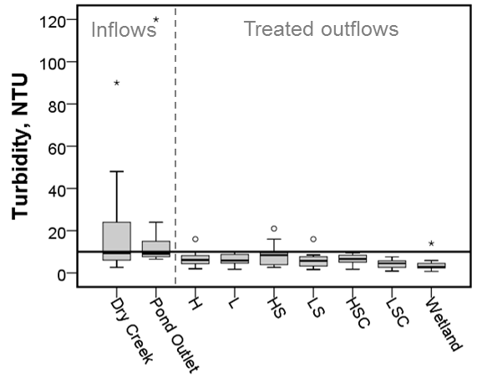

Slide 24
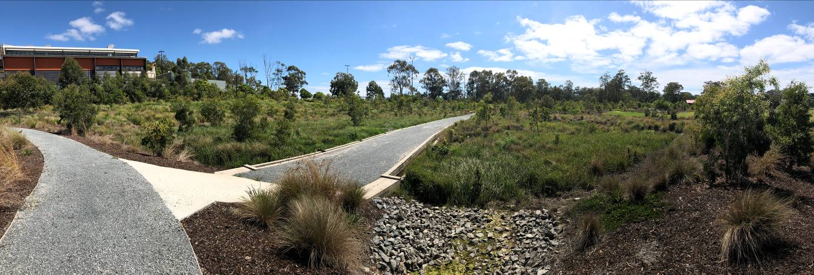

Slide 25
MUSIC

Slide 26
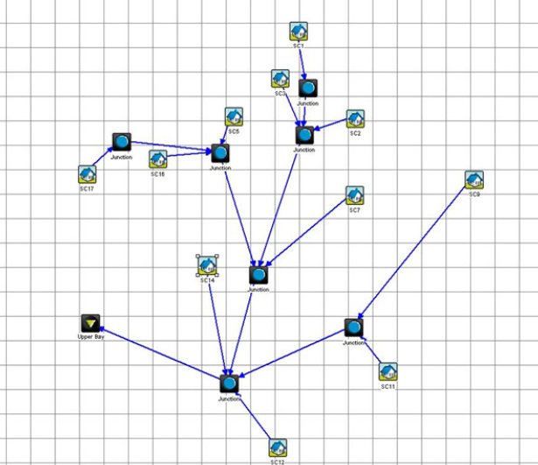

Slide 27
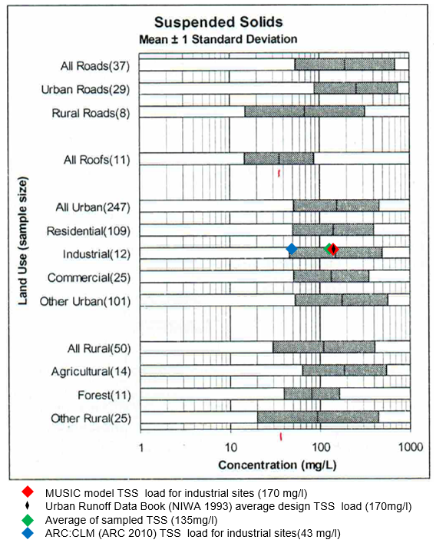

Slide 28
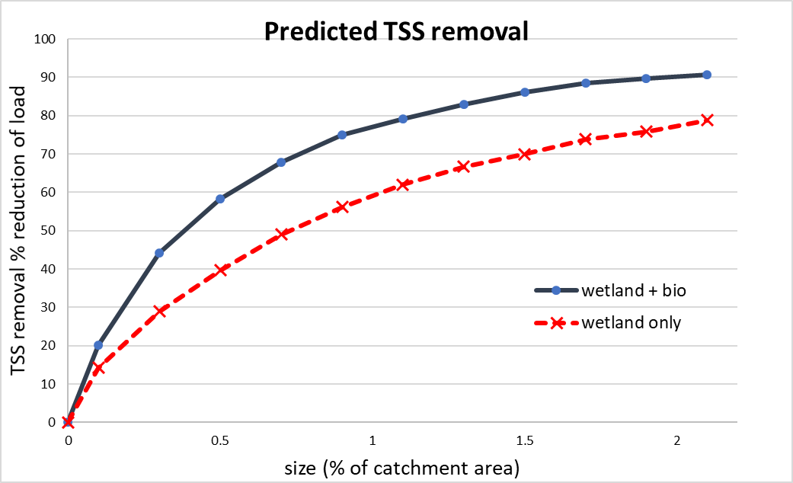

Slide 29
Hydraulics

Slide 30
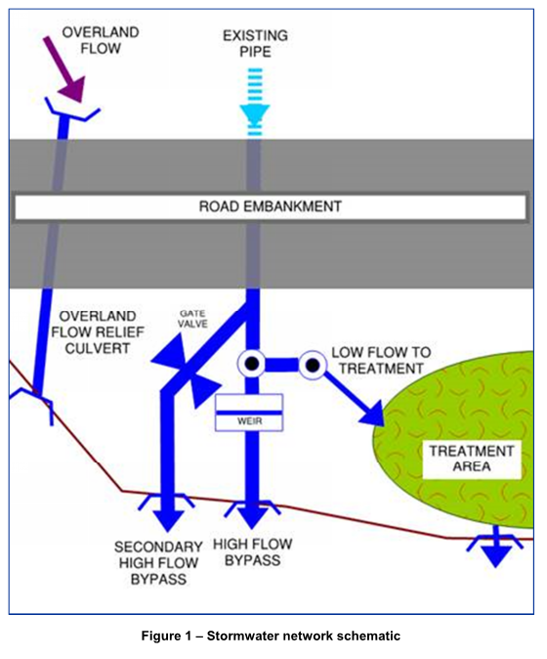

Slide 31
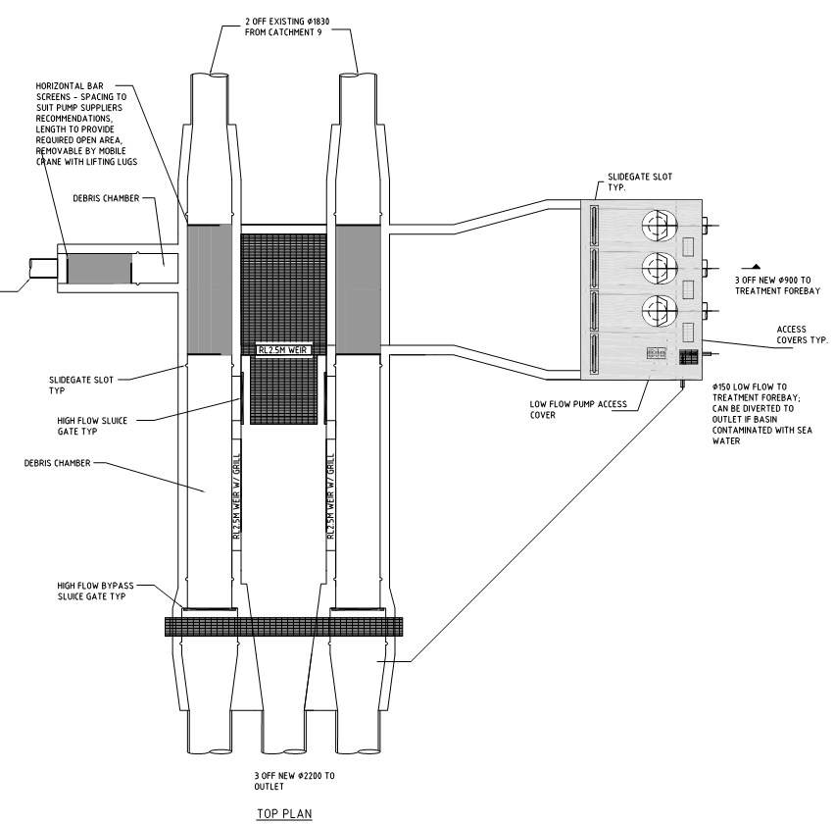

Slide 32
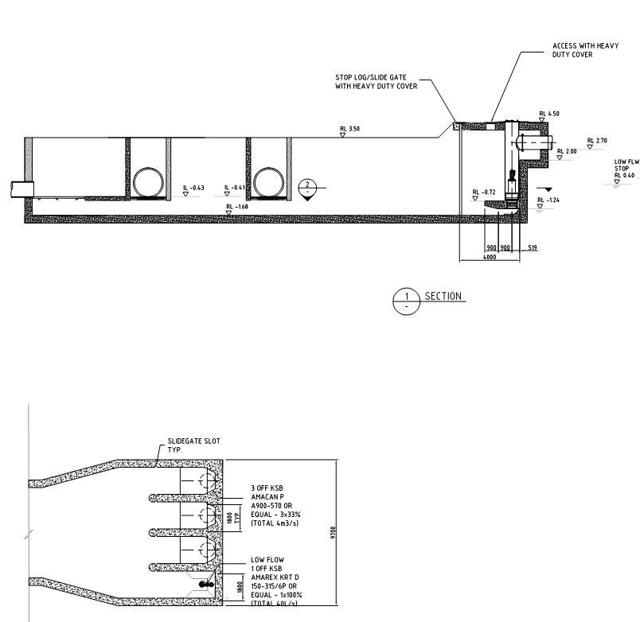

Slide 33
Concept design

Slide 34
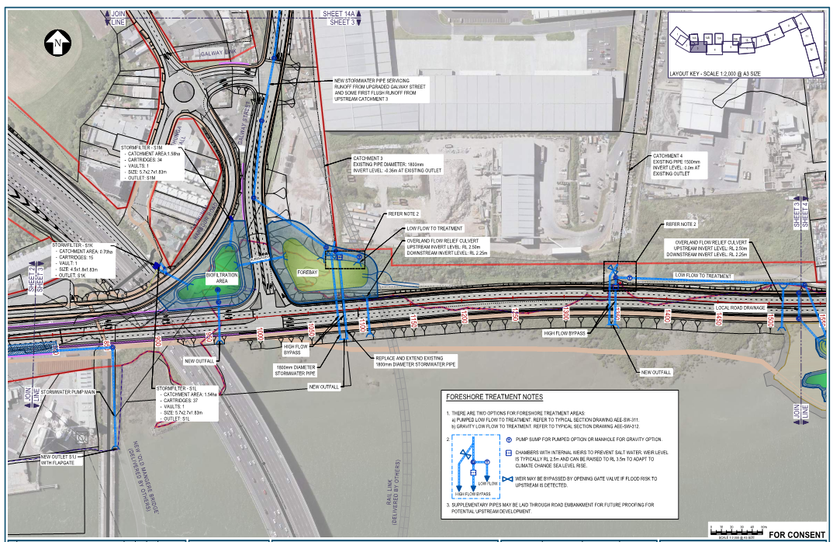

Slide 35
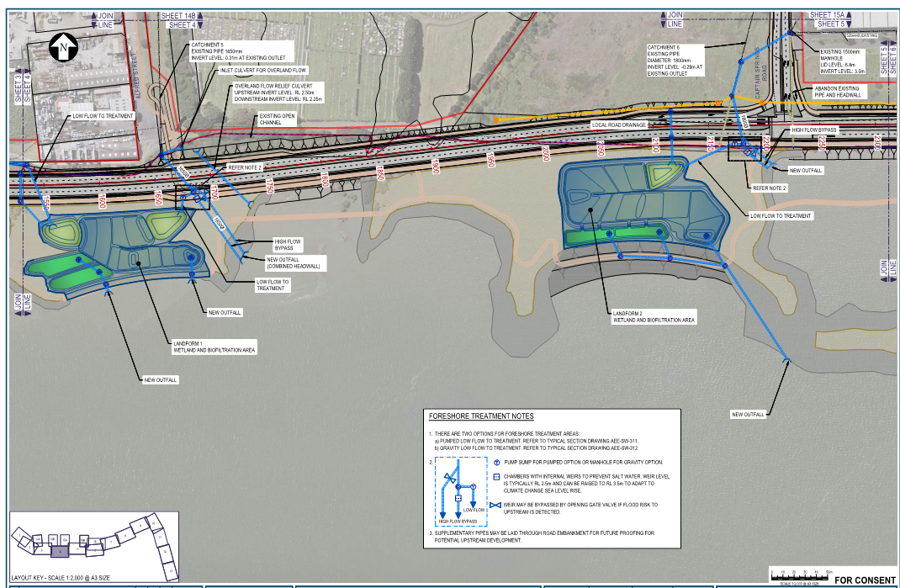

Slide 36
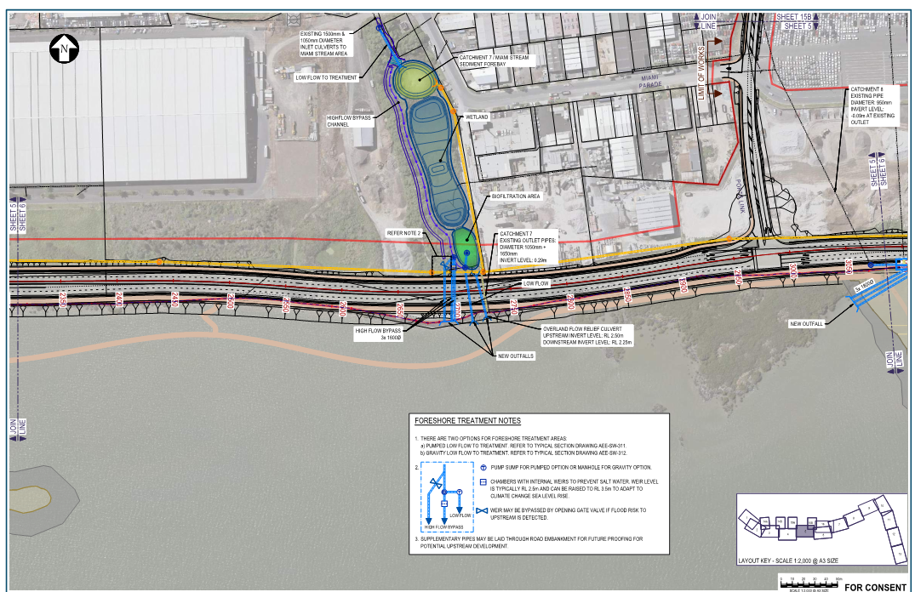

Slide 37
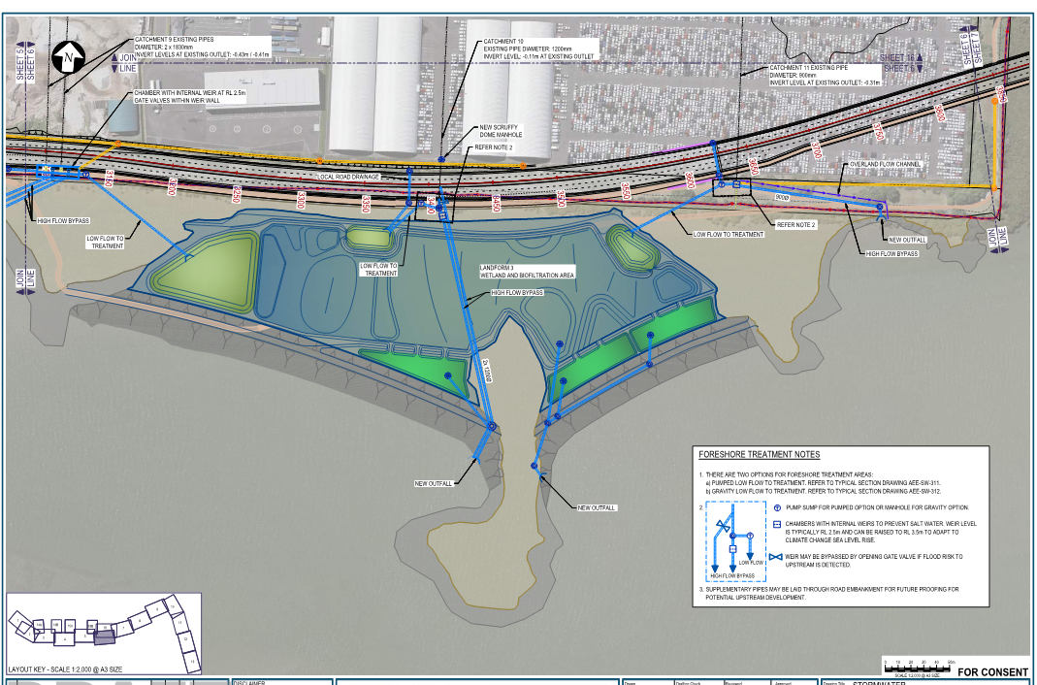

Slide 38
Acknowledgements
Dr Robin Allison
Stephen Priestley
Scott Wickman and the New Zealand Transport Agency

