Slide 1
Optimising the Heathcote
Antoinette Tan
DHI, Jacobs and CCC
Notes:
Optimising a complex network of multiple basins to reduce flooding downstream

Slide 2
Background into the Job
Heathcote Catchment and Model
Active Management
Optimisation
Future Work
Notes:
Optimising a complex network of multiple basins to reduce flooding downstream

Slide 4
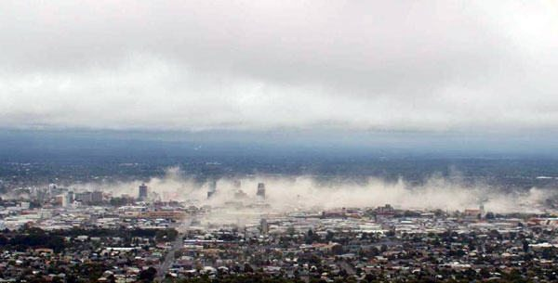

Slide 5
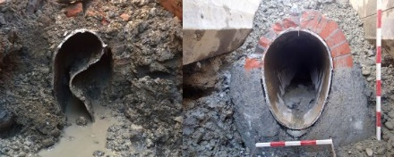
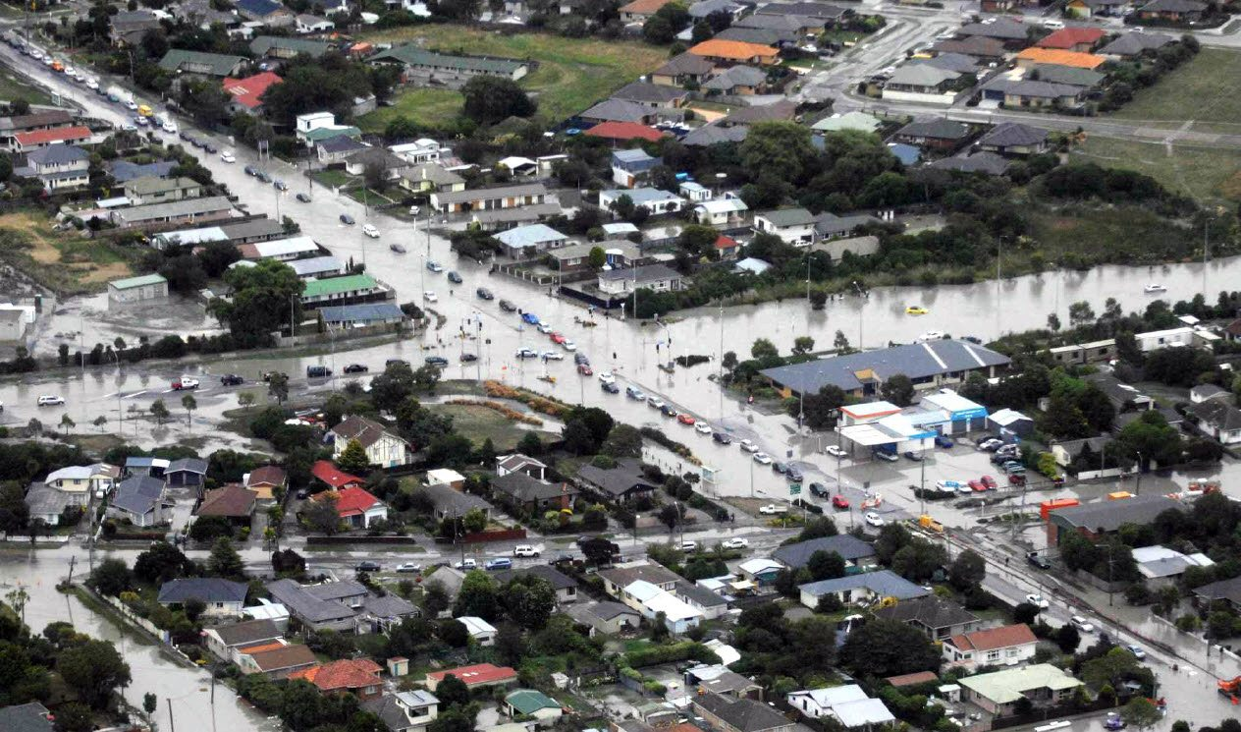
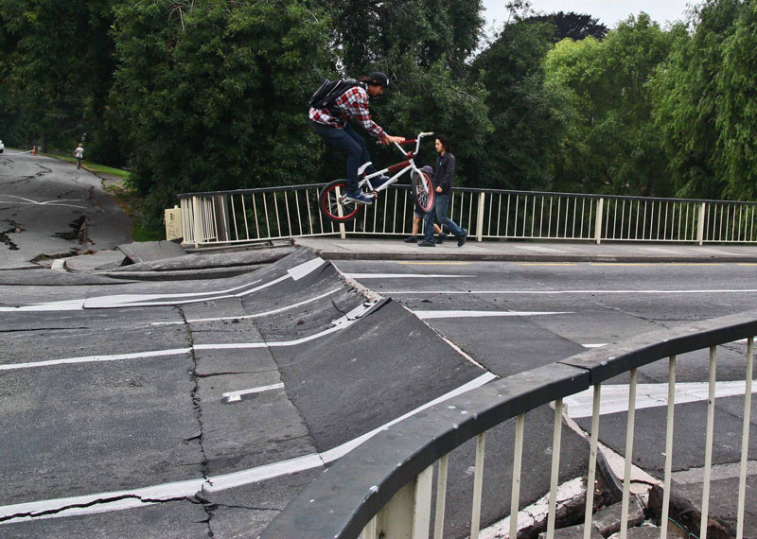
Notes:
Consequences of risk staring you in the face

Slide 6
L D R P
Notes:
Established in 2012 by CCC, to mitigate the effects of the earthquake on flooding, repair waterways, improve community resilience to flooding

Slide 7
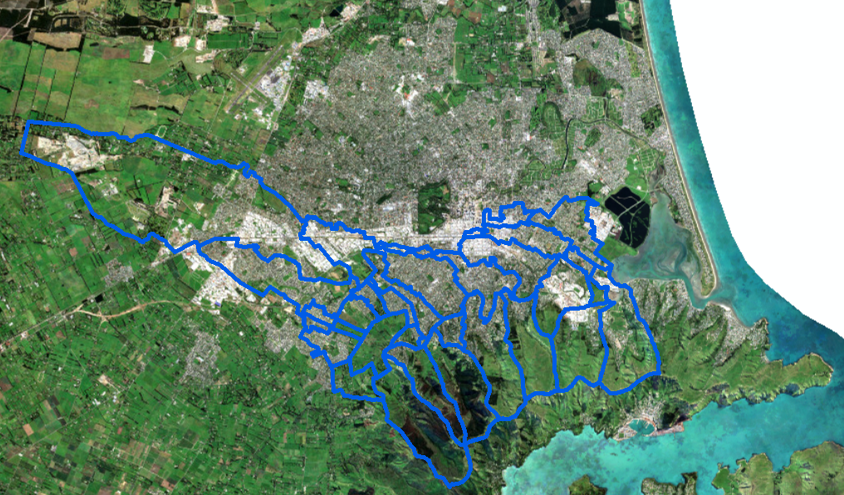
Notes:
Conversion from M11 model in 2011/12, ongoing work post earthquake. Working with Jacobs. Ongoing process of incorporating updated design elements into the master model. Later work included M11 and MF model in parallel.
Collaborative effort individual designs, constantly changing and evolving

Slide 8
Current Project
Update models to current design
Screening Model
Base scenario
Come up with Operational plan for structures
Test various “what if” scenarios
Finalise Operation
Notes:
Optimising a complex network of multiple basins to reduce flooding downstream

Slide 9
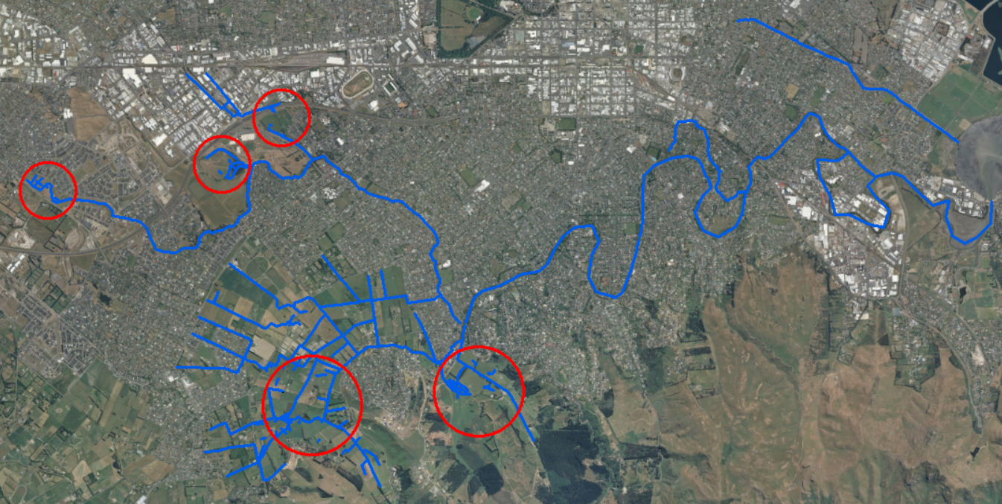
Heathcote Basins
Notes:
Picture of basins
SCADA/Sensors

Slide 10
Basin Design
Control Structures
Weirs
Culverts
First Flush
Maintain Water Levels
Infiltration
SCADA
Control Flow
Notes:
Designed by various consultants, often with their own modelling
Our job to update the current model with the newest design
Control structures work using series of logic, if statements

Slide 11
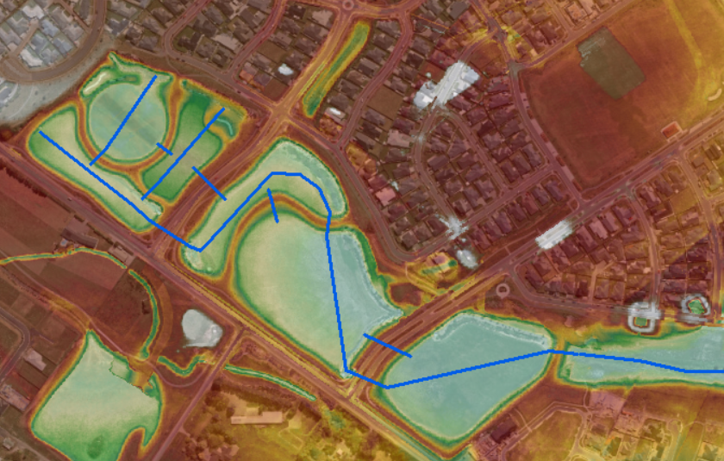
Awatea

Slide 12
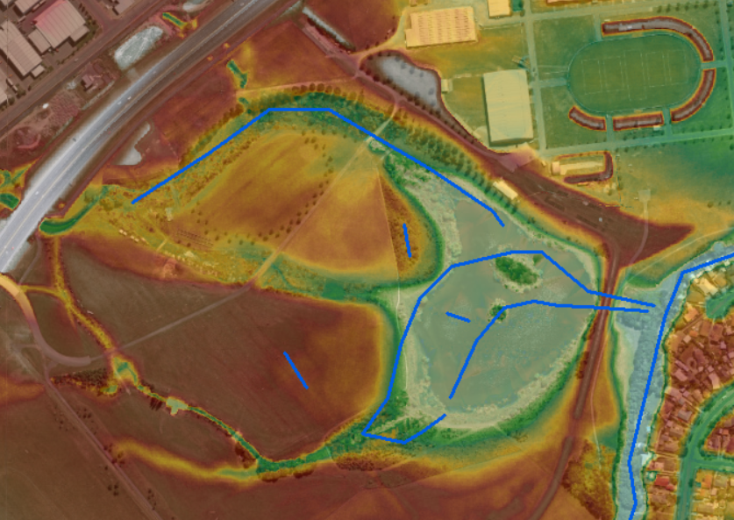
Wigram

Slide 13
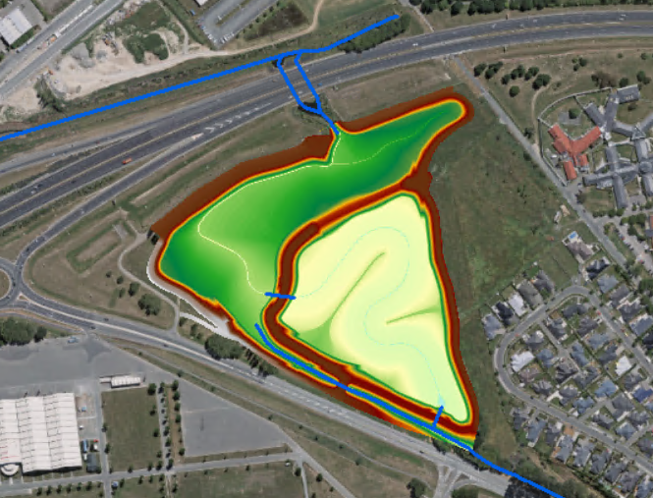
Curletts

Slide 14
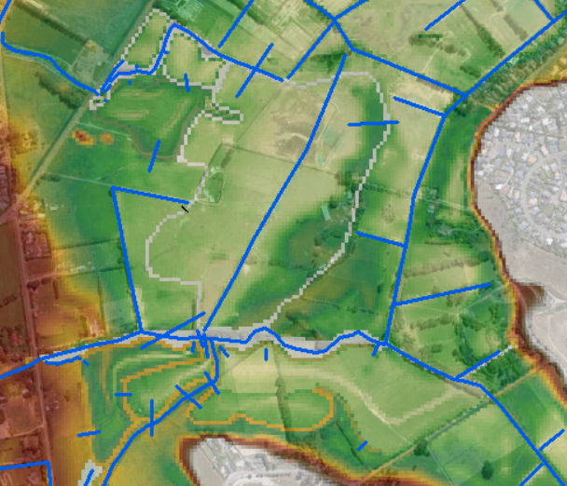
Hoonhay/Eastman

Slide 15
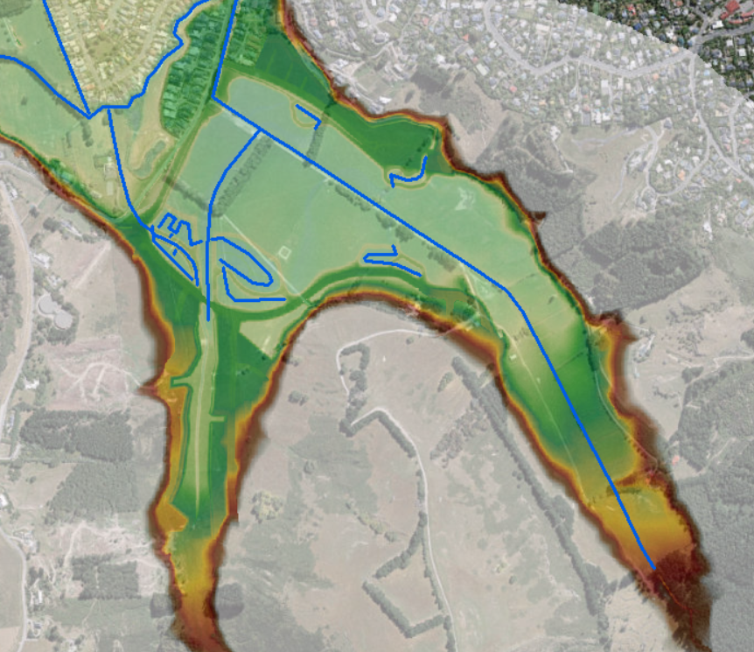
Cashmere Worsleys
Notes:
Control structure at Cashmere, where we open gate incrementally, if the water level is higher than a specified level. (talk about this later on, just say briefly that there is a gate here)

Slide 16
Current Project
Update models to current design
Screening Model
Base scenario
Come up with Operational plan for structures
Test various “what if” scenarios
Finalise Operation
Notes:
Optimising a complex network of multiple basins to reduce flooding downstream

Slide 17
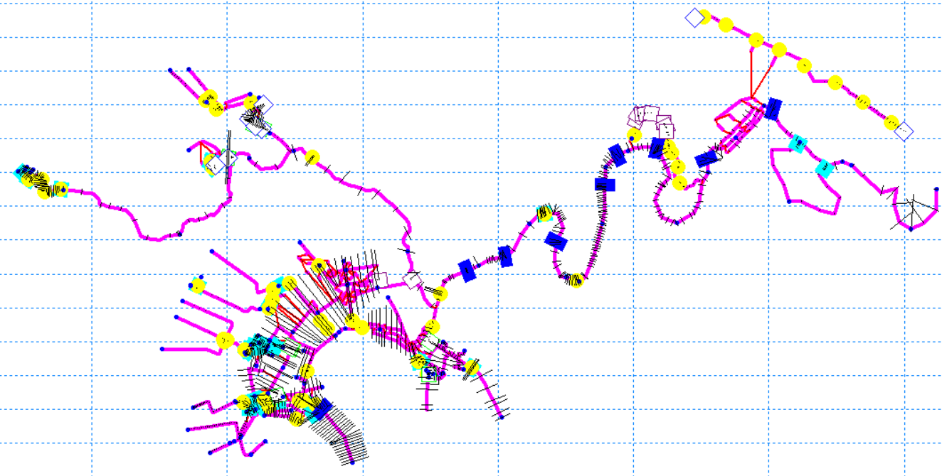
Screening Model
Notes:
Need to match to the MF model to have more confidence
Run time

Slide 18
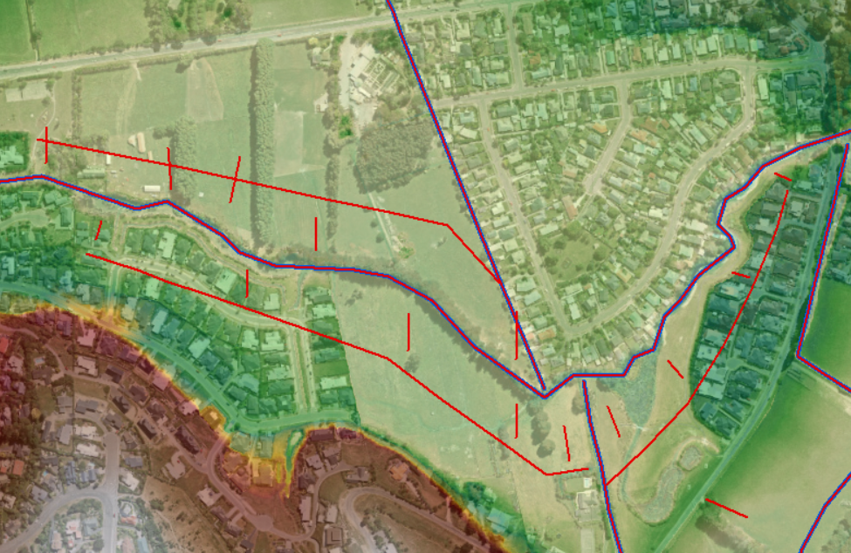
Link Channels

Slide 19
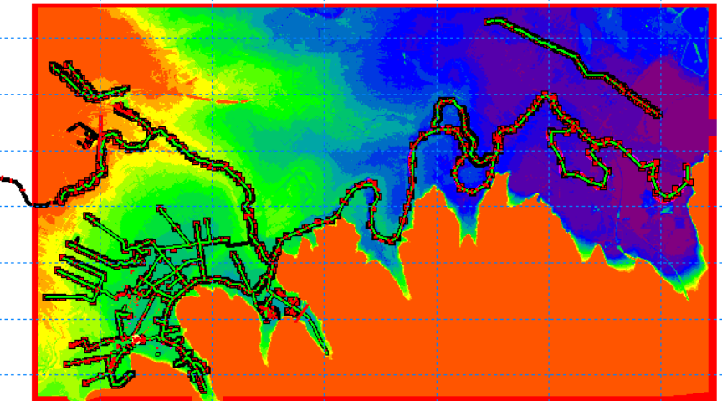
MIKE FLOOD model
Notes:
Not City Wide, Run time

Slide 20
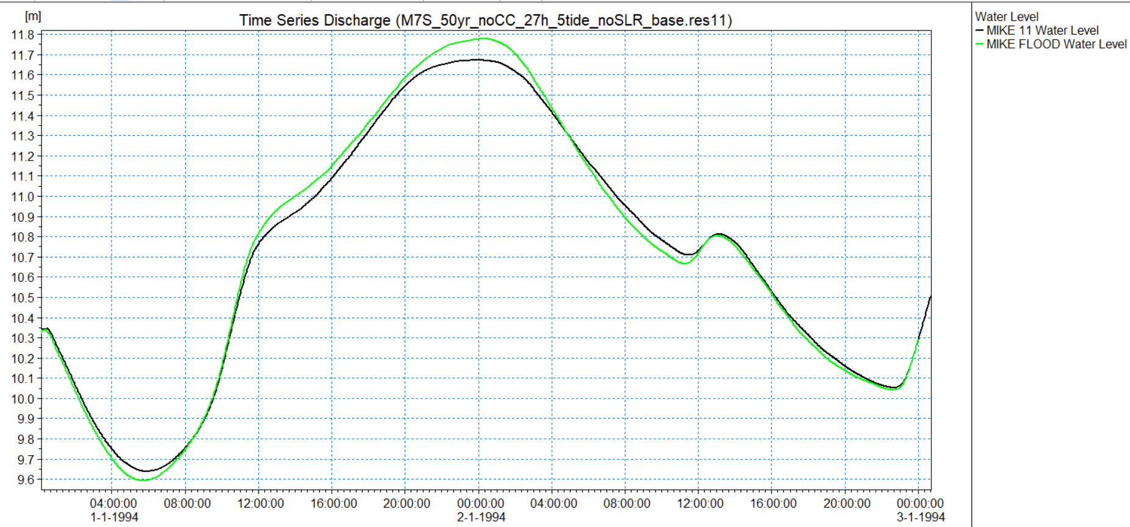
Water Level
Notes:
Difficulties, different structures, all links available, working from upstream, timing, levels within 100mm

Slide 21
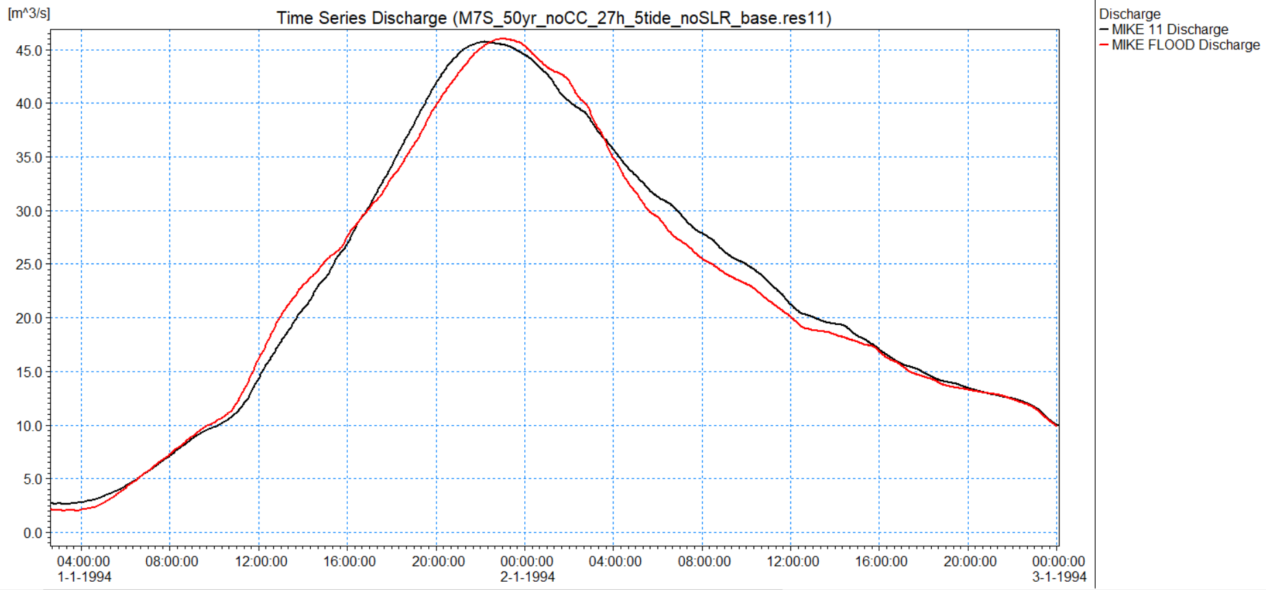
Discharge

Slide 22
Current Project
Update models to current design
Screening Model
Base scenario
Come up with Operational plan for structures
Test various “what if” scenarios
Finalise Operation
Notes:
Optimising a complex network of multiple basins to reduce flooding downstream

Slide 23
Base scenario setup
Notes:
First idea was to just hold all flow back as much as possible
But this wouldn’t work, because we have constraints as to how high water levels can get

Slide 24
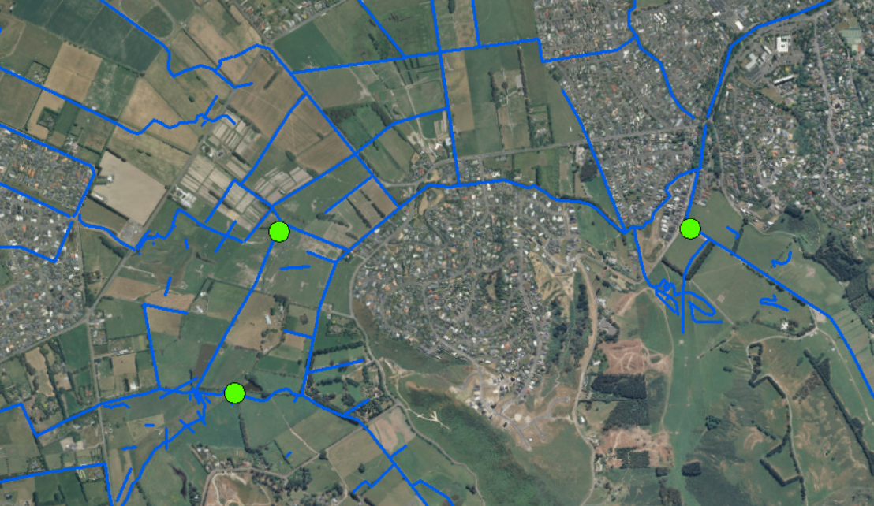
Base Scenario Setup
Notes:
Eastmans – sutherlands, based on spill at 1 weir
CW – 20% incremental opening, based on WL in basin
Cashmere, if weir is about to spill, then open gates for the rest of the simulation

Slide 25
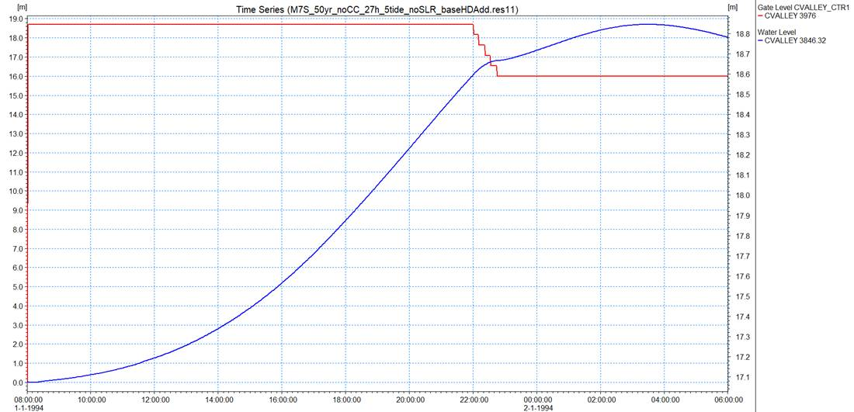

Slide 26
Current Project
Update models to current design
Screening Model
Base scenario
Come up with Operational plan for structures
Test various “what if” scenarios
Finalise Operation
Notes:
Optimising a complex network of multiple basins to reduce flooding downstream

Slide 27
Controls for each basin
Optimisation
Travel times
Realistic in terms of infrastructure available
Different gate operation
Notes:
Complex to optimise all basins to work the most efficiently together, instead of looking at each basin individually.
Optimising a complex network of multiple basins to reduce flooding downstream
Using optimisation tools such as Autocal, as well as working out travel times, and when water could be released from basins for the best effect
Can’t let water levels get too high, or have structures that can’t work physically
Different ways of operating gates such as the cashmere gate

Slide 28
AutoCal
Culvert Height
Closest to target Water Level
Optimised Culvert Height
Variable
Objective
Notes:
Autocal is software by DHI
Can use for example to optimise the size of a culvert to match a water level target

Slide 29
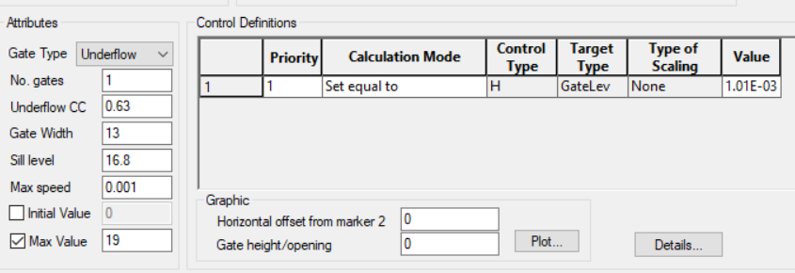
Auto Calibration
Notes:
First example at worsleys
Objective Function
Variables to change – works on any text file, use special indicator
Runs many iterations to achieve objective
Used to optimise culvert size to maximise storage without overtopping the road.

Slide 30
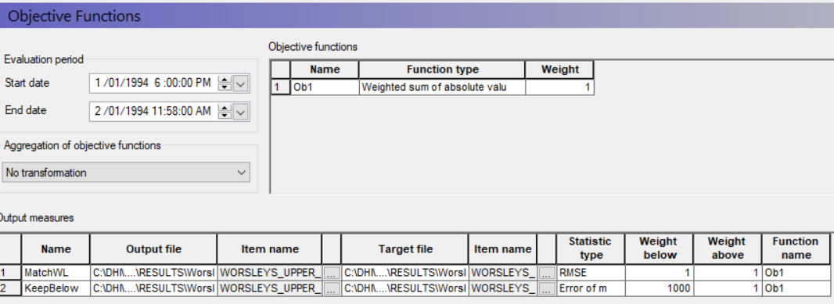
Objective

Slide 31
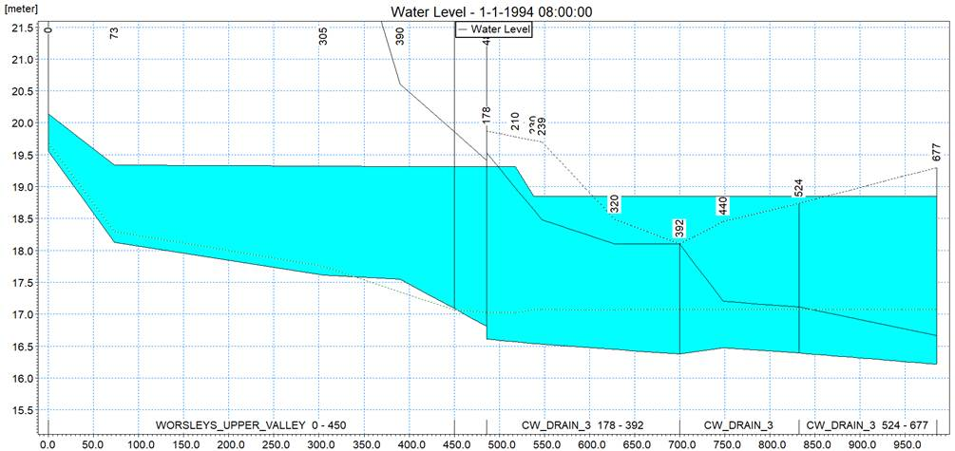

Slide 32
Current Project
Update models to current design
Screening Model
Base scenario
Come up with Operational plan for structures
Test various “what if” scenarios
Finalise Operation
Notes:
Once we have some operation decided we need to test that this will sill give a benefit under a variety of scenarios

Slide 33
What if Scenarios
Staging of basin implementation
Variable rainfall
SCADA down or incorrect
Past events
Tidal Scenarios
Rain is forecast
Notes:
Not fully decided yet
Rainfall pattern spatially and multiple peaks

Slide 34
Future work
Real time optimisation
Telemetry data
Online system
Give suggestions for gate settings

Slide 35
Conclusions
Working with complex models
Simplifying these models
Many Scenarios and Optimisation
Decision making tool for CCC
Reducing flood risk for residents
Notes:
Getting more out of our models and taking them to the next level
Work with a complex network, use fast 1d models for optimisation and decision making

Slide 36
Thank you
Antoinette Tan
Notes:
Special thanks to Jacobs and CCC

