Slide 1
Water and Wastewater Systems Improvements Through Digital Operations Analysis
Jared Thorpe

Slide 2
Untapped Digital Opportunities Within Reach
Smart Analytics
Automation Improvements
Outcomes

Slide 3
Untapped Digital Opportunities Within Reach

Slide 4
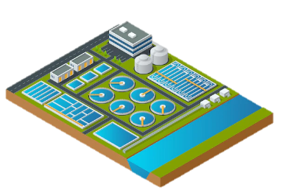
Data Rich, Analysis Poor
Large quantities of data already being collected
Limited analysis currently performed
Data analytics is a rapidly growing field with powerful technologies
Analysis can lead to better decision making and actions taken
Analysis
Decisions & Actions
Data
Systems

Slide 5
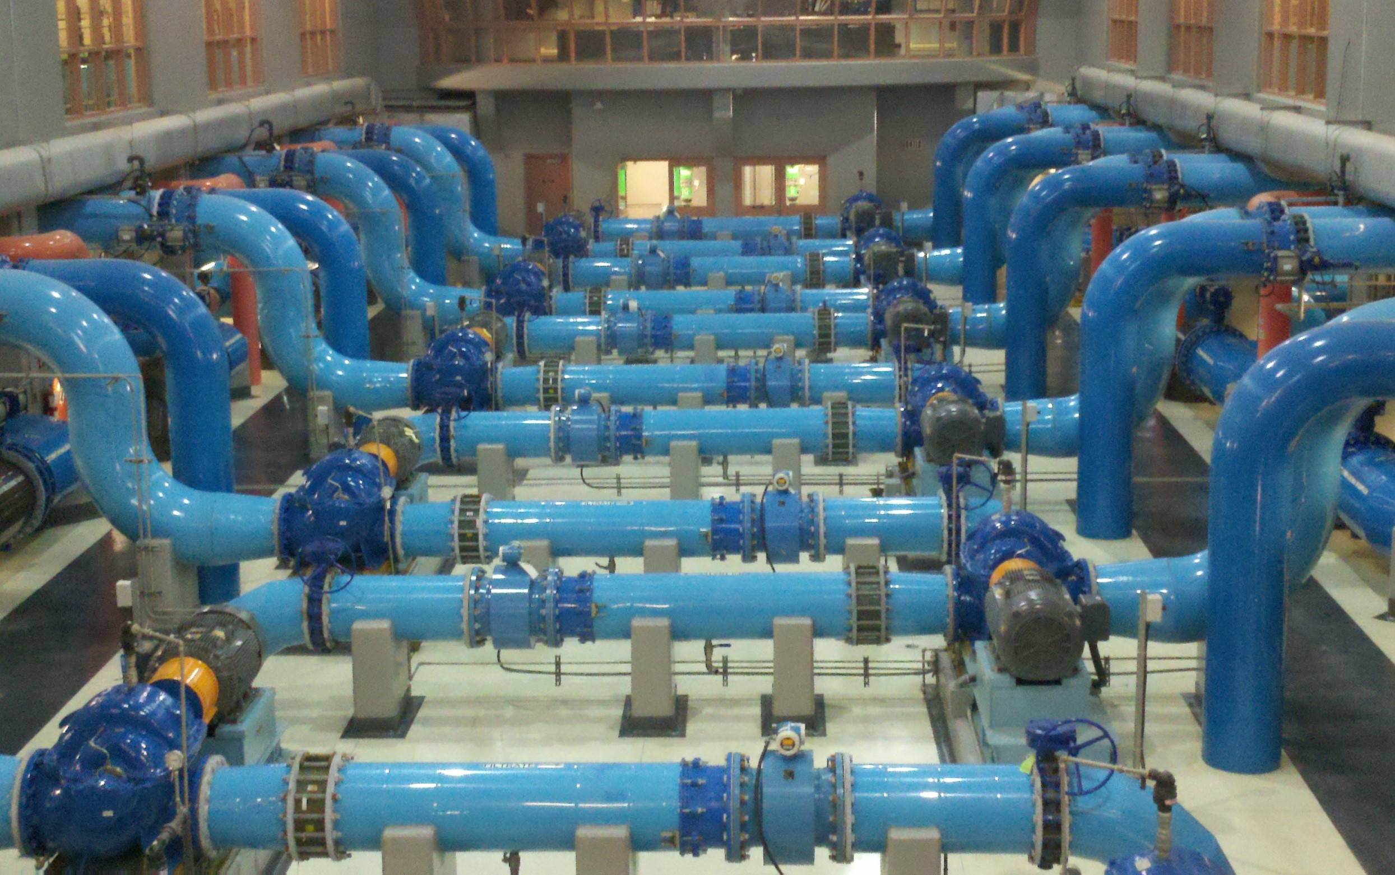
Digital Low Hanging Fruit
Take advantage of opportunities for early success
Large energy consuming systems
Adjustable equipment operations
Insightful operating data readily available
Example systems:
Pumps
Blowers
UV reactors

Slide 6
Smart Analytics

Slide 7
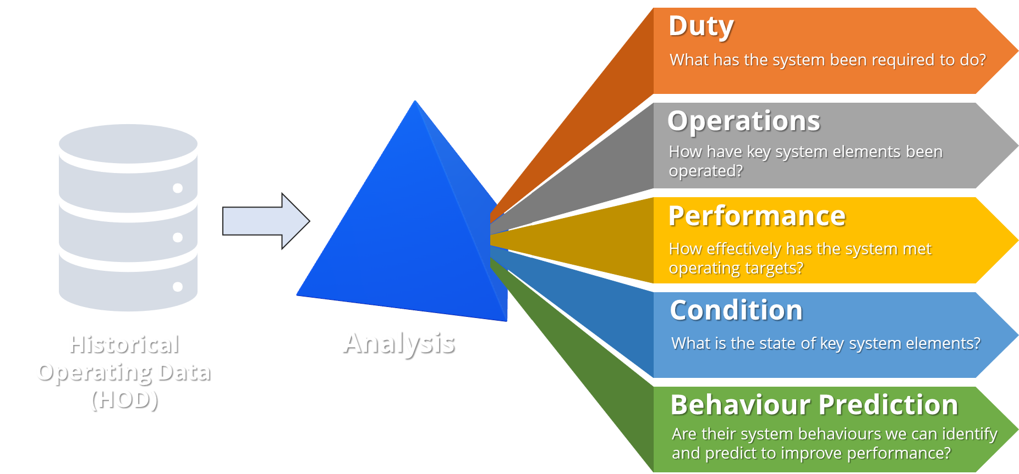
Operating Data Analysis

Slide 8
Duty: Under what conditions does the system operate?

Slide 9
Duty: Under what conditions does the system operate?

Slide 10
Duty: Under what conditions does the system operate?

Slide 11
Duty: Under what conditions does the system operate?

Slide 12
Duty: Under what conditions does the system operate?

Slide 13
Operations: Identifying overlapped operation with different unit combinations
Overlapped operation with different numbers of units

Slide 14
Performance: Comparison of power consumption for different unit combinations
Reduced power consumption for 4 units vs 5

Slide 15
Performance: Observation of conditions where energy wastage is occurring
Overlapped operation with different power consumption

Slide 16
Performance: Achievable energy savings
Current operation vs optimal -> energy savings potential

Slide 17
Performance: Evaluating control performance for tuning improvement
Under-aeration

Slide 18
Condition: Early identification of issues through equipment performance monitoring
20% efficiency decrease for Pump 4
Pump failure observed

Slide 19
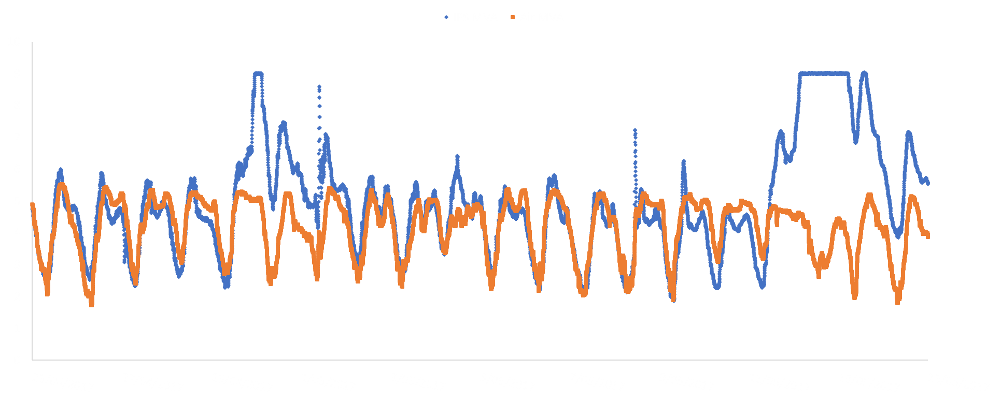
Behaviour Prediction: Using upstream system information to improve control performance
Upstream pump station flow correlates with downstream aeration demand (~30 min delay)

Slide 20
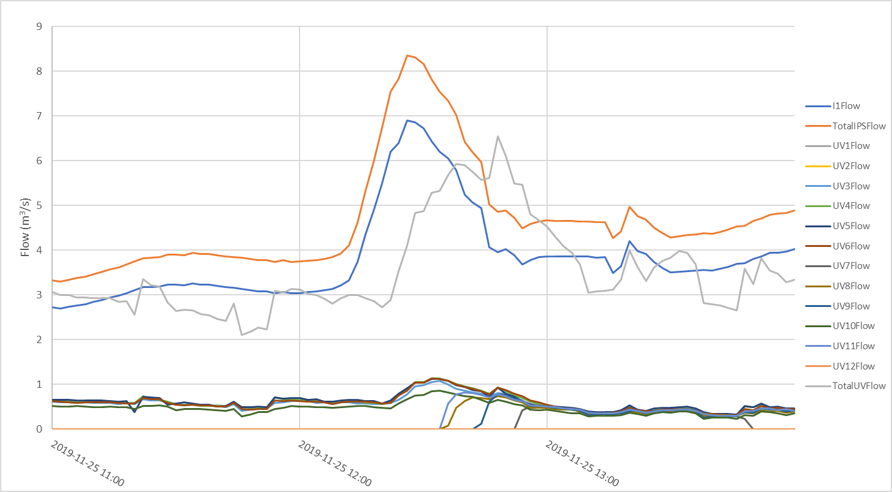
Behaviour Prediction: Using upstream system information to improve control performance
Phase lag between IPS flow and UV reactor flow
Unnecessary channel starts while upstream flow is declining

Slide 21
Operating Data Analysis
Improvements
Automation

Slide 22
Automation Improvements

Slide 23
Advanced Filtering
Optimized Loop Tuning
Reduce unnecessary measured variable noise impact on control algorithms
Maximize time at steady state and under control
Set Point Management
Model Assisted Control
Smart responses to predicted system behavior
Eliminate unnecessary control algorithm shock from set point changes
Operate in “sweet spots”
Automation Improvements
Online Performance Analysis
Optimized Transitions
Digital performance indicators inform operations and improve decisions
Optimize the conditions where equipment units turn on and off
Ensure optimal number of units are in operation for all conditions
Digital Condition Assessment
Divergence Warnings
Early identification of problems
Use digital indicators to assess equipment condition, improving the accuracy of asset management

Slide 24
Automation Improvements: Optimised Equipment Transitions
Optimise the conditions where equipment units turn on and off
Ensure optimal number of units are in operation for all conditions
Pumps
Blowers
Reactors

Slide 25
Automation Improvements: Set Point Management
Target operation in sweet spots with best efficiency
Systems with operational flexibility

Slide 26
Automation Improvements: Feed Forward Control
Unit Transitions Control (Limits)
Starts
Stops
Upstream Measured Variable (Flow)
Feed Forward Logic
Unit Property Control (Feedback)
Speed
Position
Power Output

Slide 27
Automation Improvements: Digital Condition Assessment
Tracking digital indicators of performance
Energy efficiency (decline)
Pipe/equipment head loss
Valve position vs flow and pressure
Start frequency, run hours
Temperature, vibration
Warnings/alarms that trigger responses

Slide 28
Outcomes

Slide 29
Results for a selection of pump, blower and UV reactor systems
System Type | Energy Savings | Energy Savings (MWh/yr) | Carbon Savings (Ton/yr) | Cost Savings over Asset Life | ROI (yr)
Wastewater pump station | 3.5% | 225 | 52 | $350 – 500 k | 1-2
Wastewater pump station | 7% | 323 | 75 | $500 – 700 k | 1-2
Wastewater pump station | 7.5% | 66 | 15 | $150 - 200 k | 4
Raw Water Pump Station | 15% | 1,330 | 310 | $3.6 – 5.0 M | < 1
Treated Water Pump Station | 2% | 341 | 79 | $1.8 – 2.3 M | 1-2
Aeration blowers | 3% | 683 | 159 | $1.0 -1.5 M | 1-2
UV Reactors | 4.5% | 293 | 68 | $ 0.9 – 1.3 M | 1-2

Slide 30
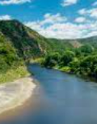
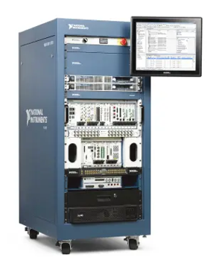
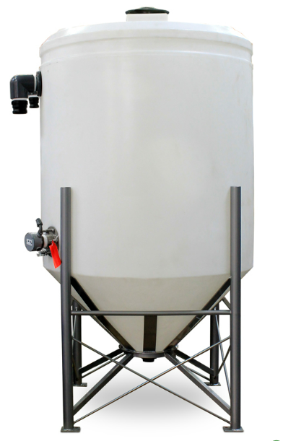
Automation improvements discovered from data analysis
Utilizing data already available
Targeted analysis for targeted systems
Quick to implement and provide ongoing benefit
3-15 % savings
1-2 years ROI
A cascade of benefits
Social & Environmental Impact
Improved Process Performance
Carbon Savings
Improved Automation
Consumables Savings
Cost Savings
Increased Energy Efficiency
Increased Asset Life

Slide 31
Want to continue the conversation?
Come and say hello to the team at the Jacobs booth, location #125

