Slide 1
STP and Modelling
Making Watercare more customer friendly and efficient
Mike Dunstone
March 2019

Slide 2
Overview
What STP is about
STP for modellers and planners
Data Lake
Dashboards
System performance
GIS connected Model
Future

Slide 3
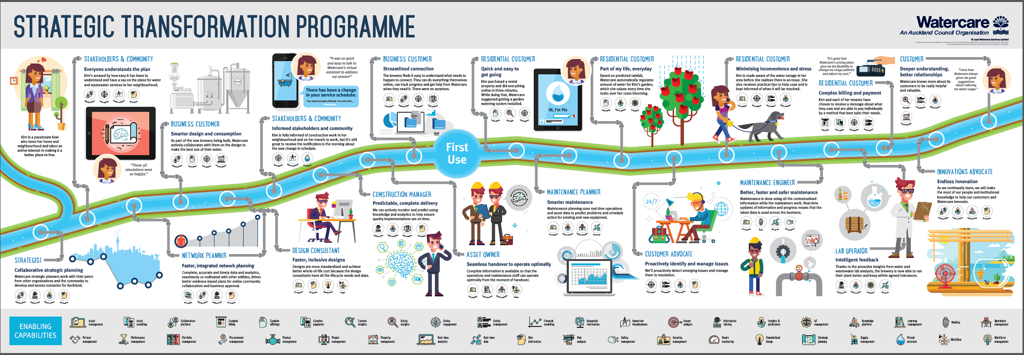
How Watercare is transforming
What STP is about

Slide 4
What STP is about
WHAT PROBLEMS ARE WE SOLVING?
WHAT’S THE STP ASPIRATION?
Every employee has the right tools, the best processes and is empowered.
Every employee can make insight-informed, fact-based decisions with confidence.
A customer can do everything for themselves, wherever they are, in a single interaction.

Slide 5
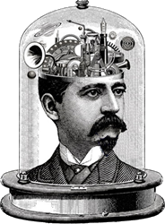
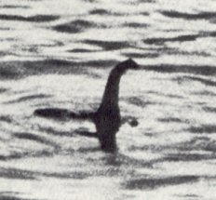
The Data Lake

Slide 6
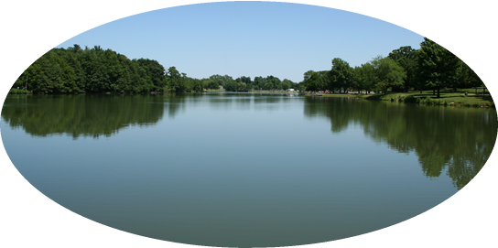
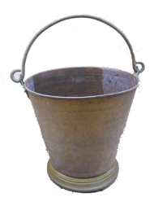
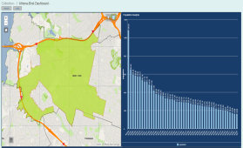
The Data Lake

Slide 7
Dashboards

Slide 8
System Performance

Slide 9
System Performance

Slide 10
System Performance

Slide 11
Connected GIS Model

Slide 12
Connected GIS Model

Slide 13
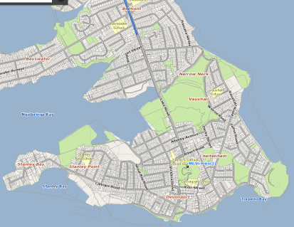
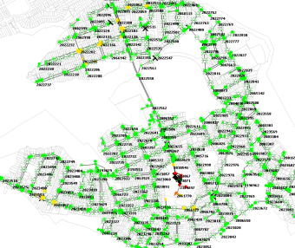
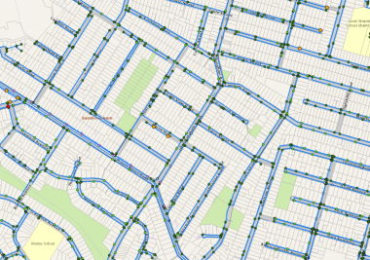
The Future
Model GIS integration
From:
To:

Slide 14
STP and Modelling
Making Watercare more customer friendly and efficient
Mike Dunstone
March 2019

