Slide 1
Natural Disasters – do they need to be?
Gill Jolly, Leader, Ngā Matepā me ngā Tūraru ā Taiao - Natural Hazards and Risks Theme
(and many other amazing experts in GNS, around the country and globally)

Slide 2
What we know that we know, what we know we don’t know, what we don’t know we don’t know….. (to paraphrase former US Sec Def Rumsfeld)
“but he left out what we do not like to know” (Daase and Kessler 2007)

Slide 3
What we know that we know, what we know we don’t know, what we don’t know we don’t know….. (to paraphrase former US Sec Def Rumsfeld)
“but he left out what we do not like to know” (Daase and Kessler 2007)

Slide 4
What we know that we know, what we know we don’t know, what we don’t know we don’t know….. (to paraphrase former US Sec Def Rumsfeld)
“but he left out what we do not like to know” (Daase and Kessler 2007)

Slide 5
Key messages
Societal change comes from:
raising awareness,
developing understanding,
gaining commitment, and
triggering action.
The natural hazards events that we might face in the next 50 years have a wide range of consequences and impacts
A few potential black swans
Collectively we can manage the risks from those events through coordinated planning to develop resilience
Natural hazards events do not need to be disasters

Slide 6
Key messages
Societal change comes from:
raising awareness,
developing understanding,
gaining commitment, and
triggering action.
The natural hazards events that we might face in the next 50 years have a wide range of consequences and impacts
A few potential black swans
Collectively we can manage the risks from those events through coordinated planning to develop resilience
Natural hazards events do not need to be disasters

Slide 7
Some truisms…
Larger events happen less frequently
Not all similar sized events have similar sized impacts
Different parts of NZ have different hazards
Risk changes through time
Researchers continue to make discoveries and refine understanding of events
As we know more, we can adapt our approaches to risk management

Slide 8
Let’s start with volcanoes
Multiple hazards:
Ashfall
Pyroclastic flows
Ballistics (bombs)
Lahars
Acid rain
Gas
Lava flows
Landslides
Most hazards are confined to close to the volcano; ash and gas (and lahars) can travel 100s km
Credit: USGS

Slide 9
Impacts (with a water focus)
Contamination of surface waters (acidic and turbidity; some toxicity)
Water demand for clean up
Clog up wastewater and stormwater networks
Mechanical and chemical damage to vulnerable parts
Compromised power
Expect increased maintenance
See: Auckland Engineering Lifelines Group (alg.org.nz) for posters

Slide 10
The cone volcanoes - Ruapehu, Taranaki, Whakaari, Tongariro or Ngauruhoe – next 50 year outlook
Ruapehu – almost certain to have a repeat of 1995/6
Tongariro/Ngauruhoe – less likely?
Whakaari – small eruptions every few years
Taranaki – 35-38% of at least one eruption in 50 years
Larger eruptions less likely, but can’t be ruled out (think Mt St Helens 1980)
Credit: USGS
Notes:
Hazards. And impacts wrt water

Slide 11
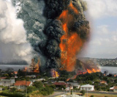
How about Auckland?
Ca. 5% in 50 years
Could pop up anywhere in wider Auckland city area
Generally small and localised impacts
Rangitoto was latest and the largest eruption – is this an anomaly or a precedent?

Slide 12
Taupō has been in the news lately – should we be worried?
Last eruption in 232AD
29 eruptions in last 26,000 years, so roughly one every 1000 years, but not at all equally spaced
Only one “super eruption” (plus one very explosive eruption – 232AD)
Other 27 eruptions much smaller
There may have been eruptions that have no geological record
An eruption is extremely unlikely, but can’t rule it out

Slide 13
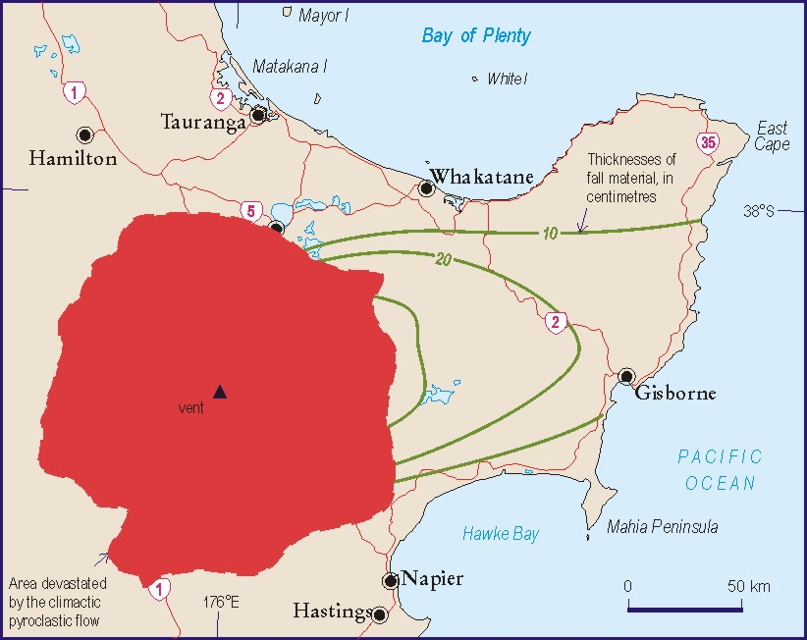
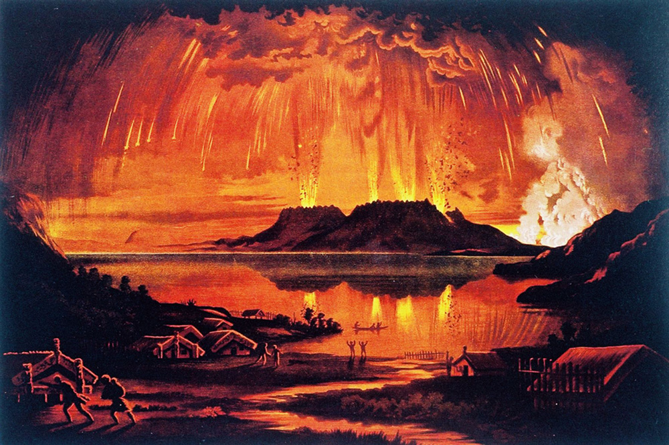
Impacts from calderas like Taupō or Okataina…..size matters
Rabaul 1994 (0.04 km³ - similar to Ruapehu 1995)
Tarawera 1886 (2 km³)
Taupo 232 AD (45 km³)
(Credit: McKee et al 2017)
(Credit: Wilson, 1985)

Slide 14
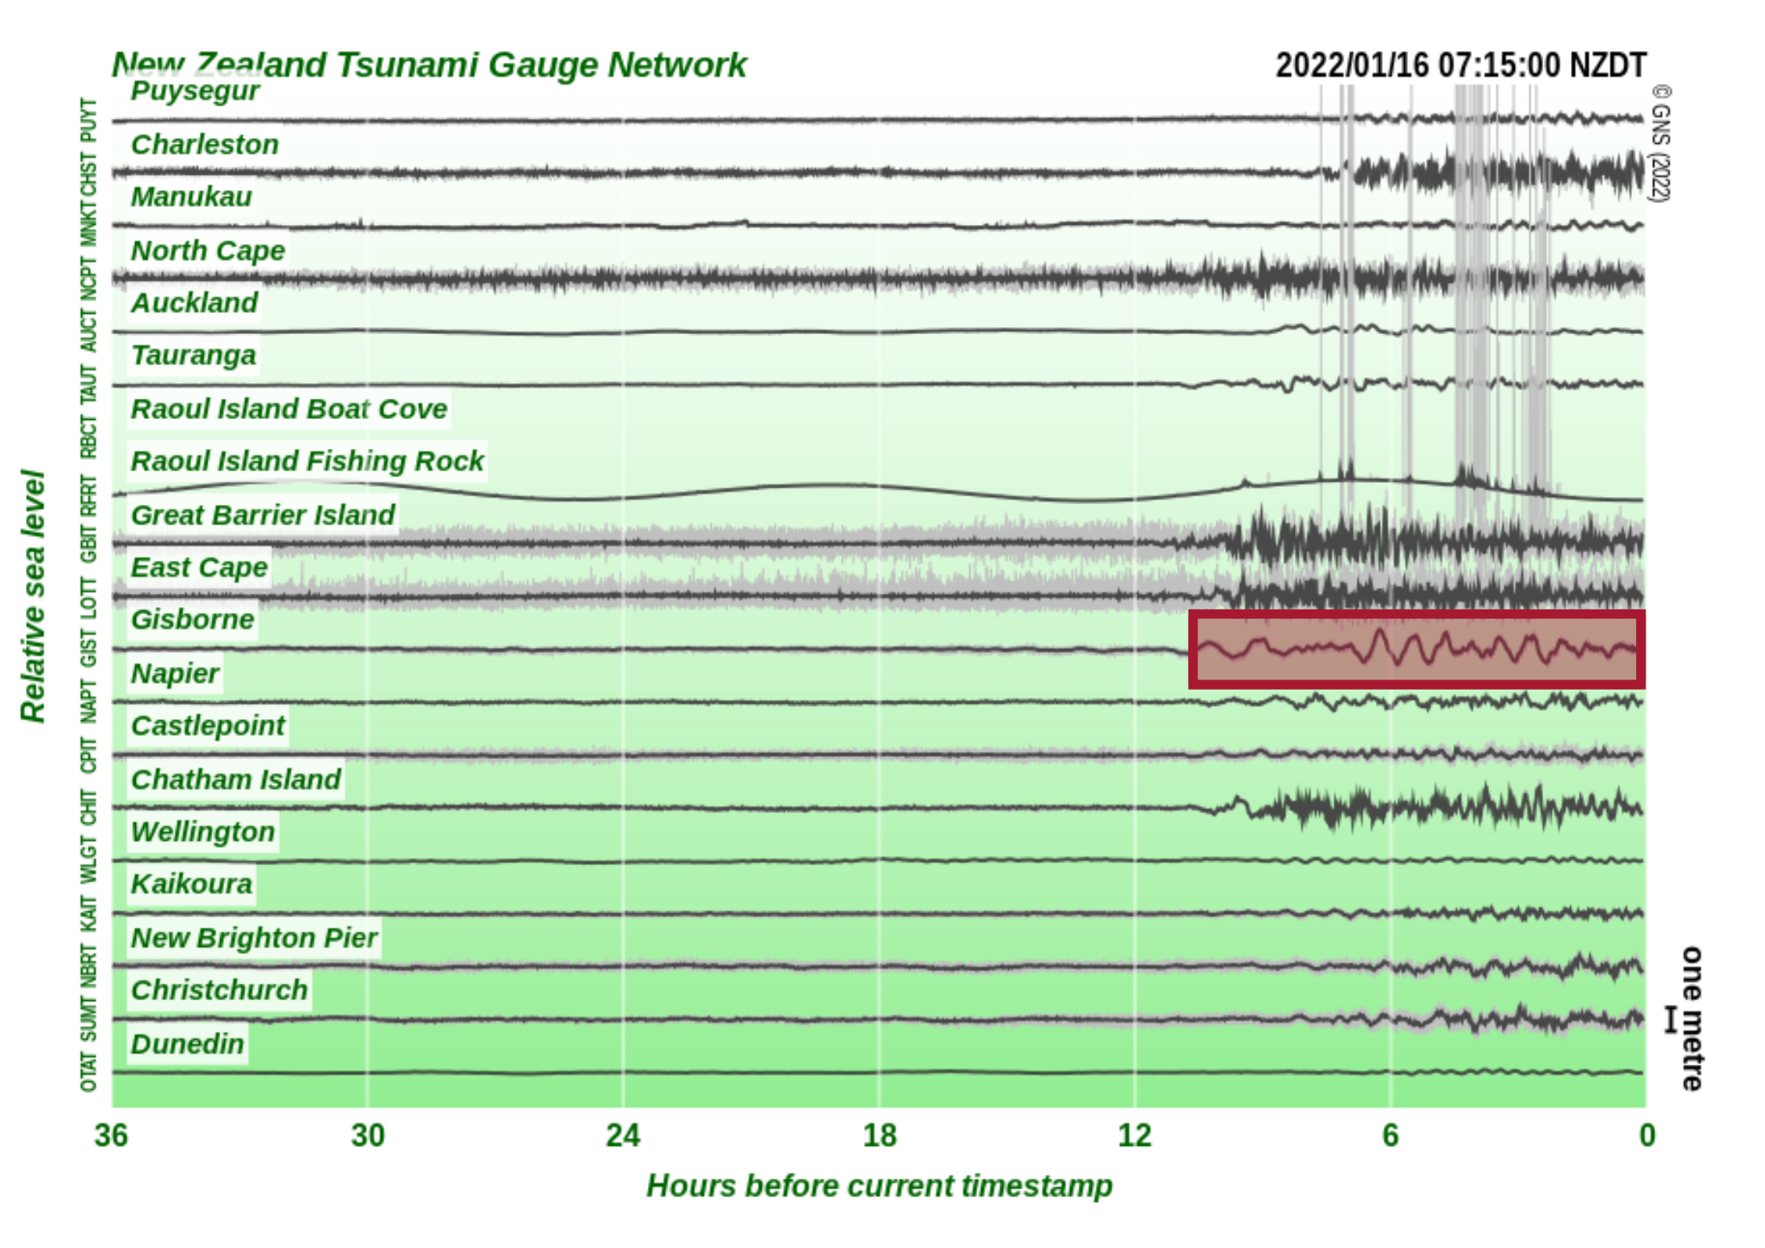
What might a volcanic black swan look like?
Hunga Tonga – Hunga Ha’apai?

Slide 15
Moving onto earthquakes – also multiple hazards and impacts
Ground shaking
Liquefaction
Landslide
Ground rupture
Tsunami
Impacts
Building and infrastructure damage
Non-structural damage
Aquifer changes
Fire following earthquake
Business continuity
Dam break floods

Slide 16
A word about the National Seismic Hazard Model
Recently revised (Oct 22)
Takes into account
New earthquake science e.g. Hikurangi, Alpine Fault
New ground motion models
Nearly 1 million possible ruptures
No single hazard “number”
Hazard has generally increased across the country compared to the 2010 (and 2002) models
Includes uncertainty
https://www.gns.cri.nz/research-projects/national-seismic-hazard-model/

Slide 17
The “most likely one” – Alpine Fault M8
75% chance of any earthquake in next 50 years
82% that the earthquake will be M8 or greater
AF8 Progamme scenarios
Each rupture is slightly different; south to north is the most challenging
Highly recommend checking out the webpage
AF8 Programme: https://af8.org.nz/af8-scenario

Slide 18
The “big one” – Hikurangi Subduction Zone
25% chance of M8+ in next 50 years
Capable of M9+
Equivalent to 2011 Tohuku
HRP M8.9 scenario
Major tsunami impacting East Coast NI
Sobering reading – not just immediate impacts but long recovery time
https://www.eastcoastlab.org.nz/our-science/our-projects/hikurangiresponseplan/

Slide 19
A seismic black swan – joining up faults
Kaikōura (and Darfield) showed us that multiple faults can rupture together
What scenarios can link faults together?
Alpine Fault to Wellington Fault?
Wellington Fault to Mohaka Fault?
Others??
We no longer think about a “M7.5 Wellington Fault”

Slide 20
How about tsunami?
As well as the Hikurangi, we have the Puysegur Subduction Zone – we don’t know so much about this one
Large earthquakes around the Pacific can also deliver a tsunami to our coasts
Offshore volcanic eruptions can cause tsunami eg Mayor Island
National Tsunami Hazard Model (at the coast) gives recurrence intervals; no national inundation model

Slide 21
A tsunami black swan…?
Landslide “graveyard” offshore north of Taranaki
6 mega-landslides over 5 million years
Could these landslides have generated tsunami along the west coast of NI?
Is there the potential for this to happen now?
https://www.gns.cri.nz/research-projects/hidden-landslides-and-silent-tsunami-2/

Slide 22
Landslides, debris flows and liquefaction
Landslides are our most costly geological hazard, both economically and in lives lost
Most frequent (rainfall as well as earthquake)
Disruptive (as we’ve seen this winter)
Not just where the slip starts, but where the material ends up (rockfall, debris flows)
Other land instability hazards include earthquake induced liquefaction, coastal erosion
https://www.gns.cri.nz/our-science/natural-hazards-and-risks/landslides/

Slide 23
And what about climate change on top of all of that….
Sea level rise can influence:
Liquefaction potential
Saline intrusions into aquifers
Frequency of flooding
Failure of stormwater and wastewater infrastructure
Sea level rise is influenced by tectonic movement
And climate change means more intense weather = more landslides and coastal erosion
https://www.searise.nz/

Slide 24
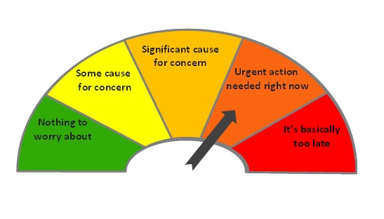
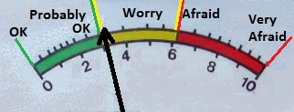
Summary of the next 50 years…..in decreasing levels on my worry-o-meter
Hikurangi SZ – eq and tsunami: 25% chance/major impact (I live in Wellington)
Taupō heightened unrest: none in last 150 years; main worry with answering the question “what is coming next?”
Alpine Fault: 75% chance/major impact especially for SI
Auckland: 5% chance/major impact/rapid onset
Other volcanoes: equal worry for moderate eruptions at Taranaki, Ruapehu, Tongariro
Black swans – if we’ve done the planning work, we should be able to adapt our response

Slide 25
It’s not all bad news, is it? Aren’t we managing our risks?
Yes, to some extent…
Long term risk reduction
Building code revision
Land use planning (RM reform)
Infrastructure strategy
Risk transfer
Readiness, response, recovery
National Disaster Resilience Strategy
All hazards – all risks?
Climate, meteo, geo
Cascading, consequent risks
How well does the system work?
“Greater sharing of information about the whole range of threats we face, so decision makers and others can get a full picture of the level of risk for our infrastructure.”
strategy.tewaihanga.govt.nz/issues/preparing-for-the-worst

Slide 26
Report card – could do better?
A⁻
B
What more do we need to do?
Scenarios to guide actions for reduction, response and recovery planning for a range of events
Nationally consistent hazard and risk models to provide the evidence base to guide decision-making priorities
Interdependence of hazards
Definition of acceptable risk?
National governance for resilience and wider system thinking?
Partnership, collaboration and system coordination to ensure optimal solutions are found
(country)
B⁻
C⁻
B
B⁻

Slide 27
Key messages
Societal change comes from:
raising awareness,
developing understanding,
gaining commitment, and
triggering action.
The natural hazards events that we might face in the next 50 years have a wide range of consequences and impacts
A few potential black swans
Collectively we can manage the risks from those events through coordinated planning to develop resilience
Natural hazards events do not need to be disasters

