Slide 1
Water New Zealand
Pre-conference Workshop – Part 1
22 February 2022

Slide 2
Ko wai, ko au, ko tātou
2
Ko te wai ahau, ko ahau te wai.
He whakaaturanga tātau nō te wai.
Ko te ora te wai ko te ora o te tangata.
He taonga te wai me tiaki.
Ko wai tātou.
Ko wai tātou.
I am wai, wai is me.
We are reflections of our wai.
The health of te wai is the health of te tangata.
Wai is a taonga that must be protected.
Ko wai tātou.
We are wai. Wai is us.
Notes:
Kia ora e te whānau.
Thank you for inviting us to join you today.
I’m going to start by reading one of our whakataukī, a cultural wisdom that inspires and guides our work.
Ko te wai ahau, ko ahau te wai
He whakaaturanga tātau nō te wai
Ko te ora te wai ko te ora o te tangata
He taonga te wai me tiaki
Ko wai tātou
Ko wai tātou
This whakatauki represents our own roles in the kaupapa of protecting the health of te wai and the health of te tangata, in balance; ko wai, ko au, ko tatou.
Each of us serve as a reflection point between tangata and wai to highlight the reciprocal relationship between the two.
Likewise, the taumata and the wai in our tohu (our brand logo) are balanced reflections of one another – they are one in the same.

Slide 3
Bill Bayfield Chief Executive
3
Notes:
Bill – 10 mins
Bill Bayfield, Chief Executive, will talk about where we’ve come from and where we’re heading, including establishing a new water services regulator with public health and te ao Māori at the forefront

Slide 4
Establishing a new regulator with your support
Our whakapapa – where we’ve come from
We’re here to lift the performance of the sector
Establishing a new water services regulator with public health and te ao Māori at the forefront
Our governance structure – Board and Te Puna
This isn’t a tick box exercise – shifting mindsets
Our kaupapa and roadmap – where we’re heading
Strategy into action
Challenges of regulating suppliers that have never been regulated
Being the voice of welcome while holding people to account
Notes:
Bill

Slide 5
What we will cover today
9.10am: Our strategy
Katy Te Amo, Head of Strategy and Insights – our strategic framework and focus areas, and Te Mana o te Wai.
9.30am: Our kaupapa and roadmap
Ray McMillan, Head of Regulatory – our regulatory approach, risk identification and management, drinking water supplier registration and timeframes, and the current public consultation.
Jim Graham, Principal Advisor Drinking Water – the proposed new drinking water standards and rules.
10.10am: Break
10.30am – 11am: Q & A
An opportunity to answer any pātai / questions you might have
Notes:
Bill
Over view of the morning and who is presenting
At 11am we’ll handover to DIA to talk about the reforms and the opportunities for the sector that these will create.
I will join you again at 1pm for the combined panel discussion

Slide 6
Katy Te Amo Head of Strategy and Insights
Notes:
Katy – 20 mins
Katy Te Amo, Head of Strategy and Insights, will talk about our strategic framework and focus areas, and Te Mana o te Wai – restoring and preserving the balance between wai (water), taiao (environment) and tangata (people).

Slide 7
Our whakapapa and kaupapa
Notes:
Katy
To introduce short video and people featured in it.
Bill Bayfield CEO
Dame Karen Poutasi, Chair of Taumata Arowai Board
Tipa Mahuta, Chair of Te Puna
Vidcom to play video. The back up if it doesn’t work is we can post this link in the comments to webinar https://www.youtube.com/watch?v=2EP3TbCIzyw&t=3s

Slide 8
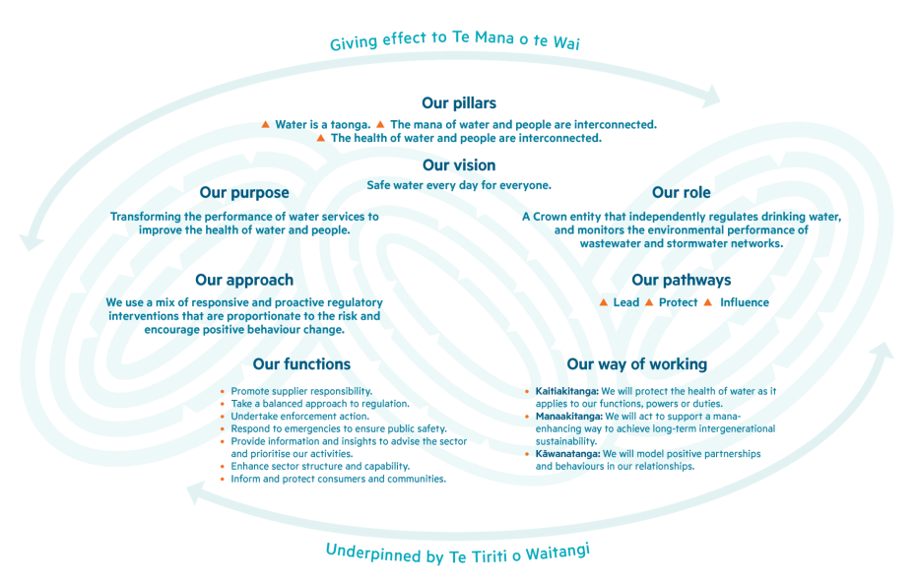
Our strategic framework
Notes:
Katy

Slide 9
Strategy development & planning
From January to April, we’ll be working with the Taumata Arowai Board and our Māori Advisory Group, Te Puna, on our long-term and medium-term strategies, including the Compliance, Monitoring and Enforcement strategy (CME).
Key thought leaders within Taumata Arowai are workshopping aspects of the CME over January/February.
We’ll develop an enduring Strategic Performance Framework, which will outline what we are seeking to achieve through our services and how we’ll measure progress/success.
The strategies and performance frameworks developed will be included in our Statement of Intent (four-year strategic plan) and Statement of Performance Expectations (one-year operational plan), both of which must be presented to Parliament early in July.
Notes:
Katy

Slide 10
Relationship between Strategy, SOI, SPE and CME
Long and medium term strategies – Outcomes and Impacts
Four-year strategy – Statement of Intent
One-year detailed plan – Statement of Performance Expectations
Compliance, Monitoring & Enforcement Strategy
Enduring performance framework
Notes:
Katy

Slide 11
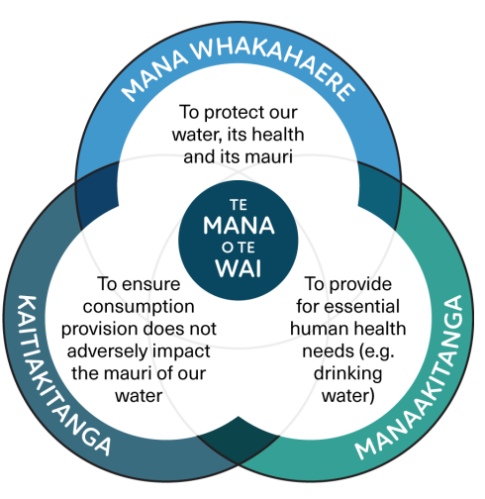
We take a lead from Te Mana o te Wai
The Te Mana o te Wai principles and hierarchy of obligations are about restoring and preserving the health, wellbeing, and balance between water, people, and the environment.
We are embracing this water centric approach and aspire to being a Crown leader in giving effect to Te Mana o te Wai.
Notes:
All persons with functions and duties under the Water Services Act must give effect to Te Mana o te Wai.
Māori have always taken a whole of system approach to water, looking at the whole picture from maunga to moana, or ki uta ki tai (from mountains to the sea).
This whole-of system approach recognises that the Te Ao Māori world view consists of fundamentals of tikanga, mātauranga Māori, and kaitiakitanga (to name a few).
There are whole knowledge systems embedded in how iwi/Māori do things, to protect and care for water in their rohe and takiwa.

Slide 12
Te Mana o te Wai
A key objective and requirement of the Water Services Act 2021 is for Taumata Arowai to give effect to Te Mana o te Wai, to the extent it applies to our functions and duties. This obligation also applies to all suppliers who operate under the Act.
The impact of giving effect to Te Mana o te Wai is something we are working through as we implement the Act.
We encourage suppliers to turn their minds to what Te Mana o te Wai means for them in their role.
It’s not the role of Taumata Arowai to define what Te Mana o te Wai means for whānau, hapū, iwi across the motu.
Join Taumata Arowai at the Water New Zealand Pre-conference Workshop – part 2 on 25 May to kōrero about Te Mana o te Wai and hear how some suppliers are giving effect to it.
Notes:
Katy

Slide 13
Ray McMillan Head of Regulatory
Unclassified
Notes:
Ray – 20 mins
Ray McMillan, Head of Regulatory, will talk about our regulatory approach, risk identification and management, drinking water supplier registration and timeframes, and the current public consultation.

Slide 14
Our regulatory approach
A balanced regulatory approach, adopting a mix of responsive and proactive regulatory activities.
Our focus will be to incentivise good practice behaviour changes in the drinking water sector and to disincentivise behaviours that do not support effective risk management or increase the likelihood of harm to consumers from unsafe drinking water.
Regulatory interventions will be proportionate and directed to address the risk and nature of the behaviours of regulated parties. Our decision to intervene will be based on the need to:
protect people and communities from serious risk to their health due to the quality or quantity of drinking water being supplied, and
support the water services sector to improve its performance and environmental outcomes.
Notes:
Ray
Interventions to protect public health and improve performance in the water services sector include:
Promoting supplier responsibility: We will provide national guidelines and good practice guidance on Te Mana o te Wai, regulatory obligations and suppliers' duty of care.
Taking a balanced approach to regulation: We will use a range of tools and approaches to ensure suppliers have effective risk management practices, strengthen the water services sector’s performance and improve environmental outcomes.
Undertaking enforcement action: Our enforcement activities will be proportionate to the risk to consumers and the extent to which the supplier has failed to meet their duties.
Responding to emergencies to ensure public safety: We will engage effectively with response agencies and ensure our emergency powers are available to support emergency responses when it is appropriate to do so.
Providing information and insights to advise the sector and prioritise our activities: We will analyse the data and information we obtain from suppliers to prioritise our work based on risk and share insights to support the continuous improvement of performance across the drinking water sector.
Enhancing sector structure and capability: We will contribute to the water services sector’s growth and development.
Informing and protecting consumers and communities: We will ensure consumers and communities understand critical information about their drinking water supply and can engage with their supplier. The public know how to raise a concern or a complaint about water services.

Slide 15
Drinking water safety planning
Drinking water safety planning is a continuous risk management process focusing on identifying, assessing, and managing the risks across the whole drinking water supply system – from where the water is sourced to the point of supply to consumers.
Registered water suppliers must update their drinking water safety plan to reflect new requirements of the Water Services Act 2021 and submit it by 15 November 2022 (or alternatively comply with an Acceptable Solution, which will be available to particular supply types and circumstances).
Drinking water safety plans will be reviewed, but not approved.
Source water risk management plans form part of a drinking water safety plan and are a new requirement.
Notes:
Ray
Water safety plans vs planning – considerable work is underway to provide guidance on the Taumata Arowai approach, the culture change we want to see and our expectations of water suppliers.
Source water risk management plans (SWRMPs) – similarly, considerable work is underway to understand what will be required of water suppliers, how Te Mana o te Wai is taken account of in SWRMPs and the guidance that will be provided to water suppliers.

Slide 16
Our approach to risk
Water suppliers understand their business the best.
Encourage a broader approach to managing risk.
Use the risk management approach that best suits your context.
Focus on process of managing the risks to the water supply and how effective you are (not just the completion of a plan).
Outcome of the planning process is documented in the Drinking Water Safety Plan.
We will provide guidance, but the focus will be on drinking water suppliers taking accountability and conducting good risk management practices.
Join Taumata Arowai at the Water New Zealand webinar on 24 March to find out more about drinking water safety planning and source water risk management planning.
Notes:
Ray

Slide 17
Roadmap for registered water suppliers
100% of Councils have registered in Hinekōrako – our self-service online portal for drinking water suppliers and laboratories. 33% have verified all of their supplies.
We need Councils to fully verify their supplies to complete the registration process by the end of February. Once verified, the supplies will be added to the public register and water carriers can register their supplies.
We are taking a phased approach to registration and are currently contacting small suppliers.
Notes:
Ray
data accurate as at 9am, 18 February 2022

Slide 18
Roadmap for unregistered water suppliers
Unregistered drinking water suppliers have plenty of time. Up to four years to register and a further three years to meet the requirements of the Water Services Act 2021.
These timeframes provide an opportunity for Taumata Arowai to work with our unregistered community to understand their needs and circumstances.
Drinking Water Acceptable Solutions will provide ready-made options for certain supply types to comply with the Act.
Notes:
Ray

Slide 19
Public consultation
We are currently seeking feedback on the following proposed documents:
Drinking Water Standards
Drinking Water Quality Assurance Rules
Drinking Water Aesthetic Values
Drinking Water Acceptable Solution for Roof Water Supplies
Drinking Water Acceptable Solution for Spring and Bore Water Supplies
Drinking Water Acceptable Solution for Rural Agricultural Water Supplies
Drinking Water Network Environmental Performance Measures
Your feedback will help to inform our decisions on the content of these documents. Submissions are open from now until 28 March 2022.
Have your say at Te Puna Kōrero – our engagement and consultation hub
(te-puna-korero.taumataarowai.govt.nz)
Notes:
Ray
On 17 January consultation began on 7 key documents
6 drafts of regulatory instruments that set out requirements.
Divided the current Standards into Standards and Drinking Water Quality Assurance Rules.
Acceptable Solutions are a new concept introduced in the Water Services Act 2021 (the Act). They provide owners and operators of some types of drinking water supplies with an approved ready-made option to meet their compliance obligations.
We’ve developed these documents in collaboration with sector reference groups from various drinking water supply types from across Aotearoa, along with international experts. The reference groups included representatives from Māori communities, rural agricultural water supplies, Federated Farmers and local authorities.
The final document is a discussion document setting out initial thinking around a proposal to introduce drinking water environmental performance measures.
The proposed documents we are consulting on are key foundations of the regulatory regime. They are targeted at drinking water suppliers and contain technical content that will guide the way drinking water is supplied safely to people in Aotearoa.
Consultation is open until 28 March.

Slide 20
Public consultation
Following consultation and the analysis of submissions, we will share a summary of the feedback received and any changes as a result of the consultation process.
It’s likely the new instruments will be implemented from 1 July 2022. The existing Ministry of Health rules will apply until then.
Join Taumata Arowai at the Water New Zealand webinars on 16 and 22 June where we will discuss Drinking Water Quality Assurance Rules and Acceptable Solutions post consultation.
Notes:
Ray
On 17 January consultation began on 7 key documents
6 drafts of regulatory instruments that set out requirements.
Divided the current Standards into Standards and Drinking Water Quality Assurance Rules.
Acceptable Solutions are a new concept introduced in the Water Services Act 2021 (the Act). They provide owners and operators of some types of drinking water supplies with an approved ready-made option to meet their compliance obligations.
We’ve developed these documents in collaboration with sector reference groups from various drinking water supply types from across Aotearoa, along with international experts. The reference groups included representatives from Māori communities, rural agricultural water supplies, Federated Farmers and local authorities.
The final document is a discussion document setting out initial thinking around a proposal to introduce drinking water environmental performance measures.
The proposed documents we are consulting on are key foundations of the regulatory regime. They are targeted at drinking water suppliers and contain technical content that will guide the way drinking water is supplied safely to people in Aotearoa.
Consultation is open until 28 March.

Slide 21
Other consultations
This is the first in a series of public consultations that relate to our regulatory role under the Water Services Act 2021.
Some of the other consultations in the future include:
Consumer complaints
Authorisations
Infringements
Fees and charges
New rules
Lead
Notes:
Ray

Slide 22
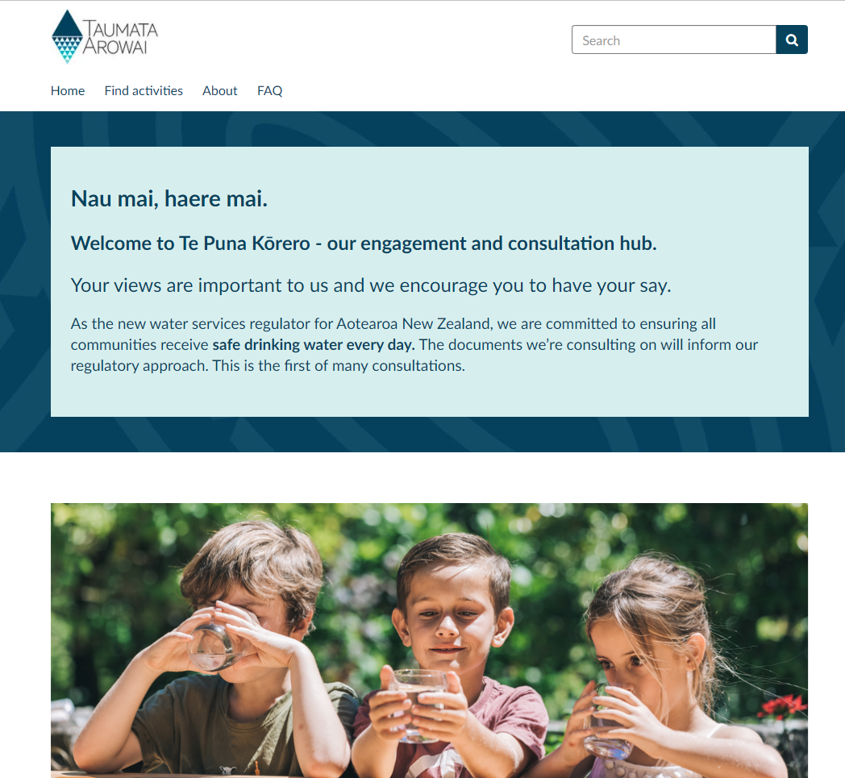
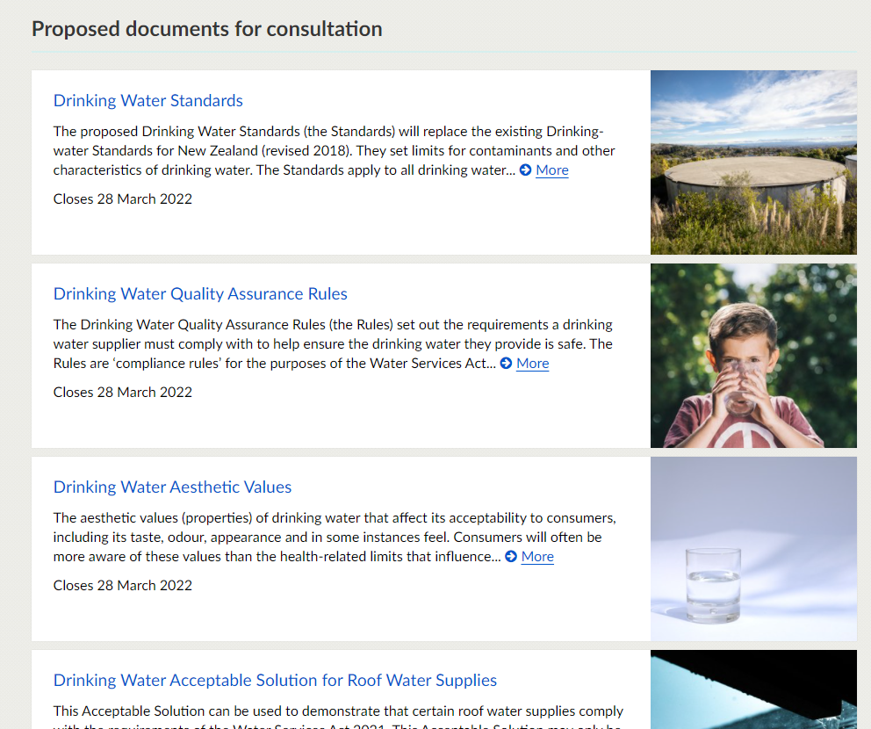
Have your say
For more information and to have your say visit Te Puna Kōrero (te-puna-korero.taumataarowai.govt.nz).
For enquires, go to Te Puna Kōrero for Frequently Asked Questions or email us on korero@taumataarowai.govt.nz.
Submissions are open until 28 March 2022.
Notes:
Ray

Slide 23
Jim Graham Principal Advisor Drinking Water
Notes:
Jim – 20 mins
Jim Graham, Principal Advisor Drinking Water, will provide more detail about the proposed new drinking water standards and rules.

Slide 24
Drinking Water Standards
The proposed Drinking Water Standards are based on section 2 of the Ministry of Health Drinking Water Standards for New Zealand 2005 (Revised 2018) and comprise MAVs for a range of determinands.
They have been reviewed but remain based on the Guideline Values provided by the World Health Organisation.
Some small changes have been made to some of the MAVs. These are set out in our consultation package.
We welcome any comment on the proposed changes to the MAVs.
Notes:
Jim
Drinking Water Standards is a technical document covering minimum or maximum amounts of substances that may be present in drinking water, and the minimum or maximum acceptable values for chemical, radiological, microbiological, and other characteristics of drinking water.
The Standards have been updated to align with the latest guideline values set by the World Health Organisation (WHO).
On our website you’ll find a document that outlines the changes to the MAVs.

Slide 25
Drinking Water Aesthetic Values
The aesthetic values are based on the Aesthetic Guideline Values set out the Ministry of Health Drinking Water Standards for New Zealand 2005 (Revised 2018).
They have been reviewed and a small number of changes have been proposed.
Some small changes have been made to some of the Aesthetic Values. These are set out in our consultation package.
We welcome any comment of the proposed changes to the Aesthetic Values.
Notes:
Jim
The Drinking Water Acceptable Values’ most important component is the general requirement that taste and odour should be acceptable to a reasonable consumer.
Drinking Water Aesthetic Values have been developed to ensure that drinking water is acceptable to consumers in terms of its appearance, taste, odour and in some instances its feel. Consumers will generally be more aware of these aesthetic values than the presence of health-significant ‘determinands’ that influence the water’s safety.
The proposed values are largely based on the existing guideline values in the current Standards.

Slide 26
Drinking Water Quality Assurance Rules
The Drinking Water Quality Assurance Rules (the Rules) set out the requirements a drinking water supplier must comply with to help ensure the drinking water they provide is safe.
The Rules are ‘compliance rules’ for the purposes of the Water Services Act 2021.
To address the considerable variation across different kinds of drinking water supplies, the Rules are categorised into different drinking water supply types. These have different modules and complexities assigned to them.
Notes:
Jim
Compliance with the Quality Assurance Rules minimises the risk that drinking water might exceed the maximum acceptable values (MAVs) of determinands, or water properties, as set out in the Drinking Water Standards.
A key difference with the existing Standards is that they are usable by all water suppliers. We have taken a modular approach with specific rules for different water supply categories e.g. on-demand network supplies, trickle feed supplies, water carriers.
Keen to hear about the content and also the format of the rules – how easy is it to follow?
On our website you’ll find guidance about how to calculate your population supply and also a document outlining key rules that have changed.

Slide 27
Rule type codes and complexity levels
Rule type codes
G = General rules
S = Source water rules
T = Treatment rules
D = Distribution rules
WC = Water Carrier Service Rules
PTE = Planned Temporary Event Drinking Water Supplies Rules
Rules complexity levels
1 = simple
2 = moderate
3 = complex
Notes:
Jim

Slide 28
Rules modules
Notes:
Jim

Slide 29
Supply categories and rules that apply to them
1. On-demand | Rule modules that compliance is demonstrated against
Very Small Supplies (<50) | G + S1 + T1 + D1
b. Small Supplies (50-500) | G + S2 + T2 + D2
c. Large Supplies (>500) | G + S3 + T3 + D3
d. Varying Population Size | G + S2 + T2 + D2¹
¹ Additional monitoring requirements when population exceeds 500
Notes:
Jim

Slide 30
What stays the same in the rules
Large supplies (serving >500 people)
Bacterial Compliance (almost)
Protozoal Compliance (some options removed)
Cyanobacterial Compliance (mostly)
Radiological Compliance
Notes:
Jim

Slide 31
What has changed in the rules
Large supplies (serving >500 people)
Discontinued secure bore water criteria (DWSNZ). All water supplies will need some form of treatment unless an exemption is granted by Taumata Arowai.
Source water testing
A new chemical compliance section for large (>500 people) supplies
More complex distribution system rules
Monitoring rules / Assurance Rules
Notes:
Jim

Slide 32
Very small supply rules
Very small supplies(serving <50 people)
Source water testing
Treatment requirements (cartridge filtration and UV disinfection)
Distribution system testing and backflow requirements
Notes:
Jim

Slide 33
Small supply rules
Small supplies(serving 50-500 people)
Source water testing
Treatment requirements and rules (cartridge filtration, UV disinfection and chlorination)
Chemical rules
Cyanotoxin rules
Distribution system testing and backflow requirements
Notes:
Jim

Slide 34
Break until 10.30am Pātai | Questions? 10.30am – 11am
Unclassified
34
Notes:
Katy to facilitate Q & A after break and then hand over to DIA at 11am.

