Slide 1
Blue Carbon - The New Green?
Opportunities towards net zero emissions
Kate Simmonds & Rebecca Phyland
Notes:
The risk of climate-related disasters is increasing and strategies to mitigate climate change are needed. Coastal ecosystems, including mangroves, tidal marshes and seagrasses, sequester and store "blue" carbon and are an essential piece of the climate change solution
Today we will present…
Blue Carbon Overview
Opportunities for NZ
Rebecca will present a couple of her projects
End with… Leverage global learnings for NZ benefit.

Slide 2
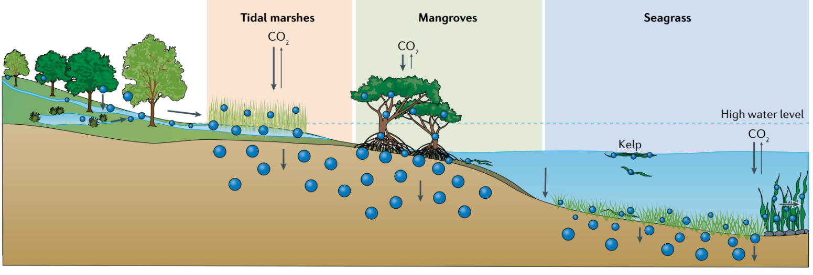
Coastal ecosystems with Blue Carbon potential
Notes:
What is Blue Carbon? - Blue Carbon is Carbon captured by the world's coastal and marine ecosystems. Blue carbon ecosystems remove significant amounts of carbon from the atmosphere, much more than land-based forests (reference ) and store it in their biomass and soil. The carbon sequestered in the soil can be stored for hundreds to thousands of years, helping to mitigate climate change. In addition, coastal wetlands provide adaptation and coastal protection benefits by absorbing incoming wave energy, providing coastal and storm surge protection, and preventing erosion. Coastal wetlands may keep pace with sea level rise and, in some instances, are more cost-effective than artificial infrastructure like seawalls and levees

Slide 3
A growing interest in Blue Carbon globally
Notes:
Potential to contribute to net zero ambitions is attracting significant interest
Globally traded C value predicted to increase by $480B US over next 30 years

Slide 4
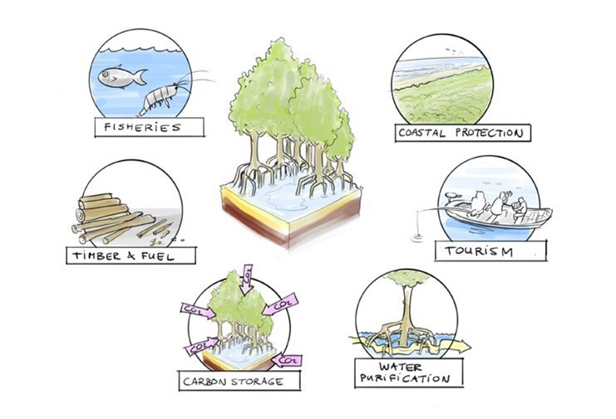
Project and infrastructure applications for Blue Carbon accounting
Notes:
There are many other benefits other than carbon sequestration from Blue Carbon including:
Environmental, social, cultural and economic value
coastal protection from storm surges and sea level rise
improving water quality and biodiversity
providing fisheries habitat
support nature-based tourism opportunities.

Slide 5
Co-author
Notes:
Who we are as Jacobs – weave into Acknowledgement

Slide 6
Opportunities in New Zealand
Where, when and how

Slide 7
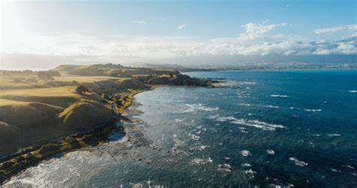
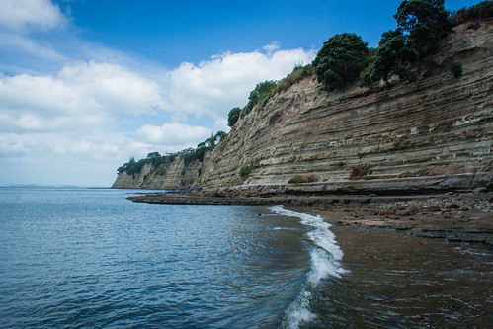
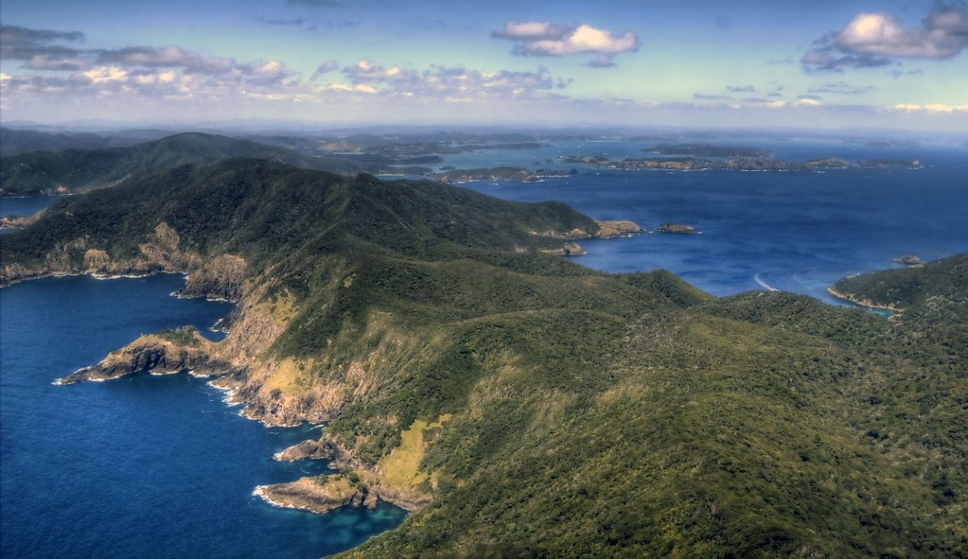
New Zealand has 15 000 kilometres of coastline

Slide 8
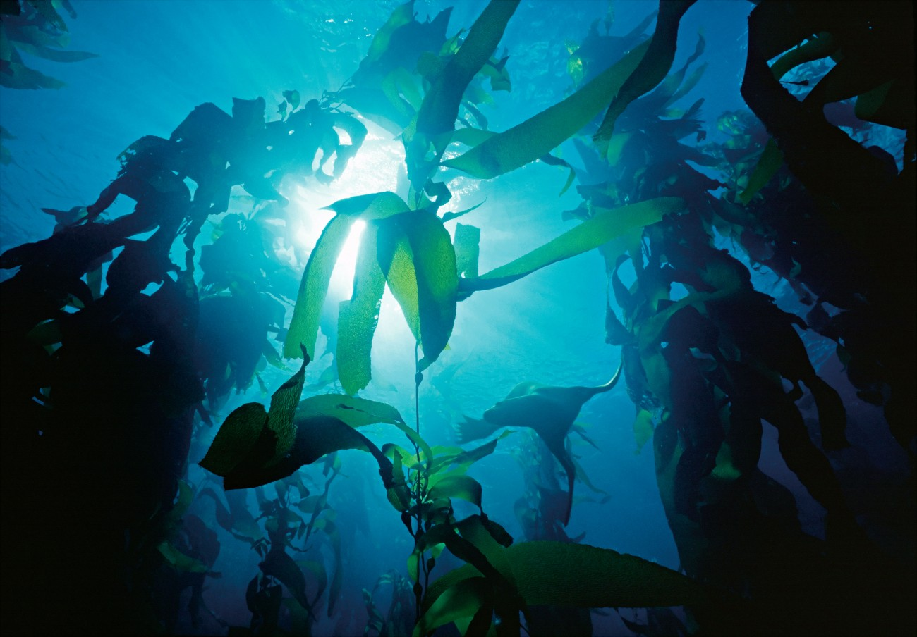
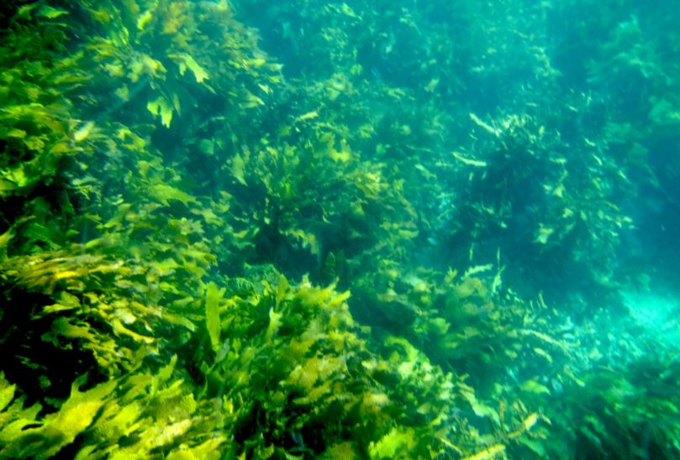
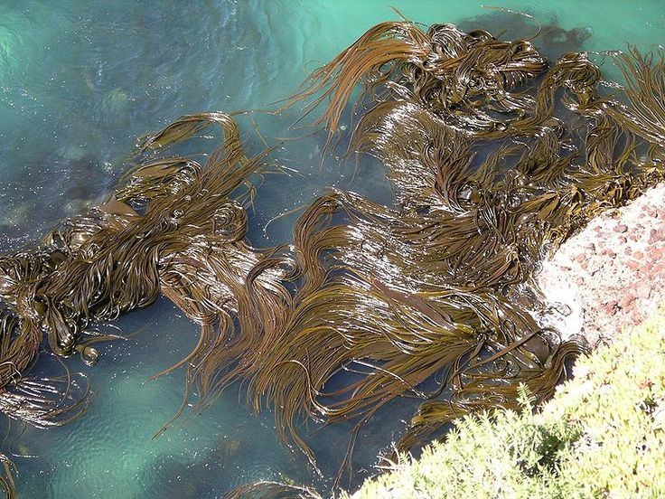
Pilot trials on kelp forests
Notes:
Blue Carbon Services, with University of Otago and Auckland University, with funding from the NZ Endeavour Fund, is studying the potential economic and environmental benefits of incorporating fast-growing kelp into existing mussel aquaculture infrastructure.

Slide 9
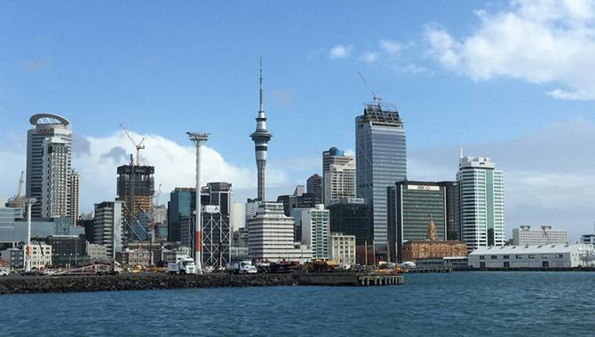
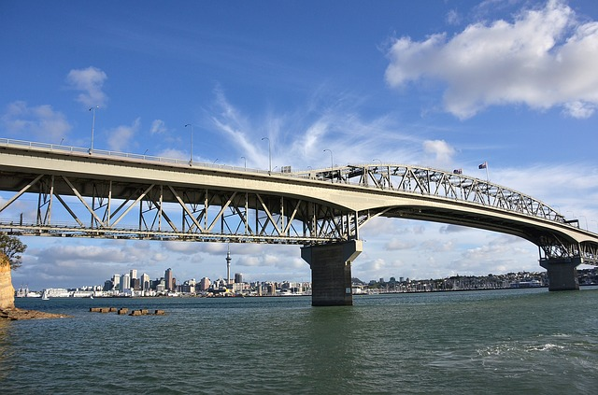
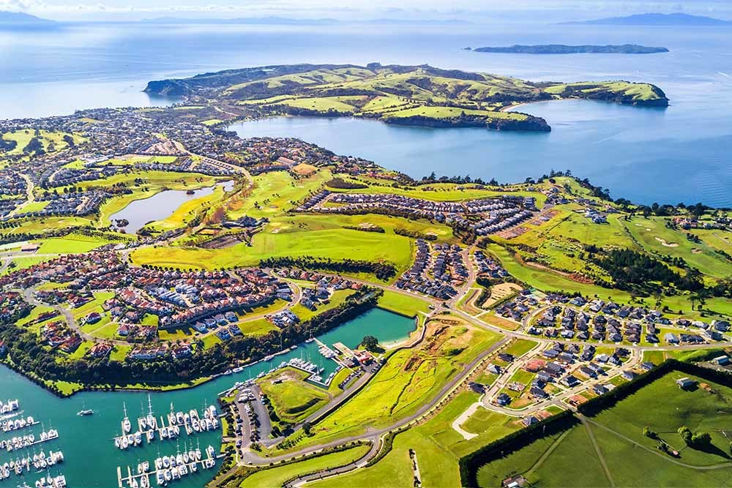
Offsets for coastal infrastructure projects
Notes:
Funding through blue carbon markets – organisations could buy credits to offset carbon emissions. Generated money through this market could be utilised to fund restoration projects

Slide 10
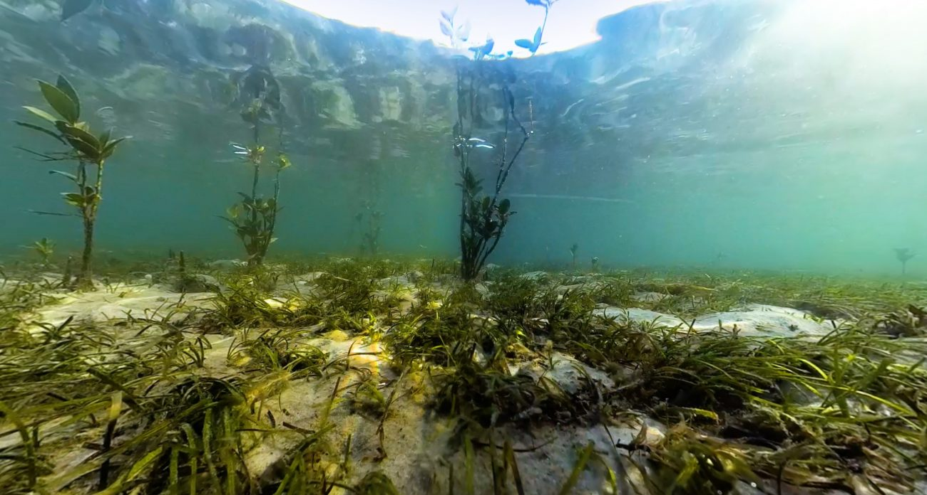
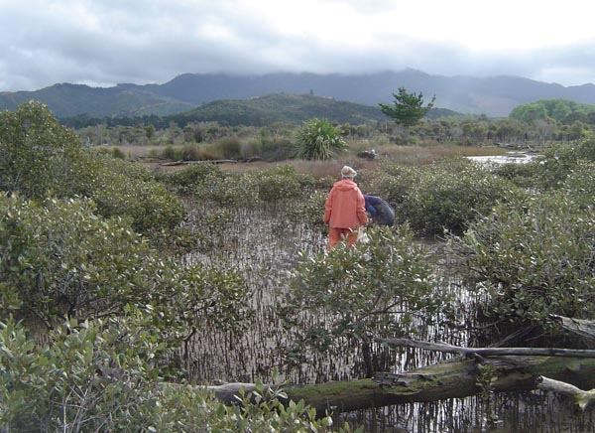
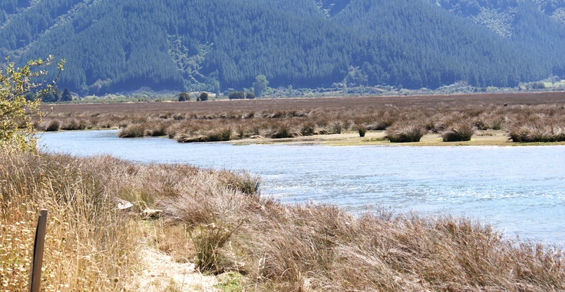
Incentive to protect and restore coastal and marine habitats

Slide 11
Carbon sequestration potential
83% of global carbon circulated through the ocean
Coastal habitats cover less than 2% of ocean - account for approximately half total carbon sequestered in ocean sediments
Protected or restored Blue Carbon ecosystems sequester and store Carbon
When degraded or destroyed, they emit the carbon they have stored for centuries
Experts estimate one billion tons CO₂ release annually
Coastal wetlands trap and bury carbon at a greater rate per area than terrestrial habitats (forests, peatlands)

Slide 12
Carbon Codes around the world
Notes:
Carbon codes provide standard accounting methods to determine the amount of carbon credits generated by different types of projects
Provide assurances to carbon market buyers that the climate benefits being sold are real, quantifiable, additional and permanent
Quantification under local regulatory & legislative frameworks. Need these codes and consistency in the codes so they can be traded, valued or offset. Currently C price is around $80/tonne in NZD.
Jacobs developed world’s first carbon code for coastal wetlands in 2014 - several methodologies have since been developed
Handover to Rebecca to talk about a couple of her projects which are supporting Blue Carbon measurement and code development through collaborative research

Slide 13
Case Study 1 – Danjugan Island, Philippines
Understanding Blue Carbon potential in seagrass communities
Notes:
5-6 mins
A key knowledge gap that remains is creating awareness for government and local communities on blue carbon ecosystems and its potential for climate change mitigation (Pangilinan 2015), especially in asia and pacific island nations.

Slide 14
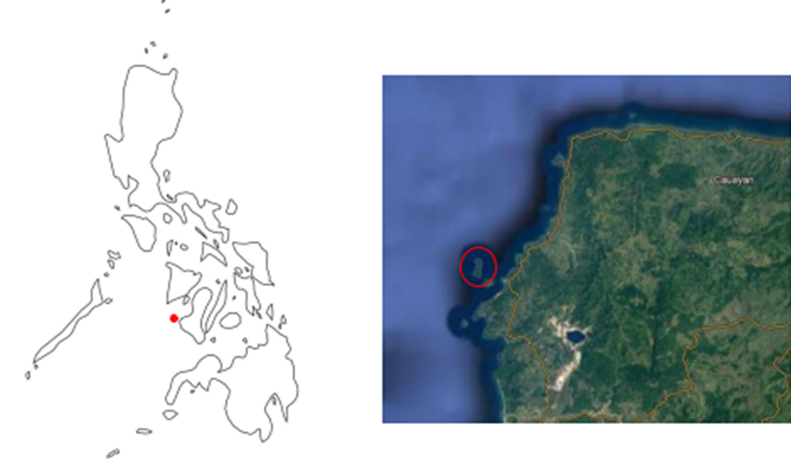
Danjugan Island, Philippines
Notes:
Current research into the importance of seagrass meadows in the Western Pacific, particularly the Philippines, is limited Project in Southern Philippines in 2020 aimed to comprehensively understand the impact of local environmental threats to seagrasses and the extent and composition of seagrass around Danjugan Island A second aim was to quantify the Blue Carbon potential.
Specific objectives were:
To map the extent of the three seagrass meadows
To survey and observe the composition of the three seagrass meadows
To calculate the Blue Carbon potential by using the extent and composition data obtained from the field site
To identify the primary local environmental threat to the seagrass meadow

Slide 15
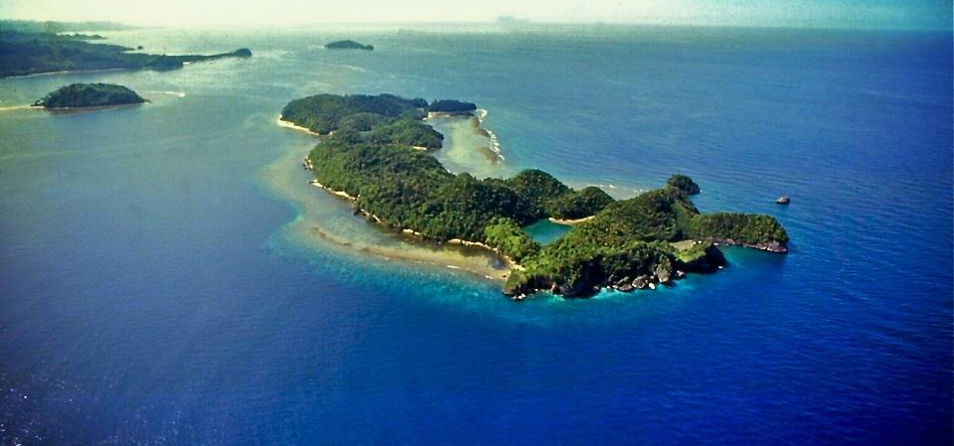
Notes:
Current research into the importance of seagrass meadows in the Western Pacific, particularly the Philippines, is limited Project in Southern Philippines in 2020 aimedto comprehensively understand the impact of local environmental threats to seagrasses and the extent and composition of seagrass around Danjugan Island A second aim was to quantify the Blue Carbon potential.
Specific objectives were:
To map the extent of the three seagrass meadows
To survey and observe the composition of the three seagrass meadows
To calculate the Blue Carbon potential by using the extent and composition data obtained from the field site
To identify the primary local environmental threat to the seagrass meadow

Slide 16
Seagrass communities with Blue Carbon potential

Slide 17
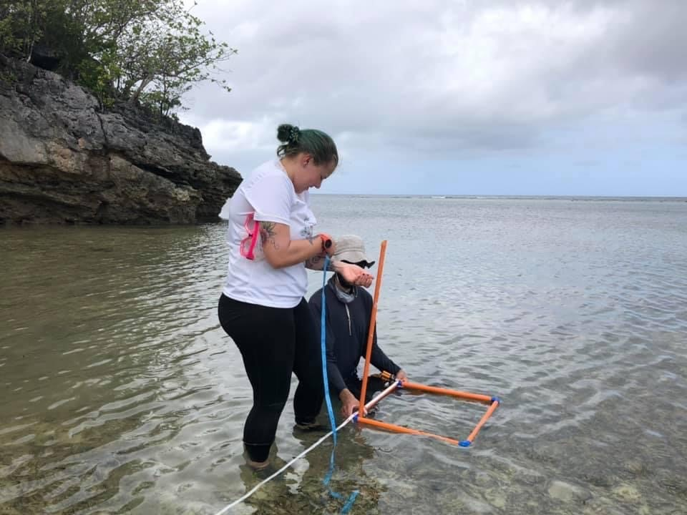
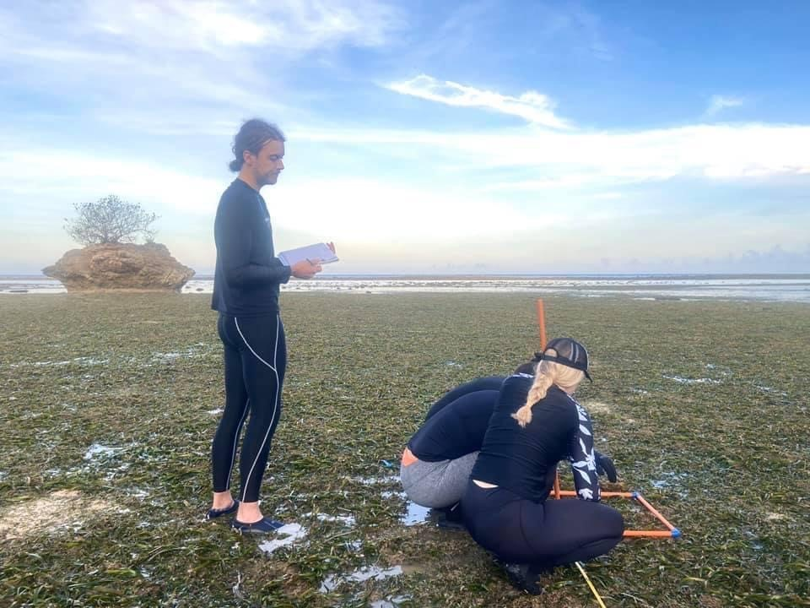
Rapid sampling technique for intertidal seagrass cover
Notes:
A measure of seagrass meadow perimeter and composition was undertaken using Seagrass Watch methods across 6 replicates within 3 different meadow orientations. Using area, composition, biomass and sediment data the Blue Carbon potential of the seagrass meadows was calculated using the equations developed through the Blue Carbon Initiative

Slide 18
Results of Danjugan Island investigations
Results are promising – were able to successfully calculate a Blue Carbon value for the Western Pacific (22.7 Mg C/ha), though lower than similar communities in the Mediterranean (ranging 50 to 300 Mg C/ha)
Due to sampling method constraints Blue Carbon values not calculated at species level – unlikely to have impacted on results – though consideration for future, especially supratidal communities
Abundance of seagrass cover across the site varied (32-63%) – this was low and contributed to below average total of organic carbon – need to consider seascape history
Blue Carbon can be stored in epiphytic cover and seagrass litter - not estimated in this study. Other studies have found macroalgal detrital material has potential to act as carbon donors to long-term sequestration habitat (e.g. seagrass meadows)
Worth considering contribution epiphytic cover, litter and macroalgal make to total carbon stock - therefore assumed estimated value is likely conservative
Notes:
Add in link to marine “gazetteing” – unique to NZ – opportunity for us

Slide 19
Case Study 2 – Eyre Peninsula, Australia
Understanding Blue Carbon potential in saltmarsh communities
Notes:
5-6 mins

Slide 20
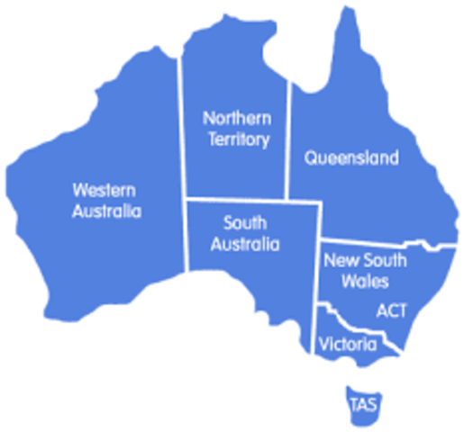
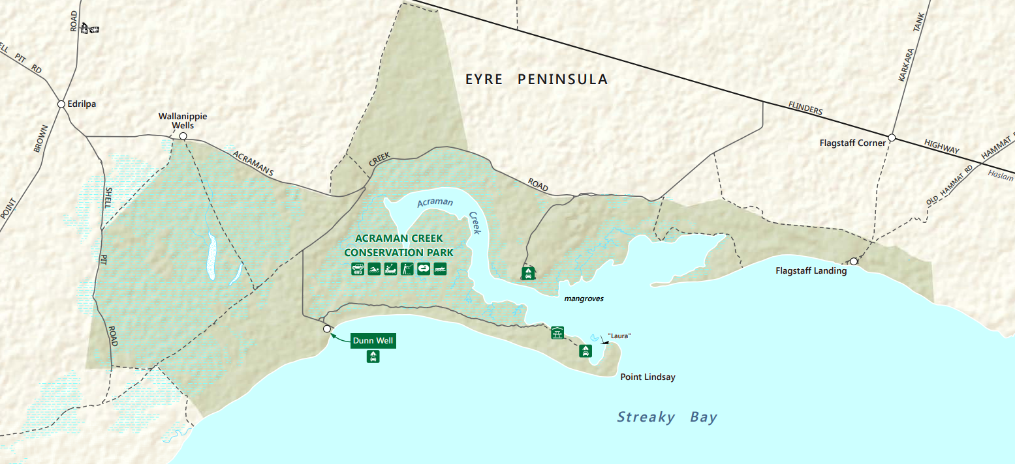
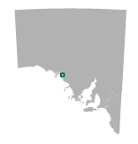
Eyre Peninsula, Australia

Slide 21
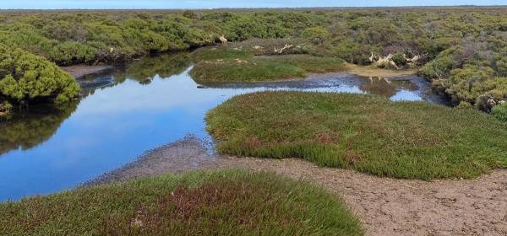
Notes:
Link to a relevant NZ project
Profiling of saltmarsh communities across Eyre Peninsula in South Australia
Recording what species are in the saltmarsh, analysing changes to sites over time and shedding new light on organic Blue Carbon stocks.
A recent saltmarsh profile survey completed at Acraman Creek – between Streaky Bay and Ceduna – as part of a baseline data comparison of the condition of saltmarsh at 11 sites across the Eyre Peninsula.
Acraman Creek is 5th profile survey to be completed as part of Saltmarsh Threat Abatement and Recovery Project - supported by local landscape board and National Landcare Program.

Slide 22
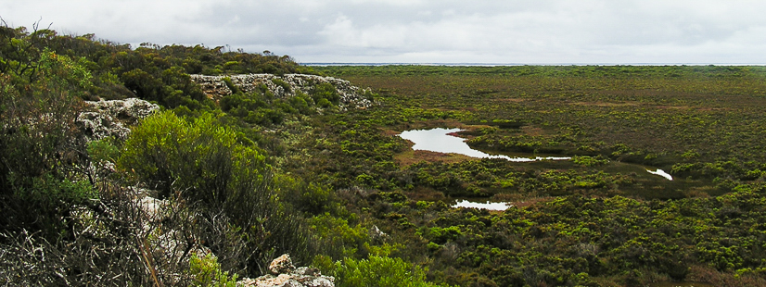
Acraman Creek Conservation Park

Slide 23
Long-term monitoring for tidal inundation on saltmarsh
Notes:
A measure of seagrass meadow perimeter and composition was undertaken using Seagrass Watch methods across 6 replicates within 3 different meadow orientations. Using area, composition, biomass and sediment data the Blue Carbon potential of the seagrass meadows was calculated using the equations developed through the Blue Carbon Initiative

Slide 24
Results of Eyre Peninsula investigations – to date
Multiple agencies, local landscape board, university researchers, consultants and state government coastal specialists involved in field sampling
Results from five surveys undertaken so far are being analysed - early indications reveal some sites have changed very little in 25 years since last detailed surveys - others are showing more significant changes likely associated with changed inundation patterns
Soil cores from different types of saltmarsh vegetation communities were taken at different heights along the profile.
Blue Carbon analysis is being undertaken and will inform investigations on tidal influence, sea level, vegetation type, and direct disturbance on Blue Carbon storage

Slide 25
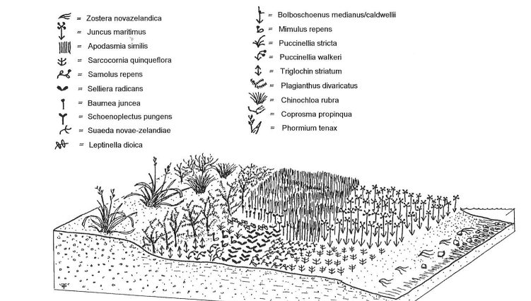
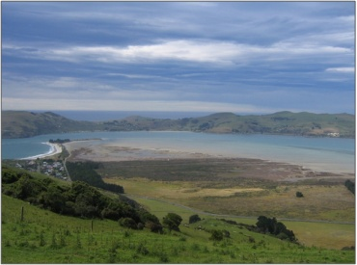
NZ applications
Notes:
Aramoana Saltmarsh Dunedin - Saltmarsh and flax-dominated swamp areas
Listed as an Area of Significant Conservation Value in the Dunedin City District Plan. Described as buffer area (pasture) dunes and sand spit. Breeding grounds for insects and feeding grounds for many birds. The saltmarsh area above mean high water springs lies adjacent to the second largest representation of dune slacks area in New Zealand. Of international/national significance
Hacks etal 2003
Impacts in NZ are drainage, infrastructure and agriculture

Slide 26
Blue Carbon Accounting
A method for Australia
Notes:
5-6 mins

Slide 27
Blue Carbon Methodology in Australia
Minister for Industry, Energy and Emissions Reduction tasked the Clean Energy Regulator with developing a blue carbon methodology under the ERF
The national method was published in 2021 aims to support projects that store carbon and direct mitigate emissions
Restoration projects are also able to earn carbon credits for emissions captured
The method aims to abate carbon by:
Increasing the carbon stored in soil and vegetation
Avoiding emissions from soils as they are rewetted
Avoiding emissions as freshwater wetlands are returned to saline wetlands
Notes:
The introduction of tidal flows to coastal land can increase carbon sequestration through promoting
the growth of blue carbon ecosystems such as mangroves, saltmarsh, seagrass, and supratidal
forests comprised of Melaleuca, Casuarina and other plant genera. Tidal introduction can also
decrease greenhouse gas emissions (GHG) from land through inundation and the increase in salinity
in soils and water. BlueCAM considers changes in organic carbon stocks and greenhouse gas
emissions following a management intervention of the introduction of tidal flows. The net change in
GHG emissions is based on change (reduction) of GHG emissions from land use prior to tidal
introduction and from the carbon sequestered and stored in living vegetation (live aboveground
biomass), the roots of living vegetation (live belowground biomass) and in soil.

Slide 28
Net Abatement a key aspect
To register a blue carbon project under Australia’s ERF, proponents must describe management activity undertaken to increase carbon storage and reduce GHG emissions from restoration of tidal area and estimate and verify how much carbon has been accumulated in soils and biomass, and GHG emissions reduced over time in a manner consistent with the ERF offset integrity standards
Studies such as the one we were involved in on the Eyre Peninsula form a baseline for assessing the Blue Carbon potential of project sites utilising the Blue CAM methodology
Notes:
Talk more about opp for NZ – avoid Oz specific detail – how to apply in an NZ context / setting

Slide 29
Operationalising Blue Carbon
Accountability in projects

Slide 30
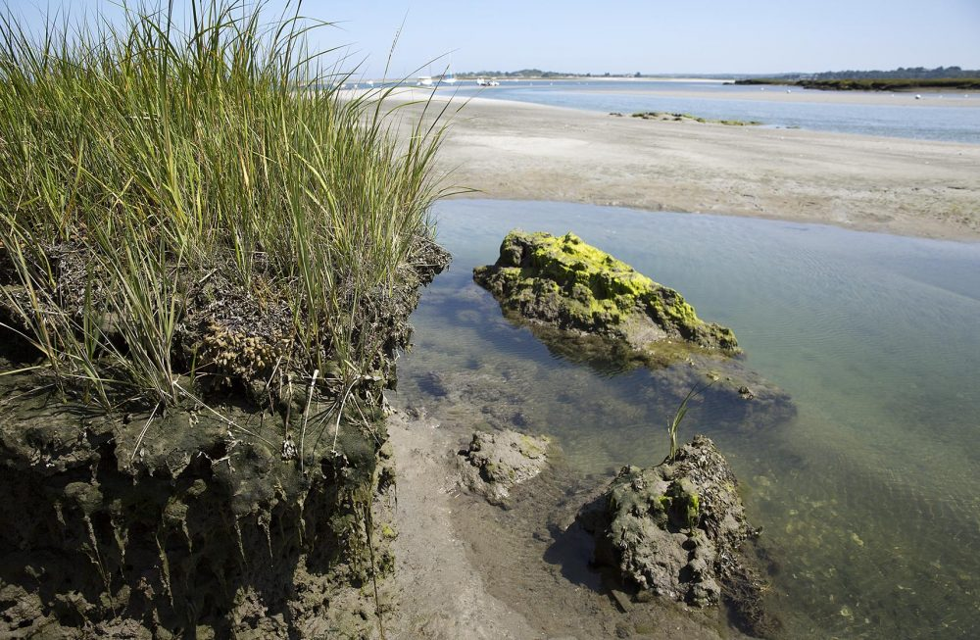
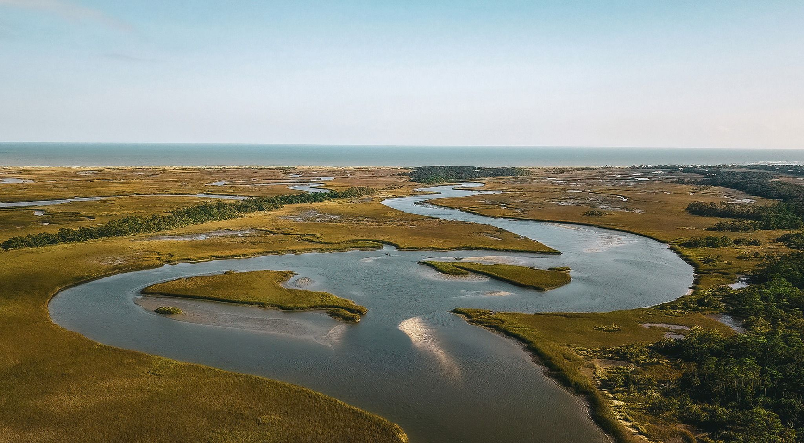
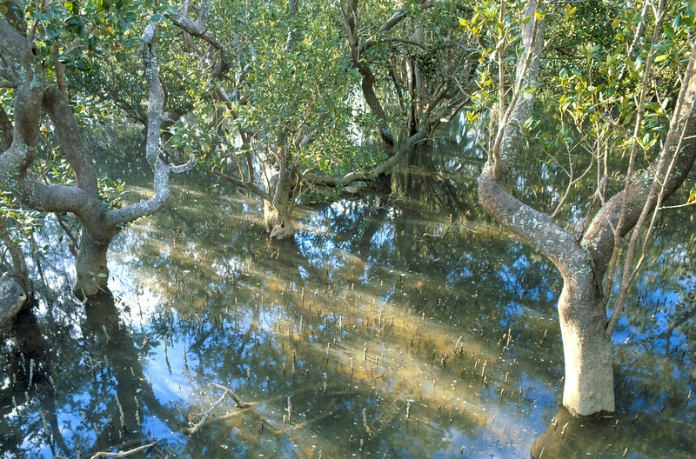
Barriers to implementation
1) A key issue for blue carbon restoration is demonstrating net carbon removal that is valid and can be used as carbon credits or in carbon trading schemes.
The system must demonstrate it can uptake and store carbon, and that the estimated benefit has a verifiable accuracy
A carbon balance is required where additional CO₂ removal needs to be estimated, coupled with climatic effects, and reliably determined according to internationally agreed standards. Sequestered carbon should be stored ‘permanently’ (>100yrs) to be considered part of long term climate mitigation action.

Slide 31
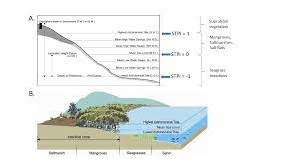
Barriers to implementation
2) A Verified Carbon Standard (VCS) for Tidal Wetlands and Seagrass Restoration has been developed, primarily in a US context. Methodology is complex and technically demanding, >30 parameters involved.
The BlueCAM method in Australia has less parameters but will need a tool to be built to calculate a large numbers of sites (opportunity).

Slide 32
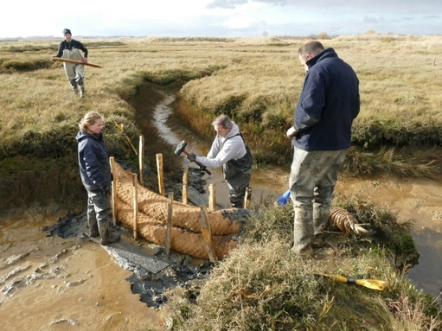
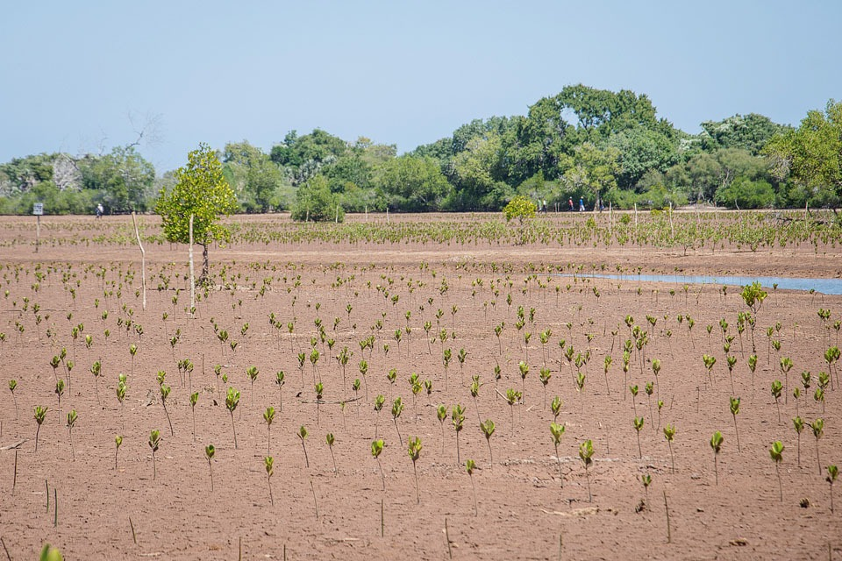
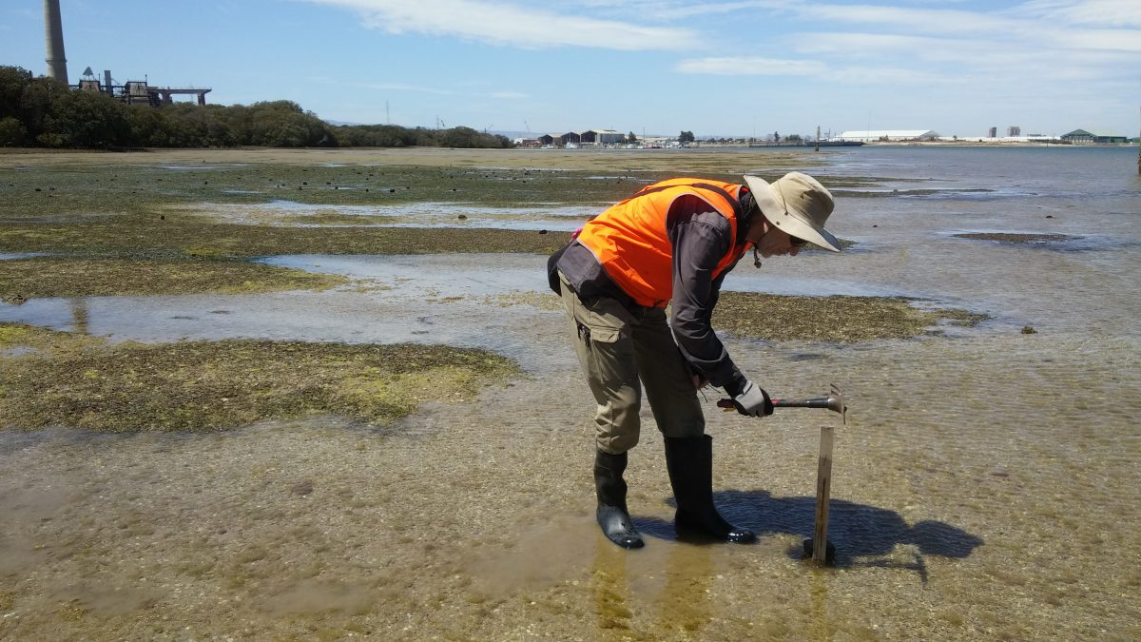
Barriers to implementation
3) Reliable estimates for carbon removal derived from in-situ measurements ideally including baseline data up to 4 years before any restoration starts.
May take further 10–20 years after start of restoration project before carbon burial rates match those of mature ecosystems and true carbon benefit realised.

Slide 33
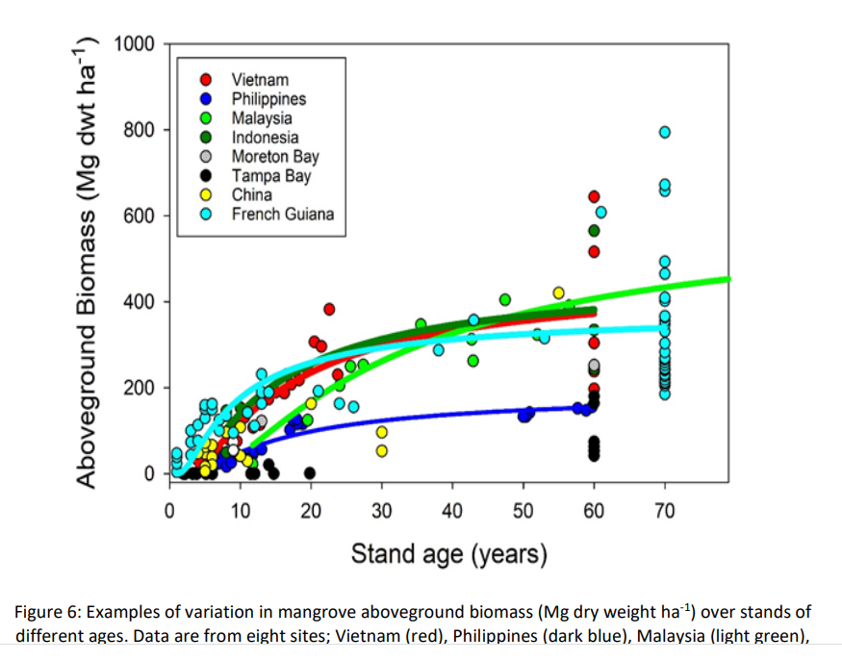
Variation in above ground biomass
(Lovelock et al, 2021)

Slide 34
Summary
Coastal ecosystems sequester and store Blue Carbon more effectively than forestry – an important climate change solution
Example projects show promise in calculating Blue Carbon value for Western Pacific and we can leverage these learnings – potential Blue Carbon projects
Number of barriers to operationalising marketable Blue Carbon. Mitigate by:
Accurate measurement
Carbon code
Long-term storage
Notes:
Highlight co-benefits as well as C

Slide 35
Can we seize the opportunity?
A key first step is in framing the policy and regulatory context to enable project applications and benefit realisation.
We can move towards a Blue Carbon future in NZ in parallel with policy and a carbon code development. In the interim we can estimate and measure carbon value and realise social, cultural, environmental and economic co-benefits.
Protection and restoration of Blue Carbon assets will achieve measurable changes to atmospheric GHGs, provide localised co-benefits, and support national obligations associated with international agreements.
Blue Carbon presents significant opportunity for Aotearoa – the new 'green'
Notes:
There are undoubtably challenges with Blue Carbon however the wider benefits that protecting, enhancing and restoring our marine and coastal habitats means that surely Blue Carbon - the new green

Slide 36
Want to continue the conversation?
Come and say hello to the team at the Jacobs booth - location #125

