Slide 1
Waikouaiti Water Supply – Lead Investigation & Response
Presenters: John McAndrew (DCC) and Belinda Cridge (ESR)
Notes:
Into
Hello everyone, my name is John McAndrew and I am the 3 Waters Plant Operations Manager at Dunedin City Council
It’s great to be here in Christchurch and I hope you are all enjoying the conference so far

Slide 2
Overview
DCC investigation and findings
Health impacts of lead
Public Health South investigation
Current status of lead in drinking water
Conclusions
Notes:
We're going to talk today about the Waikouaiti water supply system Do not drink event, health effects of lead and why this is important
I was the investigation lead for our lead response, and I’ll provide a brief overview of the event and investigation before handing over to Belinda Cridge from ESR.

Slide 3
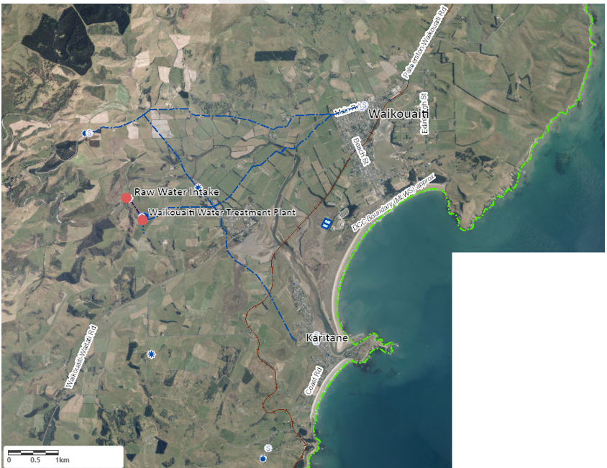
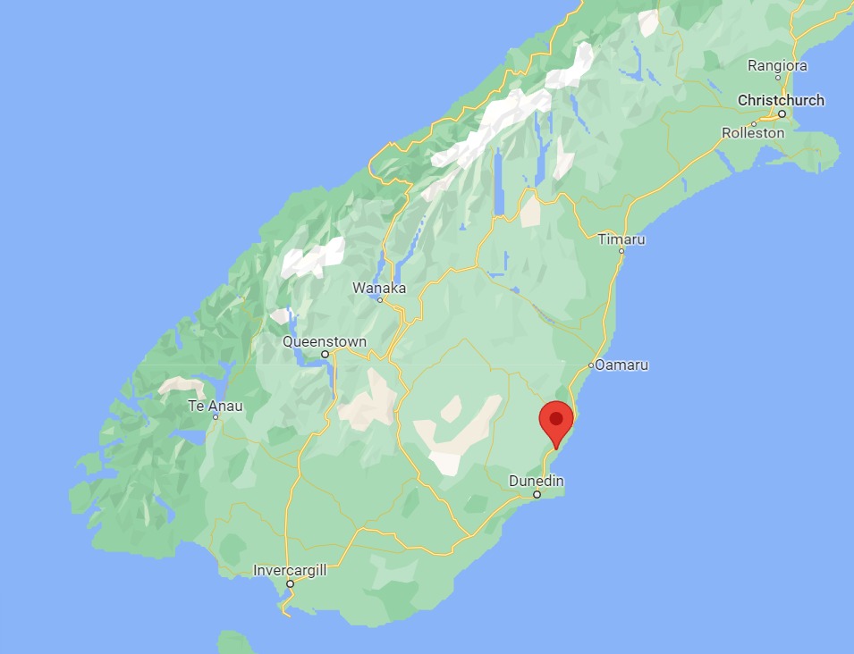
Location
Notes:
Waikouaiti –
located approx. 35 mins north of Dunedin off State Highway 1 & on the beautiful East Otago Coast
Just to the south – Karitane
Hawksbury village to the west
Total population of approx 1,500 people
Supplied by the Waikouaiti Water Treatment Plant. One of 6 plants operate by our team of dedicated water treatment staff.

Slide 4
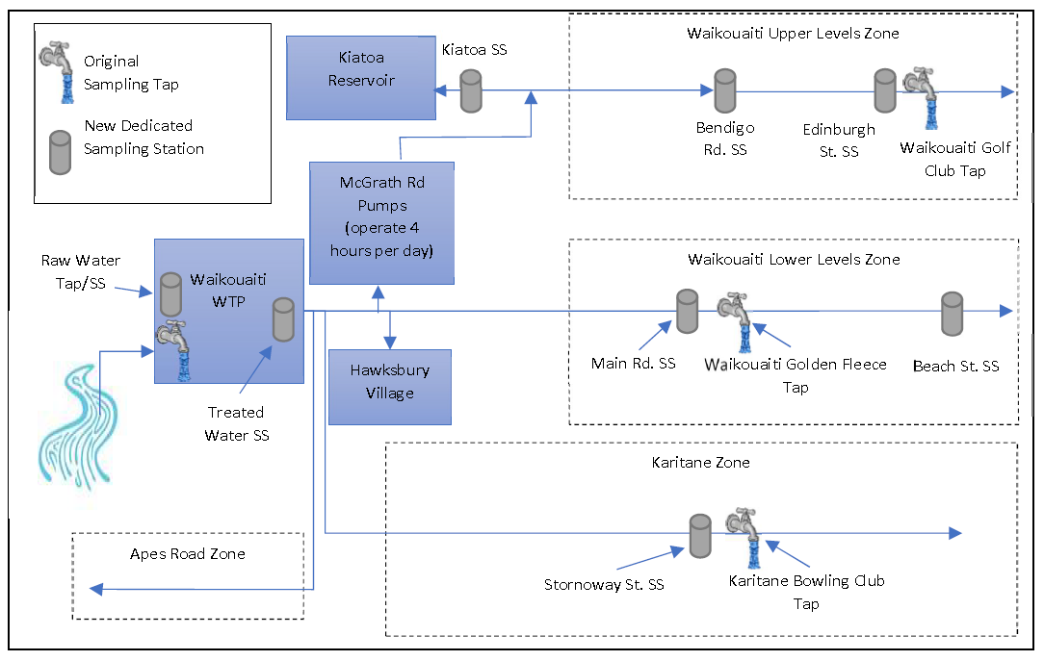
Waikouaiti Water Supply Scheme - Overview
Sites where lead was detected
Notes:
Water supply from the Waikouaiti river via pumps which lift to a WTP.
WTP comprises multiple stages of treatment - coagulation, membrane filtration, chlorination and pH and alkalinity correction with Soda Ash. This whole process removes particulate and soluble material and provides disinfection.
Water supply to three distinct zones as shown
90% of networks was made up of Asbestos cement, PVC or PE pipework. 10% Cast iron or other iron – some known led jointing. Particularly in the Upper Levels Zone.

Slide 5
Summary timeline – to beginning of investigations
14 post-flush smaples from Waikouaiti Golf Course through this period 1 > MAV
2 Feb– MoH issue DND notice
8 Jan - notify DWA of exceptional results
July 1 – sampling initiated
DCC instigate response and investigation
July 2020
August
September
October
November
December
January 2021
February
MoH instigate health screening
14 August – Result for first lead exceedance Waikouaiti Golf Course
18 August – Advice from ESR via PHU on proposed response
18 December – Exceptional lead levels, Wiakouaiti Golf Course and Karitane Bowls Club
27 Jan - meeting with DCC, DWA and PHS
29 Jan – raw water reservoir > MAV
Notes:
DCC approved budget to almost double sampling regime – water and wastewater – from 2020/2021 financial year.
This covered the whole city and all supplies.
Aim – to acknowledge that minimum compliance sampling requirements were limited – to do better to monitor and manage water quality, to input to projects & improve water safety
We started sampling for metals in Waikouaiti in July 2020
Early samples above MAV – Maximum Acceptable Value - triggered increased frequency.
Initial hypothesis was that the source of this was from local distribution pipework as there was known lead jointed pipework in the area where higher readings were observed.
Over the next 4-5 months we collected about 44 post flush samples from this distribution system at Waikouaiti with only one above MAV (which was at the Golf Club).
18 Dec received two high results on the same day but at different locations –
Golf Club & Karitane bowls – both different zones – no previous correlation
and importantly no metallic pipework in Karitane supply system
We eventually termed these – 'exceptional' - because they were not typical of other results
In late January we received a sample result in raw water >MAV –this raised concern of an intermittent supply wide issue – rather than the previous hypothesis of a localised issue at the Golf Club. This was the first and ultimately only reading above limit of detection in the raw water reservoir.

Slide 6
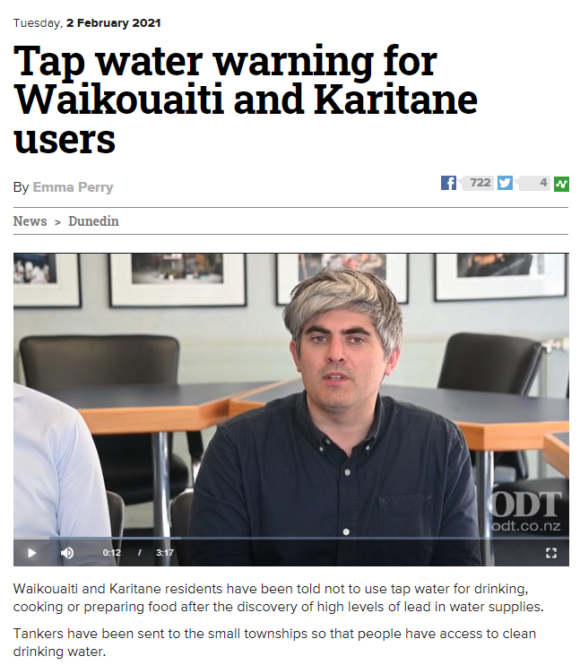
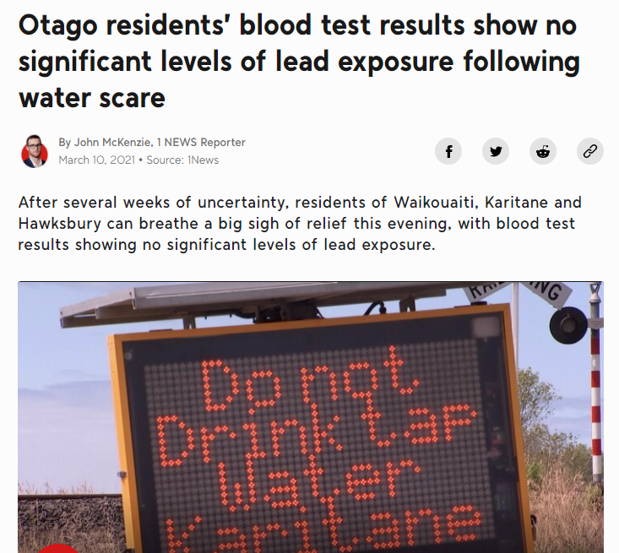
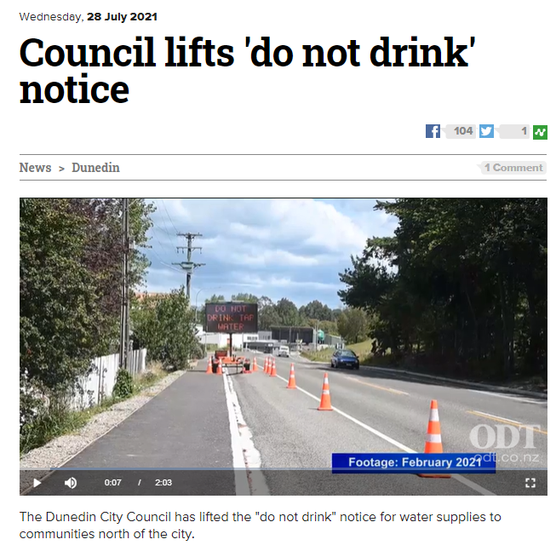
Timeline – after DNDN issued
Notes:
We let PHS know about the raw water reservoir reading on 1 Feb and scheduled a meeting for the following day where they advised DCC to issue a do not drink notice. We had never issued a do not drink notice before and stood this up within a few hours.
A multi agency response team was formed with several workstreams including operations investigation, public information and community engagement.
We wanted to keep this presentation focused on why lead is relevant and so I’ll just provide a very brief overview of the investigation before handing over to Belinda.

Slide 7
Investigation
Considerations in Lead Investigation | Issue | Investigations Undertaken
Sample Methodology and Analytical Error | Sample collection | Review of sampling and analytical protocols. Duplicate samples and blanks.
 | Laboratory Analysis
Lead Leaching and Corrosion (potential sources of internally derived lead contamination) | Corrosivity of finished water | Review of water quality data including pH, alkalinity, CSMR.
 | Distribution Network (DCC infrastructure) | Distribution main joints, service connections, backflow.
 | Localised Lead Leaching (generally local plumbing fittings and pipework) | Review of sample data, review of local plumbing, stagnation tests and profile sampling.
Lead Ingress (potential sources of externally derived lead contamination) | Raw Water Contamination | Water quality analysis, Catchment risk assessment, review of raw water and gold mine data, network water age analysis.
 | Water treatment plant | Plant operational review, chemical analysis, plant materials review and revision of tube settler operation.
 | Backflow event | Review of low-pressure events (breaks) and connected properties.
Notes:
A brief overview of potential sources. Generally felt results could be from one of 3 sources.
Results are in error / not correct – lab analysis, sample collection, sample transfer
Lead from within the system – leaching from distribution pipework – some can contain lead; leaching from materials at point of use
Ingress to the bulk water – contamination; treatment plant; backflow event
These were all lines of enquiry and we undertook extensive investigations over a period of approx. 6 months

Slide 8
Investigation Findings
Sample | Potential Causes of Exceptional Lead Results
 | Likely | Unlikely | Very Unlikely
Treated Water Waikouaiti Golf Club 8 December 2020 | Localised Lead Leaching | Sampling Error, Lead Ingress (including from catchment), Network Lead Leaching | Backflow, Plant Related Event
Treated Water Karitane Bowling Club 8 December 2020 | Localised Lead Leaching | Sampling Error, Lead Ingress (including from catchment), Network Lead Leaching | Backflow, Plant Related Event
Raw Water 20 January 2021 | Lead Ingress (including from catchment), Localised Lead Leaching | Sampling Error, Network Lead Leaching | Plant Related Event
Notes:
The most likely cause of the lead readings was found to be localized lead leaching from supply fittings or pipework at or close to the point of use
The most likely cause of lead on the raw water was either localized leaching from a brass tap (and possibly fittings) or lead ingress from catchment (likely particulate)
That’s a whirl wild overview – feel free to ask any questions at the end.

Slide 9
Investigation Lessons Learnt
Key lessons learnt
Representative sample taps
Frequency of sampling (multiple samples on each location)
Response protocols – process and systems
Interagency response
Notes:
So needless to say, this event involved a huge amount of work, and we learnt a lot of lessons. The Mayor also commissioned an independent review of the event, which made a number of recommendations.
But for the purpose of this presentation, we’ve listed out some of our key lessons learnt.
The first is to make sure you use sample taps that are representative of your network, especially when sampling for metals.
The second, is to take multiple samples at each site, to give greater confidence in the data.
The third is to set up appropriate processes and systems BEFORE starting sampling, to ensure any response to high results are efficient and well thought through. This should include an approach to media and public communication.
And finally, we would strongly encourage setting up an interagency response from the start, as we found working with PHS and other agencies critical for success
HANDOVER TO BELINDA

Slide 10
Lead Exposure
Drinking water (MAV 0.01 mg/L)
Food
Toys
Fuel
Occupation
Paint
Soil

Slide 11
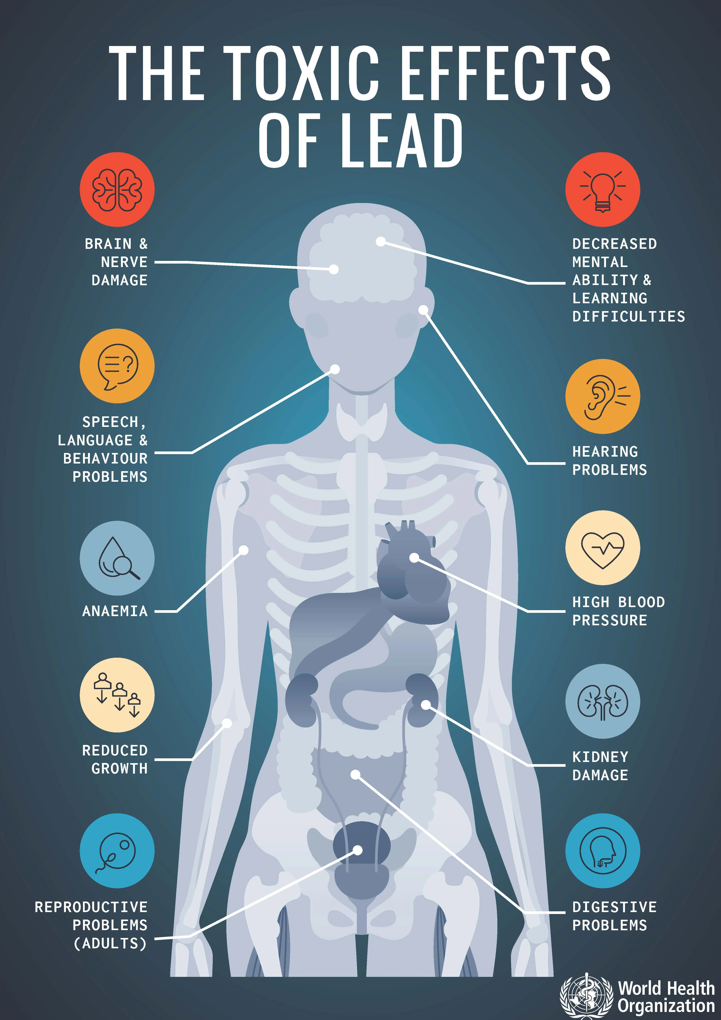
Lead Toxicity
No safe threshold of lead in children
Potent neurotoxin
Cognitive impairment
Impaired neurodevelopment
Reduced IQ
Learning difficulties
Behavioural problems
Link between childhood exposure and adult hypertension
Adult toxicity
Effects on the kidney and blood production

Slide 12
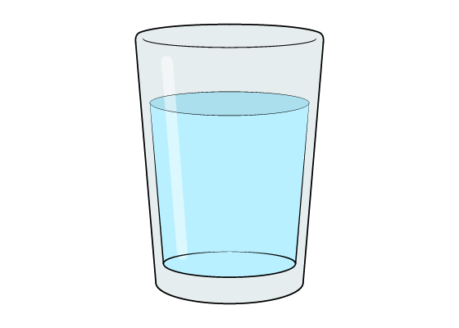
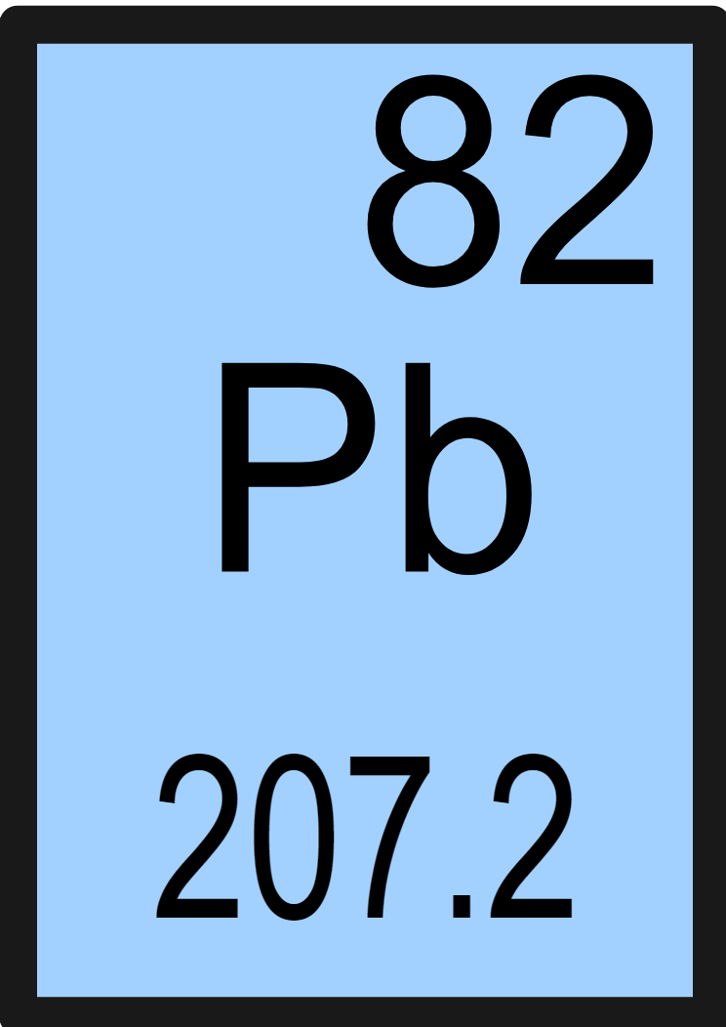
Lead in the body
Half-life 30 days
Half-life 30 years
Lead accumulates in the body (specifically in the bones)
During pregnancies lead leaves the mother bones and is absorbed by the foetus

Slide 13
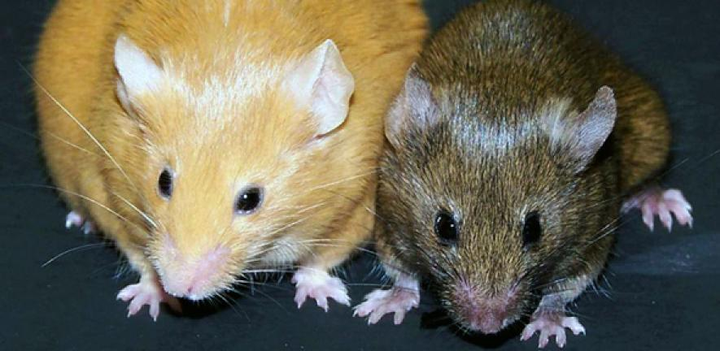
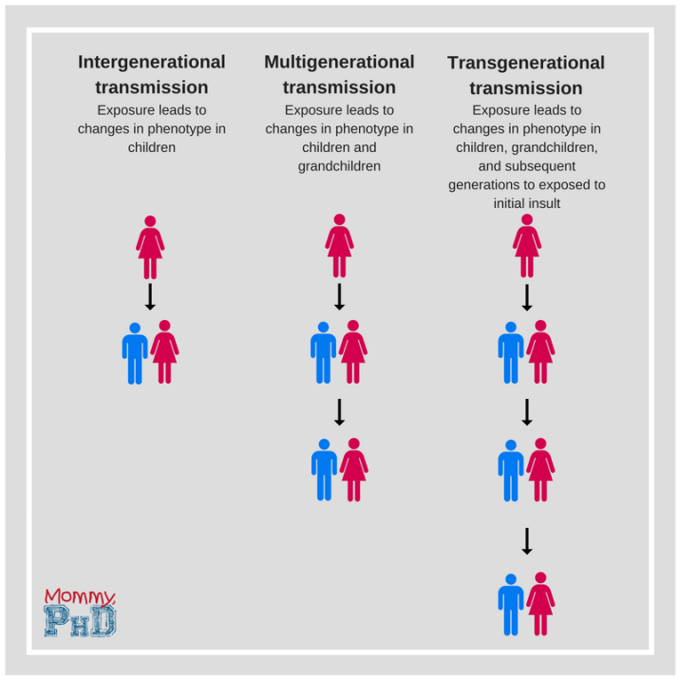
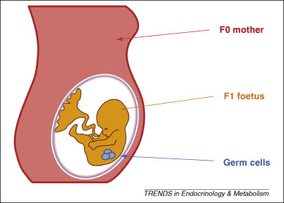
Lead multigeneration toxin?
Example of epigenetic changes
Lead accumulates in the body (specifically in the bones)
During pregnancies lead from the mother leaves the bones and can be absorbed by the foetus
This causes immediate harm and results in epigenetic changes (effects around the DNA) which can cause effects into adulthood
Transgenerational - Emerging evidence that pre-natal lead exposure affects not just child but also grandchild and possibly great-grandchild
https://doi.org/10.1289/EHP5326 https://link.springer.com/article/10.1007/s11356-022-19333-5
https://doi.org/10.1016/j.chemosphere.2018.12.049 https://doi.org/10.1289/EHP4977
https://doi.org/10.1038/srep14466 https://doi.org/10.1016/j.tox.2021.152927

Slide 14
Public Health South Investigation
Purpose
For individuals to know their own blood lead levels and risk factors for lead exposure
To check the blood lead levels of people living in Waikouaiti/Karitane/Hawksbury village to see if they were higher than expected levels
To see if blood lead levels were in any way related to drinking the water from the local supply

Slide 15
Did the lead spikes in the water have any impact on Blood Lead Levels?
Overall we didn’t find an effect in adults and children over 10 years
We don’t know if there was a very small effect from drinking water in young children
Other lead exposures were much more important

Slide 16
Lead in drinking-water: Current status
Current MAV for Lead 0.01 mg/L
Drinking Water Quality Assurance Rules (from 14 Nov 2022)
S1.1, S2.1 and S3.3 - Must test source waters for lead (frequency depending on supply category)
D2.1 - Flushed sample from end of distribution system every 150 days
D3.18 and D3.24 - Sampling plan and response plan for plumbosolvent metals must be developed. 6 monthly sampling minimum.
MBIE Building Code Update 2022 (from 1 Sept 2025)
Reduction in allowable lead contact in plumbing materials to not more than 0.25%

Slide 17
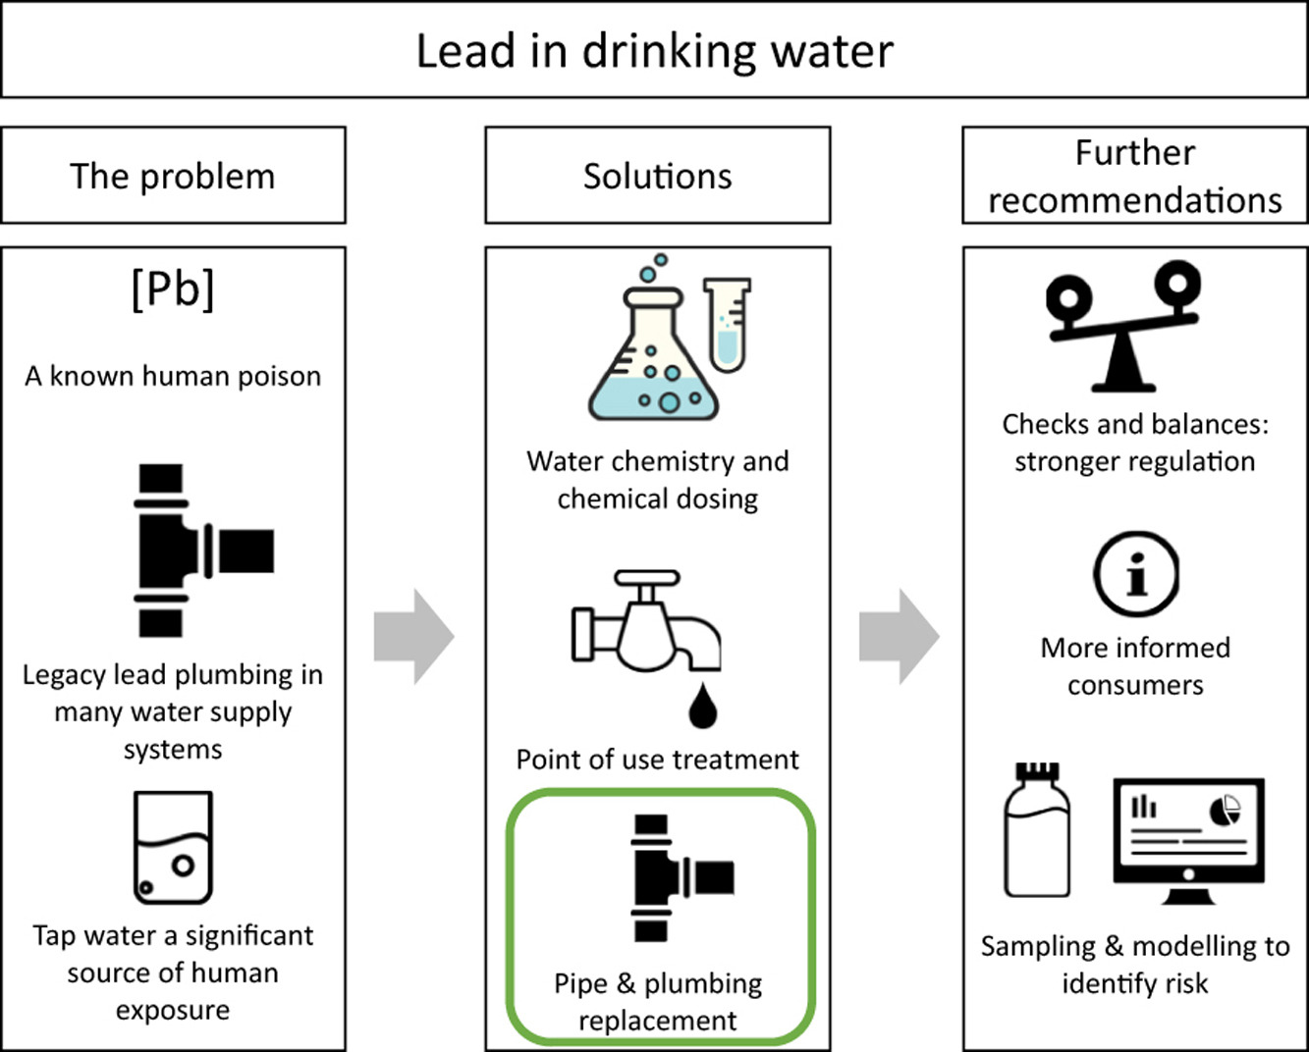
What should suppliers be doing?
https://doi.org/10.1016/j.coesh.2021.100239

Slide 18
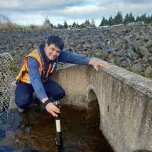
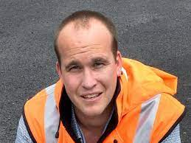
Noah
Susan
Tom
Rosemarie
John
Michael
Zoe
Some of the team
Andy

Slide 19
Acknowledgements
Public Health South
Ministry of Health
Wai Comply
Waikouaiti Coast Community Board
Dunedin City Council staff
City Care
Tonkin &Taylor
Stantec
WSP
Beca
Eurofins
The Questioning Engineer,
Residents & businesses of Waikouaiti, Hawksbury Village and Karitane
Contact details
Belinda.Cridge@esr.cri.nz
John.McAndrew@dcc.govt.nz

