Slide 1
ENVIRONMENTAL IMPACT BONDS. WHAT ARE THEY, AND HOW CAN THEY FUND STORMWATER PROJECTS TO ACHIEVE REAL IMPACT AT SCALE? "Public funding alone will not finance the scale of investment that's needed, with the urgency required, to address the climate crisis.” James Shaw, Climate Change Minister, NZ Govt, May 2023.
Brad Tiller
Tonkin + Taylor
Notes:
A bit of mouthful isn’t it – but intriguing enough to get you lot here I suppose!
Before I get started I want to imagine something. Imagine an industry where it’s common place that private capital is used to finance water quality, environmental remediation & resilience projects.
These projects would be large scale and really transformational to really shift the needle in the next 5-10 years
The money would be loaned to a public entity, and of course get paid back (with interest) but only if the project achieved measured impact.
Welcome to the general concept of the EIB’s

Slide 2
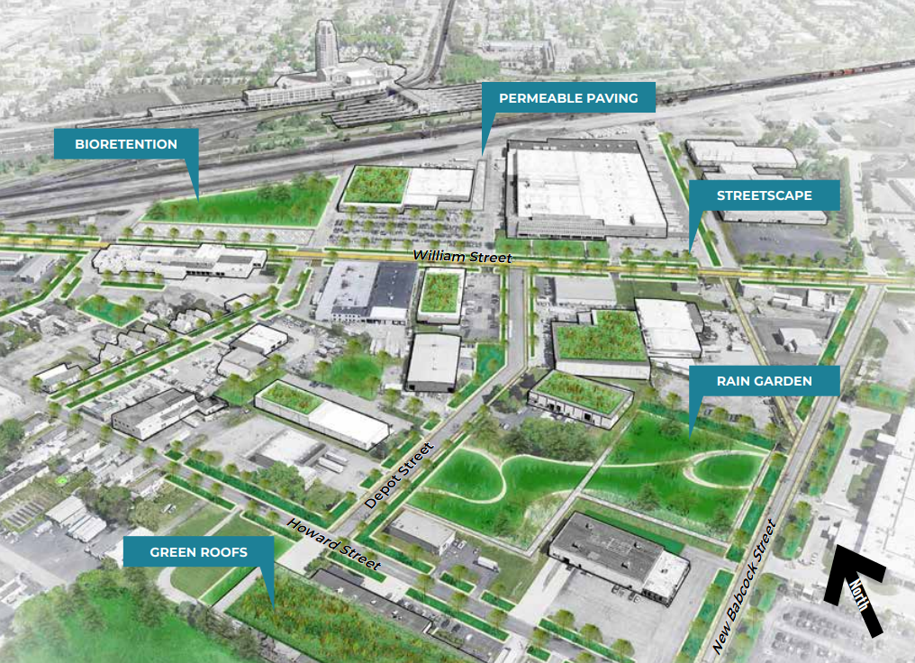
Introduction
What is an Environmental Impact Bond?
Timing is everything…
Why stormwater?
A case study – DC Water
A hypothetical NZ project
Innovation vs the status quo…
Risk & reward
Closing thoughts
Buffalo, NY where a $54m USD bond was issued to finance catchment scale green infrastructure assets in June 2021. (Image credit: Buffalo Sewer Authority)
Notes:
So why am I speaking to you about finance today?
Well like most of you that have worked in the sector you years you soon come to realise that finance is often the limiting factor or on the other hand enabling factor for stormwater projects to materialise.
We all know of projects that have been delayed for years, decades even. Despite how necessary an initiative may be, at the end of the day, someone needs to finance it.
But instead of waiting for Central or Local Govt. to essentially pay for everything, I’ve been interested in exploring alternative funding models and the role they can play in widen the pool of available capital.
Now I don’t have a finance background, but I’ve often found I learn more about a topic explained to me by someone who doesn’t practice the profession and use all the jargon, so I will be that person for you today…
Plus, I just really wanted to present on something new that hasn’t been spoken about before!
So. Let’s get into it…

Slide 3
What is an Environmental Impact Bond (EIB)?
Environmental
‘Relating to the natural world’
Bond
‘Debt security, or obligation that can be sold / purchased’
Impact
‘A significant effect or influence’
A pay-for-performance financial instrument that is designed to deliver tangible outcomes with reduced risk of project failure.
It is an outcomes-based contract between a public entity and the private sector where payment is based on measured impact.
Can also be used for public / private consortiums
In a nutshell, bonds enable short-term investment of private sector funds into historically public owned and managed infrastructure.
Been around since 2012, none issued in NZ.
Originate from more widely adopted ‘Social Impact Bonds’
Notes:
A 'pay-for-performance’ or financial instrument that is designed to deliver tangible outcomes with reduced risk of project failure.
Social Impact Bonds: Same sort of structure, but the impact relates to for instance affordable housing, funding dental care, to a defined group of people.
Waikato River Authority has arranged a10-year hybrid debt-equity bond to incentive change of land use, but I’m not sure who the investors are.

Slide 4
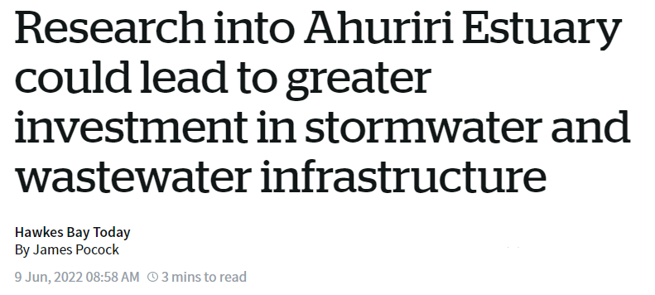
< The Finance
Gap >
Notes:
As far as the timing for this concept paper, the rhetoric around financing three waters has been a catalyst for me to learn about and debt and to research different funding and delivery models.
I’m sure you’ve all seen articles like this over the years.
Problems on the left, solutions on the right
So why are we not very good at linking them together?
So NZ is very new to the adaptation / green finance scene…
The most innovative funding and delivery model included the words ‘shovel’ and was generally considered a 1950’s approach to infrastructure, and I think we can all agree we missed the mark for transformational change.
Just a few weeks ago, the NZ Govt announced they wish to “leverage private capital”, so the question could be, are EIB’s a suitable model to deliver this money in an efficient way?

Slide 5
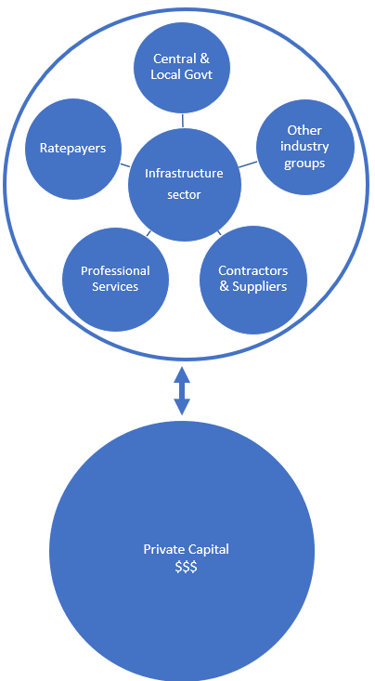
Private capital? Public infrastructure?
There is tremendous international demand from the private sector to invest in climate resilience, ecological restoration and infrastructure adaptation projects to address the global environmental crisis.
Simplicity is a Kiwisaver fund that manages almost 5 billion now ($400 billion by 2050).
“What I really like about the EIB model is that it takes the funding into the ‘equity’ side of the equation for an investor, which also allows Councils and Government to get it off their balance sheet and out of any debt covenant restraints.” Sam Stubbs – Simplicity Co-Founder/Managing Director, April 2023.
If impact is provided, and the environment benefits, does the public really care where the money comes from in the short term? And further, if an acceptable profit is made?
Notes:
So, I reached out to a some of those people on the supply / or investor side to get their thoughts…
I basically asked, why is our sovereign wealth being invested into overseas funds, but not being used here to sort out our own infrastructure deficits?
What Sam is saying here is he’s excited and qreally keen, but is essentially out in the cold with no mechanism to invest. Many NZ councils have borrowed to their maximum prudent limits, and the EIB could be a suitable method to deliver finance to reduce international debt to fund three waters

Slide 6
Why stormwater?
Stormwater is the ideal candidate for EIB’s because the impacts transcends both water quality and quantity, both of which can be modelled and measured.
A reduction in flow, achieved by increased absorption or infiltration; or a reduction in contaminants, achieved by source control and/or treatment are both considered a beneficial outcome, or environmental impact.
Catchment-scale integration of WSUD is an obvious candidate for an EIB.
Easily replicable to other sectors where environmental impact can be measured.
Can be coupled with other incentives, pervious rates credits, impervious tax etc.
Notes:
Coincidentally, the majority of EIB’s issued around the world were used for stormwater…. Why is that?
I found this quite strange, so I decided to investigate…

Slide 7
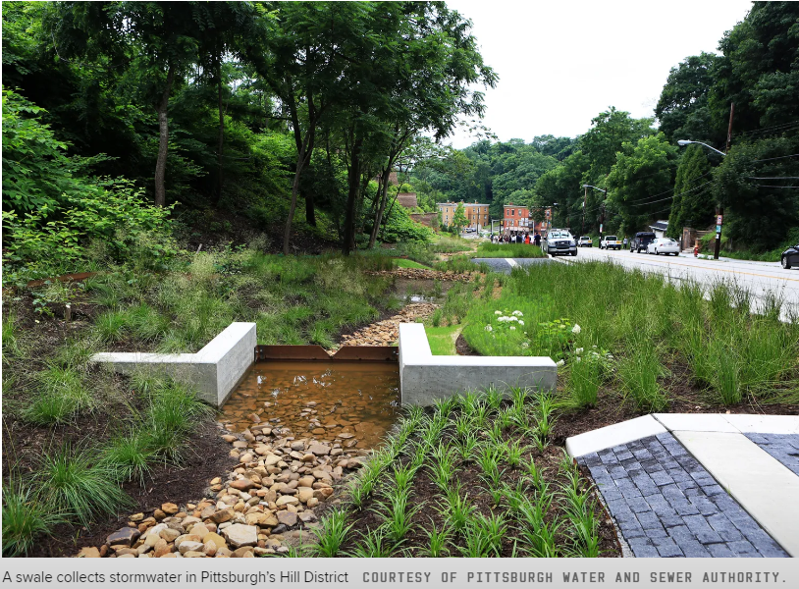
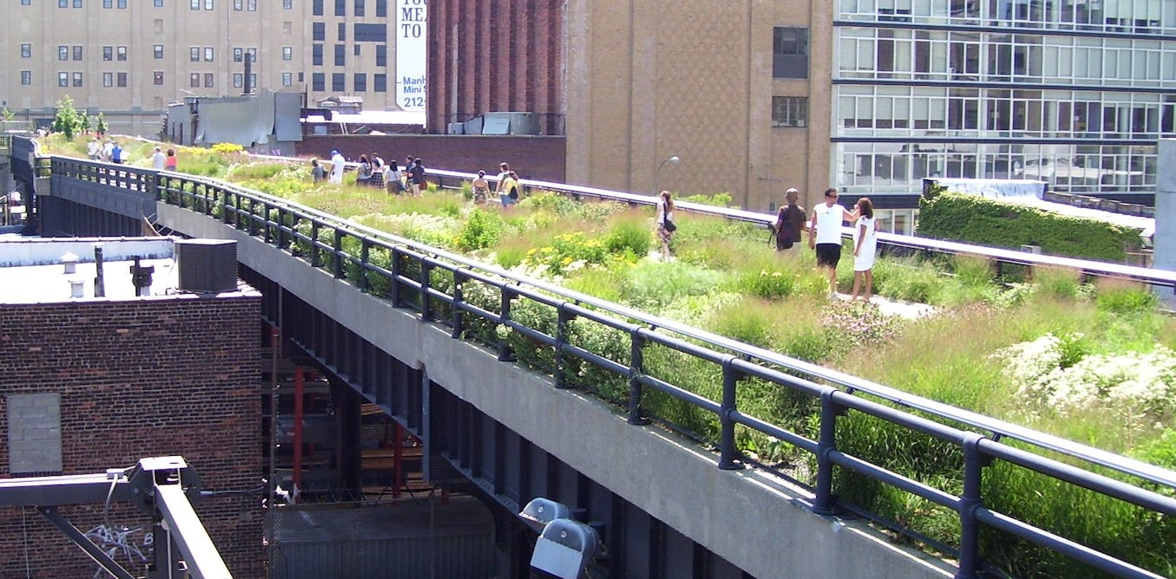
What initiatives could EIB’s finance?
Riparian planting on highly erodible soils
Day lighting streams
Combined sewer overflow diversions
Retrofit treatment devices at catchment scale
Remove impervious surfaces
Green roofs
Increased street sweeping costs
Dredging of receiving water bodies
Naturalising rivers
Above and below ground attenuation
Groundwater recharge
Wetland restoration and carbon sequestration
And all the associated social benefits toward improved standard of living!
A disused railway viaduct in New York’s High Line Park retrofitted into a biophilic city asset
Notes:
So this list is specific to SW, but essentially the EIB model can be applied to any other project where the env. impact can be measured.
For the sake of adapting to increased rainfall, flooding and declining water quality, it’s possible wish-lists like this can be delivered through the EIB model.
An even better, EIB’s enable the retrofit of these initiatives, not just green field projects.
Still don’t believe me! Let’s check out a case study…

Slide 8
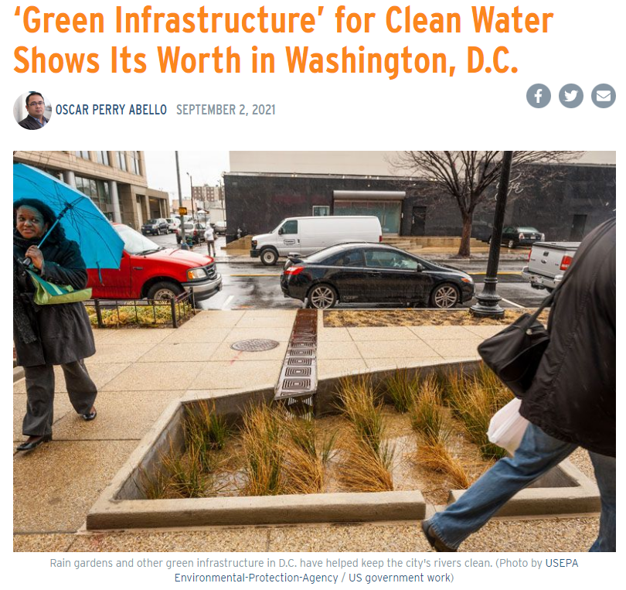
A case study - DC Water
The first ever EIB for $25m USD was issued in 2016 by DC Water in Washington, US
The bond was purchased by Goldman Sachs and the Calvert Foundation (George Hawkins).
The purpose was to reduce runoff and improve WQ of Rock Creek due to combined sewer overflows.
The proceeds were used to retrofit bioretention gardens, urban swales, kerb extensions, permeable pavements, and infiltration basins in parks across 200ha of impervious urban land…
Following 12months of baseline measuring, a 30% reduction on runoff was modelled post installation.
The performance risks and benefits of managing stormwater runoff were shared among DC Water and the investors.
Notes:
The first ever EIB for $25m USD was issued in 2016 by DC Water in Washington, US
The purpose was to reduce runoff and improve WQ of Rock Creek due to combined sewer overflows.
Following 12months of baseline measuring, a 30% reduction on runoff was modelled post installation.

Slide 9
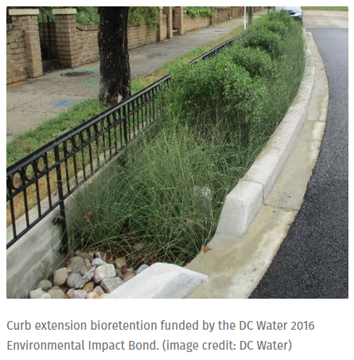
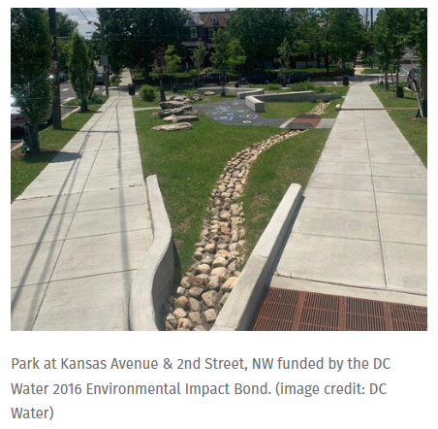
How did the project perform?
Post-construction monitoring found that the green infrastructure reduced stormwater runoff by nearly 20% from previous levels.
Following the success of this project other cities are replicating the model elsewhere, including Louisiana to restore wetlands, Atlanta to enhance flood resilience, Baltimore to address water pollution, and Hampton VA to fund nature-based flood mitigation.
Massive lessons learnt about the balance between grey and green infrastructure.
Is NZ innovative and courageous to do the same?
Notes:
Three outcome scenarios were agreed:
1 being outperform and DC water pays investors a 3.3m bonus
2 being expected range, no interest / coupon received
3 being underperform, Goldman Sachs pays DC Water 3.3m
In this case the ROI ranged from 3-5% depending on performance.

Slide 10
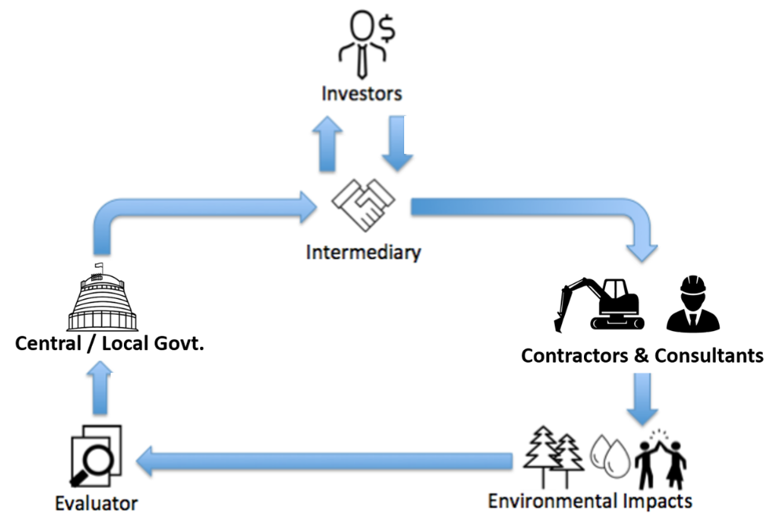
A hypothetical NZ example
Step 4:
Invest capital
Step 1:
Define the issue and project scope.
Step 2:
Assess realistic performance targets.
Step 3:
Issue the bond to the market
Step 5:
Arrange procurement
Step 7:
Assess outcomes against agreed impact targets, intermediary pays back investors.
Step 6:
Deliver the project
Notes:
Step 1: A government, iwi, or public-private consortium requires major upgrades to its sewer system to reduce the occurrence of overflows during rainfall OR, an industrialised catchment has contaminated an estuary over decades, but the local Council and the land users do not have the short-term capital to fund it OR; a Council wishes to convert an unused carpark into an infiltration basin.
Step 2: Things like reduction in stormwater contaminants, runoff volume, incidence of flooding during X mm of rain etc. This may be a year’s worth of baseline monitoring.
Step 3: Once targets are agreed, this provides the payor of outcomes with the commercial conditions required to raise capital from private sector investors.
Step 4: Private investors would then purchase the bond by transferring money to an intermediary organisation. The intermediary coordinates the parties, structures the deal and manages performance.
Step 5: The intermediary then engages Contractors / Consultants to design and construct the improvements.
Step 6: Deliver and commission the project
Step 7: Following rigorous monitoring, independent evaluators then assess whether the outcomes meet agreed-upon impact targets. Did it work? If the targets are met, payment is triggered from the outcome payor by the intermediary.

Slide 11
What about project risk?
Risk type | Owner | Description
Performance | Investor | The Risk Share Payment provides the bond issuer with funds to address performance deficiencies should project performance fall short.
Counterparty | Investor | Offsets against principal assure payment of the potential Risk Share Payment and eliminates risk that the bond issuer would otherwise have with respect to the Investors.
Construction | Investor | Cost overruns, ground conditions, delays, force majeure, environmental
Regulatory | Bond issuer | Any changes in laws, rules, regulations, policy or guidance
O&M, Lifecycle | Shared | If repayment depends on a continued performance of stormwater infrastructure, then the investor will insist on monitoring that promised maintenance is undertaken.
Notes:
Performance: Bond issuer has effectively hedged performance risk, if the project doesn’t deliver, then the risk share payment can be used to remediate, insurance if you will.
Counterparty risk: The likelihood that one of those involved in a transaction might default.
Construction: In the DC water example, the municipality retained responsibility for designing, constructing and maintaining the assets, but that could easily be passed to the investor.
O&M, Lifecycle: Really important point, in the case of DC water it was municipality, but again it could be shared.

Slide 12
What’s wrong with the status quo?
We are lacking the pace and scale required to keep ahead of infrastructure depreciation, urban growth, legacy water quality decline, climate change…
As an industry there is too much reliance on Councils to finance stormwater projects… They often delivered late, and over budget.
Many NZ councils cannot finance the short-term stormwater infrastructure necessary to improve flooding resilience and urban water quality. They have also mostly borrowed to their maximum prudent limits.
Evidence, not advocacy generates success.
Notes:
So, what’s wrong with the status quo?
We are simply too slow on the uptake of innovative financial and delivery tools, especially given the scale and pace at which change is needed…
Remember the ‘shovel-ready’ funding, it was subject to poor project selection with little accountability when in most cases, project budgets were blown.
I think there is this real divide between the public and private sector which could be narrowed…
Its obvious Councils are under funded, so why not support them with initiatives from the private sector including short term finance to get things off the ground instead of waiting on LTP’s…?
If the projects were privately financed, with financial incentives linked to impact, then surely there would be a step change in accountability to ensure the project succeeds right?
But what does the investor get in return?...

Slide 13
What does the investor get in return?
Establish/reinforce green credentials through “green projects’’
Showcase expertise, rigour and high-quality management.
More involvement in earlier project selection, using the skills of the private sector to assist in arranging finance.
Earlier negotiation of project outcomes, (potentially of a greater magnitude than what was originally proposed).
Of course, earn an acceptable profit if the project delivers.
Promotes innovation by contracting for outcomes rather than outputs.

Slide 14
What does the bond issuer get in return?
Achieve a step-change in SW improvements, wish lists ticked off.
In general, the public sector does not pay for the infrastructure upfront. This enables Councils to plan for repayment longer into the future.
Balance sheet separation.
An efficiently delivered project.
Evaluation is vigorously promoted throughout the design, delivery, commissioning, and maintenance of the asset with EIB’s.
Able to focus on other things.
Rate payers won’t contribute if project doesn’t perform.
Results defined in advance.
Reduces political risk for public funders of outcomes.
No change of ownership needs to take place.

Slide 15
Closing thoughts…
“Environmental Impact bonds have the potential to be catalytic in crowding in private investment to deliver essential infrastructure, with the pay for performance structure increasing the likelihood of desired environmental co-benefits. Outcomes based contracting require delivery of verified impact reporting data, that improves transparency on the projects broader impacts.”
Dean Spicer – ANZ Head of Sustainable Finance NZ
The whole point of the environmental impact bond model is to prove this is the most accountable way to spend government resources, and once that’s been proven it could be adopted as the new status quo.
Can stormwater pioneer this concept and lead other sectors?
Perhaps initiate a pilot project to demonstrate outcomes (we have the short term finance, we just need an innovative and courageous Council…)
Notes:
The whole point of the environmental impact bond model is to prove this is the most accountable way to spend government resources, and once that’s been proven it could be adopted as the new status quo.
The whole point is to shift behaviour and perhaps invest to protect our environment, as opposed to business as usual.

Slide 16
References
The views shared in this presentation are my own, and made possible by the talent and dedicated research into green finance / impact investing by good friends Sam and David… Thank you for providing me with the inspiration and motivation to share your work.
David Hall and Sam Lindsay (2017), Climate Finance Landscape for Aotearoa New Zealand: A Preliminary Survey, Report Prepared for the Ministry for the Environment, Auckland: Mōhio
D. Hall (2022). Adaptation finance: Risks and opportunities for Aotearoa New Zealand. Concept paper prepared for the Ministry for the Environment. Auckland: Mōhio Research and AUT.

