Slide 1
Operational Dashboard
Andrew Skelton (Auckland Council Healthy Waters)
Alex Osti (Mott MacDonald)

Slide 2
Operational Dashboard
1
Healthy Waters Operations
2
The Need
3
The Opportunity
4
The Dashboard
5
Next Steps

Slide 3
Healthy Waters Operations
by the numbers
~500,000
~9,000
~70,000
529
Total properties (90% residential)
Requests for Service in 2018
Kilometres of flood paths
Treatment facilities
>150,000
~30,000
~1,200
4
Manholes
Kilometres of total network
Millimetres of annual rainfall
Regional response and maintenance contracts

Slide 4
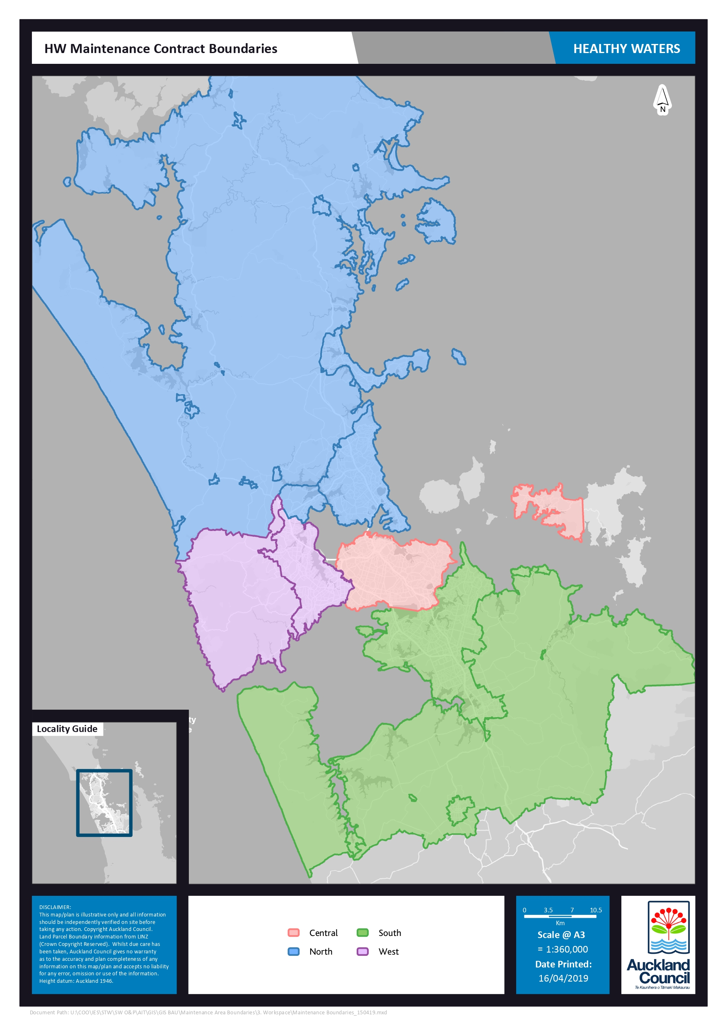
Our regions
Response & Maintenance Contracts
These range from dense urban to rural sprawl

Slide 5
The Need
1
Live event RFS monitoring
The ability to understand events and their drivers as they unfold is vital to ensuring we are best placed to deliver positive outcomes to our customers
2
Real-time consolidation and analysis
Successful operations means needing to know what kinds of service are being requested, where our people are and how we are responding in real-time.
3
Event escalation reporting in real-time
When decisions that impact large groups of customers or carry a large financial impact need to be made, our decision makers need the best available information.
4
Resource optimisation and predictive planning
Understanding historical events and our responses, combined with market leading rainfall predictions gives us the best opportunity to serve our customers.
5
One platform
The ability to make real-time decisions cannot be hampered by switching between several different platforms, run by different people often in different locations.

Slide 6
The Opportunity
Smart Infrastructure approach
Decision making
Static reporting
Isolated data
Outputs
Live analytics
Interconnected data
Outcomes
Sense making
Data integration

Slide 7
RFS data
Rainfall nowcast
Data Integration
Flow gauges
Sewer overflow gauges
GIS data
Rain gauges
CCTV Data

Slide 8
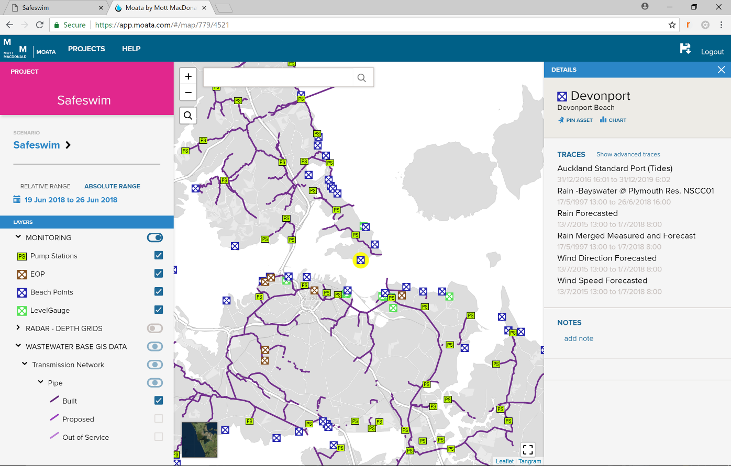
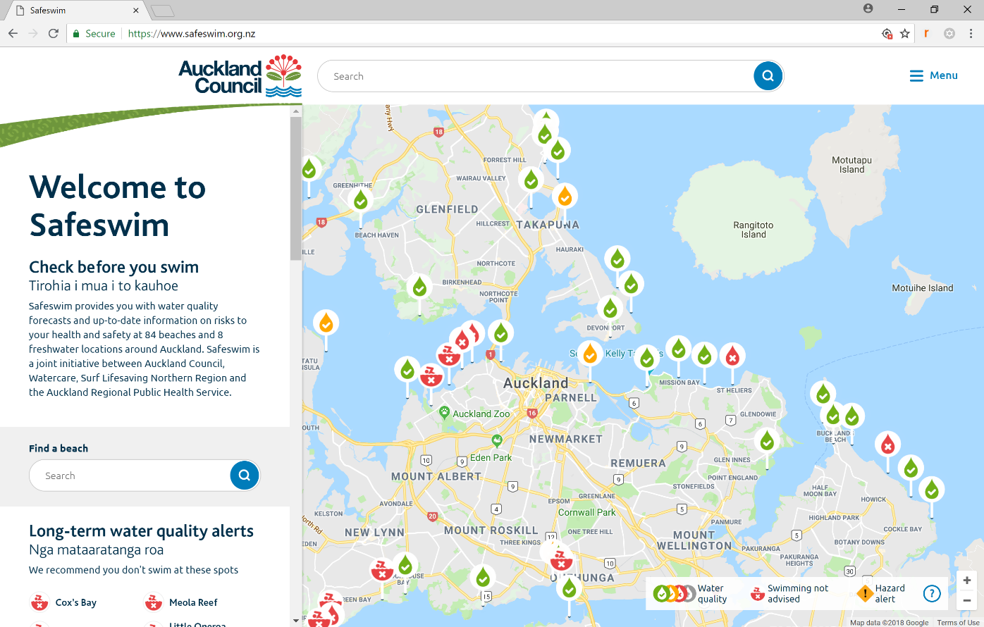
Sense Making
On Moata

Slide 9
Decision Making
The Dashboard
GIS Display Display & Interrogate Data
PowerBI Dashboard Monitor, Summarise & report

Slide 10
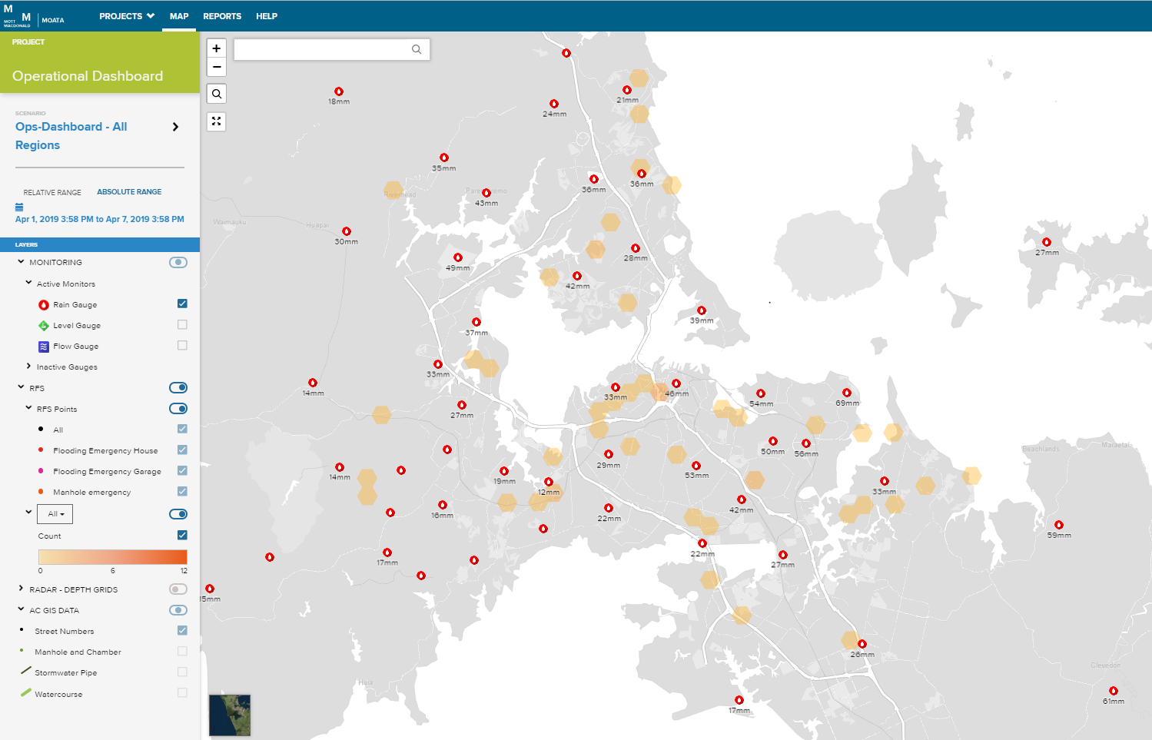
Decision Making
The Dashboard

Slide 11
Decision Making
The Dashboard

Slide 12
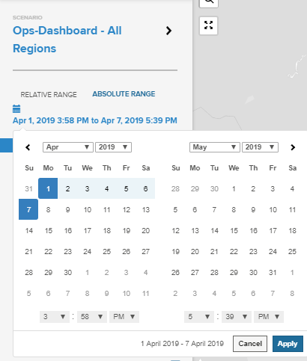
Decision Making
The Dashboard

Slide 13
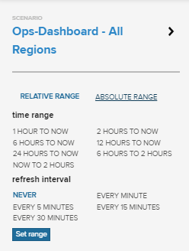
Decision Making
The Dashboard

Slide 14
Decision Making
The Dashboard

Slide 15
Decision Making
The Dashboard
Gauge locations/values
Requests for service (filterable)
Rainfall information
GIS Data

Slide 16
Decision Making
The Dashboard

Slide 17
Decision Making
The Dashboard

Slide 18
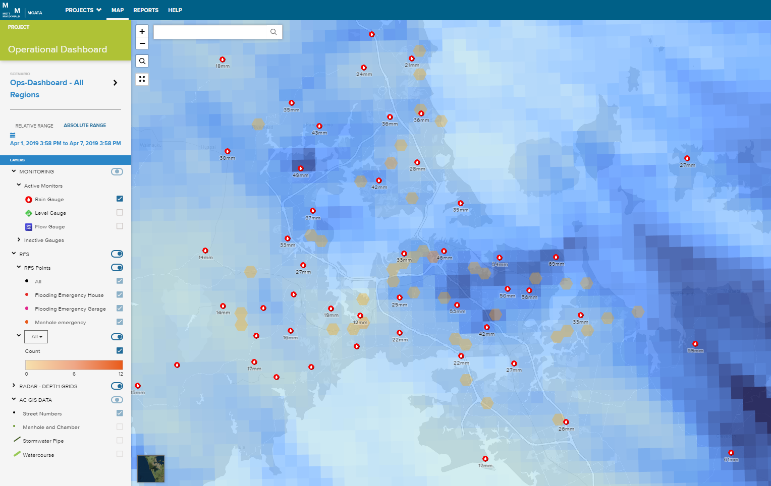

Slide 19
Decision Making
The Dashboard

Slide 20
Decision Making
The Dashboard

Slide 21
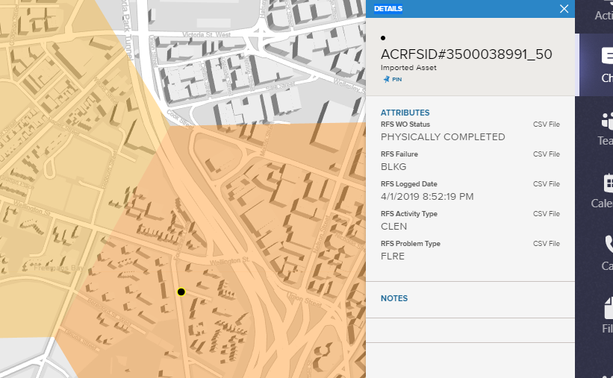
Decision Making
The Dashboard

Slide 22
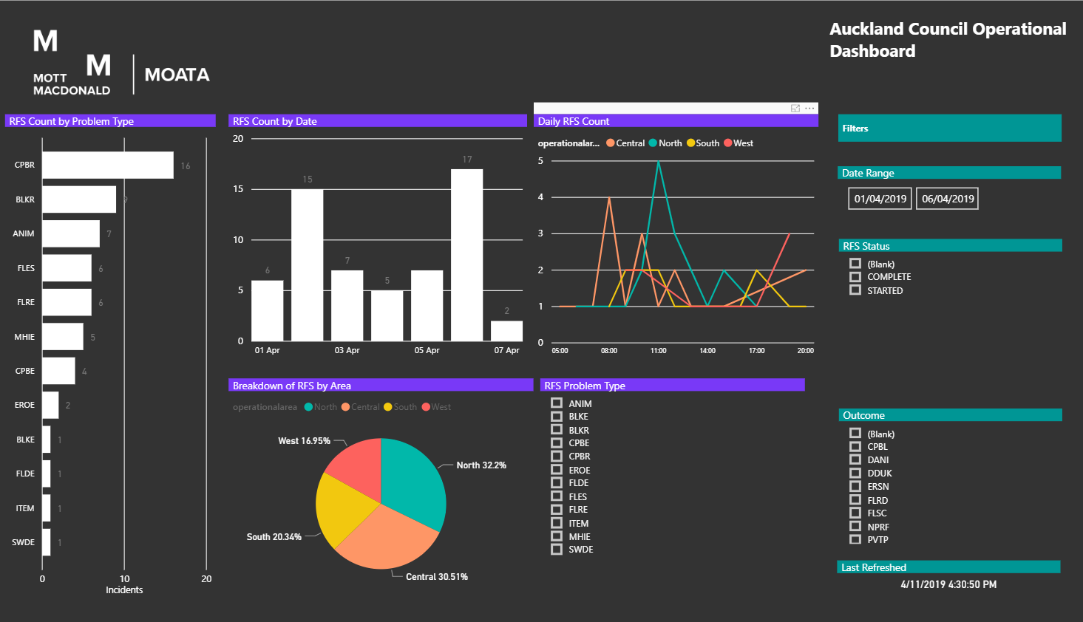
Decision Making
The Dashboard

Slide 23
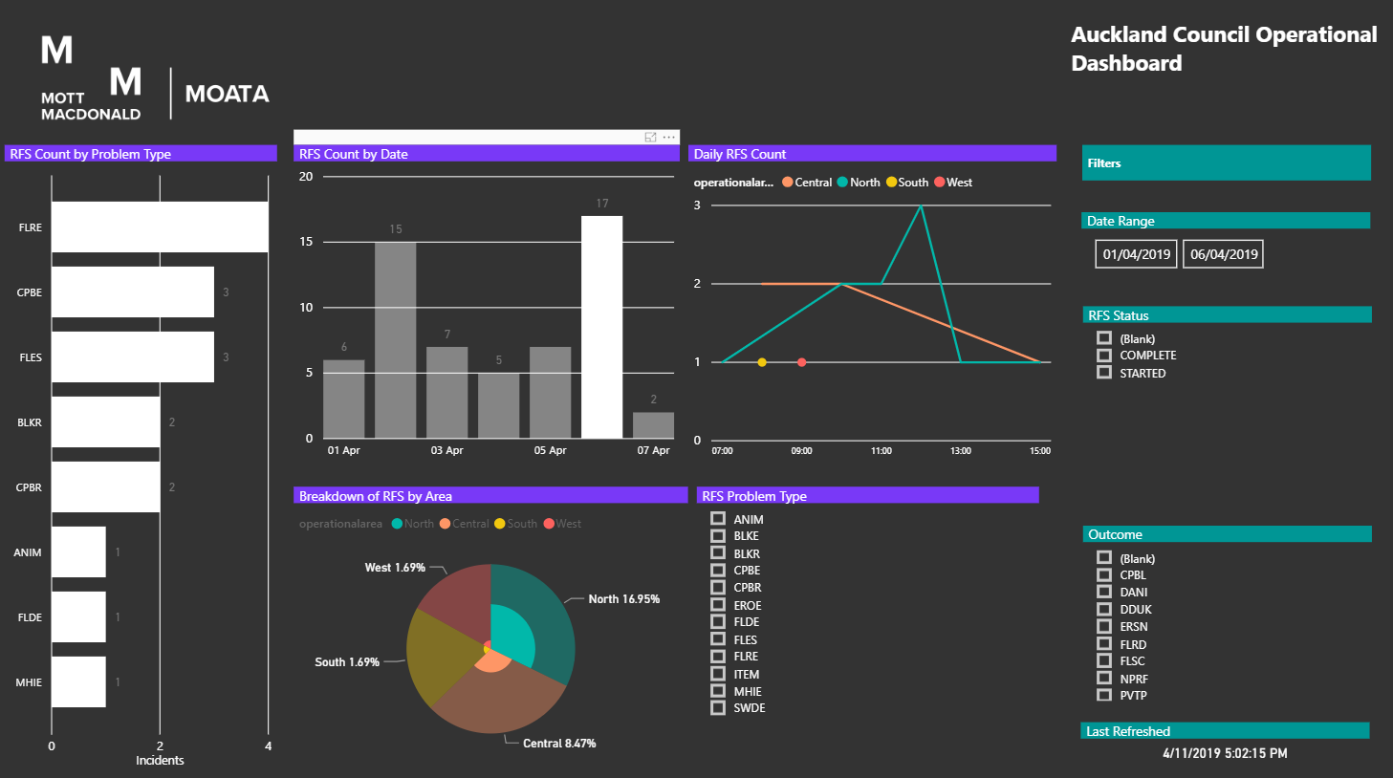
Decision Making
The Dashboard

Slide 24
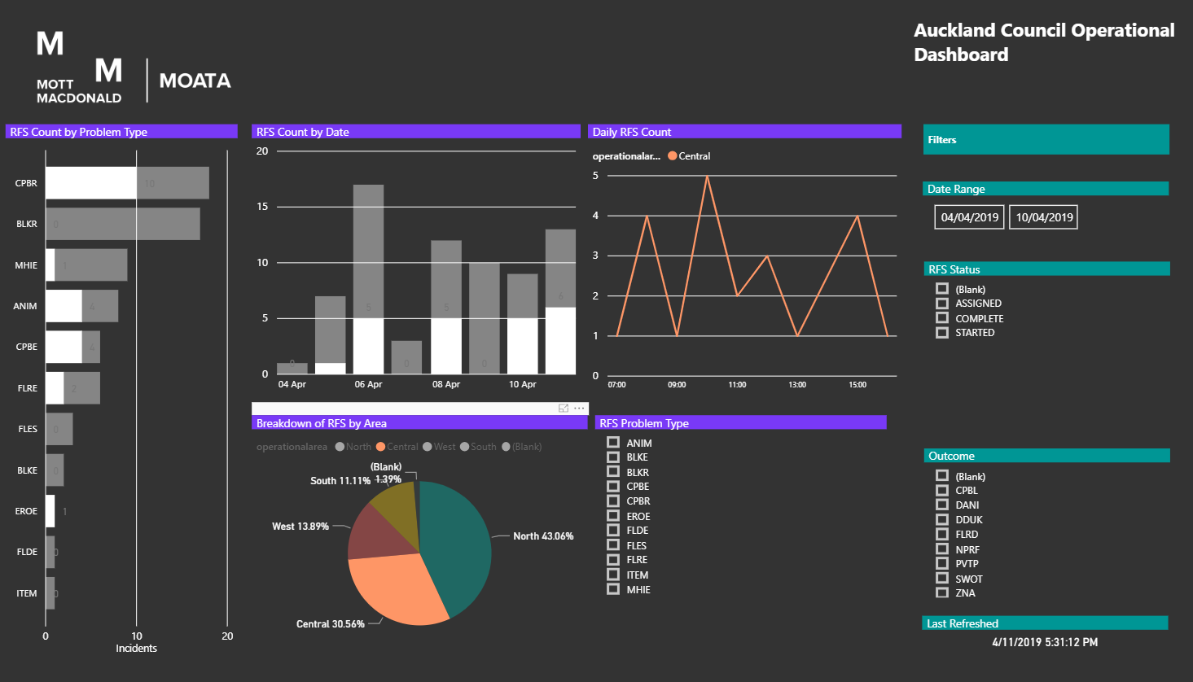
Decision Making
The Dashboard

Slide 25
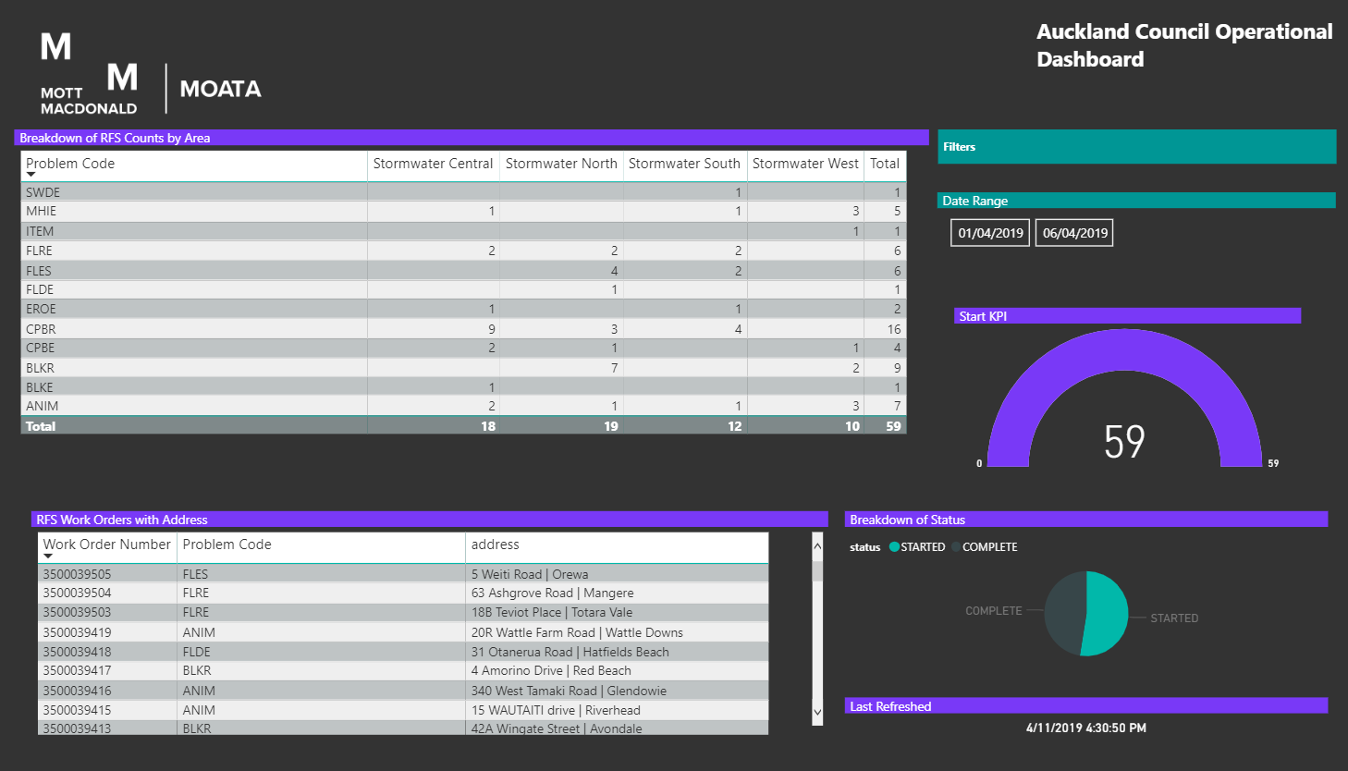
Decision Making
The Dashboard

Slide 26
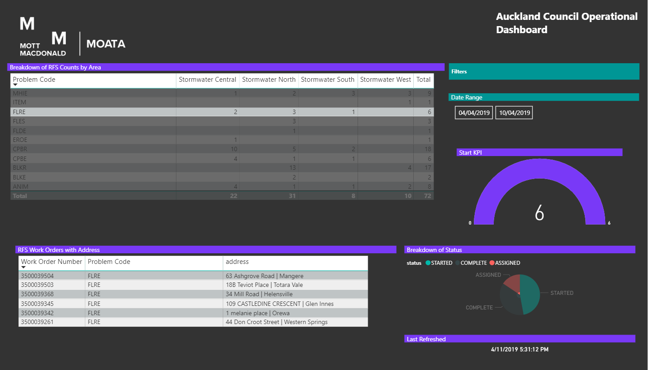
Decision Making
The Dashboard

Slide 27
The Solution
The Dashboard
Integrate 7 key data streams in real-time
Deliver better customer outcomes
Display critical information geospatially
Enable necessary reporting
Summarise key insights in dashboard

Slide 28
Where to from here
1
Additional reporting
2
Vehicle tracking
3
Prediction

Slide 29
Questions?

